Slide 1
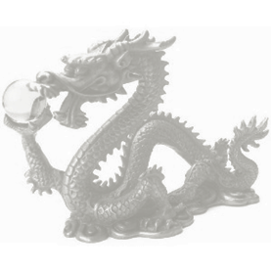
WCN2017Satellite Symposium
2017.4.26. Mexico City
Significance of hyperuricemia among community-based screening participants, focusing in longevity
Kunitoshi Iseki
Clinical Research Support Center, Tomishiro Central Hospital, Okinawa, Japan

Slide 2
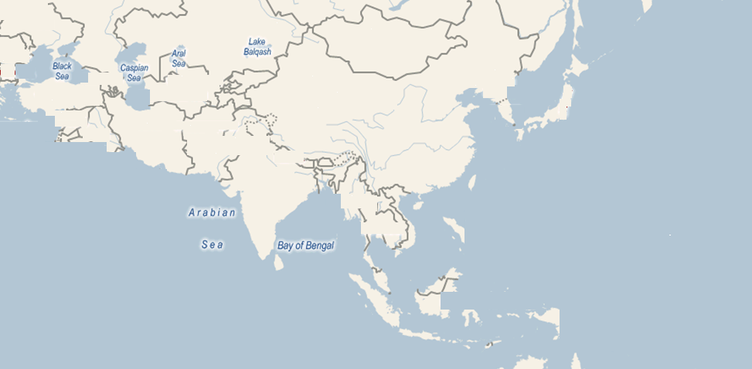
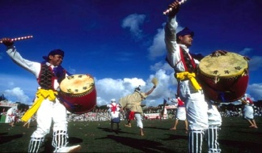
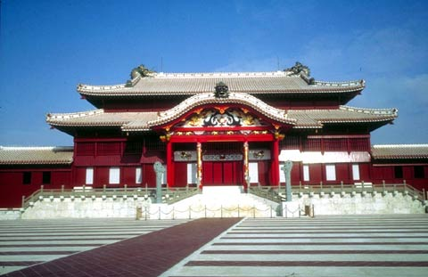
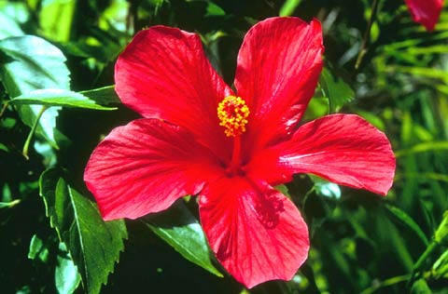
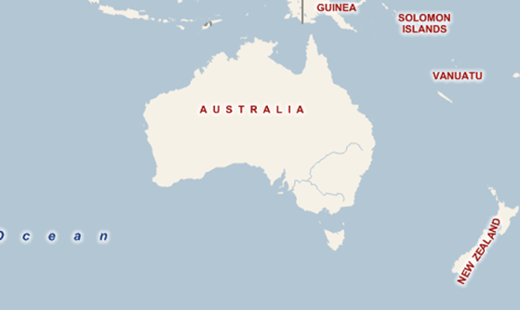
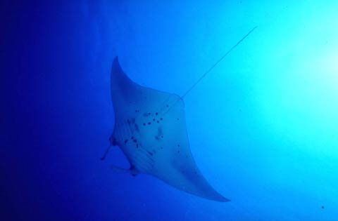
Location of Okinawa in Asia
Population : 1.423 million (as of 2012)
Ethnic groups: Ryukyuans (especially native Okinawans), Japanese,
as well as American military personnel and their families
TURKEY
CHINA
SOUTH
KOREA
JAPAN
PAKISTAN
2000ｋm
INDIA
OKINAWA
1500ｋm
HONGKONG
TAIWAN
1000 ｋm
500 km
THAILAND
PHILIPPINES
MALAYSIA
SINGAPORE
INDONESIA
AUSTRALIA
By Google map

Slide 3
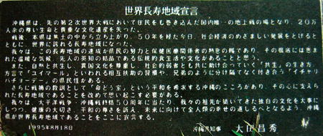
Okinawa is
the world longest longevity area.
1995, Aug 18, Governor of Okinawa: Masahide Ohta

Slide 4
Okinawa was famous as a longevity area “Traditional Life-Style” 2004 “Time magazine” Foods: Low White Rice, Low Fat Meat, Vegetables, Tofu, Fishes Eat adequately (80%) Regular Exercise: Socio-Environmental: Respect Ancestors, Yuta Strong Tie with families and community Way of living: Optimism
2004 Aug. 30
Time, Aug. 30, 2004

Slide 5
Incident ESRD Patients by Renal Disease
Mean Age
1997 2007 2015
CGN 60.5 66.4 68.8
DM 62.5 65.4 67.3
NScl 71.4 73.7 75.3
Incident Number
DM
CGN
NScl
Unknown
Year
JSDT

Slide 6
Mean Age at Start Dialysis
Japan
Okinawa
JSDT

Slide 7
Prevalent ESRD Patients
ESRD Patients, per million population
Okinawa
Japan
Year
JSDT

Slide 8
Incidence of ESRD by Gender
Men
Incidence, per million population
Difference
Women
Year
JSDT

Slide 9
Predictors of ESRD
OGHMA
OKIDS
Okinawa Dialysis Study
Okinawa General Health
Maintenance Association
vs.
A community-based screening
1983 ······· started to file in computer
1983 ······· N=106,182
1993 ······· N=143,948
Registered all ESRD patients in Okinawa
1971 to 2000, N=5,246
ESRD: chronic dialysis patients
survived at least 1 month
56 dialysis units, 78 physicians
Kidney Int 49: 800-805, 1996
Kidney Int 49: S69-S71, 1996
Kidney Int 43: 404-409, 1993
Kidney Int 61: 668-675, 2002
 Identification of ESRD patients

Slide 10
Screened/General Population
30
Women
25
Prevalence, %
Men
20
15
Mean :13.9%
Mean :13.6%
10
5
0
-29
30-39
40-49
50-59
60-69
70-79
80-
Age at Screening, years
Iseki K et al. Kidney Int 49: 800-805, 1996

Slide 11
ESRD Incidence by Proteinuria
15
UP ≥3+
Cumulative Incidence, %
10
UP 2+
5
UP 1+
0
UP ±
UP-
0
1
2
3
4
5
6
7
8
9
10
11
12
13
14
15
16
17
Time after screening, year
Iseki K et al. Kidney Int 63:1468-1474, 2003

Slide 12
Incident of ESRD by Urine Test
Iseki K et al. Kidney Int 63:1468-1474, 2003

Slide 13
ESRD Incidence by Blood Pressure
2.0
2.0
Men
Severe
Women
1.8
1.8
Cumulative Incidence of ESRD, %
1.6
1.6
1.4
1.4
1.2
1.2
Moderate
1.0
1.0
Mild
0.8
0.8
0.6
0.6
High Normal
0.4
0.4
Normal
0.2
0.2
Adequate
0
0
0
2
4
6
8
10
12
14
16
0
2
4
6
8
10
12
14
16
Years after Screening
Years after Screening
Tozawa M et al: Hypertension 41;1341-1345, 2003

Slide 14
Cumulative Incidence of ESRD by CCr & Proteinuria
100
Proteinuria (+)
y = 595.23x^{–2.2017}
R² = 0.8464
Proteinuria (-)
y = 56.708x^{– 3.4417}
10
R² = 0.9705
1
Cumulative Incidence of ESRD, per 1,000
0.1
0.01
0.001
0
15
30
45
60
75
90
105
120
135
CCr, ml/min
Iseki K et al. Am J Kidney Dis 44: 806-814, 2004

Slide 15
Distribution of Serum Uric Acid
10,000
Men (N=22,949)
Number of Participant
8,000
Women (N=25,228)
6,000
4,000
2,000
0
1-
2-
3-
4-
5-
6-
7-
8-
9-
10-
Serum Uric Acid, mg/dL
Iseki K et al. Am J Kidney Dis 44: 642-650, 2004

Slide 16
ESRD Risk by Serum Uric Acid
ESRD Incidence, per thousand
Men
Women
10
10
9
9
8
8
7
7
6
6
5
5
4
4
3
3
2
2
1
1
0
0
S-UA
mg/dL
<7.0
≥7.0
<6.0
≥6.0
N of Participants
15,617
7,332
21,795
3,433
ESRD
19
34
19
31
Iseki K et al. Am J Kidney Dis 44: 642-650, 2004

Slide 17
Baseline Serum UA vs. rise in SCr & ESRD/Death
S-UA vs. rise in Scr
S-UA vs. Risk of ESRD/Death
12
9
Risk of ESRD/Death
＊
Risk of SCr elevation
8
10
Men (Up to SCr≥ 1.4mg/dL)
Women (Up to SCr≥ 1.2mg/dL)
*:P<0.01
Trend Test
7
8
Student’s t-test
6
6
5
4
4
3
2
2
1
0
0
<5.0
5.0-5.9
6.0-6.9
7.0-7.9
8.0-
0.3-4.9
5.0-6.4
6.5-8.4
8.5-13.0
S-UA（mg/dL）
S-UA（mg/dL）
Iseki K, et al. Hypertension Res 24: 691-697, 2001
Tomita M, et al. J Epidemiol 10: 403-409,2000

Slide 18
Prevalence of CKD by Metabolic Syndrome
5
(95%CI)
NCEP
4
modified
Adjusted OR
3
*
2
*
*
*
1
0
N of Component
0
1
2
3
4
5
NCEP
2,336
2,305
1,474
658
182
25
Number
modified
2,056
1,900
1,541
1,007
402
74
Tanaka H et al. Kidney Int 69:369-374, 2006

Slide 19
CKD Incidence by Metabolic Syndrome
16
16
Metabolic Syndrome
Age, Sex adjusted
5 years
14
No
: N=5,487
14
12
Yes
: N=884
12
10
10
8
8
Cumulative Incidence, %
6
6
4
4
2
2
0
0
1
2
3
4
5
non
N=1,087
yes
N=353
≤1
2
3
4≤
Observation, years
N of Component
Metabolic Syndrome
Tozawa M et al. Hypertens Res 30: 937-943, 2007
Ninomiya T et al. Am J Kidney Dis 48: 383-391, 2006

Slide 20
CKD Prognosis Consortium Cohort Selection
Identified by Planning Committee (90)
Did not complete survey (21)
Completed Survey (69)
Excluded because of insufficient data or unable to analyze data for the Conference (16)
Completed Analysis (53)
Unable to provide data for the meta-analysis (8)
AGES-Reykjavik/ CAN-CARE/ CAN-Prevent/ CRIC/ OFUS/ Predictors of ESRD in T1DM/ Prevalence of CKD in Veterans/ Tromso
Included in Meta-Analysis (45*) N=1,555,332
General Population
ACR (14)
ARIC/ AusDiab ACR/ Beijing/ CHS/
COBRA/
Framingham/ Gubbio/ HUNT/ MESA/
NHANES III/
PREVEND/
Rancho Bernardo/ REGARDS/ ULSAM
N=105,872
General Population Dipstick (10)
AKDN DIP/
AusDiab DIP/
Beaver Dam/
ESTHER/
MRC Older People/ Ohasama/
Okinawa 83/
Okinawa 93/
Severance/ Taiwan
N=1,239,447
High Risk
(10)
ADVANCE/
AKDN ACR/
CARE/ KEEP/
KP Hawaii/
MRFIT/
ONTARGET/
Pima/
TRANSCEND/
ZODIAC
N=266,975
CKD
(14)
AASK/
British Columbia/
CRIB/ Grampian ACR/ Grampian PCR/ MASTERPLAN/ MDRD/ NephroTest/ RENAAL/ STENO/ MMKD/ REIN/ REIN-2/ KP Northwest
N=21,688
Levey AS, et al. Kidney Int. 80:17-28, 2011

Slide 21
Demographics of the screenees
Year | 1983 | 1993 | 2003
Number | 106,171 | 143,948 | 154,019
Men | 47.6% | 47.6% | 48.0%
Age, yrs | 49.1 | 49.5 | 49.8
Proteinuria | 5.3% | 3.4% | 4.3%
CKD | 16.2% | 15.7% | 15.1%
BMI, kg/m² | 23.4 | 23.9 | 24.1
Obesity(BMI≥30) | 3.5% | 4.7% | 6.2%
BP, mmHg | 130.2 | 126.1 | 123.9
TC, mg/dL | 194.3 | 201.4 | 203.3
Glucose, mg/dL | 95.3 | 96.6 | 102.4
OGHMA

Slide 22
Selection process of the study subject
Participants screened in 1993 (N=143,948)
Participants screened again in 2003
(N=44,230)
Those with serum creatinine, serum uric acid and other pertinent data (N=16,796)
Excluded those with proteinuria (N=136)
Study cohort (N=16,630)
Iseki K et al. Hypertens Res 36: 652-654, 2013

Slide 23
Men
'93 eGFR, ml/min/1.73m²
ΔeGFR ('03 - '93)
ΔSerum Uric Acid, mg/d L
N of subjects
346 | 258 | 512 | 1010 | 1466 | 1478 | 1102 | 647 | 285 | 306
Mean ± SD
Iseki K et al. Hypertens Res 36: 652-654, 2013

Slide 24
Women
'93 eGFR, ml/min/1.73m²
ΔeGFR ('03 - '93)
ΔSerum Uric Acid, mg/d L
N of subjects
133 | 134 | 391 | 993 | 1887 | 2263 | 1716 | 928 | 423 | 352
Mean ± SD
Iseki K et al. Hypertens Res 36: 652-654, 2013

Slide 25
ΔeGFR by baseline eGFR
eGFR: ≥ 90 mL/min/1.73m²
eGFR: < 90 mL/min/1.73m²
110
104.4
90
103.2
75.5
100
100.6
80
100.3
75.5
70.5
eGFR (mL/min./1.73m²)
75.2
70.0
90
85.5
70
73.7
82.0
66.3
80
80.7
60
63.7
77.6
70
50
'93
'03
'93
'03
eGFR: < 60 mL/min/1.73m²
eGFR: < 45 mL/min/1.73m²
70
60
60
55.1
57.4
50
54.8
56.9
41.0
46.3
eGFR (mL/min./1.73m²)
40.5
41.8
50
54.3
52.4
40
39.9
54.3
37.6
33.7
40
47.1
30
34.8
30
20
'93
'03
'93
'03
Group 1
Group 2
Group 3
Group 4
Iseki K et al. Hypertens Res 36: 652-654, 2013

Slide 26
Tokutei-Kenshin 2008; Background
Number 332,174 (Men 134,751, 40.6%）
Age, years 63.6（8.3）, 40～74
BMI, kg/m² 23.2（3.3）
SBP/DBP mmHg 128.9（17.4）/ 76.3（10.7）
eGFR, ml/min/1.73m² 75.0（16.2 ）
Proteinuria, dipstick 5.4%
Past History
Stroke 3.3%, Heart Disease 6.0%
Kidney Disease 0.7%
Medication
Hypertension 28.8%, Dyslipidemia 15.8%
Diabetes Mellitus 5.2%
Life style
Smoking 13.5%（Men 25.2%, Women 5.5%）
Alcohol 44.3%（Men 65.2%, Women 30.0%）
Iseki K et al. Clin Exp Nephrol 16:244-249, 2012

Slide 27
Prevalence of CVD History
UP
eGFR
Year 2008, N=332,174

Slide 28
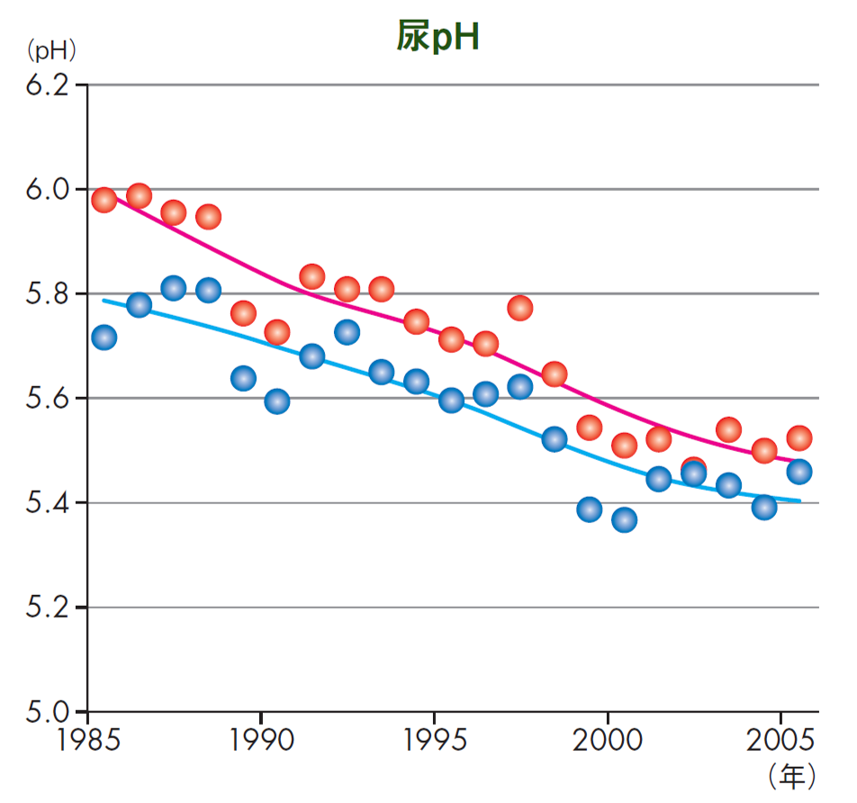
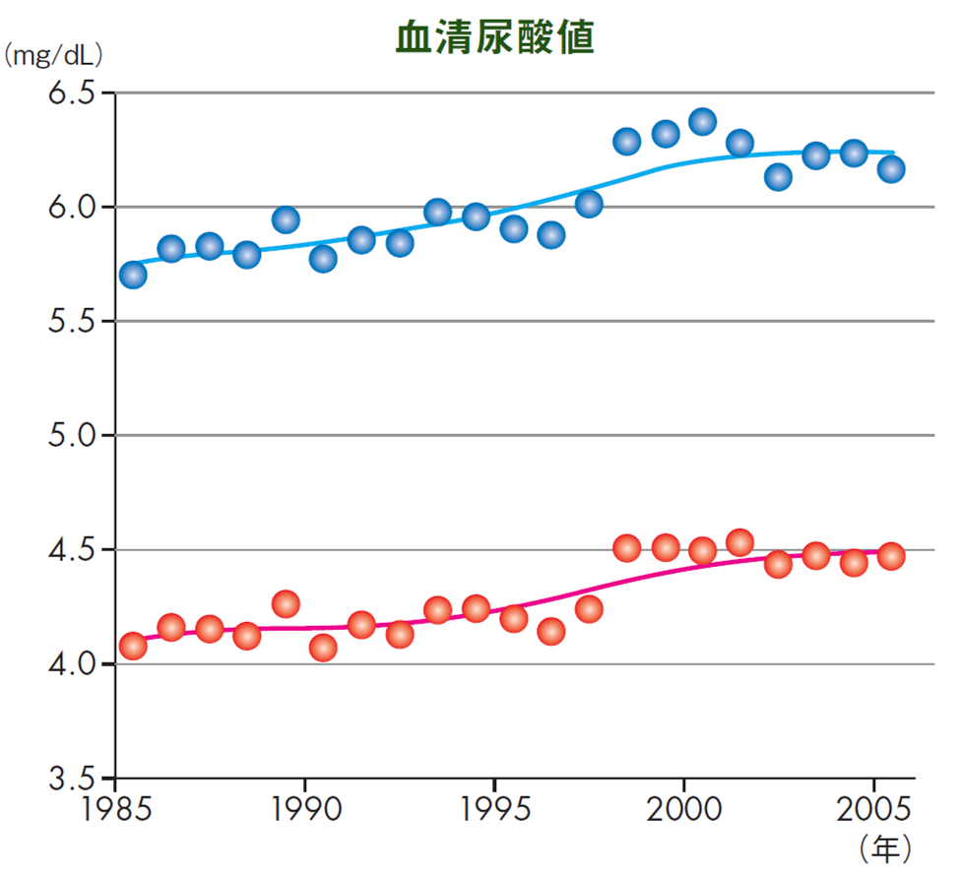
Trends of Serum Uric Acid
UpH
S-UA
men
women
men
women
Toranomon Hospital, Tokyo 1985 to 2005, N=225,826
H Tsuji, et al. Ningen Dock (Japanese) 22（3）, 55-60, 2007

Slide 29
Specific Health Check Screening
#1, Kamei K, et al. A slight increase within the normal range of serum uric acid and the decline in renal function: associations in a community-based population. Nephrol Dial Transplant 29(12):2286-2292, 2014
A slight increase within the normal range of serum uric acid (males >5.7 mg/dL, females >4.4 mg/dL), might be a risk for renal damage.
#2. Wakasugi M, et al. Association between Combined Lifestyle Factors and Non-restorative Sleep in Japan: A Population-based Cross-sectional Study.
Plos One 9 (9): e108718, 2014
A combination of several unhealthy lifestyle factors was associated with non-restorative sleep among the general Japanese population. Low risk was defined as (1) not smoking, (2) body mass index <25 kg/m², (3) moderate or less alcohol consumption, (4) regular exercise, and (5) better eating patterns.

Slide 30
Fig 1. Age- and sex-adjusted cumulative incidence of CKD, kidney dysfunction, and albuminuria according to SUA levels. *P<0.05, **P<0.01 vs. SUA ≤4.0g/dl. Sakae K, et al. Circ J 80: 1857-62, 2016
P for trend<0.001
P for trend<0.001
P for trend=0.001
**
*
*
*
Cumulative Incidence (%)
Cumulative Incidence (%)
Cumulative Incidence (%)
**
**
*
Serum unic acid, mg/dL
Serum unic acid, mg/dL
Serum unic acid, mg/dL
n (554) (515) (483) (507)
n (554) (515) (483) (507)
n (554) (515) (483) (507)

Slide 31
Fig 2. Multivariable-adjusted mean rate of annual change in eGFR during a 5-year period according to serum UA levels. *P<0.05, **P<0.01 vs. serum UA ≤4.0 mg/dl. Sakae K, et al. Circ J 80: 1857-62, 2016
-0.9
*
Annual change in eGFR
(ml/min/1.73m²/year)
**
-1.2
-1.5
≤4.0 4.1-4.9 5.0-5.8 ≥5.9
Serum unic acid, mg/dL
n (554) (515) (483) (507)

Slide 32
Uric acid crystal-independent mechanism of kidney disease: glomerular hyperfiltration via activation of the renin-angiotensin-aldosterone system or renal arteriolar damage via inflammation. Hisatome H, et al. Circ J 80: 1710-11, 2016

