Slide 1
Rebuilding the Failing Heart:
Bypassing the Roadblocks in Cell Therapy
Victor J Dzau MD
National Academy of Medicine, Mexico
February 14, 2018

Slide 2
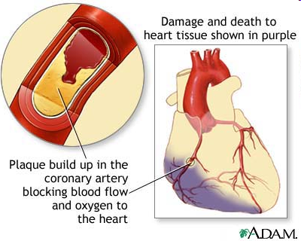
MI & Heart Failure
Acute MI
Myocyte cell death
Inflammation
Angiogenesis
Fibrosis
Remodeling
Limited cardiac regenerative
cell growth and repair
Loss of contractile function
Heart Failure

Slide 3
STEM CELLS & CARDIAC MYOCYTES
Blood
Bone Marrow
Skeletal Muscle
Adipose tissue
ES cells
Cardiac
Stem cells
Adapted from: Dimmeler S et al J Clin Invest 2005

Slide 4
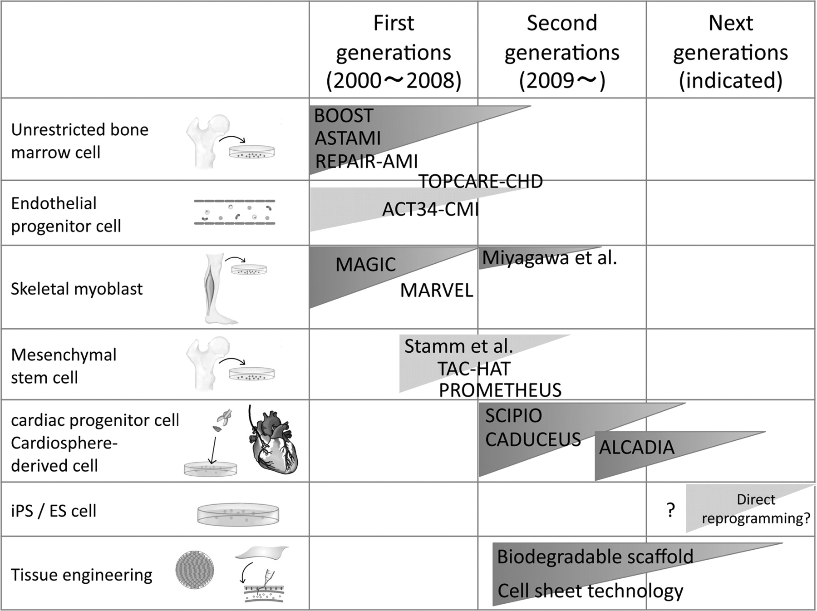
Current clinical trials (1st generations and ongoing 2nd generations) and future technology of “real” cardiac regeneration therapy
Takehara N , Matsubara H Am J Physiol Heart Circ Physiol 2011;301:H2169-H2180
Notes:
Current clinical trials (1st generations and ongoing 2nd generations) and future technology of “real” cardiac regeneration therapy. iPS, induced pluripotent stem; ES, embryonic stem. See main text for definitions of acronyms for each trial.

Slide 5
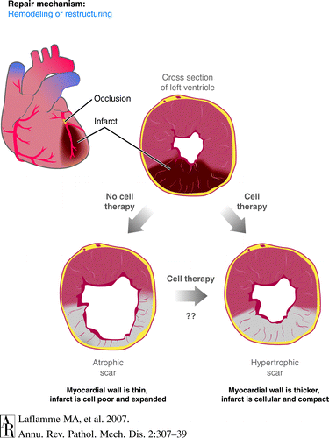
Cell based therapy: results
Stem cell therapy results…
5% -10% improvement in LV ejection fraction
Reduced end diastolic volumes
Improved perfusion in the infarcted area
Limitations of Cell Therapies to date
Need to isolate cells from tissues
Need to expand the cells in culture
Need to transplant large number of cells- low cell viability
Autologous vs allogeneic

Slide 6
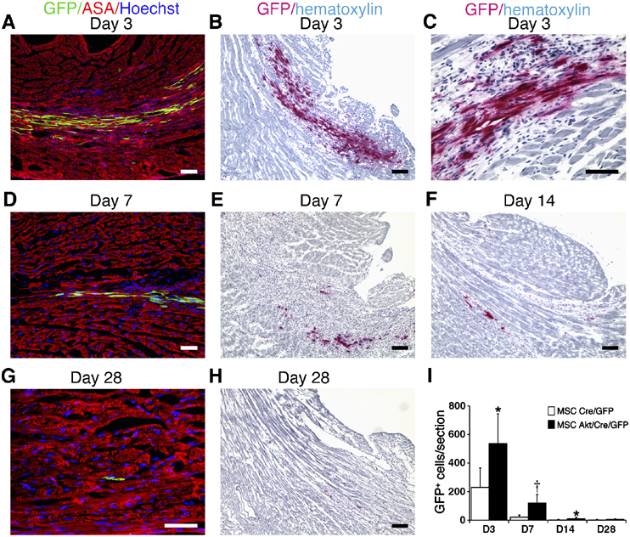
Noiseux, Dzau et al. Mol Therapy 2006

Slide 7
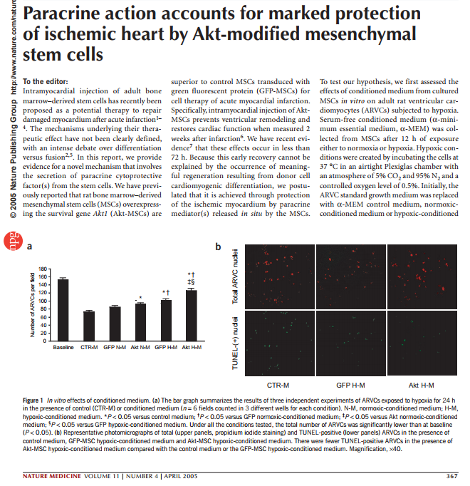
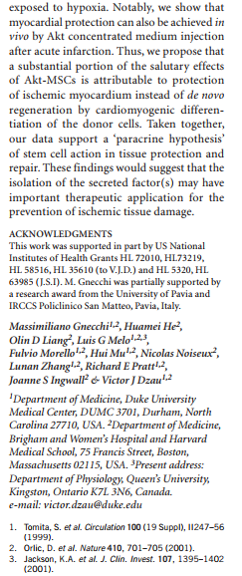
Gnecchi M, Melo L, Noisseux N, Pratt RE, Dzau VJ. Nat Med 2005
Notes:
Some notes: The journal lists the authors at the end of the article, so I’ve copied both the front page and the last column of the last page. The journal title is found at the bottom of the page so I’ve made sure it is shown.

Slide 8
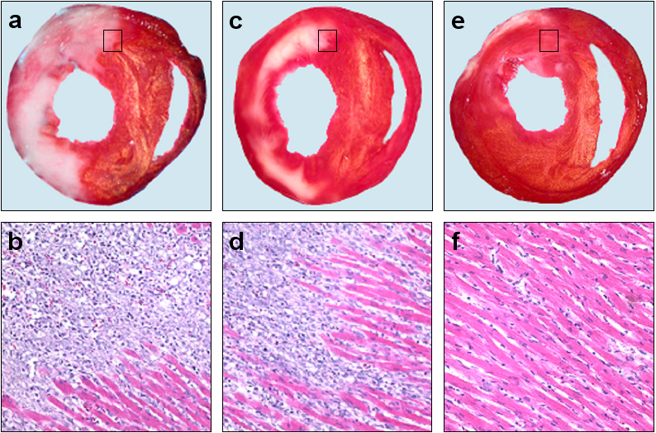
Effect of conditioned media on infarct size and inflammatory response after 72 hours
PBS
GFP cM
Akt cM
Gnecchi, Melo, Pachori & Dzau (2005) Nat Med
Notes:
Figure 2. Effect of MSCs transplantation on infarct size and inflammatory response. (a-b) LCA ligation in PBS control group resulted in an infarct equivalent in size to a third of the entire left ventricular area as calculated by TTC staining and a massive infiltration of inflammatory cells as documented by H&E staining. (c-d) After injection of GFP-MSCs infarct size and inflammatory response were reduced. (e-f) Transplantation of Akt-MSCs dramatically limited infarct size as well as the inflammatory response.

Slide 9
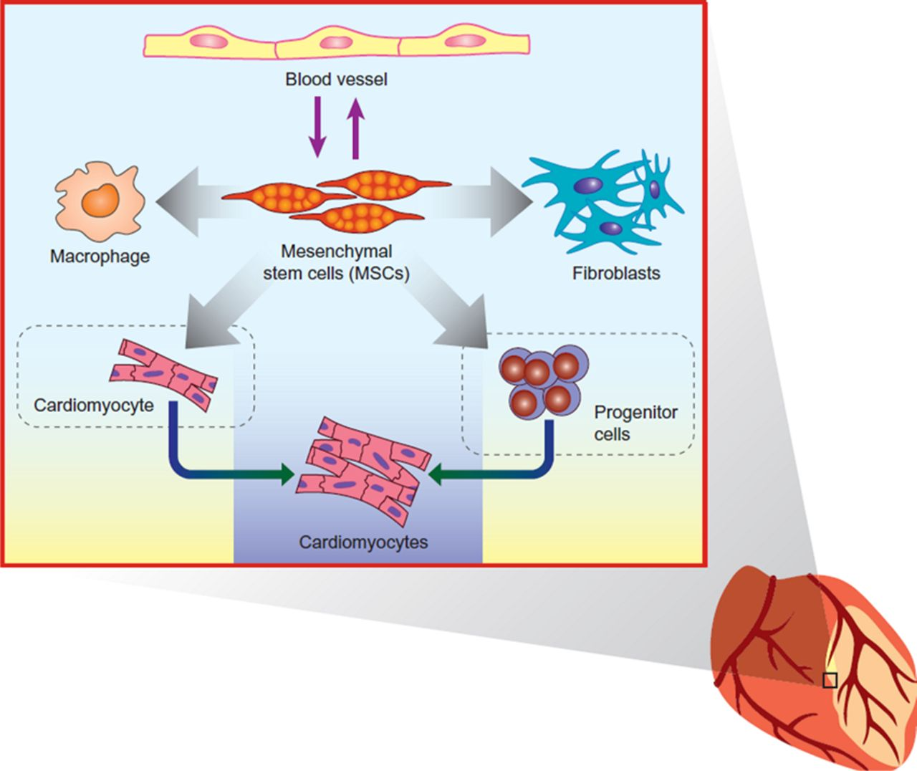
The Paracrine Hypothesis
Cardiac protection
Neovascularization
Cardiac regeneration
Cardiac remodeling
Gnecchi M, He H, Liang OD, Melo LG, Morello F, Mu H, Noiseus N, Zhang L, Pratt RE, Ingwall JS, Dzau VJ.,
Paracrine action accounts for marked protection of ischemic heart by Akt-modified
mesenchymal stem cells. Nature Medicine, 11(4):367-368, 2005
Gnecchi M, Zhang Z, Ni A, Dzau VJ. Paracrine mechanisms in adult stem cell signaling and therapy. Circ Res.103(11):1204 2008.
Hodgkinson C, Bareja A, Gomez J, and Dzau VJ. Emerging Concepts in Paracrine Mechanisms in Medicine and Biology. Circ Res. 118: 95, 2015
Notes:
Paracrine factors affect different cell types and create a microenvironment that is influenced by concentration gradients, with temporal and spatial summation of cellular responses.

Slide 10
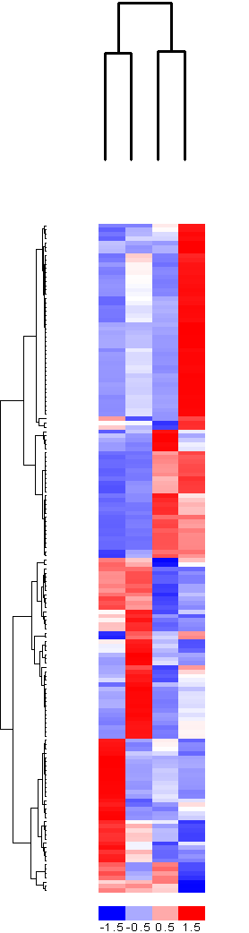
Identification of Akt-MSC Secreted Proteins
Affymetix Mouse Genome 430A 2.0
has 22,600 probe sets, representing over 14,500 genes
GFP Akt
- + - +
650 genes were differentially regulated
50 unique genes encoding for known secreted factors were differentially regulated between the different conditions
KNOWN ANGIOGENIC CYTOKINES
VEGF, IGF, HGF, Adrenomedullin,Sfrp etc…..

Slide 11
Novel Paracrine Factors
Genomic & proteomic characterization, molecular & functional studies identified 3 key factors:
Sfrp2
HASF (Hypoxia and Akt induced Stem cell Factor)
Abi3bp

Slide 12
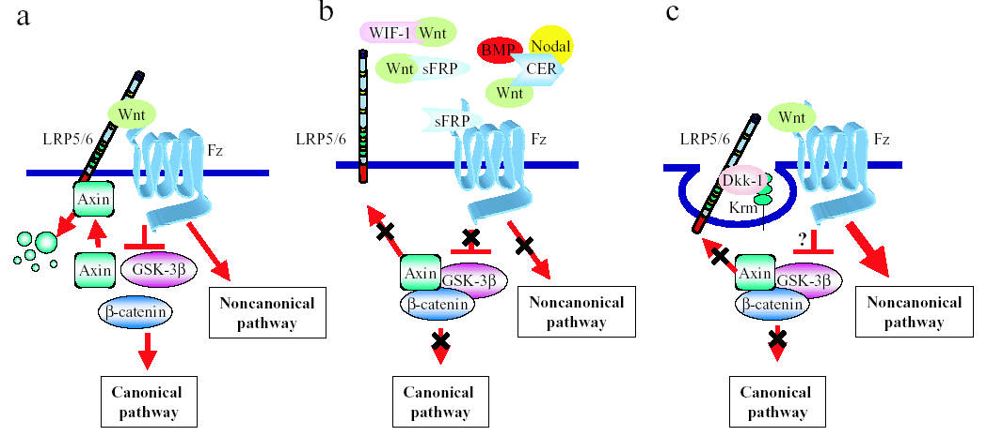
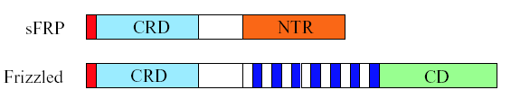
Secreted Frizzled Related Proteins
Antagonists of Wnt signaling
Wnt antagonists that have a similar CRD as Fz receptor
Currently 5 classes
Diverse cellular effects

Slide 13
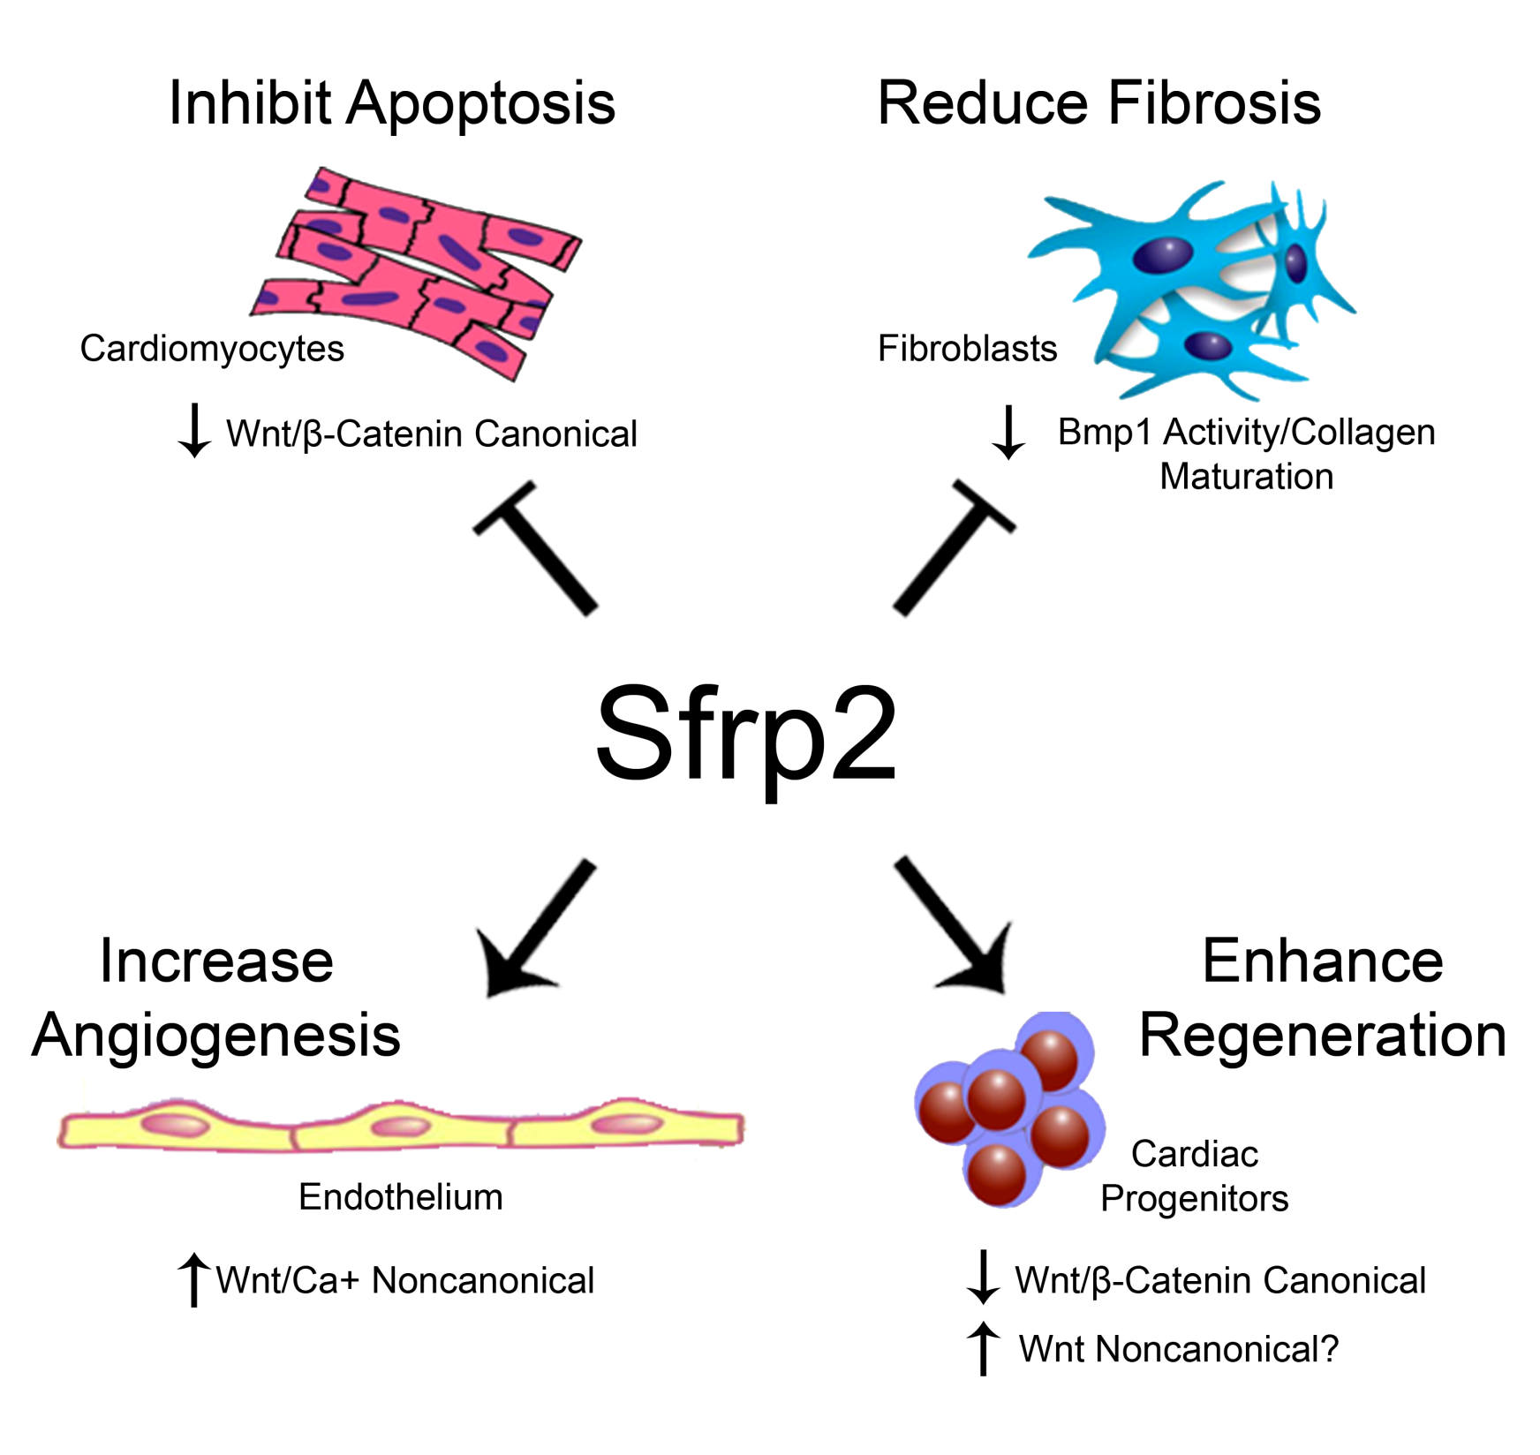

Slide 14
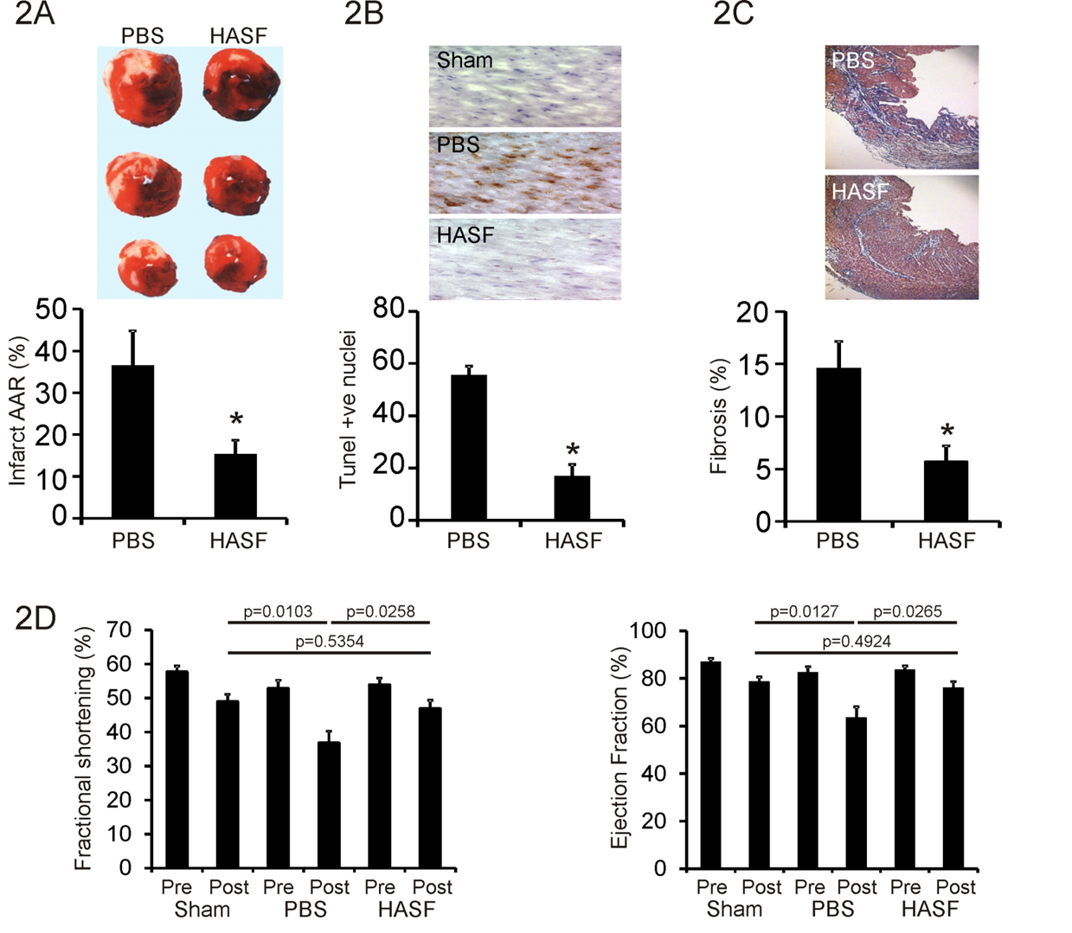
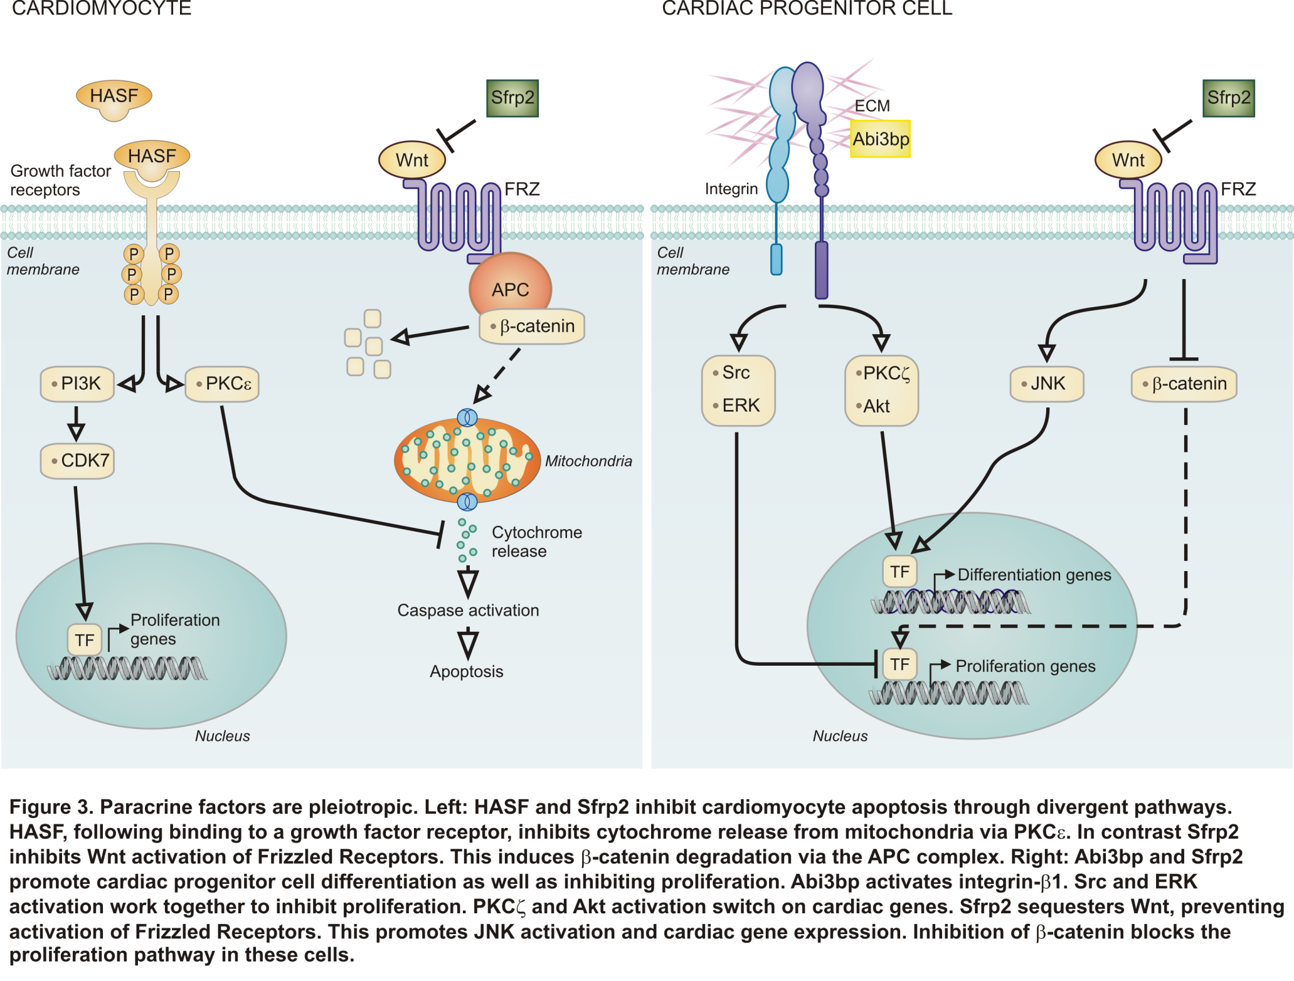
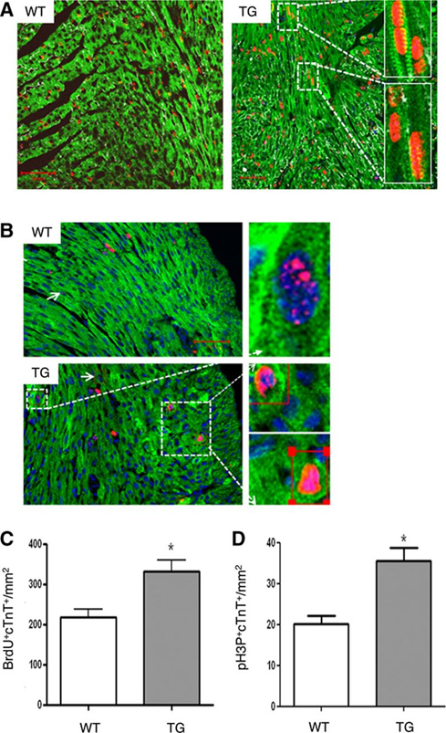

HASF promotes cardiomyocyte
proliferation and protection via IGF1R
IGF1R
BrDU staining in red
Notes:
Top panels: HASF protects the heart against myocardial injury. In this set of experiments HASF was injected into a rat heart following MI. Infarct area, the number of TUNEL positive nuclei and the amount of fibrosis were all significantly reduced by HASF. Further echocardiography measurements one month following infarct showed that HASF had a significant beneficial effect upon heart function (not shown here).
Bottom panels: In vivo, HASF increases proliferation of cardiomyocytes. Representative confocal images of wild-type and HASF transgenic 3-day-old neonatal mice heart tissue stained for various markers including BrdU (red), cardiac troponin T (cTnT; green), and laminin (white) visualized by confocal microscopy. Similar findings were also found with histone-3-phosphate, another proliferation marker, (not shown here). Quantification shows that HASF had a significant effect on neonatal cardiomyocyte proliferation.

Slide 15
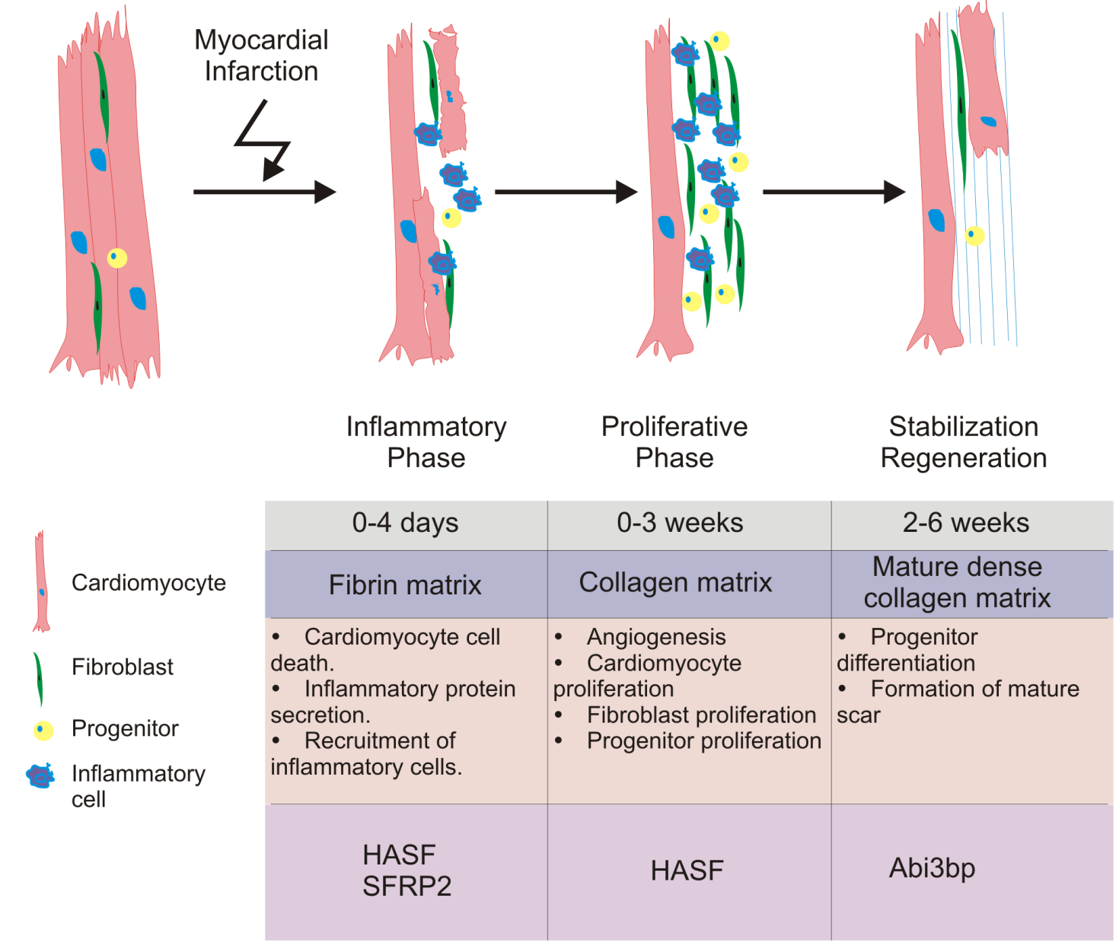
Paracrine Factors Function
in a Temporal Manner
SFRP2
Notes:
Paracrine factors are secreted temporally and affect different cells after myocardial repair and regeneration at different stages.

Slide 16
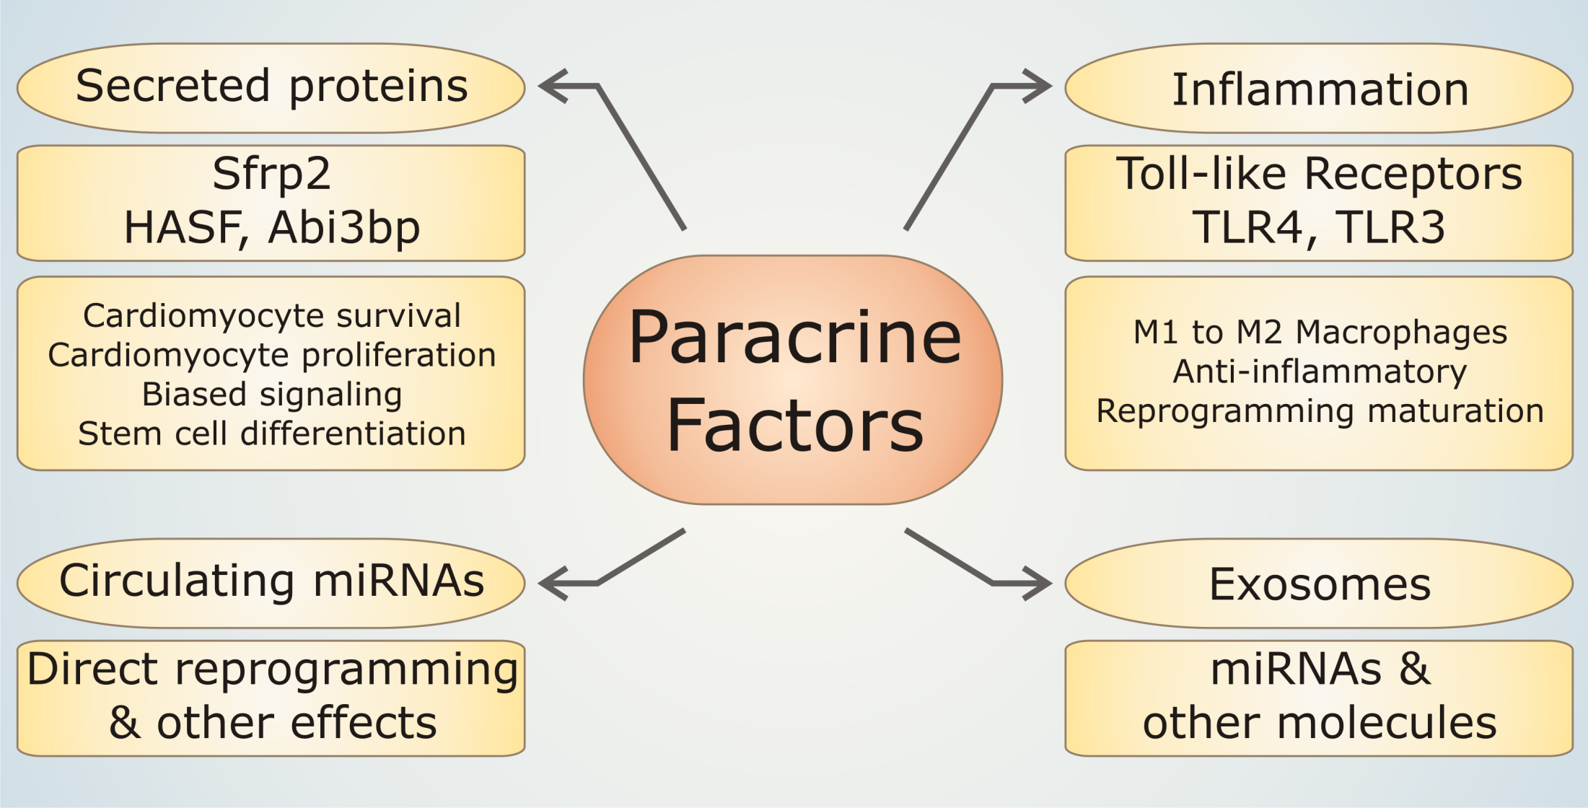
PARACRINE HYPOTHESIS 2018
Notes:
There are multiple ways to deliver paracrine factors to cells.
Eduardo’s miR is miR-146a-3p

Slide 17
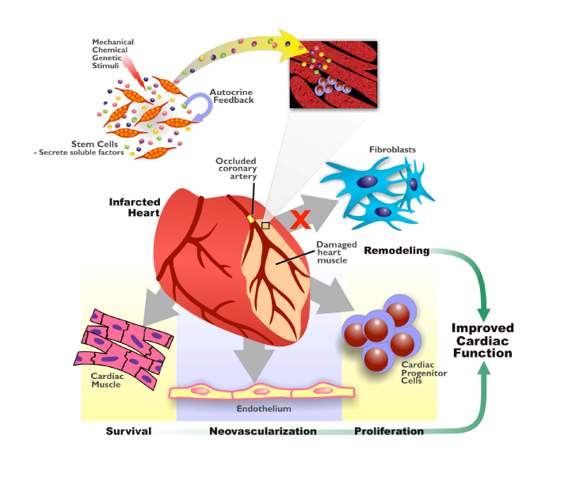
Cardiac Regeneration:
Replacing lost heart muscles
Stem cell therapy
Generating new muscle
Paracrine molecules
Stimulating resident stem cells
Cardiac Reprogramming
Turning scar to muscle
Tissue Engineering

Slide 18
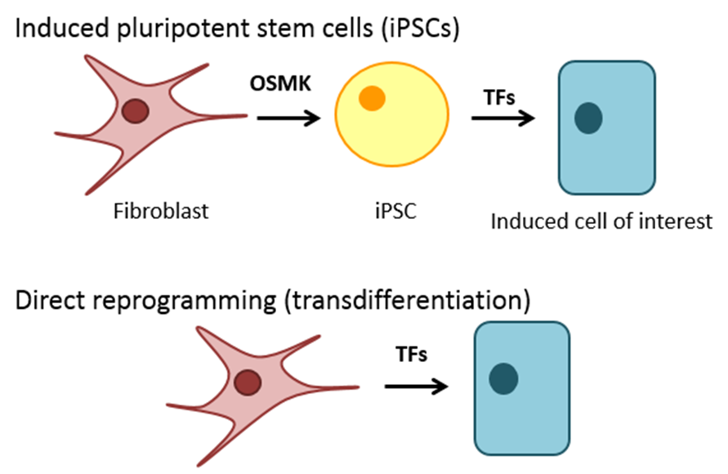
Cellular Reprogramming
Converting one somatic cell-type into another, e.g. making a skin cell into a neuron.
Takahashi and Yamanaka, Generation of inducible pluripotent stem cells (iPSC) from fibroblasts.
Indirect reprogramming: 2-steps
Generate iPSCs
Generate cell of interest from iPSCs
Direct reprogramming: 1 step
Generate cell of interest from any somatic cell of choice

Slide 19
Cellular Reprogramming for Cardiac Repair
Transcription Factors
iPS cell
MicroRNA
Small Molecules
DIRECT REPROGRAMMING
Functional
Cardiomyocyte
Fibroblast
In vivo delivery to the injured myocardium
Target cardiac fibroblasts
Direct reprogramming of “scar” tissue to
functional cardiomycocytes
Notes:
The primary approach to cellular reprogramming has involved the use of transcription factors as has been elegantly reported by several labs. However, the use of alternative mediators such as small molecules and microRNAs has also gained a lot of attention.
Stemming from many of these exciting discoveries being made in reprogramming research, our lab decided to examine the role of microRNAs in cardiac reprogramming.
We hypothesized that a reprogramming approach administering miRNAs represents a novel method that if successful, may offer more therapeutic leverage – smaller size, easier administration

Slide 20
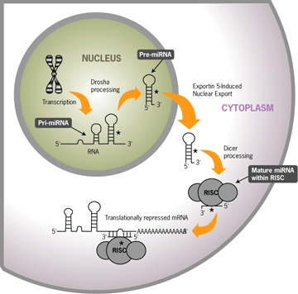
microRNAs
A tiny piece of RNA, about 21 to 23 bases in length, that binds to matching pieces of messenger RNA to make it double-stranded and decrease the production of the corresponding protein.
Each microRNA can repress 10-200
different genes
Small; potential for easier delivery in vivo
Notes:
The ability of individual miRNAs to modulate complex disease pathways through the targeting of several components of regulatory networks enables miRNAs to modulate tissue stress responses in a manner that is distinct from that of classical drugs

Slide 21
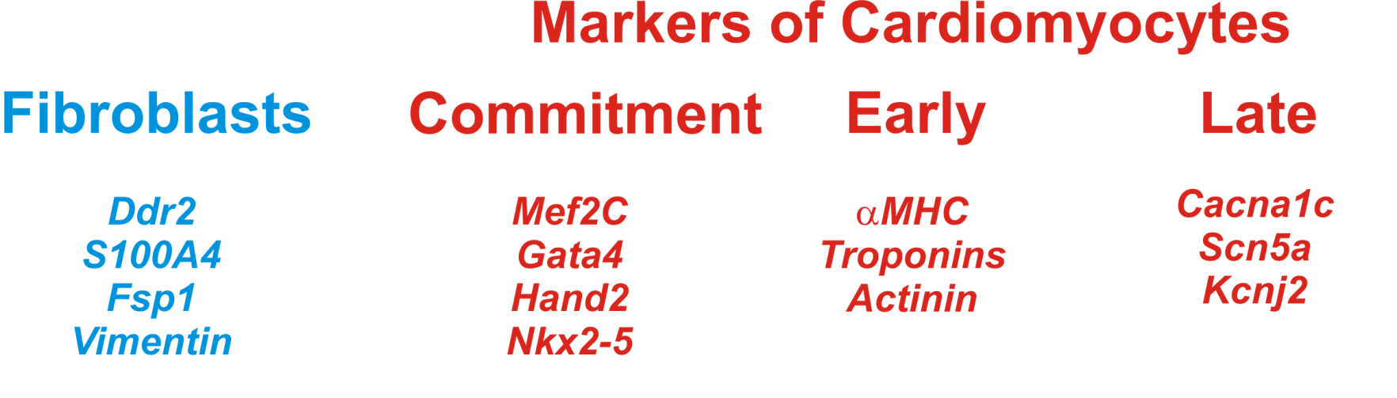
Experimental Strategy to find
Cardiac Reprogramming microRNAs
Screening and in vitro characterization
Transiently introduce 41 distinct miRNA compositions into fibroblasts
Screen for induction of early and late stage markers of cardiac differentiation

Slide 22
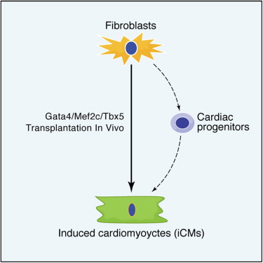
A specific combination of microRNAs (miR combo: miR-1, miR-133a, miR-208a, and miR-499-5p) reprogrammed cardiac fibroblasts into cardiomyocyte-like cells.
miRs-1, 133a, 208a, 499-5p

Slide 23
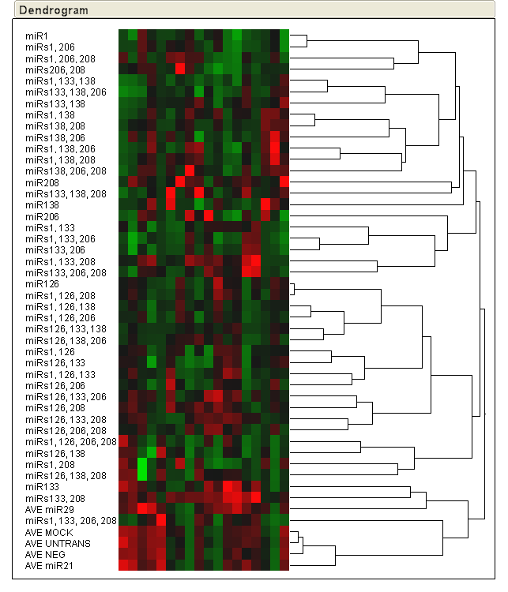
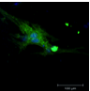
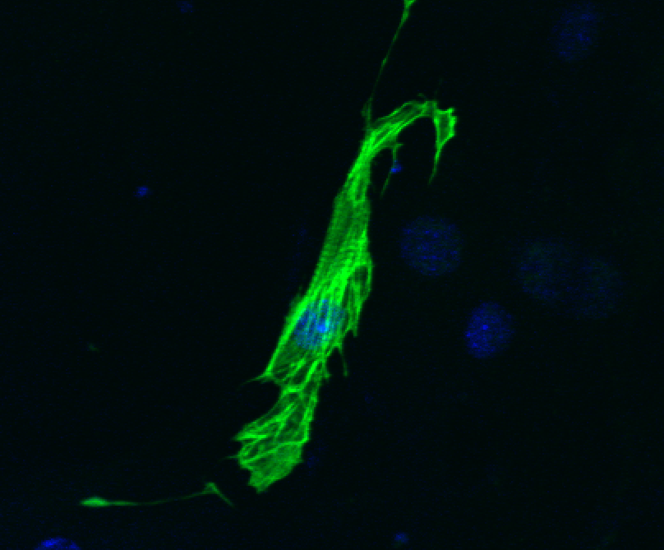

Fibroblastic
Cardiac
MicroRNAs activate expression of
Cardiac Reprogramming Factors in
Fibroblasts
qRT-PCR_Gata4; day 3
qRT-PCR_Mef2c; day 3c
miRs-1, 33, 206
miRs-1, 133, 208
miRs-1, 133, 208
miRs-1, 133, 206
Controls Individual miRNA Compositions
miR combinations
miR combinations
Ddr2, d3
Ddr2, d6
Vim, d3
Vim, d6
Isl1, d3
Isl1, d6
Flk1, d6
Nkx2.5, d3
Nkx2.5, d6
Gata4, d3
Gata4, d6
Hand2, d3
Hand2, d6
Mef2c, d3
Mef2c, d6
Tnni3, d3
Tnni3, d6
Cx43, d6
Notes:
We began by conducting a number of screens using both adult and neonatal cardiac fibroblasts conducted with all the different miR compositions and evaluated for their reprogramming potential by screening for induction of markers such as fibroblastic genes Vimentin (Vim) and Ddr2, shown here on the left and both early and late stage markers of cardiac differentiation including Gata4, Mef2c, Nkx2.5, Tbx5, as well as later stage markers such as Tnni3 (Cardiac troponin I).
As early as 3 days post-transfection, miRNA-transfected cells exhibited a major shift in expression from fibroblastic genes such as Vimentin (Vim) and Ddr2 to cardiomyocyte-specific genes. We observed for defined groups of distinct microRNA compositions, a fibroblastic-myocyte phenotypic shift not observed in non-targeting miRNA controls or transfection controls.
The bar graphs on the right highlight expression patterns of Gata4, Mef2c, in the top panel and the geometric mean of both these TFs along with Tbx5 in the bottom panel showing that in our top mir combinations 1, 133, 208 and 1, 133, 206 the expression of key reprogramming factors identified by Deepak Srivastava and others were consistently induced in our cells.

Slide 24

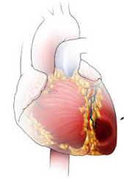
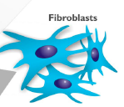
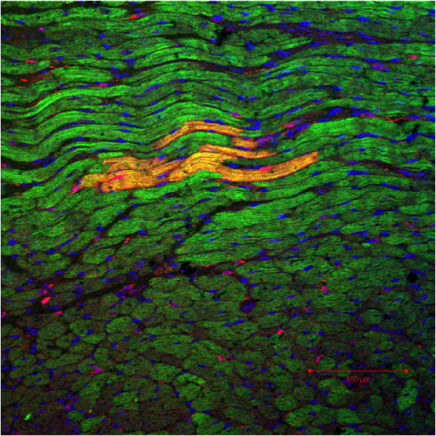
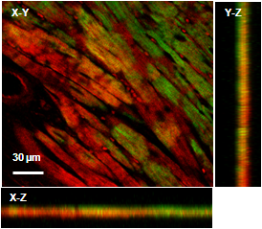
Injection of miRNAs in vivo
For lineage tracing of reprogrammed fibroblasts, we utilized the FSP1Cre-tdTomato
transgenic mouse model. tdTomato+ cardiomyocytes were taken as evidence of direct
reprogramming (from non-myocytes to cardiomyocytes).
Mark fibroblasts permanently with the fluorescent protein, tdTomato
Cells positive for tdTomato:
  Fibroblasts
  Cells that originated from a fibroblast (e.g. cardiomyocytes expressing tdTomato were once fibroblasts).
Fsp1Cre-tdTOMATO
transgenic mouse
Test for miRNA-induced reprogramming
in vivo 4 weeks following acute myocardial infarction
TROPONIN
Notes:
To evaluate the potential application of our approach in vivo, we injected lentiviral miRNAs, miR-1 alone; combination of miRs-1, 133, 208, 499; and a non-targeting-miRNA control intramyocardially immediately following injury by permanent ligation of the left ascending coronary artery. In these experiments we used FSP1Cre/tdTOMATO mice which allowed us to lineage trace the fate of cardiac fibroblasts in vivo. Evidence of cardiac reprogramming would be confirmed by co-expression of tdTOMATO, which marks the cardiac fibroblast line, and cardiomyocyte markers. Four weeks after infarction, hearts were harvested, fixed and stained for cardiac troponin T (TNNT2) expression. We also verified activation of the Fsp1Cre promoter in other cell types such as smooth muscle cells, endothelial cells, and progenitor cells.

Slide 25
miR combo reprogrammed cardiomyocytes possess gap junctions
Notes:
FSP1-Cre/tdTomato mice were subjected to either a sham operation or myocardial infarction [MI] and injected with lentivirus containing either miR combo or negmiR. Seven weeks following injury the entire peri-infarct region was visualized by serial sectioning through the heart tissue. Sections were probed for
(C) tdTomato, cardiac troponin-T, and connexin-43, and

Slide 26
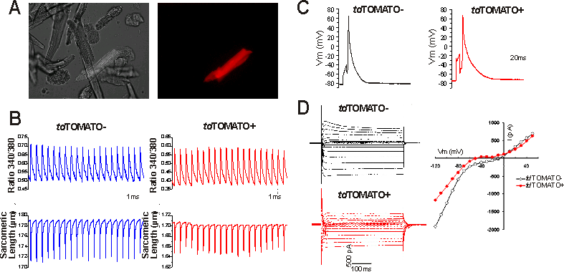
Physiological testing of induced cardiomyocytes
Notes:
Physiological profiles of tdTOMATO+ cardiomyocytes isolated from FSP1Cre/tdTOMATO
transgenic mice ~5-6 weeks post-infarct (permanent ligation) and miR combo delivery.
Cardiomyocytes were isolated according to conventional methods and maintained in a holding
solution on ice prior to imaging (within 12 hours). A) Representative example of a tdTOMATO+
cardiomyocyte from a dissociated prep. B) Simultaneous Calcium transients and contractility traces
obtained from tdTOMATO- and tdTOMATO+ cardiomyocytes. Cells were captured with electrical
field stimulation using IonOptix system. C) Representative recordings of action potentials generated
using patch-clamping of tdTOMATO- and tdTOMATO+ cardiomyocytes. D) Example of
current-voltage (I-V) relationship in a control and a tdTOMATO+ cardiomyocyte. I-V curve was
generated from steady-state current at the end of the voltage step. Holding potential was -40 mV
(which inactivates Na currents).

Slide 27
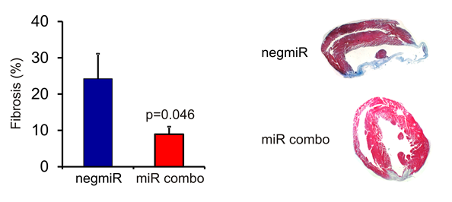
miR combo reduces fibrosis

Slide 28
miR combo restores function to the injured heart
Notes:
Fractional shortening is used as an estimate of myocardial contractility.

Slide 29
miR combo
Reprograms fibroblasts into mature fully functional cardiomyocytes in vivo.
Promotes recovery following myocardial infarction.

Slide 30
Delayed improvements in cardiac function are dependent on the maturation of reprogrammed cells
Notes:
Schematic describing the hypothesis that the time-delayed improvements in cardiac function are dependent on the maturation of reprogrammed cells.

Slide 31
Mechanism of miR combo reprogramming
  Mechanical
  Epigenetic
  Innate Immunity

Slide 32
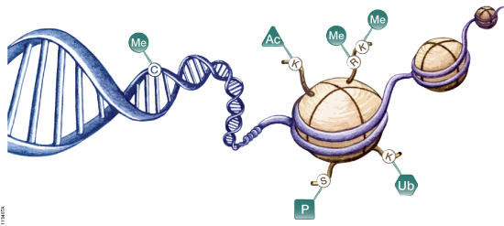
Epigenetic Modification and Transcription
DNA methylation: Gene repression
Histone Modifications:
  Acetylation: Gene Activation
  Methylation:GeneActivation/Repression
  Ubiquitination: Gene Activn/Repression
  Phosphorylation: Gene Activn/Repression
Notes:
From Promega website
https://www.promega.com/resources/product-guides-and-selectors/protocols-and-applications-guide/epigenetics/
DNA methylation is typically associated with epigenetic gene repression, and many targets of de novo DNA methylation during differentiation are promoters of stem cell- and germline-specific genes (Weber et al. 2007; Mohn et al. 2008; Farthing et al. 2008). DNA methylation also recruits methyl-CpG-binding proteins, which recruit additional proteins that add silencing modifications to neighboring histones. This coordination between DNA methylation and silencing histone marks leads to compaction of chromatin and gene repression.
Histone modifications:
Acetylation of a lysine residue neutralizes a positive charge on a histone protein, reducing the electrostatic interaction with negatively charged DNA. This reduction in affinity leads to increased accessibility of the DNA to protein complexes, which can lead to increased gene expression.
Methylation
Histone methylation occurs at lysine residues, which can be mono-, di- or trimethylated, and arginine residues, which can be mono- or dimethylated. Histone methylation is catalyzed by protein lysine methyltransferases (PKMTs) and protein arginine methyltransferases (PRMTs) but can be reversed by protein demethylases. To date, researchers have identified >30 demethylating enzymes, >50 protein lysine methyltransferases and >10 protein arginine methyltransferases, suggesting that protein methylation is a dynamic and complex process (Janzen et al. 2010). Histone methylation has different effects on transcriptional activity, depending on the number of methyl groups and position of the amino acid being modified. In general, the H3K9me1 mark is activating, whereas H3K9me2 and H3K9me3 are repressive; H3K4me3 and H3K36me3 are associated with active chromatin, whereas H3K9me3, H3K27me3, H3K36me2 and H4K20me1 often are found in transcriptionally repressed heterochromatin.
The downstream effects of histone methylation are largely determined by proteins that bind to the modified histones. For example, H3K9me3 acts as a binding site for heterochromatin protein 1 (HP1), which then can recruit histone methyltransferases, histone deacetylases and other proteins that affect chromatin structure. H3K4me3 recruits proteins that promote euchromatin, whereas H3K9me1, H3K9me2 and H3K27me3 interact with proteins that promote heterochromatin. Two such groups of proteins are the polycomb group (PcG) proteins and their antagonists, the trithorax (trxG) group proteins, which were first identified as regulators of hox gene expression in Drosophila (Schwartz and Pirrotta, 2008). More recent studies have shown that related proteins exist in mammals and plants. PcG proteins repress transcription; trxG proteins activate transcription. Some PcG and trxG proteins possess histone methyltransferase activity and can modify histones directly, while others bind to and interpret histone modifications.
Histone Ubiquitination
Conjugation of ubiquitin, a 76-amino acid protein, to lysine residues of histone proteins can affect transcription activity as well as nucleosome stability and, as a result, gene accessibility. The consequences of histone ubiquitination depend on the histone substrate and degree of ubiquitination (reviewed by Weake and Workman, 2008). Mono-ubiquitination of histone H2A (H2Aub1) is often considered a repressive mark, while H2B mono-ubiquitination can play a role in both transcriptional activation and silencing. In addition, there is evidence of cross-talk between histone ubiquitination and other forms of histone modification. For example, ubiquitinated H2B has been identified as a docking site for the COMPASS protein complex (Chandrasekharan et al. 2010), which includes the histone methyltransferase responsible for H3K4 methylation. Also, H2Aub, but not H2A, specifically represses di- and trimethylation of H3K4, and ubiquitin-specific protease 21 (USP21) relieves this repression (Nakagawa et al. 2008).
Ubiquitination of histones can be reversed by cleaving the peptide bond between ubiquitin and the ubiquitinated protein. Several deubiquitinases (DUBs) have been reported to deubiquitylate histones 2A, 2A.Z and 2B, including USP3, USP10, USP21, USP22 and Bap1. Histone deubiquination has been associated with both transcription activation (Nakagawa et al. 2008; Draker et al. 2011; Gutiérrez et al. 2012) and repression (van der Knaap et al. 2005; van der Knaap et al. 2010).
Histone Phosphorylation
Histones can be phosphorylated on serine, threonine and tyrosine residues. Many of the serine and threonine phosphorylation events play a role in DNA repair or DNA condensation, segregation and decondensation during mitosis, but some are involved in epigenetic regulation of transcription, including H3T3ph, H3T6ph, H3T11ph, H2.AS1ph, H3S10ph and H4S41ph (reviewed in Pérez-Cadahía et al. 2010). H3S10ph is one of the best characterized of these histone modifications. In addition to its DNA-restructuring responsibilities during mitosis, H3S10ph seems important for chromatin decondensation associated with transcriptional activation of target genes. H3S10ph recruits chromatin-modifying enzymes and chromatin-remodeling complexes and prevents binding of HP1 to neighboring H3K9me3 marks at the onset of mitosis. H3S10ph, as well as H3T3ph and H3T11ph, can block binding of DNMT3a to H3, reducing methylation of nearby chromatin (Zhang et al. 2010).
Several kinases are involved in phosphorylation of H3S10, including IkB kinase α (IKKα) (Yamamoto et al. 2003; Anest et al. 2003), proviral integration site for Moloney murine leukemia virus 1 (PIM1) (Zippo et al. 2007) and ribosomal S6 kinase 2 (RSK2) (Sassone-Corsi et al. 1999). Addition of the H3S10ph mark to H3K9me3 is catalyzed by Aurora B kinase (Sabbattini et al. 2007), which also modulates chromosome structure during mitosis and mediates chromosome alignment and attachment to microtubules of the mitotic spindle.

Slide 33
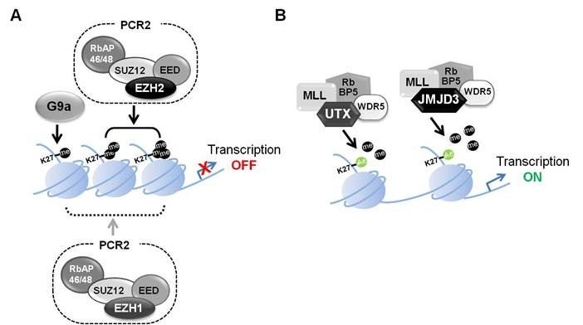
H3K27 Methylation and Transcription regulation
Histone H3K27 Methyl Transferase
Histone H3K27 DeMethylase
EZH2
EZH1
Kdm6b
Kdm6a
Transcription OFF
Transcription ON

Slide 34
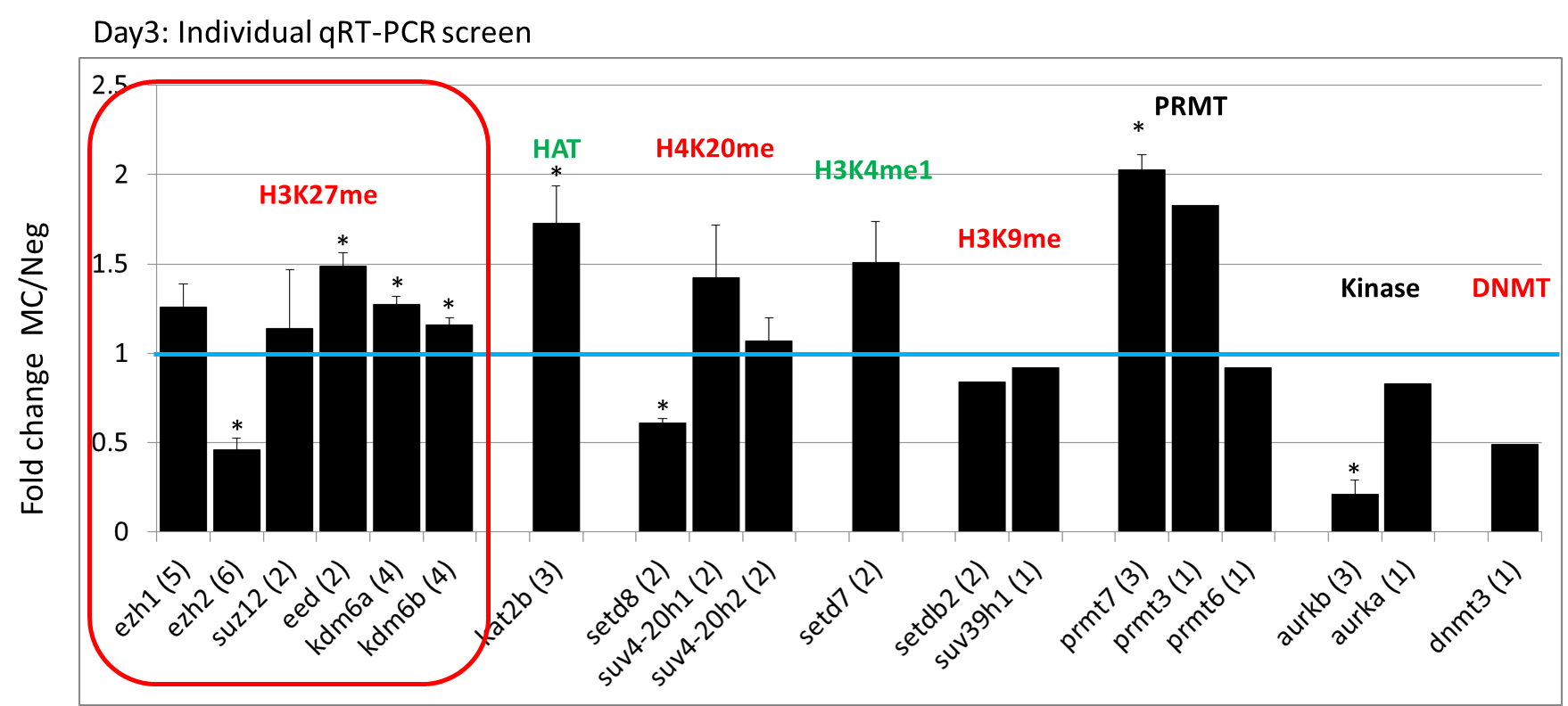
Mechanism of miR combo reprogramming
Modification of the epigenetic landscape by miR combo
Notes:
We hypothesized that miR combo promoted reprogramming by modifying the epigenetic landscape.
To that we end we conducted a qPCR screen to identify epigenetic modifiers, enzymes that modify chromatin, regulated by miR combo, the results of which are shown here.
We specifically focussed on those proteins involved in H3K27 trimethylation, the ones in the red box, specifically Kdm6a and Kdm6b.

Slide 35
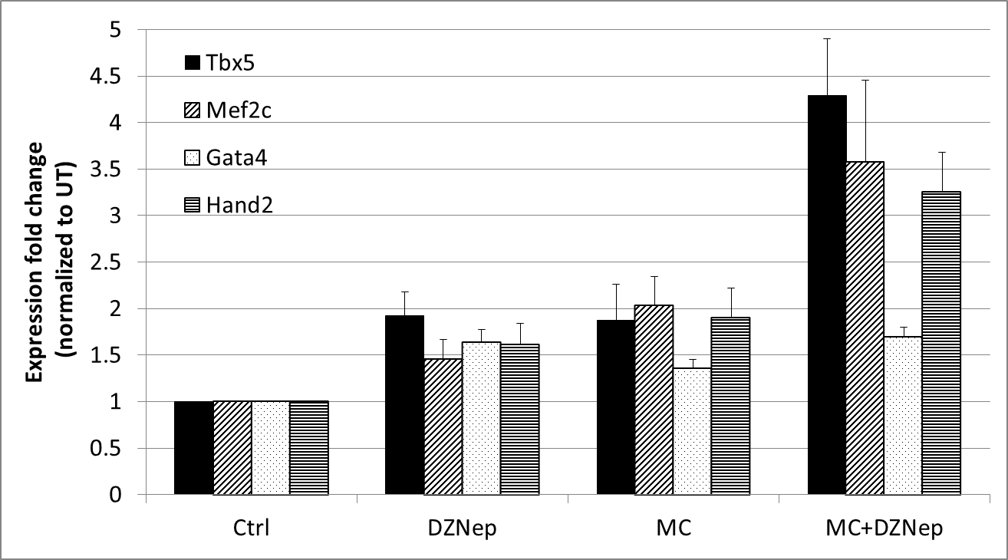
Inhibiting H3K27 methylases promotes reprogramming
  DZNEP: a general inhibitor of H3K27 methylases
#*
*
#*
#
*
*
*
#
#
*

Slide 36
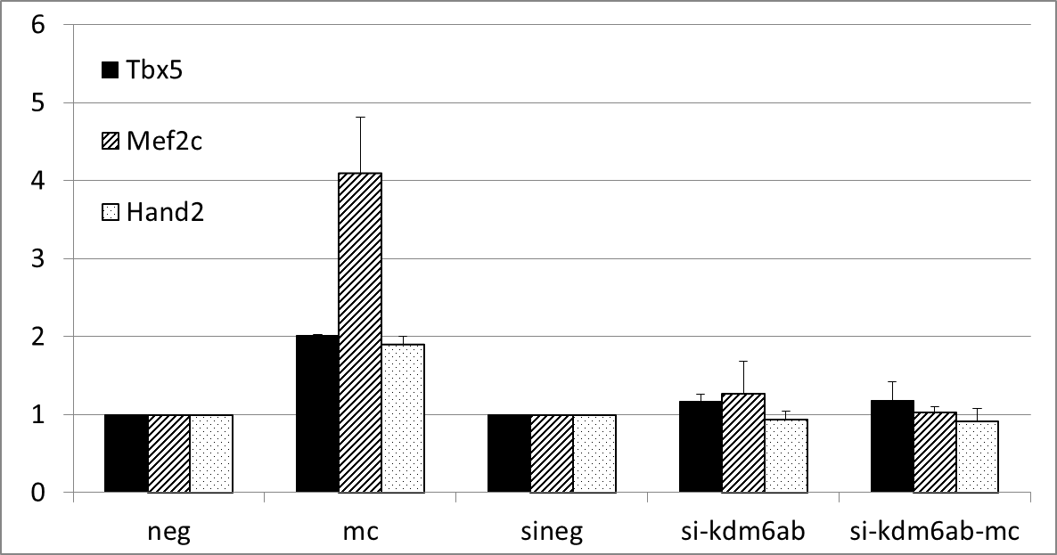
Knockdown of the histone demethylase Kdm6a/b inhibits miR combo
*
*
*
Notes:
Neonatal cardiac fibroblasts were transfected with negmiR (neg), miR combo (mc), a negative control siRNA (sineg), siRNA targetting Kdm6a and Kdm6b (si-kdm6ab) and miR-combo in combination with siRNA targetting Kdm6a and Kdm6b (si-kdm6ab-mc).
As expected miR combo induced cardiac gene expression in the neonatal fibroblasts (2nd group of bars from the left).
The effect of miR combo was completely inhibited by knockdown of kdm6a and kdm6b (5th group of bars from the left), implying a role for these histone demethylases in miR combo mediated reprogramming.

Slide 37
Hypothesis: micro RNAs mediate direct cardiac reprogramming of somatic cells through epigenetic modifications (histone methylation)
Current Model
Neonatal cardiac FB
Cardiac microRNAs
Immature CM
cardiac TFs OFF
Tbx5
Mef2c
Gata4
Hand2
cardiac TFs ON
Tbx5
Mef2c
Gata4
Hand2
HMT (Ezh2)
↑ HDMT (Kdm6a/b)
H3K27me3
H3K27me3
day 0
day 3-4
Notes:
miRs mediate direct cardiac reprogramming through epigenetic modification of histone methylation

Slide 38
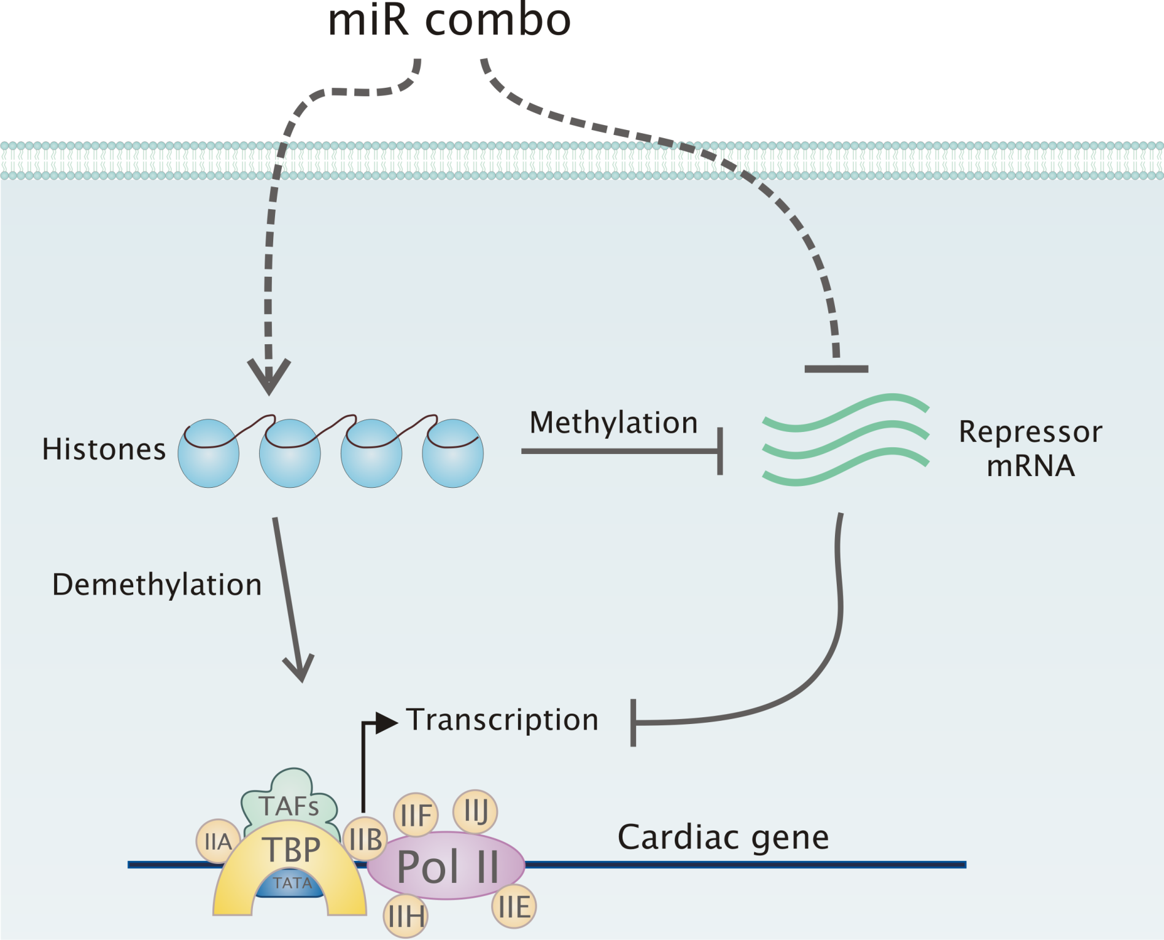

Slide 39
Mechanism of miR combo reprogramming
  Mechanical
  Epigenetic
  Innate Immunity

Slide 40
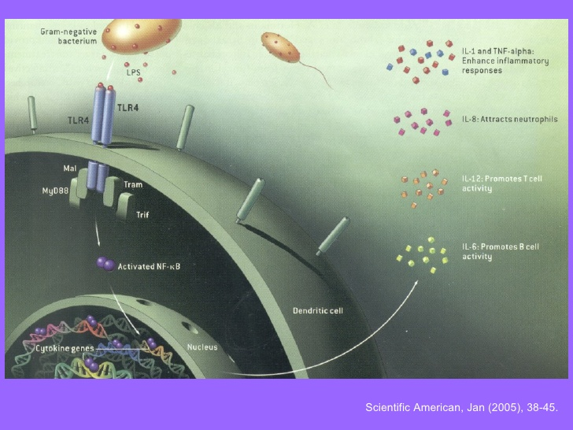
Innate immunity
Innate immunity is the first line of defense against invading organisms.
Ancient system that first evolved to protect simple organisms from invaders
Notes:
Add in pretty picture about TLRs,
Ancient system that was first evolved to protect organisms from invaders.

Slide 41
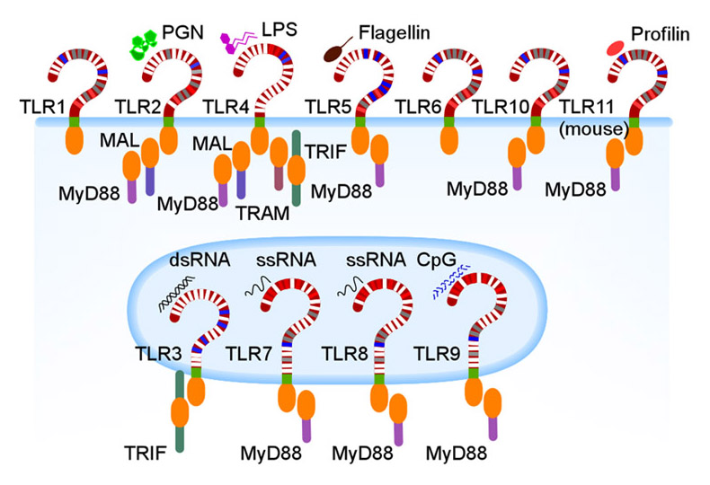
TLRs: mediators of innate immunity
TLRs recognize molecular patterns that are expressed on these infectious agents and through the production of cytokines recruit immune cells to the site of infection.

Slide 42
TLR3
TLR3 recognizes double-stranded RNA associated with viral infection and thus plays a role in the host defense against viruses.
TLR3 also has roles beyond innate immunity
  protects against atherosclerosis
  may prevent damage to the brain following stroke
  reprogramming fibroblasts to iPS cells
Notes:
Add in pretty picture about TLRs,
Ancient system that was first evolved to protect organisms from invaders.
(look in Scientific American for a picture)

Slide 43
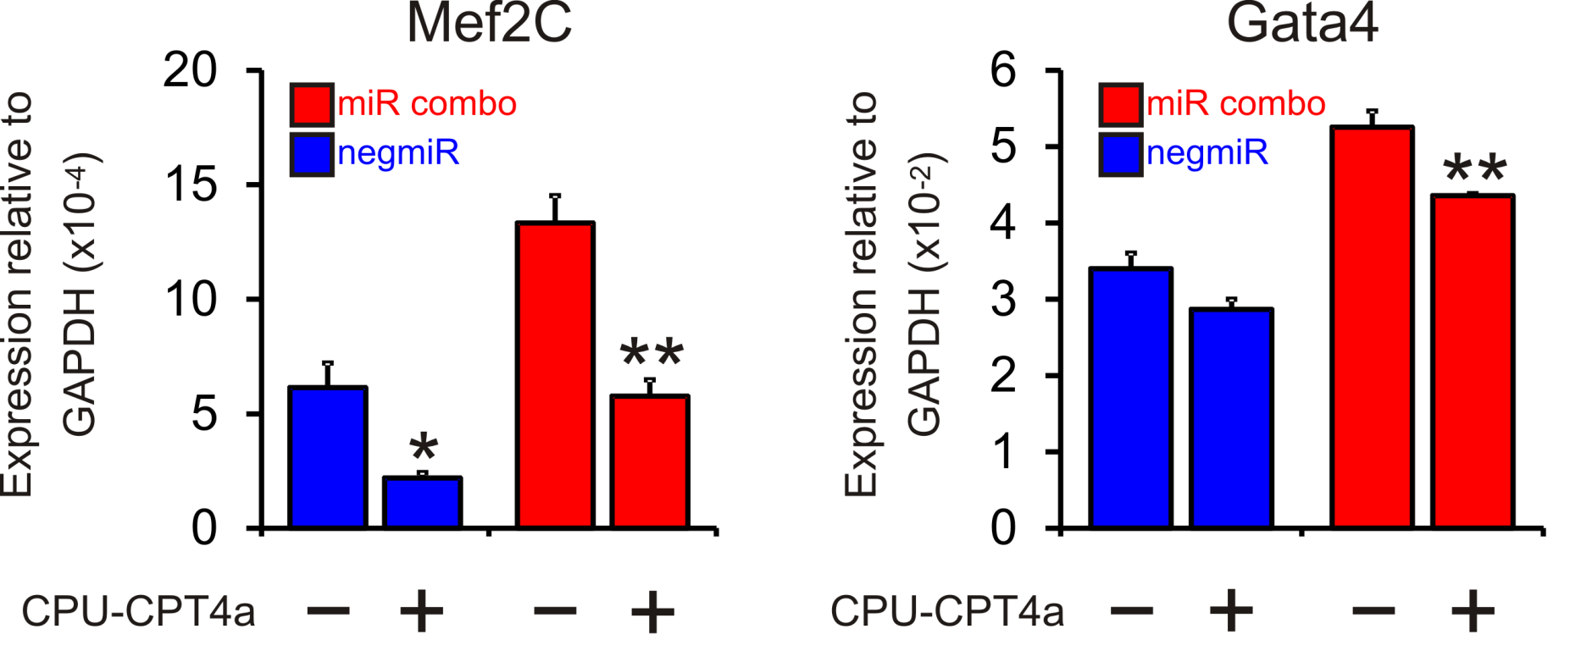
TLR3 is essential for miR combo reprogramming
(TLR antagonist CPU-CPT4a)
Notes:
Cardiac fibroblasts were transfected with miR combo or the control negmiR. One day later they were exposed to various doses of the TLR3 antagonist CU-CPT4a or vehicle for 3 days. RNA was then analyzed for the expression of these cardiac transcription factors. As we can see here, the TLR3 antagonist inhibited expression of Mef2C and Gata4.

Slide 44
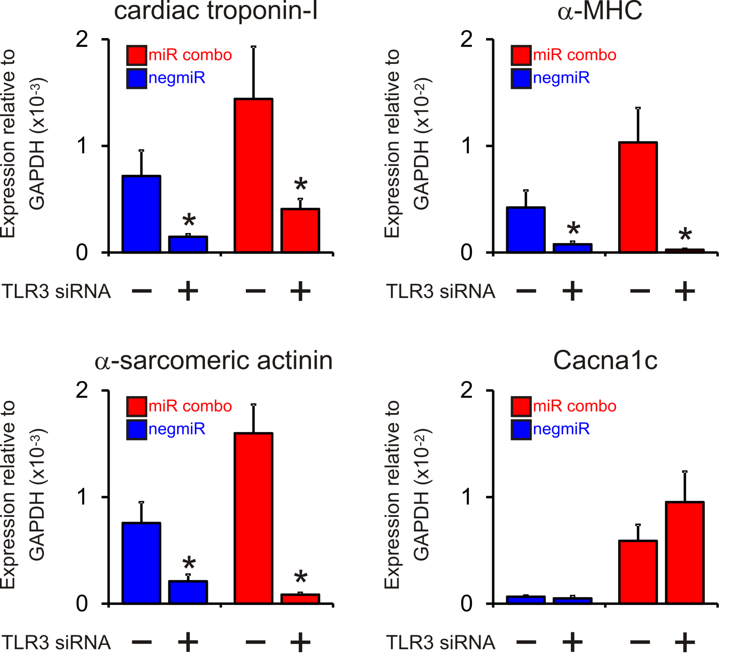
Knockdown of TLR3 inhibits reprogramming by miR combo
Notes:
To validate these results we ablated the expression of TLR3 with siRNAs. Cardiac fibroblasts were transfected with miR combo or the control negmiR as well as a control siRNA or siRNA that targeted TLR3. After 14 days the cells were extracted and RNA analyzed for the expression of these mature cardiac markers. TLR3 knockdown inhibited the effect of miR combo, blocking reprogramming when we looked at cardiac troponin-I and alpha myosin heavy chain.

Slide 45
TLR3 activation promotes
reprogramming & maturation
Notes:
Efficiency, add some more detail
Mechanism: evidence for TLR3 involvment in mir combo reporgramming>>>this is for slide 45 and 46
Put the statement here after the data
Conlcuiosn slide before this

Slide 46
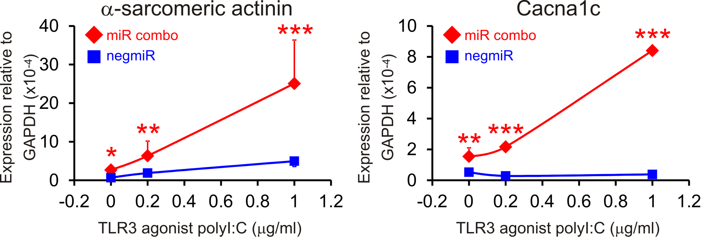
TLR3 activation enhances the expression of mature cardiomyocyte markers
Notes:
cardiac fibroblasts were transfected with miR combo or the control negmiR. One day later they were exposed to various doses of the TLR3 agonist poly I:C or vehicle for 4 days. After 14 days the cells were extracted and RNA analyzed for the expression of these mature cardiac markers. as you can see here, activation of TLR3 enhanced the effect of miR combo.

Slide 47
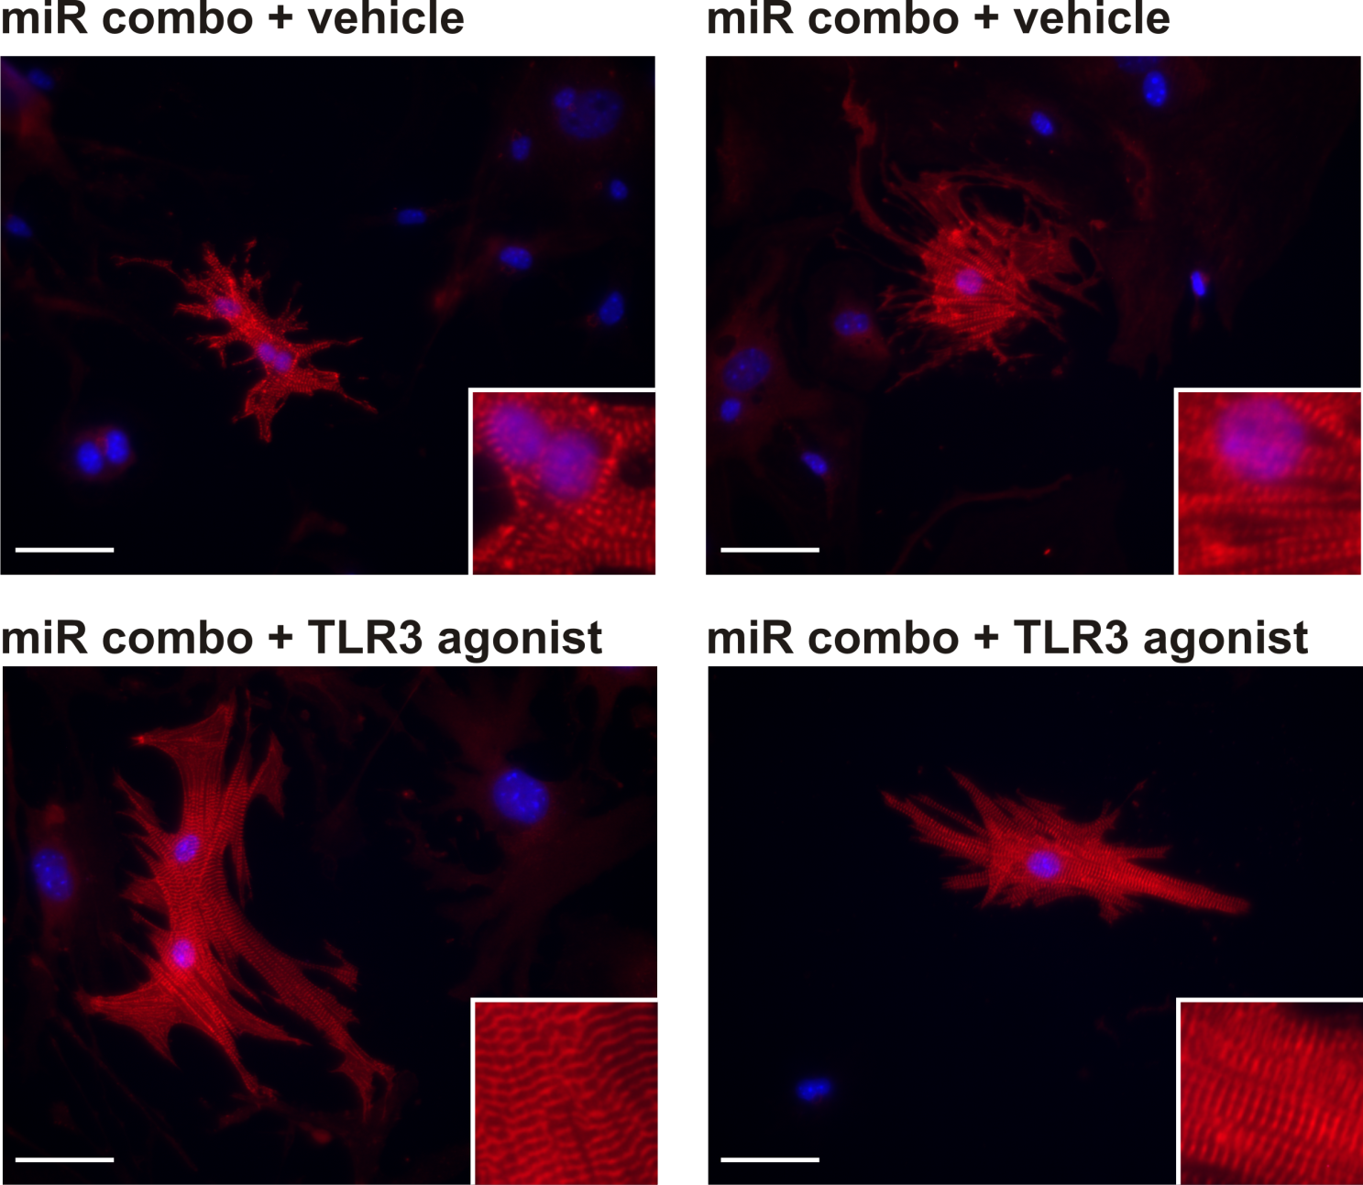
TLR3 activation enhances maturation of miR combo reprogrammed cardiomyocytes
Notes:
Neonatal cardiac fibroblasts were transfected with negative control miR (negmiR) or miR combo. The day after transfection media was replaced and the cells incubated with vehicle or the TLR3 agonist Poly(I:C) LMW (low molecular weight Poly(I:C)) for a further 4 days. After incubation with the TLR3 agonist, cells were cultured in normal growth media for a further 10 days. Cells were stained with sarcomeres. It is hopefully apparent that in the bottom set of panels, which represent miR combo transfected cells treated with the TLR3 agonist polyIC, that the sarcomeres are more apparent and more mature in appearance.

Slide 48
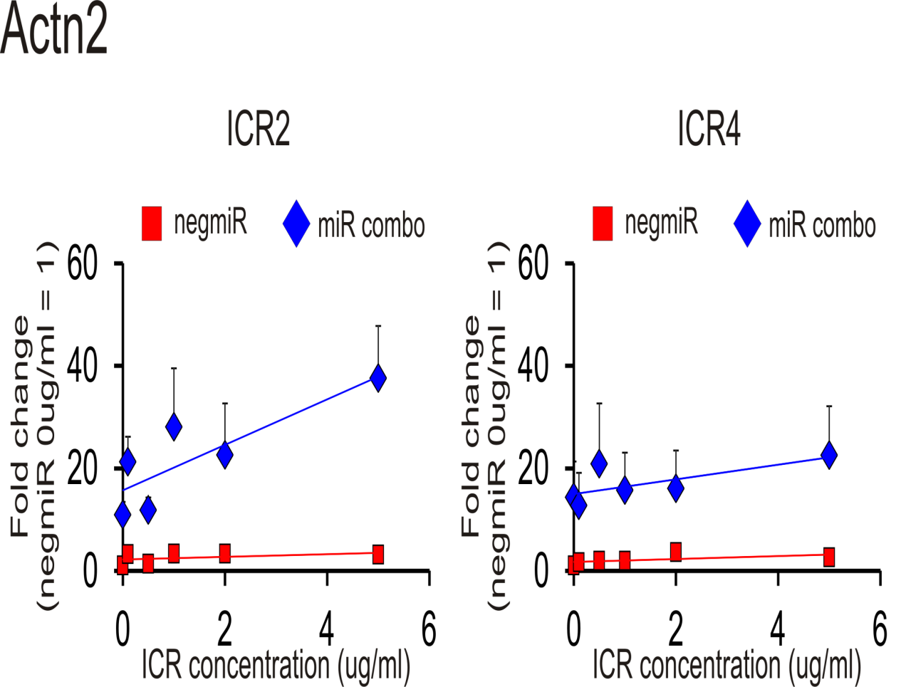
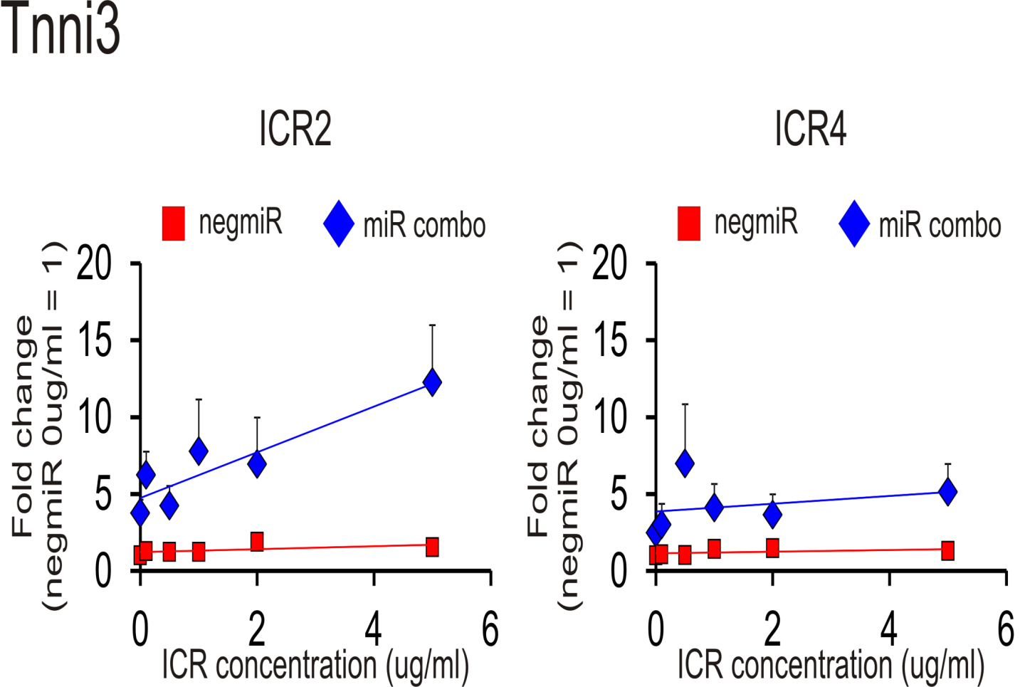
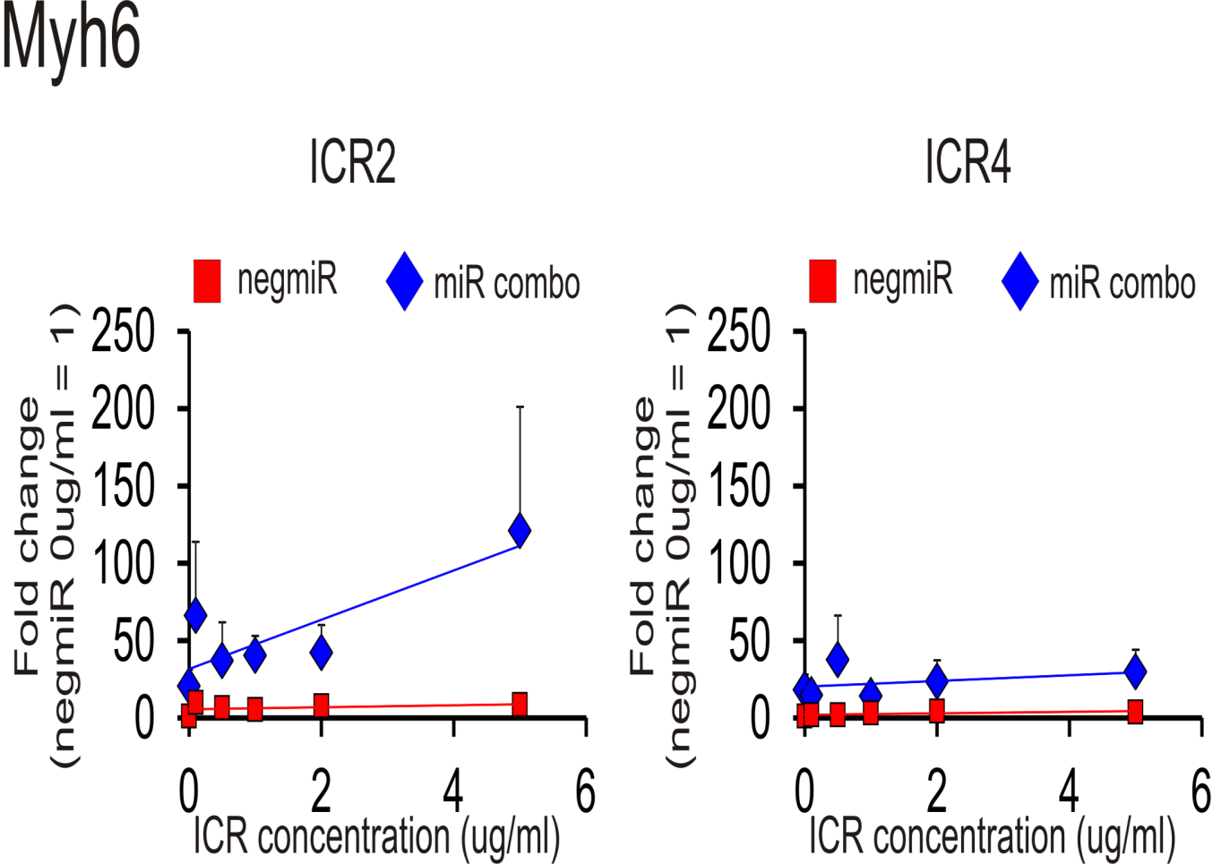
Synthetic RNA agonists

Slide 49
Summary: miR combo & Cardiac Reprogramming
Reprograms fibroblasts into mature fully functional cardiomyocytes in vivo
Promotes delayed functional recovery following MI
3 D environment activates MMP that enhances maturation
Reprogramming requires inhibition of histone methylases
Reprogramming involves activation of innate immunity.
TLR3 & JAK inhibition enhances reprogramming & maturation

Slide 50
Moving forward:
Improve in vivo delivery
  multicistronic scAAV- miR
Enhance reprogramming in vivo with
TLR 3 agonists
Crispr Cas : permanent reprogramming
.

Slide 51
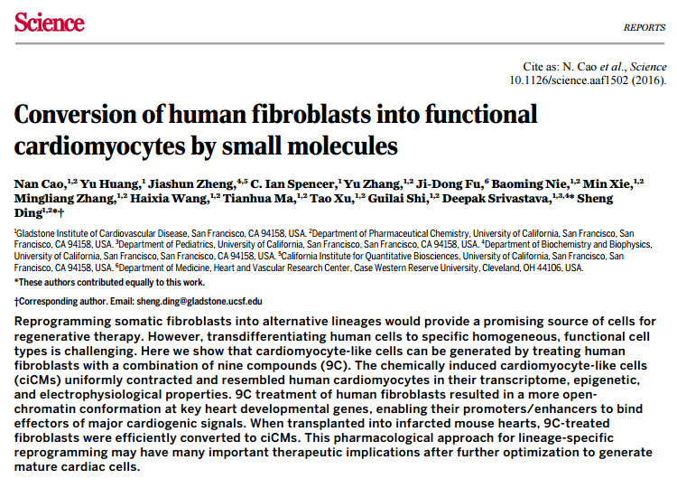

Slide 52
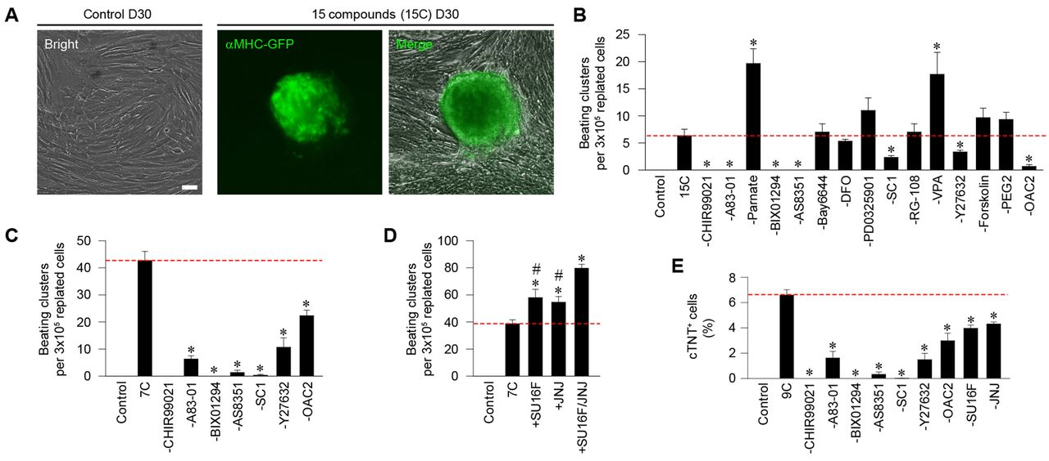
Identifying a chemical cocktail for reprogramming (screen 89 molecules)
Notes:
Using human foreskin fibroblasts the authors screened 89 small molecules for cardiac reprogramming by virtue a alpha-MHC GFP reporter.
(Top) After several rounds of testing they identified a cocktail of 15 molecules that generated about 5 aMHC-GFP colonies that beat spontaneously per 300,000 cells plated.
(Bottom) After further testing they narrowed it down to the 9 compounds shown here, and which they called 9C.

Slide 53
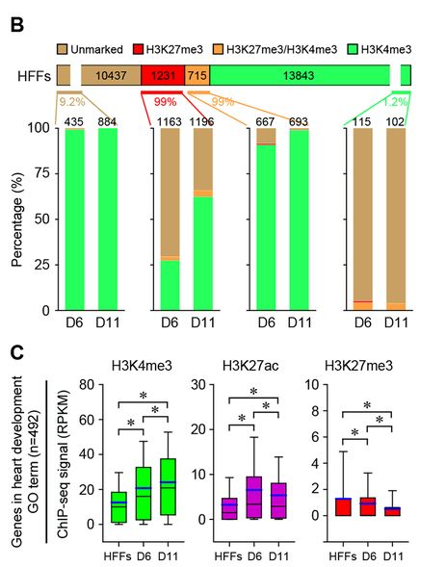
9C promotes reprogramming through an epigenetic mechanism
Notes:
To assess this mechanism further, they analyzed the genome-wide epigenetic changes by ChIP-seq analysis of H3K4me3 and H3K27ac (active chromatin marks) and H3K27me3 (inactive chromatin mark). They observed a dynamic loss of most H3K27me3 and specific gain of H3K4me3 among a subset of genomic loci during reprogramming (panel B). Specifically, they observed a significantly increased enrichment of H3K4me3 and H3K27ac on a cohort of heart developmental genes during reprogramming, whereas the deposition of H3K27me3 was downregulated (panel C).

Slide 54
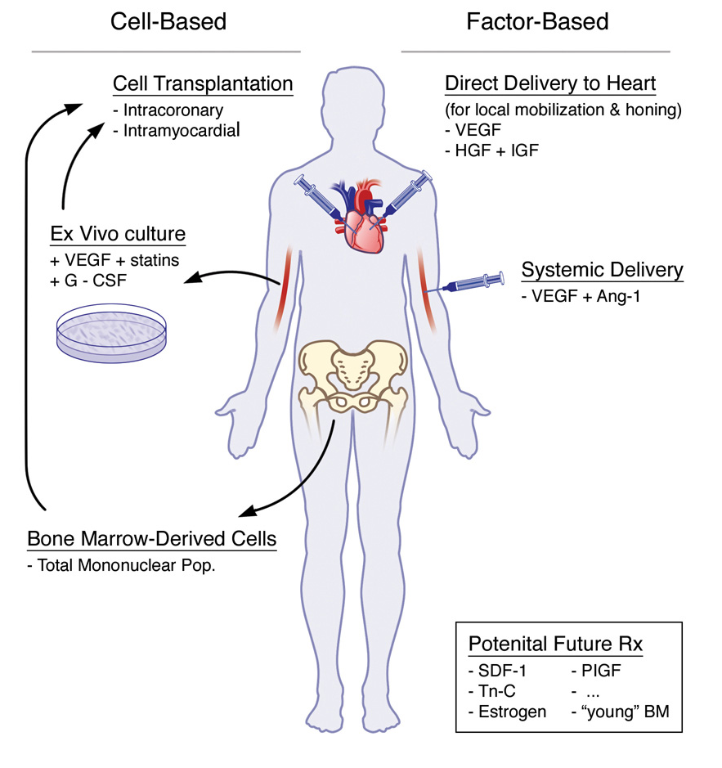
Transition to pharmacotherapy
Future Approaches
Cardiac Progenitor/ iPS
Paracrine Factors
Direct Reprogramming
Systemic Stimulation of
Cardiomyogenesis
Factors/Small Molecules
Adapted from Ballard and Edelberg (2007) Circ Res.

Slide 55


Acknowledgments
The Dzau Lab
Rosenberg Laboratory
Paul Rosenberg
Elizabeth Finch
Hengtao Zhang
Rockman Laboratory
Lan Mao
Mandel
Tilanthi Jayawardena
Baykt Egemnazarov
Imke Kirste

Slide 57
3D environment improves direct cardiac reprogramming
Collaboration with the Bursac’s lab

Slide 58





3D Tissue-engineered cardiac patch
PDMS mold (Polydimethylsiloxan)
reusable
Mixture of hydrogel (Matrigel + fibrin) + cells
Progressive
Compaction of cell–hydrogel mixture
PDMS
PDMS
Neonatal rat CMs Day 13
SAA
Cx43
DAPI
Fast polymerization
Technique used with various cell types (ESCs, skeletal/cardiac myocyte, mixture)
Allow formation of functional cardiac tissue:
  Elongated sarcomeres, intercellular junction, electro-mechanical coupling
  Rapid action potential
  Significant contractile force
Dense, aligned and striated CMs with GAP junction (Cx43)

Slide 59

3D increases the efficiency of cardiac reprogramming
#
0.07
Expression relative to GAPDH
#
#
#
0.08
N=5, SEM, #: Significant difference (T Test, p<0.05) between 2D/3D.

Slide 60




Culture of miRs-transfected fibroblasts in 3D enhances cardiac reprogramming efficiency
A
B
FACS of aMHC-CFP (N=4)
Fold change of %CFP+ cells relative to UT-2D
miR 2D
miR 3D
C
D
Passive force of 3D bundles
Immunofluorescence (N=1)
(N=3, one experiment shown)
Passive Force (mN)
UT
miR
% Strain
Notes:
(D) Bundles containing miRs-transfected fibroblasts are less stiff than bundles containing untransfected fibroblasts suggesting that miRs-transfected fibroblasts are less fibrotic.

Slide 61
MiRs-transfected fibroblasts (FBs) improve the functionality of primary cardiomyocytes (CMs) in 3D cultures
*
*
CMs + Neg-FBs
CMs + miRs-FBs
CMs + Neg-FBs
CMs + miRs-FBs

Slide 62

Cells interact with their environment
Cadherins mediate cell cell communication.
Soluble growth factors activate their cognate receptors.
Integrins respond to the extracellular matrix.
Serine proteases
The extracellular matrix acts as a repository of growth factors. Matrix metalloproteinases can release these growth factor by degrading the ECM. For example, plasminogen when activated can lead to ECM degradation via MMP activation.
Notes:
Cells interact with their environment in multiple ways.
Cadherins mediate cell cell communication.
Soluble growth factors activate their cognate receptors and integrins respond to the extracellular matrix.
The extracellular matrix also acts as a repository of growth factors. Matrix metalloproteinases can release these growth factor receptors by degrading the ECM. I show one example here, where plasminogen, a component of blood, can activate ECM degradation via MMP activation.

Slide 63
Mechanism of miR combo reprogramming
  Mechanical
  Epigenetic
  Innate Immunity

