Slide 1



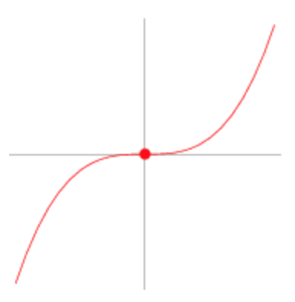
La Analítica del Aprendizaje en Educación Médica: ¿Punto de Inflexión?

Slide 2
Programa
Mtro. Gerardo Moreno Salinas
Dr. Tomás Bautista Godínez
Dr. Melchor Sánchez Mendiola
Dr. Adrián Martínez González
Comentarista
Dr. Carlos Varela Rueda
Invitados Especiales
Dr. Luis Felipe Abreu Hernández
Dr. Joaquín López Bárcena

Slide 4
Aplicaciones de Analítica del Aprendizaje en Educación Médica
Dr. Melchor Sánchez Mendiola
UNAM
melchorsm@unam.mx

Slide 5
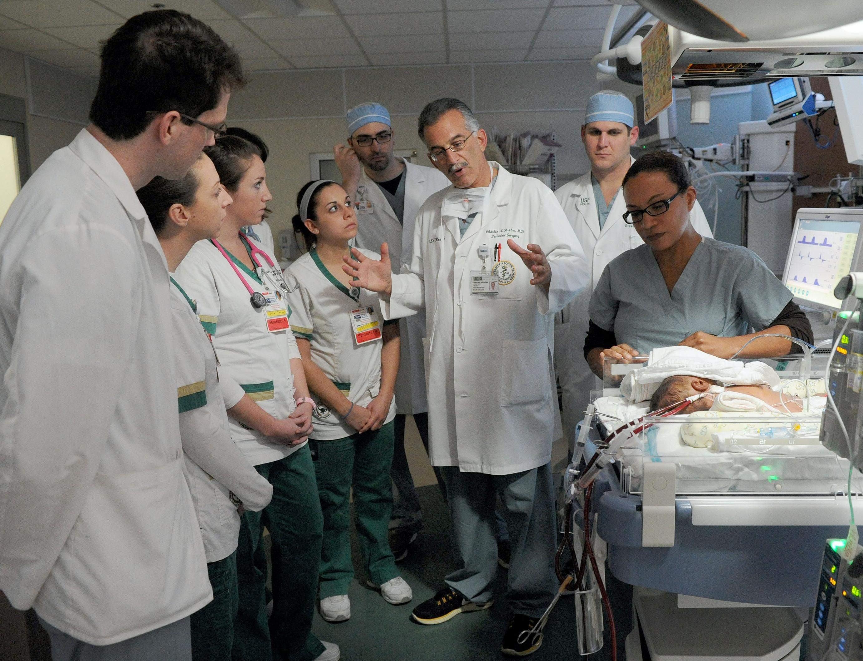
¿Cómo enseña y evalúa a sus estudiantes?

Slide 6

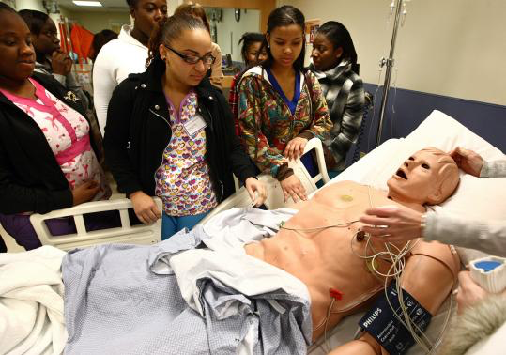


Ecología del aprendizaje
Ringsted C, Hodges B, Scherpbier A. Med Teach 2011; 33:695-709.

Slide 7

Huella digital (en la vida y en educación)

Slide 8
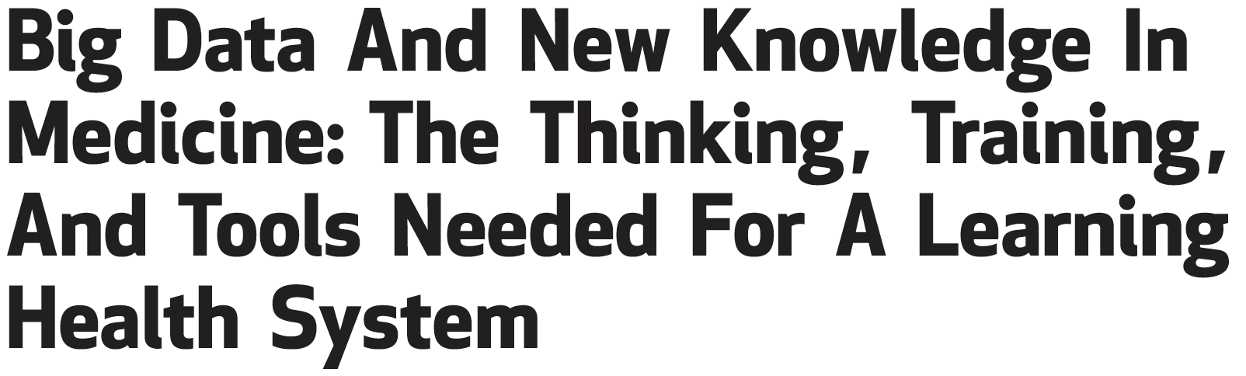
La medicina es una profesión de información, la investigación debe incluir a la ciencia de datos.
Es necesario fortalecer estas habilidades en los investigadores clínicos.
Estos conceptos deben formar parte de los currículos de las escuelas de medicina y posgrados.
Krumholz HM. Health Affairs 2014; 33(7):1163–1170
Notes:
Big data in medicine—massive quantities of health care data
accumulating from patients and populations and the advanced analytics
that can give those data meaning—hold the prospect of becoming an
engine for the knowledge generation that is necessary to address the
extensive unmet information needs of patients, clinicians,
administrators, researchers, and health policy makers. This article
explores the ways in which big data can be harnessed to advance
prediction, performance, discovery, and comparative effectiveness
research to address the complexity of patients, populations, and
organizations. Incorporating big data and next-generation analytics into
clinical and population health research and practice will require not only
new data sources but also new thinking, training, and tools. Adequately
utilized, these reservoirs of data can be a practically inexhaustible source
of knowledge to fuel a learning health care system.

Slide 9

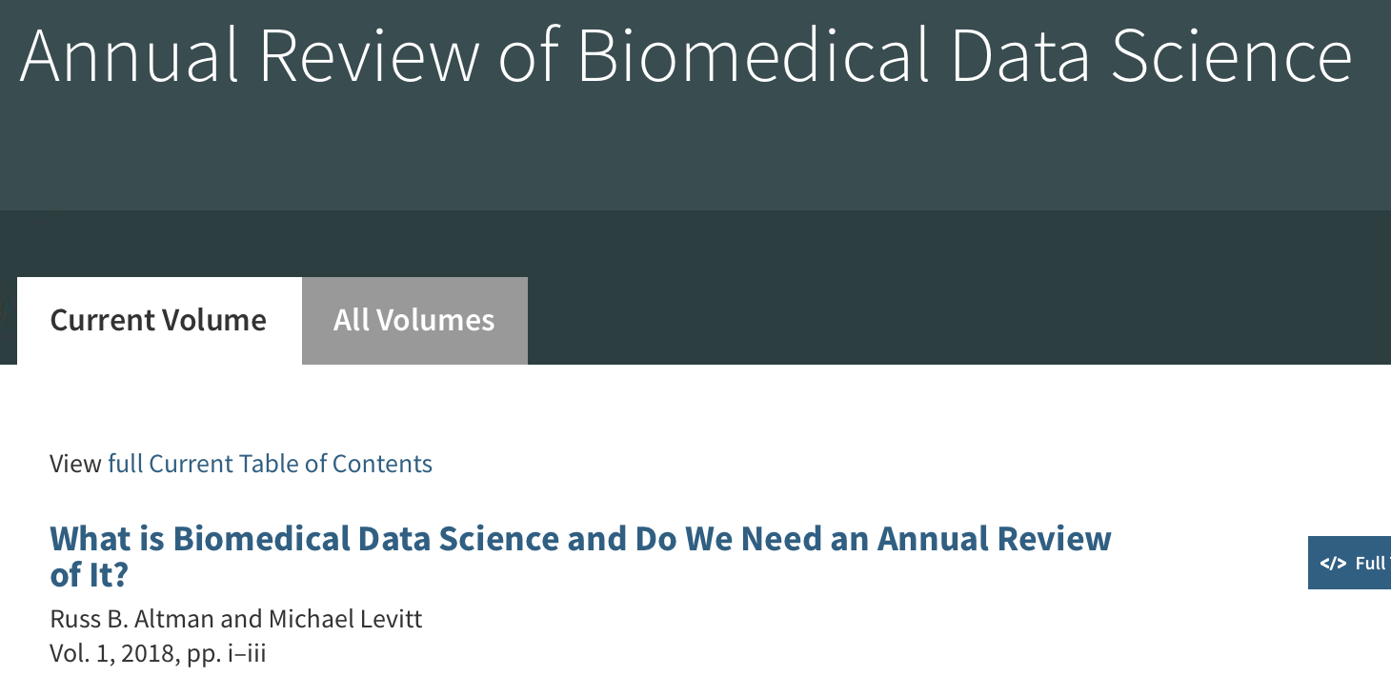
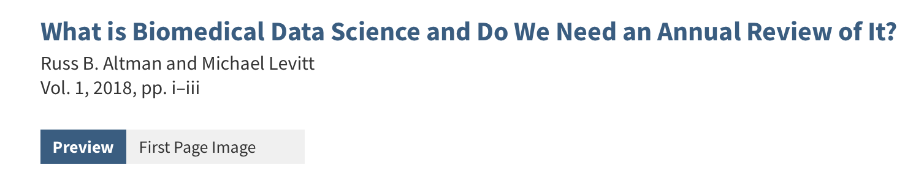
www.annualreviews.org/journal/biodatasci
Notes:
The term “data science” describes expertise associated with taking
(usually large) data sets and annotating, cleaning, organizing, storing, and analyzing
them for the purposes of extracting knowledge. It merges the disciplines of statistics,
computer science, and computational engineering. Many are irritated by the term—all
of science depends ultimately on data, and many of the activities listed above sound like
engineering (which is about solving problems) and not science (which is about discovery
of new knowledge). If “data science” is not about science and the adjective “data” has no
particular meaning, why does this term exist?
Indeed, the allied fields of informatics have existed for several decades in many
forms—medical informatics, clinical informatics, health informatics, bioinformatics, and
biomedical informatics—and variants all refer to the development ofmethods to analyze
data, information, and knowledge within the space of biology and medicine. Practitioners
of these fields are quick to point out that most if not all of data science falls within
the purview of informatics. Informatics is a broad field that includes the social aspects of
interacting with data, information, and knowledge; the challenges of human–computer
interfaces; and the issues associated with introducing disruptive new computational interventions
into systems (like hospitals and laboratories) with existing workflows.
Technical activities that are data intensive and require special skills in managing
the large, noisy, and complex data typical of biology and medicine.
Deep learning
Text mining
Visualization
Sequence analysis
Protein–RNA interactions
Molecular interaction networks
Simulation of cells/tissues
Challenges for mass spectrometry
Deconvolution of gene expression signals
Clinical and genomic phenotyping
Cancer therapy resistance

Slide 10
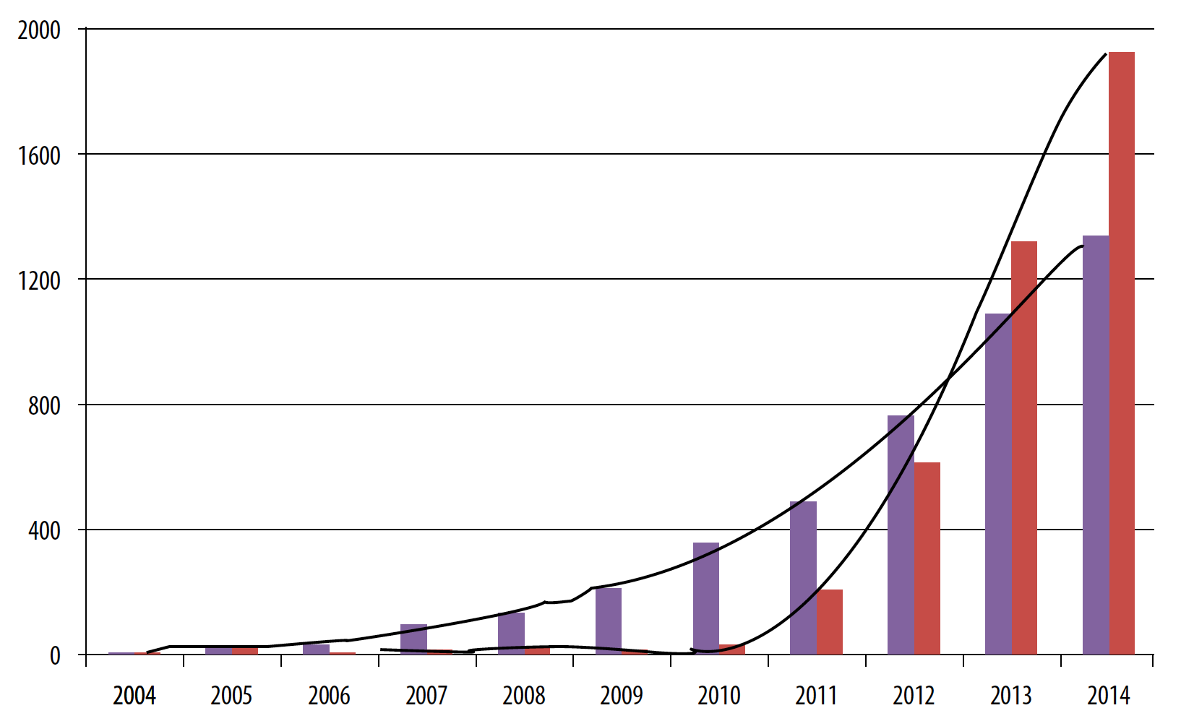


Referencias de MDE y AA en Google Scholar
Minería de datos educativos
Analítica del aprendizaje

Slide 11
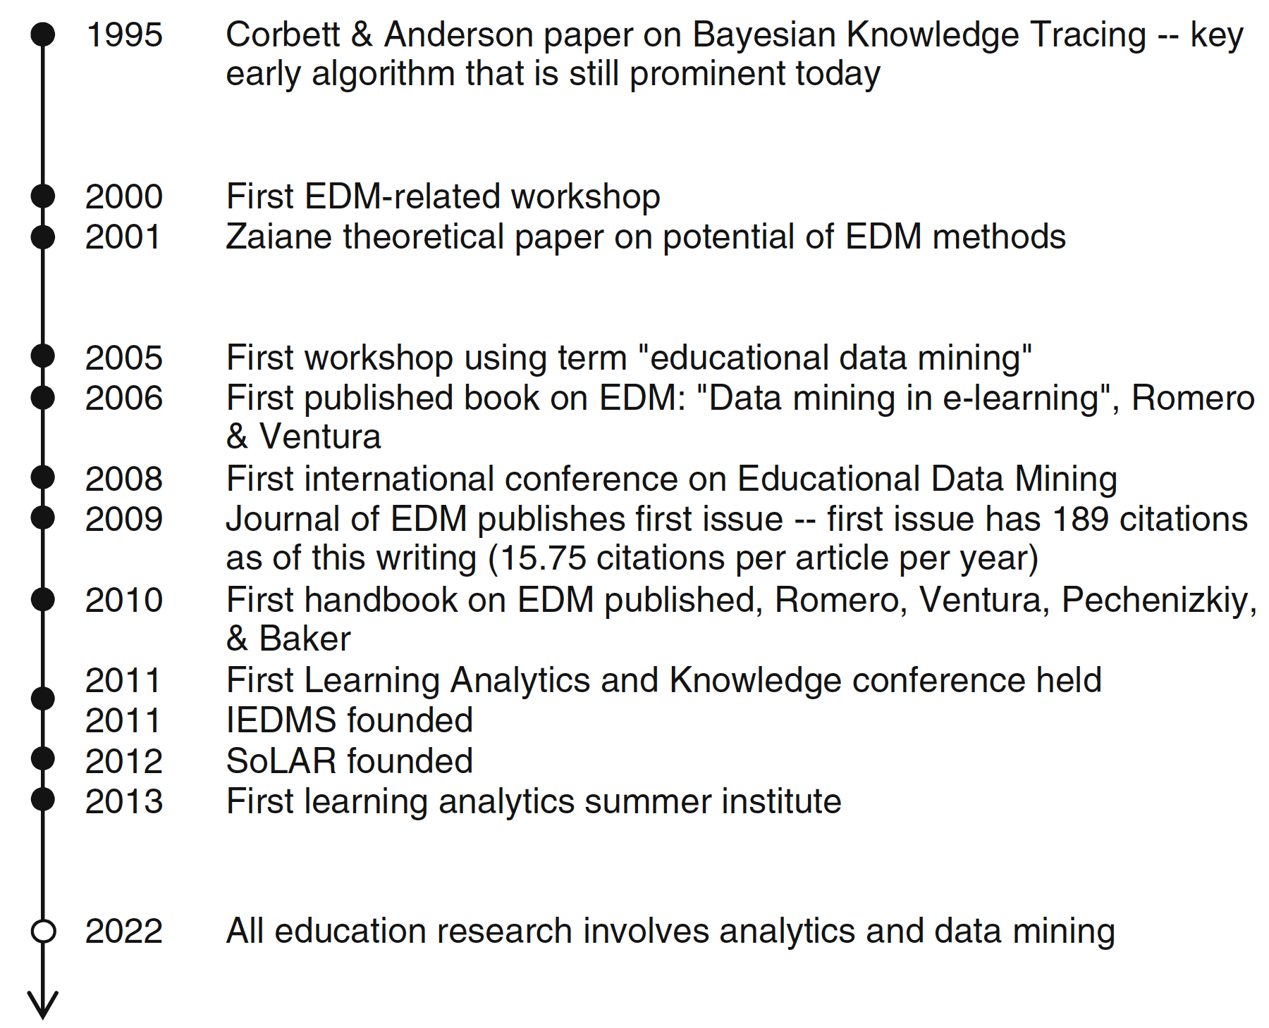
Hitos en la minería de datos educativos
www.springer.com/gp/book/9781461433040

Slide 12


“…la era de analítica de datos ya está aquí y la educación médica se está quedando atrás”.
Chan T et al. AEM Education and Training 2018;2:178-187
Notes:
ABSTRACT
With the implementation of competency-based medical education (CBME) in emergency medicine, residency
programs will amass substantial amounts of qualitative and quantitative data about trainees’ performances. This
increased volume of data will challenge traditional processes for assessing trainees and remediating training
deficiencies. At the intersection of trainee performance data and statistical modeling lies the field of medical
learning analytics. At a local training program level, learning analytics has the potential to assist program directors
and competency committees with interpreting assessment data to inform decision making. On a broader level,
learning analytics can be used to explore system questions and identify problems that may impact our
educational programs. Scholars outside of health professions education have been exploring the use of learning
analytics for years and their theories and applications have the potential to inform our implementation of CBME.
The purpose of this review is to characterize the methodologies of learning analytics and explore their potential to
guide new forms of assessment within medical education.

Slide 13
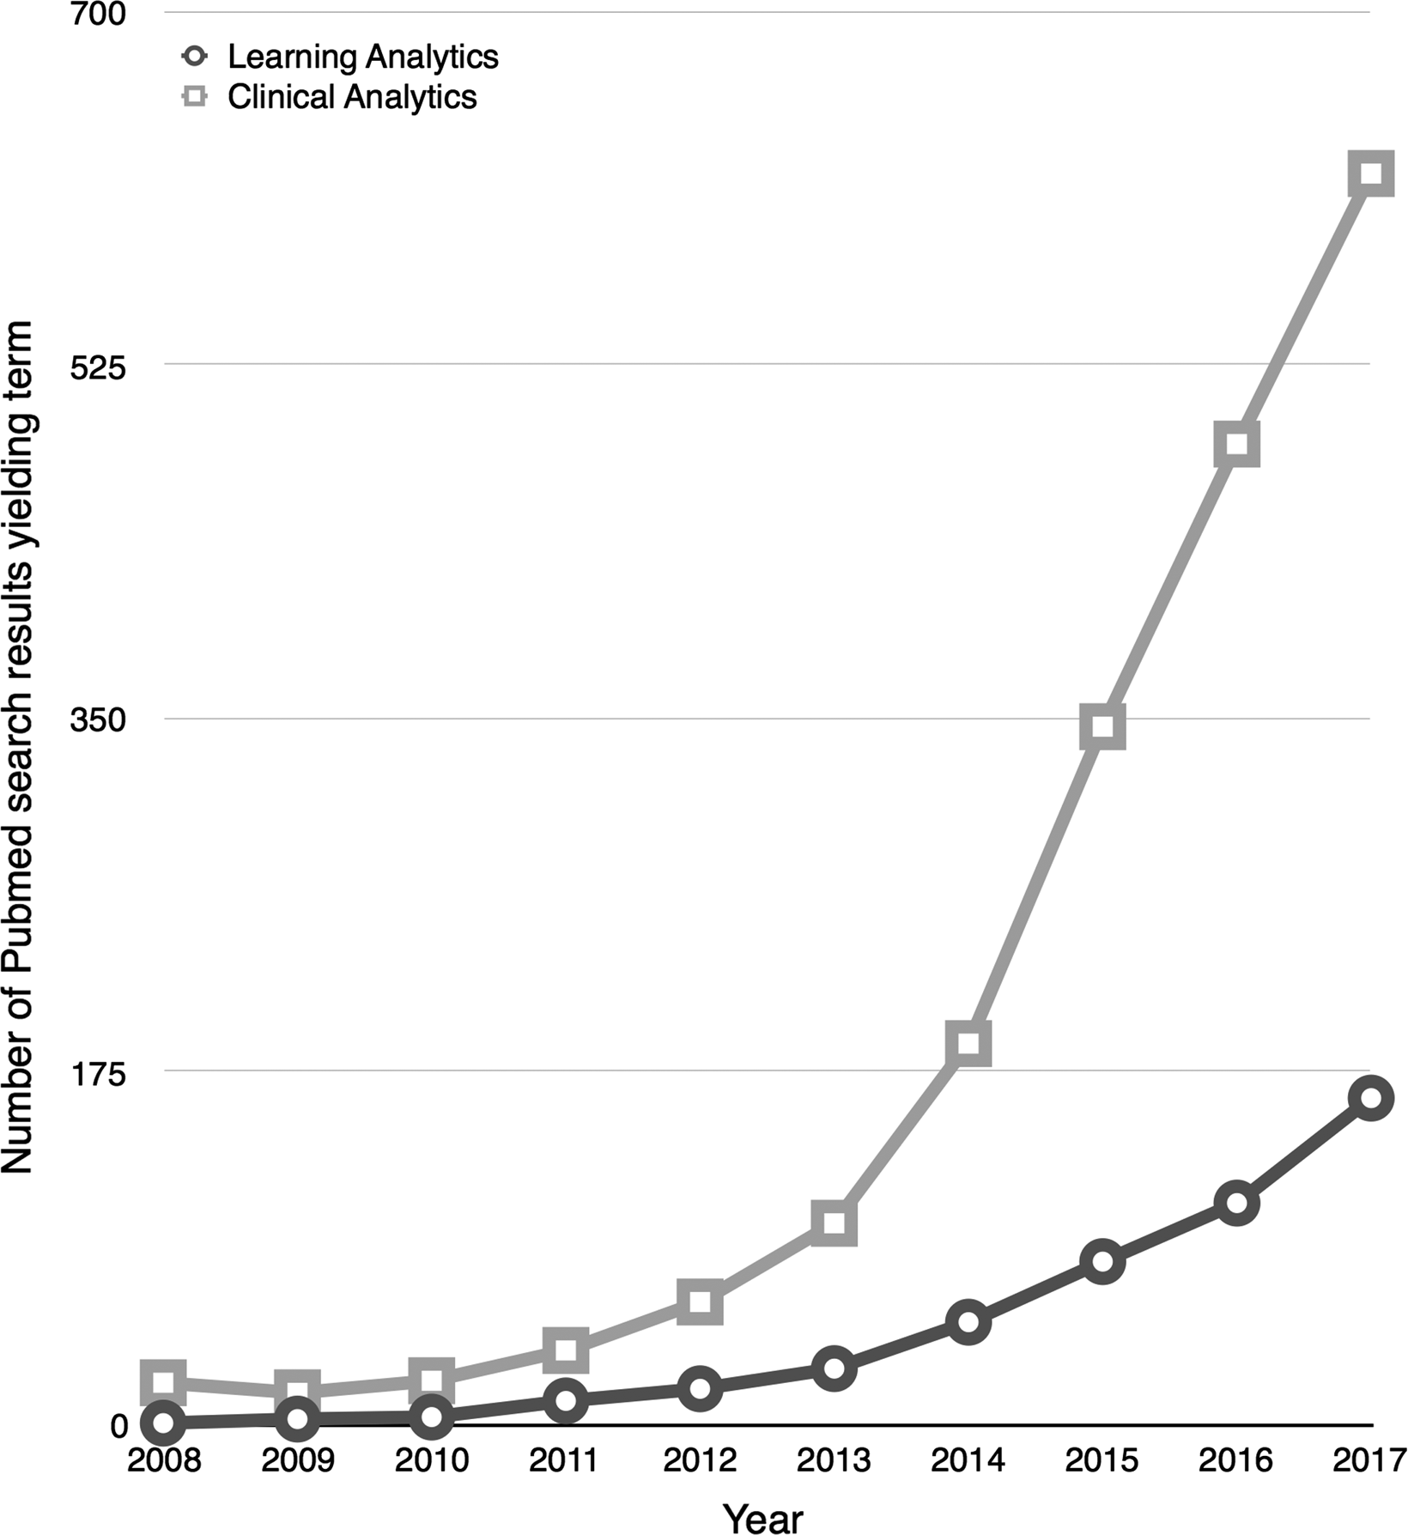
Analítica clínica
# Resultados en PubMed
Analítica del
aprendizaje
Chan T et al. AEM Education and Training 2018;2:178-187

Slide 14
Categoría | Técnicas | Ejemplo en educación médica
Análisis descriptivos de datos cuantitativos | Estadísticas resumen, analítica visual, análisis de racimos, de redes sociales, mapas de calor | Gráficas de series de promedios de puntuaciones de logro (e.g. exámenes). Gráficas de radar (múltiples puntos de datos en malla de competencias).
Análisis descriptivos de datos cualitativos | Análisis lingüísticos computacionales de coherencia de textos, complejidad sintáctica, diversidad de léxico, similaridad semántica | Procesamiento Natural del Lenguaje (PNL) (aplicación de IA a lenguaje). Análisis automatizado de contenidos (AAM “aprende” códigos humanos en grandes volúmenes de datos) e.g. Identificación de comentarios cualitativos del profesorado
Chan T et al. AEM Education and Training 2018;2:178-187
Notes:
Different analytics techniques explore different kinds of
patterns and rely on different key technologies (Baker & Yacef
2009). These include:
Predictive analytics: patterns of existing behavior are used
to more precisely model future behavior. Algorithmic
prediction of behavior has been dubbed ‘‘propensity’’
(Mayer-Scho¨nberger & Cukier 2013) and could, for
instance, be used to select or deselect potential candidates
for admission to health professional school or be
used by fitness for practice committees to identify learners
who may in the future act unprofessionally. Key technique:
machine learning (systems that can learn from the
data they process).
Cluster and outlier identification: this allows remedial
action to be taken when, for example, an identifiable
group has difficulty gaining needed competencies. Key
technique: cluster analysis.
Decision support: this involves the monitoring of dynamic
flows of data that are then used to inform the decisionmaker,
whether it be the learner, teacher, or manager.
Key technique: dynamic information visualizations.
Knowledge discovery: this involves searching for unpredicted
associations and patterns identified through the
systematic application of computer algorithms to large
and aggregated datasets. Key technique: data mining.
Alerting: this involves surveillance and monitoring of data
for critical events that require timely intervention by
looking for patterns in the data that equate to these critical
events. Key technique: pattern recognition.

Slide 15
Categoría | Técnicas | Ejemplos en educ. médica
Modelación explicativa | Factores de dificultad y de aprendizaje, regresión lineal, automatización de modelos cognitivos, árboles de decisión | Trayectorias de aprendizaje. Curvas de aprendizaje. Diagramas acumulativos de puntuaciones.
Modelación predictiva | Regresión lineal y logística, clasificadores de vecinos cercanos, clasificadores Bayesianos, máquinas de apoyo de vectores, redes neurales | Predicción de dificultad en las residencias (e.g., remediación, condicionamiento, fracaso). Detección de patrones de desempeño en residentes.
Análisis evaluativos | Los anteriores, cambiando el interés del educando hacia el programa de residencia, profesorado o sistema. | Evaluaciones diarias de datos de hitos de competencias. Sesgo de género en evaluación.
Chan T et al. AEM Education and Training 2018;2:178-187

Slide 16
Analítica visual
Datos complejos
Análisis de
los datos
Visualización de
la información
Nuevo conocimiento
Vaitsis et al. 2014. PeerJ 2:e683; DOI 10.7717/peerj.683
Notes:
Introduction. The big data present in the medical curriculum that informs
undergraduate medical education is beyond human abilities to perceive and analyze.
The medical curriculum is the main tool used by teachers and directors to plan,
design, and deliver teaching and assessment activities and student evaluations
in medical education in a continuous effort to improve it. Big data remains
largely unexploited for medical education improvement purposes. The emerging
research field of visual analytics has the advantage of combining data analysis and
manipulation techniques, information and knowledge representation, and human
cognitive strength to perceive and recognize visual patterns. Nevertheless, there is a
lack of research on the use and benefits of visual analytics in medical education.
Methods. The present study is based on analyzing the data in the medical curriculum
of an undergraduate medical program as it concerns teaching activities, assessment
methods and learning outcomes in order to explore visual analytics as a tool for
finding ways of representing big data from undergraduate medical education for
improvement purposes. Cytoscape software was employed to build networks of the
identified aspects and visualize them.
Results. After the analysis of the curriculum data, eleven aspects were identified.
Further analysis and visualization of the identified aspects with Cytoscape resulted
in building an abstract model of the examined data that presented three different
approaches; (i) learning outcomes and teaching methods, (ii) examination and
learning outcomes, and (iii) teaching methods, learning outcomes, examination
results, and gap analysis.
Discussion. This study identified aspects of medical curriculum that play an
important role in how medical education is conducted. The implementation of visual
analytics revealed three novel ways of representing big data in the undergraduate
medical education context. It appears to be a useful tool to explore such data with
possible future implications on healthcare education. It also opens a new direction in
medical education informatics research.

Slide 17
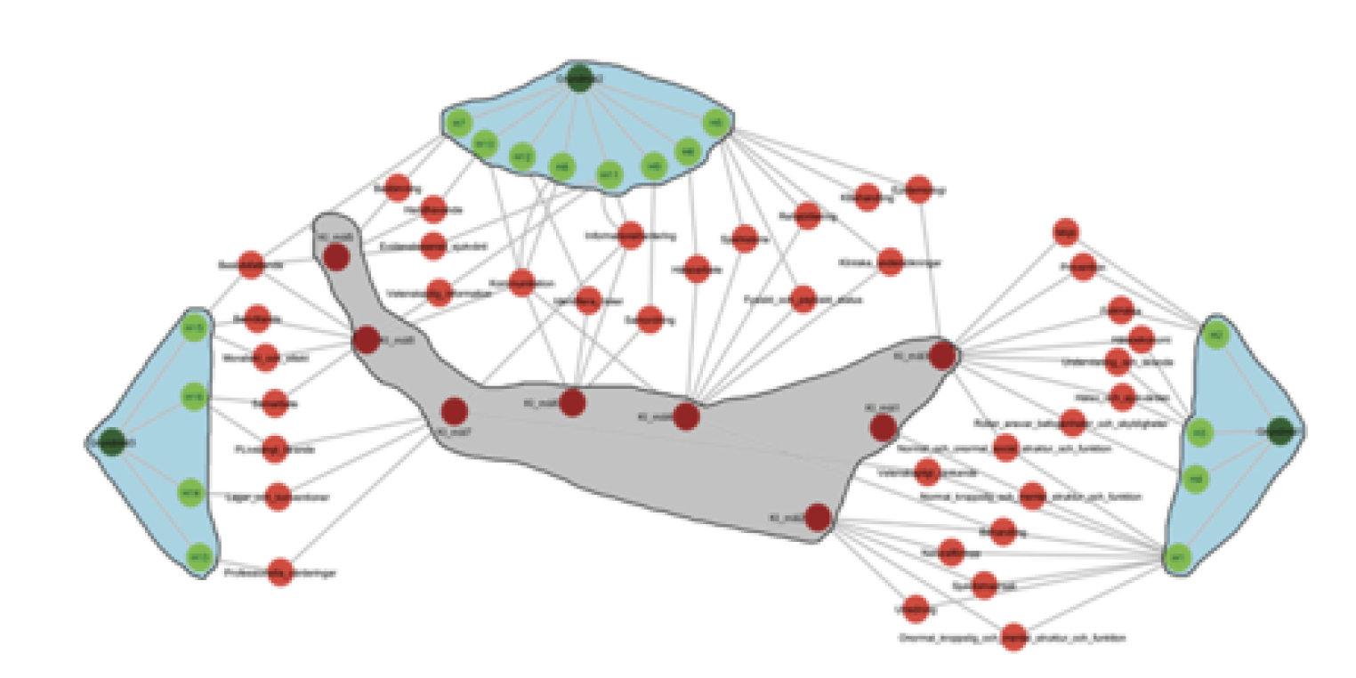
Racimos de competencias y objetivos de aprendizaje
Lovis et al. e-Health – For Continuity of Care. European Federation for Medical Informatics and IOS Press. 2014. doi:10.3233/978-1-61499-432-9-1163
Notes:
Abstract. A continuous effort to improve healthcare education today is currently
driven from the need to create competent health professionals able to meet
healthcare demands. Limited research reporting how educational data
manipulation can help in healthcare education improvement. The emerging
research field of visual analytics has the advantage to combine big data analysis
and manipulation techniques, information and knowledge representation, and
human cognitive strength to perceive and recognise visual patterns. The aim of this
study was therefore to explore novel ways of representing curriculum and
educational data using visual analytics. Three approaches of visualization and
representation of educational data were presented. Five competencies at
undergraduate medical program level addressed in courses were identified to
inaccurately correspond to higher education board competencies. Different visual
representations seem to have a potential in impacting on the ability to perceive
entities and connections in the curriculum data.
VA can be used to explore and provide novel ways to represent curriculum and
educational data. Moreover, different visual representations seem to have a potential in
impacting on the ability to perceive entities and connections in the curriculum data thus
enhance data perception and cognition. The new direction VA opened in this study for
medical educational informatics research, requires further investigation towards both
curriculum's structure complexity and ways to represent it, and the role that plays on
impacting quality improvement and decision making in medical education.

Slide 18
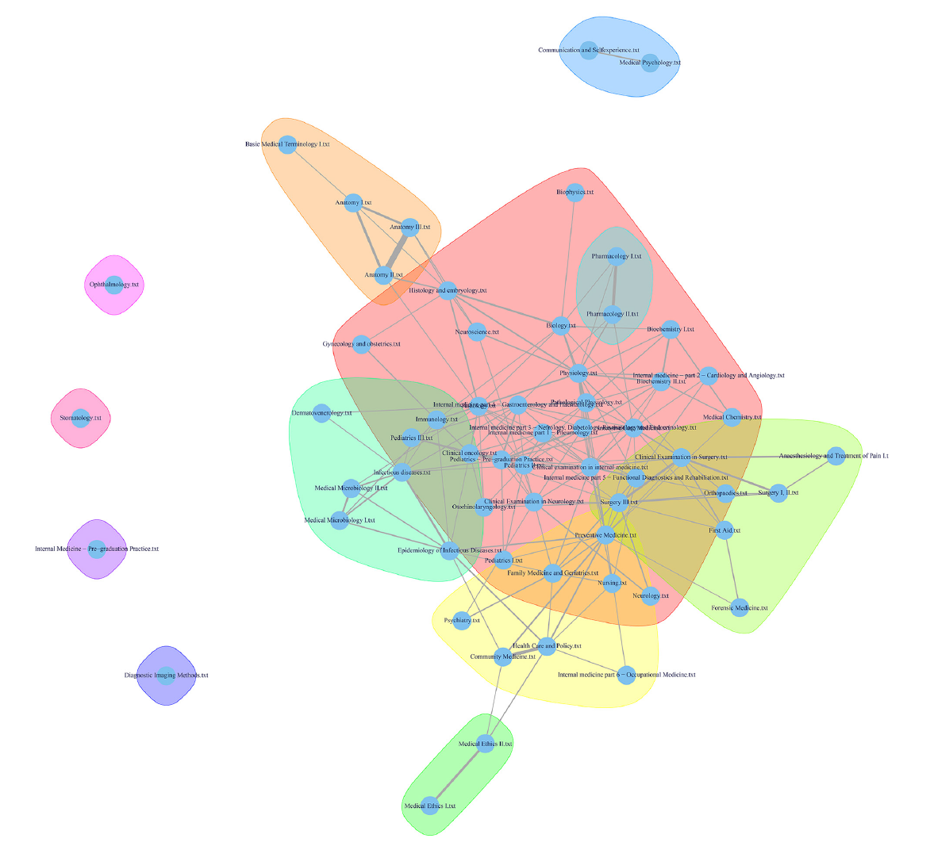
Panorama del currículo, con comunidades descubiertas con el algoritmo Walktrap
Komenda M, et al. PLoS ONE 2015, 10(12): e0143748.
doi:10.1371/journal.pone.0143748
Notes:
Background
No universal solution, based on an approved pedagogical approach, exists to parametrically
describe, effectively manage, and clearly visualize a higher education institution’s curriculum,
including tools for unveiling relationships inside curricular datasets.
Objective
We aim to solve the issue of medical curriculum mapping to improve understanding of the
complex structure and content of medical education programs. Our effort is based on the
long-term development and implementation of an original web-based platform, which supports
an outcomes-based approach to medical and healthcare education and is suitable for
repeated updates and adoption to curriculum innovations.
Methods
We adopted data exploration and visualization approaches in the context of medical curriculum
innovations in higher education institutions domain. We have developed a robust platform,
covering detailed formal metadata specifications down to the level of learning units,
interconnections, and learning outcomes, in accordance with Bloom’s taxonomy and direct
links to a particular biomedical nomenclature. Furthermore, we used selected modeling
techniques and data mining methods to generate academic analytics reports from medical
curriculum mapping datasets.
Results
We present a solution that allows users to effectively optimize a curriculum structure that is
described with appropriate metadata, such as course attributes, learning units and outcomes,
a standardized vocabulary nomenclature, and a tree structure of essential terms.
We present a case study implementation that includes effective support for curriculum
reengineering efforts of academics through a comprehensive overview of the General Medicine
study program. Moreover, we introduce deep content analysis of a dataset that was
captured with the use of the curriculum mapping platform; this may assist in detecting any
potentially problematic areas, and hence it may help to construct a comprehensive overview
for the subsequent global in-depth medical curriculum inspection.
Conclusions
We have proposed, developed, and implemented an original framework for medical and
healthcare curriculum innovations and harmonization, including: planning model, mapping
model, and selected academic analytics extracted with the use of data mining.

Slide 19
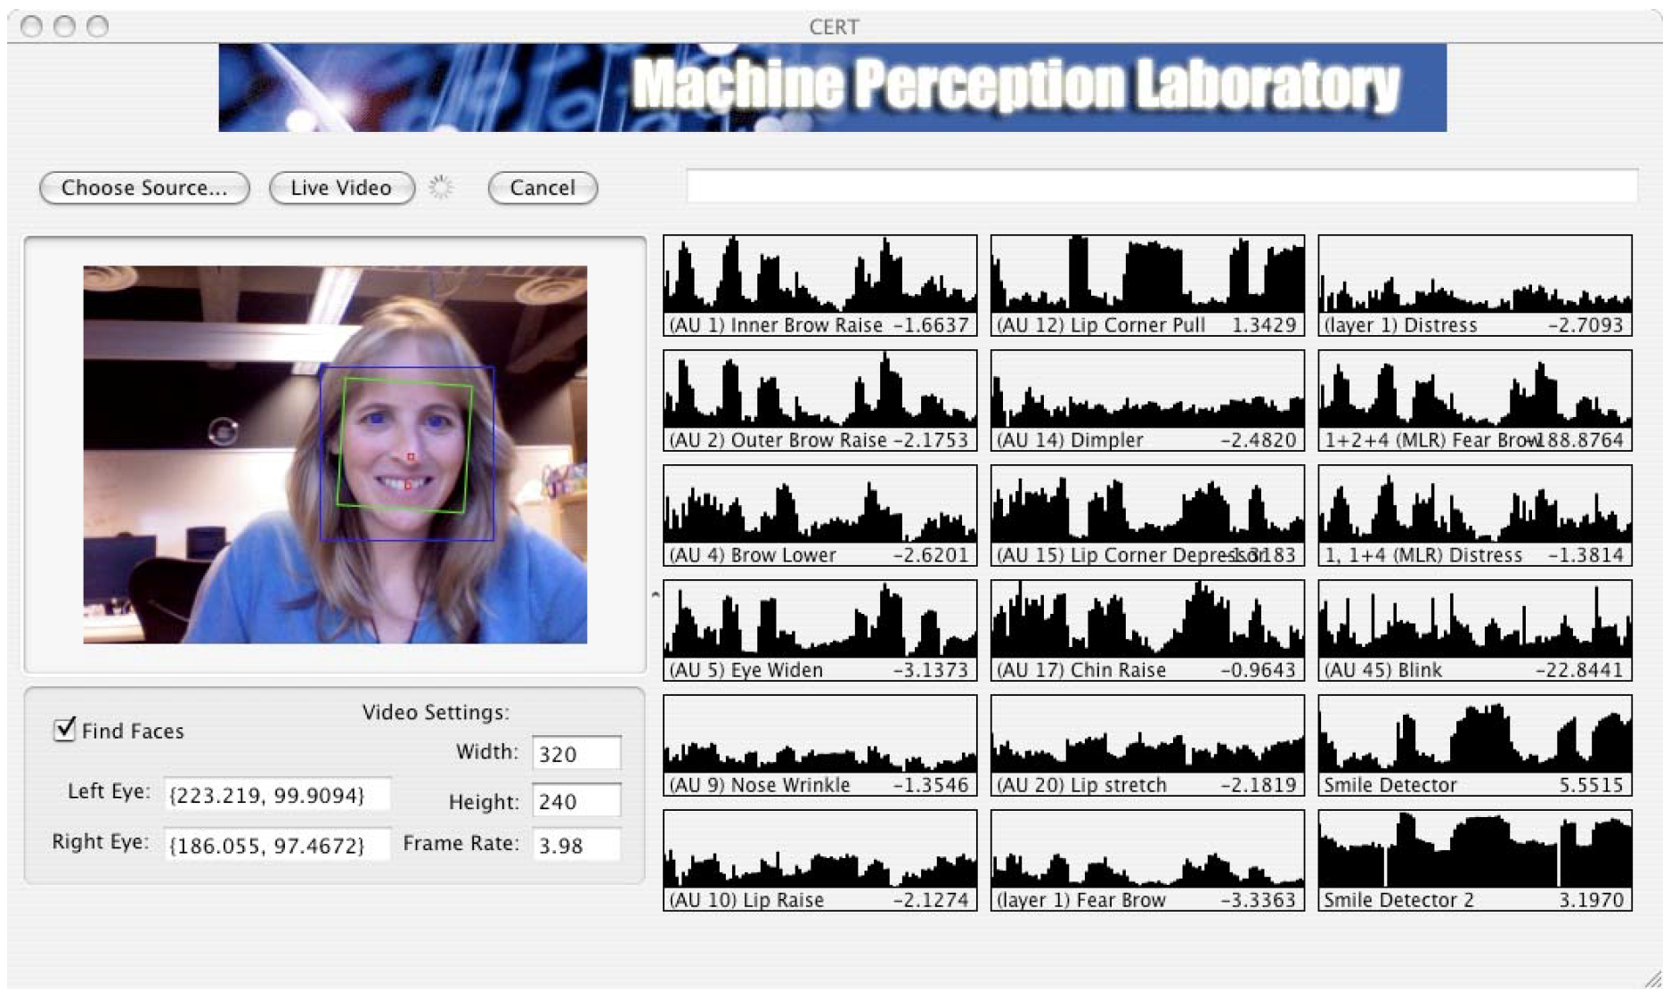
Caja de herramientas computarizada de
reconocimiento de expresiones
http://mplab.ucsd.edu/~marni/pubs/Bartlett_demo_FG2008.pdf

Slide 20

División de Analítica del Aprendizaje
https://med.nyu.edu/institute-innovations-medical-education/
Notes:
The Division of Learning Analytics (DLA) facilitates innovation in the use of
educational data at NYUSOM. It’s mission is to identify and develop innovative
learning analytics measures for improving the process and effectiveness of medical
education.
DLA faculty and staff have expertise in some of the more advanced education
research data analysis methods including:
• Linear modeling;
• Item-response theory;
• Classical test theory; and
• Learning curve methodologies.
DLA’s ultimate goal is to nurture a system of continuous, embedded data analytics to
promote positive action by students, faculty and their collaborators, in service of the
health and well-being of their patients. DLA contributes to the development of
individualized learning pathways by providing data and analysis templates that guide
both learners and educators as they navigate the rich set of educational
opportunities at NYUSOM.

Slide 21

“...a flexible, technology-enabled curriculum to train medical students in using big data—extremely large and complex data sets—to improve care coordination and quality.
This three-year blended curriculum is founded on patient panel databases, derived from deidentified data gathered from NYU Langone’s outpatient physician practices and government-provided open data from the 2.5 million patients admitted each year to New York State hospitals”.
https://med.nyu.edu/institute-innovations-medical-education/research-scholarship/grants/health-care-the-numbers

Slide 22

https://lak19.solaresearch.org

Slide 23

https://solaresearch.org

Slide 24


https://learning-analytics.info/journals/index.php/JLA/index

Slide 25
Peñaloza Báez MJ.
Inv Ed Med 2017; 7(25):61-66
Notes:
Resumen Big data y la analítica del aprendizaje son herramientas que permiten aprovechar
enormes cantidades de datos que hoy existen en formato digital, y que se generan durante
la prestación de servicios de salud y cuando se incorporan plataformas digitales al proceso
de ense˜nanza-aprendizaje en la formación de médicos. El objetivo es dise˜nar proyectos que
exploten las ventajas de las capacidades técnicas actuales para el procesamiento automatizado
de datos en grandes volúmenes y distintos formatos, para buscar su entendimiento y mejorar
la toma de decisiones. Las asociaciones, los patrones y las tendencias que pueden emerger del
análisis de datos generados en la educación médica pueden facilitar el seguimiento e incluso
modelar la conducta de los estudiantes, y perfilar su desempe˜no. Con big data y la analítica
del aprendizaje es posible transformar grandes cantidades de datos en información de muy
alta calidad. Lo anterior es un área que puede ser aprovechada por el educador médico, quien
conoce la información que tiene disponible y la que puede obtener mediante alianzas y acuerdos
legales, a partir de un problema que se requiera resolver; se necesita apoyo de expertos técnicos
pero, en todo momento, el rumbo del proyecto le corresponde a quien ha definido el problema,
pues es quien conoce el marco de referencia y las posibles acciones a tomar con los hallazgos y
las ideas que surjan. Ciertamente se requiere infraestructura, pero con las posibilidades para
el trabajo en la nube, y los recursos disponibles en las instituciones médicas y de educación
superior, se puede partir de un primer nivel de hardware y software, y escalar a plataformas
más sofisticadas cuando la combinación de hallazgos en los datos y de los volúmenes a procesar
lo justifique. Sin duda, big data y analítica del aprendizaje son herramientas en las que el
educador médico debe poner atención.
a) Modelos del conocimiento del usuario, que buscan
indagar sobre los contenidos y las habilidades que el estudiante
domina, con base en sus respuestas, los errores
cometidos y repetidos, las habilidades que practicó y su
desempe˜no en general a partir de su trabajo en plataforma
o bien por los resultados obtenidos en exámenes
estandarizados.
b) Modelos de la conducta del usuario, con el objetivo de
conocer más sobre la motivación de los alumnos y los
patrones de interacción que muestran los estudiantes a
través del proceso de aprendizaje, por vía de datos muy
similares a los del punto anterior, a los que se agrega el
análisis de los cambios en el contexto de cada alumno
durante un período.
c) Modelos de la experiencia del usuario, para evaluar su
nivel de satisfacción, a través de sus respuestas a encuestas
y cuestionarios, y de la evaluación de las decisiones
que tomen y el desempe˜no que muestren en los siguientes
cursos o unidades de aprendizaje.
d) Perfiles de los estudiantes, que se logran al identificar
los grupos de alumnos a partir de los datos disponibles
que se mencionan en otras áreas de aplicación. Con los
perfiles definidos pueden dise˜narse acciones remediales,
por ejemplo, si se detecta que un grupo ha tenido dificultades
en el desarrollo de ciertas competencias.
e) Modelos de los dominios, para valorar el nivel de desagregación
que más conviene para dividir los temas en
módulos y la secuencia en que deben ser presentados.
f) Análisis de los componentes del aprendizaje y de los principios
instruccionales, para identificar los elementos que
son más eficaces.
g) Análisis de tendencias, para indagar sobre el impacto de
las acciones a través del tiempo, para lo cual se requieren
datos sobre al menos tres momentos, con la finalidad de
lograr identificar una tendencia; la información requerida
incluye registros de ingreso y egreso de alumnos.
h) Adaptación y personalización, que es uno de los objetivos
de la mayoría de los proyectos de analítica de aprendizaje,
con el objetivo de identificar las acciones idóneas
que se deben sugerir a cada individuo, y cómo debe modificarse
la experiencia para el siguiente usuario a partir de
lo sucedido previamente, tanto para el propio estudiante
como para otros alumnos y, de ser posible, lograr este
nivel de personalización en tiempo real. Para ello normalmente
se requiere recolectar datos históricos sobre
cada usuario, de la misma manera como lo hacen las
redes sociales.

Slide 26
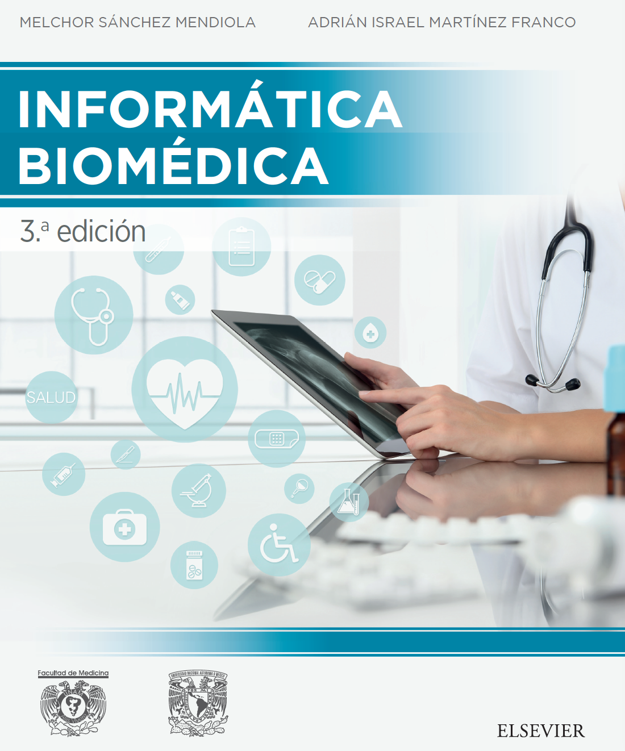
Sánchez Mendiola M, Martínez Franco I.
FM UNAM-Elsevier. 3ª Ed. 2018

Slide 27
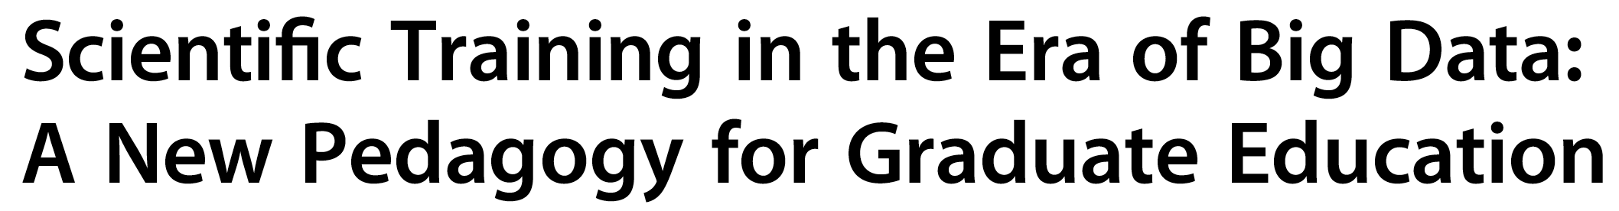
Aikat J et al.
Big Data 2017;
5(1): 12-8.
Notes:
Abstract
The era of ‘‘big data’’ has radically altered the way scientific research is conducted and new knowledge is discovered.
Indeed, the scientific method is rapidly being complemented and even replaced in some fields by data-driven approaches
to knowledge discovery. This paradigm shift is sometimes referred to as the ‘‘fourth paradigm’’ of dataintensive
and data-enabled scientific discovery. Interdisciplinary research with a hard emphasis on translational outcomes
is becoming the norm in all large-scale scientific endeavors. Yet, graduate education remains largely focused
on individual achievement within a single scientific domain, with little training in team-based, interdisciplinary dataoriented
approaches designed to translate scientific data into new solutions to today’s critical challenges. In this article,
we propose a new pedagogy for graduate education: data-centered learning for the domain-data scientist. Our
approach is based on four tenets: (1) Graduate training must incorporate interdisciplinary training that couples the
domain sciences with data science. (2) Graduate training must prepare students for work in data-enabled research
teams. (3) Graduate training must include education in teaming and leadership skills for the data scientist. (4) Graduate
training must provide experiential training through academic/industry practicums and internships. We emphasize
that this approach is distinct from today’s graduate training, which offers training in either data science or a
domain science (e.g., biology, sociology, political science, economics, and medicine), but does not integrate the
two within a single curriculum designed to prepare the next generation of domain-data scientists. We are in the
process of implementing the proposed pedagogy through the development of a new graduate curriculum
based on the above four tenets, and we describe herein our strategy, progress, and lessons learned. While our pedagogy
was developed in the context of graduate education, the general approach of data-centered learning can and
should be applied to students and professionals at any stage of their education, including at the K-12, undergraduate,
graduate, and professional levels. We believe that the time is right to embed data-centered learning within our
educational system and, thus, generate the talent required to fully harness the potential of big data

Slide 28

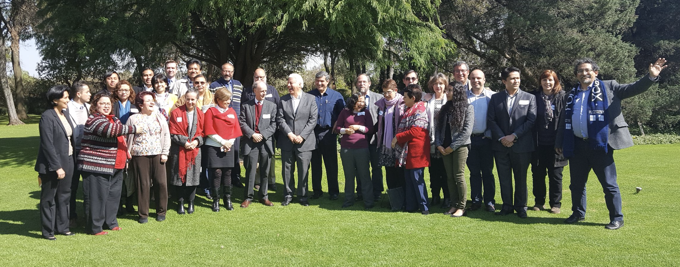




Slide 29
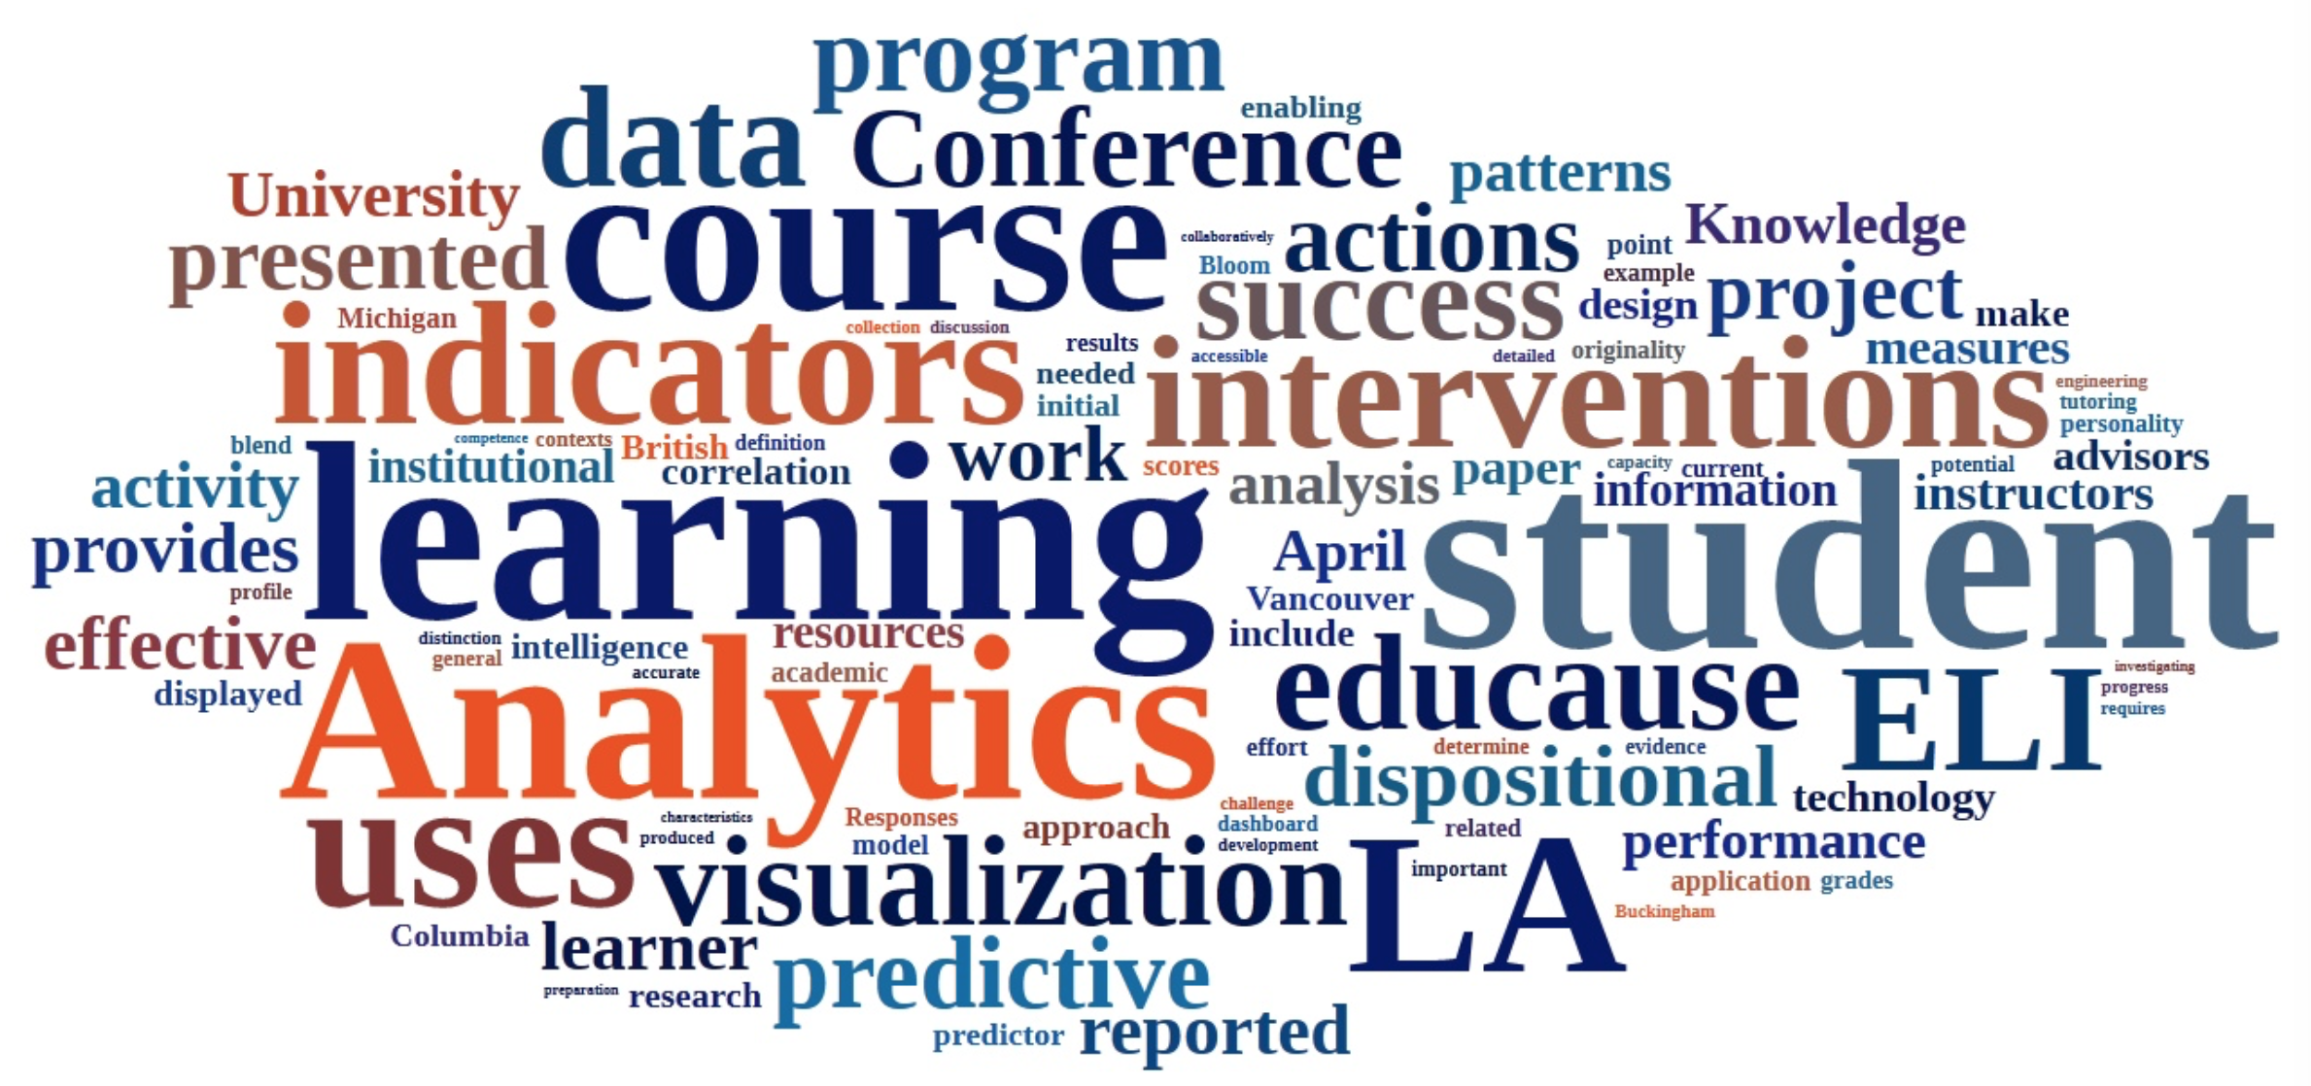
El nuevo lenguaje de la analítica

Slide 30
Notes:
The School of Athens (Italian: Scuola di Atene) is one of the most famous frescoes by the Italian Renaissance artist Raphael. It was painted between 1509 and 1511 as a part of Raphael's commission to decorate the rooms now known as the Stanze di Raffaello, in the Apostolic Palace in the Vatican. In the center of the fresco, at its architecture's central vanishing point, are the two undisputed main subjects: Plato on the left and Aristotle, his student, on the right. Both figures hold modern (of the time), bound copies of their books in their left hands, while gesturing with their right. Plato holds Timaeus, Aristotle his Nicomachean Ethics. Plato is depicted as old, grey, wise-looking, and bare-foot. By contrast Aristotle, slightly ahead of him, is in mature manhood, handsome, well-shod and dressed with gold, and the youth about them seem to look his way.

Slide 31
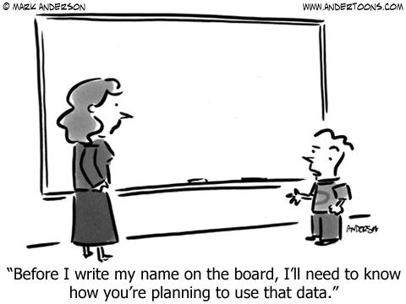
“Antes de que escriba mi nombre en el pizarrón,
necesito saber cómo planear usar ese dato”.

Slide 32
“¿Qué cuenta como hallazgo significativo cuando el número de puntos de datos es tan grande que siempre habrá algo significativo?”
Wise AF, Shaffer DW. Why theory matters more than
ever in the age of big data. J Learn Anal 2015; 2:5-13.

Slide 33

“Si torturas a los datos por un tiempo suficiente, confesarán”
Ronald Coase
Tollock G. A comment on Daniel Klein’s “A Plea to Economists Who Favor Liberty”. East Econ J 2001;27:203-7.

