Slide 1
El sueño en el crustáceo acocil
Dr. Fidel Ramón y Romero
Fac. Medicina, UNAM
Notes:
Bigger brains. In terrestrial vertebrates, large brains evolved, independently, twice. Relative brain size I livng mammals and birds has increased by at least a factor of 10 over that in living reptiles. Pictured brains show the relative dimensions of the olfactory bulbs and cerebral hemispheres, the midbrain, the cerebellum, and the medulla. I birds, the midbrain lobes hae been displaced laterally and ventrally by the expansion of the cerebral hemispheres, and the expansion of the cerebellum in both mammals and birds has resulted I pronounced foliation (folding) of thecerebellum.
R. Gleen Northcutt. Science 332: 926-927, 2011

Slide 2

Colaboradores
(Theodore Bullock, Jesús Hernández, Bao Nguyen, ??, Fidel Ramón)
Notes:
Bigger brains. In terrestrial vertebrates, large brains evolved, independently, twice. Relative brain size I livng mammals and birds has increased by at least a factor of 10 over that in living reptiles. Pictured brains show the relative dimensions of the olfactory bulbs and cerebral hemispheres, the midbrain, the cerebellum, and the medulla. I birds, the midbrain lobes hae been displaced laterally and ventrally by the expansion of the cerebral hemispheres, and the expansion of the cerebellum in both mammals and birds has resulted I pronounced foliation (folding) of thecerebellum.
R. Gleen Northcutt. Science 332: 926-927, 2011

Slide 3

Colaboradores
(Jesús Hernández, Karina Mendoza, Fidel Ramón)

Slide 4
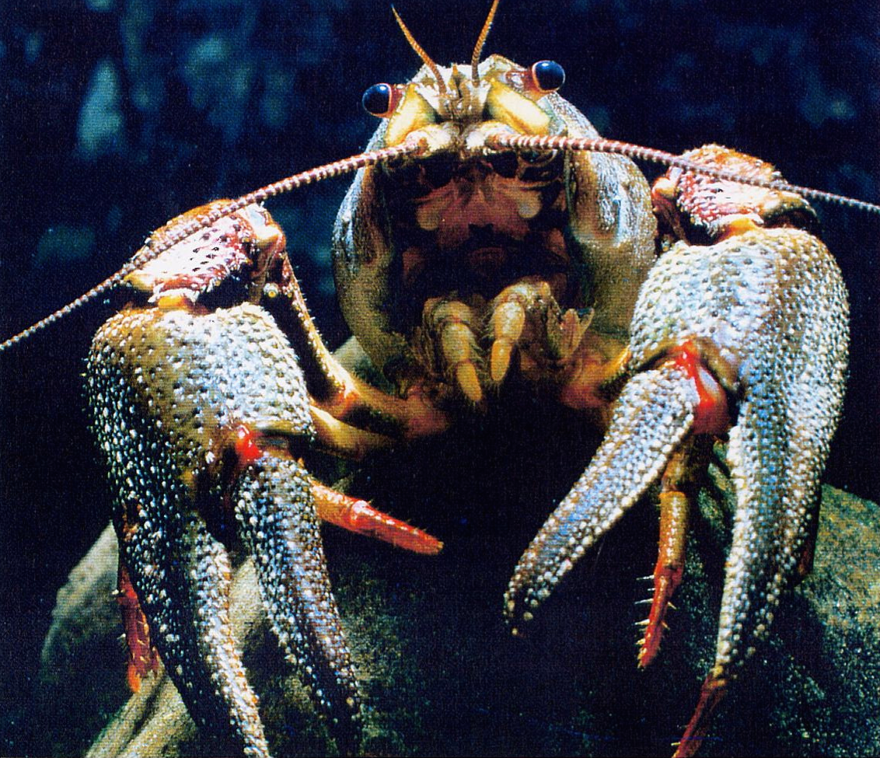
Acocil
(Gehirn & Geist No. 5, 2004)

Slide 5
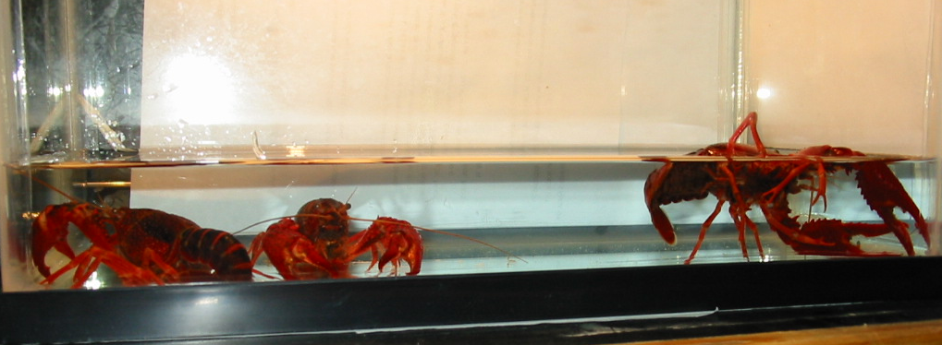
Acociles despiertos y durmiendo
(Ramón et al.,Proc. Nal. Acad. Sci. 101(32): 11857-11861, 2004)
Notes:
Bigger brains. In terrestrial vertebrates, large brains evolved, independently, twice. Relative brain size I livng mammals and birds has increased by at least a factor of 10 over that in living reptiles. Pictured brains show the relative dimensions of the olfactory bulbs and cerebral hemispheres, the midbrain, the cerebellum, and the medulla. I birds, the midbrain lobes hae been displaced laterally and ventrally by the expansion of the cerebral hemispheres, and the expansion of the cerebellum in both mammals and birds has resulted I pronounced foliation (folding) of thecerebellum.
R. Gleen Northcutt. Science 332: 926-927, 2011

Slide 6
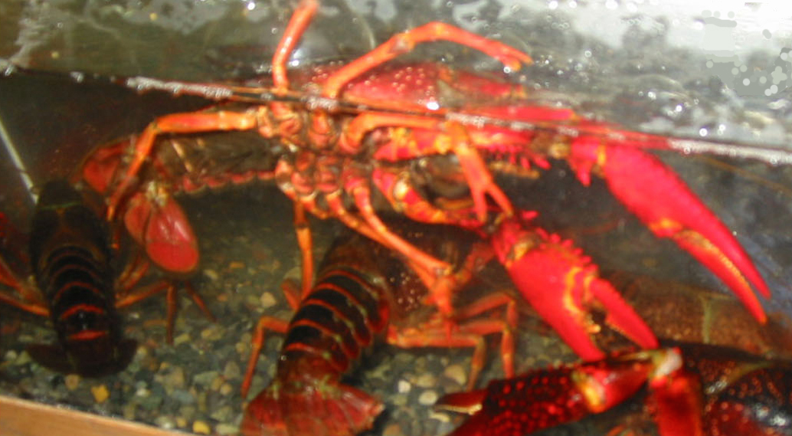
Acocil durmiendo
(Front. Biosci. S4: 1190-1200, 2012)
Notes:
Bigger brains. In terrestrial vertebrates, large brains evolved, independently, twice. Relative brain size I livng mammals and birds has increased by at least a factor of 10 over that in living reptiles. Pictured brains show the relative dimensions of the olfactory bulbs and cerebral hemispheres, the midbrain, the cerebellum, and the medulla. I birds, the midbrain lobes hae been displaced laterally and ventrally by the expansion of the cerebral hemispheres, and the expansion of the cerebellum in both mammals and birds has resulted I pronounced foliation (folding) of thecerebellum.
R. Gleen Northcutt. Science 332: 926-927, 2011

Slide 7
Gráfica de locomoción, curvas intensidad-duración y tiempo durmiendo durante 24 horas
(Proc. Natl. Acad. Sci. 101(32): 11857-11861, 2004
Notes:
Bigger brains. In terrestrial vertebrates, large brains evolved, independently, twice. Relative brain size I livng mammals and birds has increased by at least a factor of 10 over that in living reptiles. Pictured brains show the relative dimensions of the olfactory bulbs and cerebral hemispheres, the midbrain, the cerebellum, and the medulla. I birds, the midbrain lobes hae been displaced laterally and ventrally by the expansion of the cerebral hemispheres, and the expansion of the cerebellum in both mammals and birds has resulted I pronounced foliation (folding) of thecerebellum.
R. Gleen Northcutt. Science 332: 926-927, 2011

Slide 8
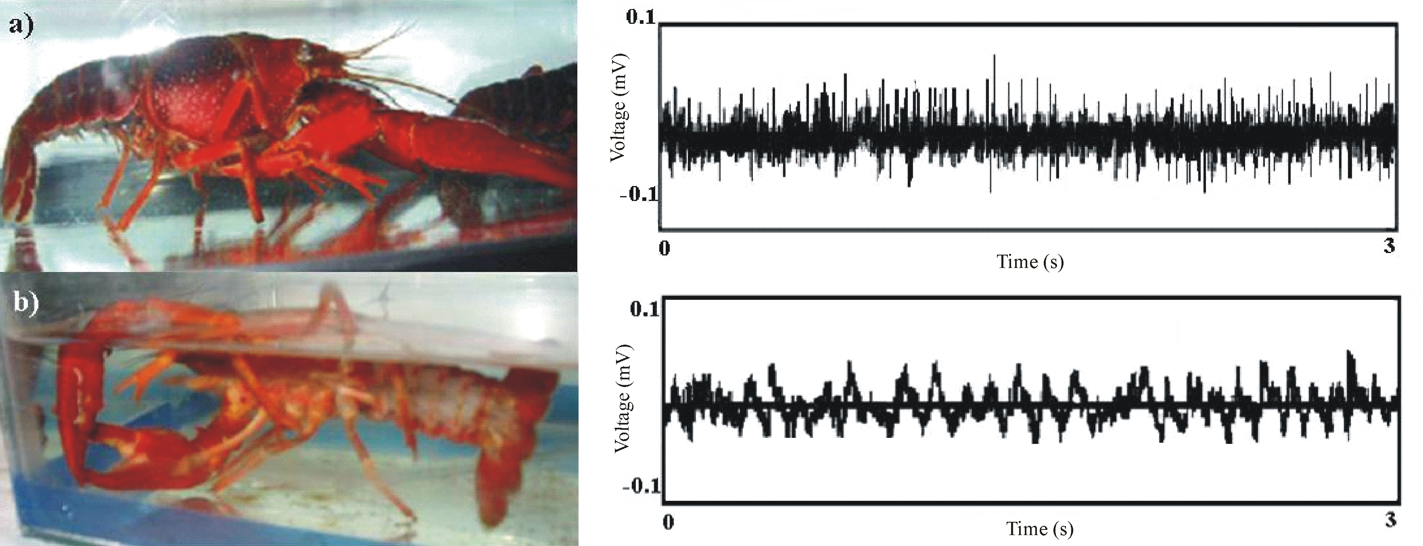
Acocil, despierto y durmiendo
(J. Exp. Biol. 213: 2154-2164, 2010)
Notes:
Bigger brains. In terrestrial vertebrates, large brains evolved, independently, twice. Relative brain size I livng mammals and birds has increased by at least a factor of 10 over that in living reptiles. Pictured brains show the relative dimensions of the olfactory bulbs and cerebral hemispheres, the midbrain, the cerebellum, and the medulla. I birds, the midbrain lobes hae been displaced laterally and ventrally by the expansion of the cerebral hemispheres, and the expansion of the cerebellum in both mammals and birds has resulted I pronounced foliation (folding) of thecerebellum.
R. Gleen Northcutt. Science 332: 926-927, 2011

Slide 9
Acocil – Trancisión de despierto a dormido
(Mendoza-Angeles et al.,J. Exp. Biol. 213: 2154-2164, 2010)

Slide 10
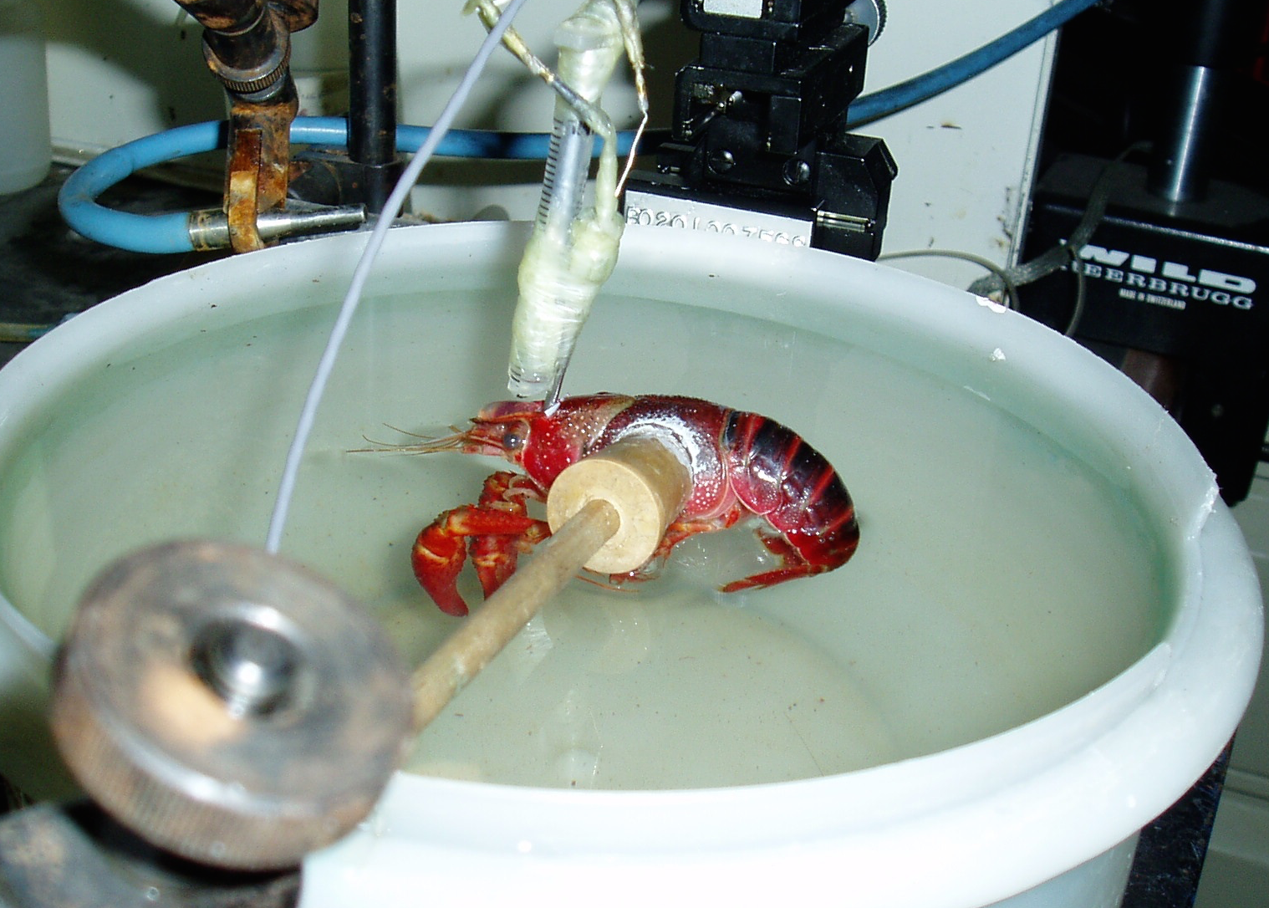
Acocil suspendido para registro del cerebro
(Mendoza-Angeles et al., J. Exp. Biol.: 2154-2164, 2010 & J. Neurosci. Meth. 2013; 2154-2164) )

Slide 11
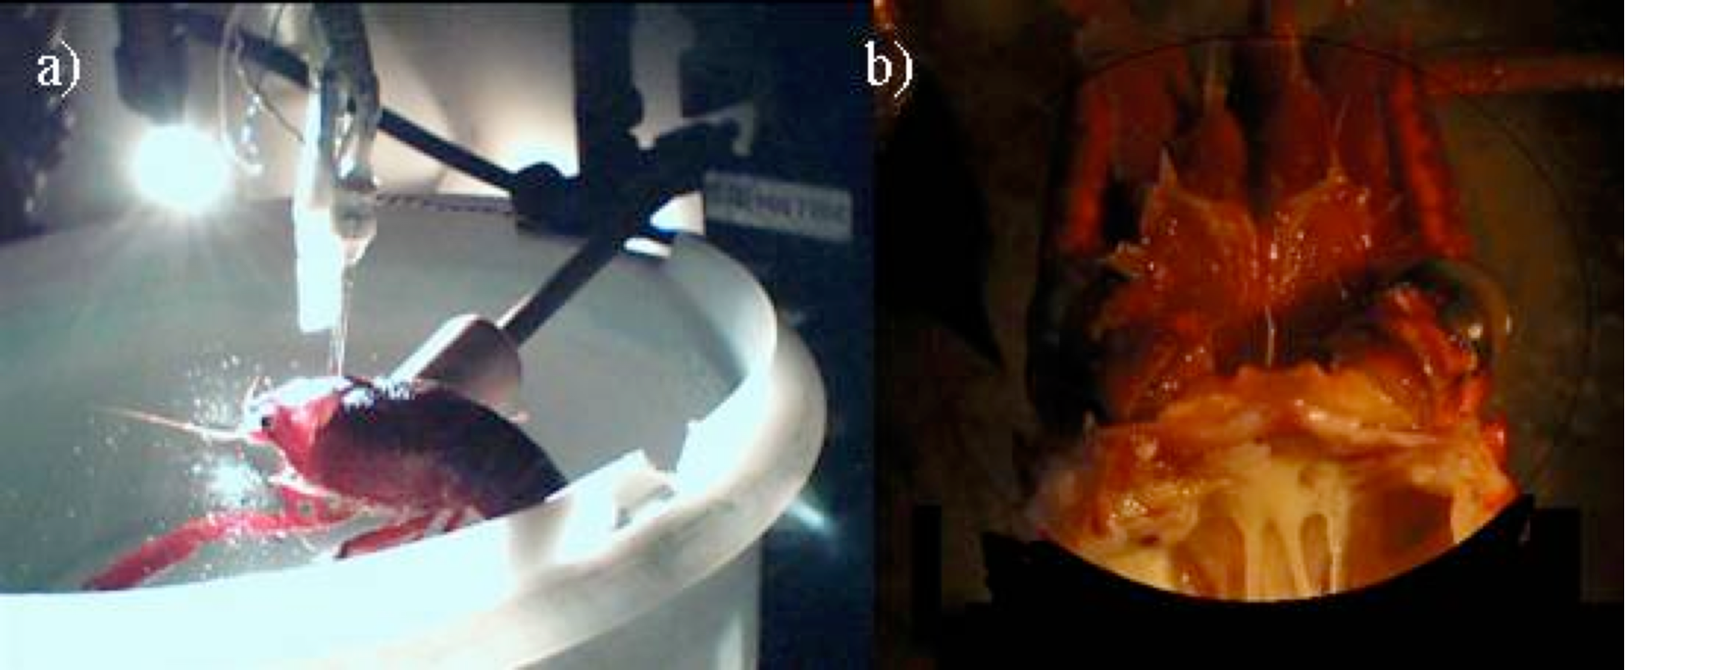
Acocil suspendido para registro del cerebro (a) y vista del cerebro (b)
(Mendoza-Angeles et al., 213: 2154-2164, 2010)

Slide 12
Las ondas lentas se inician en el complejo central del cerebro del acocil
(Mendoza-Angeles et al., 213: 2154-2164, 2010)

Slide 14
Acocil suspendido para registros del cerebro
Notes:
Bigger brains. In terrestrial vertebrates, large brains evolved, independently, twice. Relative brain size I livng mammals and birds has increased by at least a factor of 10 over that in living reptiles. Pictured brains show the relative dimensions of the olfactory bulbs and cerebral hemispheres, the midbrain, the cerebellum, and the medulla. I birds, the midbrain lobes hae been displaced laterally and ventrally by the expansion of the cerebral hemispheres, and the expansion of the cerebellum in both mammals and birds has resulted I pronounced foliation (folding) of thecerebellum.
R. Gleen Northcutt. Science 332: 926-927, 2011

Slide 15
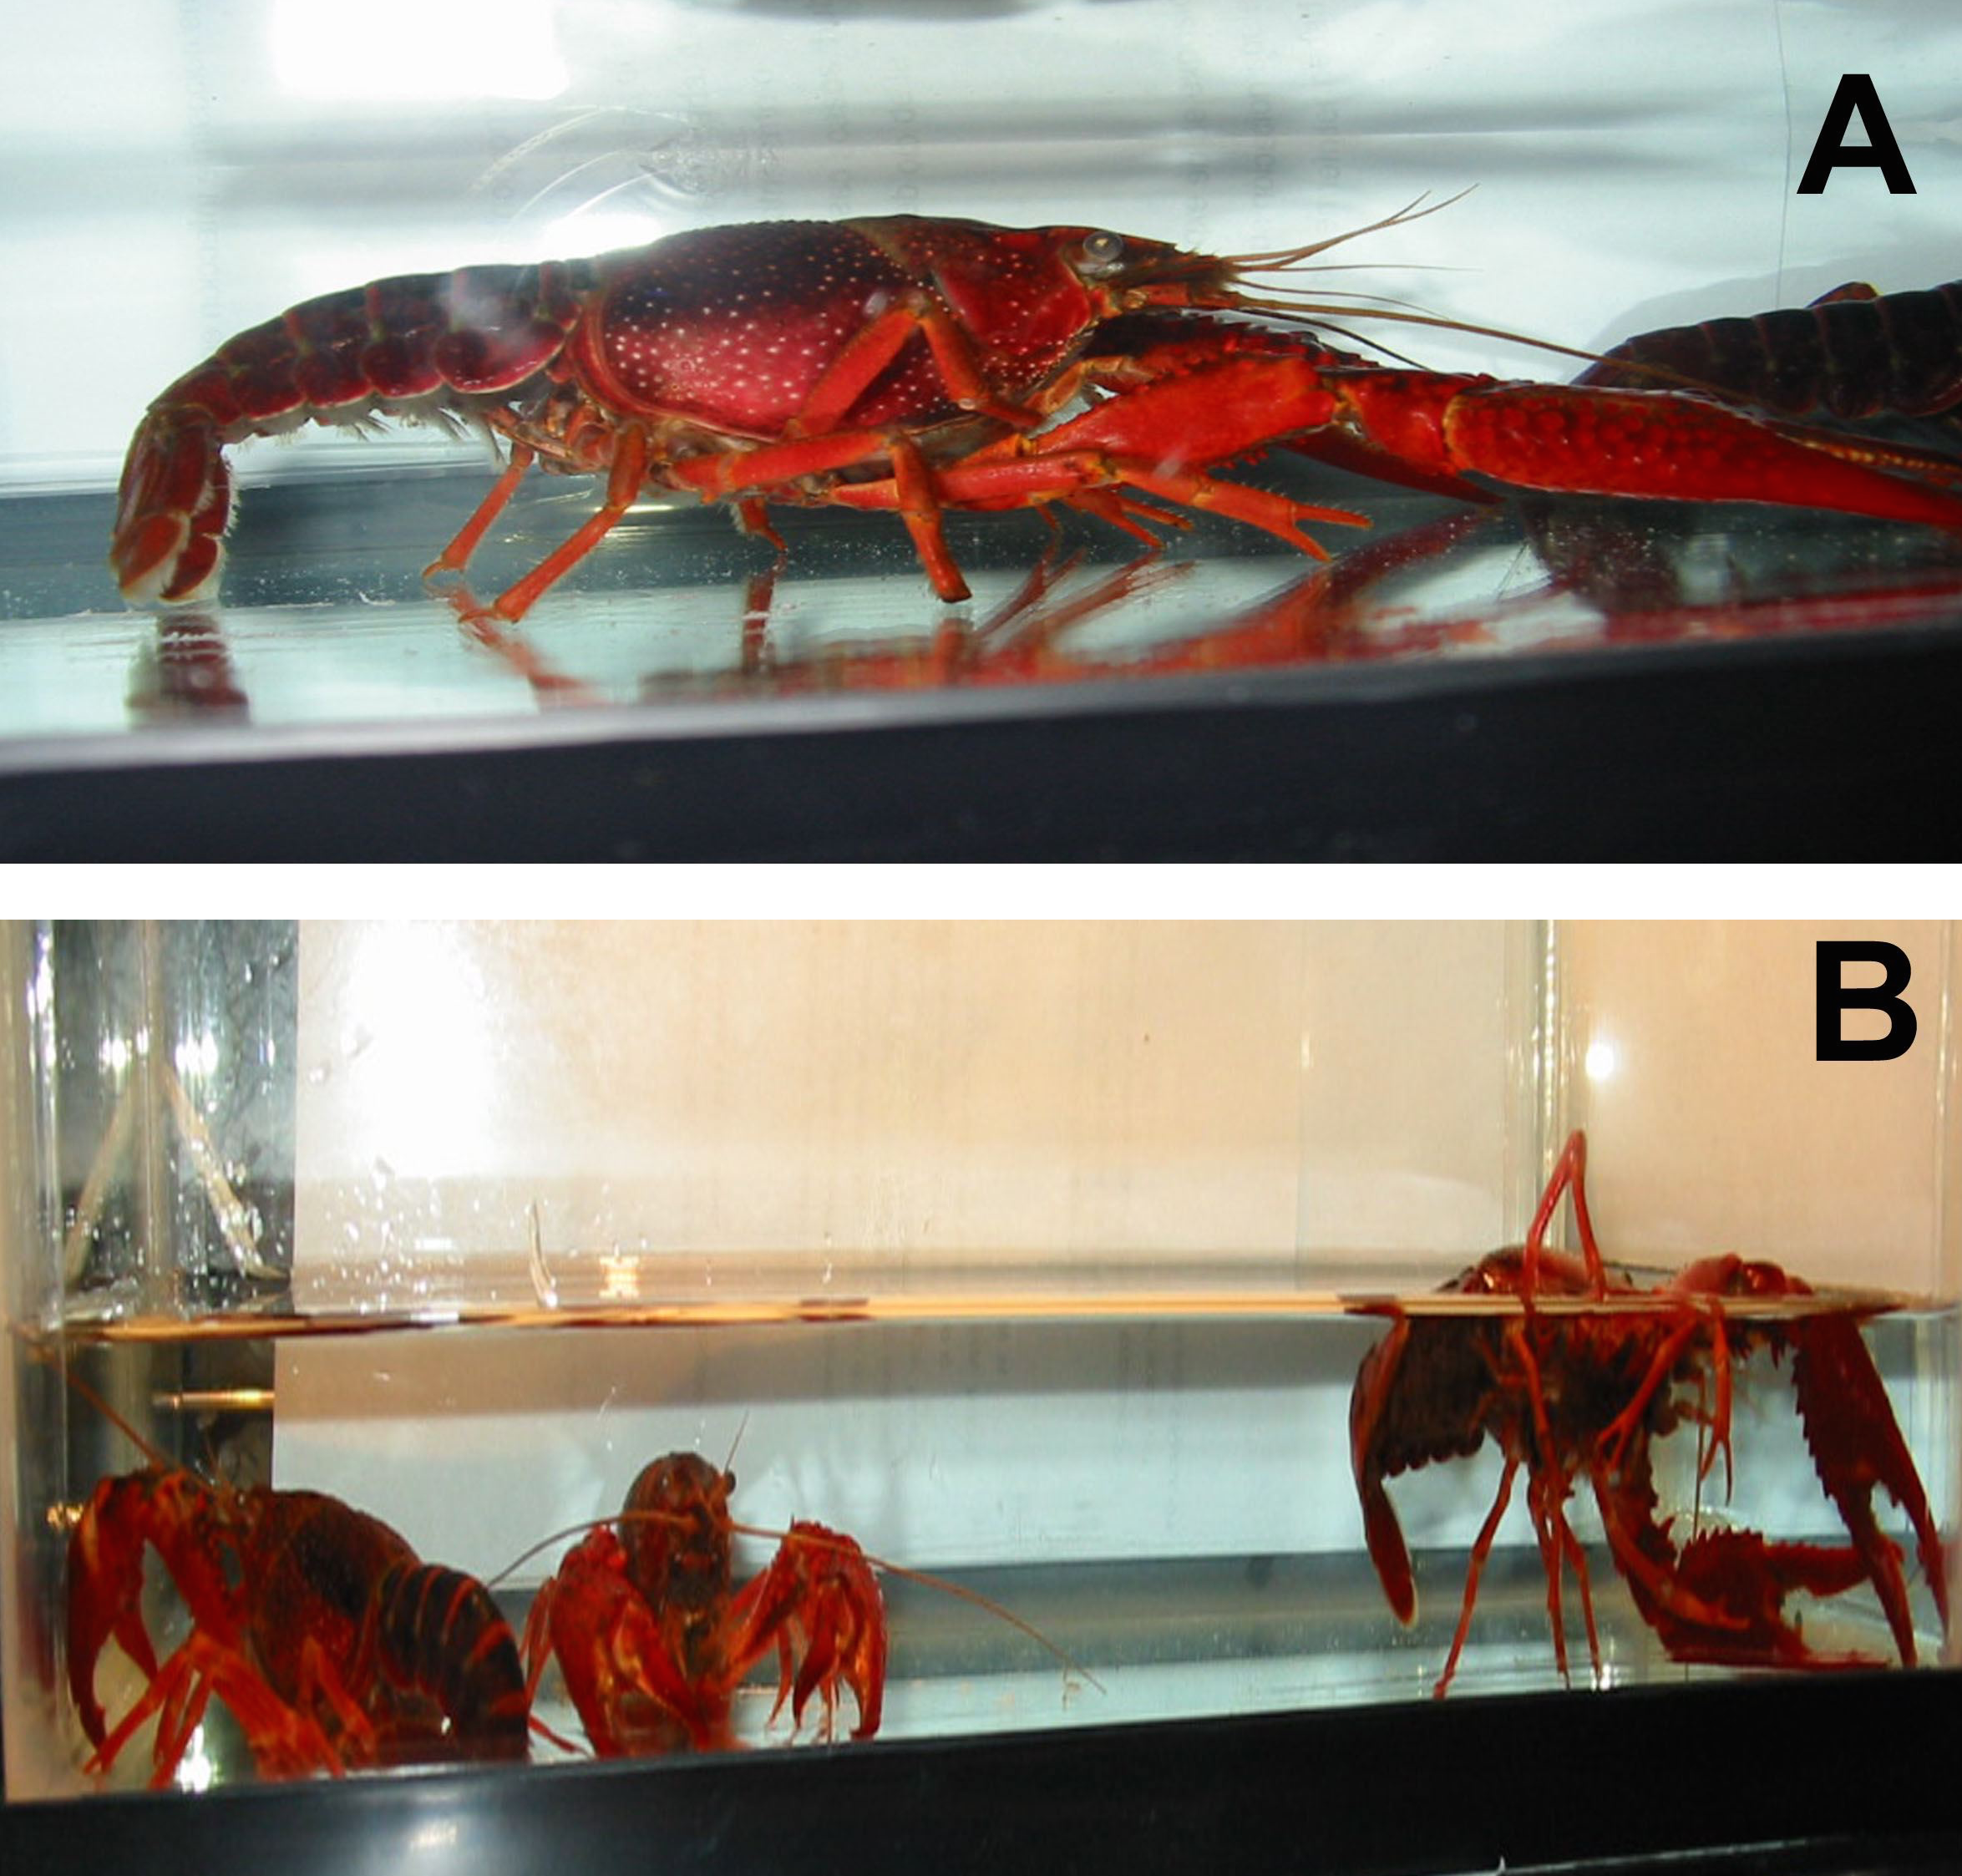
Acocil despierto (A) y durmiendo (B)
(Proc. Natl. Acad. Sci. 101(32): 11857-11861, 2004)

Slide 16
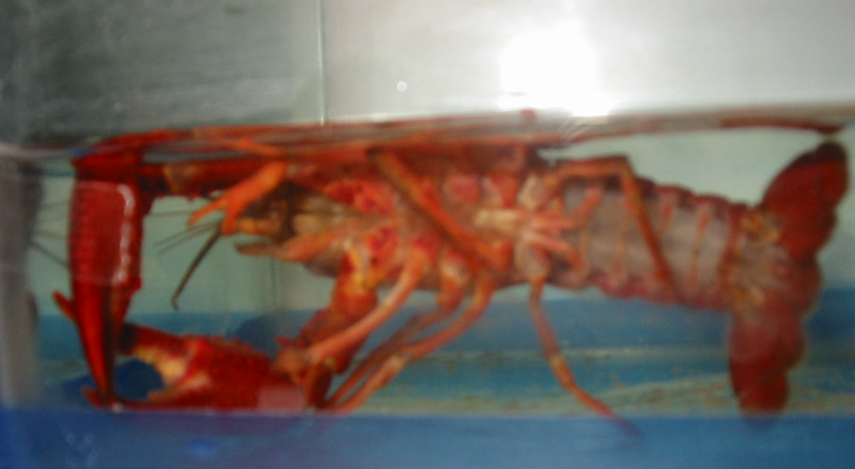
Acocil durmiendo
Notes:
Bigger brains. In terrestrial vertebrates, large brains evolved, independently, twice. Relative brain size I livng mammals and birds has increased by at least a factor of 10 over that in living reptiles. Pictured brains show the relative dimensions of the olfactory bulbs and cerebral hemispheres, the midbrain, the cerebellum, and the medulla. I birds, the midbrain lobes hae been displaced laterally and ventrally by the expansion of the cerebral hemispheres, and the expansion of the cerebellum in both mammals and birds has resulted I pronounced foliation (folding) of thecerebellum.
R. Gleen Northcutt. Science 332: 926-927, 2011

