Slide 1


Descubrimiento de la Proteína ARP2 como una Molécula Determinante en la Muerte Celular de Células Tumorales
Jaime Mas Oliva
Academia Nacional de Medicina
30 de mayo 2018

Slide 2
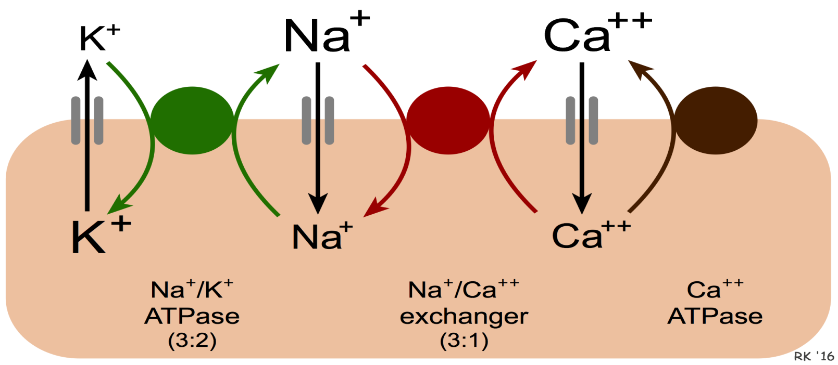
Plasma membrane calcium extrusion mechanisms

Slide 3
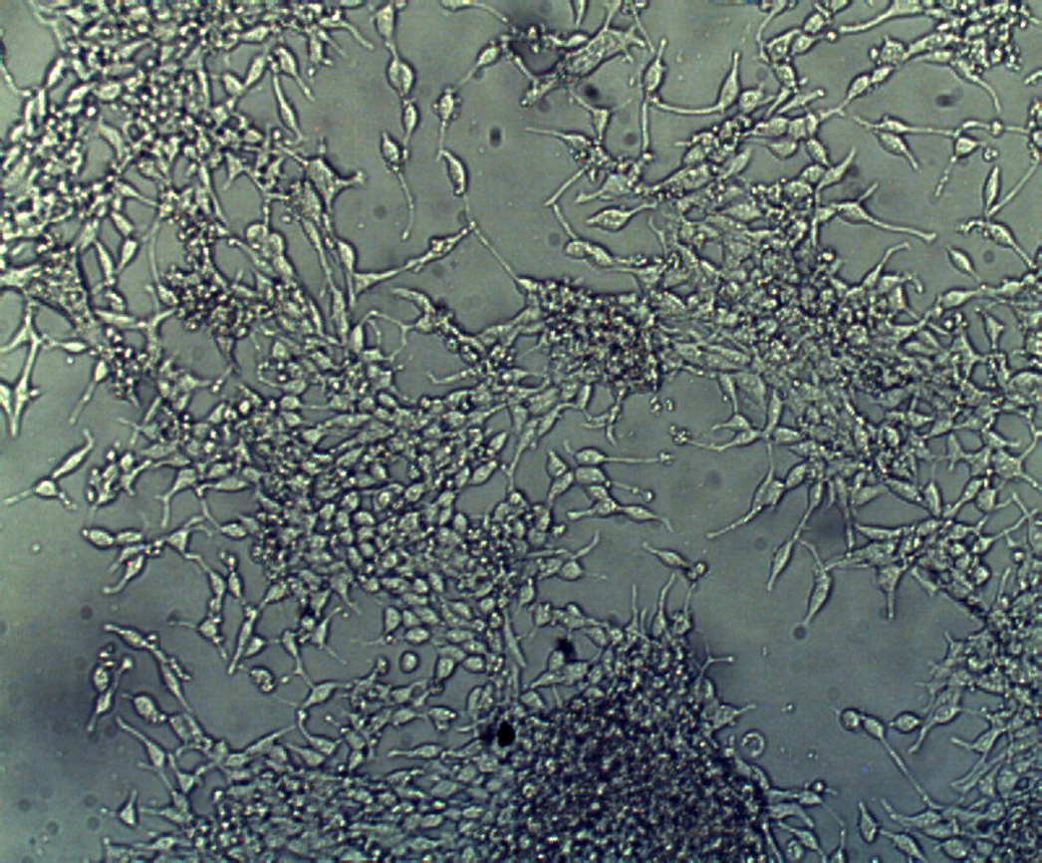
Androgen independent LNCaP Cells
Induction to apoptosis by elimination of serum (starvation).
Activation of a non-selective cation channel permeable to Ca2+ and conductance of 23pS

Slide 4
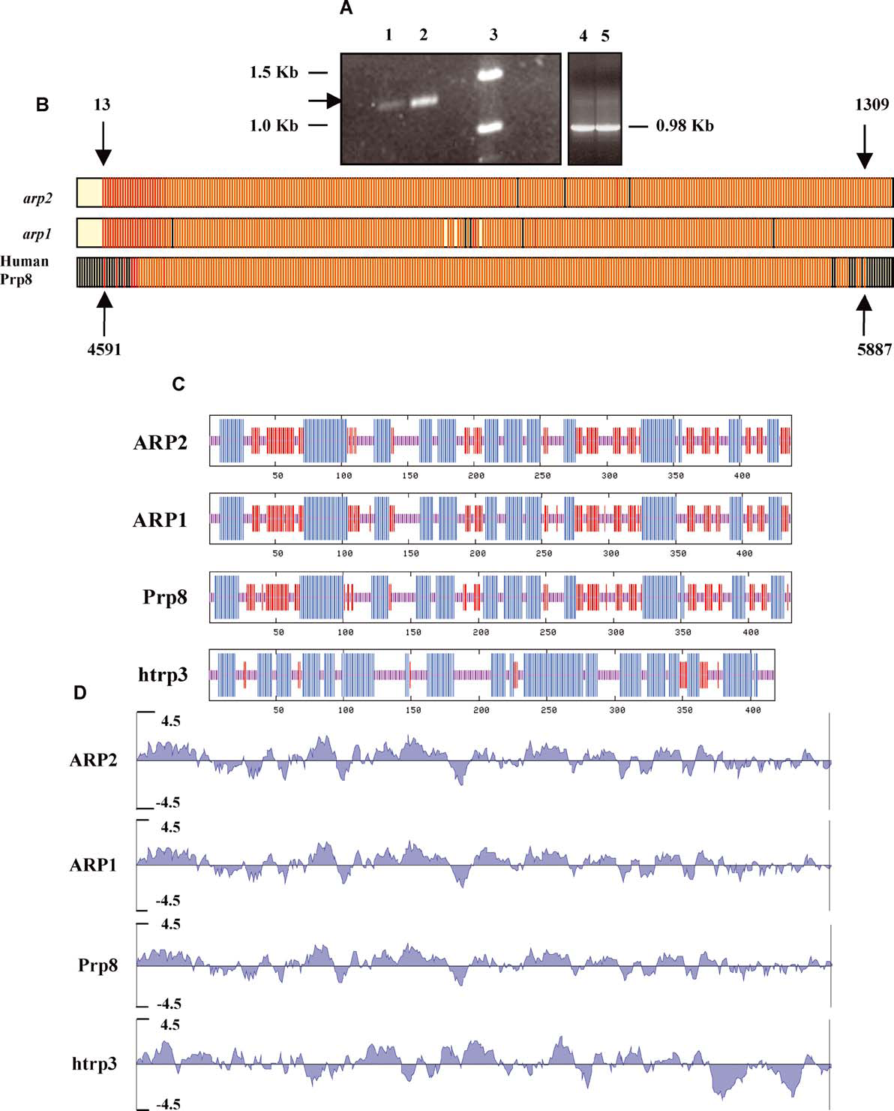
Cloning of arp1 and arp2

Slide 5
Apoptosis regulator protein (ARP2) aminoacid sequence
437 aa

Slide 6
Secondary structure prediction analysis and sequence alignment for ARP2, ARP1, Prp8 and htrp3

Slide 7
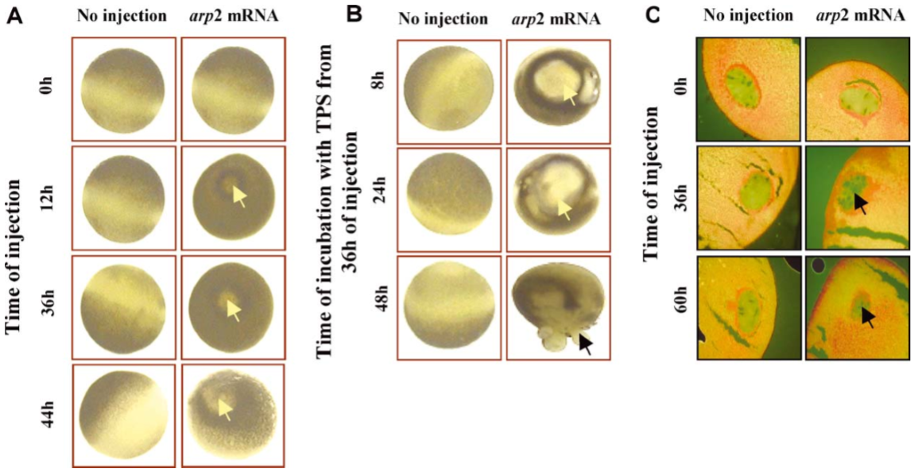
Functional expression of arp2 mRNA in Xenopus laevis oocytes

Slide 8
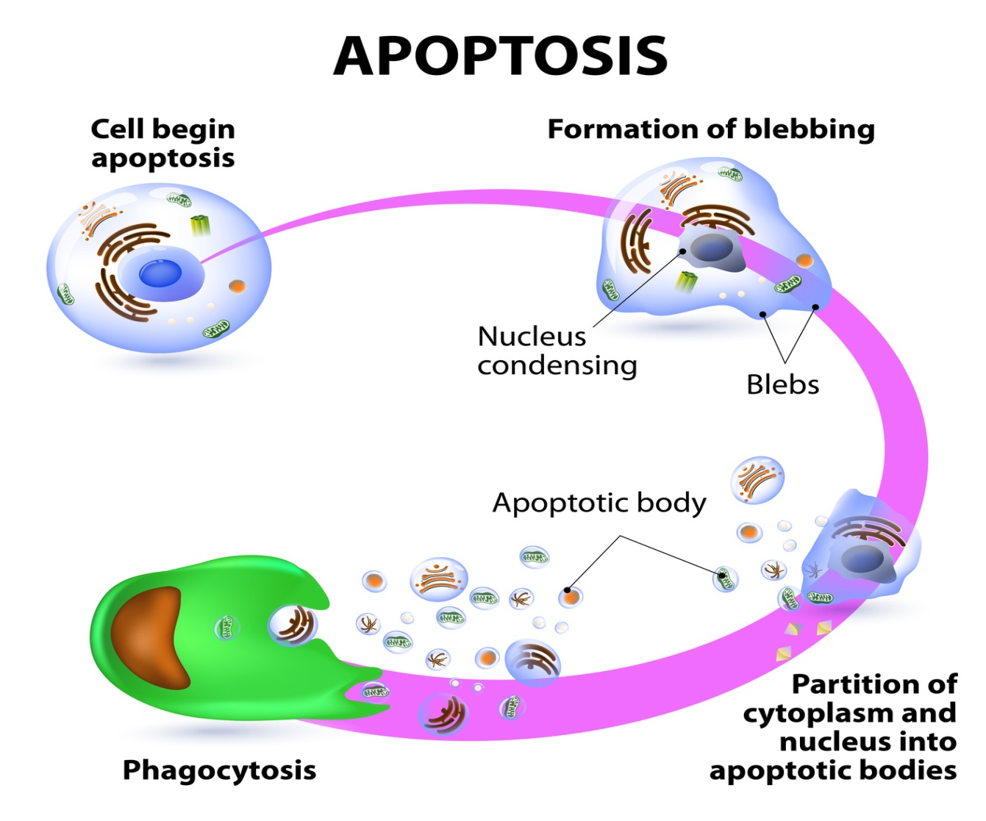

Slide 9
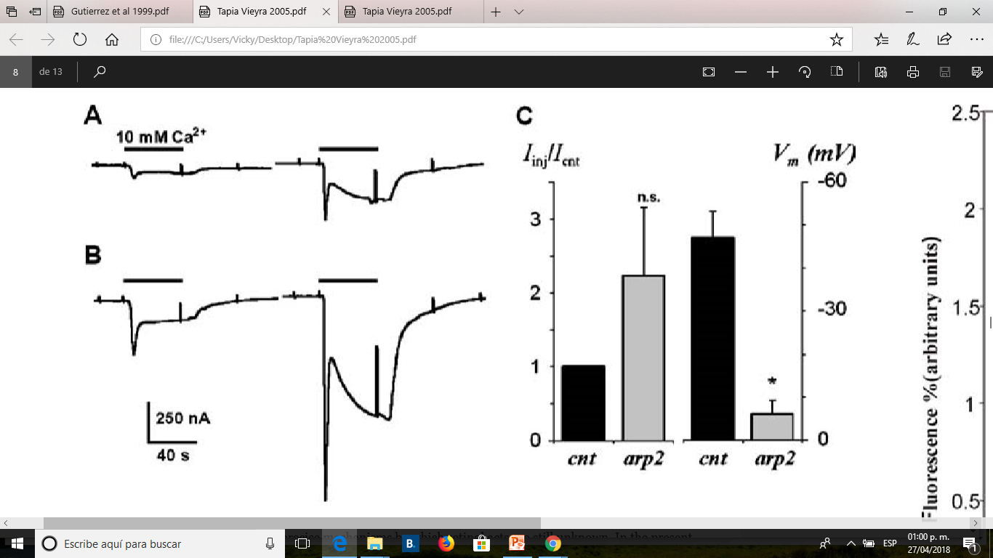
Functional expression of arp2 mRNA in Xenopus laevis oocytes
.

Slide 10
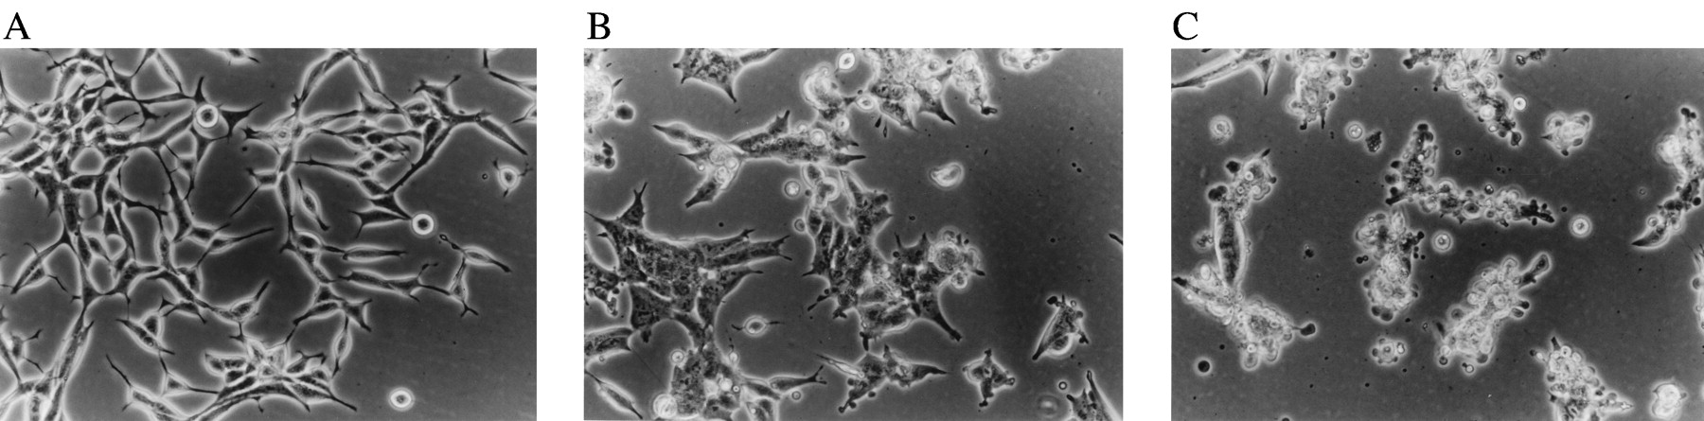
Androgen independent LNCaP Cells

Slide 11
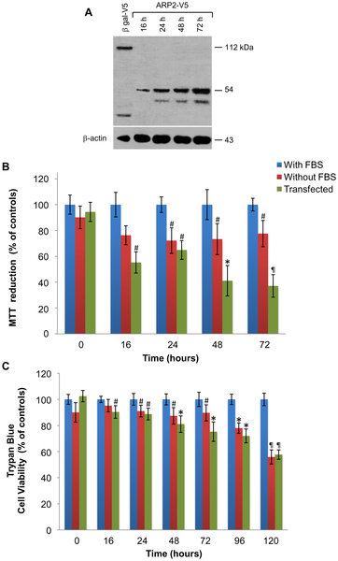
ARP2 expression induces apoptosis in LNCaP cell

Slide 12
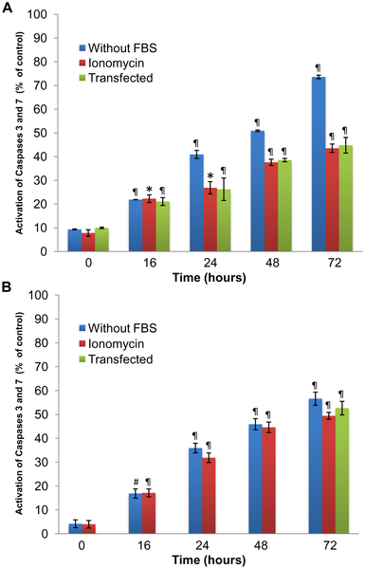
Activity of caspases 3 and 7

Slide 13
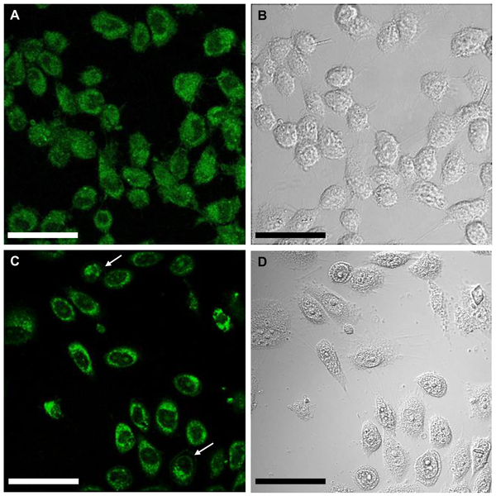
Confocal microscopy of ARP2 fusion protein expressed in CHO cells.

Slide 14
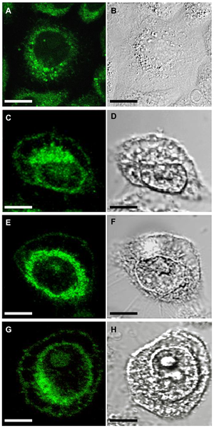
Confocal microscopy of ARP2 fusion protein expressed in CHO cells.

Slide 15
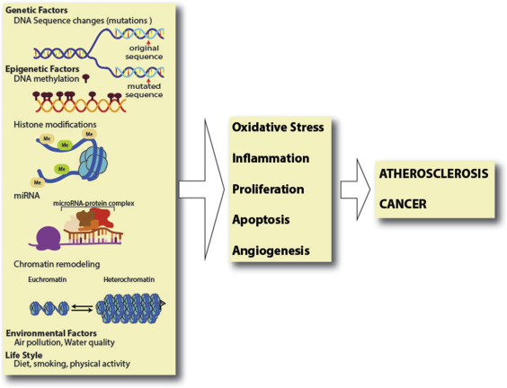

Slide 16


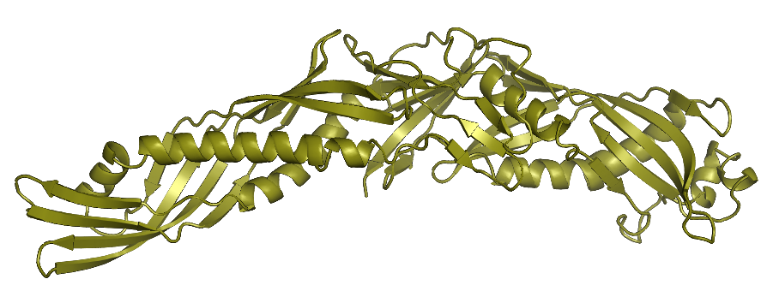
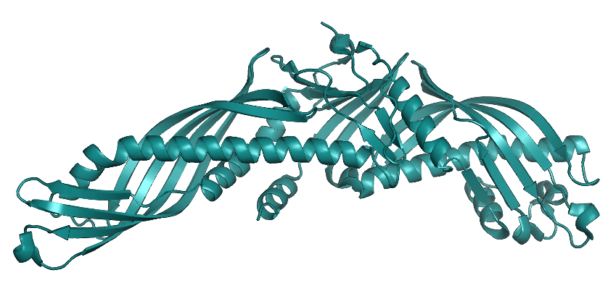
Bactericidal/permeability increasing protein (BPI)
Union to lipopolisacharides (LPS)
CETP
Lipid Transfer
CETPI
Union to
lipopolisacharides (LPS)

