Slide 1

CANNABINOIDES Y EPILEPSIA
DRA. LUISA L. ROCHA
Cinvestav

Slide 2
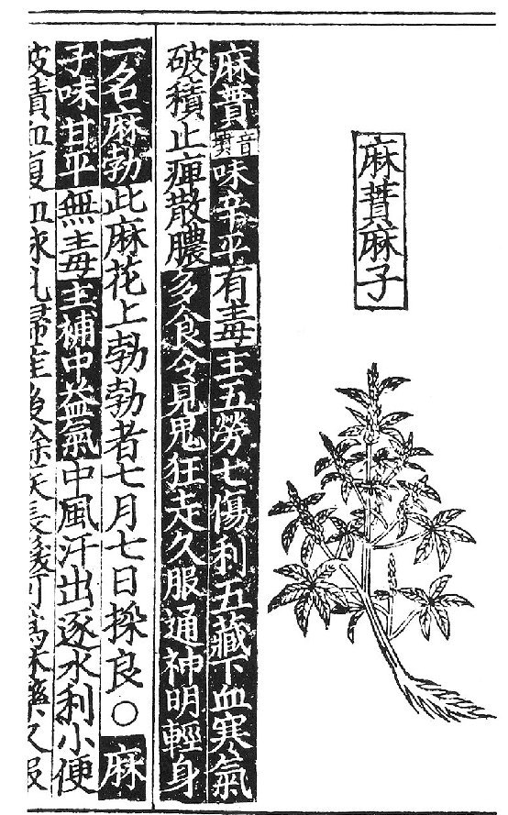
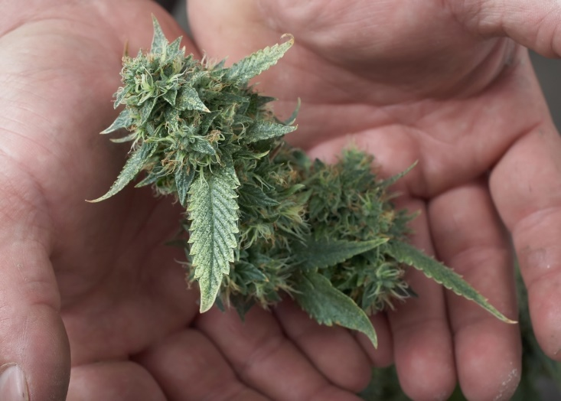

Notes:
During centuries cannabis plants have been used for both medicinal and recreational uses as described
in Chinese, Indian, and Arab pharmacopeias [ 1 ]. Página del Pen-Ts’ao Ching (Imagen: http://antiquecannabisbook.com/chap2B/China/Pen-Tsao.htm)
TRANSLATION:
Column 5 (right most column)
[1,2] Medical Cannabis [4,5] is spicy when eaten [7-8] but has poison [9-13] good for the five organs, to bring the bodies Yin Yang into balance.
Column 4
[1,2 ] Medical Cannabis [3,4] stop eating [4,5] let go [eat more] [9-12] you will see white ghosts [13] walking around [14-20] and eat long enough, you will know how to talk to the Gods.
Column 3
Plant has grown and is good on July 7th, when plant can be picked.
(Note: The hemp plant grows to maturity within 2 to 6 months, but usually in 4 months. Given the fact that planting season is probably (after winter) in February, this statement should actually translated as -- The plant should be picked just at the right time of maturity).
Column 2
[1] Not a major drug, but it [2,3] tastes good [4] is not rough [5, 6,7] and is NOT poison [8] Can help many middle -- Helps much your energy, your whole body -- stops sweat (because of cold) and leaves the water from the body, urine
Column 1 (left most)
[1] Skin . . stomach . . . forever . . . women . . . with baby . . . long hair . . . can be . . . medicine . . time.

Slide 3
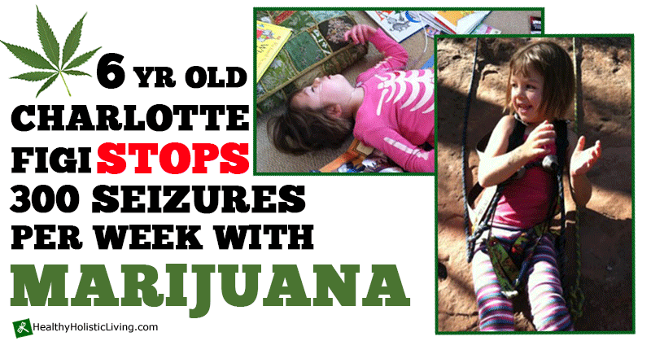

Slide 4
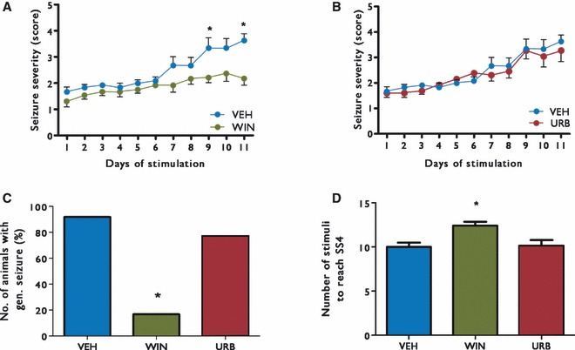
Cannabinoides y Efectos Antiepileptogénicos
Di Maio et al., 2015
Wendt et al., 2011
Notes:
WIN 55,212-2 treatment prevents the occurrence of severe epileptic behavior.
(A)WIN 55,212-2 treated rats showed a significant reduction of behavioral seizure severity
during the time-window of observation (1 to 6 months after PILO-induced SE; Racine
grade at the 22ndweek: 0.78±0.18 forWIN 55,212-2-treated animals; n=14; n=3 independent
experiments; p b 0.001)when compared to vehicle-treated animals,which developed
severe epilepsy within 4 weeks (Racine grade at the 22nd week: 4.5 ± 0.13 for
PILO-treated animals; n=15; n=3 independent experiments). (B)WIN 55,212-2 treatment
also showed efficacy in reducing the duration of individual seizures (at the 22nd
week: 141.5± 10.38 s for PILO-treated animals; n=15; n=3 independent experiments
vs. 24.36 ± 5.16 s forWIN 55,212-2-treated animals; n= 14; n= 3 independent experiments;
p b 0.0001). (C)WIN 55,212-2 treatment also reduced weekly seizure frequency
in PILO-treated animals (at the 22nd week: 14.20 ± 5.9 seizures/week for PILO-treated
animals; n = 15; n = 3 independent experiments vs. 2.50 ± 1.03 seizures/week for
WIN 55,212-2-treated animals; n = 14; n = 3 independent experiments; p b 0.0001).
Seizure severity is shown for each day of the initial stimulation phase with ongoing treatment (mean ± SEM): (A) vehicle and WIN55.212-2, (B) vehicle and URB597. The percentage of animals exhibiting generalized seizures during the initial 11-day stimulation phase is shown in (C). (D) shows the number of stimuli required to reach seizure severity 4; note that we considered data from the initial stimulation phase with ongoing treatment and from the restimulation phase following washout for calculation of these data. (*Significant difference to vehicle; p < 0.05).
CB1 receptor agonist (WIN55.212-2)
and of an inhibitor of the enzymatic degradation of the endocannabinoid
anandamide (fatty acid hydrolase inhibitor
URB597) i

Slide 5
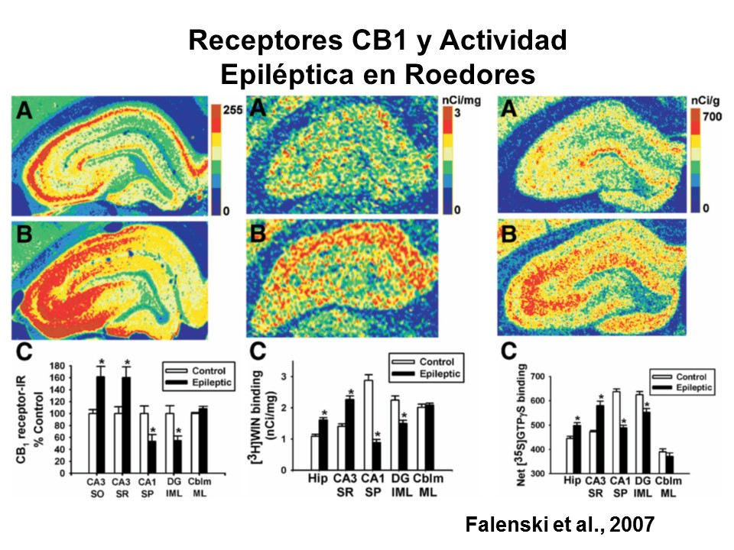

Slide 6
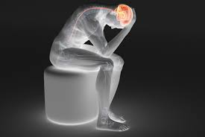


Slide 7
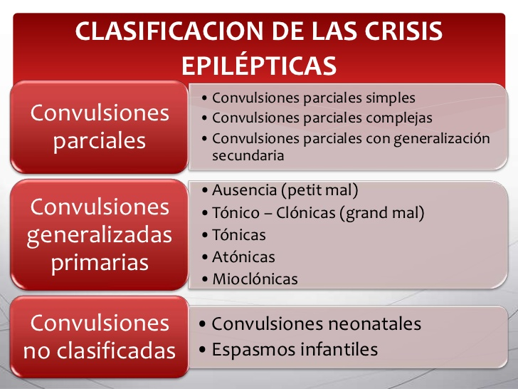

Slide 8

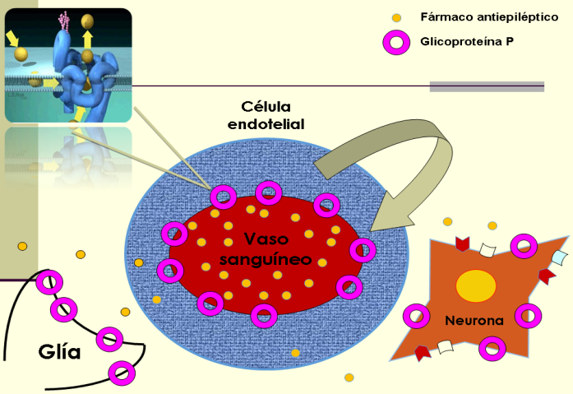
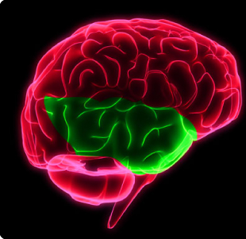
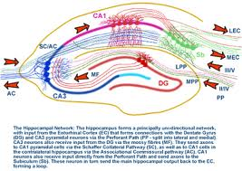
Epilepsia del Lóbulo Temporal
1%
40%
Sloviter, 1993; Zentner et al., 1995; Lanerolle y Lee, 2005.

Slide 9
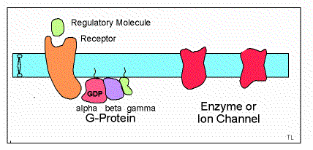
Receptores CB1 en Pacientes con ELTM
Ludanyi et al., 2008
Goffin et al., 2011
?
Notes:
Romigi: (A) The graphs show that AEA levels are significantly reduced in the CSF of epileptic versus control patients. (B) The graphs show that there is no significant difference in 2-AG levels in CSF of epileptic versus control patients.
Goffin: Statistical parametric mapping results showing average differences in the relative CB1R availability in patients with mesial
temporal lobe epilepsy due to hippocampal sclerosis compared to healthy volunteers. Serial axial (top two rows) and coronal (bottom row) brain sections show an increase in CB1R availability in patients with mesial temporal lobe epilepsy due to hippocampal sclerosis in the ipsilateral temporal lobe extending from inferotemporal to mid-temporal and superior temporal cortex (yellow/red) and a decrease in the ipsilateral and contralateral superior insular cortex (green/blue). Significance at the voxel level is shown with a t-statistic colour scale. Results are projected on a spatially normalized T1-weighted magnetic resonance imaging template. L = left; R = right.

Slide 10
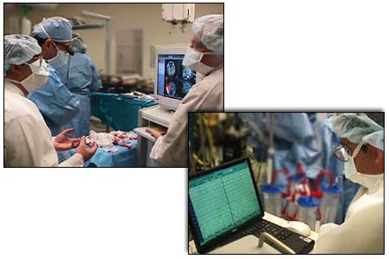
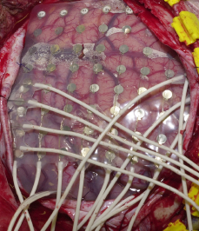
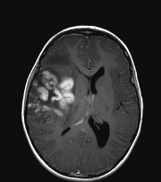
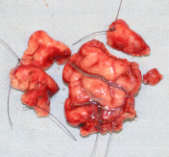
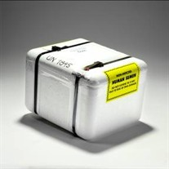
Obtención del tejido cerebral

Slide 11
CB1
CB2
Activación de Gi/o por Agonistas CB1

Slide 12
Hipocampo
*
CB1
Corteza Temporal
*

Slide 13
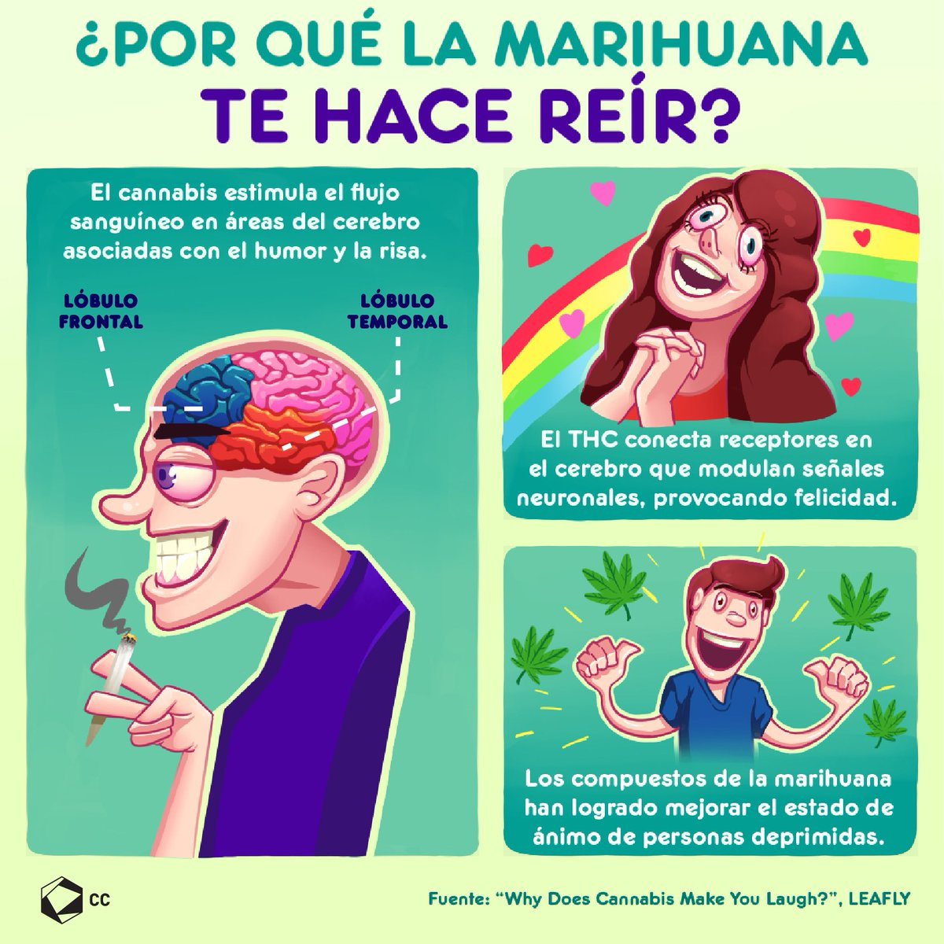

Slide 14


Slide 15
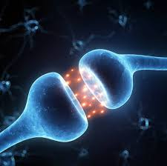
Sistema Endocannabinoide en Pacientes con Depresión y Ansiedad
Patel & Hillard, 2009

Slide 16
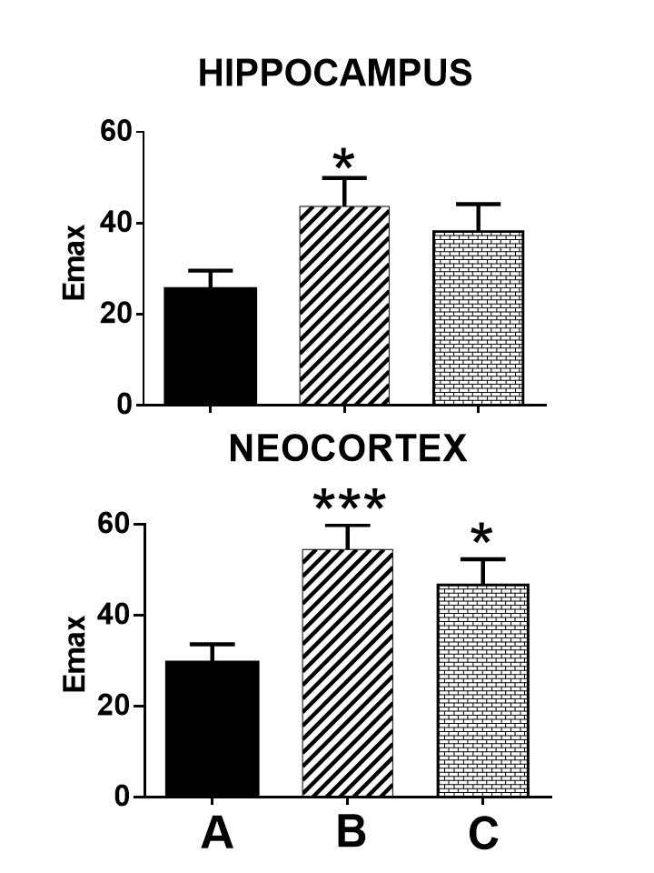
Hipocampo
*
Corteza Temporal
*

Slide 17
Notes:
Although some studies suggest alterations of mu and NOP receptors as a result of epilepsy, no evidence exist indicating changes in signal transduction mechanisms downstream of the mu opioid and NOP receptors in the human epileptic neocortex.

Slide 18

ANSIEDAD Y DEPRESIÓN EN PACIENTES CON ELTM

Slide 19
Anandamida y 2-Araquidonilglicerol
Lu& Mackie, 2016
Notes:
Overview of the localization of endocannabinoid system componentsat the synapse. Schematic of an inhibitory and excitatory terminal
synapsing onto the dendritic shaft of a representative cortical principal neuron. The increased number of CB1
receptors on the CCK/GABA terminal represents the higher density of CB1 receptors found on these axon terminals.
AA, arachidonic acid; ABHD6, alpha/beta domain-containing hydrolase 6; 2-AG, 2-arachidonoyl glycerol;
ATP, adenosine triphosphate; CB1, CB1 cannabinoid receptor; CCK, cholecystokinin; COX-2, cyclooxygenase-
2; DAG, diacylglycerol; DAGLα, diacylglycerol lipase α; GABA, γ-aminobutyric acid; M1, M1 muscarinic receptor; MAGL, monoacylglycerol
lipase; mGluR5, metabotropic glutamate receptor 5; FAAH, fatty acid
aminohydrolase; NAPE-PLD, N-arachidonoy phosphatidyl ethanolamine-
preferring phospholipase D; PGE2-GE, prostaglandin E2 glicerol ester; PIP2, phosphatidyl inositol bisphosphate;
PLCβ, phospholipase C β.

Slide 20
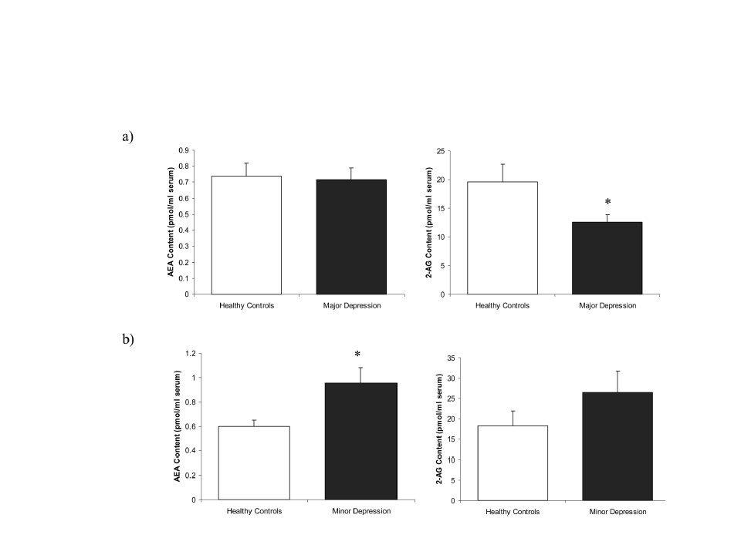
Depresión y Endocannabinoides
Hill et al., 2008
Notes:
Nivel sérico de endocannabinoides en mujeres con depresión mayor y menor

Slide 21
Lu& Mackie, 2016
Notes:
Overview of the localization of endocannabinoid system componentsat the synapse. Schematic of an inhibitory and excitatory terminal
synapsing onto the dendritic shaft of a representative cortical principal neuron. The increased number of CB1
receptors on the CCK/GABA terminal represents the higher density of CB1 receptors found on these axon terminals.
AA, arachidonic acid; ABHD6, alpha/beta domain-containing hydrolase 6; 2-AG, 2-arachidonoyl glycerol;
ATP, adenosine triphosphate; CB1, CB1 cannabinoid receptor; CCK, cholecystokinin; COX-2, cyclooxygenase-
2; DAG, diacylglycerol; DAGLα, diacylglycerol lipase α; GABA, γ-aminobutyric acid; M1, M1 muscarinic receptor; MAGL, monoacylglycerol
lipase; mGluR5, metabotropic glutamate receptor 5; FAAH, fatty acid
aminohydrolase; NAPE-PLD, N-arachidonoy phosphatidyl ethanolamine-
preferring phospholipase D; PGE2-GE, prostaglandin E2 glicerol ester; PIP2, phosphatidyl inositol bisphosphate;
PLCβ, phospholipase C β.

Slide 22
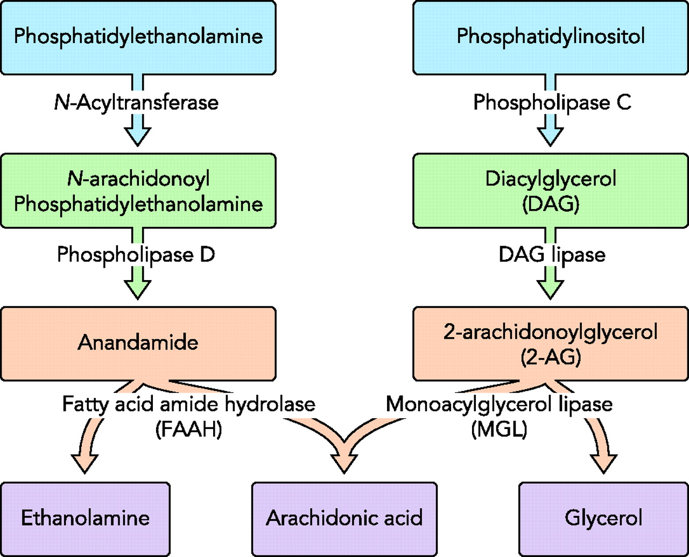
Neuroprotección

Slide 23
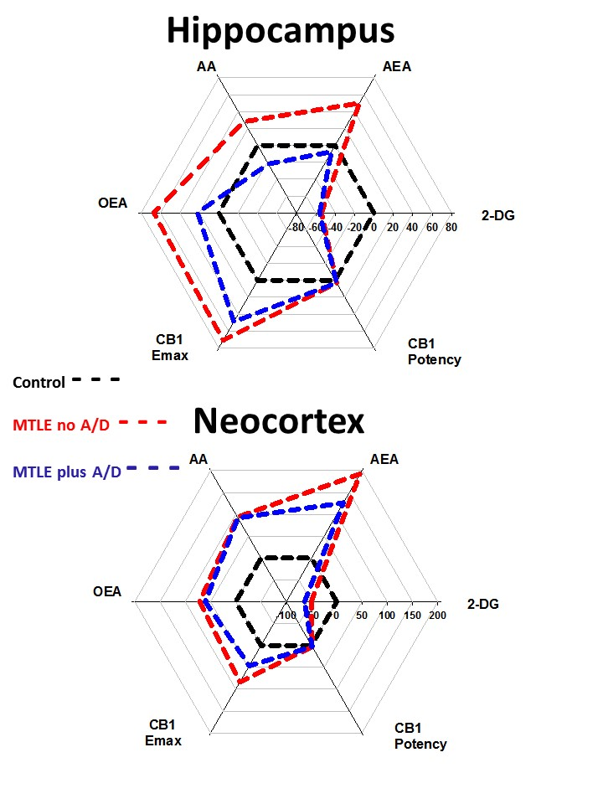
2-AG
2-AG
OEA (Oleiletanolamida)
Notes:
2-araquinodilglicerol
oleiletanolamida (OEA

Slide 24
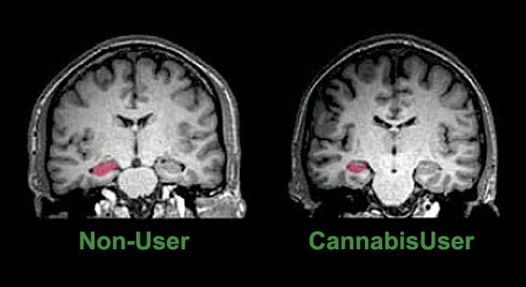


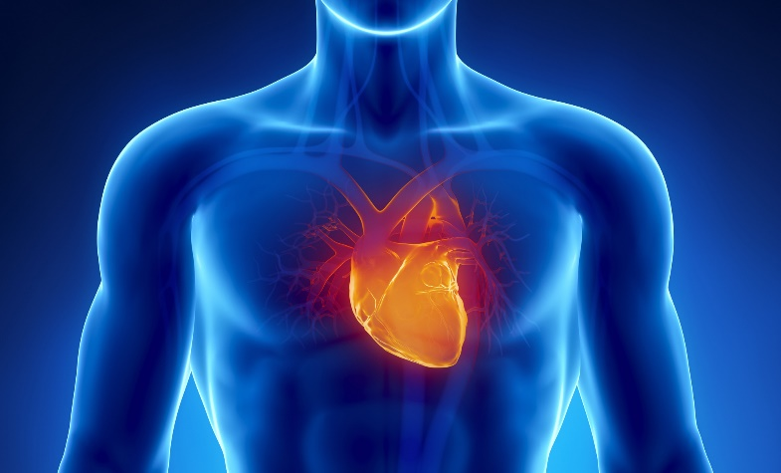

Notes:
Efectos secundarios del Cannabis:
Deficiencias en el aprendizaje y funciones cognitivas, alteraciones cardiovasculares, alucinaciones temporarias
paranoia temporaria
intensificación de los síntomas en los pacientes de esquizofrenia, un trastorno mental grave con síntomas como alucinaciones, paranoia y pensamiento desorganizado.

Slide 25
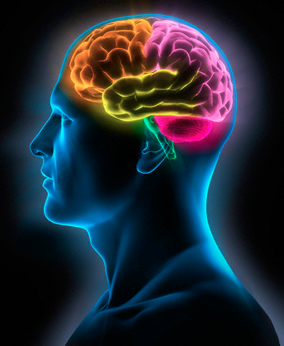
DEPT. FARMACOBIOLOGIA
CINVESTAV. MEXICO
Dra. Luisa Rocha
Q.F.B. Francia Carmona
INSTITUTO NACIONAL DE NEUROLOGIA Y NEUROCIRUGIA “Manuel Velasco Suárez”
Dr. Mario Alonso Vanegas
Dra. Iris Martínez
INSTITUTO MEXICANO DEL SEGURO SOCIAL
Dra. Sandra Orozco-Suárez
HOSPITAL GENERAL DE MEXICO
Dra. Ana Luisa Velasco
Dr. Francisco Velasco
Dra. Manola Cuéllar
National Institute of Health, USA
Dr. Resat Cinar

