Slide 1
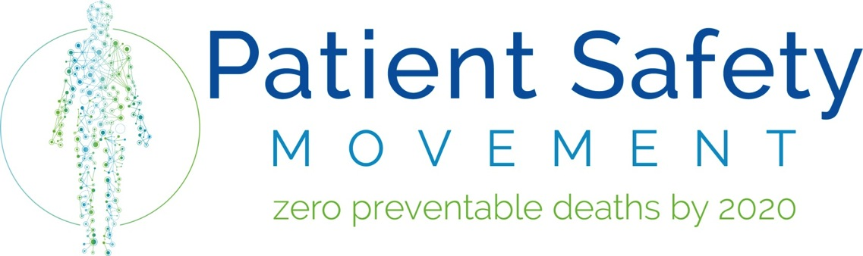
Dr. Javier Dávila Torres.
Regional Network Chair PSMF

Slide 2
The Patient Safety Movement is connecting people, ideas, and technology to confront the large scale problem of more than
200,000 preventable patient deaths in US hospitals each year
3 million preventable patient deaths across the world each year.
Notes:
The objective of the PSMF is to connect all the players in the healthcare delivery echo-system from providers, innovators, patients, and technology to confront the broad challenge of preventing more than 200,000 preventable patient deaths in US hospitals alone each year. Let alone the 3 million around the world.

Slide 3
Medical Errors…
Cause over 200,000 preventable deaths every year;
Are the third-leading cause of death in the US, behind Heart Disease and Cancer;
$0.45 of every dollar in healthcare ($1.26 trillion per year) is spent committing and recovering from medical errors, or is the result of a preventable death.
Notes:
As you know, Medical errors come a great cost to the healthcare system. As the 3rd leading cause of death, costs are estimated at $1.26 trillion per year.

Slide 4
Numbers
The total number of Americans dying prematurely from medical errors was about 400,000 per year *
The epidemic of patients harm in hospitals must be taken more seriously if it is to be curtailed**
*Office of the Inspector General of the Department of Health and Human Services
**Journal of Patient Safety:September 2013-Vol.9-Issue3-p122-128d:10.1097/PTS.0b013e3182948a69.

Slide 5
Our mission is
ZERO Preventable Patient Deaths
by 2020
Notes:
This mission of the PSMF is to eliminate Preventable Patient Deaths by 2020. It’s a bold and audacious goal, but the only acceptable goal and one we are passionate about.

Slide 6
A Fresh Approach to an
Old Problem
Convene thought-leaders from the patient, hospital, and medical technology communities.
Inspire stakeholders to focus on real-world problems that can be solved today.
Collaborate and devise prescriptive plans to solving safety problems.
Demonstrate leadership through commitments to action.
Notes:
The PSMF wanted to take a new approach to fostering and building patient safety programs through a Commitment program. Through the Coommitment process healthcare providers, systems or collaborative groups post harm reduction goals based on initiatives they are working on. As they post their improvement, they also share a little about the key interventions that are driving improvement. Creating a non-threatening public forum to share and celebrate their success as well as their solutions.
The goal is not necessary to come with something new but share with the broader healthcare community your success and strategies to accelerate progress as others learn from you and don’t need to struggle with reinventing the wheel.
Additionally, committed organizations join workgroups that develop Actionable Patient Safety Solutions (APSS as we call them) or prescriptive evidence-based plans on how to solve specific safety problems such as HAIs, Critical Congenital Heart Defects, etc.
Instead of talking about it, organizations demonstrate their leadership by publicly committing to act and post their harm reduction goals.

Slide 7
Who Can Take Action?
Hospitals & Hospital Systems
  Make a Commitment
Healthcare Technology Companies
  Sign the Pledge
Patient & Family Advocates
  Share their Story
Notes:
Healthcare partners are engaging in this work by doing the following:
Speak to slide
Many programs look at the relative avoidance of harm we need them to demonstrate the number of lives saved so that we can demonstrate to regulators and policy makers that these programs should become mandates.

Slide 8
Hospital & Hospital System Commitments
By implementing Actionable Patient Safety Solutions (APSS) developed collaboratively by workgroups and the PSMF board.
By implementing well documented and innovative new patient safety action plans developed by the institution.
By introducing innovative metrics to existing patient safety programs to better measure the number of lives saved.
Notes:
Review slide content
Many programs look at the relative avoidance of harm we need them to demonstrate the number of lives saved so that we can demonstrate to regulators and policy makers that these programs should become mandates.

Slide 9

Actionable Patient Solutions (APSS)
1. Culture of Safety
2. Healthcare-associated Infections (HAIs)
4. Failure to Rescue: Monitoring for Opioid Induced Respiratory Depression
3. Medication Errors
5. Anemia and Transfusions
6. Hand-off Communications
7. Neonatal Safety
8. Airway Safety
9. Early Detection & Treatment of Sepsis
10. Optimal Resuscitation
11. Optimizing Obstetric Safety
12. Venous Thromboembolism
13. Mental Health: Access to Acute Psychiatric Beds
15. Nasogastric Feeding and Drainage Tube Placement & Verification
16. Person and Family Engagement
14. Falls and Fall Prevention
Notes:
Review slide content
Many programs look at the relative avoidance of harm we need them to demonstrate the number of lives saved so that we can demonstrate to regulators and policy makers that these programs should become mandates.

Slide 10
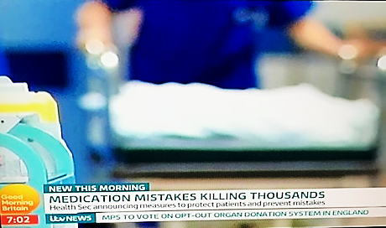

Slide 11
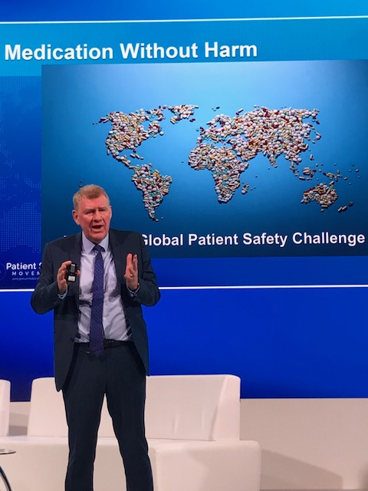

Slide 12


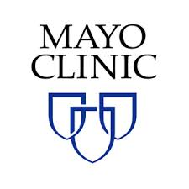



















Select Hospital Commitments
Notes:
Here are just a few of the 3500 hospitals around the world that have made a commitment; These hospitals have reported to save over 70k lives through their commitments.

Slide 13
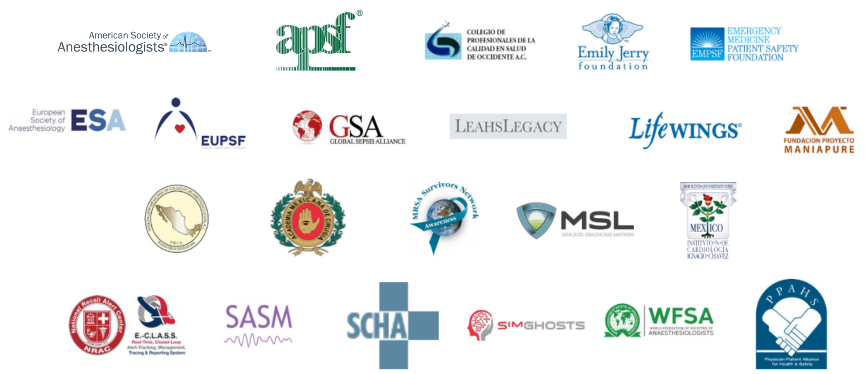
Select Committed Partners

Slide 14



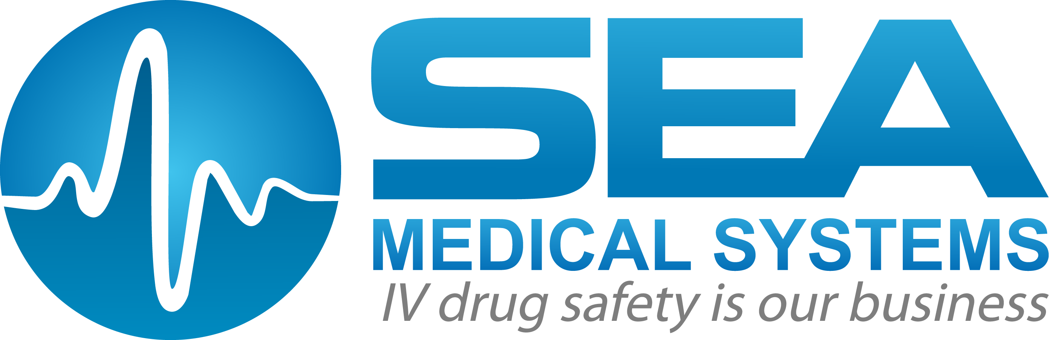



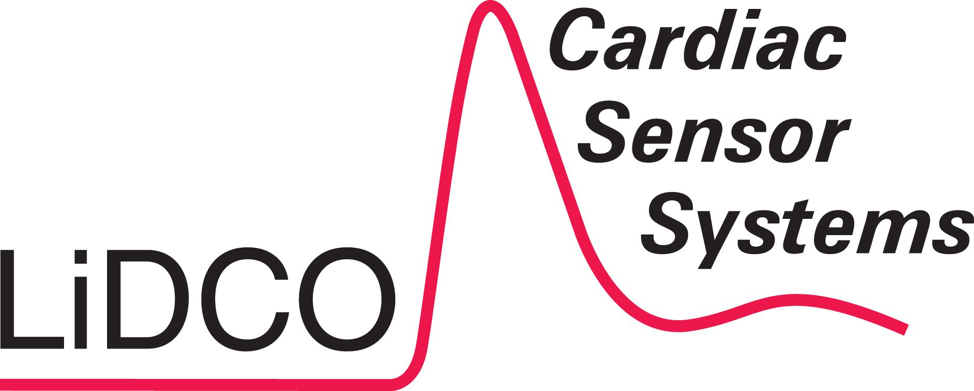















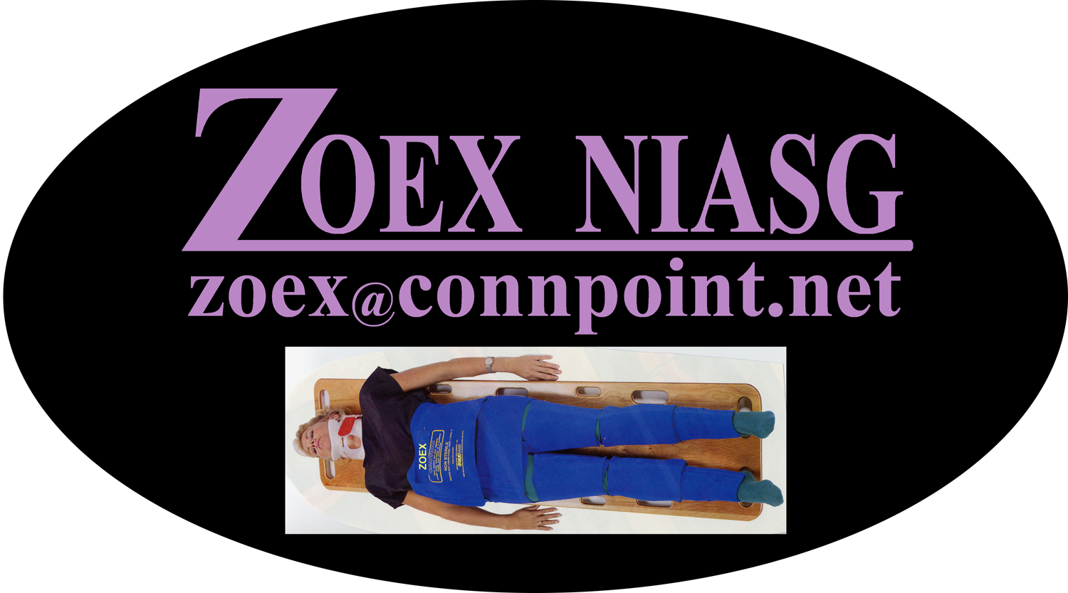


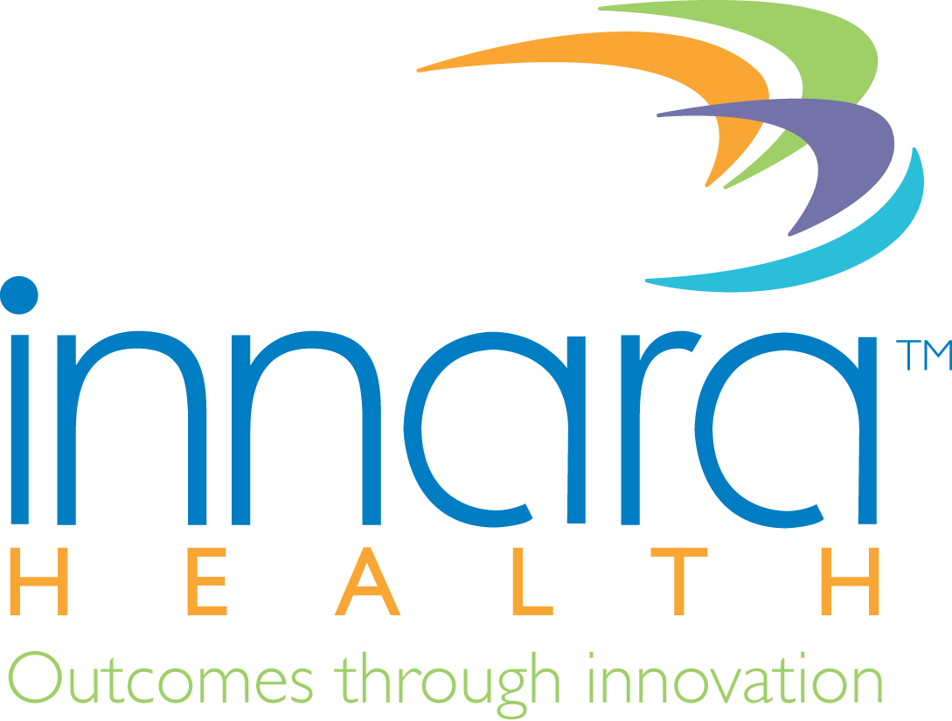


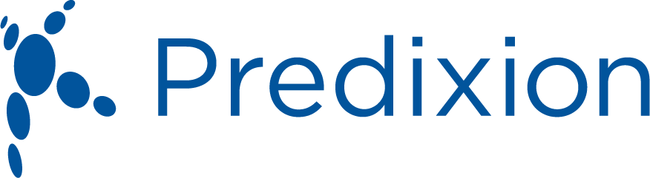
Select Healthcare Technology Companies Committed to 0X2020
IBM Watson Health
Notes:
Here are some of the Healthcare Tech companies that have made the Open data pledge

Slide 15
2013 Results
51
Hospitals and Healthcare Systems
Committed to implement safety solutions to help save lives
9
Medical Technology Companies
Pledged to freely share data from their devices or systems
63
Patient Lives Saved, Annually

Slide 16
6th Annual World Patient Safety, Science & Technology Summit
•4,598 Hospitals
•49 countries across all groups who have joined our Movement
•83 Open Data Pledges
•47 Committed Partners
•Total Lives Saved: 81,533 lives saved
• US: 25,095
• OUS: 56,438

Slide 17
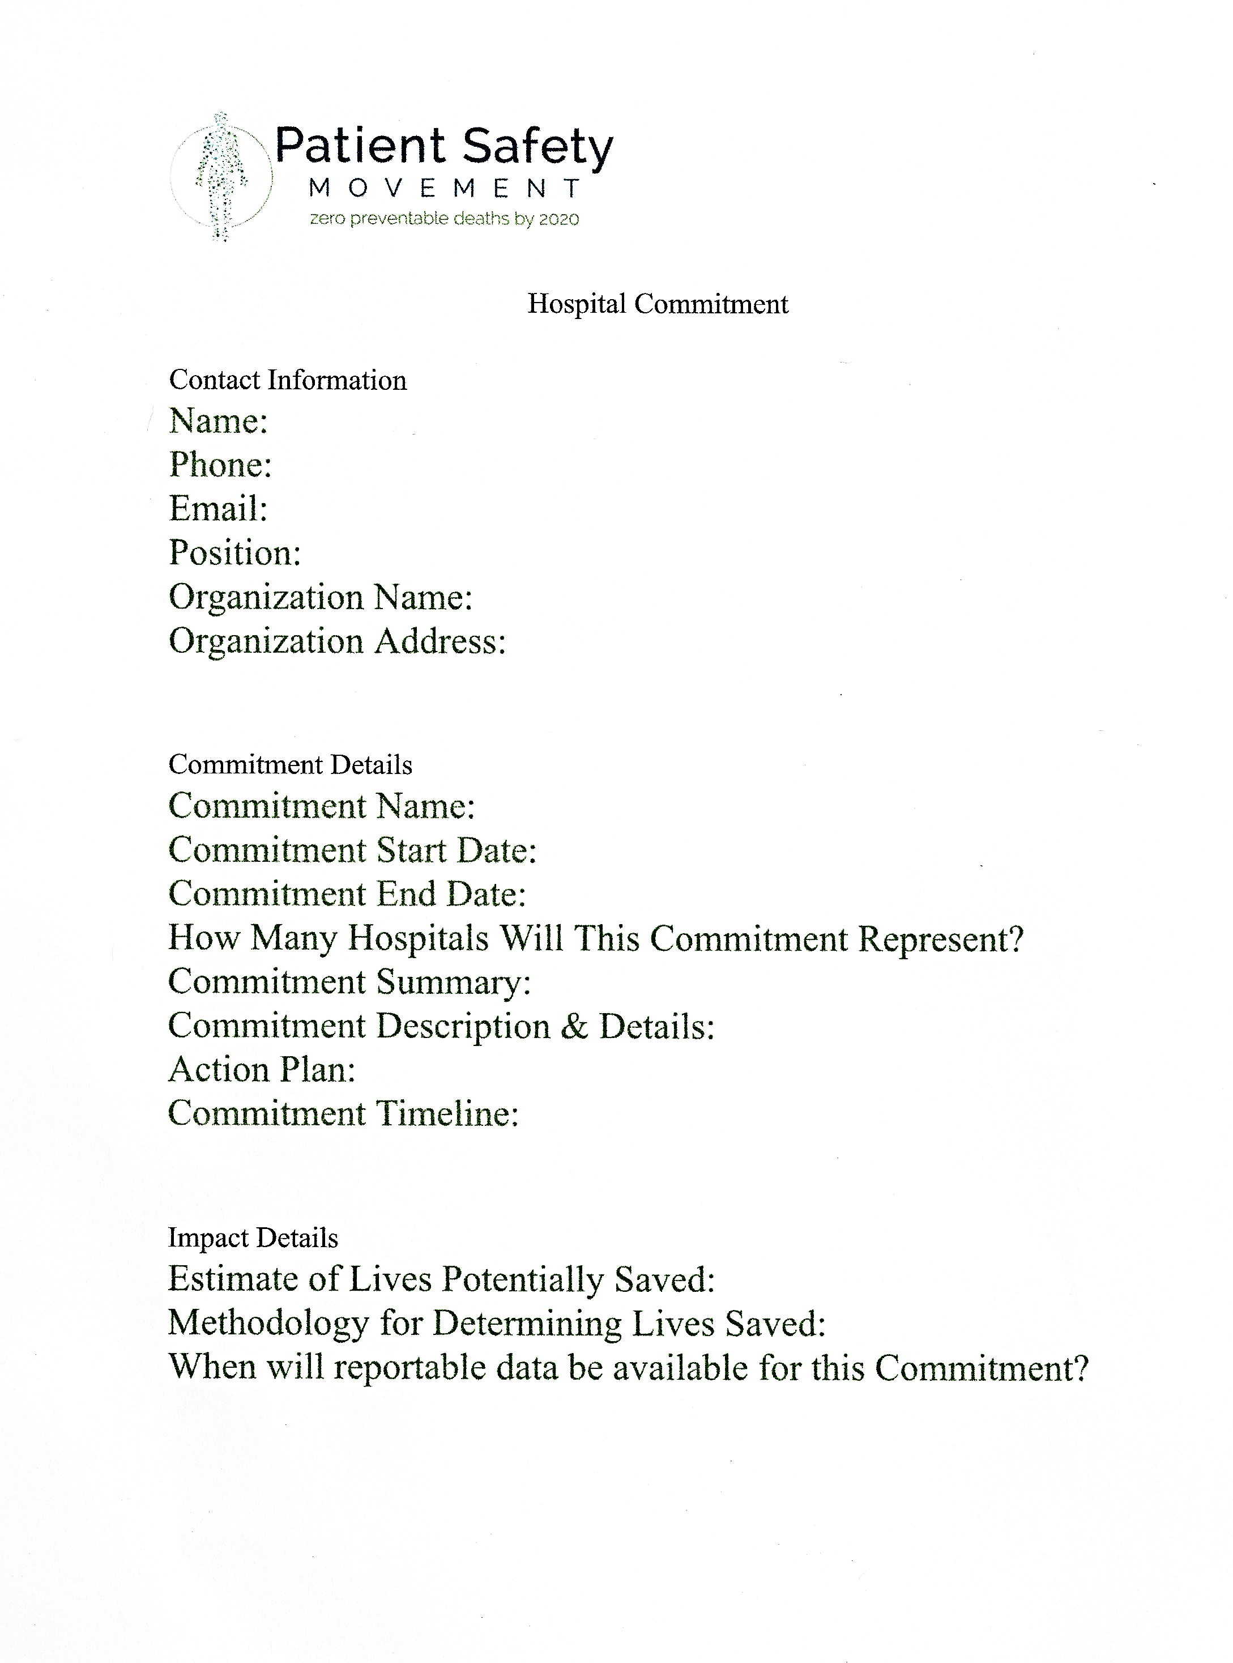

Slide 18
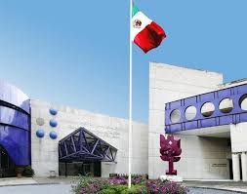

Slide 19
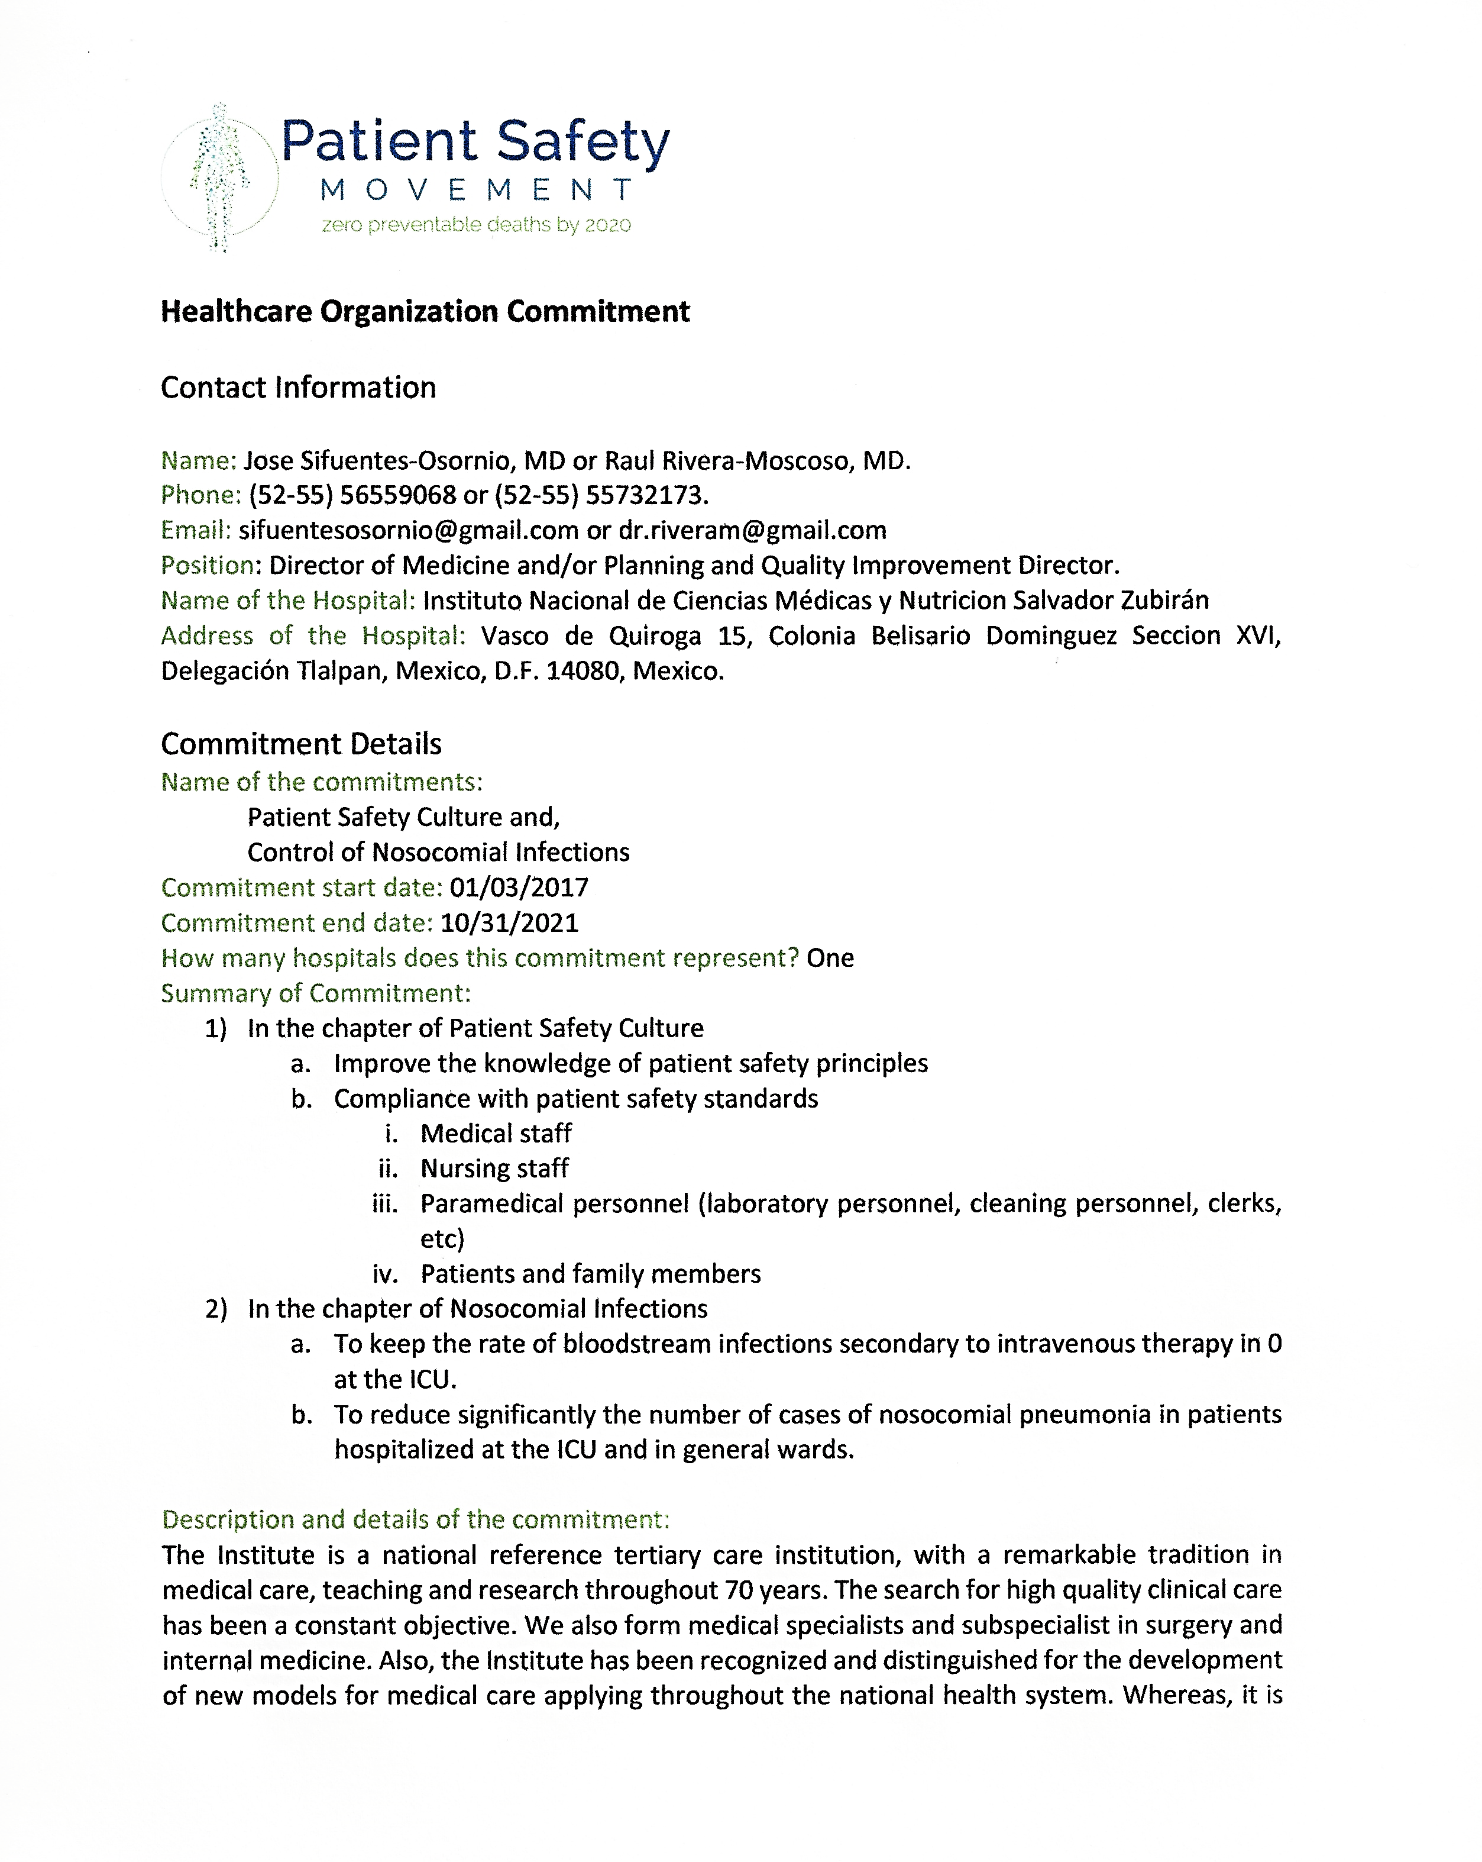

Slide 20
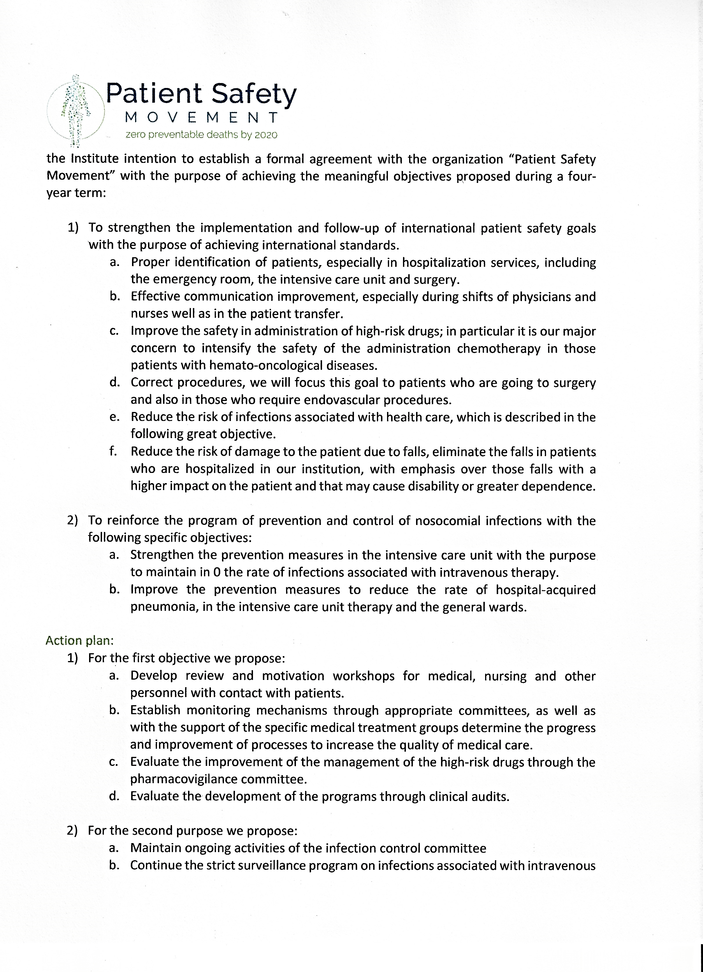

Slide 21
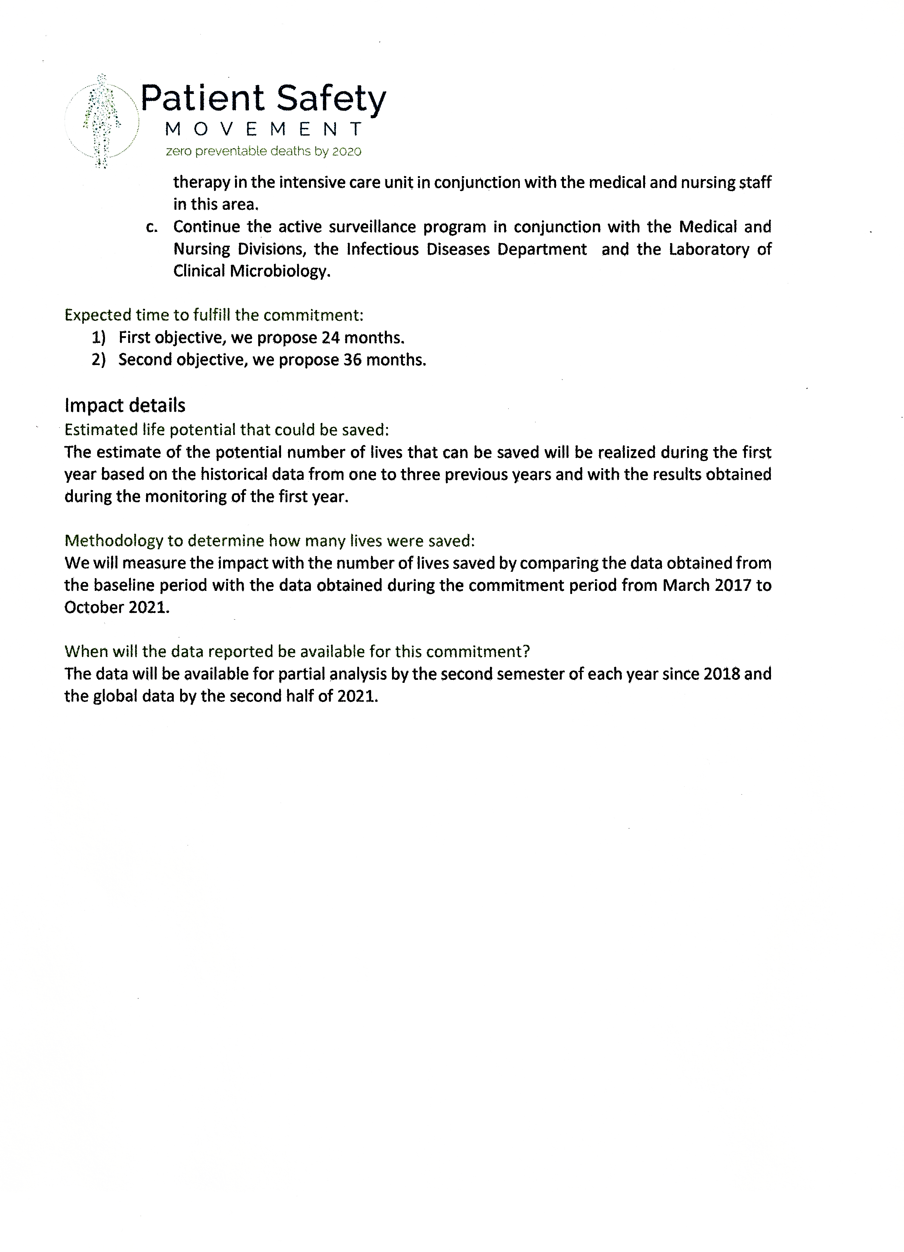

Slide 22

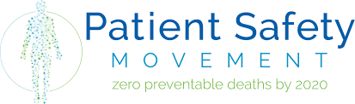
Experiencia del Hospital Español de México en la Implementación de los Compromisos del Patient Safety Movement (PSM)

Slide 23

Compromisos realizados con el
Patient Safety Movement
APSS 1 Desarrollo de un Sistema de Notificación y Análisis de Eventos Adversos asociados con la atención médica.
APSS 14 Prevención del riesgo de caídas en pacientes hospitalizados.
APSS 16 Prevención de tromboembolismo venoso en pacientes hospitalizados.
APSS 6 Mejora en la Comunicación efectiva.

Slide 24
Compromisos en espera de aprobación por parte del Patient Safety Movement
APSS 2 Infecciones asociadas a la asistencia sanitaria
- Infecciones de tracto urinario asociadas
con catéter
- Higiene de Manos
- Infecciones de sitio quirúrgico
- Neumonía asociada a ventilador
- Infecciones asociadas a catéter venoso
central
APSS 4 Depresión respiratoria inducida por opioides
APSS 8 Seguridad de vías respiratorias
APSS 10 Prevención y reanimación de paro cardiorespiratorio

Slide 25
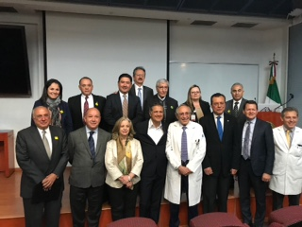

Slide 26
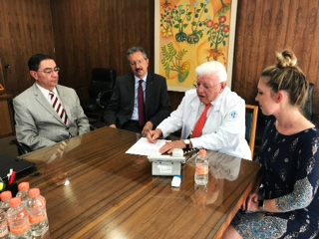

Slide 27
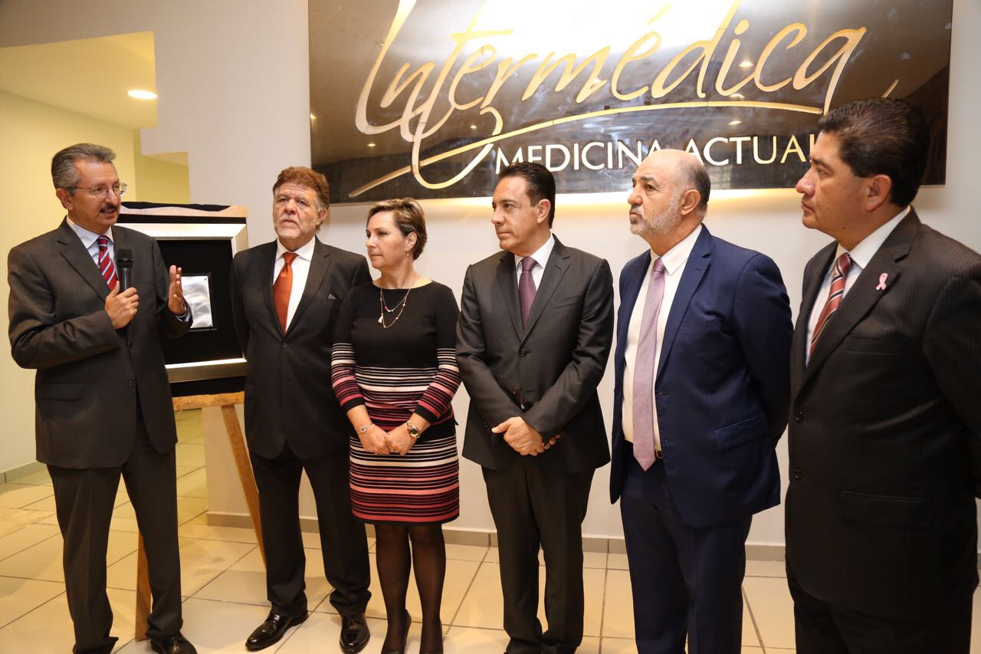

Slide 28
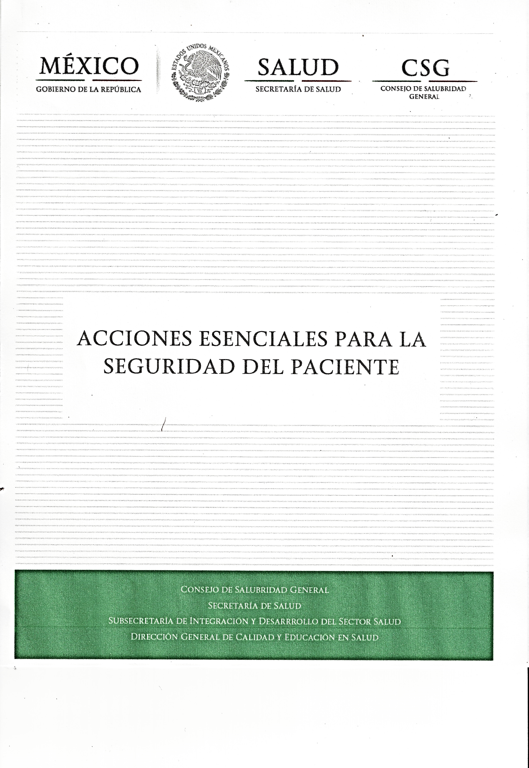

Slide 29
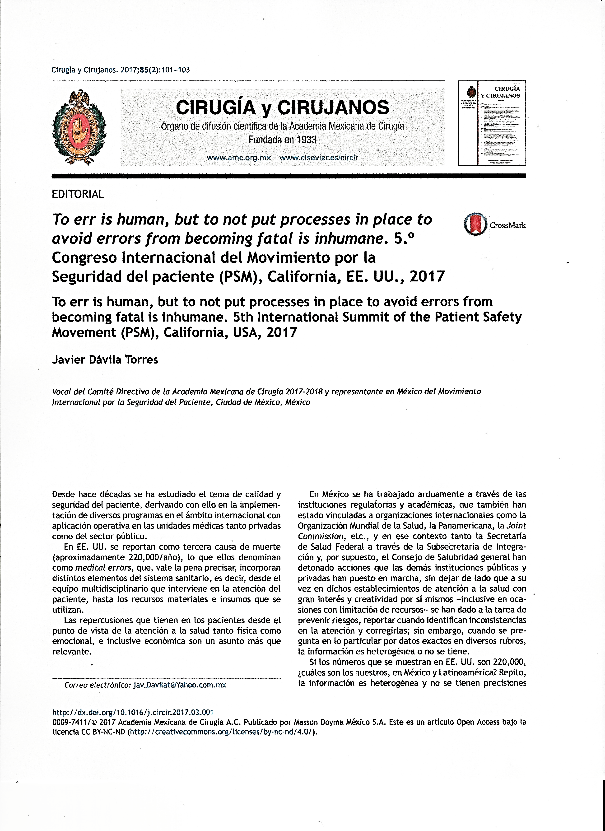

Slide 30
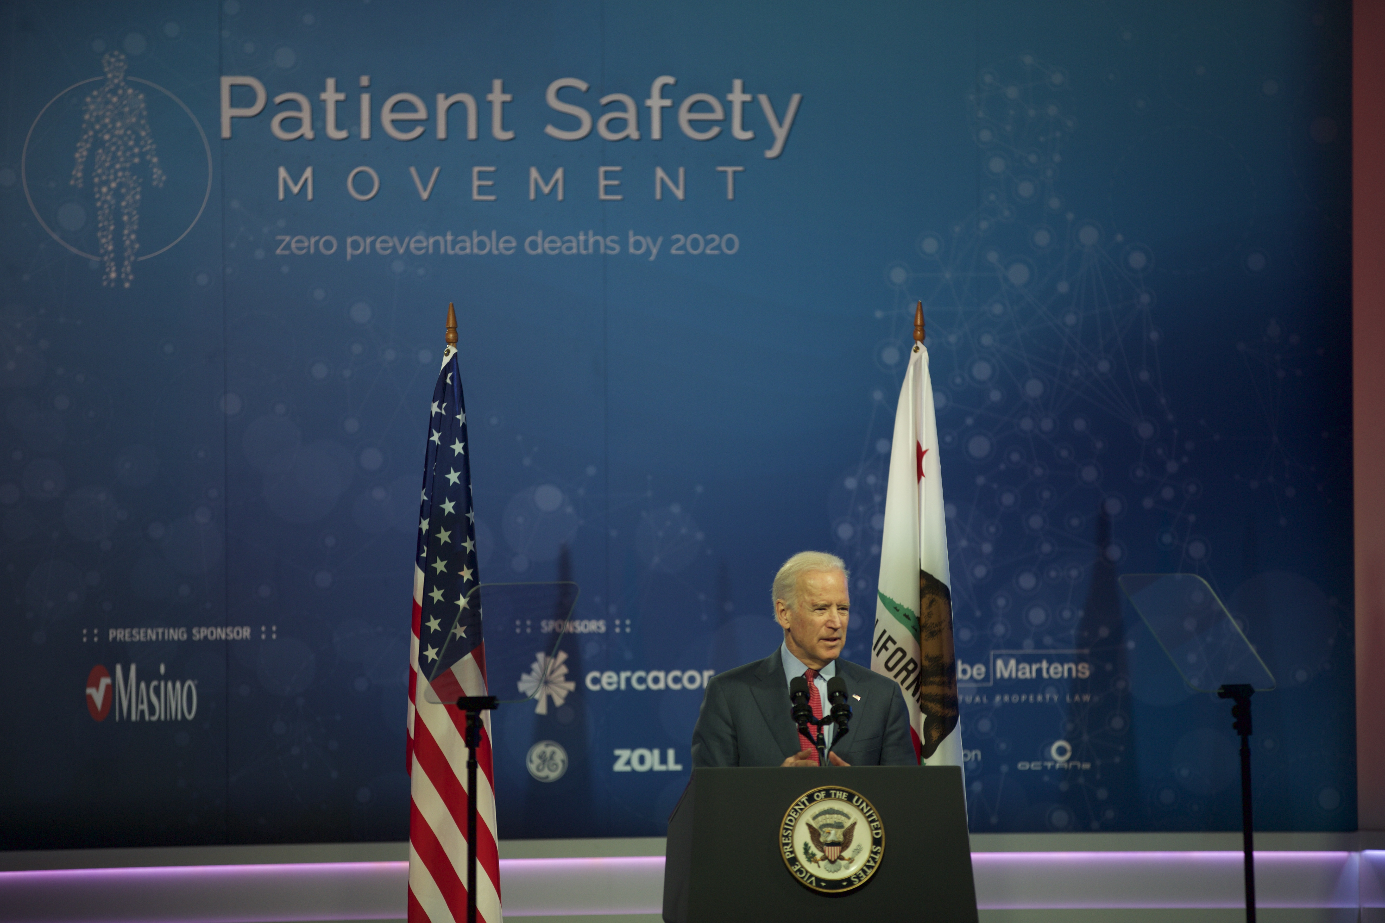
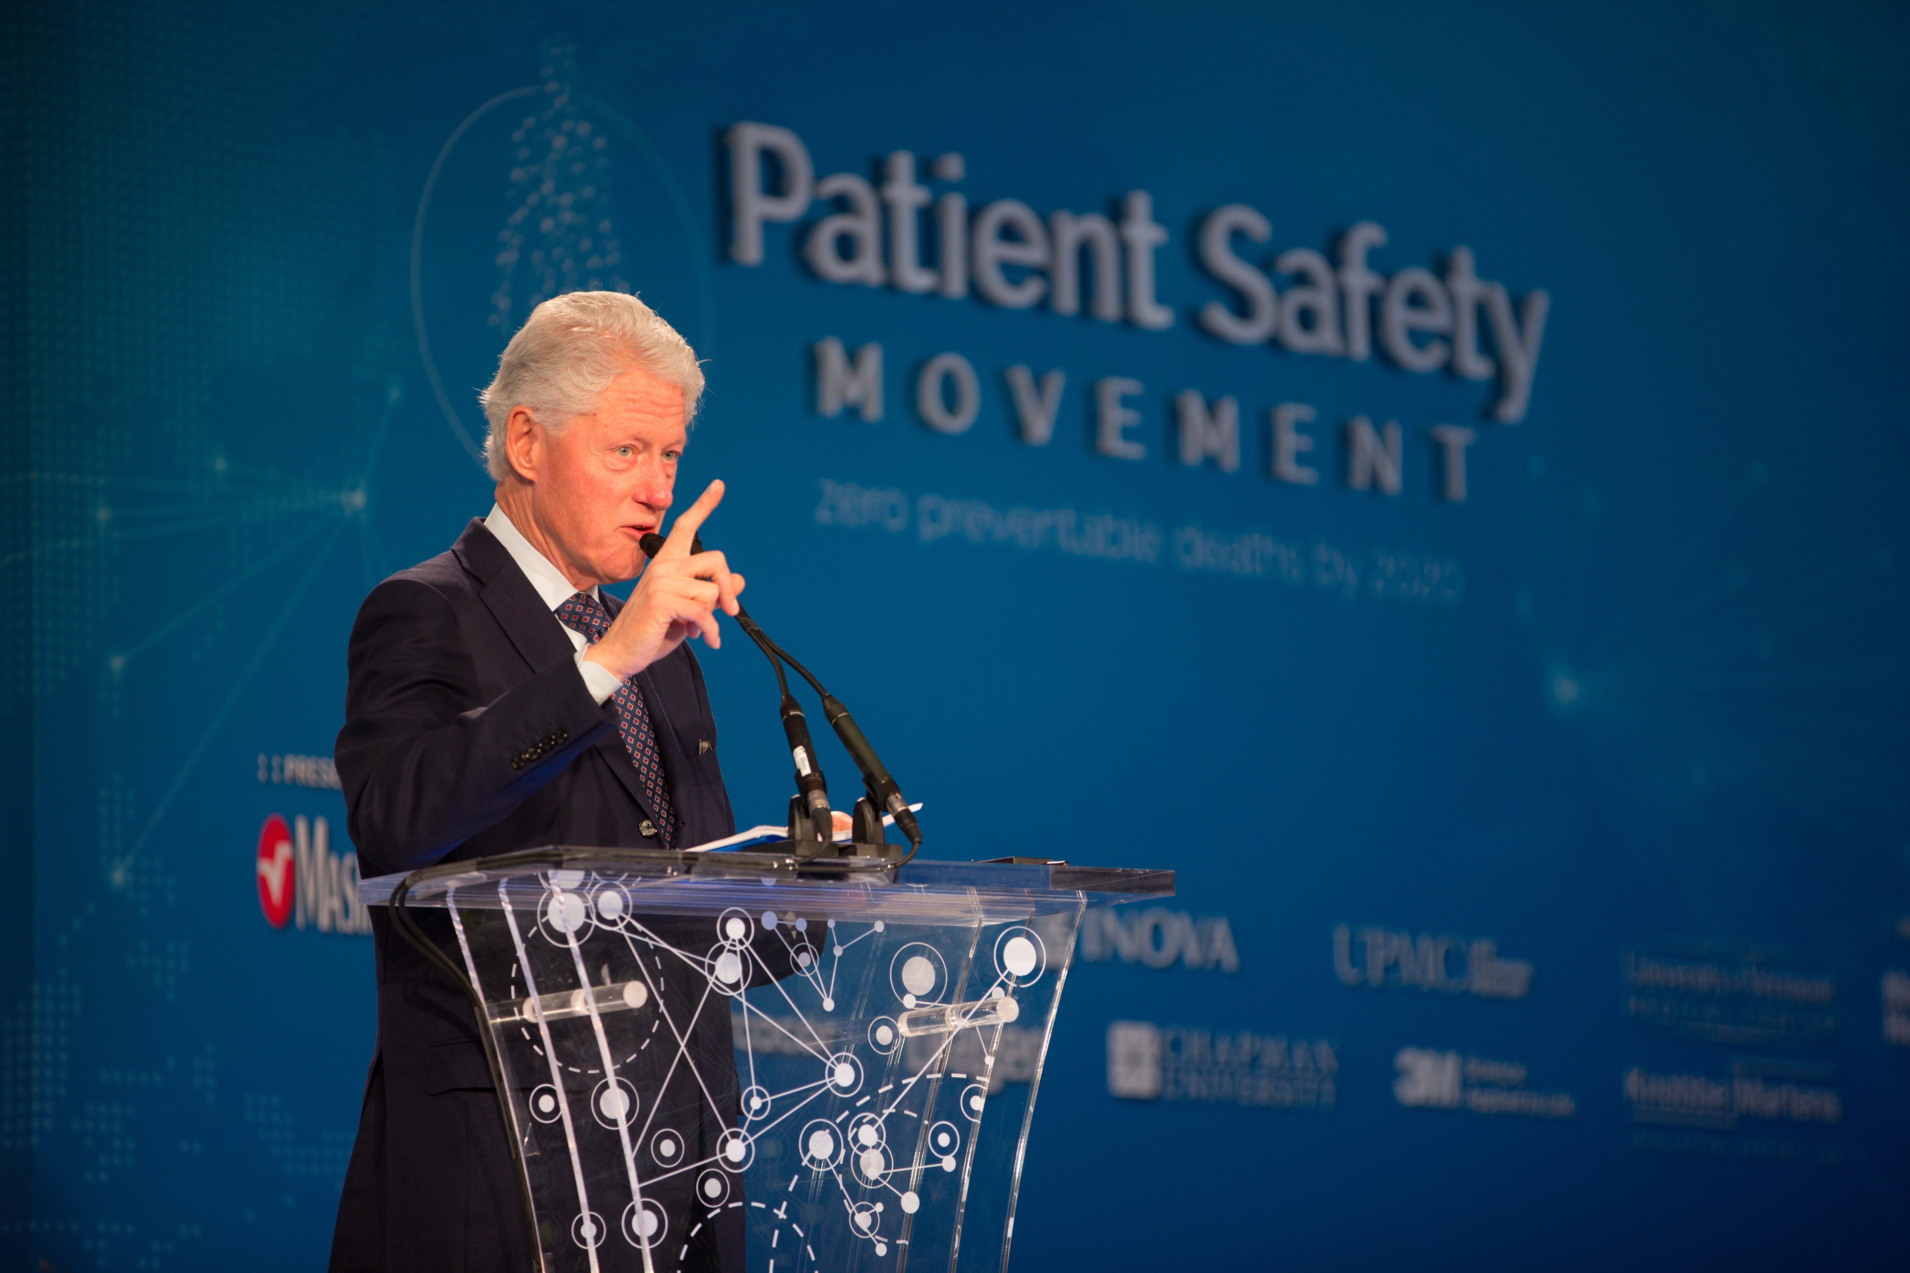
World Patient Safety, Science & Technology Summit
Vice President Joe Biden
Keynote Speaker
“You will move the earth if you keep these numbers going.”
Former President Bill Clinton
Keynote Speaker

Slide 31


Slide 32
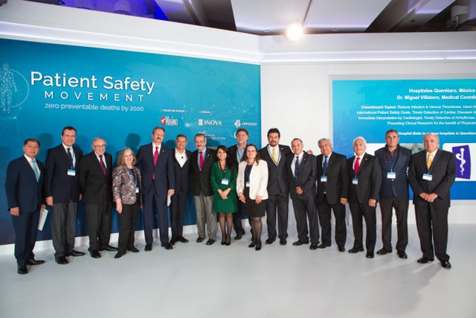

Slide 33


Slide 34
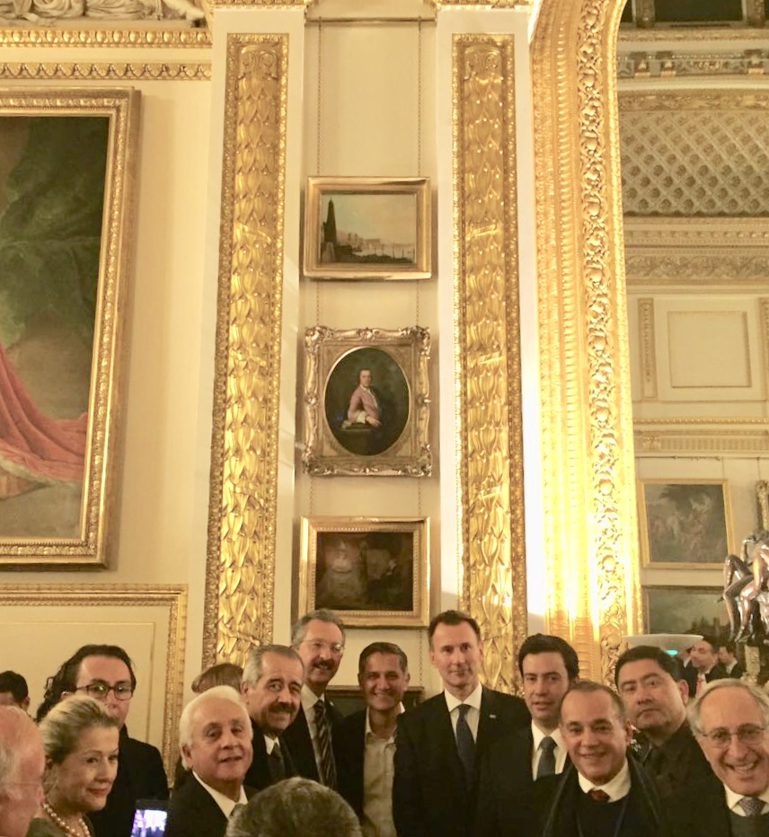
6th Summit. London 2018
J. Kiani, J. Hunt (Minister of Health), Mexican Delegation

Slide 35
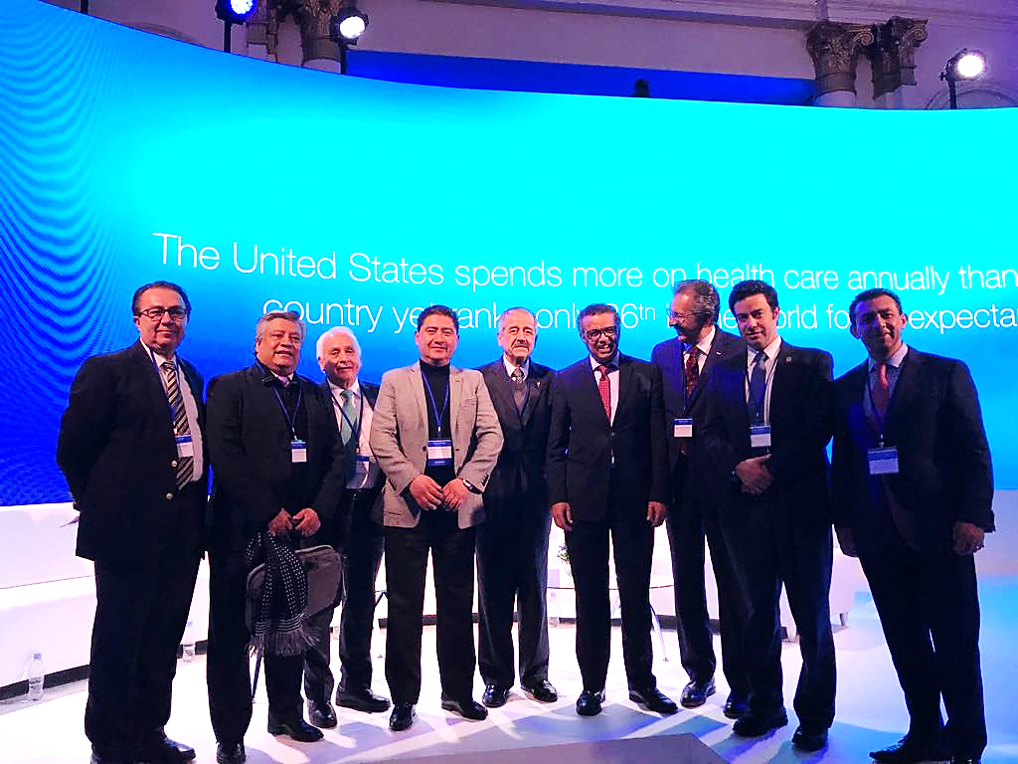
General Director World Health Org.

Slide 36
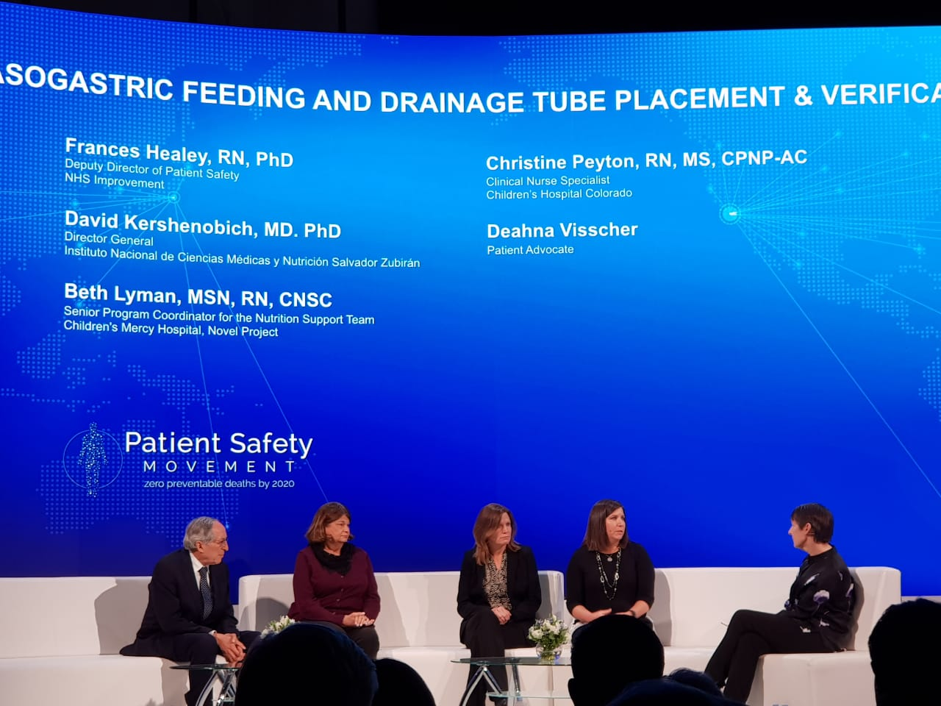

Slide 37
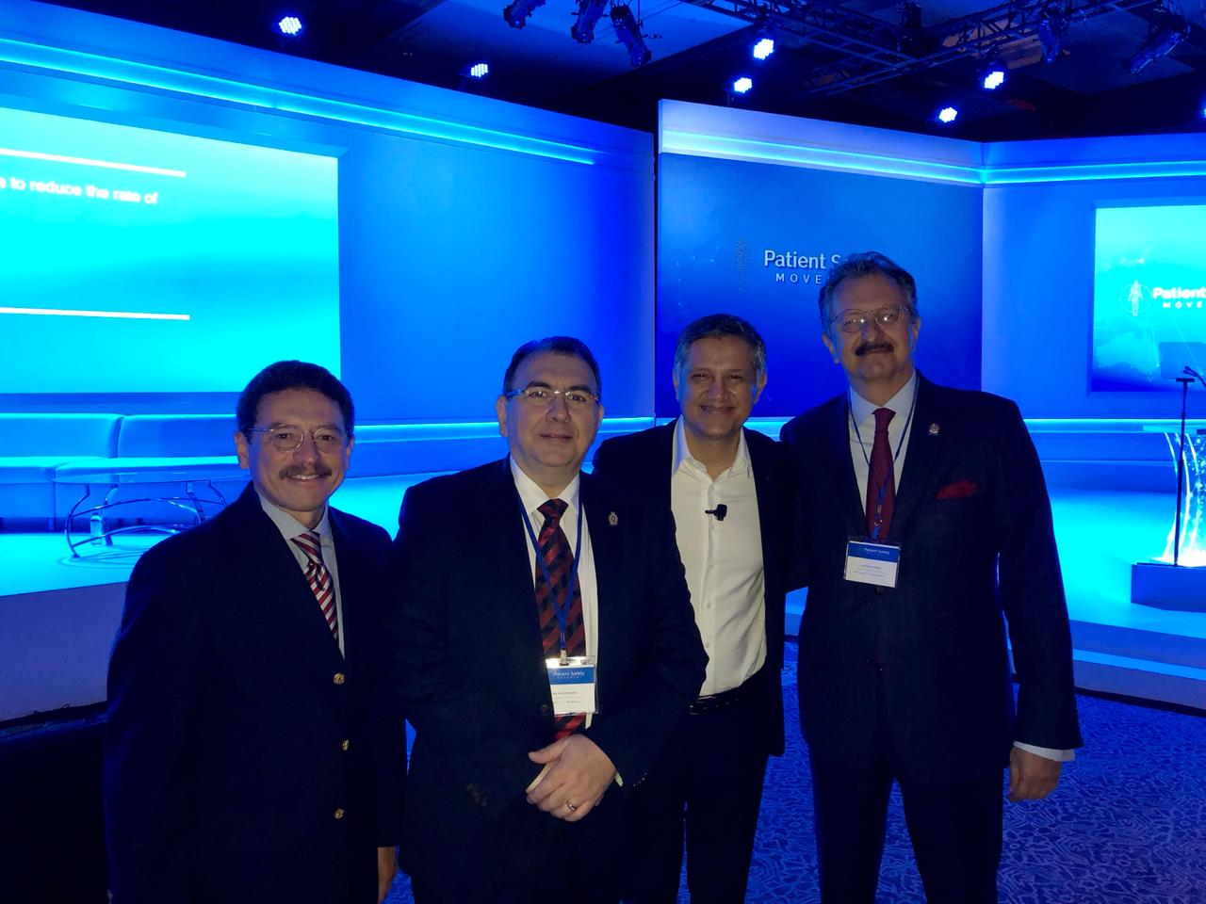
7th Summit. California, EEUU 2019
[J. Kiani, J.M. Abdo (Presidente de la AMC), R. Anaya (DG Certificación de Hospitales CSG)]

Slide 38
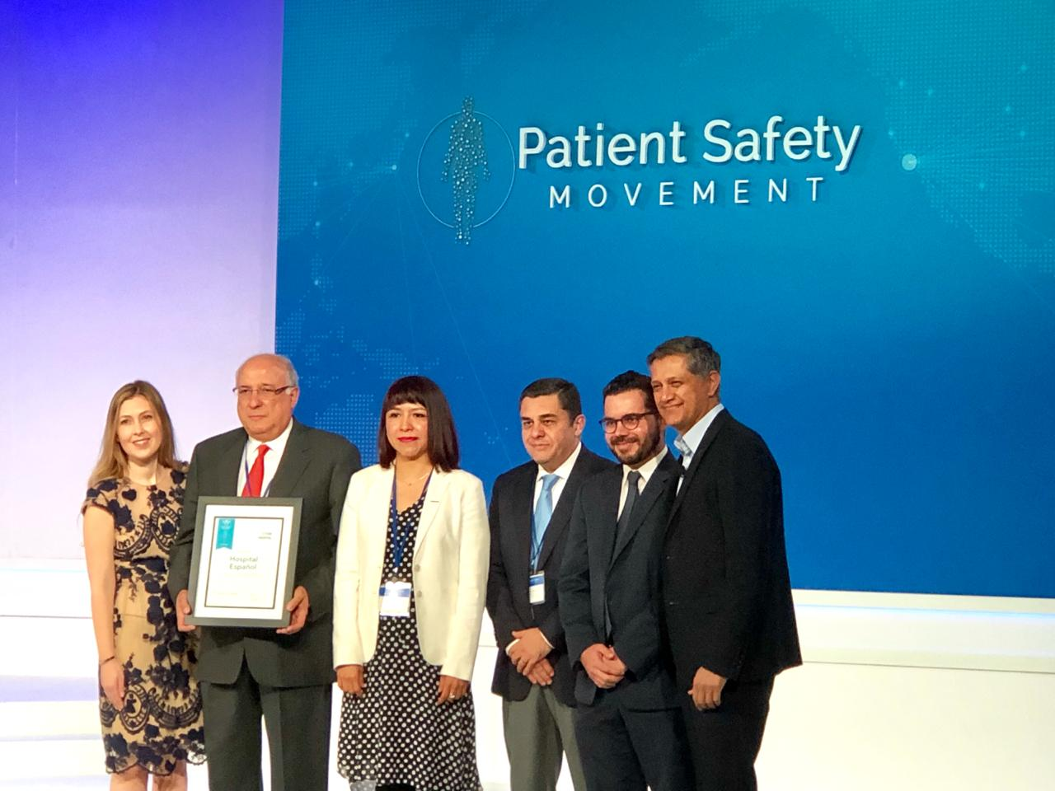
Reconocimiento al Hospital Español de México por afiliación en las 16 APSS. Primer Hospital fuera de EEUU en lograrlo.

Slide 39
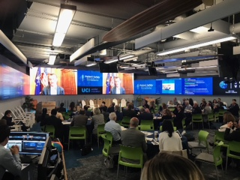

Slide 40
Midyear Planning Meeting
Sept. 2018
DELIRIUM
2.6 million
Estimated number of patients affected by delirium in the U.S.
30 to 40
Percent of delirium estimated to be preventable.
$164 billion
U.S. health care costs attributed to delirium per year in the U.S.
2.6 million
Estimated U.S. health care cost saving by preventing delirium.
2017 AMERICAN SOCIETY OF ANESTHESIOLOGISTS. BRAIN HEALTH INITIATIVE

Slide 41
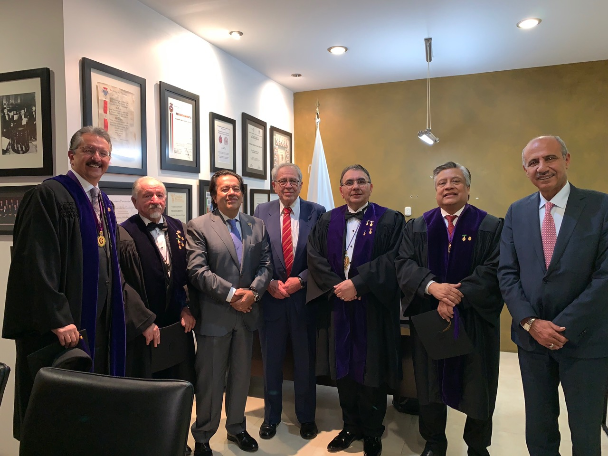
Srio. de Salud, Dr. Jorge Alcocer, en la AMC.

Slide 42
