Slide 1


Alfa-sinucleína y neuroinflamación en la enfermedad de Parkinson
Instituto Nacional de Neurología y Neurocirugía

Slide 2
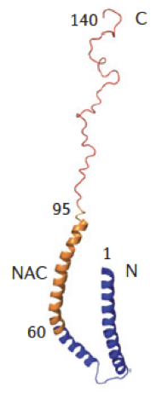
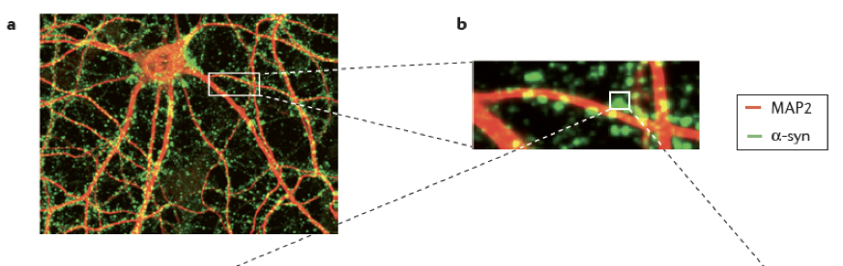
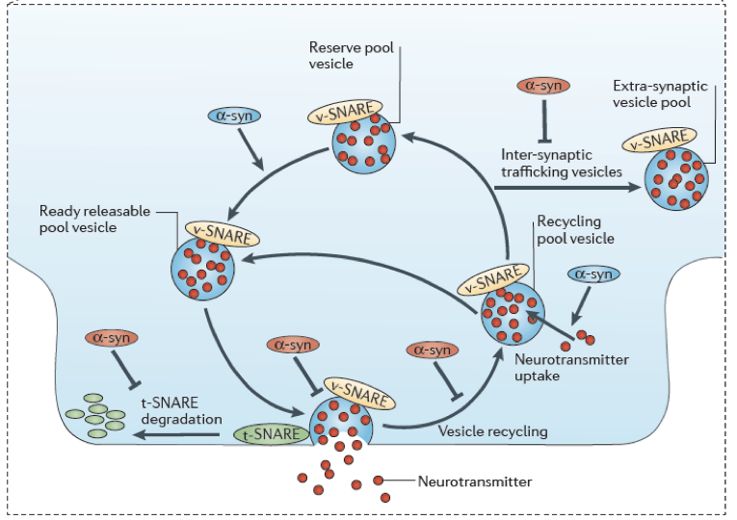
Estructura
SNCA 4q22.1
Proteína citosólica.
Peso: 14 kDa.
Longitud: 140 aminoácidos.
Composición:
  N terminal anfipático rico en lisina. (Modula la interacción con membranas y la conformación).
  Centro hidrofóbico, NAC (Non-amyloid-β component de las placas de amiloide en la EA). (Crucial para la agregación).
  C terminal ácido. (Interacción con metales, moelculas pequeñas y proteínas).
Localización en las terminales pre-sinápticas.
Asociación con el “pool” distal de reserva de vesículas sinápticas.
Notes:
α‐syn is the product of SNCA, a gene located at position 21 in the long arm of chromosome 4. As mentioned before, α‐syn is a small protein (140 amino acids) abundantly expressed in neurons and its primary amino acid sequence can be divided into three major domains: (i) the N‐terminal domain (1–60), which contains a multi‐repeated consensus sequence (KTKEGV) and has alpha‐helical propensity; (ii) the central domain (61–95), known as the non‐amyloid‐beta component (NAC), which is highly hydrophobic and is involved in α‐syn aggregation when acquiring beta‐sheet structure; and (iii) the C‐terminal domain (96–140), enriched in negative charged and proline residues, providing flexibility to the polypeptide

Slide 3
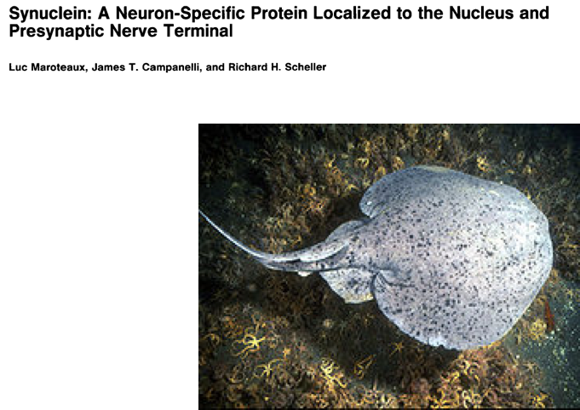
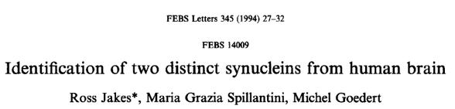
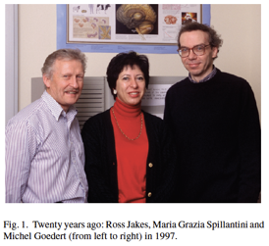
Alfa-Sinucleína es una proteína pequeña intracelular identificada inicialmente por Maroteaux in 1988 obteniendo su nombre de ‘syn’ por sinapsis y ‘nuclein’ por núcleo.
En 1997 fue identificada como el principal componente de los cuerpos y neuritas de Lewy (Spillantini et al. 1997),
Sinucleína de 140 aa. “Perfectina” Alfa.
Sinucleína de 134 aa. “Imperfectina”. Beta.

Slide 4
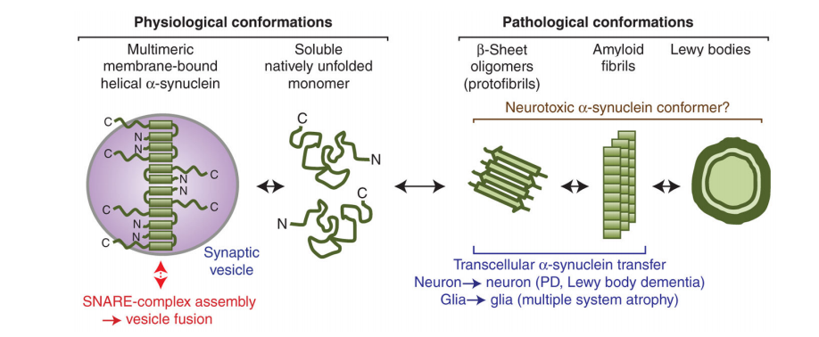
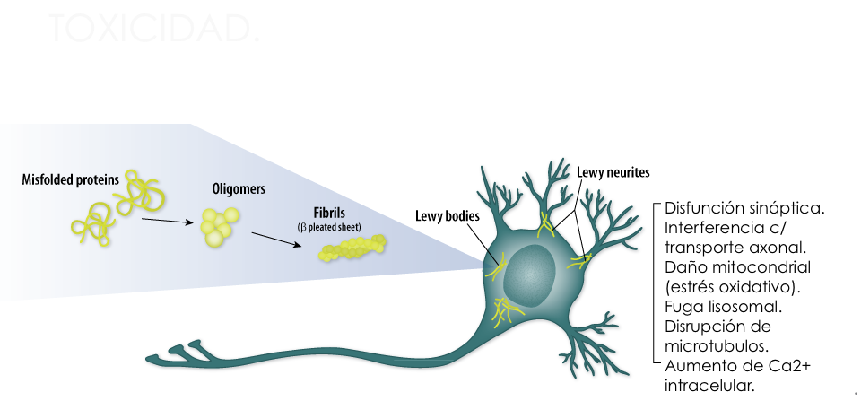
Notes:
Multiple studies have highlighted an association between sustained inflammation and a number
of neurodegenerative diseases including Alzheimer’s disease (AD), Parkinson’s disease (PD),
amyotropic lateral sclerosis (ALS), and frontal temporal dementia (FTD)
Pathologically, PD brains are characterized by progressive degeneration of dopaminergic neurons in the substantia nigra (SN) pars compacta and Lewy pathology.
Misfolded a-synuclein (a-syn) becomes insoluble and aggregates to form intracellular inclusions within the neuronal cell bodies (Lewy bodies) and processes (Lewy neurites) (7). Lewy pathology is not only
restricted to the central nervous system (CNS) but is also present in the peripheral nervous system (PNS), cardiac plexus, sympathetic ganglia, enteric nervous system (ENS), and other neurons (8).
a-Syn aggregates are hypothesized to progress from the periphery, through the spinal cord, into the midbrain and from there across multiple cortical brain regions, as classified in Heiko Braak’s staging system (8).
Over the past two decades, the pre-synaptic protein alpha-synuclein (a-syn) has been irrefutably tied to the neurodegenerative disorder Parkinson’s disease. First, a genetic link was found to associate a-syn to Parkinson’ disease; the point mutation in SNCA (A53T) was demonstrated to cause autosomal dominant Parkinson’s disease and several other point mutations (A30P, E46K, H50Q, G51D and A53E) have since been shown to cause familial forms of Parkinson’s disease and dementia with Lewy bodies

Slide 5
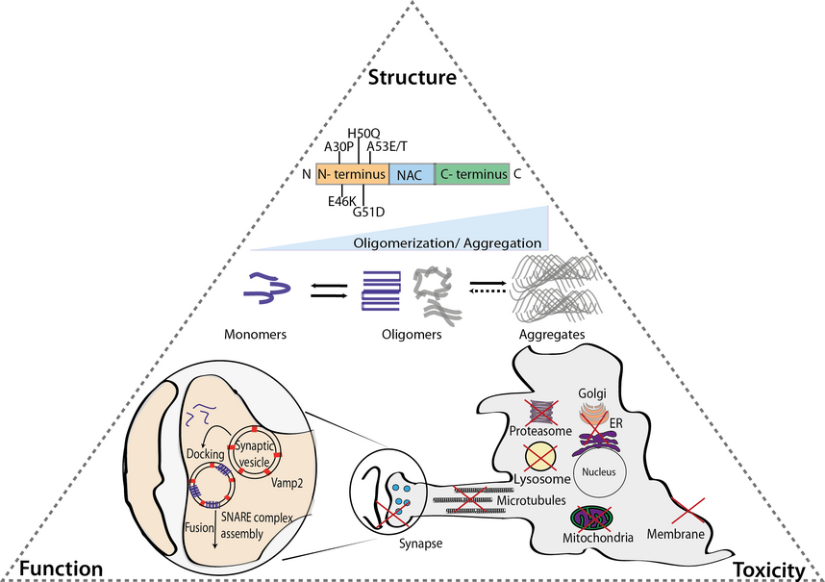
Structure, function and toxicity of alpha‐synuclein: the Bermuda triangle in synucleinopathies
Journal of Neurochemistry, Volume: 139, Issue: S1, Pages: 240-255, First published: 18 July 2015, DOI: (10.1111/jnc.13249)
Notes:
The triangle between alpha‐synuclein (α‐syn) structure, function and toxicity. α‐syn is an intrinsically disordered protein with six synucleinopathy‐related point mutations described so far. The protein can undergo oligomerization/multimerization processes that, under pathological conditions can lead to the formation of beta‐sheet structured aggregates. The outcome of the oligomerization can determine the existence of a functional (blue) – as suggested in (Burré et al. ) – or random dysfunctional (grey) α‐syn with recent data suggesting a crucial role for the protein′s membrane‐binding domains in this process. Regarding the function, α‐syn has been strongly associated with vesicular trafficking, in particularly synaptic vesicles, interacting with important players in this pathway. Although it is still not fully understood which α‐syn species are toxic, a putative deleterious effect on several intracellular organelles and pathways has been described, including proteasomes, lysosomes, synapses, microtubules, endoplasmic reticulum (ER)‐to‐Golgi trafficking, mitochondria and membranes.

Slide 6

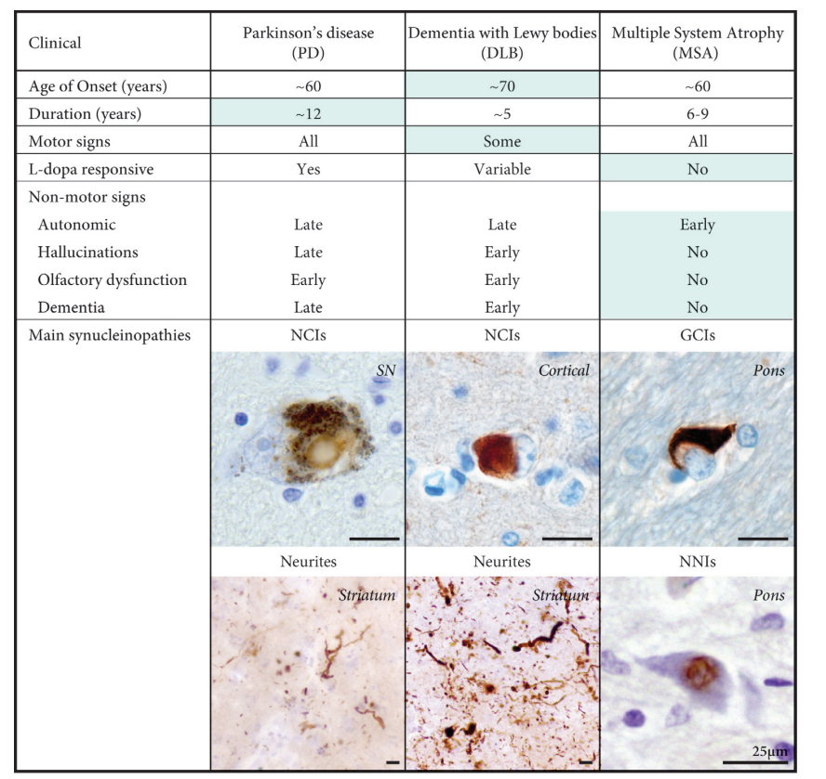

Slide 7

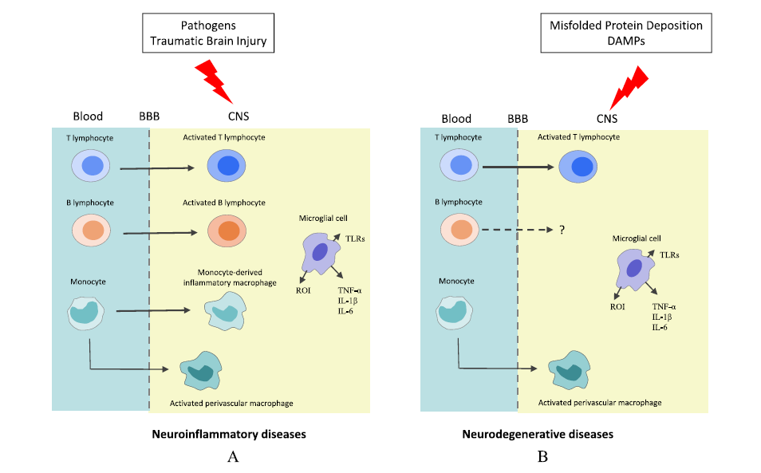
Damage-Associated Molecular Patterns

Slide 8
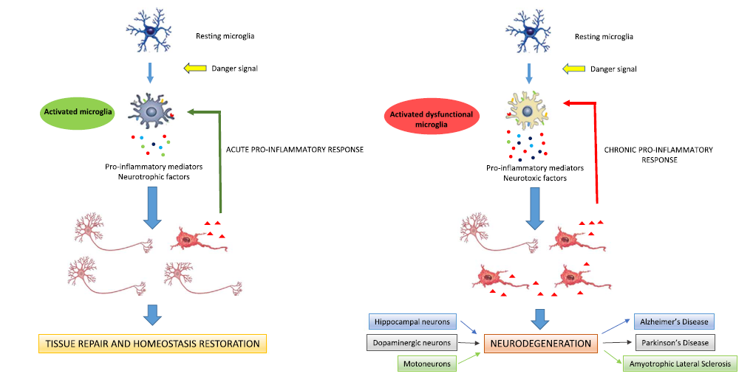

Slide 9

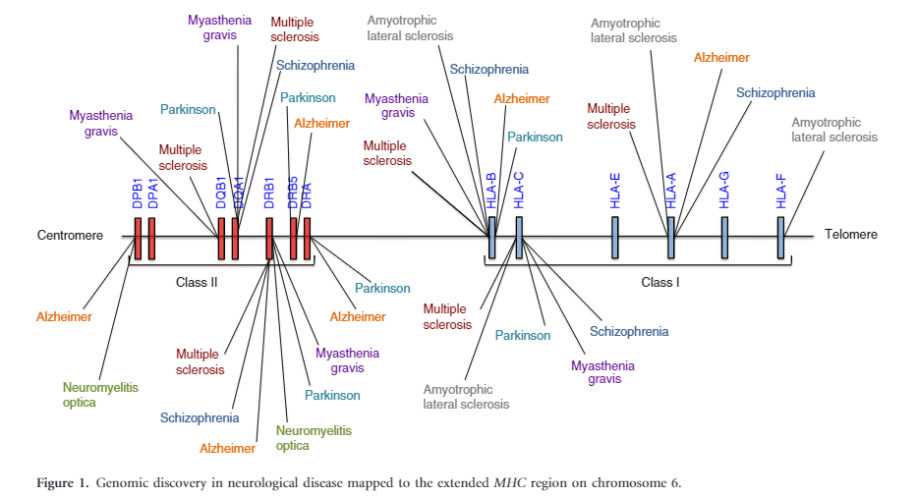
Notes:
SN and LC neurons recently have been shown to express MHC-I and co-localize with CD8+ T cells in response to stimuli such as IFNg. Catecholamine neurons are particularly sensitive to inflammation in comparison to other neuron types. A lower amount of IFNg is required by dopaminergic neurons to express
MHC-I in comparison to other neuronal subtypes. The MHC-I presented by dopaminergic neurons is functional and can result in cytotoxicity in the presence of matching antigen and CD8+T cells . Dopaminergic neuron sensitivity to inflammation and corresponding MHC-I upregulation could render the susceptible to infiltrating T cells versus neighboring, more resistant GABAergic neurons. GWAS in PD have shown an association with haplotypes of MHC II genes, including DRB501 and DRB115:01 alleles and a polymorphism in a non-coding region that may increase levels of MHC class II expression. MHC-II positive microglia are detected in the SN of PDpatients and their levels increase with disease severity. Association of HLA alleles to late-onset PD and a positive correlation between levels of MHC-II expression and disease severity in humans, in conjunction with the necessity for MHC-II expression in PD mouse models, suggests that antigen presentation and adaptive immune signaling may be involved in dopaminergic neuron death. Infiltrating T cells, MHC expression, and sensitivity of dopaminergic neurons to inflammation support the concept that PD possesses features of
an autoimmune disorder.

Slide 10
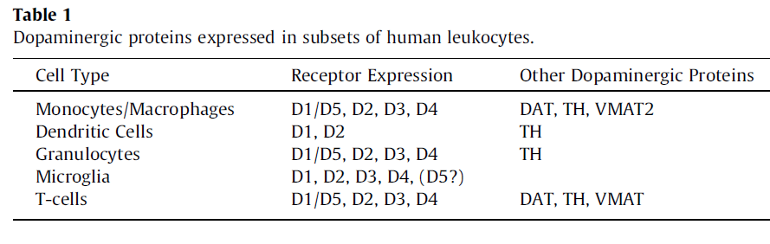
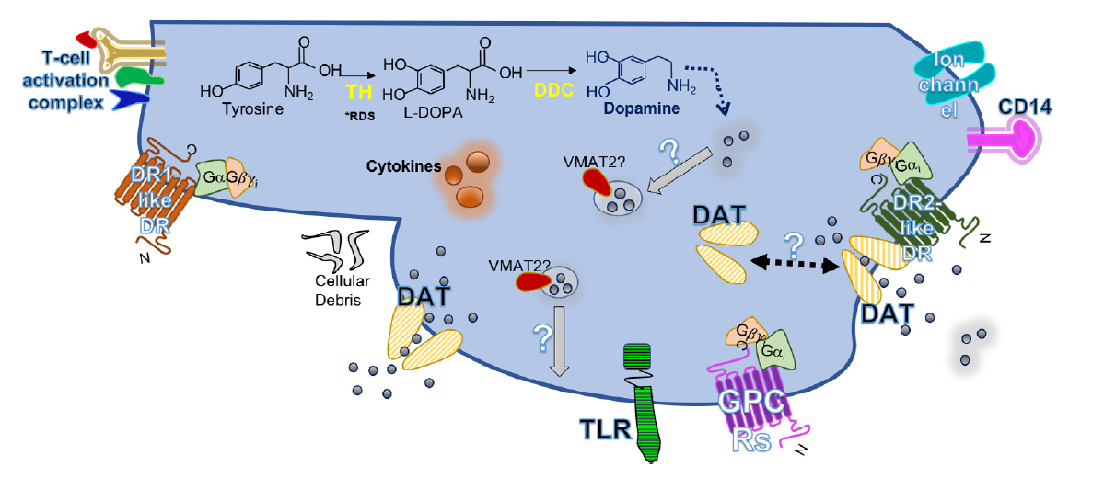
Dopamine System in Macrophages
Notes:
Postulated Dopamine System in Macrophages. Macrophages function as phagocytic and antigen presenting cells of the innate immune system and as such express receptors such as Toll-like receptor, T-cell activating proteins (MHC molecules with peptides, adhesion molecules, and costimulatory proteins), and markers such as CD14.
They are also capable of engulfing cellular debris or pathogens and can be induced to secrete cytokines. Furthermore, studies have shown macrophages contain mRNA for all DRs, DAT, and TH. The latter may indicate DA is endogenously synthesized in macrophages from tyrosine via TH—the rate-limiting enzyme—to L-dihydroxyphenylalanine then to DA via AADC.
There is conflicting evidence regarding the expression of these enzymes at protein level and regarding expression of VMAT2 at any level. This raises the question of vesicular storage and release of DA. Similarly, evidence regarding the level of DAT expression is unclear, and whether or not it functions as it does in neurons, with complex uptake, efflux, and trafficking mechanisms, is also inconsistent.
Functional studies have shown that DA treatment and DR activation may modulate macrophage
functions such as cytokine production and secretion.

Slide 11

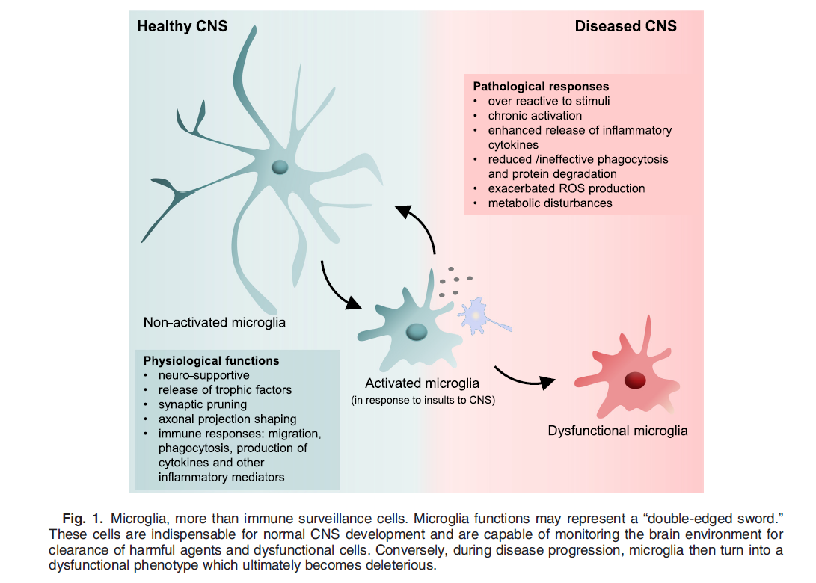
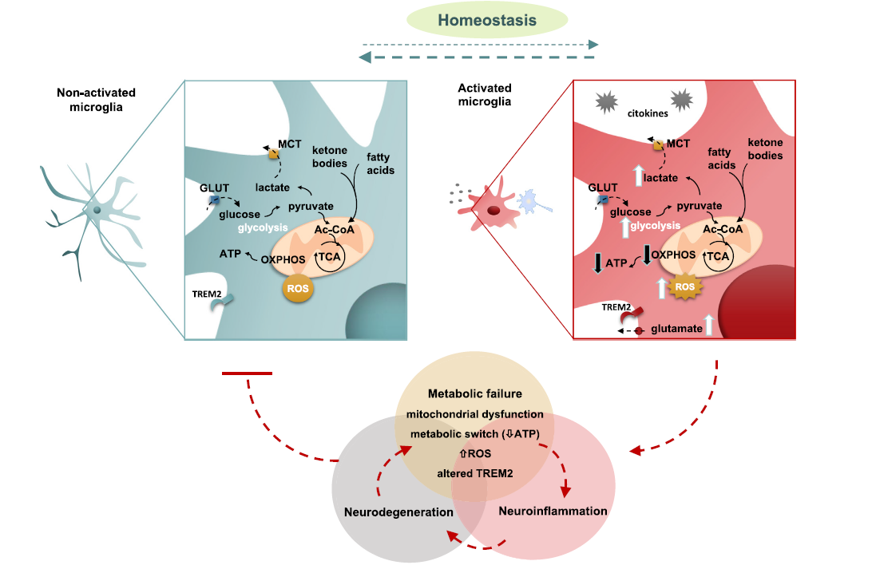

Slide 12
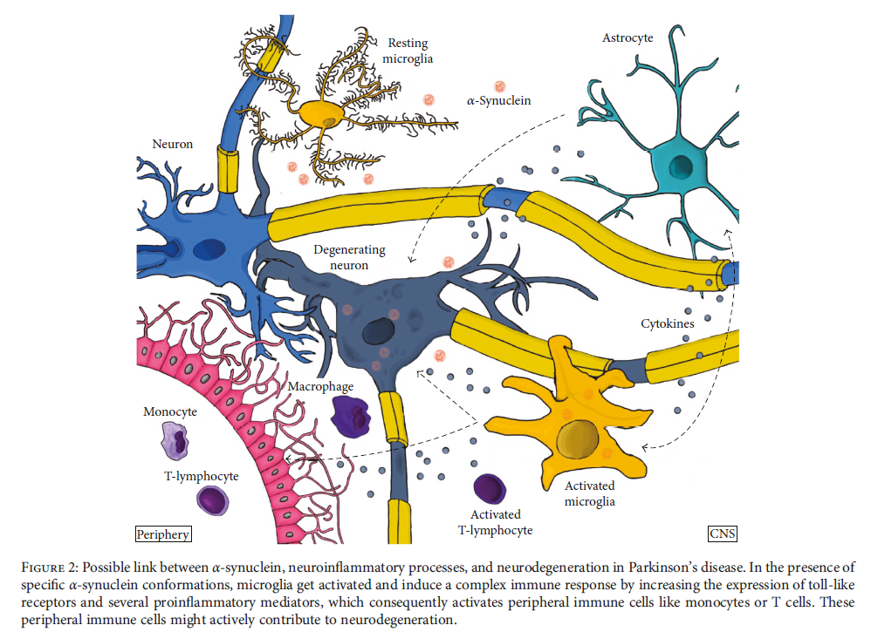


Slide 13
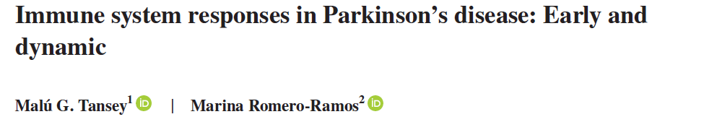
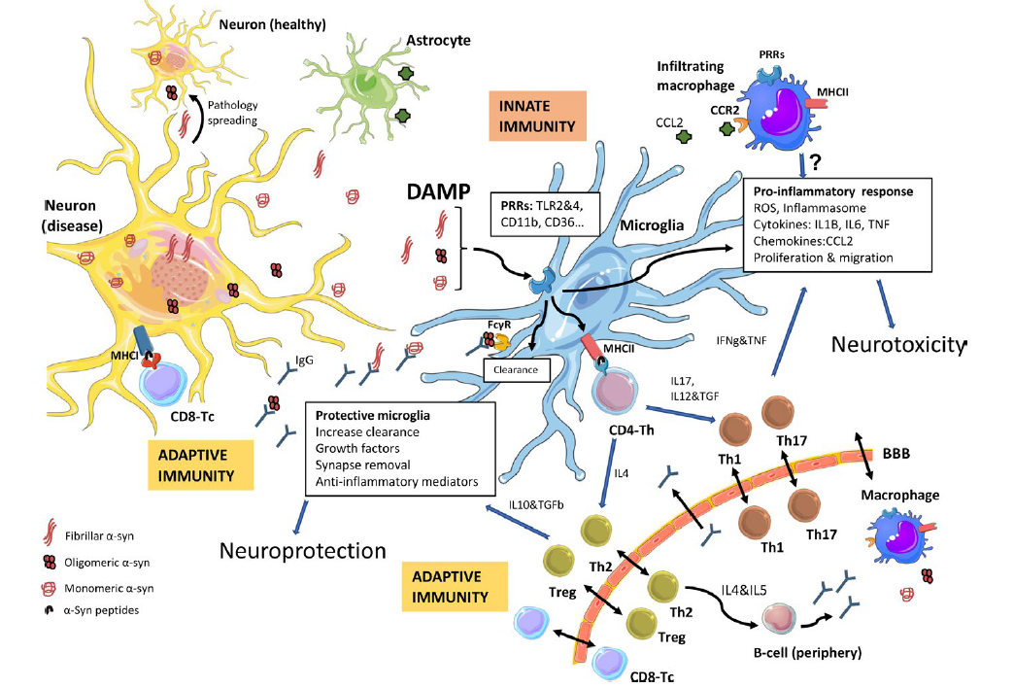
La microglia in vivo es capaz de responder directamente a los agregados de α-syn
Patológica.
La microglía también responde a la disfunción neuronal debido a la toxicidad intraneuronal por α-syn mucho antes de la muerte neuronal.
Notes:
Immune response to α‐synuclein induced neurodegeneration. In Parkinson's disease, α‐synuclein (α‐syn) undergoes modifications (phosphorylation, nitration, truncation…) and forms toxic oligomers that progressively form aggregates in the nervous system. The neurons, through exocytosis, will release all types of α‐syn (monomeric, oligomeric, or fibrillar) to the extracellular media, where it will be taken up and cleared by microglia and/or macrophages, but also by astrocytes. If this process fails, the α‐syn can be taken up by neighboring neurons, promoting the spread of pathological forms of α‐syn. Microglia will also encounter α‐syn when phagocyting (trogocytosis) synapses (not shown). α‐Syn can act as a damage‐associated molecular pattern (DAMP) and via diverse immune receptors, pattern recognition‐receptors (PRRs), will initiate a sterile inflammatory response, which will result in a pro‐inflammatory immune milieu that will contribute to neuronal dysfunction and neurodegeneration. The α‐syn‐induced microglia activation also leads to proliferation and migration of microglia and to the infiltration of peripheral monocytes/macrophages, likely through a CCL2‐CCR2 process. In parallel, α‐syn peptides will be presented by neurons, through MHCI, and by microglia (or by infiltrating monocytes/macrophages from the periphery) through MHCII. This will initiate an adaptive immune response through CD8 (T‐cytotoxic cells, Tc) or CD4 (T‐helper cells, Th), respectively. Depending on the cytokines produced the CD4‐Th cells will undergo differentiation/maturation to various helper subsets, including differentiation into Th1 or Th17 T‐cells, which typically potentiate pro‐inflammatory events; whereas differentiation into Th2 or regulatory (Treg) T‐cells typically resolve the inflammation and lead to B‐cell activation (in the periphery) with the production of antibodies that may cross the BBB into the CNS. The clearance of α‐syn will be aided by the presence of IgG, to mitigate the pro‐inflammatory process and the spread of pathologic α‐syn to other healthy neurons. In parallel to this event, the α‐syn‐induced neurodegenerative process will change the expression of proteins involved in neuron‐glia interactions, such as CD200 and CX3CL1 (not shown), which will also trigger a microglia response

Slide 14
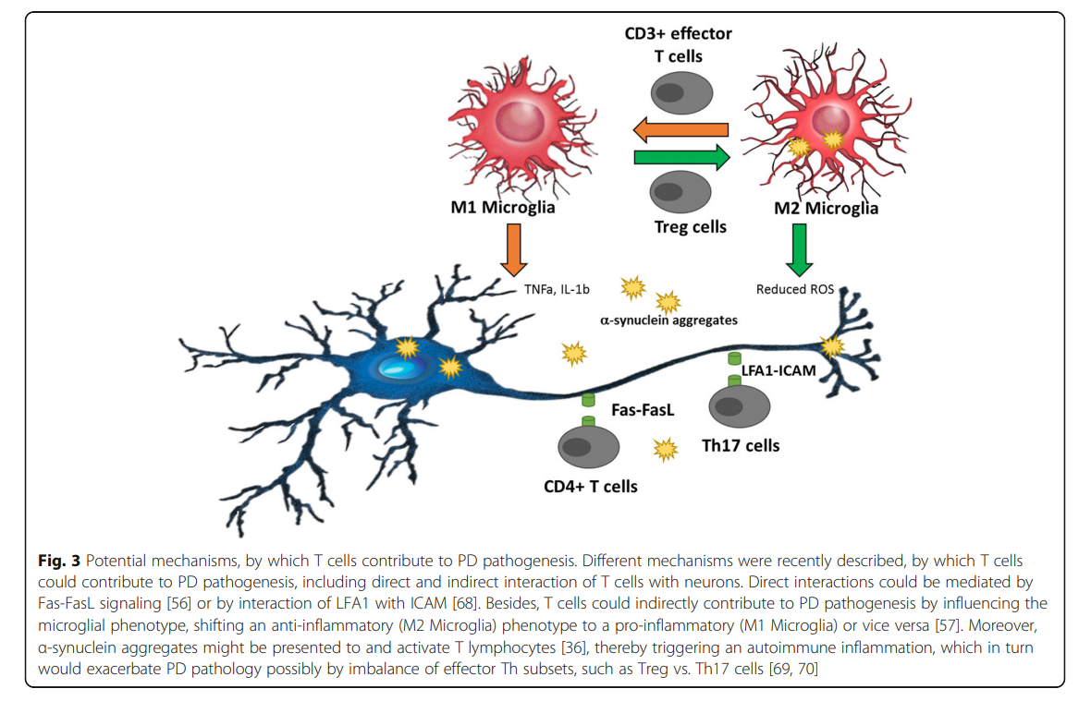

Slide 15
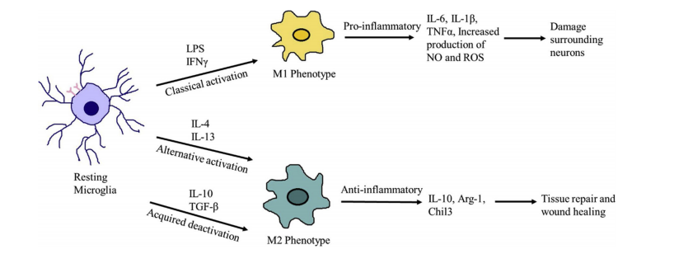

Slide 16
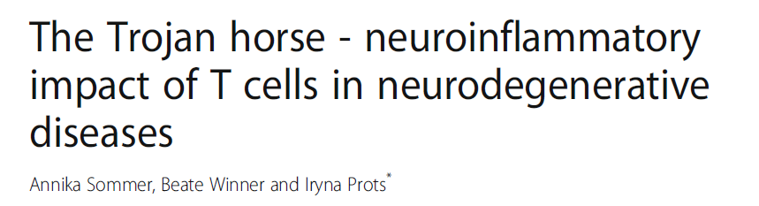
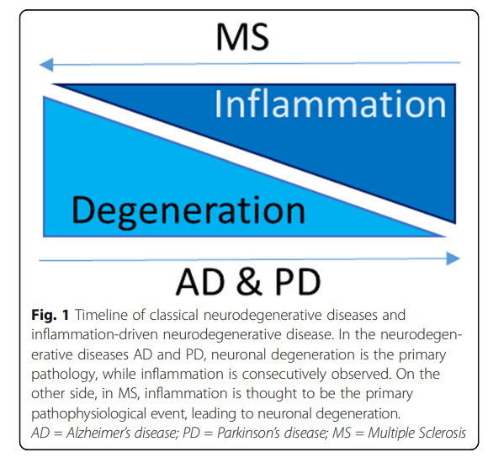
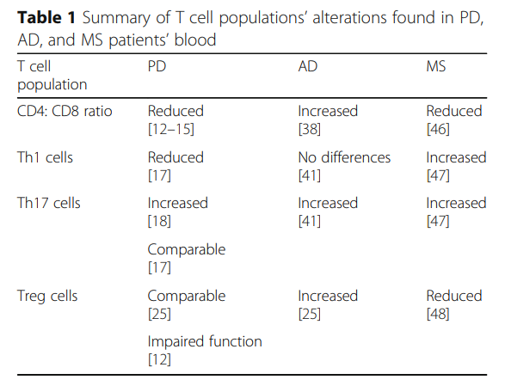


Slide 17
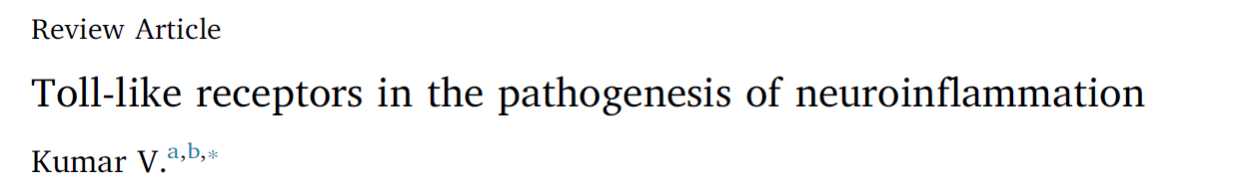
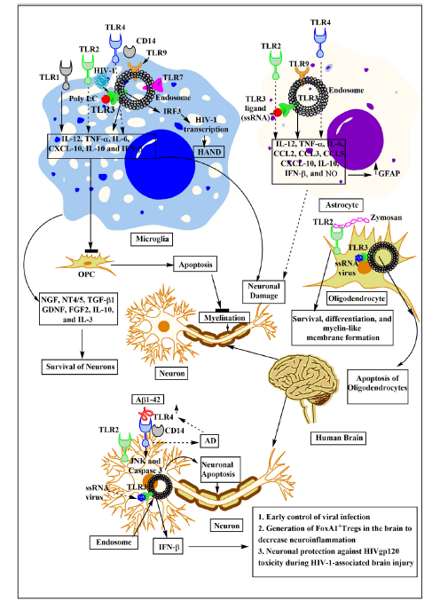
Los receptores tipo Toll (TLR) son receptores cruciales de reconocimiento de patrones (PRR) involucrados en la identificación de patrones moleculares asociados a patógenos (PAMPs).
También se ha demostrado que están involucrados en el reconocimiento de la patones moleculares asociados a peligros/daño (DAMPs)
La hiperactivación, vinculada a la detección de lDAMPs del sistema TLR puede llevar a una situación patológica, de ahí la importancia de su regulación.

Slide 18
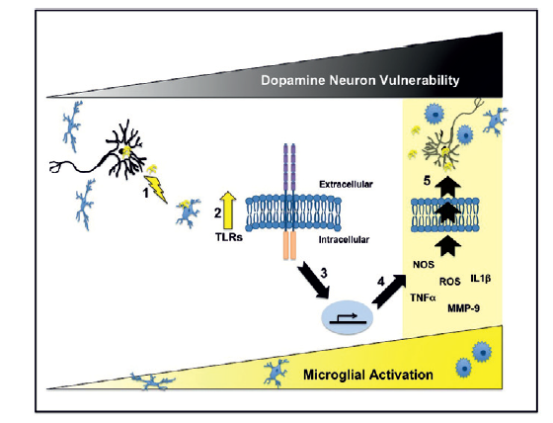
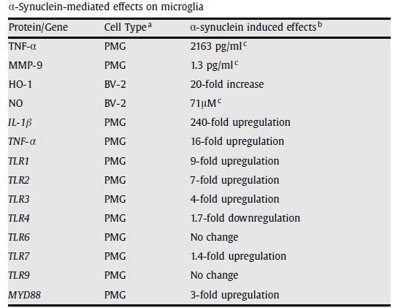
α-synuclein directly activates microglia inciting the production of proinflammatory molecules and altering the expression of Toll-like receptors (TLRs)

Slide 19


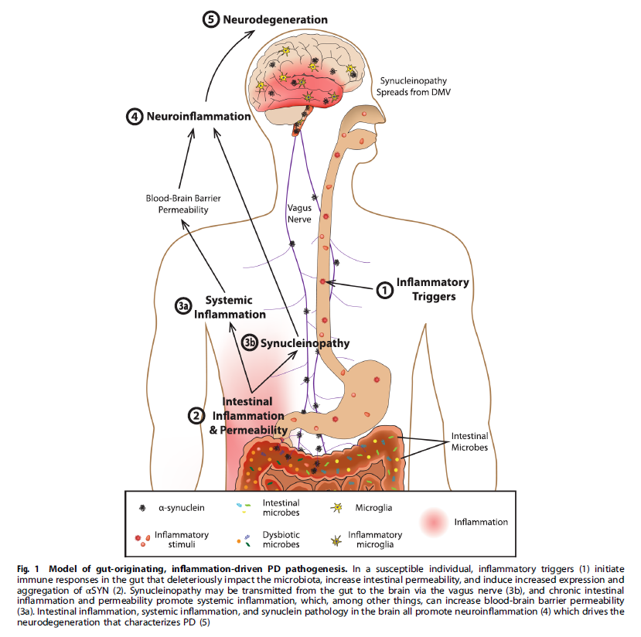
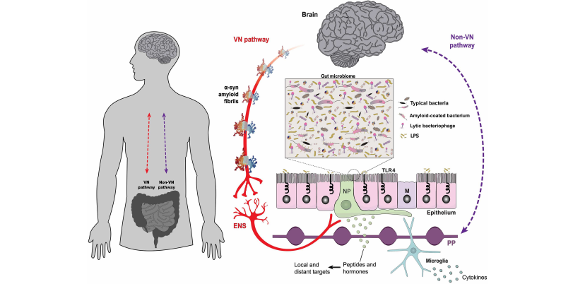

Slide 20

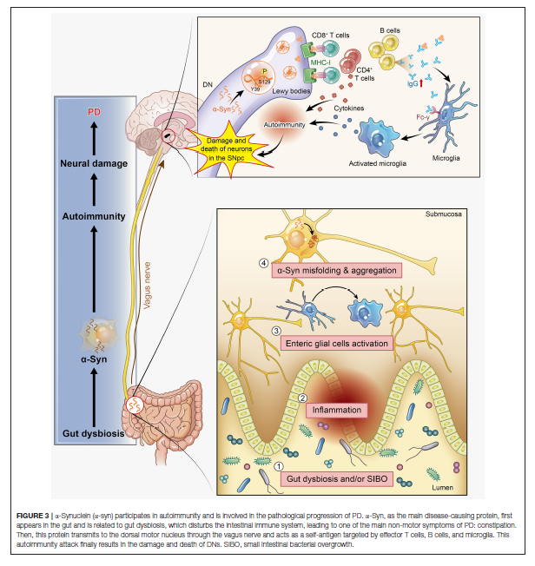
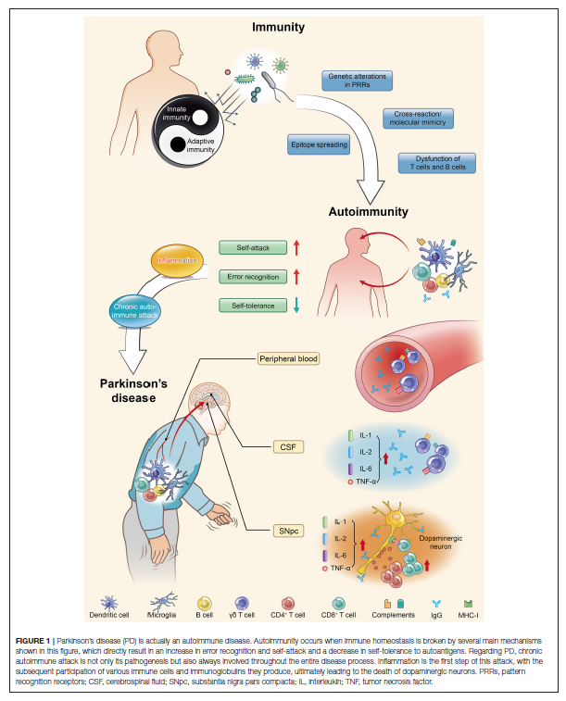

Slide 21

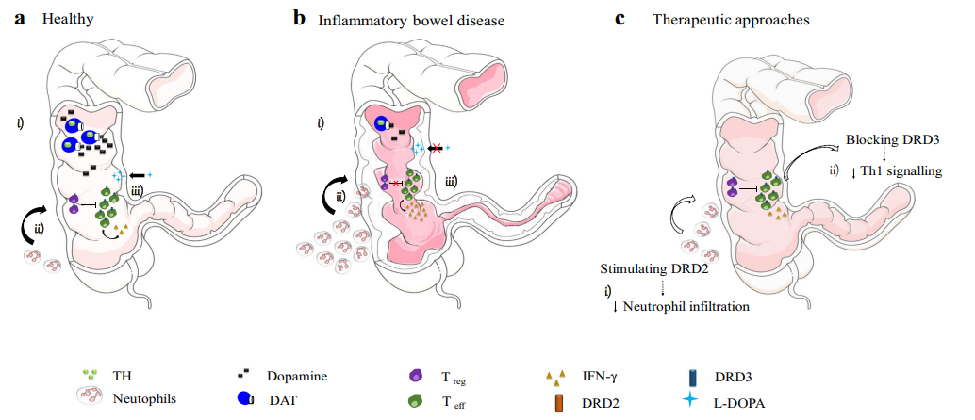
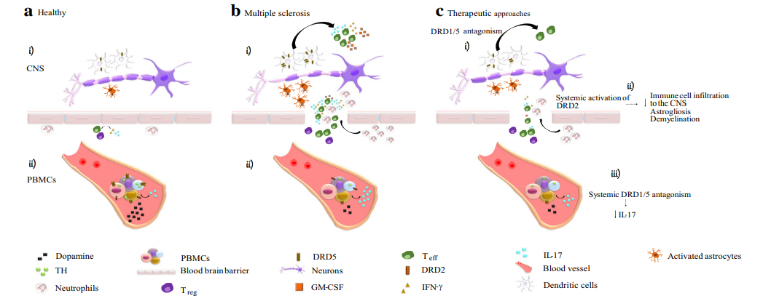
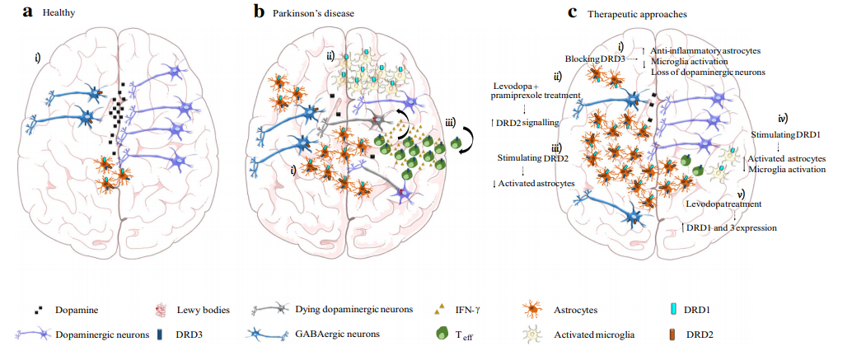


Slide 22
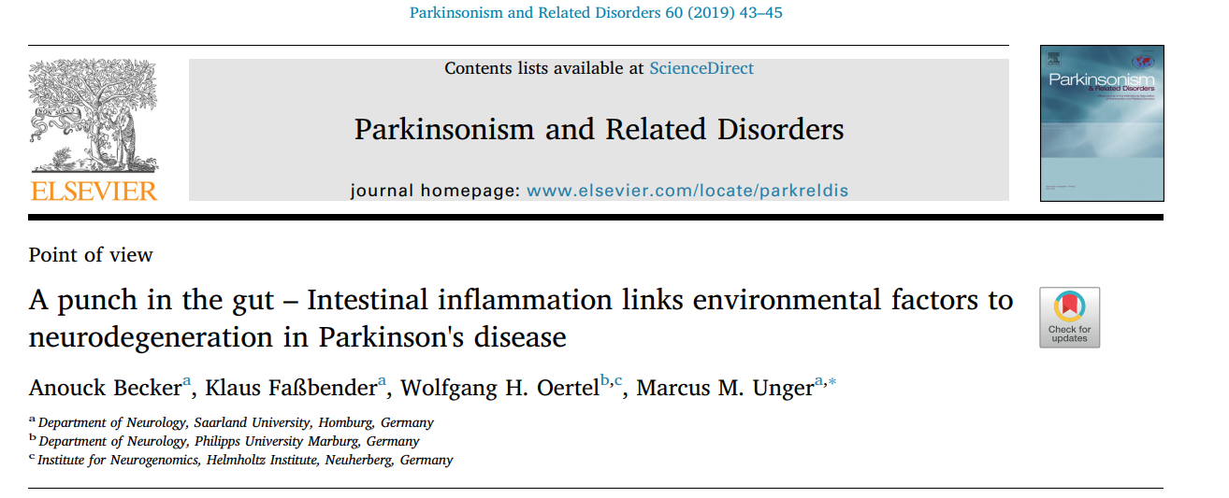

Slide 23

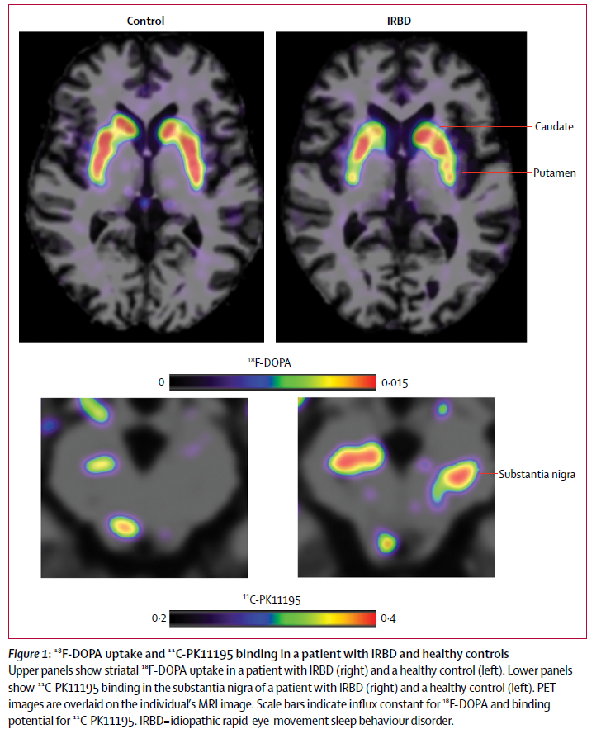
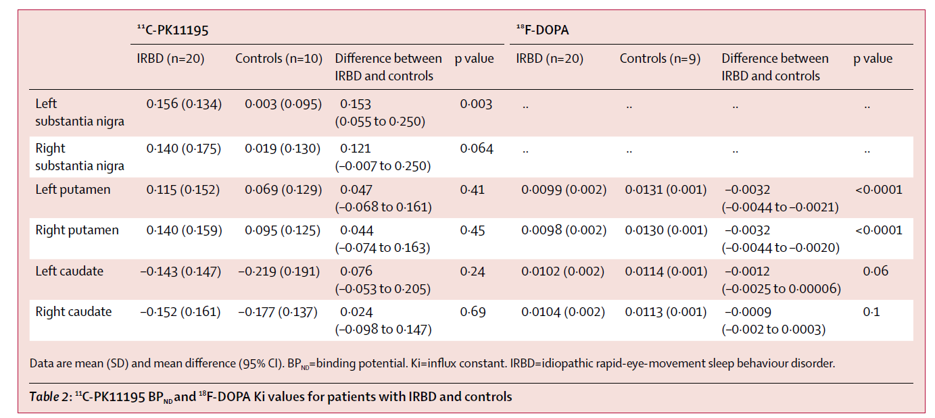

Los pacientes con RBD idiopático muestran incremento en la activación de la microglia en sustancia nigra por PET junto con reducción de la función dopaminérgica en putamen

Slide 24
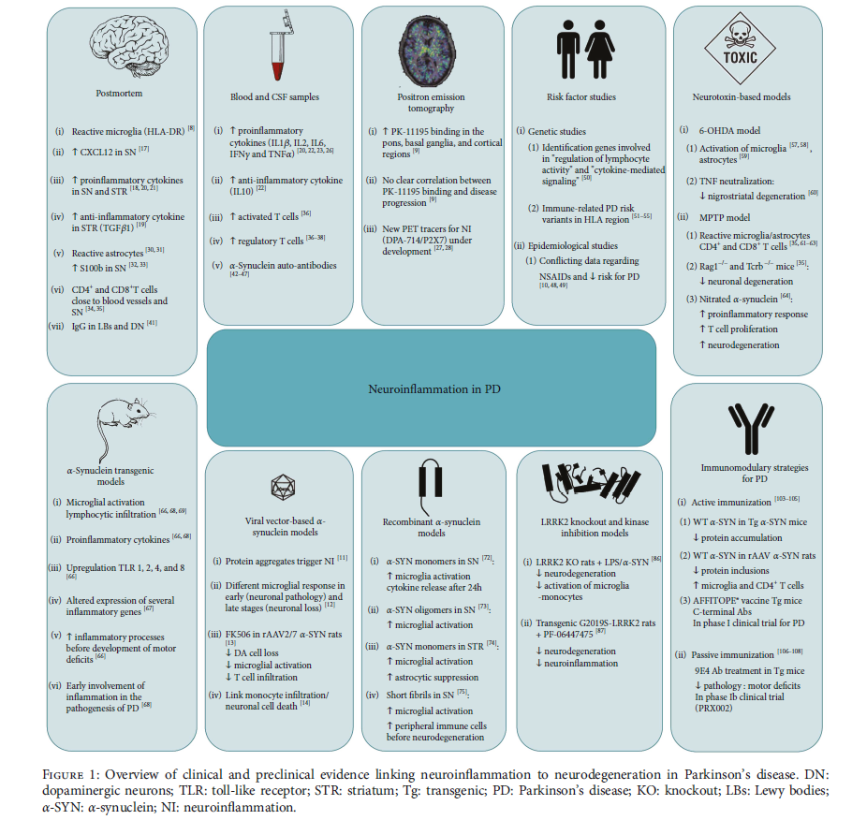

Slide 25
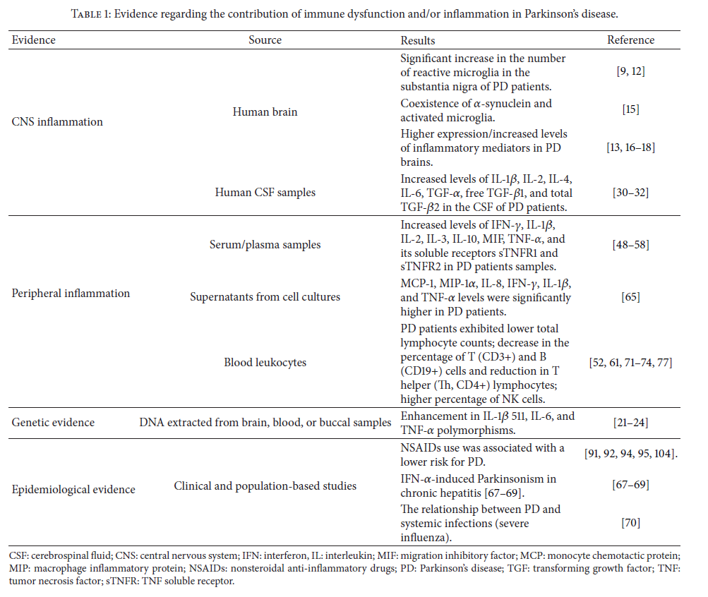


Slide 26
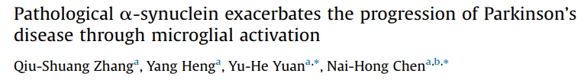
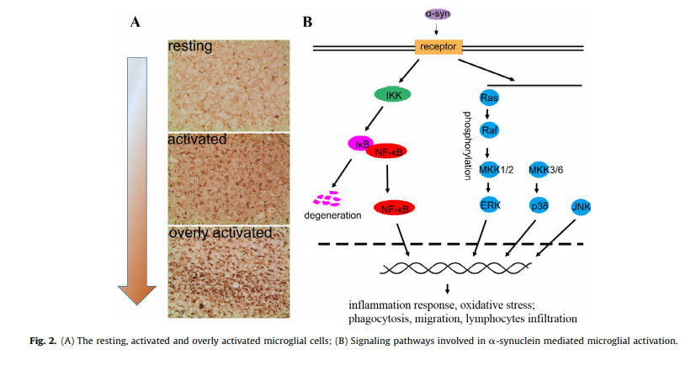
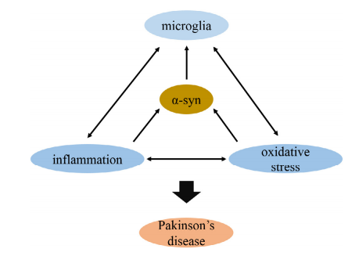

Slide 27
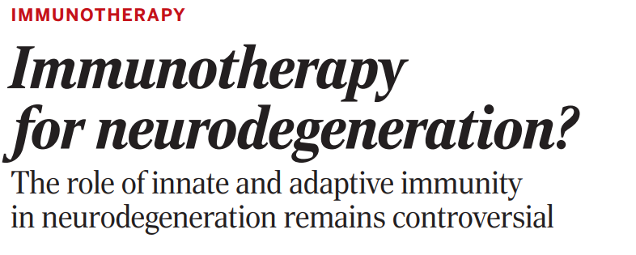

Slide 28


Slide 29

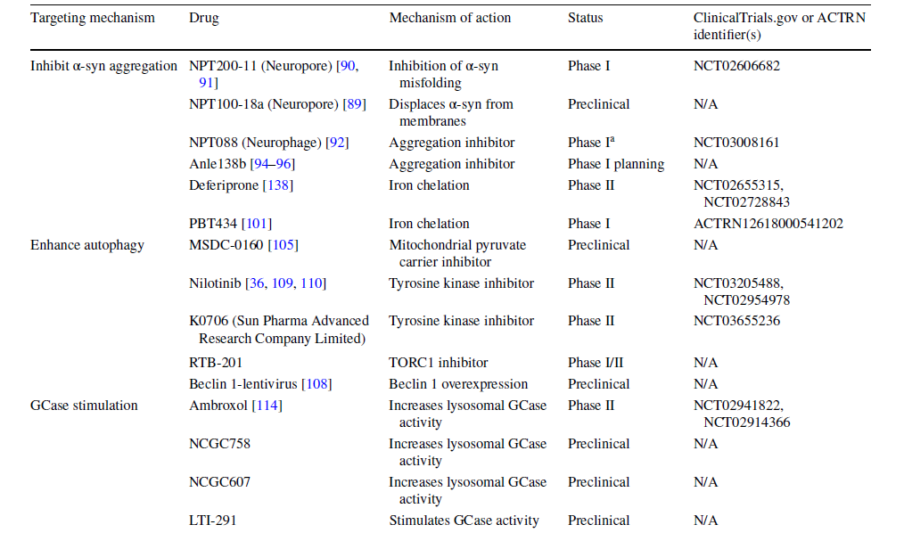


Slide 30
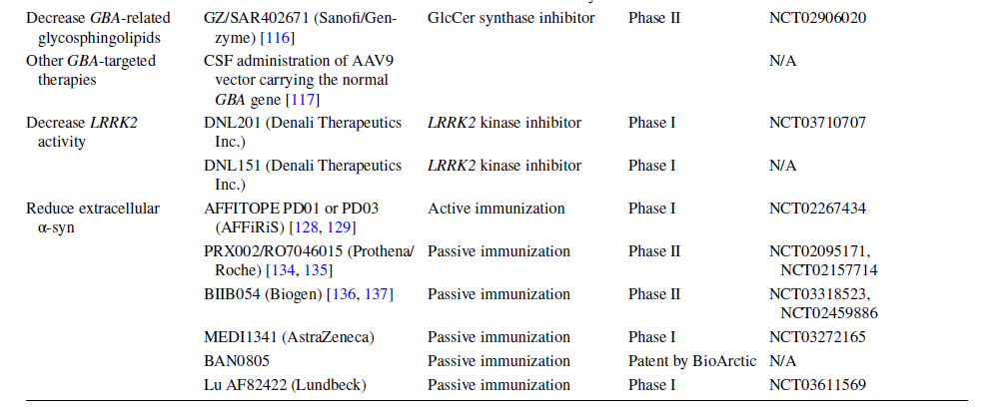

Slide 31
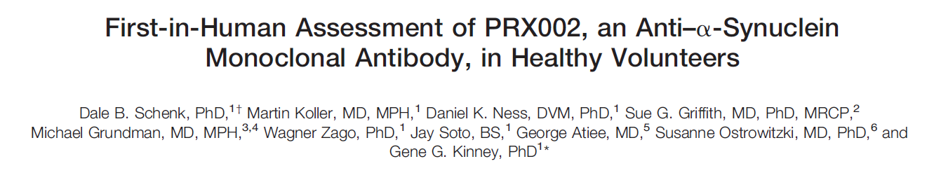
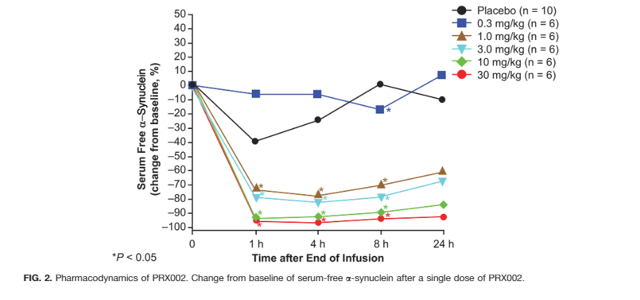

This study demonstrates that serum α-synuclein can be safely modulated in a dose-dependent manner after single intravenous infusions of an anti–α-synuclein antibody.

Slide 32
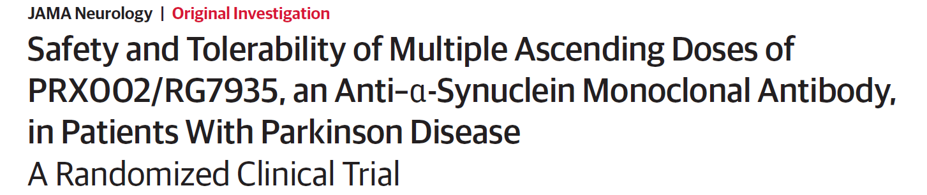

Single and multiple doses of PRX002 were generally safe and well tolerated and resulted in robust binding of peripheral α-synuclein and dose-dependent increases of PRX002 in cerebrospinal fluid, reaching cerebrospinal fluid concentrations that
may be expected to engage extracellular aggregated α-synuclein in the brain.

Slide 33



BIIB054 is a human-derived monoclonal antibody targeting α-syn that was generated from a library of memory B cells.
BIIB054 has a≥800-fold greater apparent affinity for pathologic aggregatedα-syn than for the more abundant physiological monomeric protein.
The presence of BIIB054/α-synuclein complexes in plasma was confirmed.

Slide 34


Active Immunization: AFFITOPE PD01A and PD03A
There was no significant signal in terms of safety and tolerability.

Slide 35



Slide 36


Slide 37


Slide 38
Conclusiones
La respuesta inmune observada en los pacientes con Enfermedad de Parkinson, ha adquirido un papel mas relevante a través del tiempo, dejando la posibilidad de que esta sea una de las causas y no consecuencia de la muerte neuronal
2. La patología de alfa sinuclñeína inicia en la periferia a tavés del sistema nervioso entérico.
3. La inflamación sostenida afecta la barrera hemato encefñalica aumentando su permeabilidad.
4. La acumulación y la propagación de alfa sinucleína, la microgliosis y la presentación de antígeno pueden ayudar a reclutar y atraer células T específicas.
5. CD4+ y CD8+ pueden reconocer péptidos específicos ligados al CMH-II en la microglia y CMH-I en las neuronas dopaminérgicas.
6. Nuevos biomarcadores, herramientas diagnósticas y tratamientos de acuerdo a esta hipótesis se estan desarrollando.

Slide 39

Gracias! mrodriguez@innn.edu.mx
Profesores adjuntos
Amin Cervantes
Christian Pérez
Alta Especialidad EP
Arturo Abundes
Omar Cárdenas
Emmanuel Escobar
Fanny Herrera
MPSS
Ángel Alcocer
Israel González
Susana López
Cynthia Sarabia
Neurocirugía
Alfonso Arellano
Alta Especialidad NQx Alberto Serrano
Neuropsiquiatría
Leo Baylis
Ángel Ruíz Chow
Neuropsicología
Mireya Chávez
Yaneth Rodríguez
Rodolfo Solis
Genética
David Dávila
Nancy Monroy
Medicina Nuclear
Iván Díaz M
Coordinadora Estudios
Vanessa González

