Slide 1


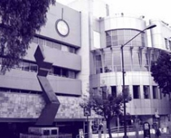
Lung cancer in LATAM and Mexico
Oscar Arrieta
Unidad Funcional de Oncología Torácica
National Cancer Institute of Mexico

Slide 2
Financial Disclosures
Employment or Leadership Position: None
Advisory Role or Expert Testimony: Novartis, Bristol, BI, Roche, Lilly, Merck, Asofarma, Amgen, AstraZeneca
Stock Ownership: None
Patent, Copyright, Licensing: None
Honoraria: None
Financing or Scientific Research: Bristol, AstraZeneca
Other Financial Relationships: None

Slide 3
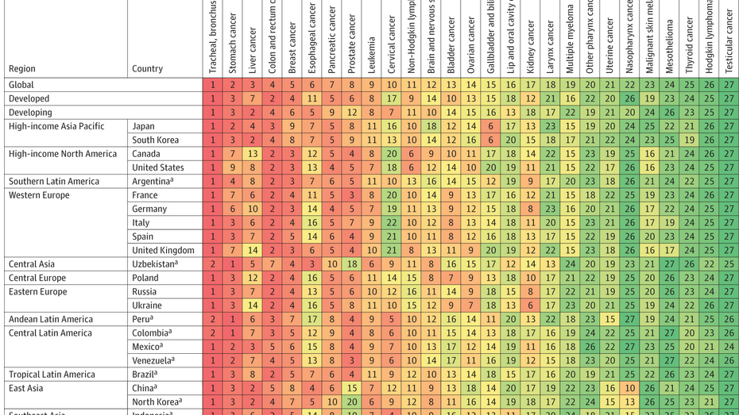
PROBLEMÁTICA / NECESIDAD

Slide 4
Lung Cancer / GLOBOCAN 2018
2,093,876 new cases worldwide in 2018 (11.6% of malignant neoplasms)
Most frequent cancer (11.6% both sexes; 14.5% males, 8.4% females )
1,761,007 deaths (18.4% overall)
Ratio mortality/incidence = 0.87
In Europe > 25% cancer deaths
In USA women mortality overcomes breast cancer in 1987; while in Europa the figures crossed in 2015
CA: A Cancer Journal for Clinicians 2018;0:1-31.

Slide 5
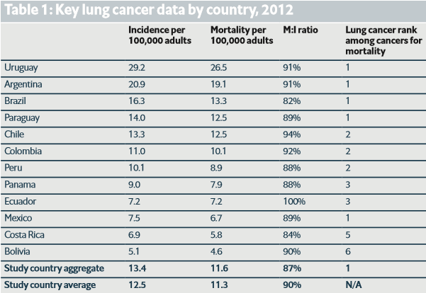
LATAM

Slide 6
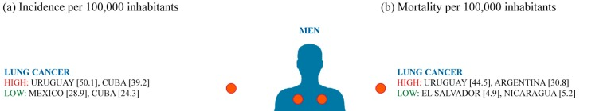
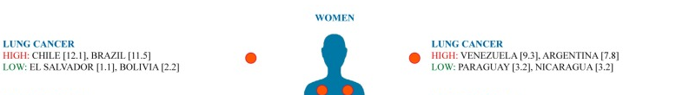
Cancer incidence and mortality in Latin America. (a) Cancer incidence per 100,000 inhabitants in men and women; (b) Cancer mortality per 100,000 inhabitants in men and women.

Slide 7
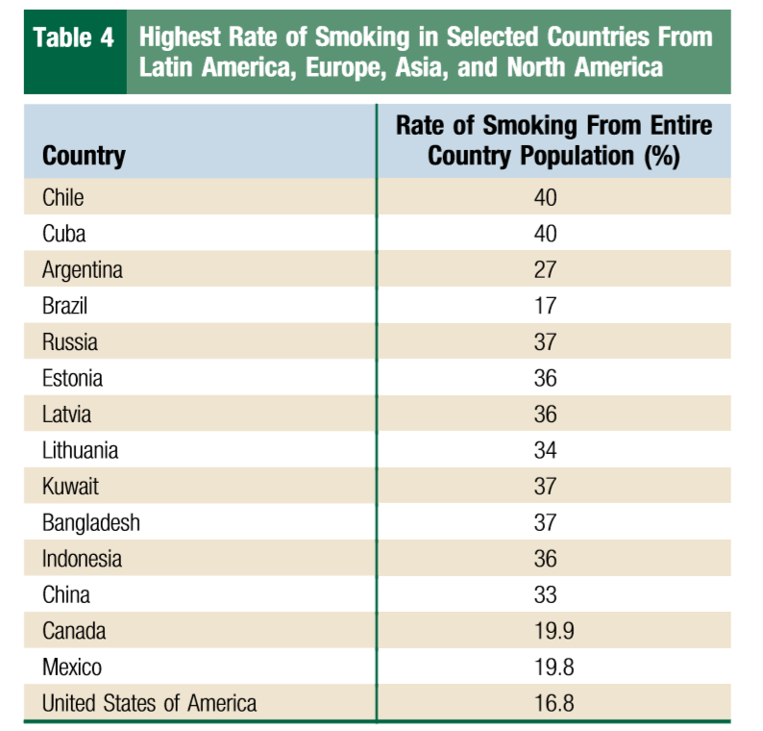
Challenges in Facing the Lung Cancer Epidemic and Treating Advanced Disease in Latin America.
Raez LE, Santos ES, Rolfo C, Lopes G, Barrios C, Cardona A, Mas LA, Arrieta O, Richardet E, Vallejos S C, Wistuba I, Gandara D, Hirsch FR.

Slide 8
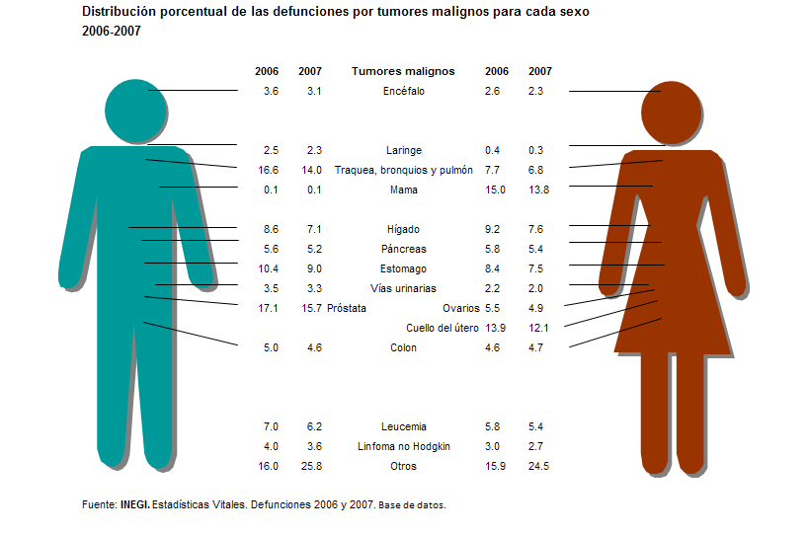

Distribución porcentual de las defunciones por tumores malignos para cada sexo (2006-2007)

Slide 9
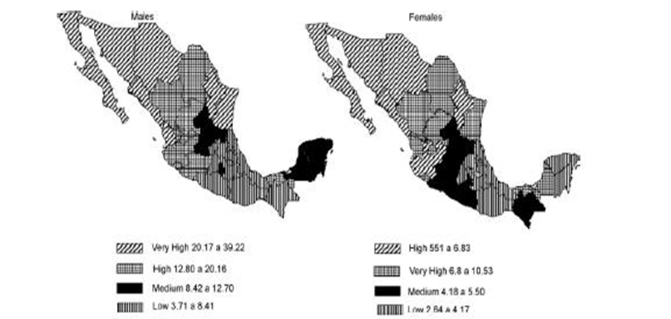
Mortality by age in patients with pulmonary tumors, México 1993-2003

Slide 10
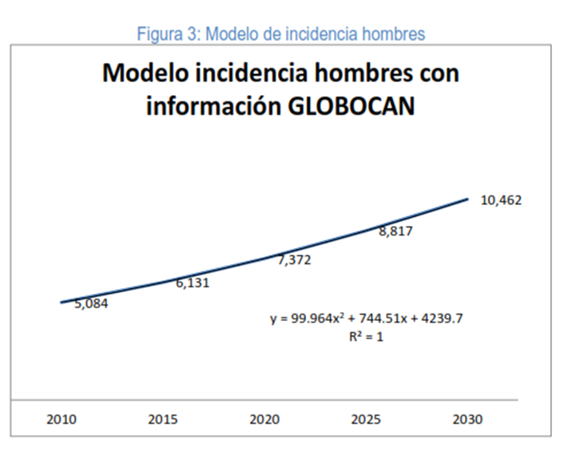
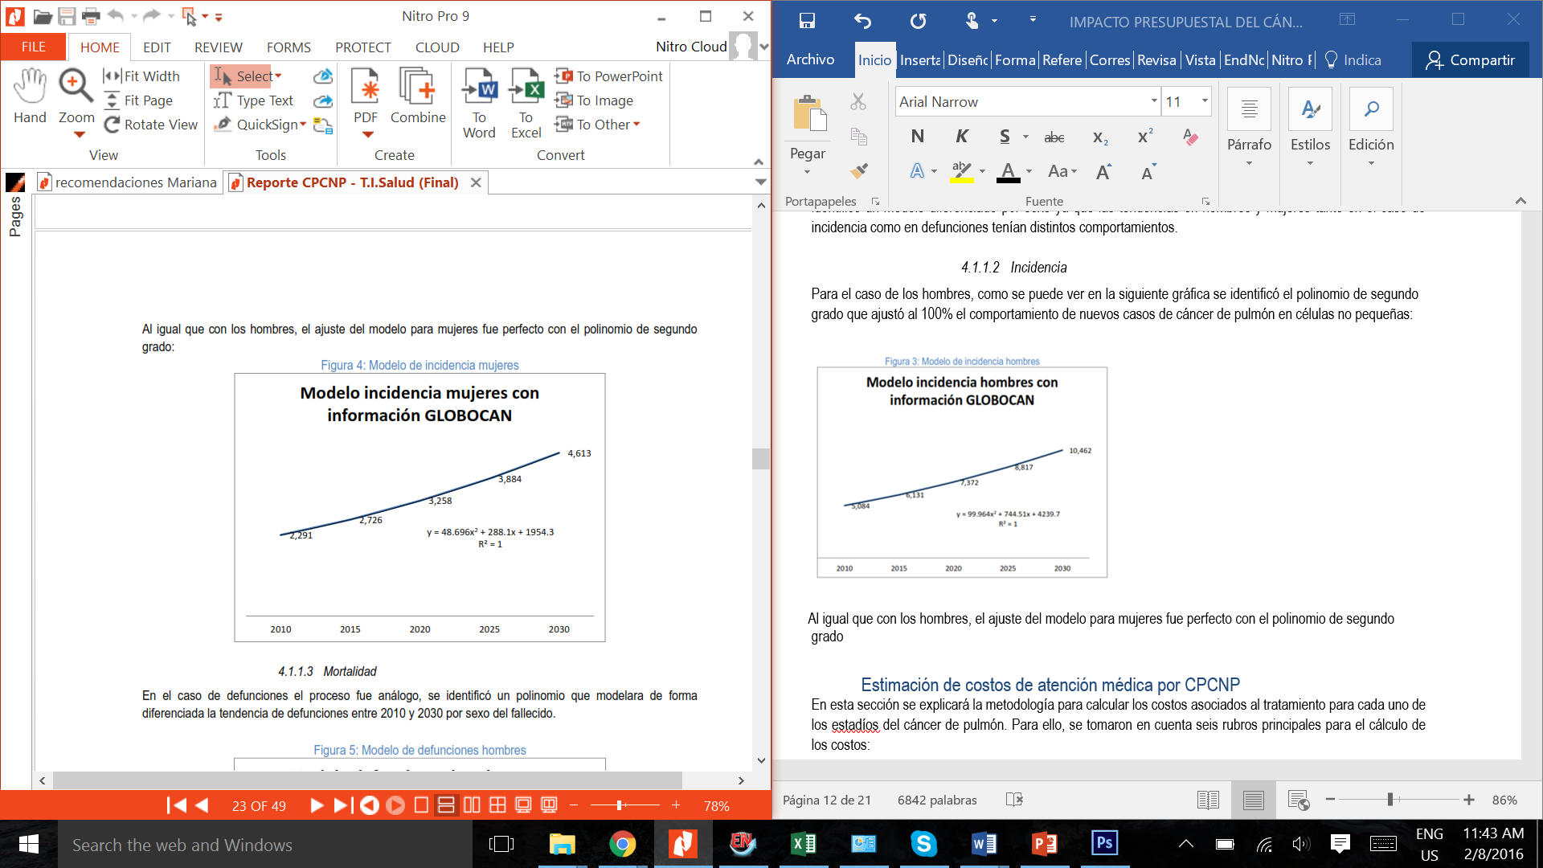
Año | Nuevos casos |  |  | Defunciones
 | Hombres | Mujeres | Ambos sexos | Hombres | Mujeres | Ambos sexos
2010 2016 2020 2025 2030 | 6,778 8,174 9,829 11,756 13,949 | 3,054 3,635 4,344 5,178 6,151 | 9,832 11,809 14,173 16,934 20,100 | 6,464 7,790 9,383 11,246 13,368 | 2,993 3,559 4,262 5,092 6,063 | 9,457 11,349 13,645 16,338 19,431

Slide 11
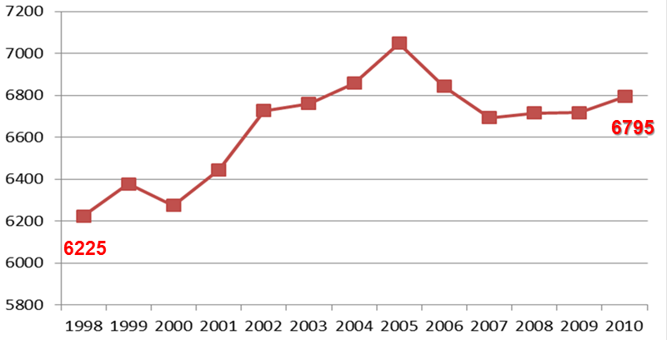
Impacto del cáncer de pulmón en México
Es la primera causa de muerte por tumores en México
La tasa de mortalidad es de 6 por cada 100,000 habitantes

Slide 12

General characteristics of patients
Disease Stage
II | 0.6 (8/1260)
IIIa | 4.8 (60/1260)
IIIb | 18.4 (231/1260)
IV | 76.3 (961/1260)
ECOG PS
0-1 | 73.2 (922/1260)
2-4 | 26.8 (338/1260)
Histology
Adenocarcinoma | 76.3 (961/1260)
Squamous | 13.3 (167/1260)
Large Cell Carcinoma | 3.3 (41/1260)
Undifferentiated and others NSCLC | 7.2 (91/1260)
KRAS Mutation
Positive | 10.2 (129/1260)
Negative | 89.8(1131/1260)
EGFR Mutation
Positive | 28.1 (354/1260)
Negative | 71.9 (906/1260)
 | % (n/N)
Gender
Female | 46.2 (582/1260)
Male | 53.8 (678/1260)
Age(years)
Mean (± S.D.) | 60.5 (13.0)
Range | 18-91
Smoking history
Non-smoker | 43.5 (548/1260)
Smoker | 56.5 (712/1260)
Current | 20.8 (262/1260)
Former | 35.7 (450/1260)
Tobacco (pack/years)
Mean | 34.7
Wood-smoke exposure
Present | 37.2 (469/1260)
Absent | 62.8 (791/1260)
Wood-smoke exposure index
Mean | 94.5
¹Patel MI, Schupp CW, Gómez SL, et al. How do social factors explain outcomes in non-small-cell lung cancer among Hispanic in California? Explaining the Hispanic Paradox. Journal Clin Oncol 2013; 31: 1-8.

Slide 13
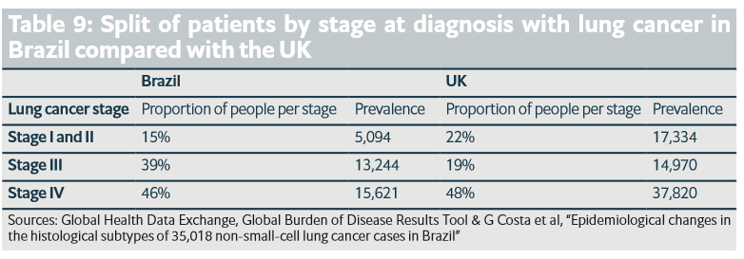
Stage at diagnosis with lung cancer
MX
0.6%
23.2%
76.2%

Slide 14

 | Female | Male | p-Value
 | % (n/N) | % (n/N)
Age at diagnosis
< 60 years | 48.5 (282/582) | 40.7 (276/678)
>= 60 years | 51.5 (300/582) | 59.3 (402/678) | 0.006
Age at diagnosis
Mean (± S.D.) | 59.5 (13.5) | 61.3 (12.5) | 0.015
Smoking history
Non-smoker | 67.0 (390/582) | 23.3 (158/678)
Smoker | 33.0 (192/582) | 76.7 (520/678) | <0.001
Smoking Index
Mean (± S.D.) | 19.8 (26.7) | 40.1 (182.7) | 0.004
Wood-smoke exposure
No | 51.2 (298/582) | 72.7 (493/678)
Yes | 48.8 (284/582) | 27.3 (185/678) | <0.001
KRAS Mutation
Negative | 89.9 (520/582) | 89.7 (608/678)
Positive | 10.1 (62/582) | 10.3 (70/678) | 0.939
EGFR Mutation
Negative | 63.1 (367/582) | 81.5 (553/678)
Positive | 36.9 (215/582) | 18.5 (125/678) | <0.001
General characteristics of patients according to gender

Slide 15
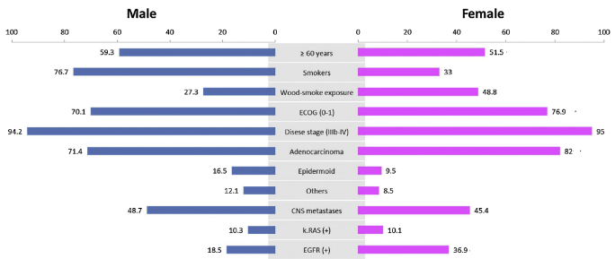
Clinical and epidemiological differences among NSCLC by gender

Slide 16
Indoor coal use, especially with poor ventilation, is a known lung carcinogen. Wood is strongly suspected.
A practice more associated with Africa and Asia than Latin America, more than one in five households in Bolivia (23%), Peru (34%) and Paraguay (42%) still use solid fuel indoors to heat or cook.

Slide 17
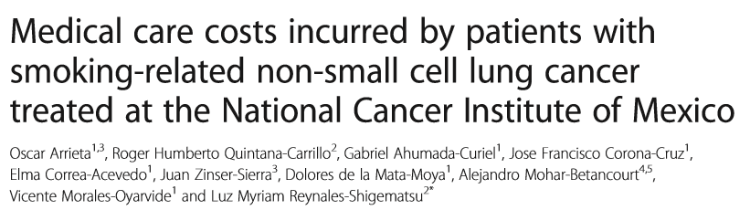
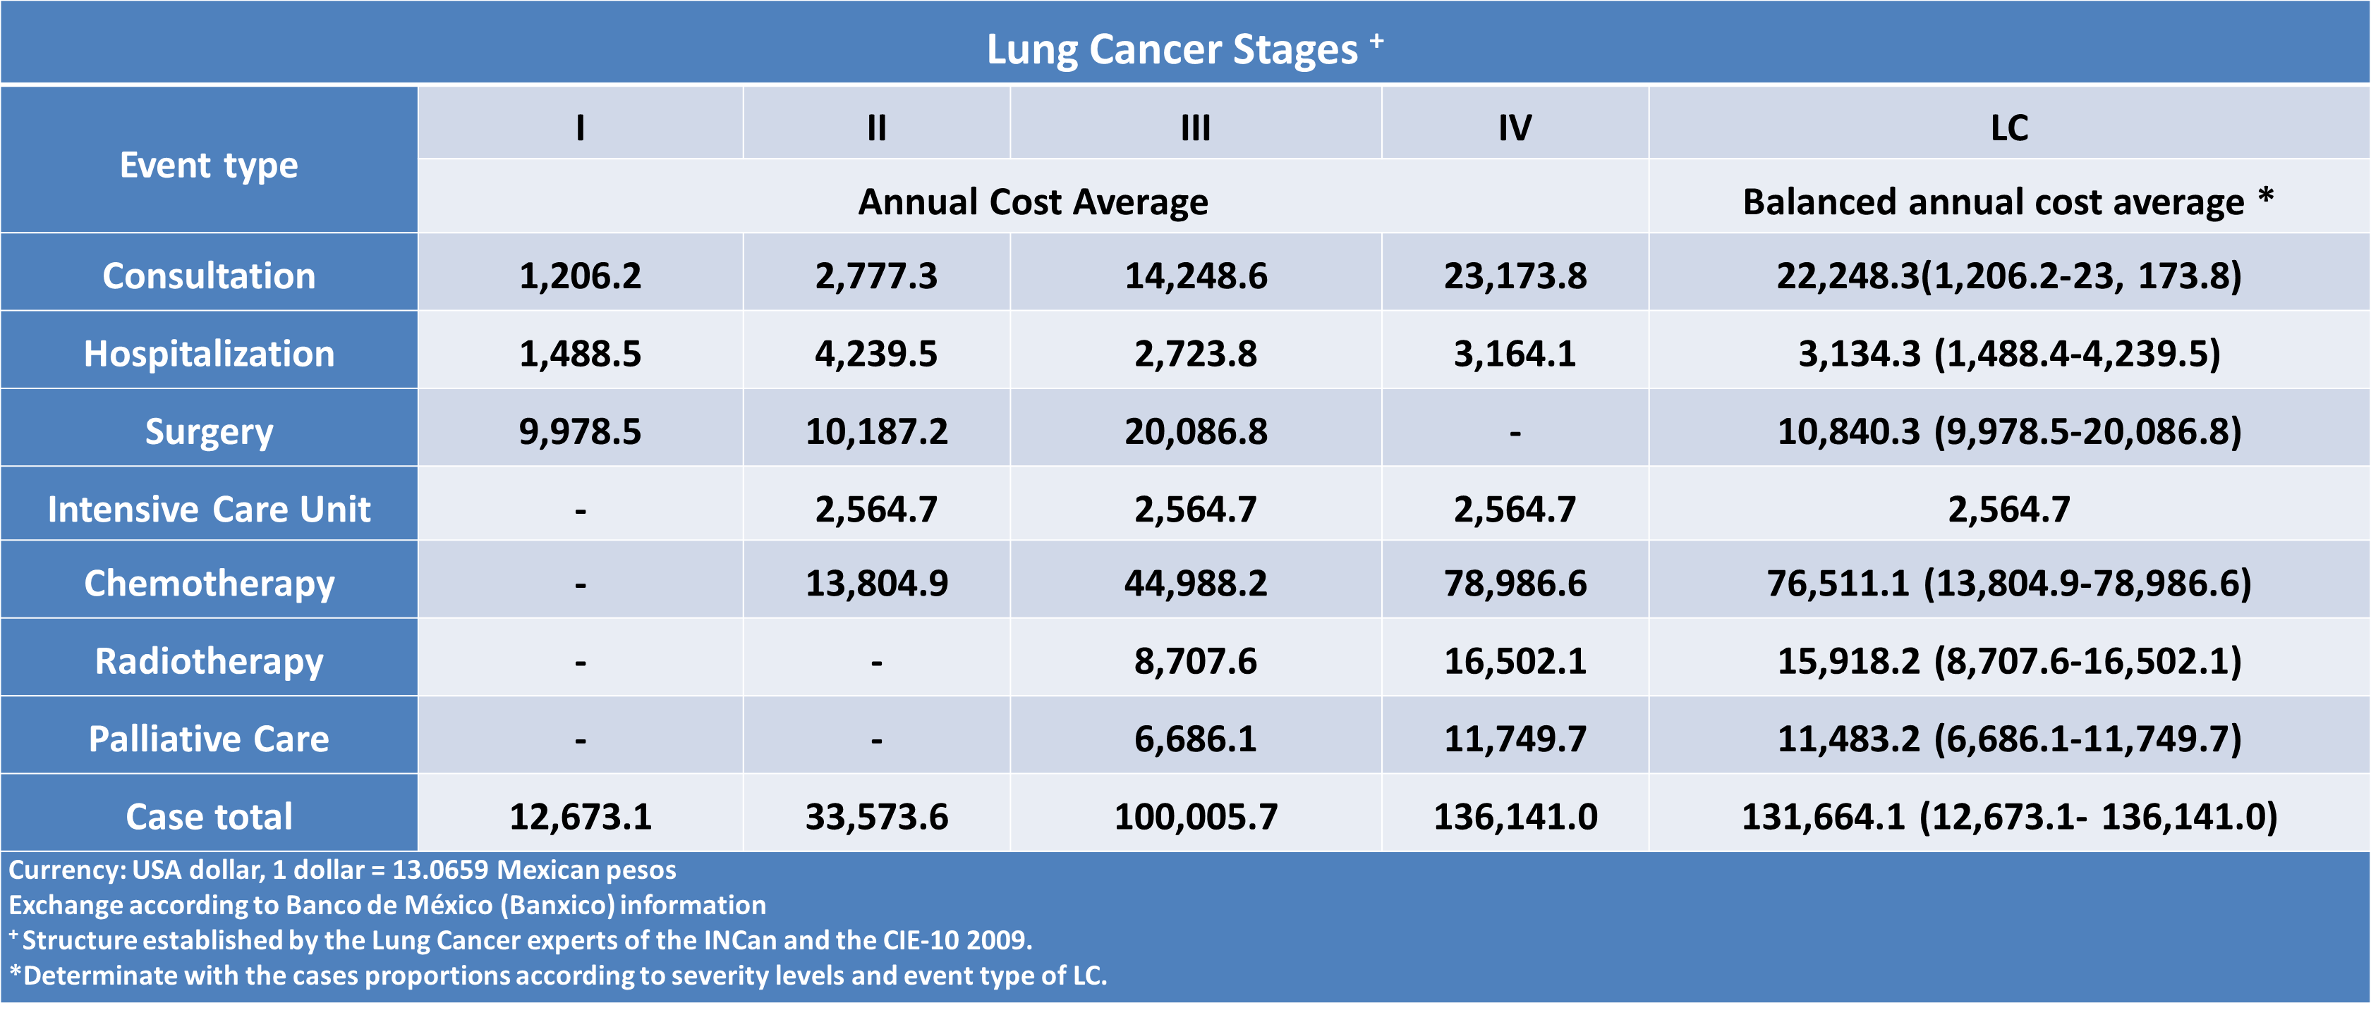
Arrieta et al. Tobacco Induced Diseases (2014) 12:25 DOI 10.1186/s12971-014-0025-4

Slide 18
“Epidemiological changes in the histological subtypes of 35,018 non-small-cell lung cancer cases in Brazil”,

Slide 19
Cost for lung cancer

Slide 20
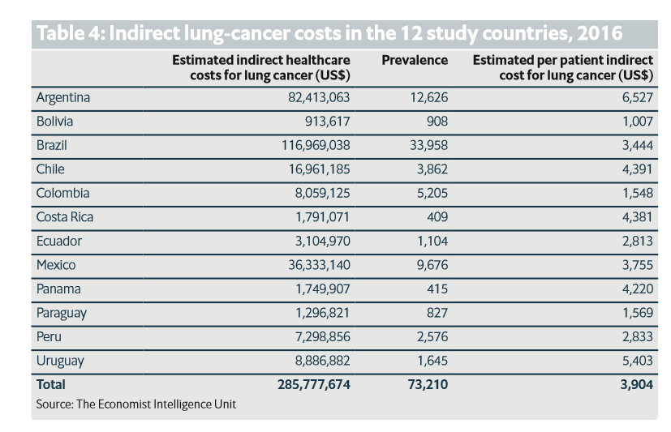
The indirect costs for lung cancer

Slide 21

Changes in the approach of the disease
Current therapy tends to be personalized ....
Correct medication
Correct patient
Correct moment
Notes:
De tal manera que actualmente estamos tratando de lograr es hacer un tratamiento personalizado para tratar de encontrar un mayor beneficio para el paciente, tener menos toxicidad y obviamente reducir los costos, es decir aplicar el medicamento correcto, al paciente correcto en el momento correcto es así como las caracteristicas geneticas marcan la diferencia

Slide 22
NSCLC genomic landscape
  8-10 mutations per I megabase (million base pairs)
  Chromosomal copy number alterations
  Gene rearrangements
  DNA single-nucleotide alterations, deletions or insertions
  Epigenetic alterations
  Transcriptome alterations
  Pathway alterations
MTE 07.01 : Molecular biology for clinicians

Slide 23
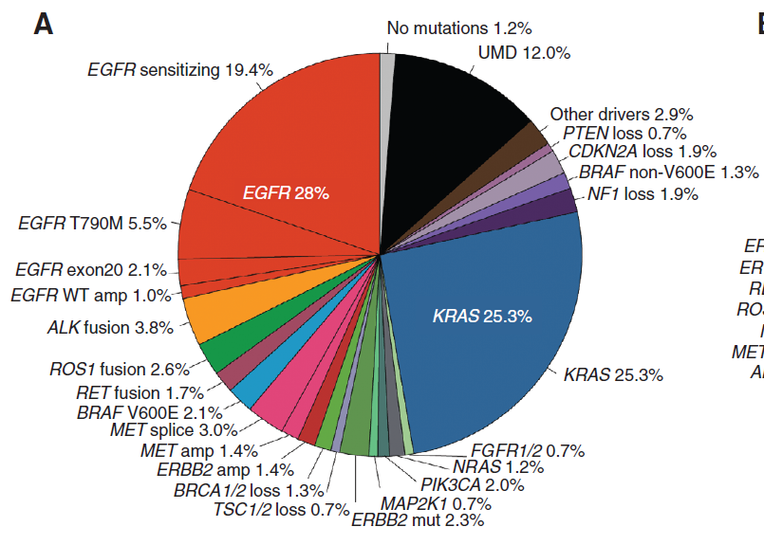
Molecular subtyping in pulmonary adenocarcinoma in 2017
860 patients
Prospective analysis of >300 cancer-associated genes
MTE 07.01 : Molecular biology for clinicians
Jordan EJ, Riely GJ Cancer Discov 2017

Slide 24
Lung Cancer Mutation Consortium:
OS by Mutation and Treatment
100
D + T: 3.49 y
D + no T: 2.38
No D: 2.08
p < 0.001
80
60
OS (%)
40
20
Driver mutation + targeted therapy (n = 313)
Driver mutation + no targeted therapy (n = 265)
No driver mutation (n = 361)
0
0
1
2
3
4
5
Yrs
Kris M, Johnson BE, Berry LD. JAMA 2014; 311(19):1998-2006
Notes:
OS, overall survival.
Why we should do that? Clinical evidence coming from the Lung Cancer Mutation Consortium data indicates that when an actionable target is detected and the patients are treated with the appropriate therapies, survival expectation will be much better than for those with actionable targets not treated with appropriate targeted therapies, giving this group an inferior survival expectation that is comparable in some way to that of those patients without oncogenic drivers and treated with cytotoxic chemotherapy.

Slide 25
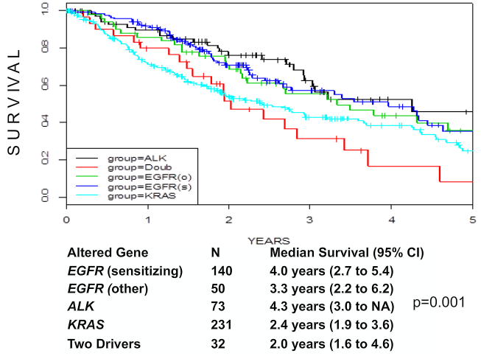
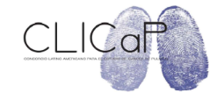
Survival with five most frequent oncogenic drivers (n=526)
NSCLC Mutation Consortium. IASLC 2013.

Slide 26
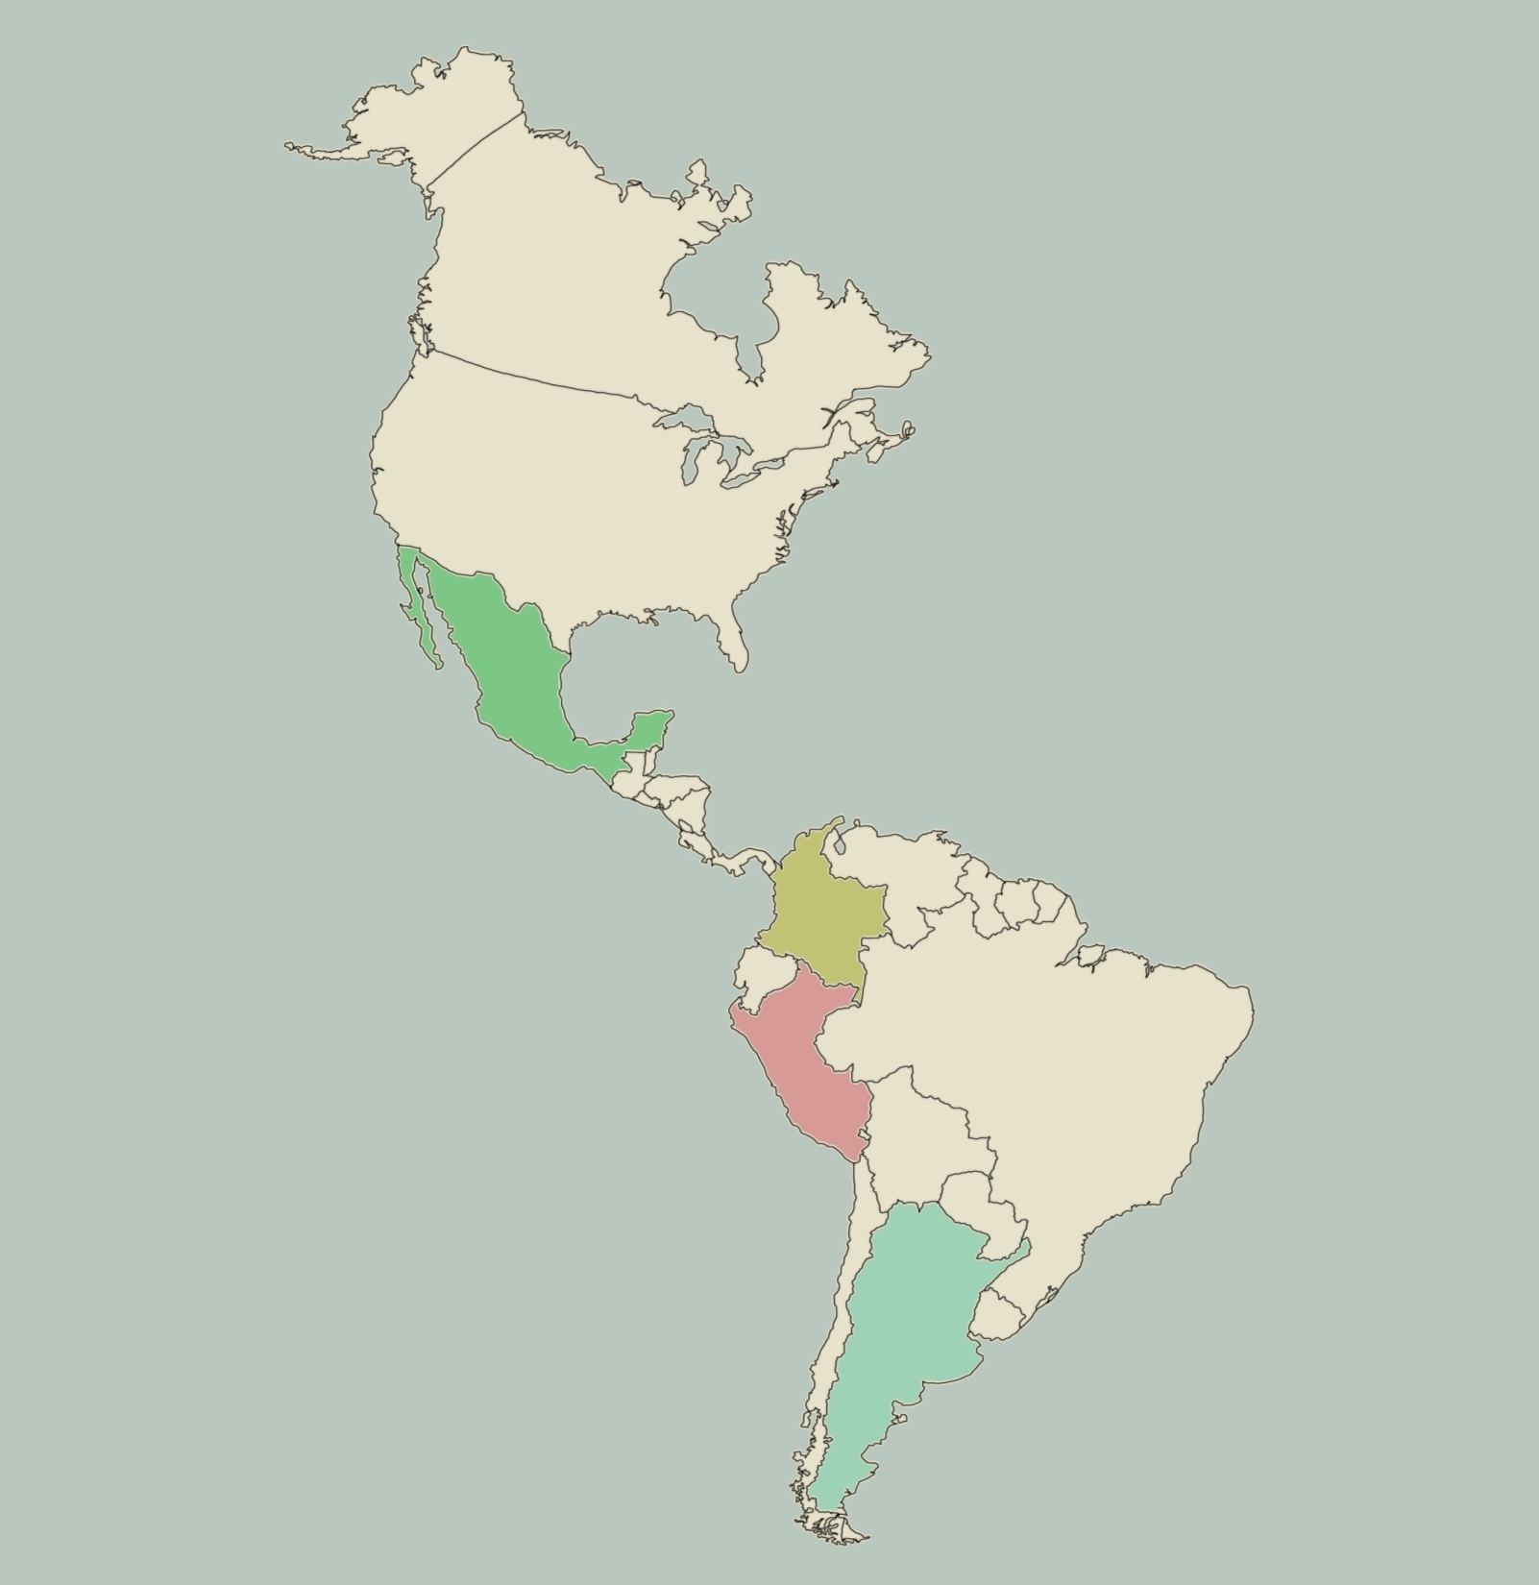
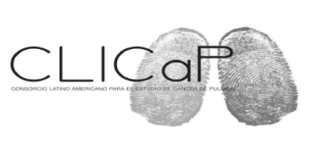
Number of patients 5738 Mutation Rate
1491 (26.0%) (95%CI: 25.3-26.7)
Mexico 486/1417
(EGFR (34.3)
Panama
47/174 (27.3)
PE5CXX
PE5CXX
Costa Rica
32/102 (31.4)
Colombia 479/1939
(EGFR (24.7))
Perú 201/393 (EGFR 51.1%)
Argentina 247/1713
(EGFR 14.4%)
Arrieta et al, J Thorac Oncol. 2011 Nov;6(11):1955-9

Slide 27
Factores que afectan la genotipificación de KRAS/EGFR
Clásicos
Sexo femenino
No fumador
Histología (adenocarcinoma)
Patrón histológico (leptidico, papilar)
Edad>65 años
Regionales
Infección por VPH
Tuberculosis
Susceptibilidad genética
Factores inmunológicos
Exposición a humo de leña
Genotyping Non-small Cell Lung Cancer (NSCLC) in Latin America.
Arrieta O. J Thorac Oncol. 2011 Nov;6(11):1955-1959.

Slide 28
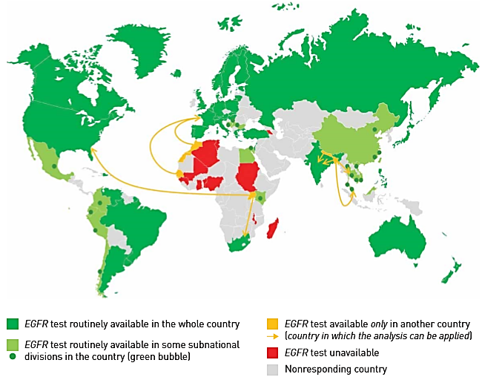
Inequalities in lung cancer: a world of EGFR
EGFR mutation testing and EGFR-TKIs are widely accessible in routine practice worldwide. However, there are large discrepancies in access to this innovative treatment path and in its cost for patients as a function of country development
Carbonnaux M, et al. Eur Respir J. 2016; In press. DOI: 10.1183/13993003.01157-2015.

Slide 29
Cost-effectiveness analysis of EGFR mutation testing in patients with non-small cell lung cancer (NSCLC) with gefitinib or carboplatin–paclitaxel
The European Journal of Health Economics · August 2015
ratios de coste-efectividad incremental

Slide 30
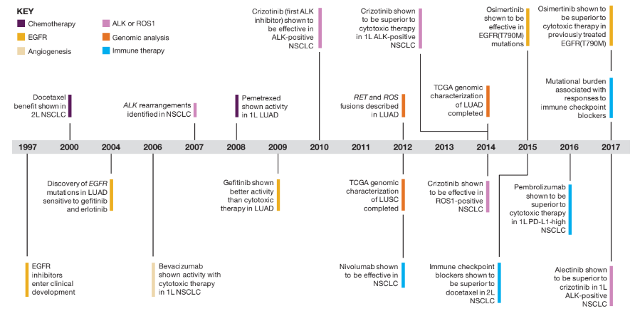

Slide 31
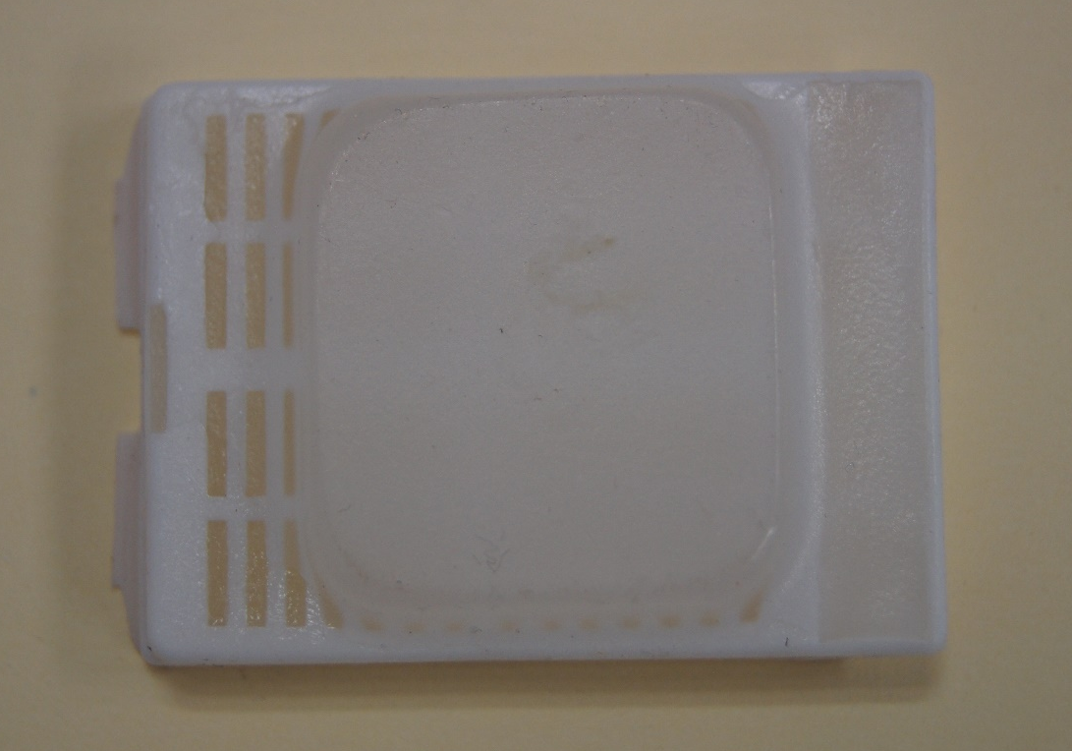
We need optimal biopsy
60‐70% of lung cancer patients only have fine needle or core biopsy specimens

Slide 33
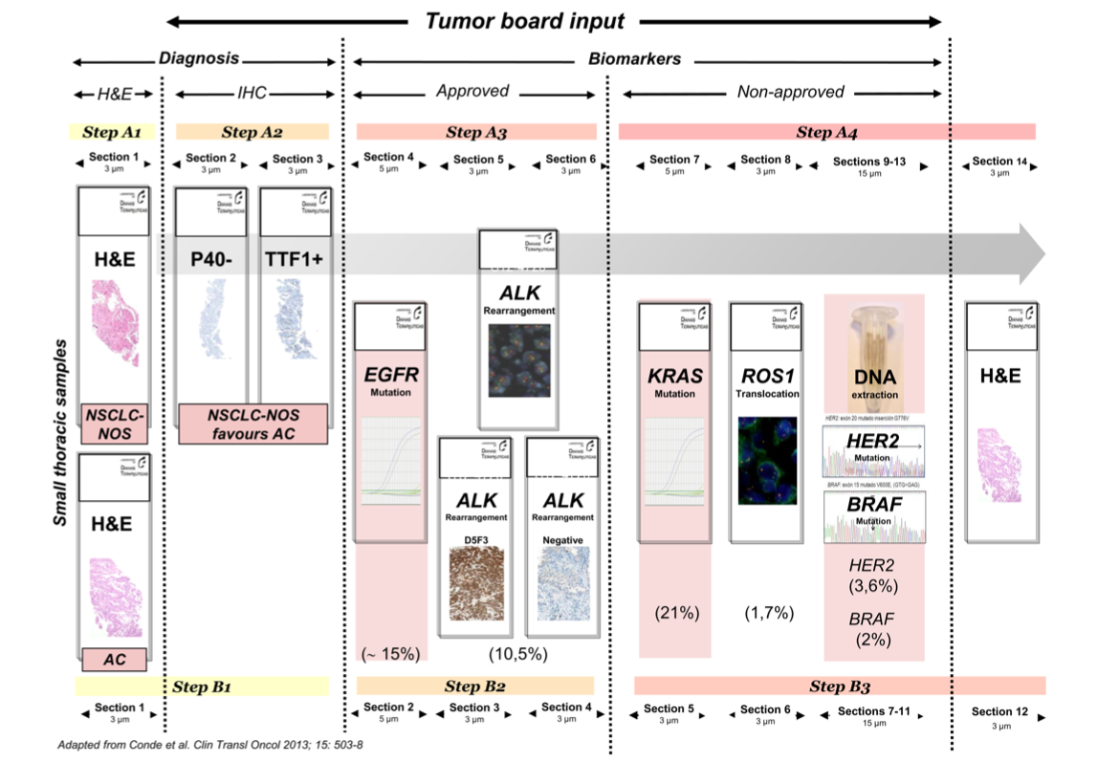
We need optimal biopsy

Slide 34
Health System in Mexico

Slide 35
El Cáncer de Pulmón No cuenta con apoyo de Seguro Popular
De las primeras causas de muerte por cáncer de pulmón
Pulmón
Mama
Colon
Próstata
Cervico-uterino
La única que no cuenta con seguro popular es Cancer de pulmón

Slide 36
Health System in Mexico
Treatment | IMSS (42%) | ISSSTE (8.5%) | Pemex Sedena, Marina (2%) | SSA (33.5%) | Privado (10.5%) | INCAN
Medical Insure or Seguro Popular | + | + | + | --- | +/- | --- *
Chemotherapy first Line | + | + | + | --- | +/- | --- *
Chemothearpy Second Line | + | + | + | --- | +/- | --- *
Genotyping (hospital) | --- | --- | --- | --- | +/- | +
Genotyping (PC) | --- | + | + | + | + | +
TKI (ALK and EGFR) | --- | + | + | --- | +/- | +
Avastin | --- | +/- | + | --- | +/- | +/-
Inmunotherapy | --- | --- | +/- | --- | +/- | --- **
Paliative Care | + | + | + | + | + | +
* Tratment for women ** Protocol

Slide 37
Clinical trials in INCAN
First Line EGFR/ALK negative
  Inmunotherapy Vs Chemotherapy (PC)
First Line EGFR Positive
  GOAL (G vs G plus Olaparib) (Spanish Group)
  TKI vs TKI plus Metformin (INCAN)
Second Line EGFR/ALK negative
  Docetaxel vs Docetaxel plus pembro
Second Line EGFR Positive
  TKI vs TKI plus Metformin (INCAN)
First Line ALK Positive (PC)
Second line c-met (PC)
Prophylactic brain radiation therapy in EGFR patients (INCAN)
Nitroglicerin in Brain Metastases (INCAN)
Early attention to palliative care

Slide 38
Importancia de desarrollar investigación independiente
  Mejorar el pronóstico del paciente
  Obtención de recursos para el tratamiento oncológico
  Evaluar objetivamente nuestros resultados
  Obtención de resultados de NUESTRA población

Slide 39
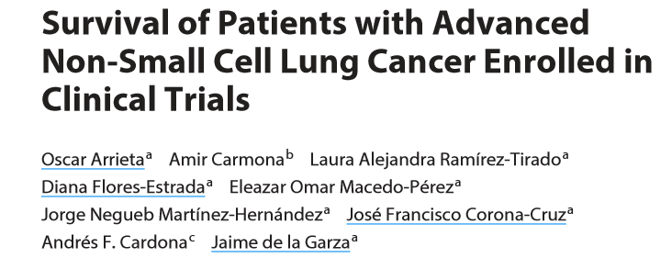
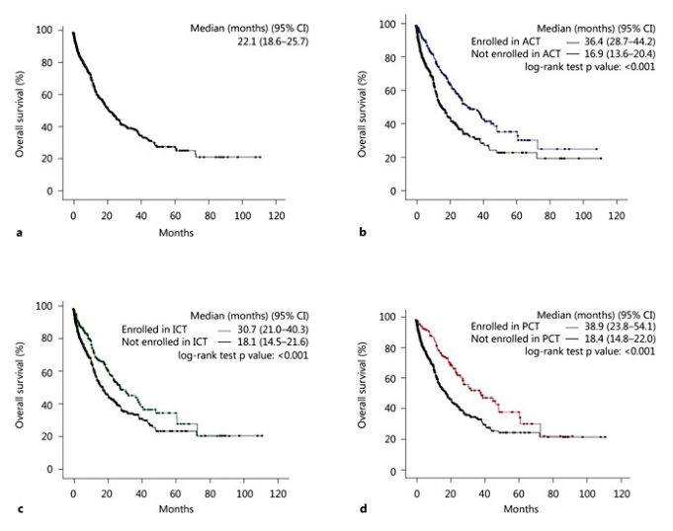

Slide 40
ACCIONES REALIZADAS PARA SOLUCIONARLO
Por el área operativa (clínica)
Búsqueda de fondos: a) Seguro popular b) Fundaciones c) Cámara de senadores d) Secretaria de Salud e) Programas especiales
Por las autoridades tomadores de decisión
Registro de Cáncer

Slide 41
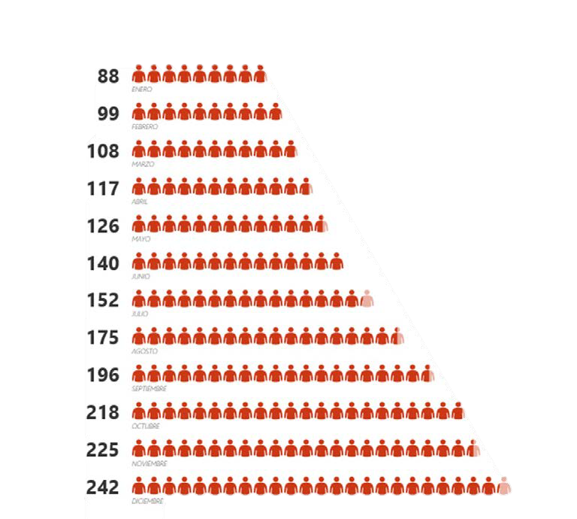
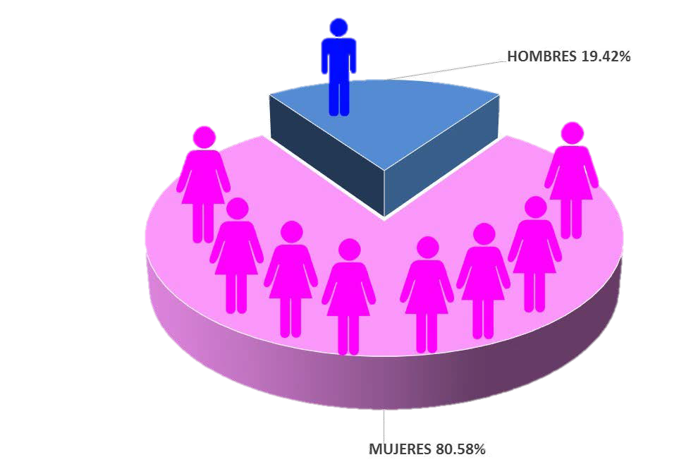
Con el presupuesto de la cámara de diputados se puede ofrecer una mayor atención a las pacientes con cáncer de pulmón, para el 31 de diciembre de 2016 se han beneficiado un total de 242 pacientes, con tratamiento y atención multidisciplinaria dentro de la Unidad Funcional de Oncología Torácica.

Slide 42
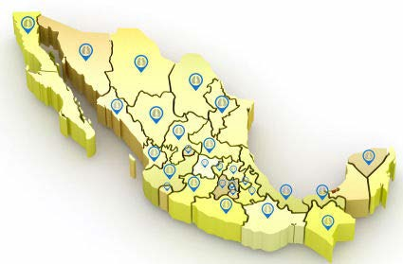
INFORME DE RESULTADOS 2016
ESTADO | CANTIDAD
Aguascalientes | 2
Baja California | 1
Coahuila | 2
Colima | 1
Chiapas | 1
Chihuahua | 2
Ciudad de México | 75
Durango | 3
Guanajuato | 10
Guerrero | 7
Hidalgo | 15
Jalisco | 4
México | 36
Michoacán | 19
ESTADO | CANTIDAD
Morelos | 6
Nayarit | 3
Nuevo León | 4
Oaxaca | 9
Puebla | 7
Querétaro | 3
San Luis Potosí | 6
Sinaloa | 2
Sonora | 2
Tabasco | 2
Tlaxcala | 7
Veracruz | 7
Yucatán | 2
Zacatecas | 4

Slide 43
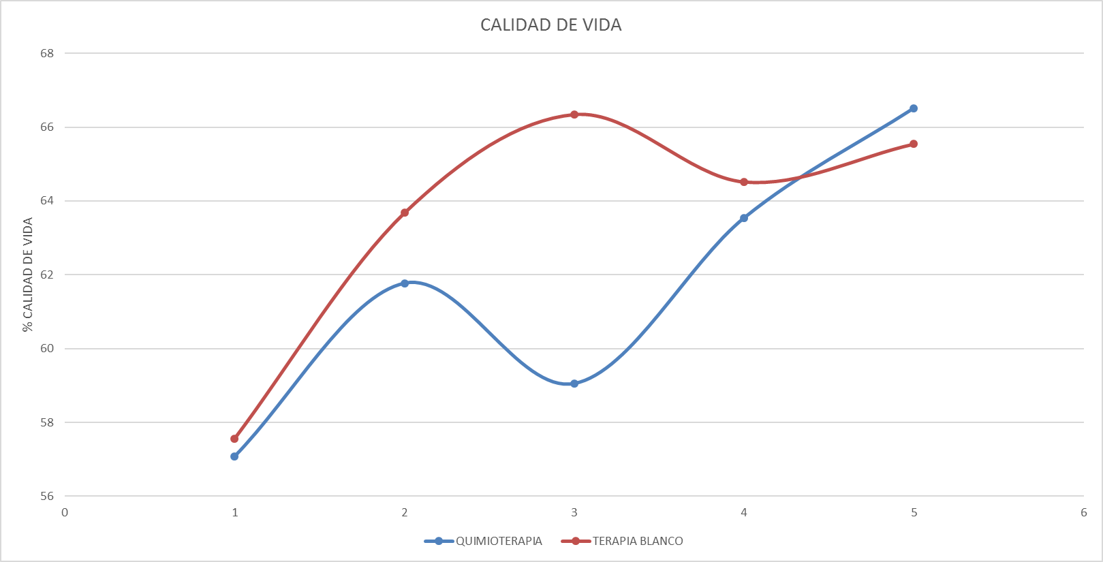
INFORME DE RESULTADOS 2016
CALIDAD DE VIDA PACIENTES CON QUIMIOTERAPIA Y PACIENTES CON TKI

Slide 44
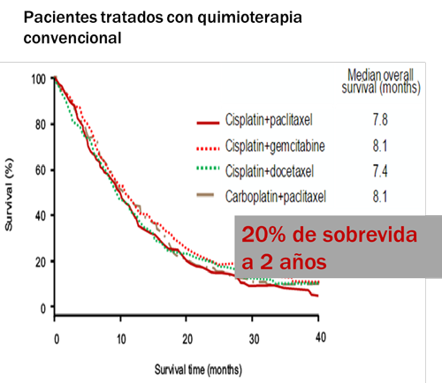
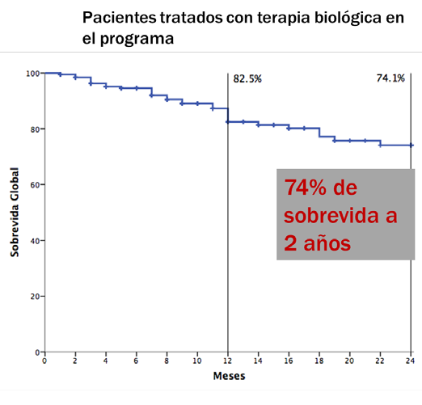

Slide 45

421 Pacientes ingresados de marzo 2015 a mayo 2018
60% Vivos
40% Fallecidos

Slide 46
427 Pacientes ingresados de marzo 2015 a mayo 2018
60% Vivos
40% Fallecidos

Slide 47
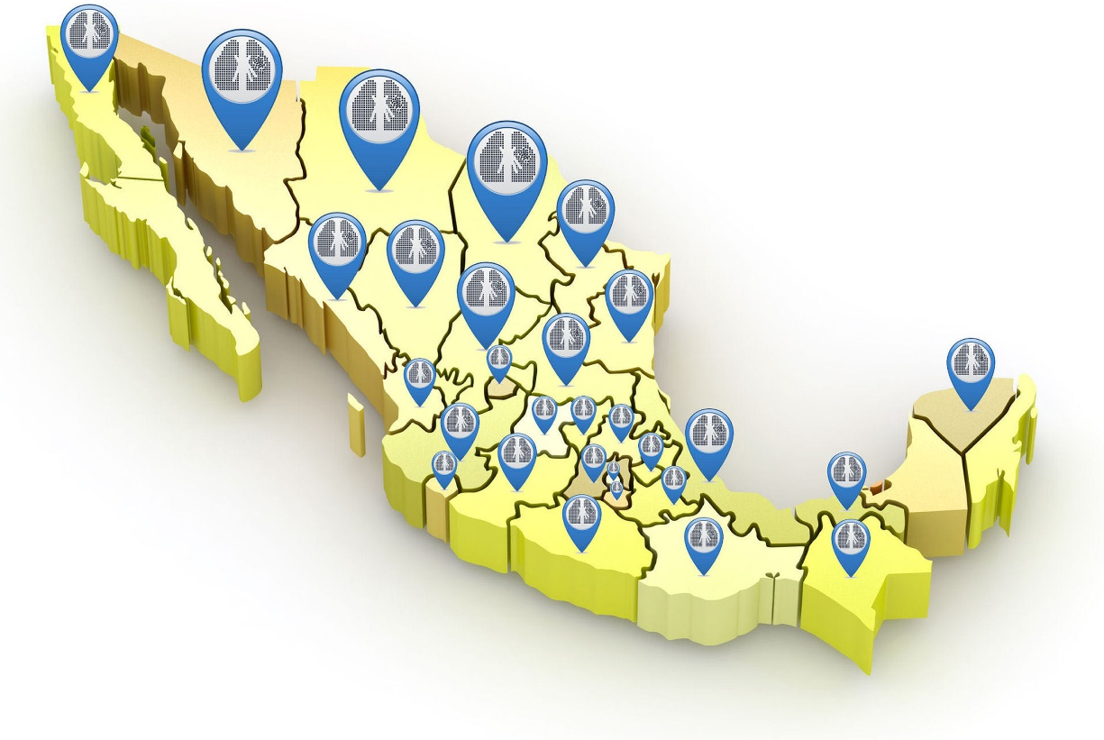

Slide 48
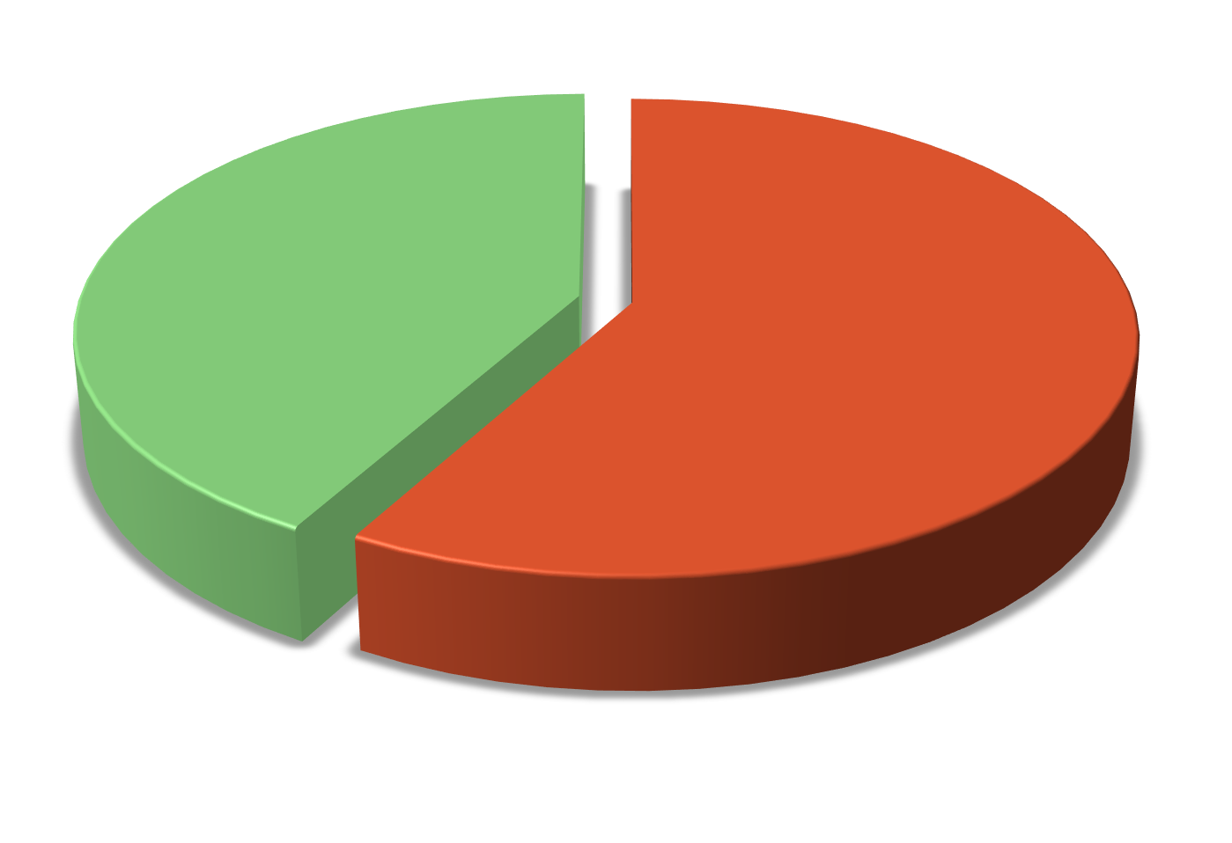
58 % DE PACIENTES VIVOS A marzo 2019

Slide 49
MUTACIONES

Slide 50
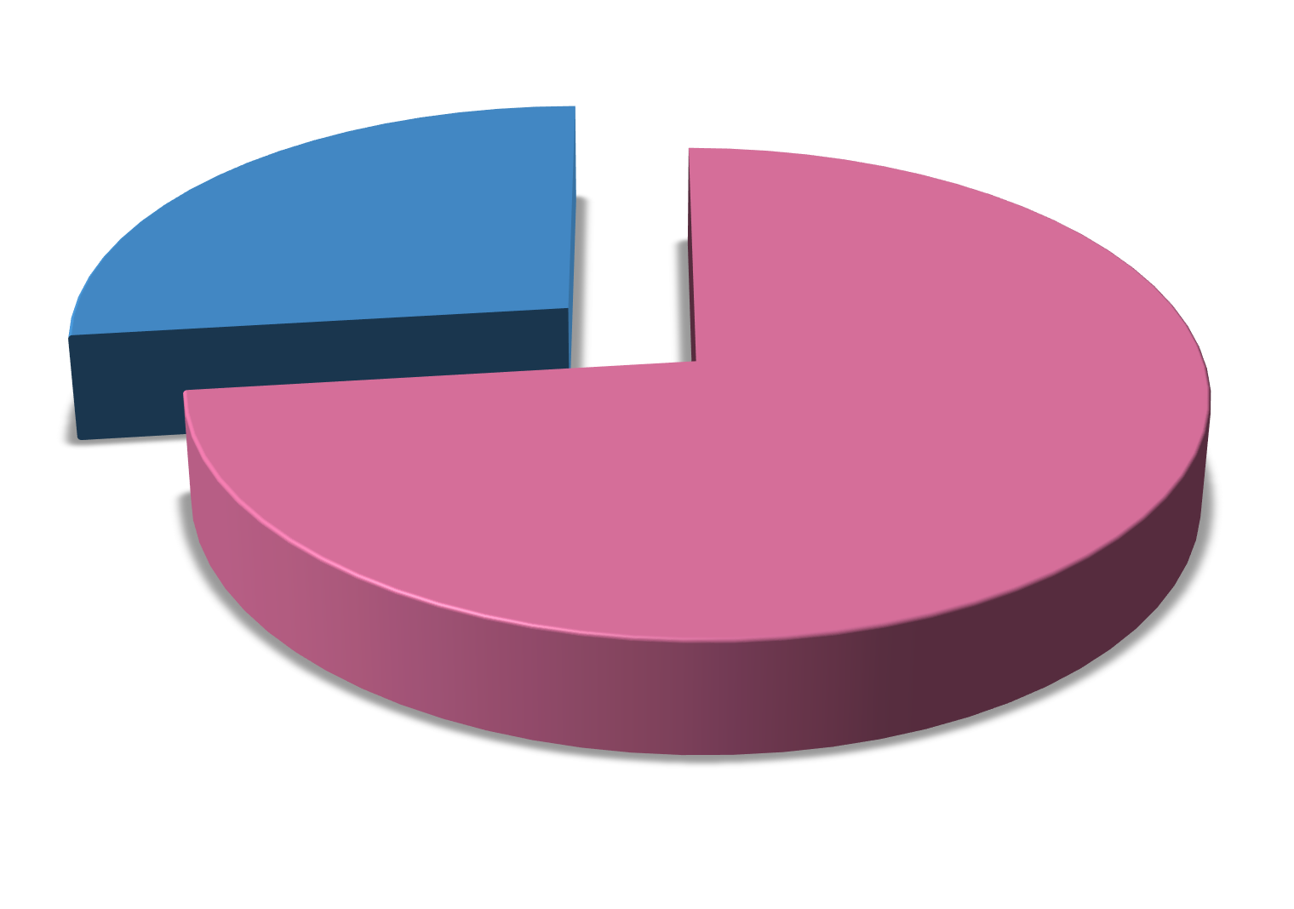
313 PACIENTES INGRESADAS SON MUJERES

Slide 51
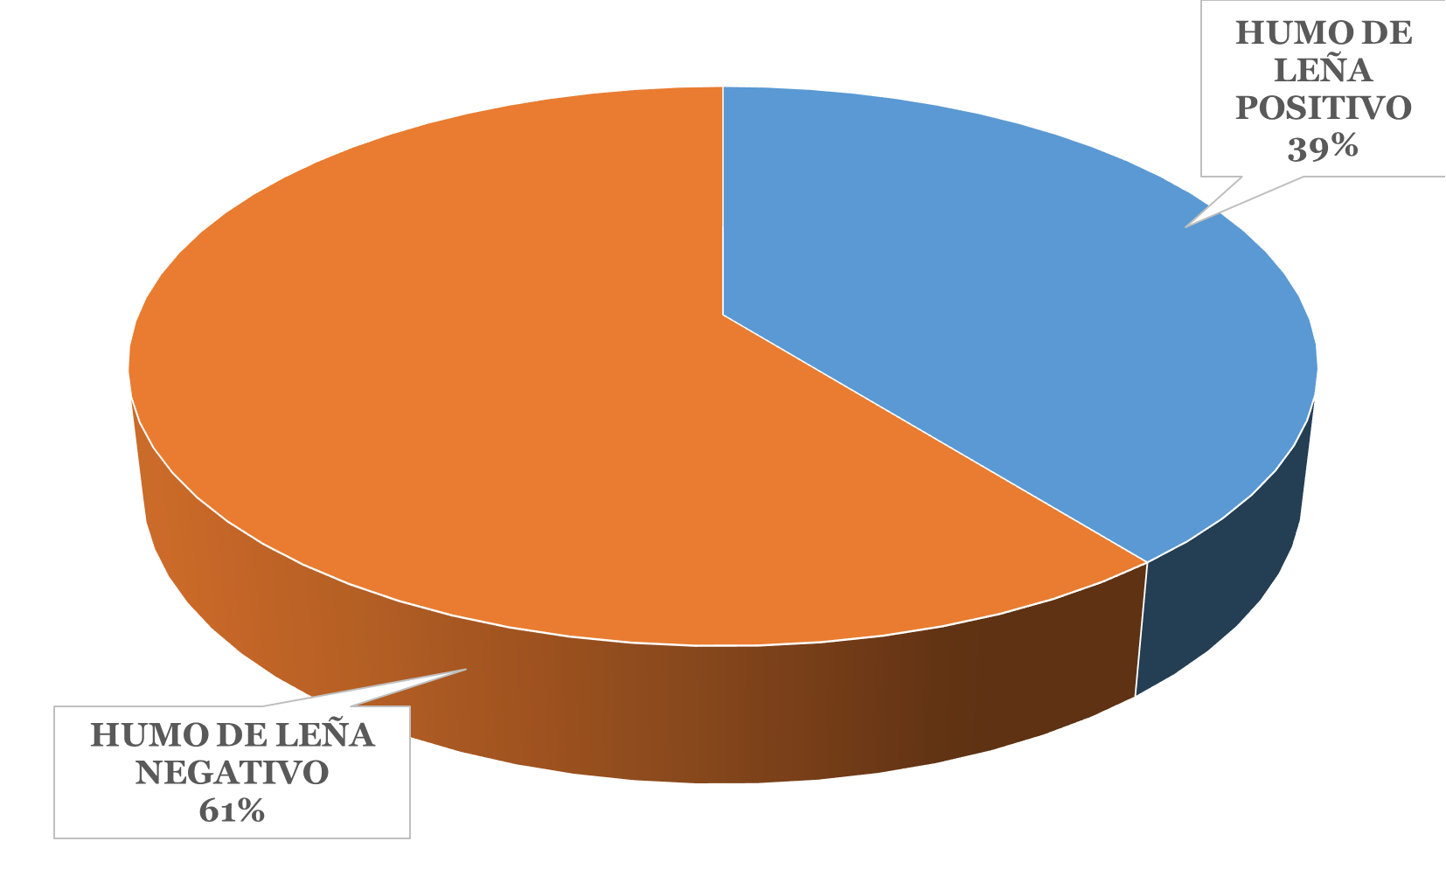
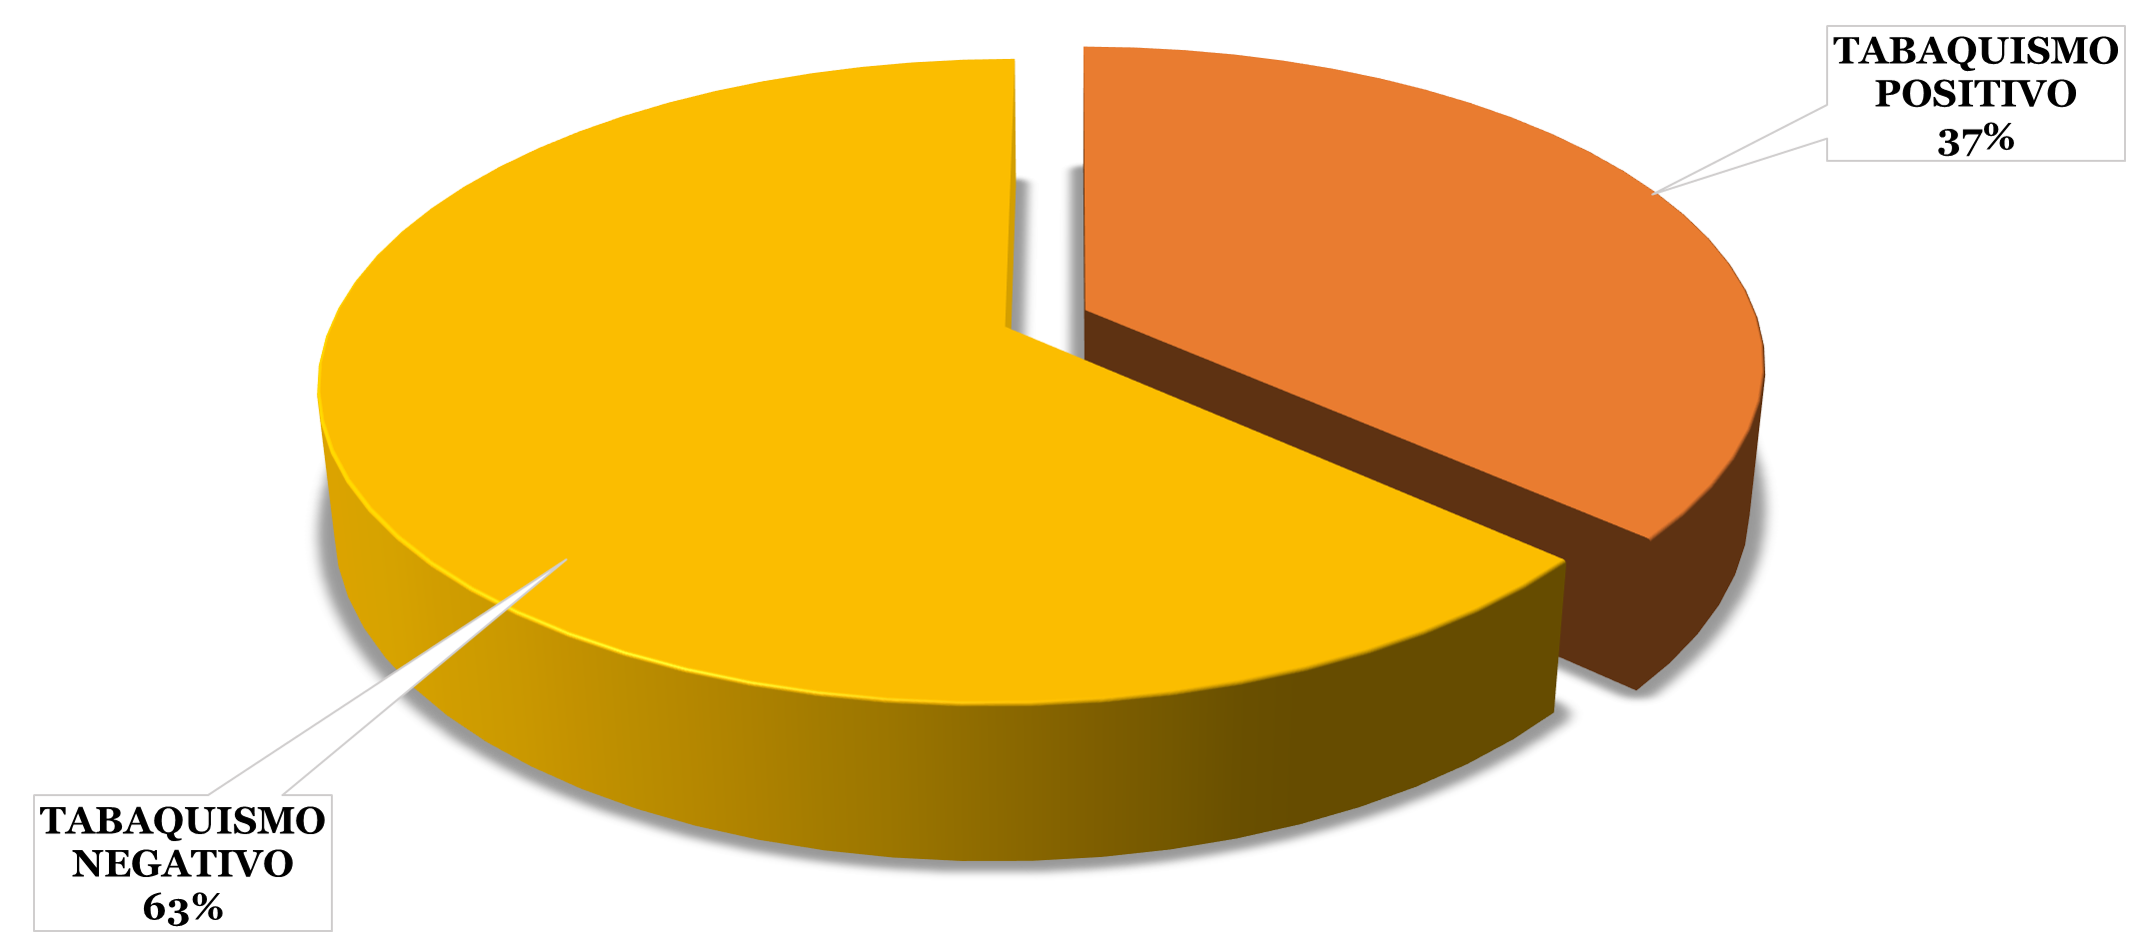
63 % DE LOS PACIENTES SON NO FUMADORES
61 % DE LOS PACIENTES NO HAN TENIDO CONTACTO CON HUMO DE LEÑA

Slide 52
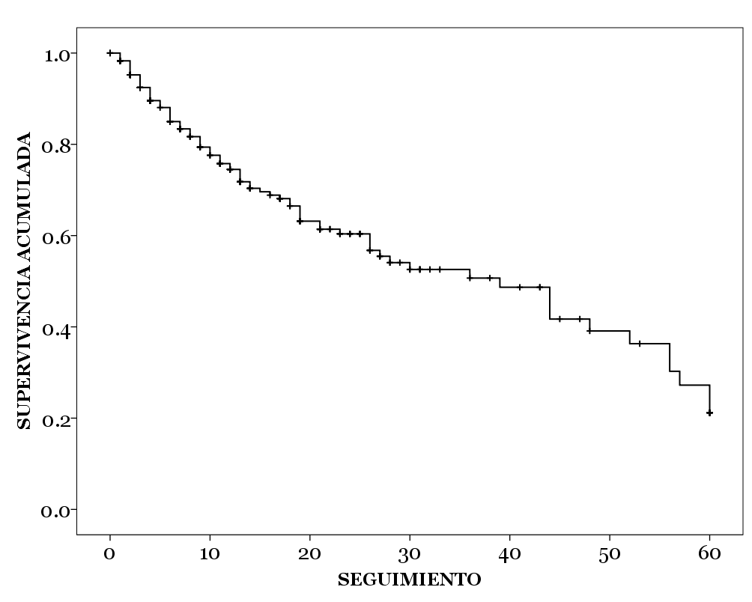
SUPERVIVENCIA
PACIENTES TRATADOS CON TERAPA BIOLÓGICA
CON MÁS DE 12 MESES DE TRATAMIENTO
Mediana de 39 meses
IC 26.875 – 51.125

Slide 53
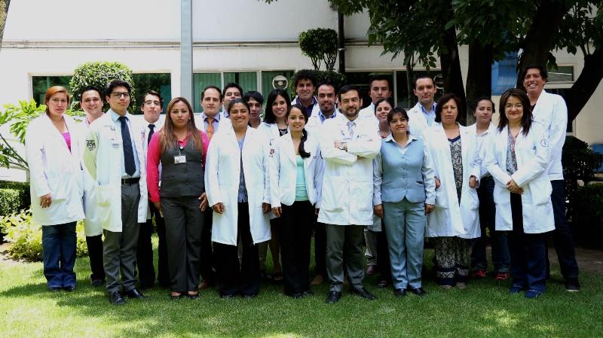
Unidad Funcional de Oncología Torácica
Oncología
  Feliciano Barrón
  Oscar Arrieta
  Luis Cabrera
  Jaime de la Garza
Cirugía
  Edgardo Jiménez
  Francisco Corona
Radioterapia
  Federico Maldonado
Neumología y Tabaquismo
  Elma Correa
Patología
  Alejandro Aviles
Dermatología
  Tere Vega
Radiología
  Jorge Guerrero
Laboratorio de Medicina personalizada
Rehabilitación
Nutrición
Psicología
Coordinación de protocolos
Administración (Leonor Báez)
Pasantes de SS
Estudiantes de Maestría y doctorado
Post doctorado y Cátedras de Conacyt
Alumnos de alta especialidad
Coordinación de la Unidad Funcional
Enfermería
Secretarías (Lourdes Sánchez)

