Slide 1


Slide 2

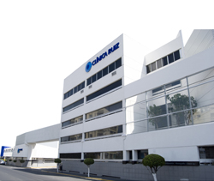
Dr. Guillermo J. RUIZ DELGADO
Director médico
Centro de Hematología y Medicina Interna
Puebla, Pue.
gruiz2@clinicaruiz.com
222 2438100 Ext. 234/261

Slide 3
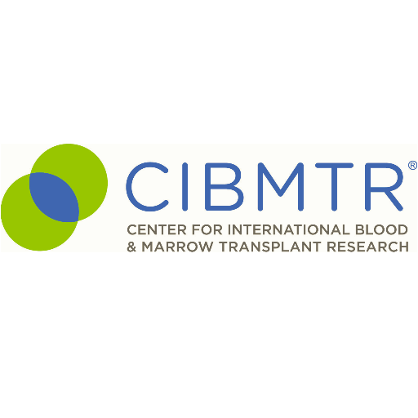


Slide 4
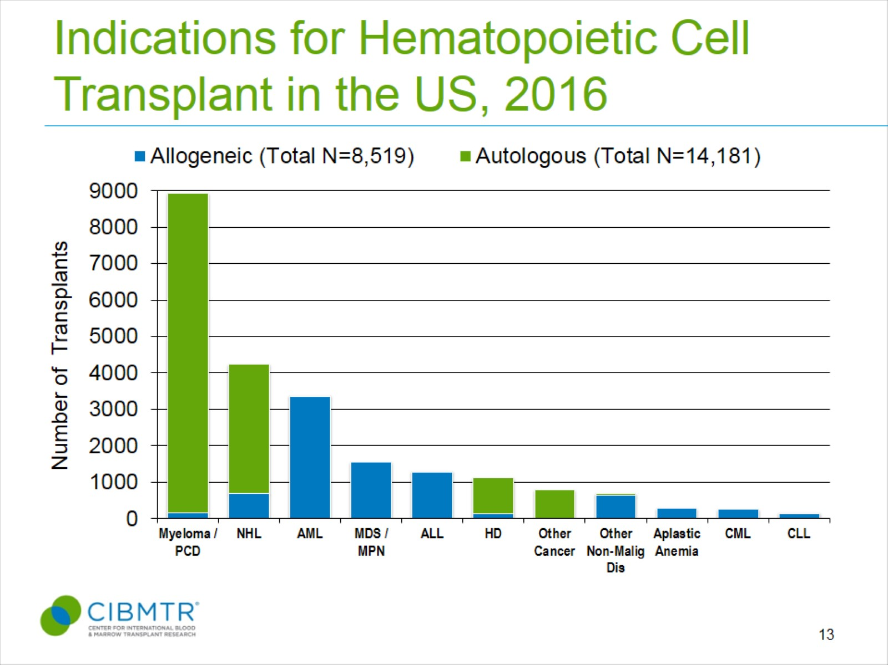
Indications for Hematopoietic Cell Transplant in the US, 2016
Notes:
Slide 13: The most common indications for HCT in the US in 2016 were multiple myeloma and lymphomas (NHL and HD) accounting for 63% of all HCTs. Acute leukemias (AML, ALL) and MDS (combined with MPNs) are the most common indications for allogeneic transplants accounting for 72% of allogeneic HCTs. MDS/MPN transplants have increased after the availability of Centers for Medicare and Medicaid Services (CMS)-approved Coverage with Evidence Development studies allowing allogeneic HCT in Medicare-insured patients for MDS (since 2010) and will continue to increase with the approval for myelofibrosis in 2017.

Slide 5
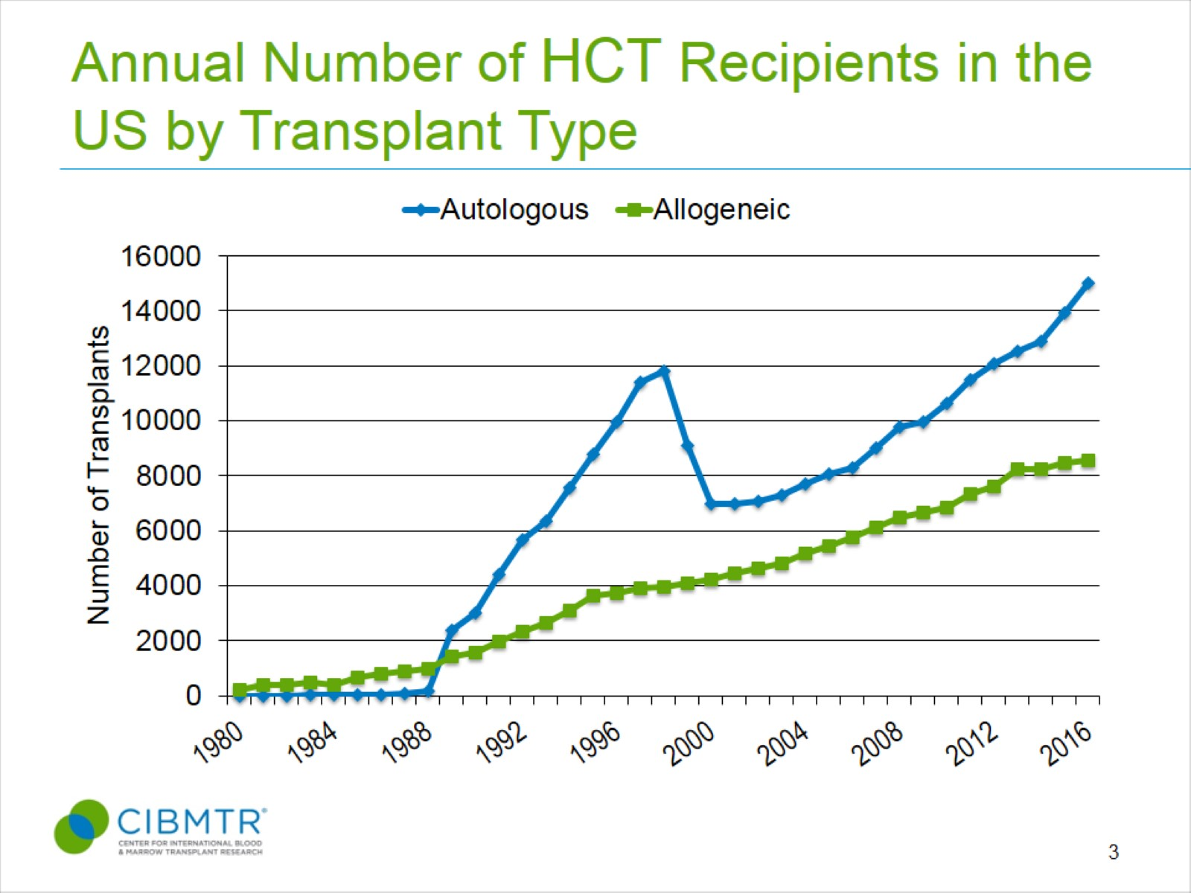
Annual Number of HCT Recipients in the US by Transplant Type
Notes:
Slide 3: The estimated annual numbers of transplant recipients in the U.S. were compiled according to the number of first transplants registered with the CIBMTR. Estimates of how closely the numbers reported are representative of actual transplant activity vary according to the type of transplant and number of centers reporting data per year. Prior to 2007, all transplants, except unrelated donor allogeneic transplants facilitated by the NMDP, were reported voluntarily. It was estimated that the CIBMTR captured 90% of all unrelated donor transplants performed in the US, 60-90% of related donor allogeneic transplants and 65 to 75% of autologous transplants. These estimates were extrapolated from other databases that capture transplant center activity, accreditation or hospital discharges. After 2007, the Stem Cell Transplant Outcomes Database (SCTOD) was initiated which changed reporting requirements and data capture to an electronic format. The SCTOD requires that all allogeneic transplants performed in the US be registered with CIBMTR. The numbers of allogeneic transplants from the US in the CIBMTR are representative of the total US transplant activity. Data reporting of autologous transplants remains voluntary and the numbers in the CIBMTR database are estimated to be 80% in 2016.
The estimated annual number of allogeneic transplants recipients surpasses 8,000 a year in the US in 2013 with 8539 transplants estimated in 2016, up from 8474 in 2015. The number of autologous transplants recipients in the US continues to increase at a much faster rate, most prominently since 2010, mainly from transplants performed for plasma cell and lymphoproliferative disorders extending to older patients.

Slide 6
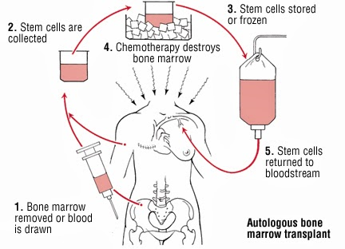

Slide 7
Fundamentos
Eliminar linfocitos autoreactivos y reiniciar el sistema inmune en un ambiente no inflamatorio libre de señales coestimuladoras.
Reinicialización de la población linfoide T (CD4+) para que deje de ser autorreactiva.

Slide 8
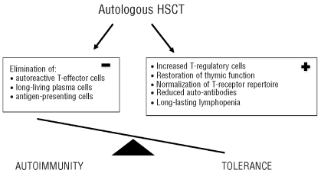

Slide 9
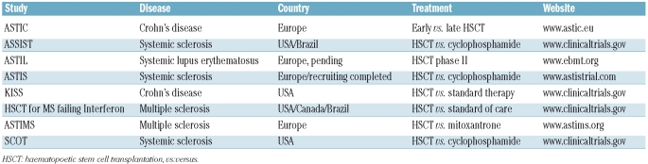

Slide 10
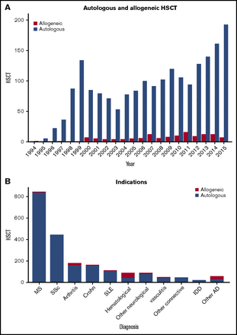

Slide 11
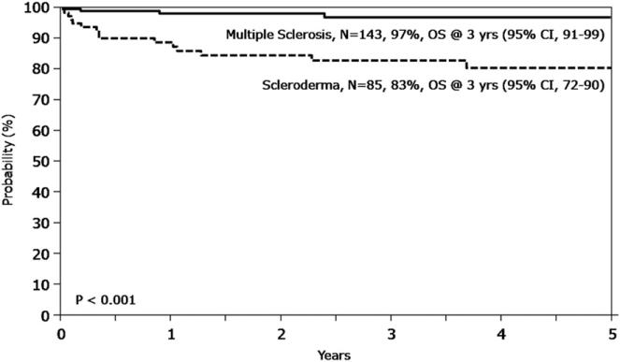

Slide 13

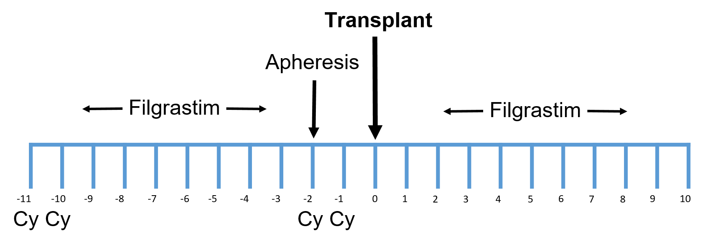

TMO en EM

Slide 15
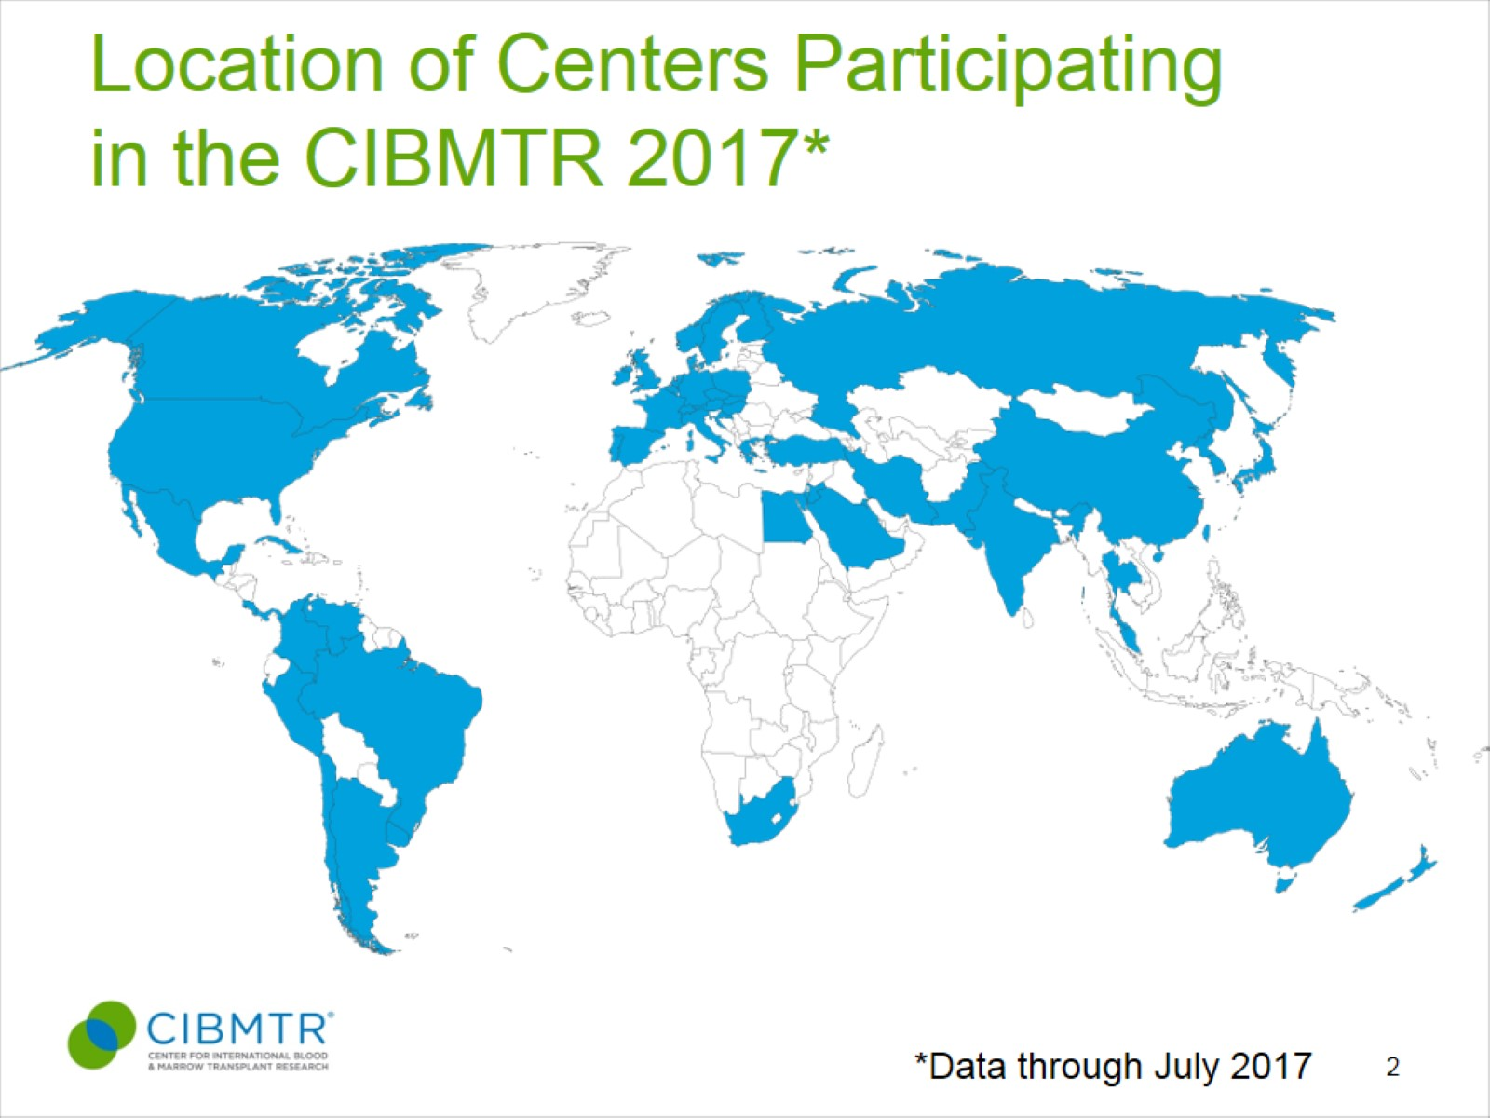
Location of Centers Participating in the CIBMTR 2017*
Notes:
Slide 2: This slide shows the location of transplant centers that report data to the CIBMTR.

Slide 16
Annual Number of HCT Recipients in the US by Transplant Type
Notes:
Slide 3: The estimated annual numbers of transplant recipients in the U.S. were compiled according to the number of first transplants registered with the CIBMTR. Estimates of how closely the numbers reported are representative of actual transplant activity vary according to the type of transplant and number of centers reporting data per year. Prior to 2007, all transplants, except unrelated donor allogeneic transplants facilitated by the NMDP, were reported voluntarily. It was estimated that the CIBMTR captured 90% of all unrelated donor transplants performed in the US, 60-90% of related donor allogeneic transplants and 65 to 75% of autologous transplants. These estimates were extrapolated from other databases that capture transplant center activity, accreditation or hospital discharges. After 2007, the Stem Cell Transplant Outcomes Database (SCTOD) was initiated which changed reporting requirements and data capture to an electronic format. The SCTOD requires that all allogeneic transplants performed in the US be registered with CIBMTR. The numbers of allogeneic transplants from the US in the CIBMTR are representative of the total US transplant activity. Data reporting of autologous transplants remains voluntary and the numbers in the CIBMTR database are estimated to be 80% in 2016.
The estimated annual number of allogeneic transplants recipients surpasses 8,000 a year in the US in 2013 with 8539 transplants estimated in 2016, up from 8474 in 2015. The number of autologous transplants recipients in the US continues to increase at a much faster rate, most prominently since 2010, mainly from transplants performed for plasma cell and lymphoproliferative disorders extending to older patients.

Slide 17
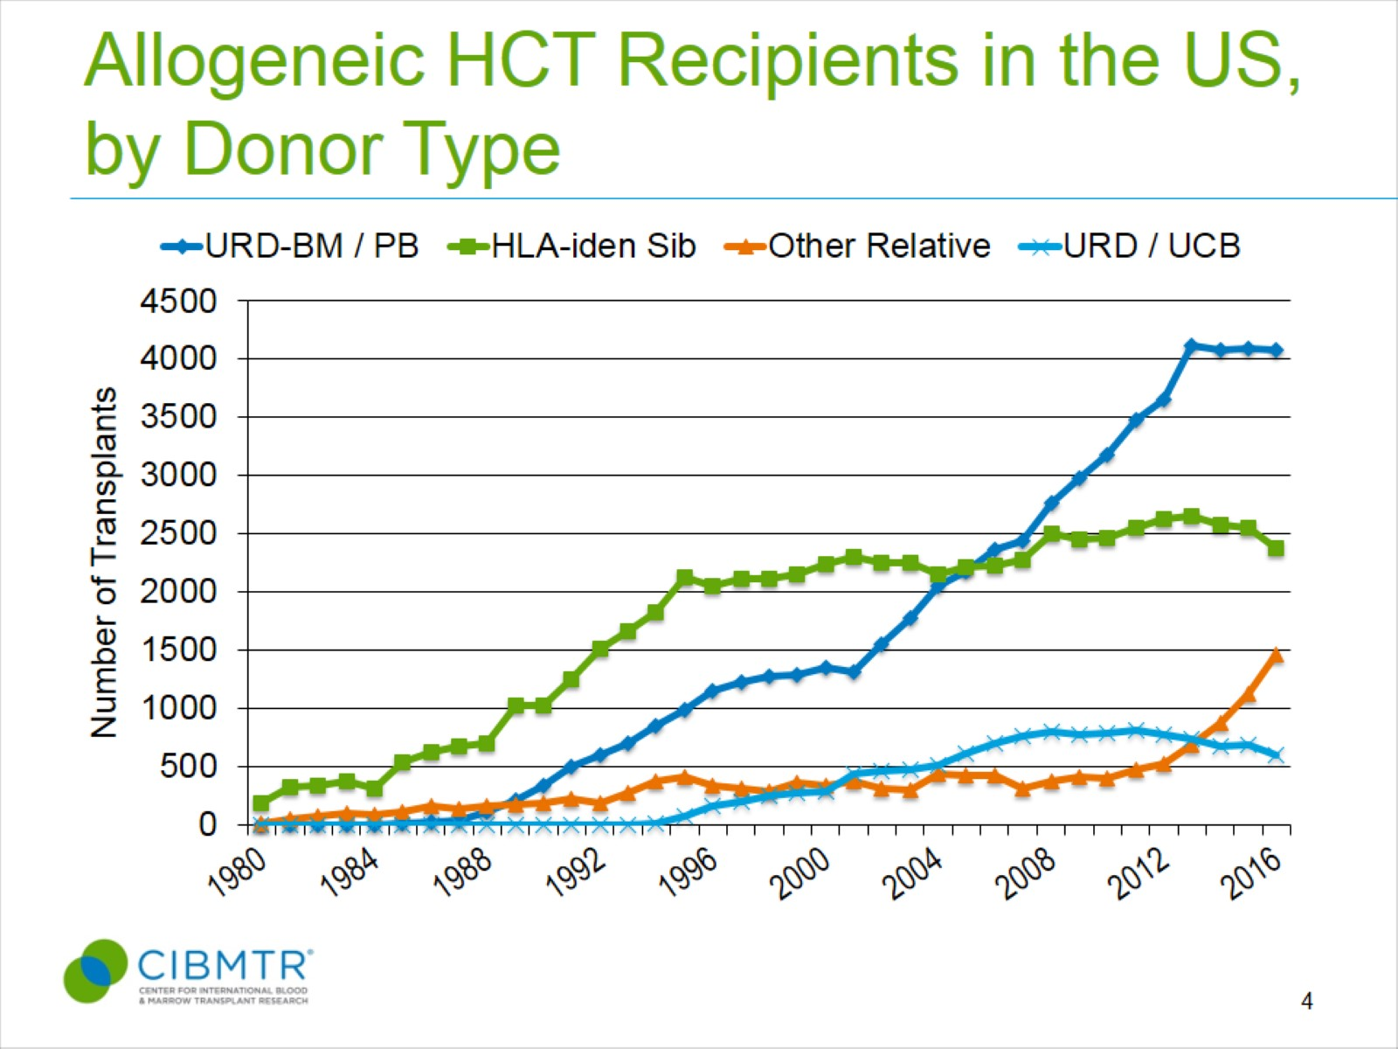
Allogeneic HCT Recipients in the US, by Donor Type
Notes:
Slide 4: Upon further stratifying the number of allogeneic transplants recipients in the US by donor type, recipients of unrelated donor transplants represent the largest group. The number of unrelated donor (URD) transplants has surpassed the number of allogeneic transplants from related donors after 2006 and the gap between these two types of approaches peaked in 2012. After 2012, the numbers of URD and HLA-identical siblings transplants has shown a downward trend in absolute numbers. Transplants performed with alternative donors is increasing. From 2003 to 2011, there were a steady increase in the numbers of transplants using umbilical cord blood as a result of several published studies demonstrating its benefit in both children and adults. From 2012 onward, there was an increase in the numbers of transplants from ‘Other Relatives’, likely due to the use of haploidentical donors with post-transplant cyclophosphamide strategy. In 2014, the numbers of transplants using ‘Other Relatives’ surpassed the total numbers of umbilical cord transplant performed in the US, accounting for 11% of all allogeneic transplants performed in the US. In 2016, this is the only group of donor type that is increasing with all other donor types showing decline or stability in use.

Slide 18
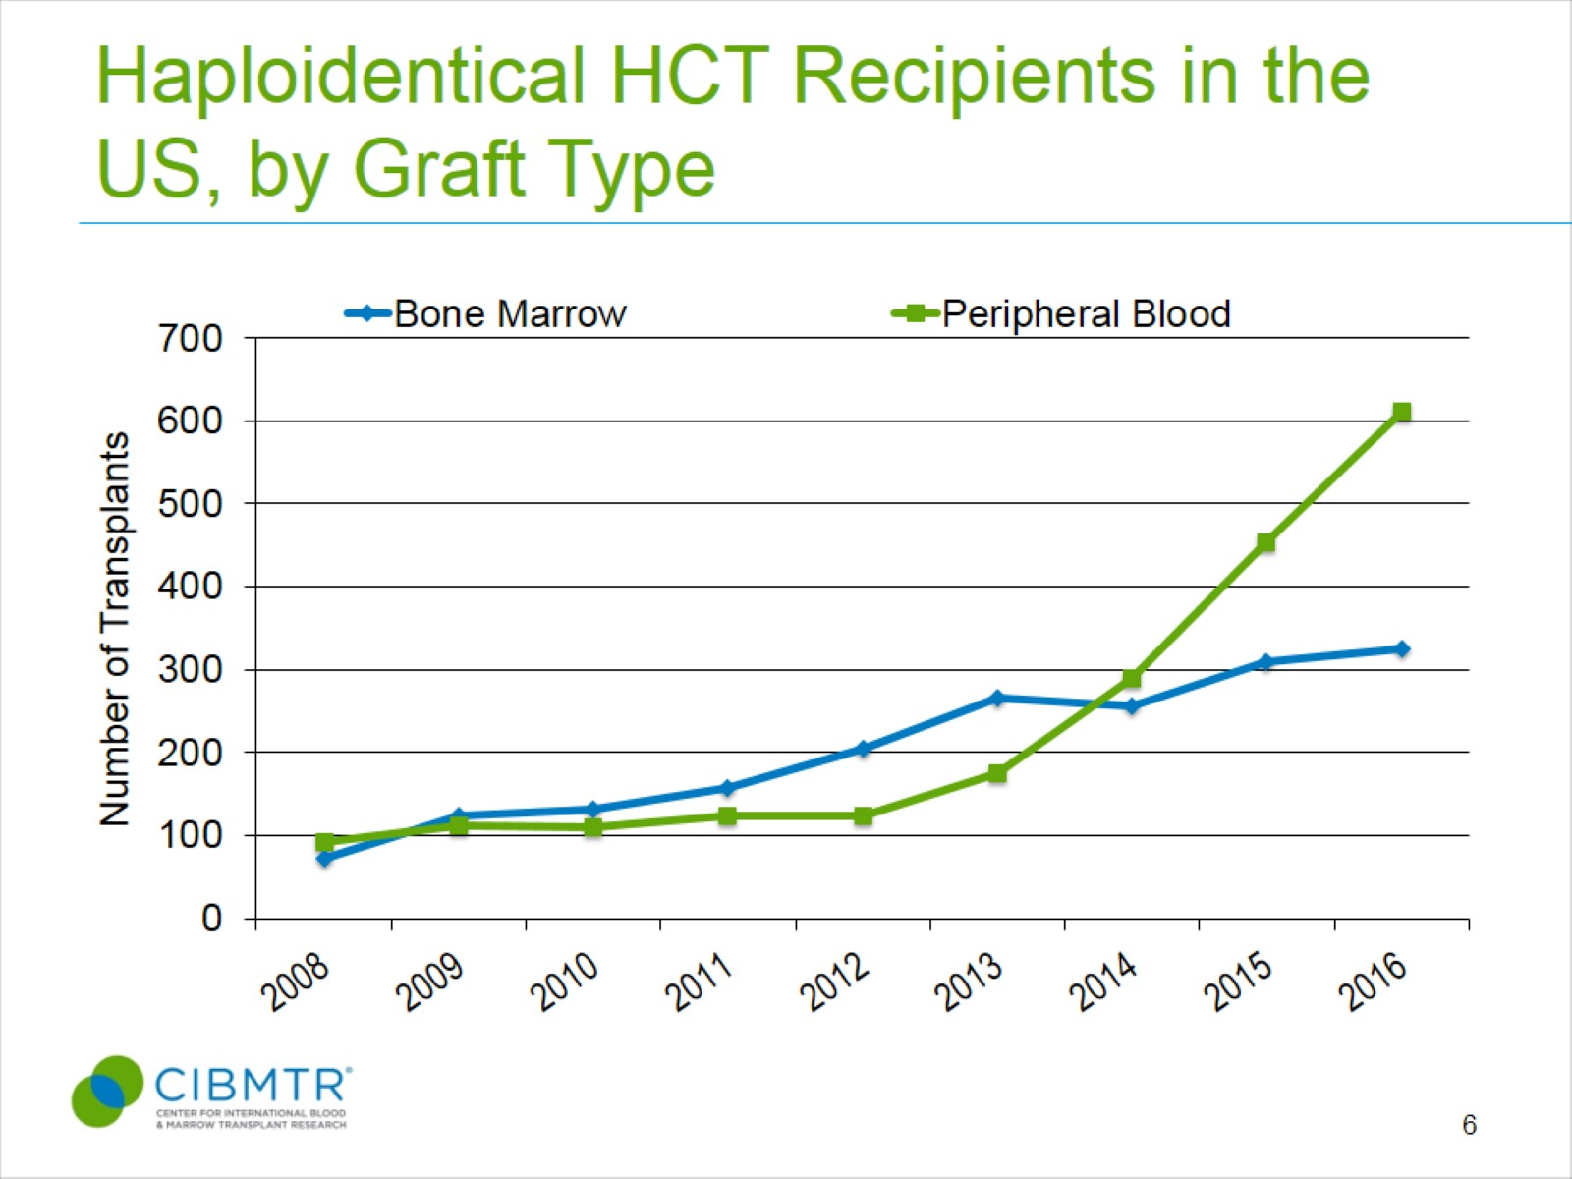
Haploidentical HCT Recipients in the US, by Graft Type
Notes:
Slide 6: The graft source was peripheral blood in over 65% of haploidentical transplants in 2016.

Slide 19
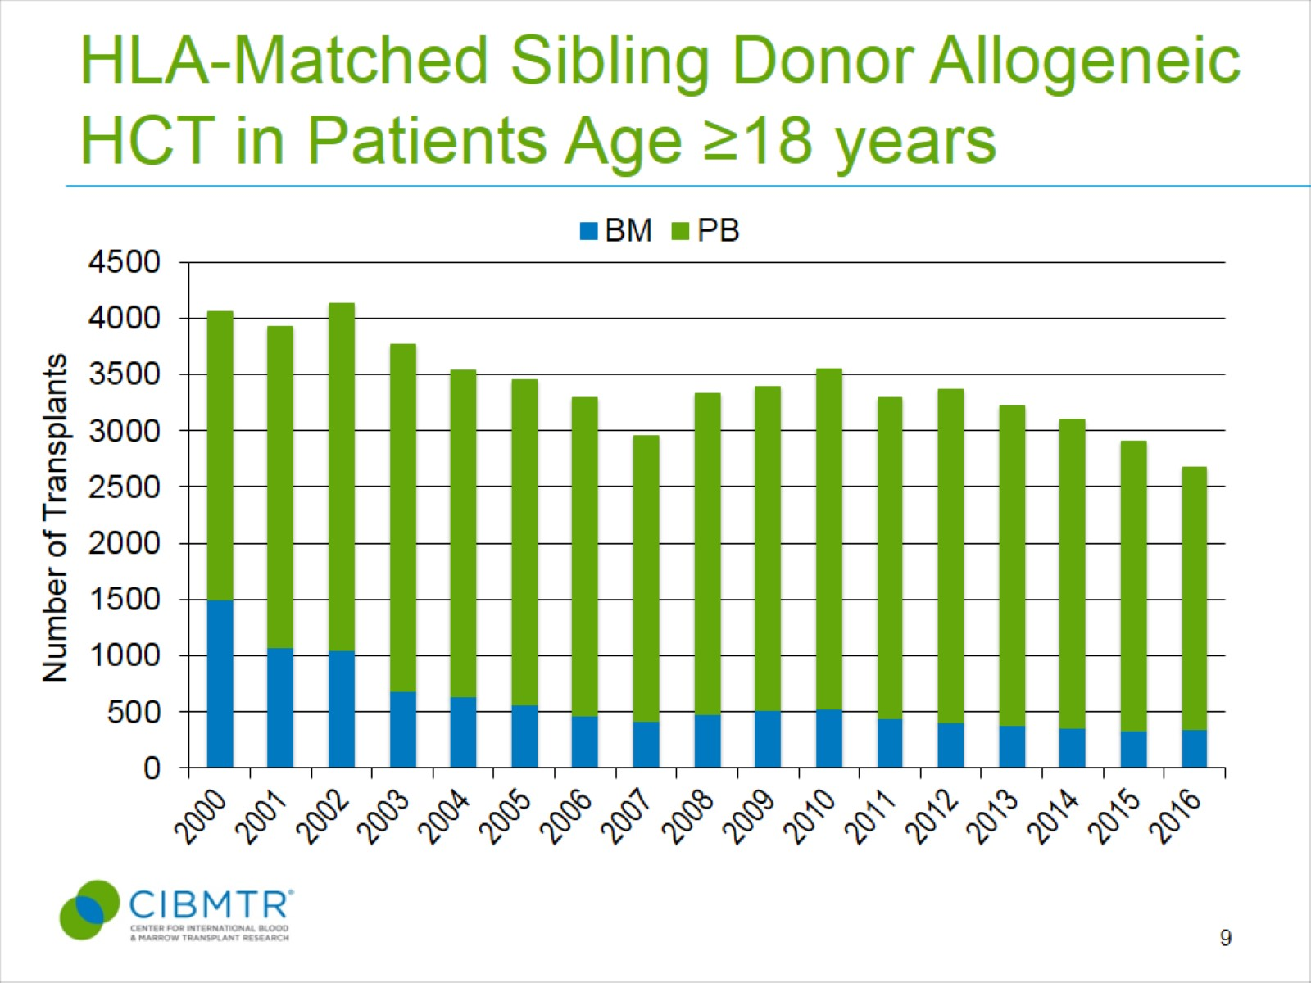
HLA-Matched Sibling Donor Allogeneic HCT in Patients Age ≥18 years
Notes:
Slide 9: Among adult recipients of HLA-matched sibling transplant, mobilized peripheral blood stem cells are the most common graft type. The proportion of bone marrow grafts for sibling transplants has ranged from 11% to 15% since 2006.

Slide 20
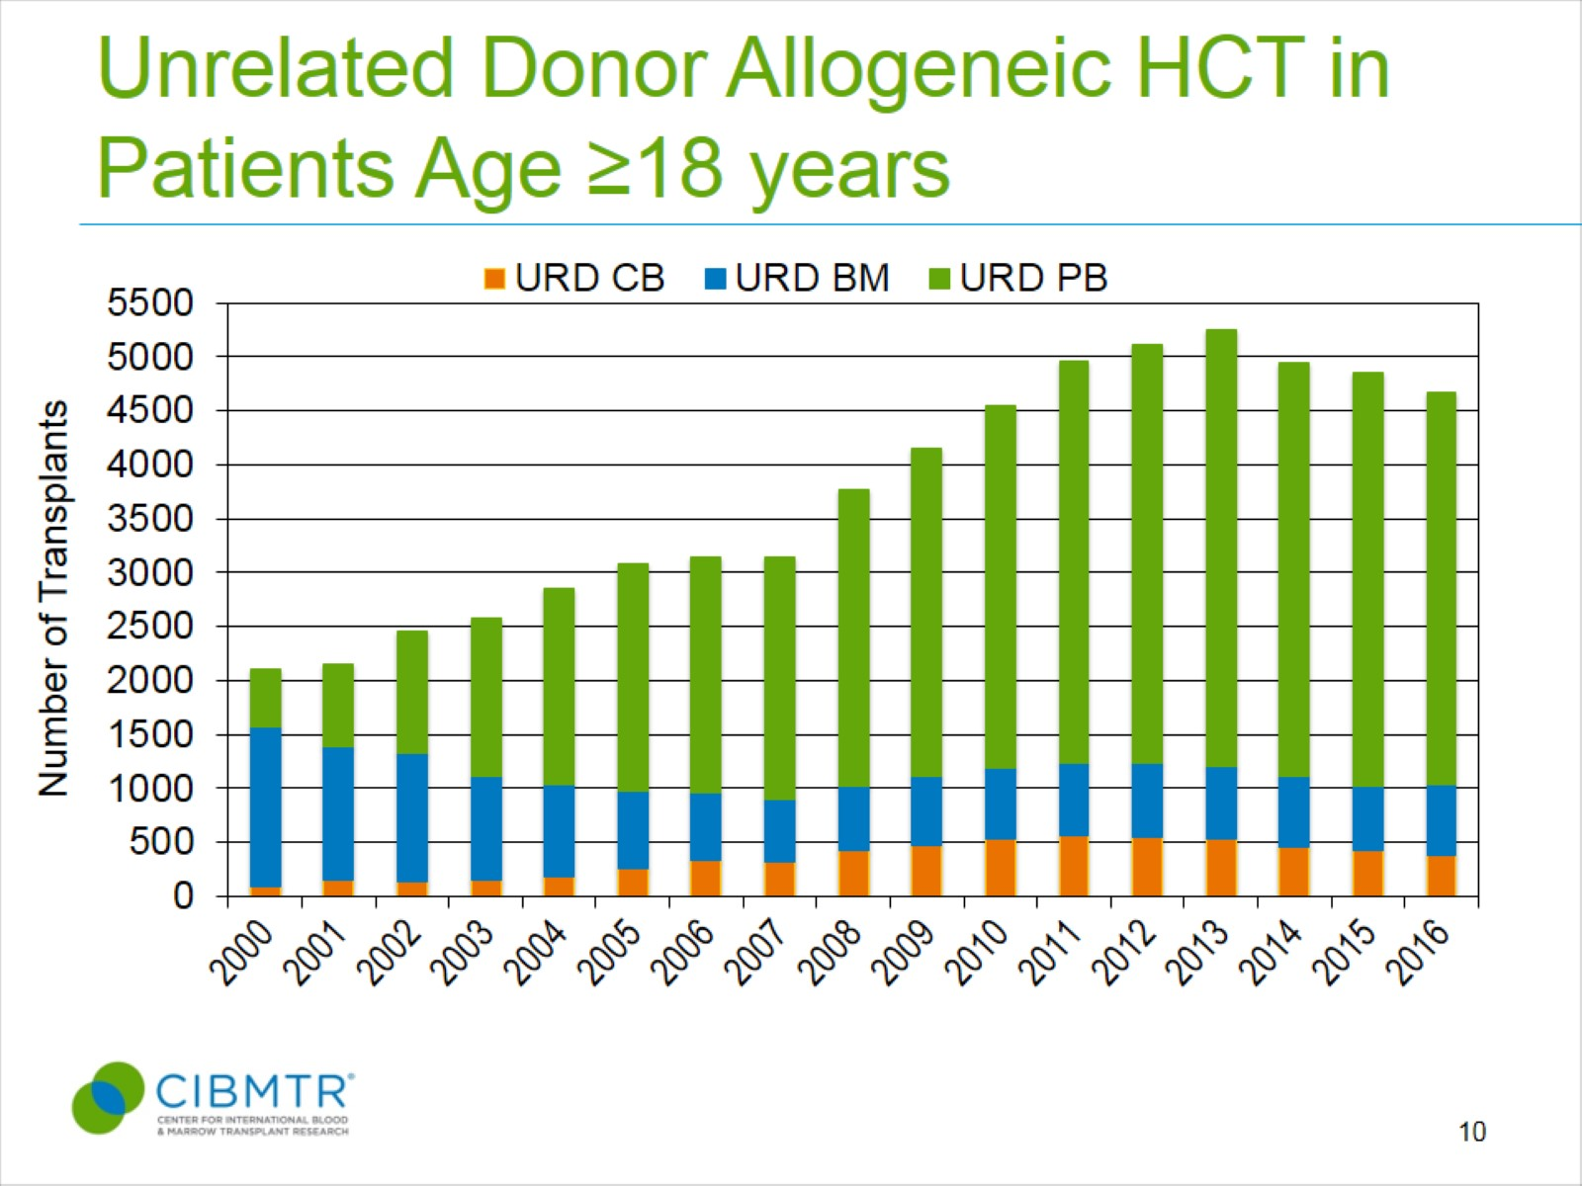
Unrelated Donor Allogeneic HCT in Patients Age ≥18 years
Notes:
Slide 10: Among adult recipients of unrelated donor transplants, mobilized peripheral blood stem cells is also the predominant graft source, accounting for 78% of unrelated donor transplants in 2016. This practice continues to remain high despite randomized clinical trial results demonstrating increased late complications such as chronic graft-versus-host disease with peripheral blood stem cells. The number of umbilical cord transplants in adults peaked at 12% in 2010 but has since declined to <10% and accounted for 8% of unrelated donor grafts in 2016 among adult recipients.

Slide 21
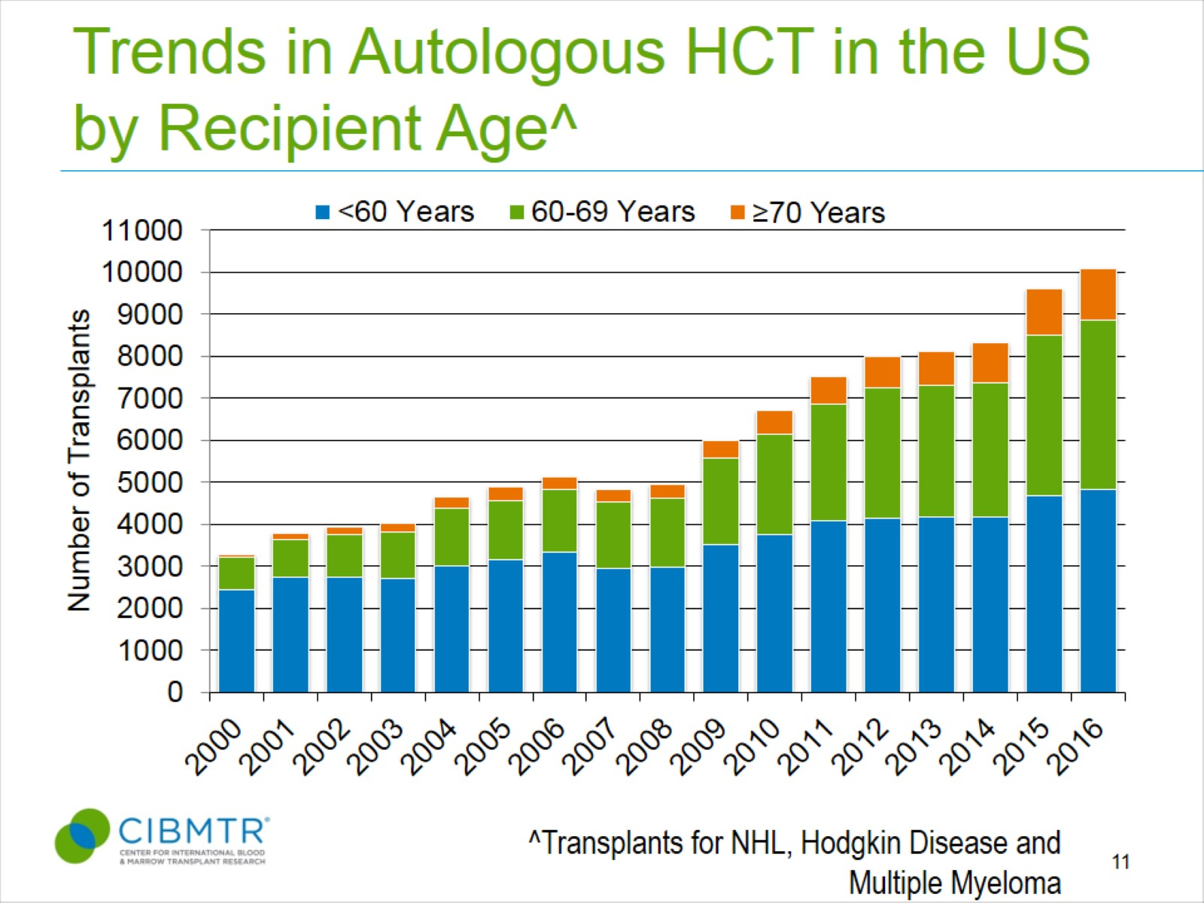
Trends in Autologous HCT in the US by Recipient Age^
Notes:
Slide 11: The number of autologous transplants for treatment of malignant diseases in older patients continue to increase. Over 50% percent of autologous transplant recipients for lymphomas and multiple myeloma were older than 60 in 2016. There is a trend to increase use of autologous transplant in lymphomas and multiple myeloma in patients ≥70 years, representing 12% of autologous transplant activity in 2016.

Slide 22
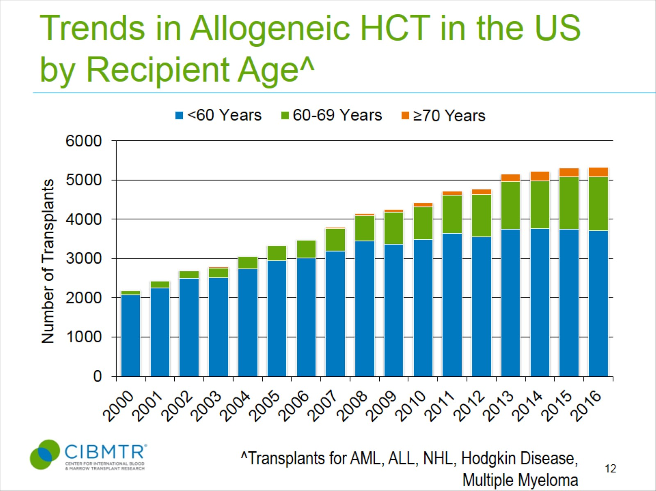
Trends in Allogeneic HCT in the US by Recipient Age^
Notes:
Slide 12: The number of allogeneic transplants for treatment of malignant diseases in ≥60 years also continues to increase. In 2016, 30% percent of allogeneic transplant recipients were older than 60. There is an increasing trend of ≥70 year recipients which represented 4.6% of allogeneic transplants for AML, ALL, NHL, HD, and MM in 2016.

Slide 23
Indications for Hematopoietic Cell Transplant in the US, 2016
Notes:
Slide 13: The most common indications for HCT in the US in 2016 were multiple myeloma and lymphomas (NHL and HD) accounting for 63% of all HCTs. Acute leukemias (AML, ALL) and MDS (combined with MPNs) are the most common indications for allogeneic transplants accounting for 72% of allogeneic HCTs. MDS/MPN transplants have increased after the availability of Centers for Medicare and Medicaid Services (CMS)-approved Coverage with Evidence Development studies allowing allogeneic HCT in Medicare-insured patients for MDS (since 2010) and will continue to increase with the approval for myelofibrosis in 2017.

Slide 24
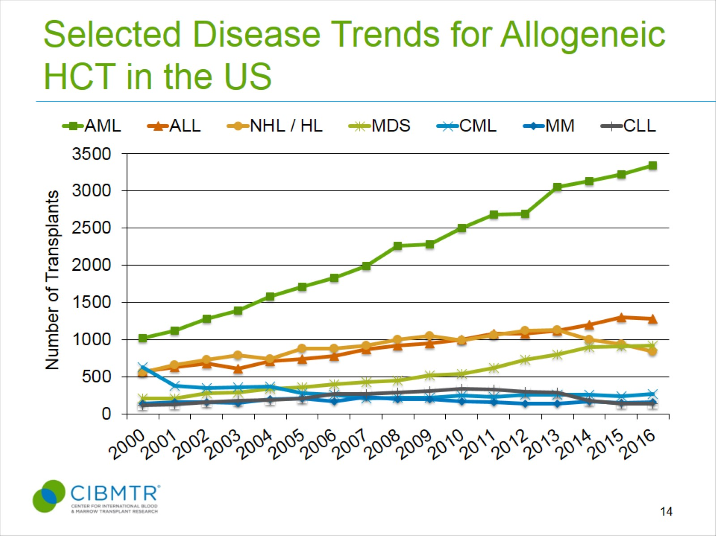
Selected Disease Trends for Allogeneic HCT in the US
Notes:
Slide 14: This slide represents trends in the utility of allogeneic transplants for various indications and shows that allogeneic transplant activity is decreasing in lymphomas and CLL highlighting the availability of non-transplant therapeutic options.

Slide 25
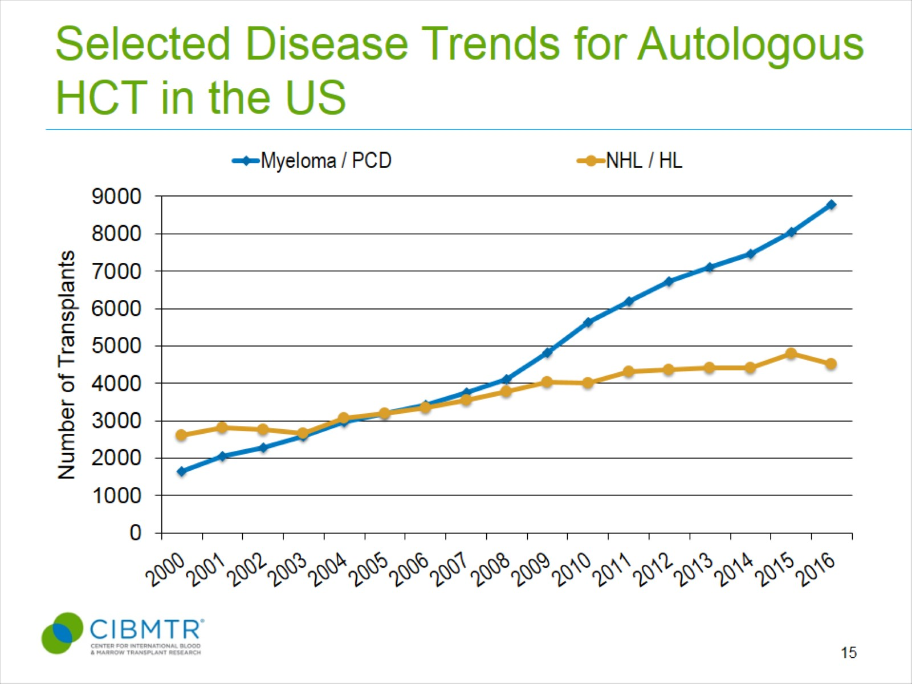
Selected Disease Trends for Autologous HCT in the US
Notes:
Slide 15: In 2016, the number of transplants for lymphomas decreased after a steady increase since 2007, and may represent the increased availability of novel non-transplant therapeutic options for some lymphoma subsets. The annual number of autologous transplants for multiple myeloma is increasing steadily. In 2016, 8776 myeloma autologous transplants were performed, up from 5621 in 2010.

Slide 26
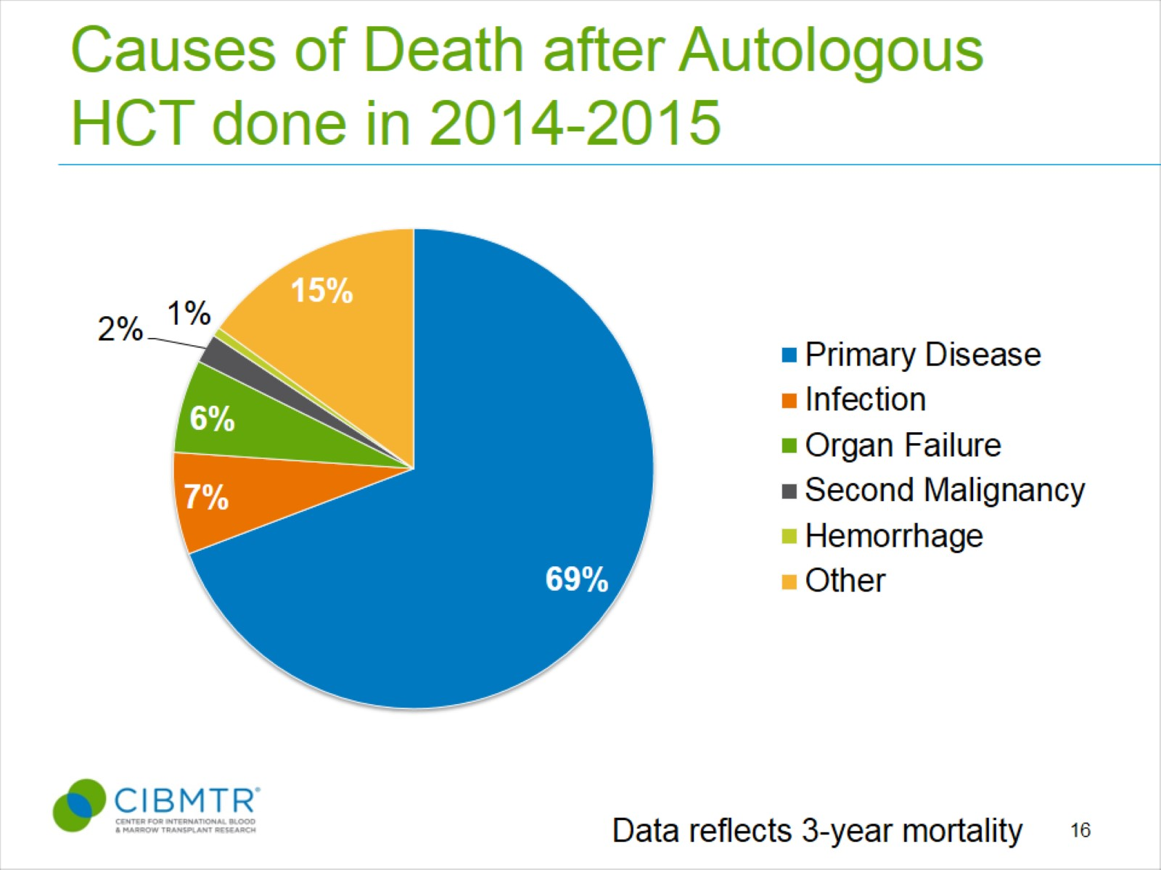
Causes of Death after Autologous HCT done in 2014-2015
Notes:
Slide 16: After an autologous HCT, primary disease is the most commonly reported cause of death representing 69% of deaths.

Slide 27
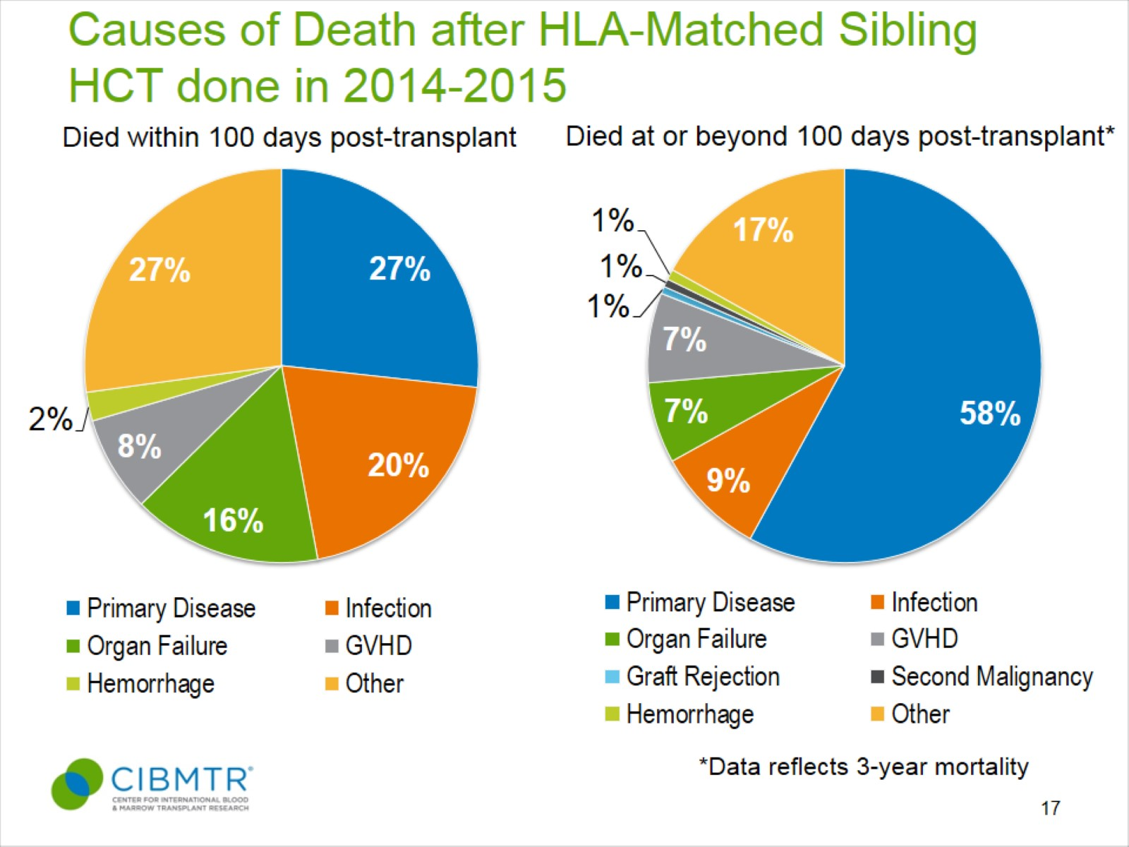
Causes of Death after HLA-Matched Sibling HCT done in 2014-2015
Notes:
Slide 17: Among HLA-matched sibling transplant recipients, within the first 100 days, primary disease accounts for 27% of deaths, while infection and organ failure represent 36% of deaths. At or after 100 days, 58% of deaths are attributed to primary disease.

Slide 28
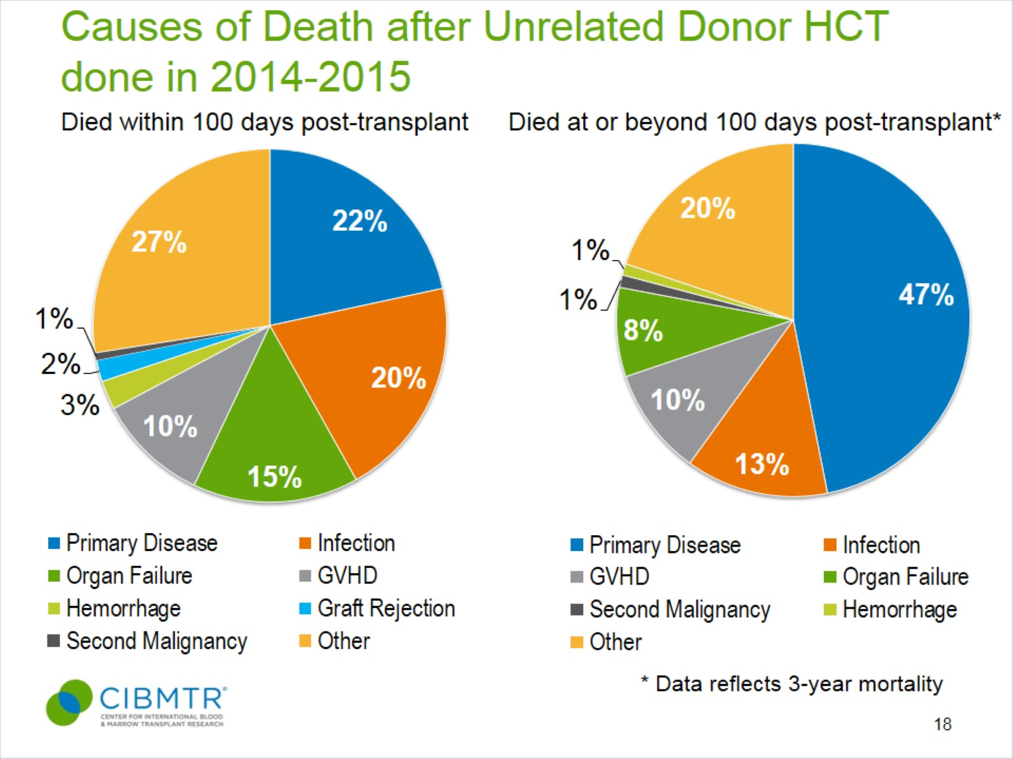
Causes of Death after Unrelated Donor HCT done in 2014-2015
Notes:
Slide 18: Among unrelated donor allogeneic HCT, within 100 days, mortality related to infection, organ failure, GVHD accounts for 45% of deaths; after 100 days, 47% of deaths are related to primary disease.

Slide 29
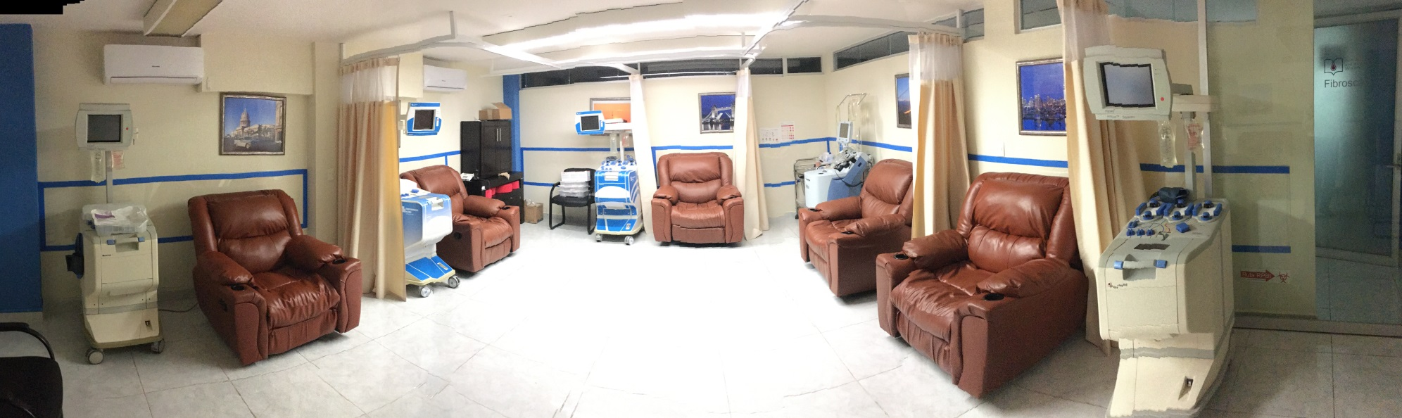

Slide 31
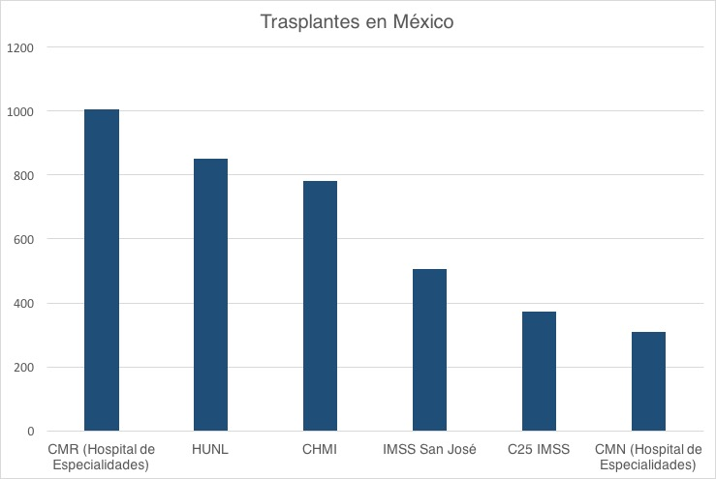
Octubre 2017

Slide 32


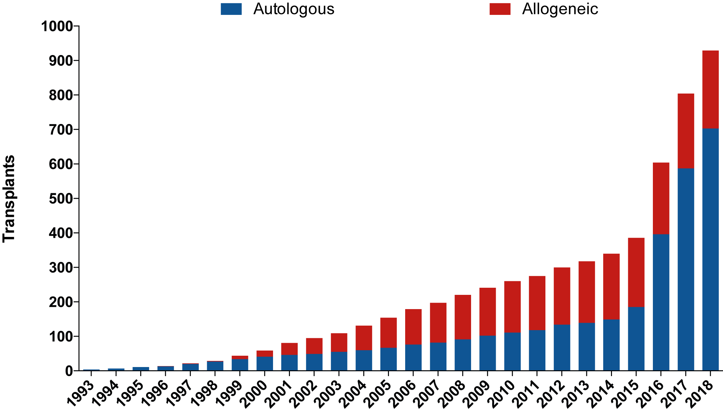

Septiembre, 2018
*Cumulative Data

Slide 33
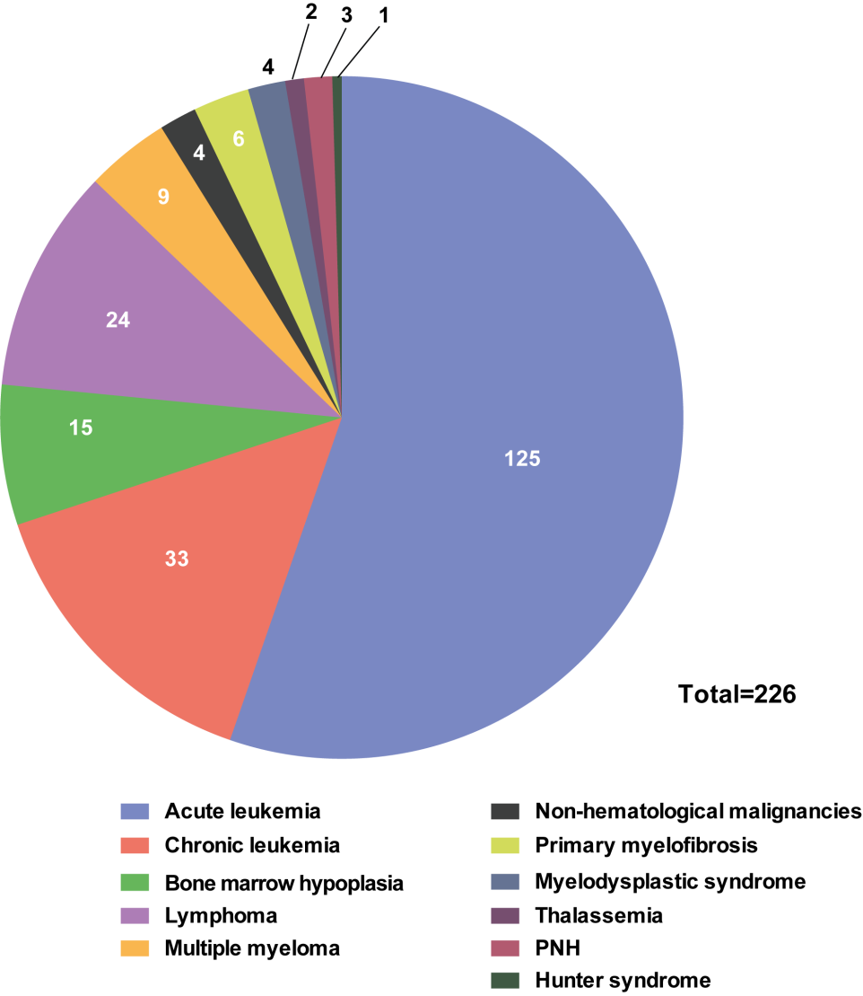
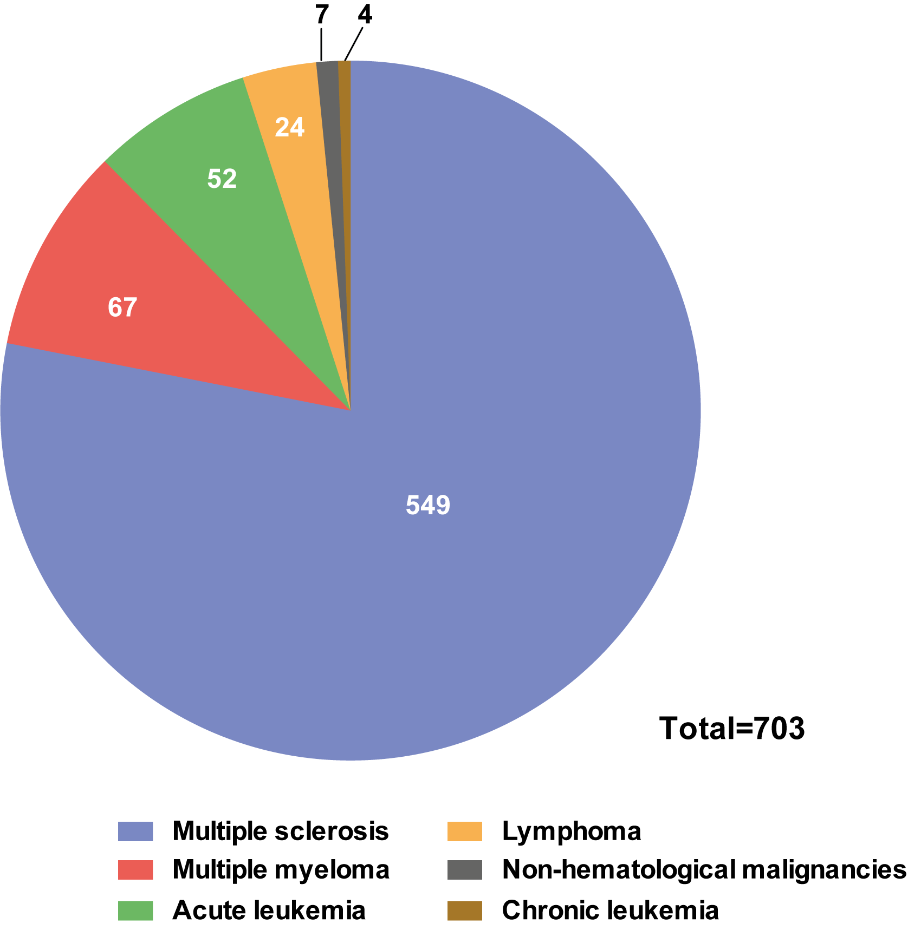
Alogénicos
Autólogos

Slide 34
Autotrasplantes
Pacientes ambulatorios
CTSP no congeladas
Periodos cortos de quimioterapia de acondicionamiento (DA-MFL)
Aféresis para obtener 1-6 x10⁶/Kg de células CD34
Antibióticos y antimicóticos orales
G-CSF

Slide 35
Autotrasplantes simplificados:
703 pacientes (septiembre 2018)
Pacientes ambulatorios 95%
Hospitalizados 5%
1-4 aféresis(1-6 x 10⁶/Kg de células CD34)
Plerixafor excepcional
Pocas transfusiones

Slide 36
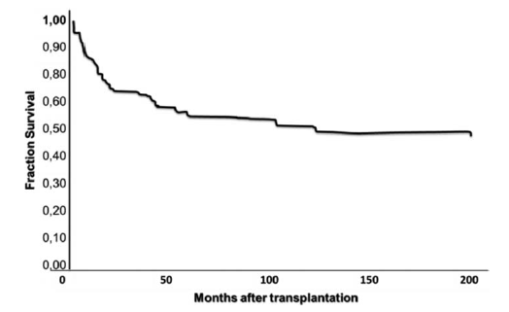
128 pacientes con hemopatías

Slide 37
Autotrasplantes

Slide 39
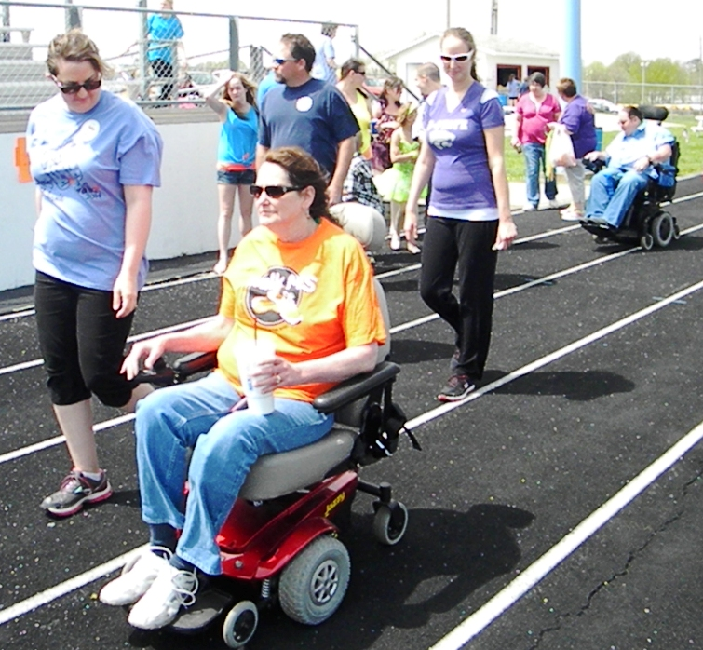
549

Slide 40

NCT02674217

Slide 41
TMO en EM

Slide 42
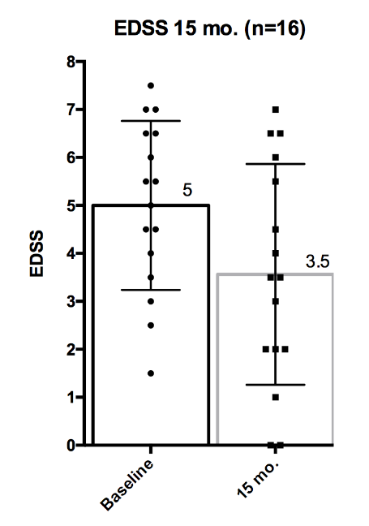

Slide 43
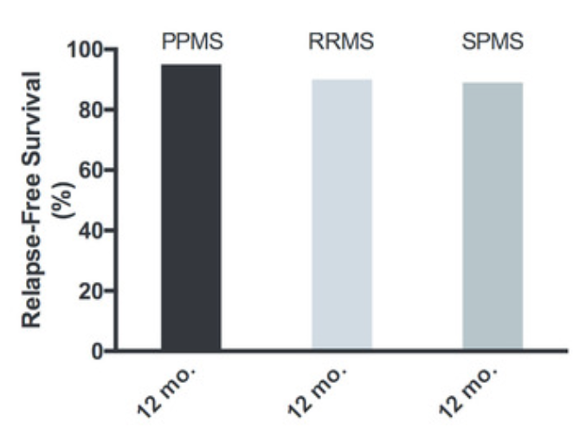

Slide 44
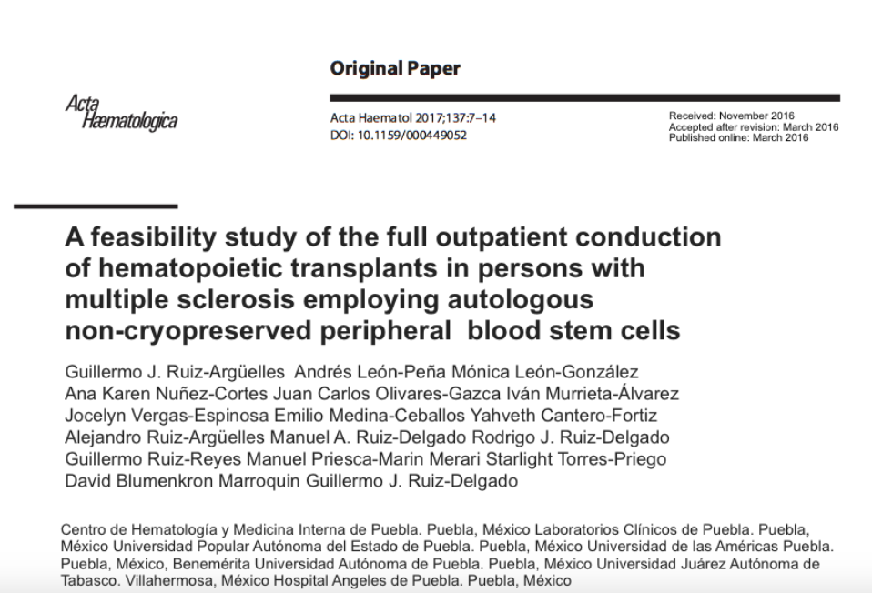

Slide 47
Alotrasplantes

Slide 48
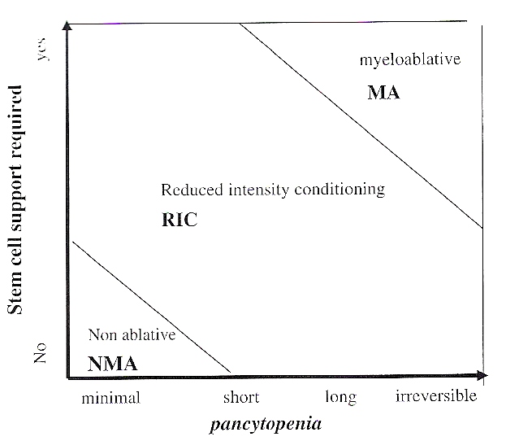
BBMT 2009; 15:1628

Slide 49
El método mexicano:
Medicamentos accesibles (BU, Cy, FLU)
Pacientes ambulatorios
Pocas aféresis (1-6 x 10⁶/Kg de CD34)
Pocas transfusiones
Sin administración de ganciclovir
Sin administración Ig IV
Sin administración de factores de crecimiento

Slide 50
El método mexicano:
BSF: 4 mg/Kg, días -6, -5
Cy: 350 mg/m², días -4, -3, -2
FLU: 30 mg/m², días -4, -3, -2
CyA: 5 mg/Kg, días –1 a +180
MTX: 5 mg/m² días +1, +3, +5, +11

Slide 51
Alotrasplantes simplificados:
226 pacientes (septiembre 2018)
13 días > 500 granulocitos
12 días > 20 000 plaquetas
EICH agudo: 21%
EICH crónico: 17%
Mortalidad al día 100: 17%
Supervivencia a 150 meses: 48%
Mediana de supervivencia: 1350 días

Slide 52
226 alotrasplantes:
13 días > 500 granulocitos
12 días > 20 000 plaquetas
EICH agudo: 21%
EICH crónico: 17%
Mortalidad al día 100: 17%
Supervivencia a 150 meses: 48%
Mediana de supervivencia: 1350 días

Slide 53
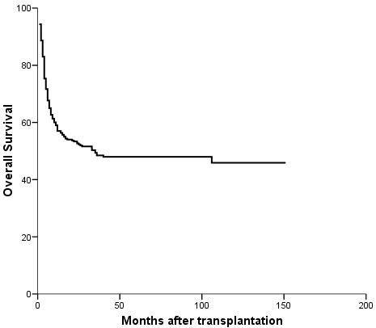
226 alotrasplantes
0
20
40
60
80
100

Slide 54
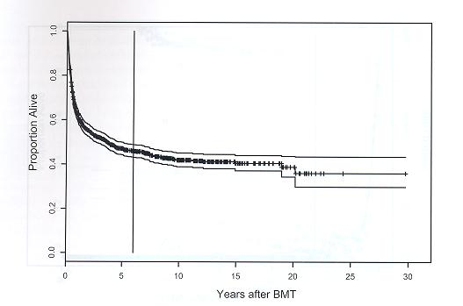
Supervivencia
CHMI + HUM
Months after BMT
Princess Margaret, Toronto

Slide 55
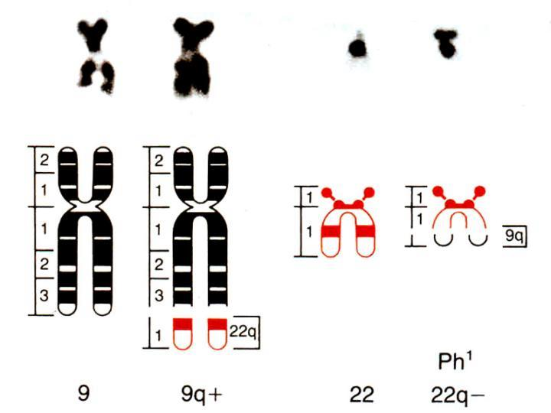
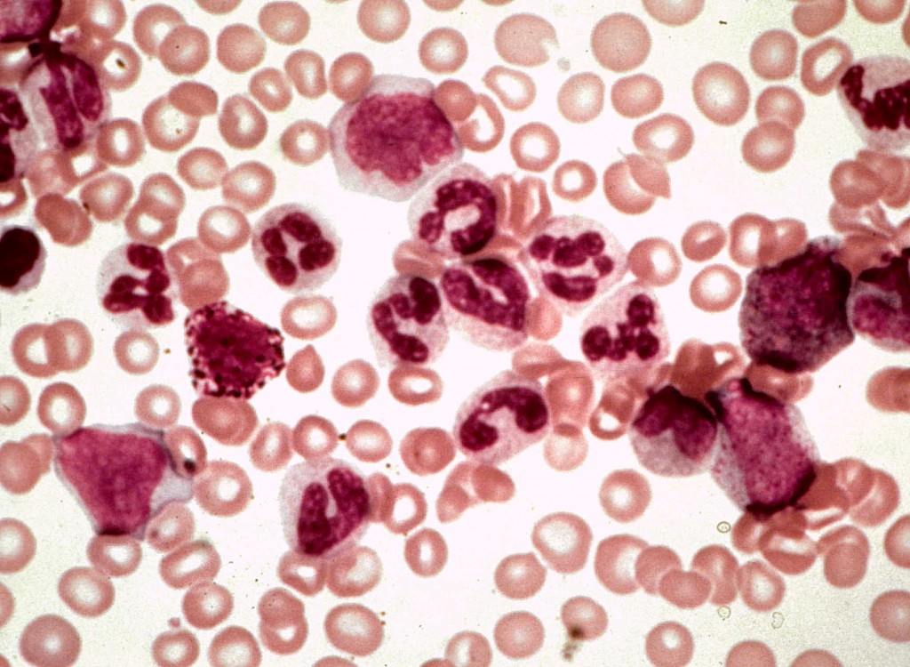

Slide 56
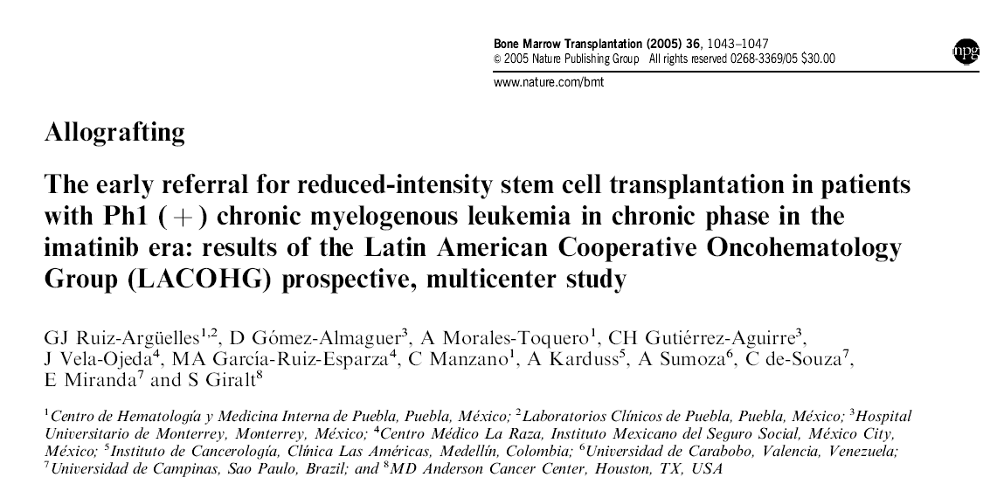

Slide 57
2008

Slide 58
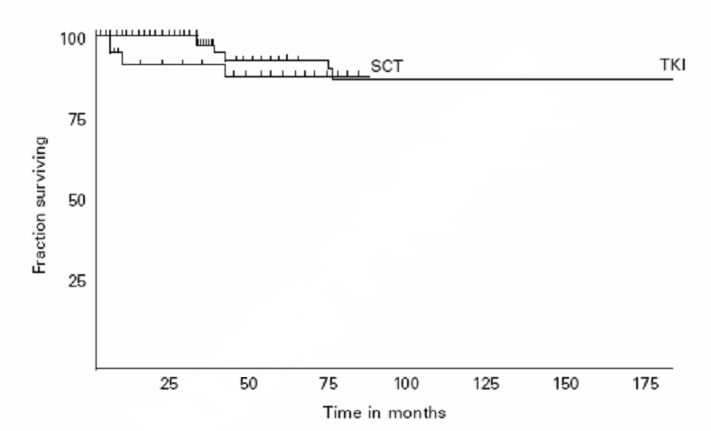

Slide 59
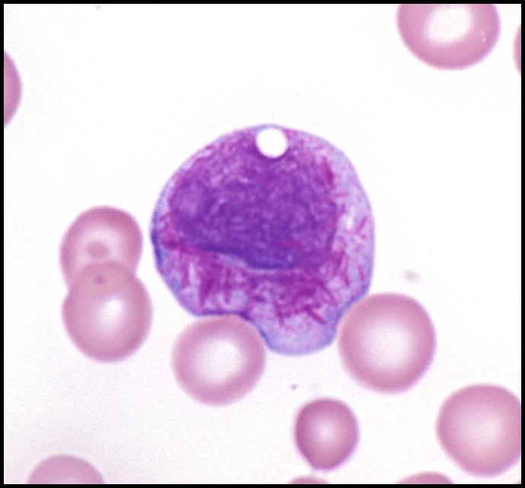

Slide 60
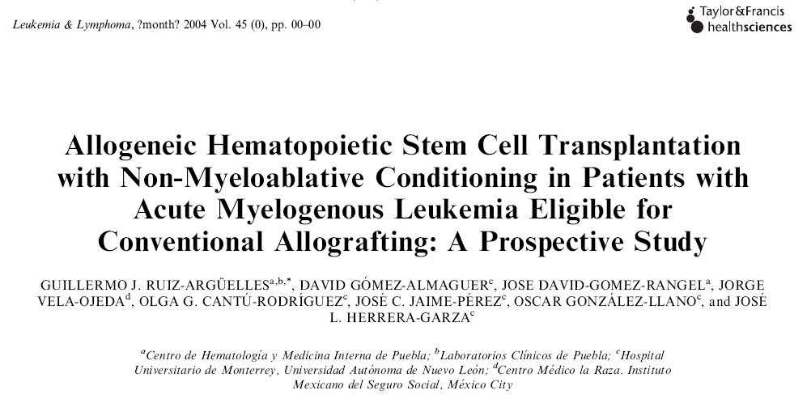
2004; 45:1191
2004; 45:1191

Slide 61
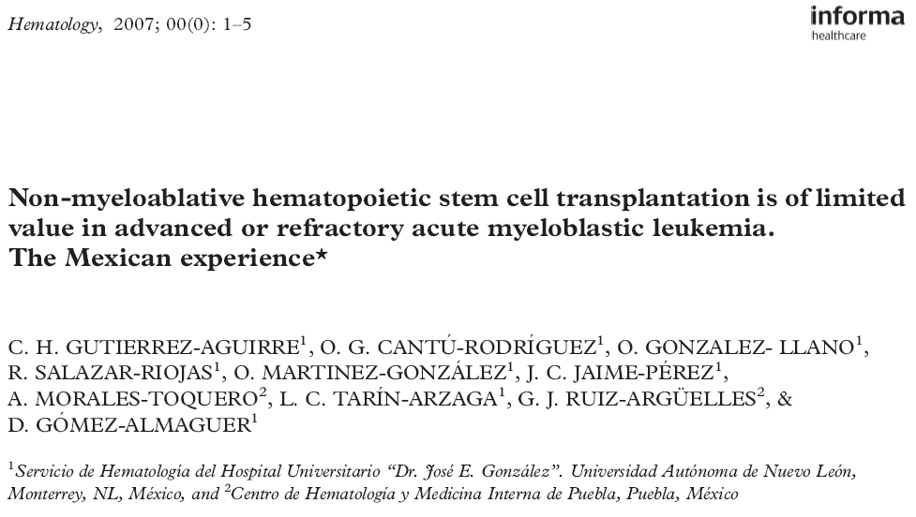
2007; 12:193

Slide 62
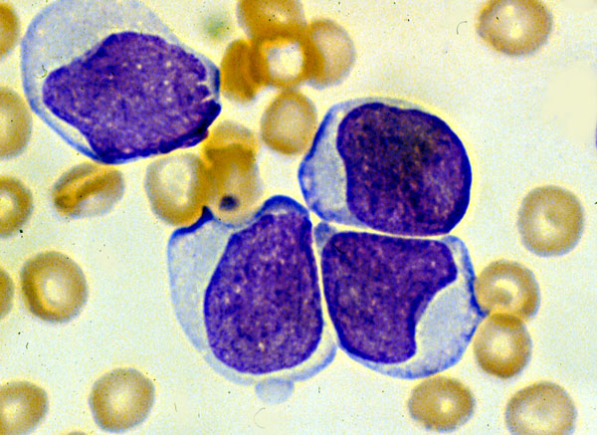

Slide 63
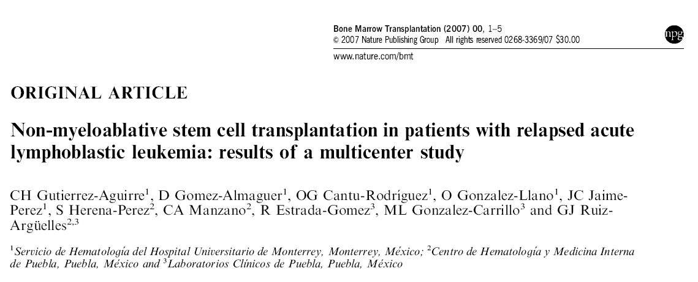

Slide 64
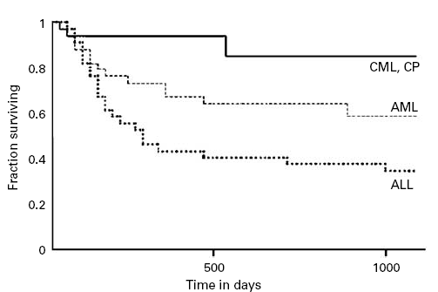
TIR en Leucemias

Slide 65
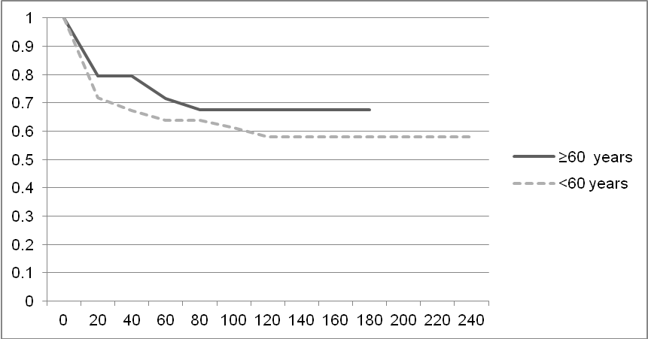

autotrasplantes

Slide 66
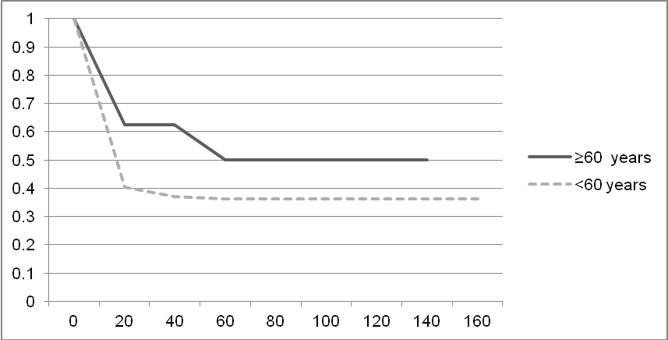
alotrasplantes

Slide 67
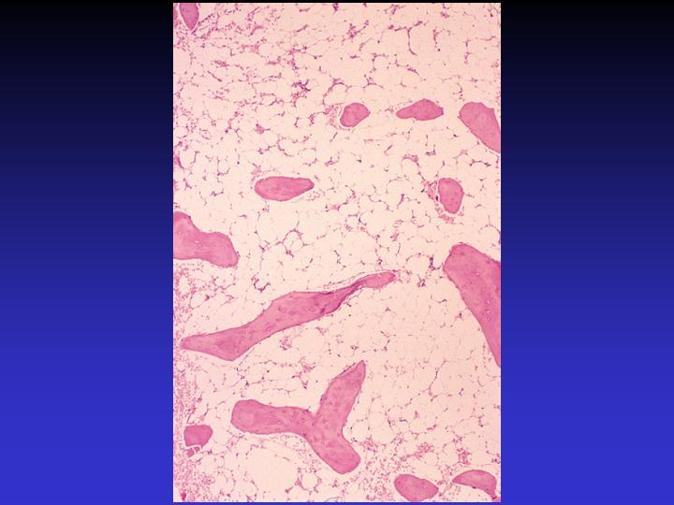

Slide 68
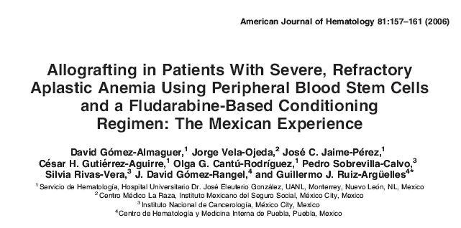
2006

Slide 69
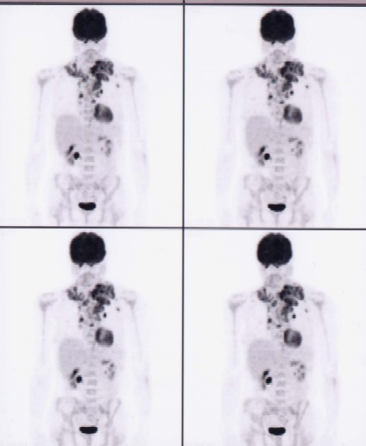

Slide 70

2003
34: 242-245

Slide 71
2010
Ann Hematol 2010; May 21

Slide 74
2004
2004; 75:200

Slide 75

EICH

Slide 76
EICH
Mayor riesgo si se emplean CTSP
Mayor riesgo si el paciente está
hospitalizado
Mayor riesgo si se usa un esquema de
acondicionamiento ablativo

Slide 77
2011

Slide 78
EICH en el Método Mexicano
TIR
ambulatorios
CTSP
EICH

Slide 79

Alotrasplantes
 | Imposible Imposible ++ ++ | Posible Posible + / - +
 | 30 – 50% 300 000 DLS Difícil | 17 % 20 000 DLS Posible
Recuperación autóloga
Ambulatorios
Transfusiones
EICH
Mortalidad día 100
Costo
Países en desarrollo

Slide 80
Métodos mexicanos para TMO
Trasplantes autólogos
Trasplantes alogénicos
Trasplantes de cordón
Trasplantes haploidénticos
Trasplantes en esclerosis múltiple

Slide 81
Los métodos mexicanos para TMO
“Curan” la misma proporción de pacientes
No son una manera sencilla de trasplantar
Necesitan mucho apoyo de laboratorio
No requieren unidades especiales
Se pueden llevar a cabo de manera ambulatoria
Son más baratos

Slide 82




Slide 83
Fundamentos
Eliminar linfocitos autoreactivos y reiniciar el sistema inmune en un ambiente no inflamatorio libre de señales coestimuladoras.
Reinicialización de la población linfoide para que deje de ser autorreactiva.

Slide 84


