Slide 1
Cáncer Infantil, Genómica y Bioinformática
Notes:
El HIMFG está interesado en contar con un secuenciador de 2ª generación. En este documento se describen la naturaleza de este equipo y las aplicaciones de esta herramienta es en el contexto de las neoplasias infantiles, de las malformaciones congénitas y de las enfermedades mendelianas.

Slide 2
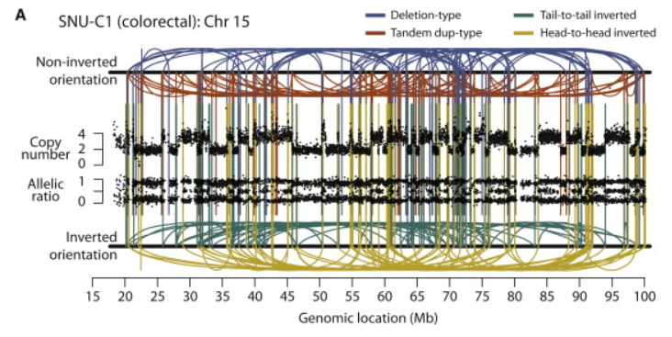
Chromothripsis
Stephens P.J., et. al., (2011) Cell 144, 27-40.
Notes:
Stephens P.J., et. al., (2011) Massive genomic rearrangement acquired in a single catastrophic event during cancer development. Cell 144, 27-40. (PMID 21215367)
Figure 2. Rearrangement Screens in Three Cancer Cell Lines Showing Evidence for Chromothripsis
Copy number profiles derive from SNP6 microarray data and are shown as the upper panel of points for each cell line. Allelic ratios for each SNP are shown in the lower panel of dots: homozygous SNPs cluster at allelic ratios near 0 or 1, heterozygous SNPs cluster around 0.5. Intrachromosomal rearrangements of all four possible orientations are shown, with deletion-type events as blue lines, tandem duplication-type in red, tail-to-tail inverted rearrangements in green and head-to-head inverted rearrangements in yellow.
(A) SNU-C1, a cell line from a colorectal cancer, carries 239 rearrangements involving chromosome 15.
(B) 8505C, a thyroid cancer cell line, has 77 rearrangements involving chromosome 9p.
(C) TK10, a renal cancer cell line, has 55 rearrangements involving chromosome 5.

Slide 3
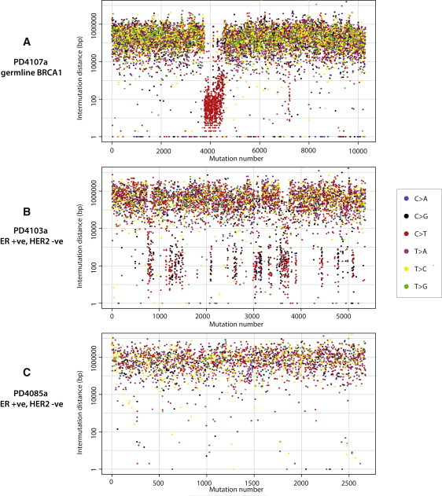
Kataegis
Nik-Zainal S. et al., (2012) Cell 149, 979-93.
Notes:
Nik-Zainal S. et al., (2012) Mutational Processes Molding the Genomes of 21 Breast Cancers. Cell 149, 979-93. (PMID 22608084)
Figure 3. Kataegis, Regional Hypermutation of Base Substitutions, Related to Figure S2
(A) Rainfall plot of PD4107a. Mutations are ordered on the x axis from the first variant on the short arm of chromosome 1 to the last variant on the long arm of chromosome X and are colored according to mutation-type. The distance between each mutation and the one prior to it (the intermutation distance) is plotted on the vertical axis on a log scale. Most mutations in this genome have an intermutation distance of ∼10⁵ bp to ∼10⁶ bp. Mutations in a region of hypermutation present as a cluster of lower intermutation distances.
(B) Rainfall plot for PD4103a demonstrating kataegis occurring at multiple loci through the genome.
(C) Rainfall plot for PD4085a, showing no kataegis.
(D) Plots of flanking sequence of all C>X mutations and C>X mutations within the regions of kataegis in PD4107a. Mutated base is at position 0 with ten bases of flanking sequence provided, demonstrating a strong preference for T at the −1 position.

Slide 4
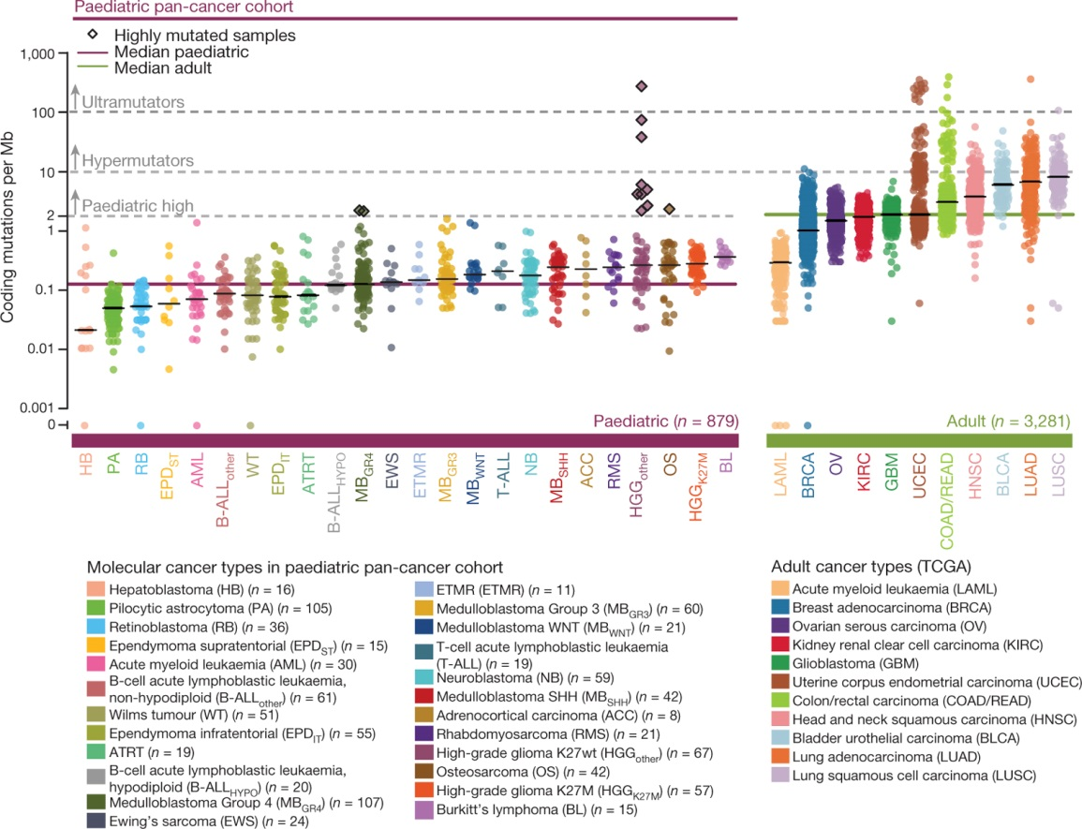
Mutaciones en tumores pediátricos vs de adultos
S N Gröbner et al. Nature 555, 321–327 (2018) doi:10.1038/nature25480
Notes:
Grobner S.N., Worst B.C., Weischenfeldt J., Buchhalter I., Kleinheinz K., Rudneva V.A., Johann P.D., Balasubramanian G.P., Segura-Wang M., Brabetz S., Bender S., Hutter B., Sturm D., Pfaff E., Hubschmann D., Zipprich G., Heinold M., Eils J., Lawerenz C., Erkek S., Lambo S., Waszak S., Blattmann C., Borkhardt A., Kuhlen M., Eggert A., Fulda S., Gessler M., Wegert J., Kappler R., Baumhoer D., Burdach S., Kirschner-Schwabe R., Kontny U., Kulozik A.E., Lohmann D., Hettmer S., Eckert C., Bielack S., Nathrath M., Niemeyer C., Richter G.H., Schulte J., Siebert R., Westermann F., Molenaar J.J., Vassal G., Witt H., Project I.P.-S., Project I.M.-S., Burkhardt B., Kratz C.P., Witt O., van Tilburg C.M., Kramm C.M., Fleischhack G., Dirksen U., Rutkowski S., Fruhwald M., von Hoff K., Wolf S., Klingebiel T., Koscielniak E., Landgraf P., Koster J., Resnick A.C., Zhang J., Liu Y., Zhou X., Waanders A.J., Zwijnenburg D.A., Raman P., Brors B., Weber U.D., Northcott P.A., Pajtler K.W., Kool M., Piro R.M., Korbel J.O., Schlesner M., Eils R., Jones D.T.W., Lichter P., Chavez L., Zapatka M. & Pfister S.M. (2018) The landscape of genomic alterations across childhood cancers. Nature 555, 321-7. (PMID 29489754)
Figure 1 : Somatic mutations in the paediatric pan-cancer cohort.
Somatic coding mutation frequencies in 24 paediatric (n = 879 primary tumours) and 11 adult (n = 3,281) cancer types (TCGA)⁷. Hypermutated and highly mutated samples are separated by dashed grey lines and highlighted with black squares. Median mutation loads are shown as solid lines (black, cancer types; purple, all paediatric; green, all adult).

Slide 5
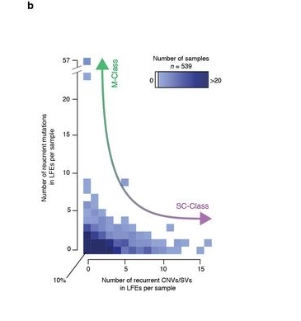
Mutaciones Puntuales vs Alteraciones Estructurales
S N Gröbner et al. Nature 555, 321–327 (2018) doi:10.1038/nature25480
Notes:
Grobner S.N., Worst B.C., Weischenfeldt J., Buchhalter I., Kleinheinz K., Rudneva V.A., Johann P.D., Balasubramanian G.P., Segura-Wang M., Brabetz S., Bender S., Hutter B., Sturm D., Pfaff E., Hubschmann D., Zipprich G., Heinold M., Eils J., Lawerenz C., Erkek S., Lambo S., Waszak S., Blattmann C., Borkhardt A., Kuhlen M., Eggert A., Fulda S., Gessler M., Wegert J., Kappler R., Baumhoer D., Burdach S., Kirschner-Schwabe R., Kontny U., Kulozik A.E., Lohmann D., Hettmer S., Eckert C., Bielack S., Nathrath M., Niemeyer C., Richter G.H., Schulte J., Siebert R., Westermann F., Molenaar J.J., Vassal G., Witt H., Project I.P.-S., Project I.M.-S., Burkhardt B., Kratz C.P., Witt O., van Tilburg C.M., Kramm C.M., Fleischhack G., Dirksen U., Rutkowski S., Fruhwald M., von Hoff K., Wolf S., Klingebiel T., Koscielniak E., Landgraf P., Koster J., Resnick A.C., Zhang J., Liu Y., Zhou X., Waanders A.J., Zwijnenburg D.A., Raman P., Brors B., Weber U.D., Northcott P.A., Pajtler K.W., Kool M., Piro R.M., Korbel J.O., Schlesner M., Eils R., Jones D.T.W., Lichter P., Chavez L., Zapatka M. & Pfister S.M. (2018) The landscape of genomic alterations across childhood cancers. Nature 555, 321-7. (PMID 29489754)
Extended Data Figure 10 : Genetic events define mutation classes.
a, Genes significantly or recurrently affected by mutations, amplification, deletions, and gene-disrupting structural variants (likely functional events, LFEs). Copy-number and structural variations are summarized as SC-class in contrast to mutations (SNVs or indels) as M-class. b, Number of SC-class (x-axis) and M-class (y-axis) alterations per tumour. c, Proportion of events from M-class and SC-class within each tumour. Tumours with more than 50% (mixed) or 100% (unique) events from one category are considered to be members of the associated class; tumours with equal contributions from both categories are ‘ambiguous’, and tumours without an LFE are assigned class ‘none’ (not shown). Colours indicate germline mutations per tumour. d, Fraction of tumours assigned to different classes per cancer type.

Slide 6
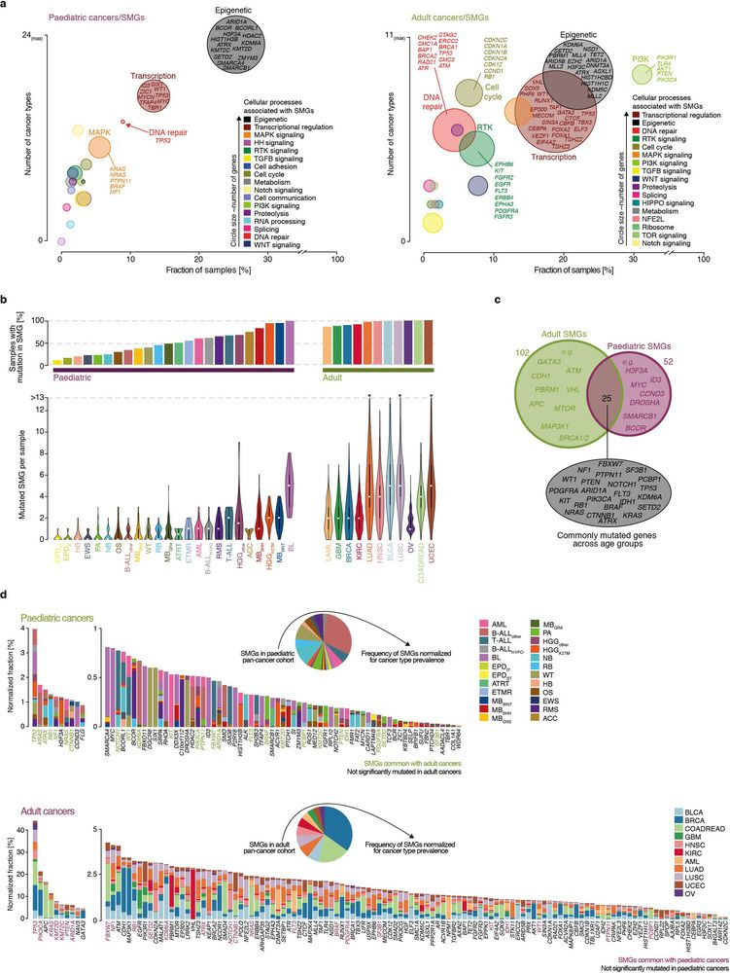
Mutaciones en tumores pediátricos vs de adultos
S N Gröbner et al. Nature 555, 321–327 (2018) doi:10.1038/nature25480
Notes:
Grobner S.N., Worst B.C., Weischenfeldt J., Buchhalter I., Kleinheinz K., Rudneva V.A., Johann P.D., Balasubramanian G.P., Segura-Wang M., Brabetz S., Bender S., Hutter B., Sturm D., Pfaff E., Hubschmann D., Zipprich G., Heinold M., Eils J., Lawerenz C., Erkek S., Lambo S., Waszak S., Blattmann C., Borkhardt A., Kuhlen M., Eggert A., Fulda S., Gessler M., Wegert J., Kappler R., Baumhoer D., Burdach S., Kirschner-Schwabe R., Kontny U., Kulozik A.E., Lohmann D., Hettmer S., Eckert C., Bielack S., Nathrath M., Niemeyer C., Richter G.H., Schulte J., Siebert R., Westermann F., Molenaar J.J., Vassal G., Witt H., Project I.P.-S., Project I.M.-S., Burkhardt B., Kratz C.P., Witt O., van Tilburg C.M., Kramm C.M., Fleischhack G., Dirksen U., Rutkowski S., Fruhwald M., von Hoff K., Wolf S., Klingebiel T., Koscielniak E., Landgraf P., Koster J., Resnick A.C., Zhang J., Liu Y., Zhou X., Waanders A.J., Zwijnenburg D.A., Raman P., Brors B., Weber U.D., Northcott P.A., Pajtler K.W., Kool M., Piro R.M., Korbel J.O., Schlesner M., Eils R., Jones D.T.W., Lichter P., Chavez L., Zapatka M. & Pfister S.M. (2018) The landscape of genomic alterations across childhood cancers. Nature 555, 321-7. (PMID 29489754)
Extended Data Figure 5 : Significantly mutated genes across age groups.
a, Cellular processes associated with paediatric (left) and adult (right) SMGs. b, Frequency of mutations in SMGs in paediatric (n = 879) compared to adult (n = 3,281) cancers. Top, percentage of SMG-mutated samples. Bottom, mutations in SMGs per sample (centre, median; range, minimum to maximum). c, Overlap of SMGs detected in paediatric and adult cancers. d, Projected mutation rates of SMGs based on normalization of the cohort frequencies for cancer type incidence among patients for paediatric and adult cancers. a–d, Information on adult SMGs is based on TCGA data and previous analysis⁷.

Slide 7
Mutaciones en tumores pediátricos vs de adultos
S N Gröbner et al. Nature 555, 321–327 (2018) doi:10.1038/nature25480
Notes:
Grobner S.N., Worst B.C., Weischenfeldt J., Buchhalter I., Kleinheinz K., Rudneva V.A., Johann P.D., Balasubramanian G.P., Segura-Wang M., Brabetz S., Bender S., Hutter B., Sturm D., Pfaff E., Hubschmann D., Zipprich G., Heinold M., Eils J., Lawerenz C., Erkek S., Lambo S., Waszak S., Blattmann C., Borkhardt A., Kuhlen M., Eggert A., Fulda S., Gessler M., Wegert J., Kappler R., Baumhoer D., Burdach S., Kirschner-Schwabe R., Kontny U., Kulozik A.E., Lohmann D., Hettmer S., Eckert C., Bielack S., Nathrath M., Niemeyer C., Richter G.H., Schulte J., Siebert R., Westermann F., Molenaar J.J., Vassal G., Witt H., Project I.P.-S., Project I.M.-S., Burkhardt B., Kratz C.P., Witt O., van Tilburg C.M., Kramm C.M., Fleischhack G., Dirksen U., Rutkowski S., Fruhwald M., von Hoff K., Wolf S., Klingebiel T., Koscielniak E., Landgraf P., Koster J., Resnick A.C., Zhang J., Liu Y., Zhou X., Waanders A.J., Zwijnenburg D.A., Raman P., Brors B., Weber U.D., Northcott P.A., Pajtler K.W., Kool M., Piro R.M., Korbel J.O., Schlesner M., Eils R., Jones D.T.W., Lichter P., Chavez L., Zapatka M. & Pfister S.M. (2018) The landscape of genomic alterations across childhood cancers. Nature 555, 321-7. (PMID 29489754)
Extended Data Figure 5 : Significantly mutated genes across age groups.
a, Cellular processes associated with paediatric (left) and adult (right) SMGs. b, Frequency of mutations in SMGs in paediatric (n = 879) compared to adult (n = 3,281) cancers. Top, percentage of SMG-mutated samples. Bottom, mutations in SMGs per sample (centre, median; range, minimum to maximum). c, Overlap of SMGs detected in paediatric and adult cancers. d, Projected mutation rates of SMGs based on normalization of the cohort frequencies for cancer type incidence among patients for paediatric and adult cancers. a–d, Information on adult SMGs is based on TCGA data and previous analysis⁷.

Slide 8
Genes mutados en tumores pediátricos vs adultos
S N Gröbner et al. Nature 555, 321–327 (2018) doi:10.1038/nature25480
Notes:
Grobner S.N., Worst B.C., Weischenfeldt J., Buchhalter I., Kleinheinz K., Rudneva V.A., Johann P.D., Balasubramanian G.P., Segura-Wang M., Brabetz S., Bender S., Hutter B., Sturm D., Pfaff E., Hubschmann D., Zipprich G., Heinold M., Eils J., Lawerenz C., Erkek S., Lambo S., Waszak S., Blattmann C., Borkhardt A., Kuhlen M., Eggert A., Fulda S., Gessler M., Wegert J., Kappler R., Baumhoer D., Burdach S., Kirschner-Schwabe R., Kontny U., Kulozik A.E., Lohmann D., Hettmer S., Eckert C., Bielack S., Nathrath M., Niemeyer C., Richter G.H., Schulte J., Siebert R., Westermann F., Molenaar J.J., Vassal G., Witt H., Project I.P.-S., Project I.M.-S., Burkhardt B., Kratz C.P., Witt O., van Tilburg C.M., Kramm C.M., Fleischhack G., Dirksen U., Rutkowski S., Fruhwald M., von Hoff K., Wolf S., Klingebiel T., Koscielniak E., Landgraf P., Koster J., Resnick A.C., Zhang J., Liu Y., Zhou X., Waanders A.J., Zwijnenburg D.A., Raman P., Brors B., Weber U.D., Northcott P.A., Pajtler K.W., Kool M., Piro R.M., Korbel J.O., Schlesner M., Eils R., Jones D.T.W., Lichter P., Chavez L., Zapatka M. & Pfister S.M. (2018) The landscape of genomic alterations across childhood cancers. Nature 555, 321-7. (PMID 29489754)
Extended Data Figure 5 : Significantly mutated genes across age groups.
a, Cellular processes associated with paediatric (left) and adult (right) SMGs. b, Frequency of mutations in SMGs in paediatric (n = 879) compared to adult (n = 3,281) cancers. Top, percentage of SMG-mutated samples. Bottom, mutations in SMGs per sample (centre, median; range, minimum to maximum). c, Overlap of SMGs detected in paediatric and adult cancers. d, Projected mutation rates of SMGs based on normalization of the cohort frequencies for cancer type incidence among patients for paediatric and adult cancers. a–d, Information on adult SMGs is based on TCGA data and previous analysis⁷.

Slide 9
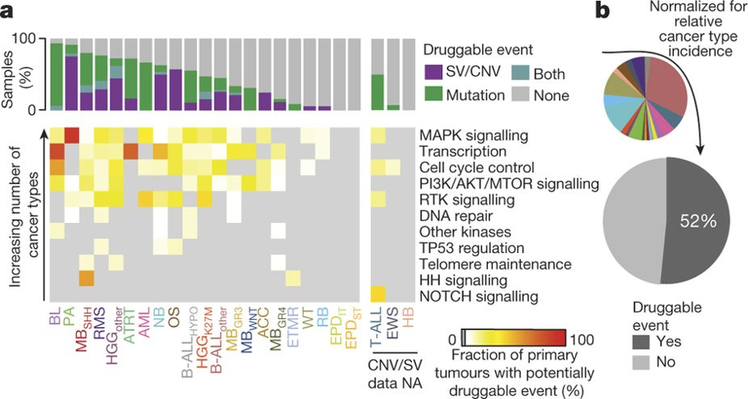
Alteraciones con Posibles Compuestos para Tratamiento
S N Gröbner et al. Nature 555, 321–327 (2018) doi:10.1038/nature25480
Notes:
Grobner S.N., Worst B.C., Weischenfeldt J., Buchhalter I., Kleinheinz K., Rudneva V.A., Johann P.D., Balasubramanian G.P., Segura-Wang M., Brabetz S., Bender S., Hutter B., Sturm D., Pfaff E., Hubschmann D., Zipprich G., Heinold M., Eils J., Lawerenz C., Erkek S., Lambo S., Waszak S., Blattmann C., Borkhardt A., Kuhlen M., Eggert A., Fulda S., Gessler M., Wegert J., Kappler R., Baumhoer D., Burdach S., Kirschner-Schwabe R., Kontny U., Kulozik A.E., Lohmann D., Hettmer S., Eckert C., Bielack S., Nathrath M., Niemeyer C., Richter G.H., Schulte J., Siebert R., Westermann F., Molenaar J.J., Vassal G., Witt H., Project I.P.-S., Project I.M.-S., Burkhardt B., Kratz C.P., Witt O., van Tilburg C.M., Kramm C.M., Fleischhack G., Dirksen U., Rutkowski S., Fruhwald M., von Hoff K., Wolf S., Klingebiel T., Koscielniak E., Landgraf P., Koster J., Resnick A.C., Zhang J., Liu Y., Zhou X., Waanders A.J., Zwijnenburg D.A., Raman P., Brors B., Weber U.D., Northcott P.A., Pajtler K.W., Kool M., Piro R.M., Korbel J.O., Schlesner M., Eils R., Jones D.T.W., Lichter P., Chavez L., Zapatka M. & Pfister S.M. (2018) The landscape of genomic alterations across childhood cancers. Nature 555, 321-7. (PMID 29489754)
Figure 6 : Potentially druggable events in paediatric cancers.
a, Proportion of primary tumours with potentially druggable events and associated biological pathways, per cancer type (n = 675 tumours with complete genomic information). NA, not available. b, Proportion of patients with potentially druggable events, projected after normalization for incidence.

Slide 10
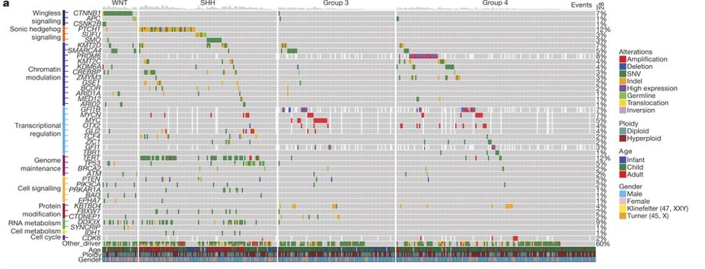
Heterogeneidad intertumoral Meduloblastoma
Northcott P.A. et. al. (2017) Nature 547, 311-7.
Notes:
Northcott P.A., Buchhalter I., Morrissy A.S., Hovestadt V., Weischenfeldt J., Ehrenberger T., Grobner S., Segura-Wang M., Zichner T., Rudneva V.A., Warnatz H.J., Sidiropoulos N., Phillips A.H., Schumacher S., Kleinheinz K., Waszak S.M., Erkek S., Jones D.T.W., Worst B.C., Kool M., Zapatka M., Jager N., Chavez L., Hutter B., Bieg M., Paramasivam N., Heinold M., Gu Z., Ishaque N., Jager-Schmidt C., Imbusch C.D., Jugold A., Hubschmann D., Risch T., Amstislavskiy V., Gonzalez F.G.R., Weber U.D., Wolf S., Robinson G.W., Zhou X., Wu G., Finkelstein D., Liu Y., Cavalli F.M.G., Luu B., Ramaswamy V., Wu X., Koster J., Ryzhova M., Cho Y.J., Pomeroy S.L., Herold-Mende C., Schuhmann M., Ebinger M., Liau L.M., Mora J., McLendon R.E., Jabado N., Kumabe T., Chuah E., Ma Y., Moore R.A., Mungall A.J., Mungall K.L., Thiessen N., Tse K., Wong T., Jones S.J.M., Witt O., Milde T., Von Deimling A., Capper D., Korshunov A., Yaspo M.L., Kriwacki R., Gajjar A., Zhang J., Beroukhim R., Fraenkel E., Korbel J.O., Brors B., Schlesner M., Eils R., Marra M.A., Pfister S.M., Taylor M.D. & Lichter P. (2017) The whole-genome landscape of medulloblastoma subtypes. Nature 547, 311-7. (PMID 28726821)
Figure 2 : Driver genes and pathways altered in MB.
a, Oncoprint summarizing recurrently altered genes according to MB subgroup (n = 390; WGS series only). b, Top, Venn diagram summarizing the subgroup overlap of recurrently mutated genes (≥3 affected cases). Bottom, incidence plot of recurrently mutated genes (≥3 affected cases) detected in the series (n = 356 genes; n = 491 samples). c, Graphical summary of the most frequently mutated genes (≥10 affected cases) and their subgroup distribution. d, Venn diagram summarizing the significantly mutated gene lists output from multiple significance algorithms. e, Results from d restricted to Cancer Gene Census (CGC) genes.

Slide 11
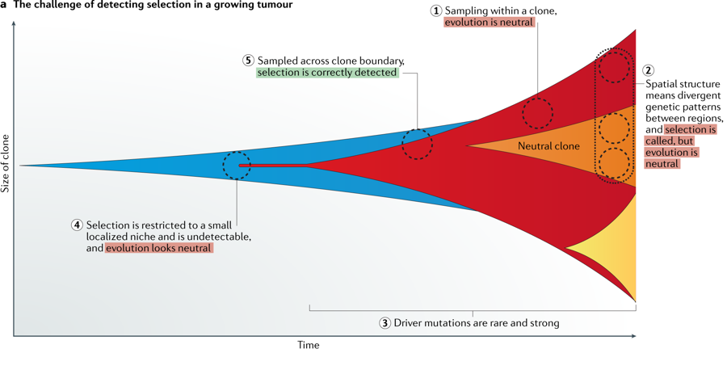
Heterogeneidad intratumoral Evolución espacio-temporal
Turajlic S., et al., (2019) Nat Rev Genet.
Notes:
1
Turajlic S., Sottoriva A., Graham T. & Swanton C. (2019) Resolving genetic heterogeneity in cancer. Nat Rev Genet. (PMID 30918367)
a | Limited sampling in time and space confounds measurement of evolutionary dynamics. (Step 1) Sampling within a clone shows neutral dynamics. (Step 2) Non-uniform spatial sampling can look like selection when it is just genetic divergence. (Step 3) If driver mutations accrue rarely but exhibit a strong effect, most evolutionary time shows only neutral dynamics. (Step 4) Selection occurs within a small niche that is below the detection limit such that evolution appears neutral because selected subclones are undetectable. (Step 5) Using frequency and/or phylogenetic methods, selection can only be detected when multiple subclones are sampled. b | Bulk sequencing data have profound time biases, permitting only the earliest — and so highest frequency — mutations to be detected. As a tumour doubles its cell number, new mutations that arise represent an exponentially smaller fraction of the tumour and thus rapidly fall below detectable frequency. c | Error in copy number and single-nucleotide variant mutation multiplicity assignment propagates and confounds the identification of tumour subclones. Limited depth sequencing (for example, 100×) causes dispersion in the true variant allele frequency (VAF), and true VAF is determined by clonal abundance and underlying copy number state (coloured shapes on plot). This leads to mutations in different clones or at different copy number states, being erroneously misassigned clonal identities. The 1/f² tail of low frequency mutations is an inevitable consequence of tumour growth and further complicates clonal inference on VAF data. CCF, cancel cell fraction.

Slide 12
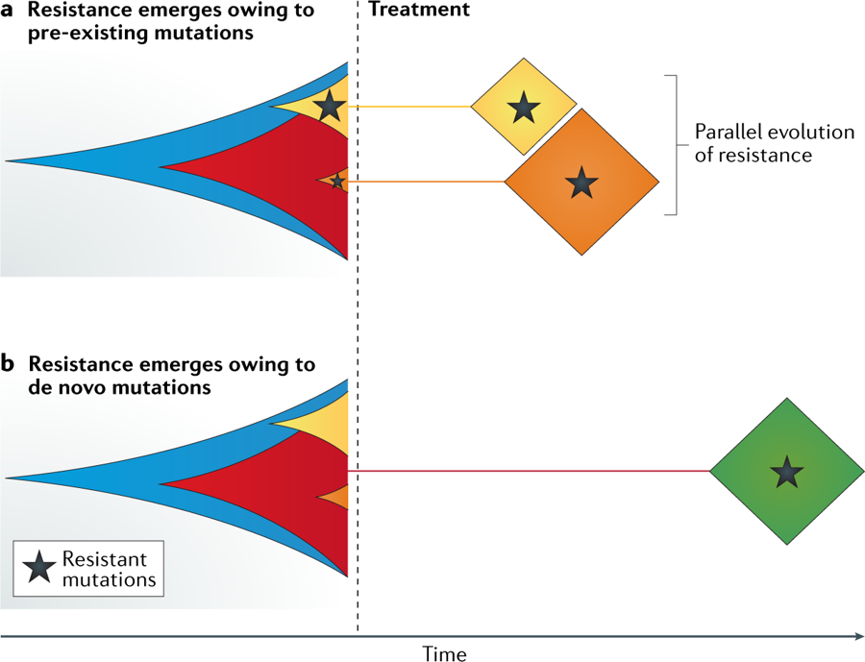
Heterogeneidad intratumoral Evolución espacio-temporal
Turajlic S., et al., (2019) Nat Rev Genet.
Notes:
1
Turajlic S., Sottoriva A., Graham T. & Swanton C. (2019) Resolving genetic heterogeneity in cancer. Nat Rev Genet. (PMID 30918367)
a | Resistant mutations can be present in the tumour population before the start of therapy, usually as a minor subclone^{132,134}. They may evade detection in the baseline sample if they are present at very low frequency or are restricted to an unsampled region of the tumour. They may even be neutral or deleterious before therapy. Under the selective pressure of therapy, the treatment-sensitive population diminishes, leaving the resistant population to expand under positive selection. Multiple subclones bearing distinct resistant mutations can emerge at the same time, indicating parallel evolution of resistance^{135,136,137,138}. b | Treatment resistance can be a result of a de novo mutation that carries a selection advantage under therapy and becomes fixed in the tumour population. In this case, resistance takes longer to emerge¹²⁹.

Slide 13
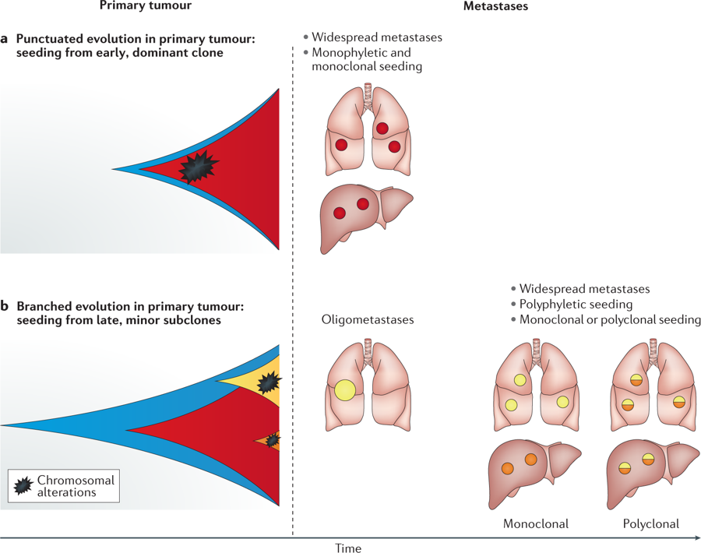
Heterogeneidad intratumoral Evolución espacio-temporal
Turajlic S., et al., (2019) Nat Rev Genet.
Notes:
1
Turajlic S., Sottoriva A., Graham T. & Swanton C. (2019) Resolving genetic heterogeneity in cancer. Nat Rev Genet. (PMID 30918367)
Different modes of evolution in the primary tumour can impact the mode of metastatic progression²⁶. Metastatic capacity is associated with increased chromosome complexity⁹¹. a | Tumours that evolve in a punctuated fashion with early onset of clonal chromosome complexity grow rapidly and metastasize early and widely. Metastases are monophyletic (a single dominant clone seeds all the metastatic sites) and monoclonal (a single clone seeds a single site), and there is limited intermetastatic heterogeneity. b | Tumours that evolve in a branched (Darwinian) fashion grow more slowly and are composed of distinct subpopulations of cells with differential metastatic capacity. Chromosome complexity is acquired late, and they are associated with solitary or oligometastases. When they spread to multiple sites, they may do so in a polyphyletic fashion (different subclones seed different sites), which may include organ-specific patterns and result in intermetastatic heterogeneity¹¹⁷. If multiple clones seed the same site, the metastasis is polyclonal.

Slide 14
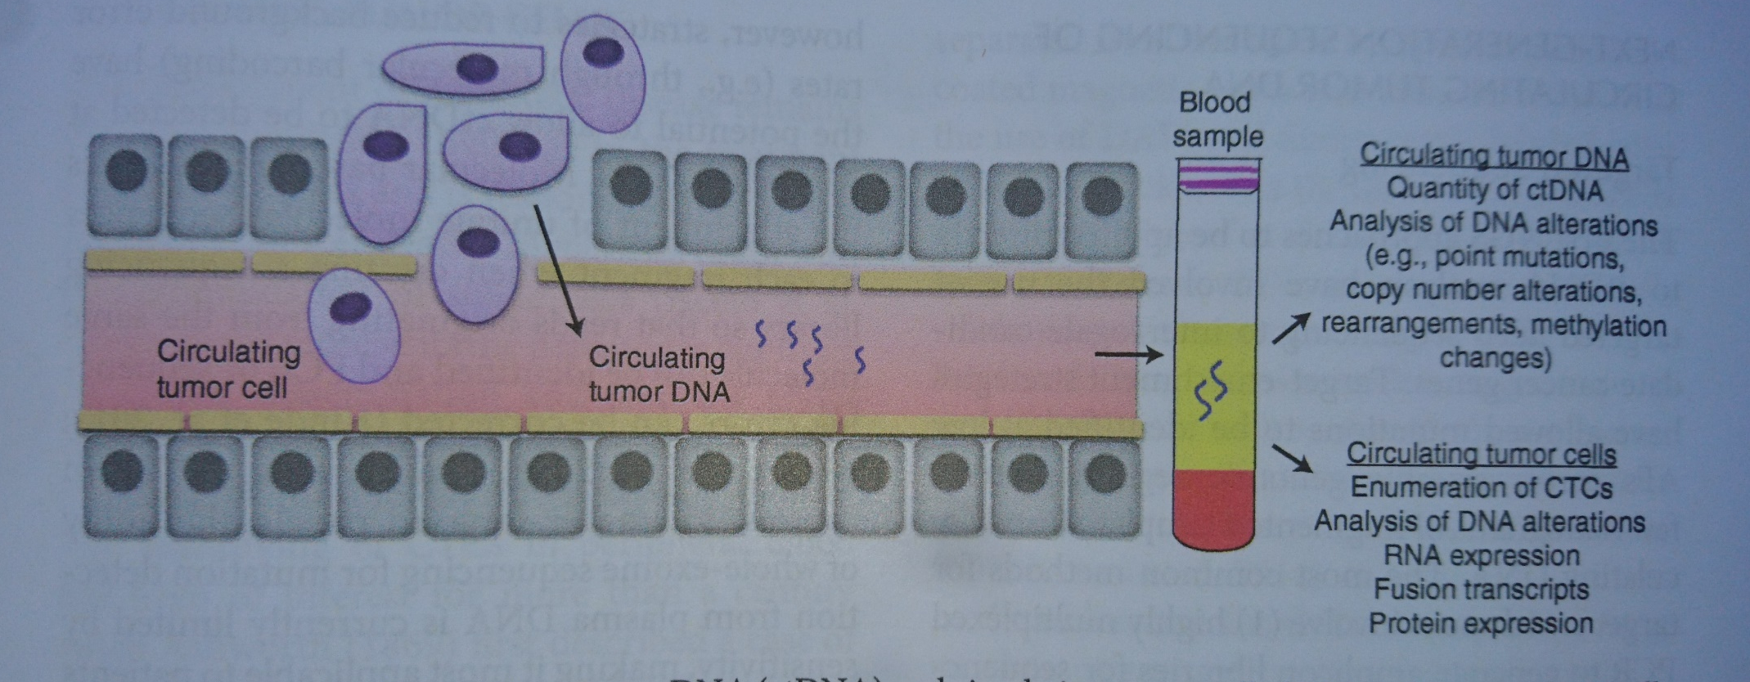
Biopsias líquidas
Cold Spring Harb Perspect Med doi: 10.1101/cshperspect.a026880
Notes:
Dawson, S.-J. 2019. Characterizing the cancer genome in blood. Cold Spring Harb Perspect Med doi: 10.1101/cshperspect.a026880
Figure 1.
Detection of circulating tumor DNA (ctDNA) and circulating tumor cells (CTCs). Cancers release cell-free ctDNA and CTCs into the bloodstrwam and these can be used as biomarkers to follow various tumor-specific parameters from a simple blood test in cancer patients.

Slide 15
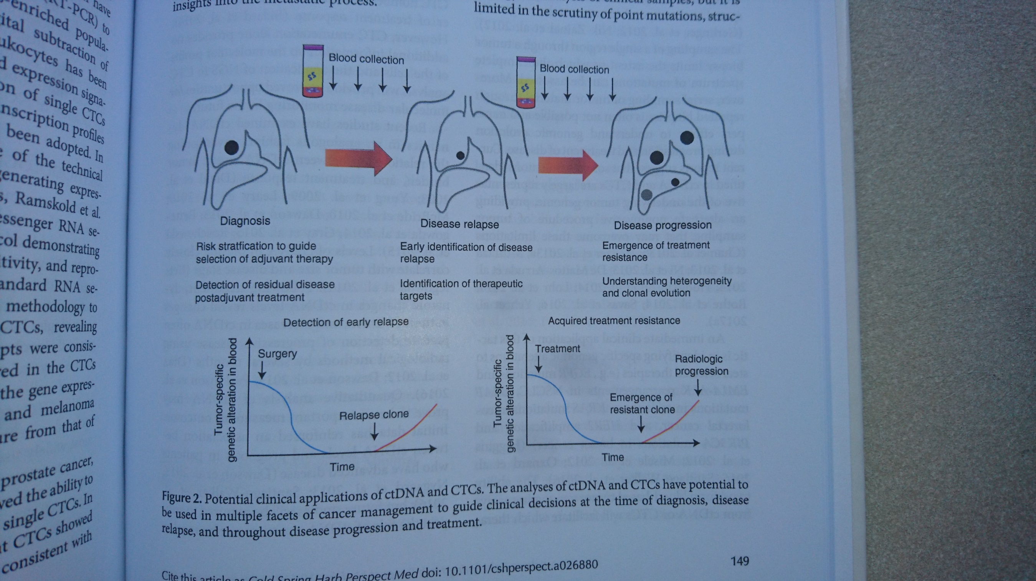
Biopsias líquidas
Cold Spring Harb Perspect Med doi: 10.1101/cshperspect.a026880
Notes:
Dawson, S.-J. 2019. Characterizing the cancer genome in blood. Cold Spring Harb Perspect Med doi: 10.1101/cshperspect.a026880
Figure 2.
Potential clinical applications of ctDNA and CTCs. The analyses of ctDNAand CTCs have potentrial to be used in multiple facets of cancer management to guide clinical decisions at the time of diagnosis, disease relapse, and throughout disease progression an treatment.

