Slide 1

El cáncer en los niños
El reto diagnóstico
Dr. Pedro F Valencia Mayoral
Departamento de Patología

Slide 2
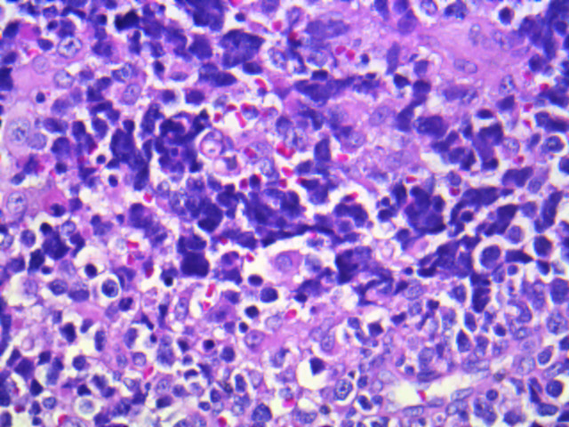
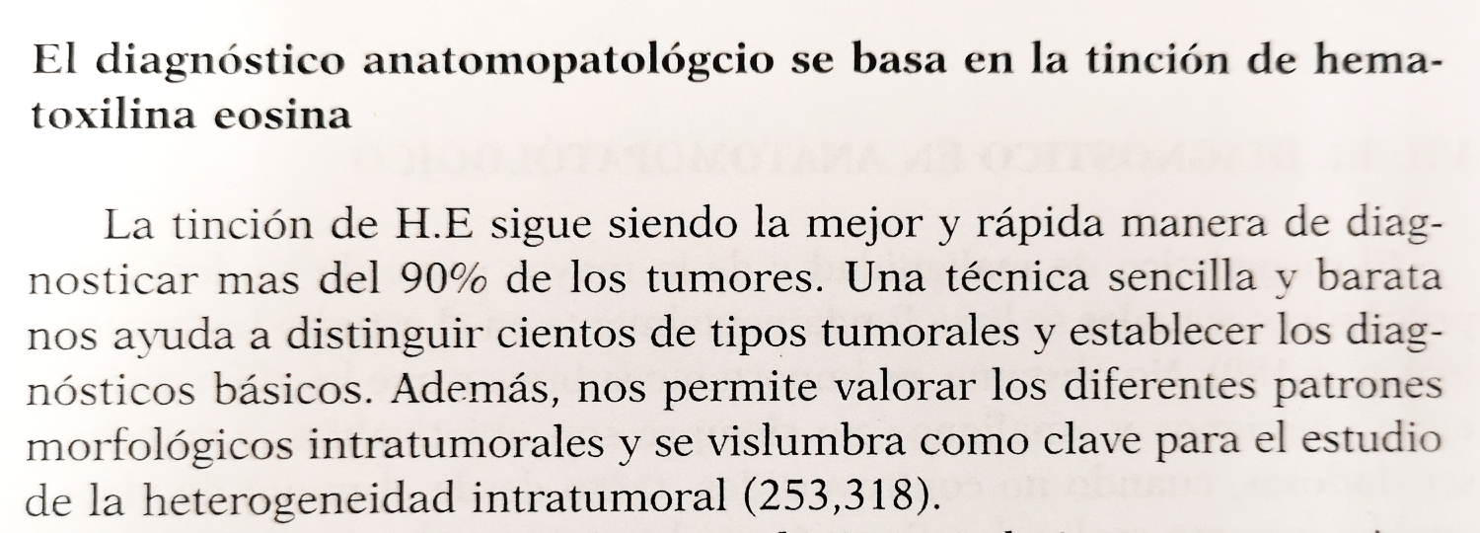
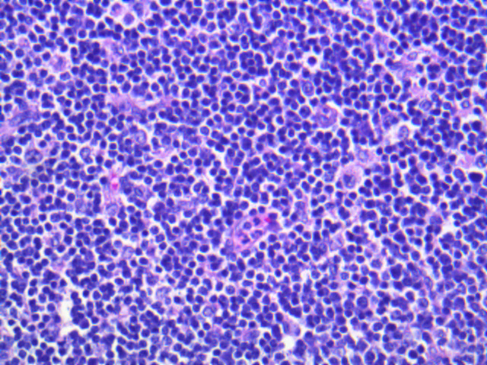
El reto diagnóstico
Clínico, radiológico, bioquímico…
Santiago Ramón y Cajal. 2014

Slide 3
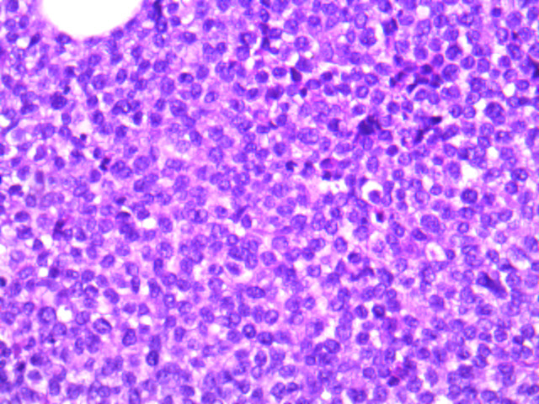
Tumores
De
Células
Pequeñas,
Redondas y azules
Linfomas
Leucemias
Sarcomas
Blastomas
T Neurogénicos
Carcinomas

Slide 4
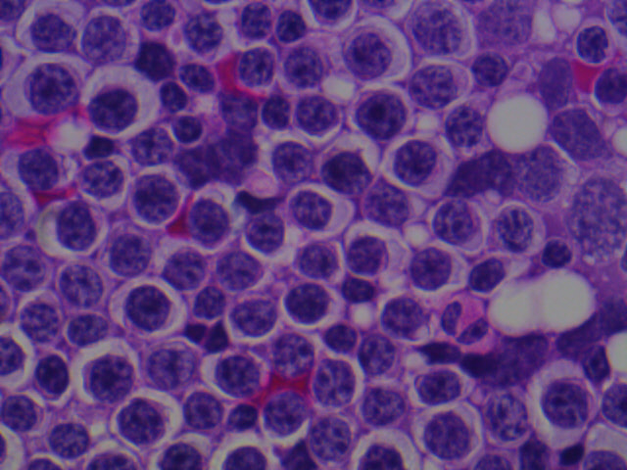
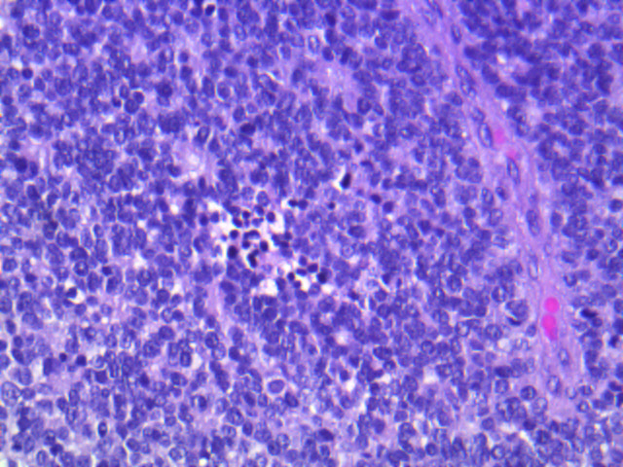
Tumores
De
Células
Pequeñas,
Redondas y azules

Slide 5
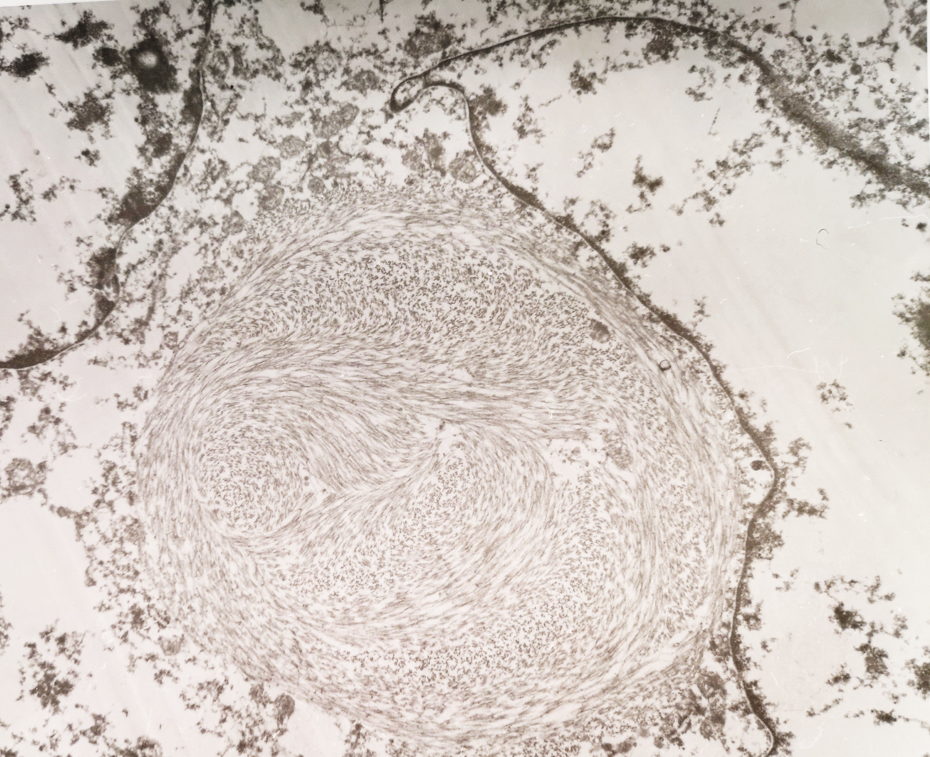
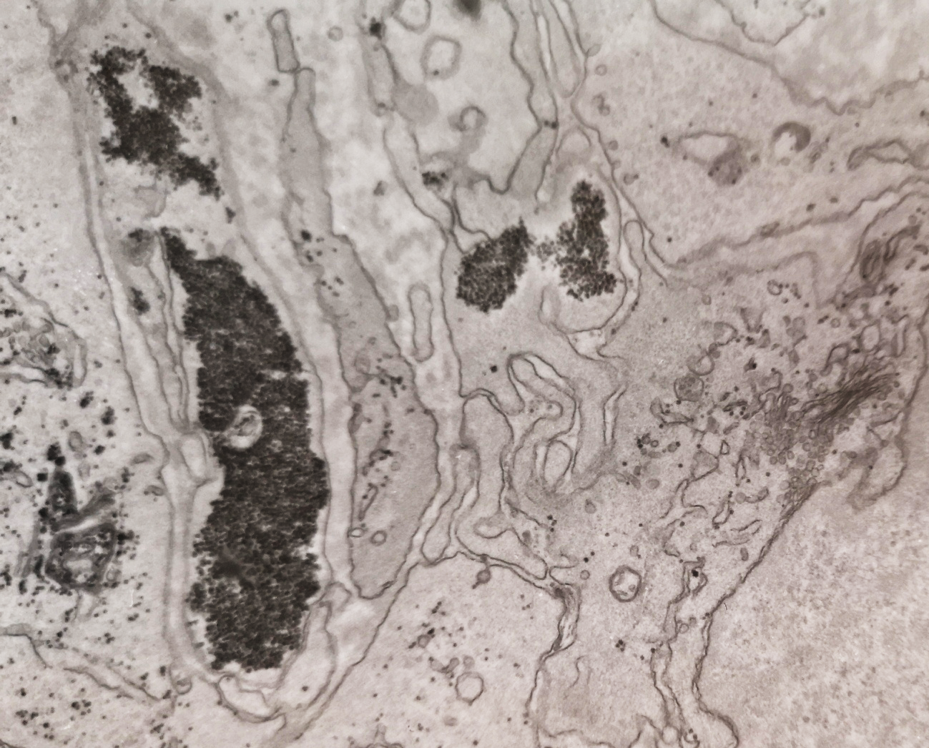
El reto diagnóstico
Diagnóstico
Morfológico convencional
Hematoxilina y eosina
Ultraestructural

Slide 6
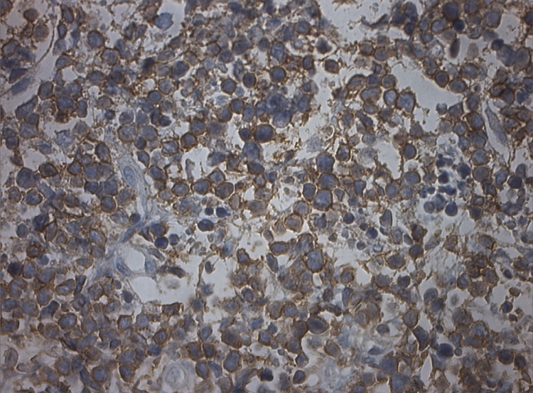
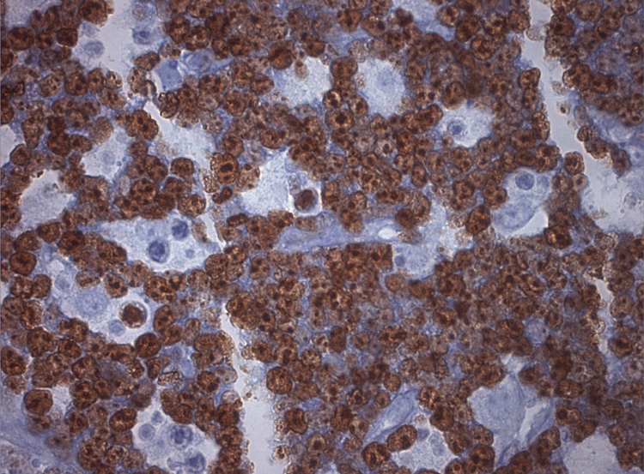
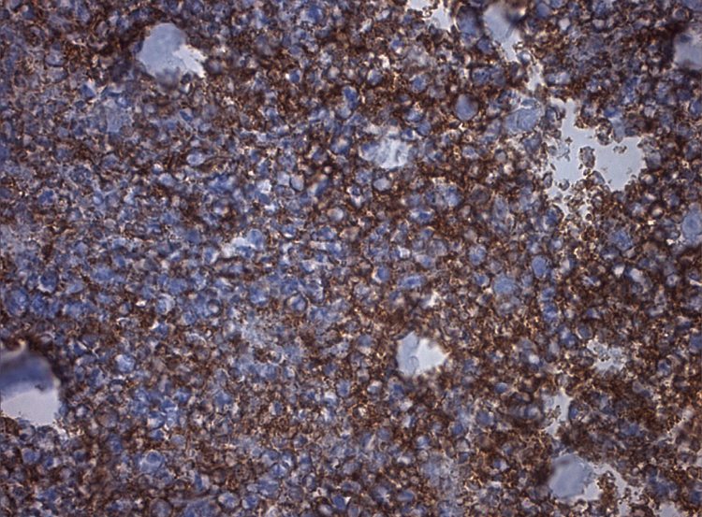
El reto diagnóstico
Inmunohistoquímica
“Paneles”
Linfomas, Leucemias, Epiteliales,
Sarcomas, Blastomas, T Neurogénicos
CD99
KI67
CD20

Slide 7
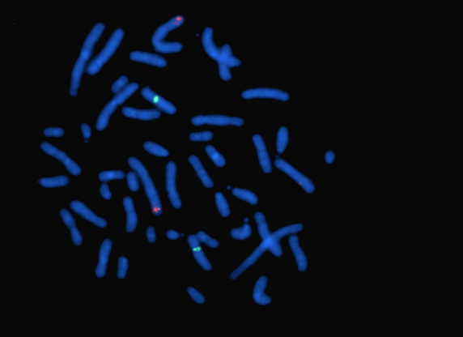
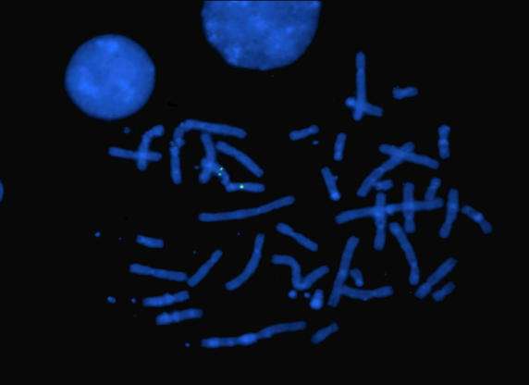
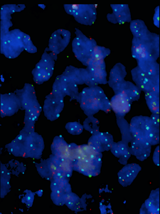
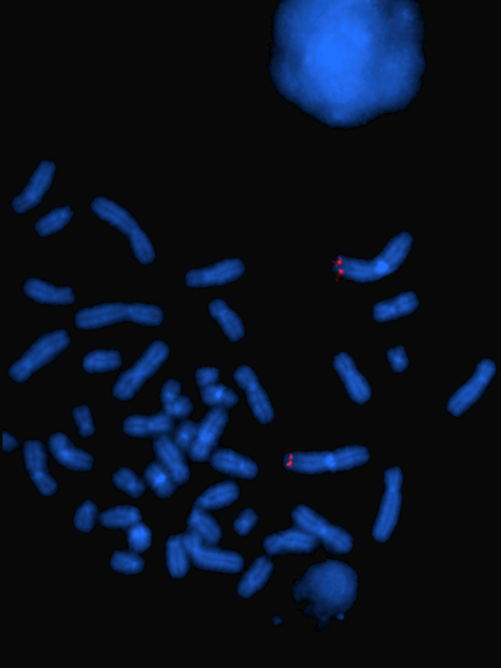
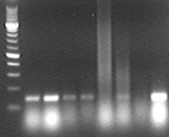
El reto diagnóstico
Biología molecular
Genética y epigenética
A
B
C
C: Paciente con translocación ARMS, fusión de genes PAX3-FOX1 (flechas)
PM 1 2 3 4 5 6 7 C+
Electroforesis gel de agarosa donde se observa la translocación t(2;13)(q35;q14) en el ARMS, producto de 147 pares de bases

Slide 8
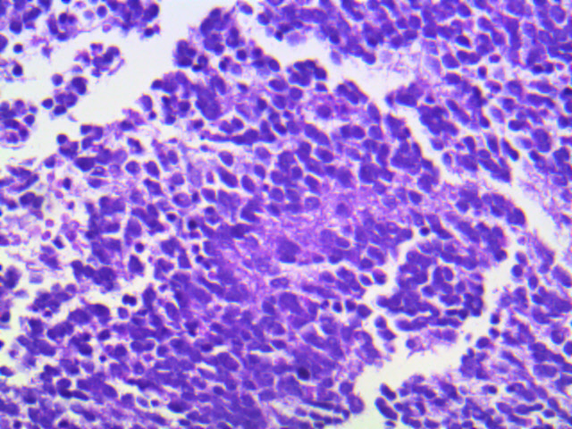
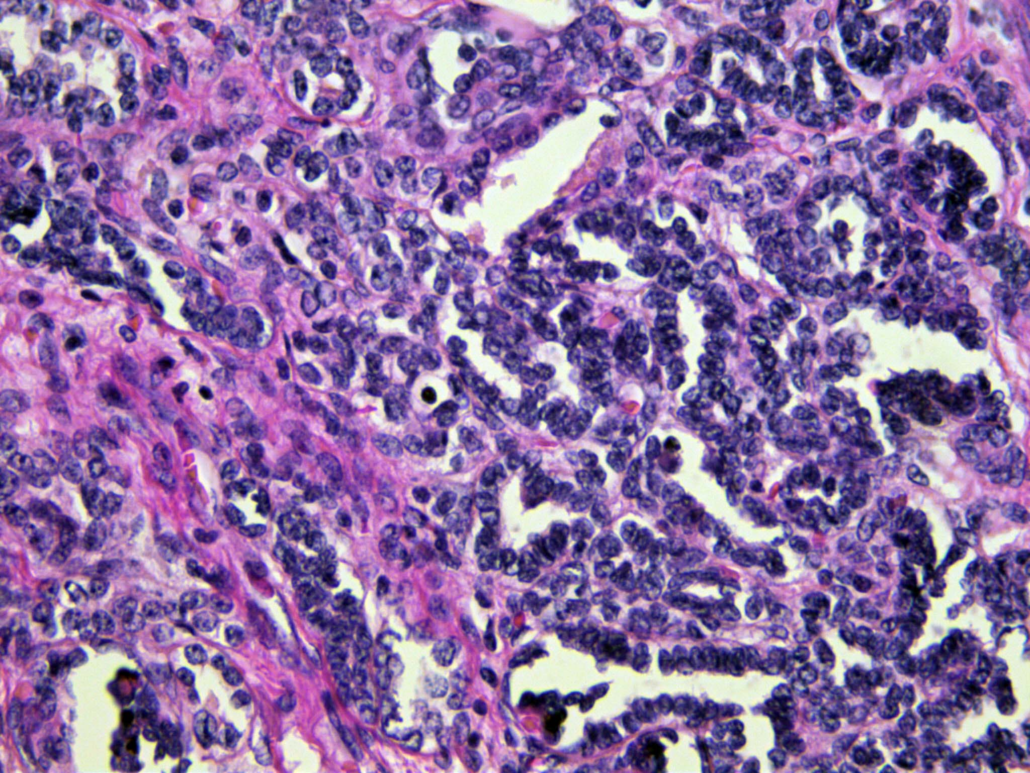
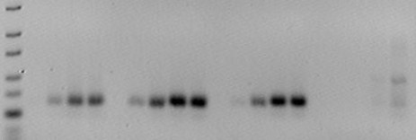
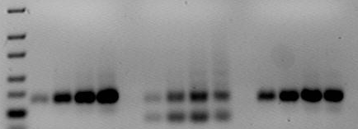
El reto diagnóstico
Diagnóstico
Morfológico convencional
Hematoxilina y eosina
Ultraestructural
Inmunohistoquímica
Biología molecular
Genética y epigenética
Heterogeneidad
miR-124
miR-21
1 2 3 4
1 2 3
75pb
50pb
75pb
50pb
25 30 35 40 25 30 35 40 25 30 35 40 25 30 35 40
25 30 35 40 25 30 35 40 25 30 35 40

Slide 9
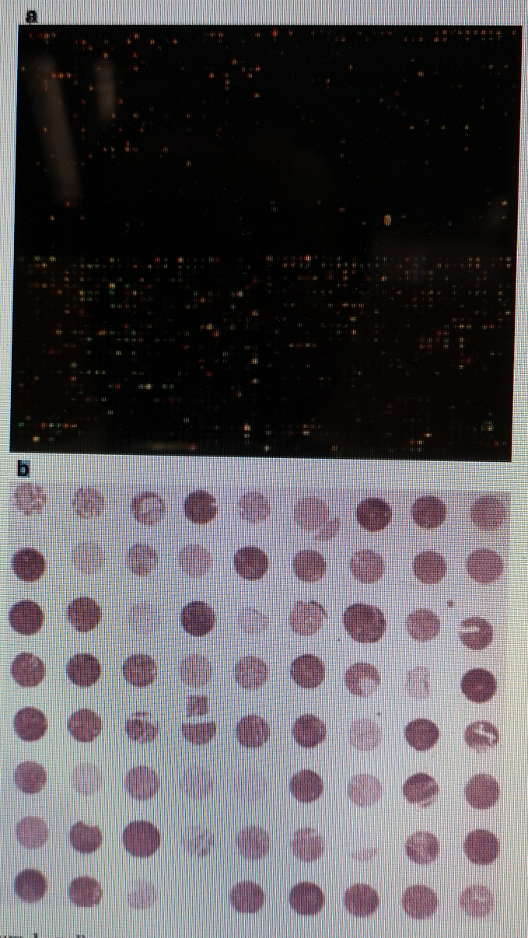
El reto diagnóstico
Autopsy, histology and cytology have been and histology and cytology still are the main diagnostic tools in surgical pathology. During the last two decades molecular biology gradually has extended the diagnostic armamentarium. In tumor pathology molecular biology techniques are used to diagnose and subclassify tumors, predict response to therapies and identify therapeutic targets. Molecular pathology has evolved into a novel focus of clinical pathology and transforms the historically morphology based discipline. Traditional pathology and molecular pathology combine and guide tumor therapy.
M van de Rijn,2018

Slide 10
El reto diagnóstico
Genes routinely analysed for mutations in solid tumors in diagnostic molecular pathology (selection)
Tumor | Altered genes | Therapy (selection)
Lung adenocarcinoma | EGFR | Gefitinib, erlotinib, afatinib, osimertinib
 | ALK | Crizotinib, ceritinib
 | ROS1 | Crizotinib
 | MET exon 14 | Crizotinib
Gastrointestinal stroma tumor (GIST) | KIT | Imatinib, sunitinib
 | PDGFRA | Imatinib, sunitinib
Colorectal carcinoma | KRAS, NRAS, BRAF, MSIª | Cetuximab, panitumumab, immune checkpoint inhibitor
Malignant melanoma | BRAF | Vemurafenib, dabrafenib, trametinib, cobimetinib
 | KIT | Imatinib, sunitinib, dasatinib
Breast carcinoma | HER2 | Trastuzumab, pertuzumab
Ovarian carcinoma; triple negative breast carcinoma | BRCA1/2 | Olaparib
Medullary thyroid cancer | RET | Vandetanib

