Slide 1


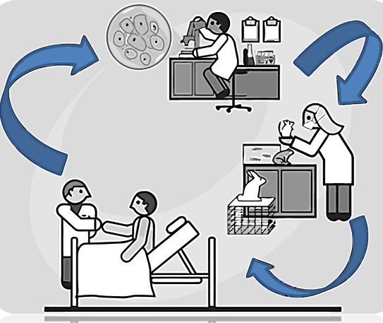
Medicina Traslacional en las Enfermedades Metabólicas
Coordinador Acad. Dr. Miguel Cruz López
Estrategia basada en la investigación científica y su aplicación en la clínica para establecer: diagnóstico, tratamiento y prevención.
Revista Science Translational Medicine: promueve y divulga la MT, donde los investigadores pueden difundir nuevos resultados en diferentes campos de conocimiento.
Médicos, Enfermeras, Químicos, Biólogos, Farmacobiólogos. Bioinformáticos, ingenieros, técnicos, que contribuyen en el diagnóstico, tratamiento y/o control de las enfermedades

Slide 2
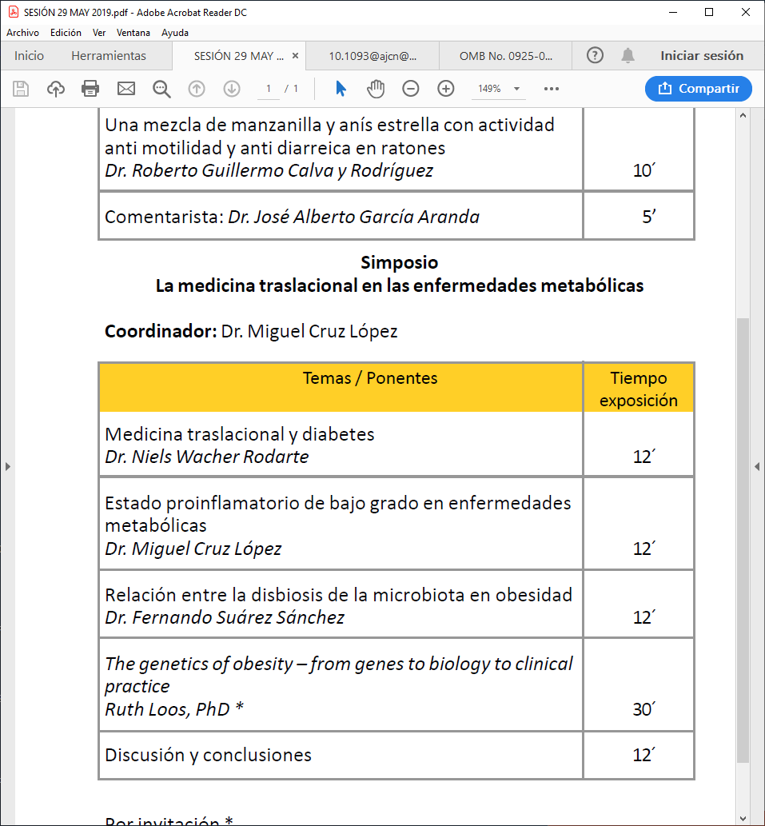
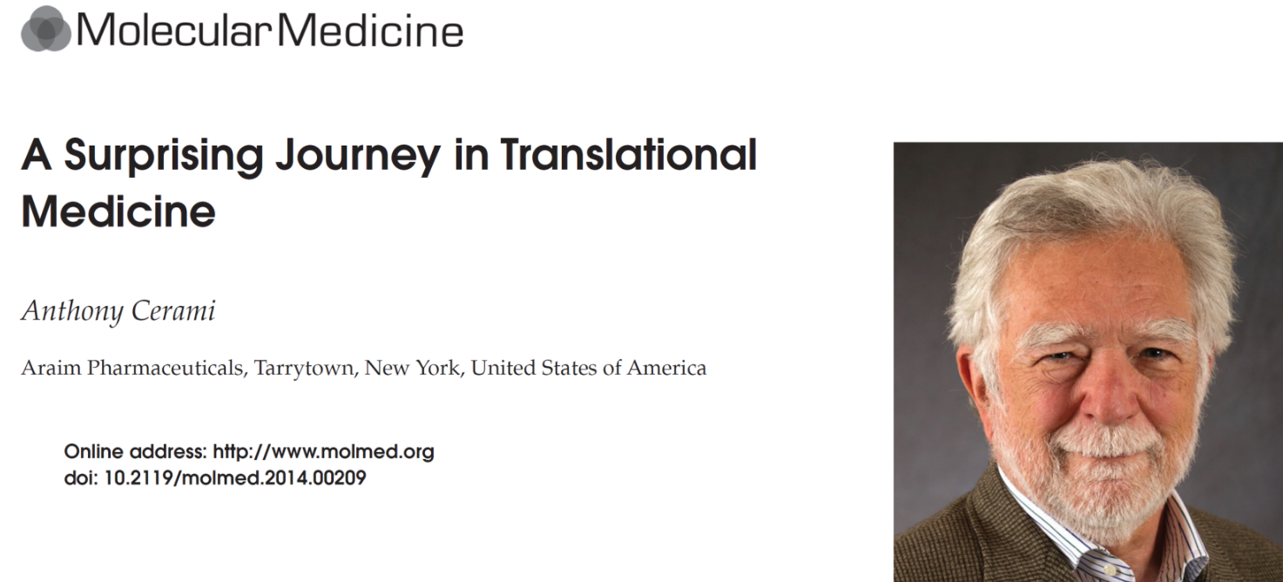
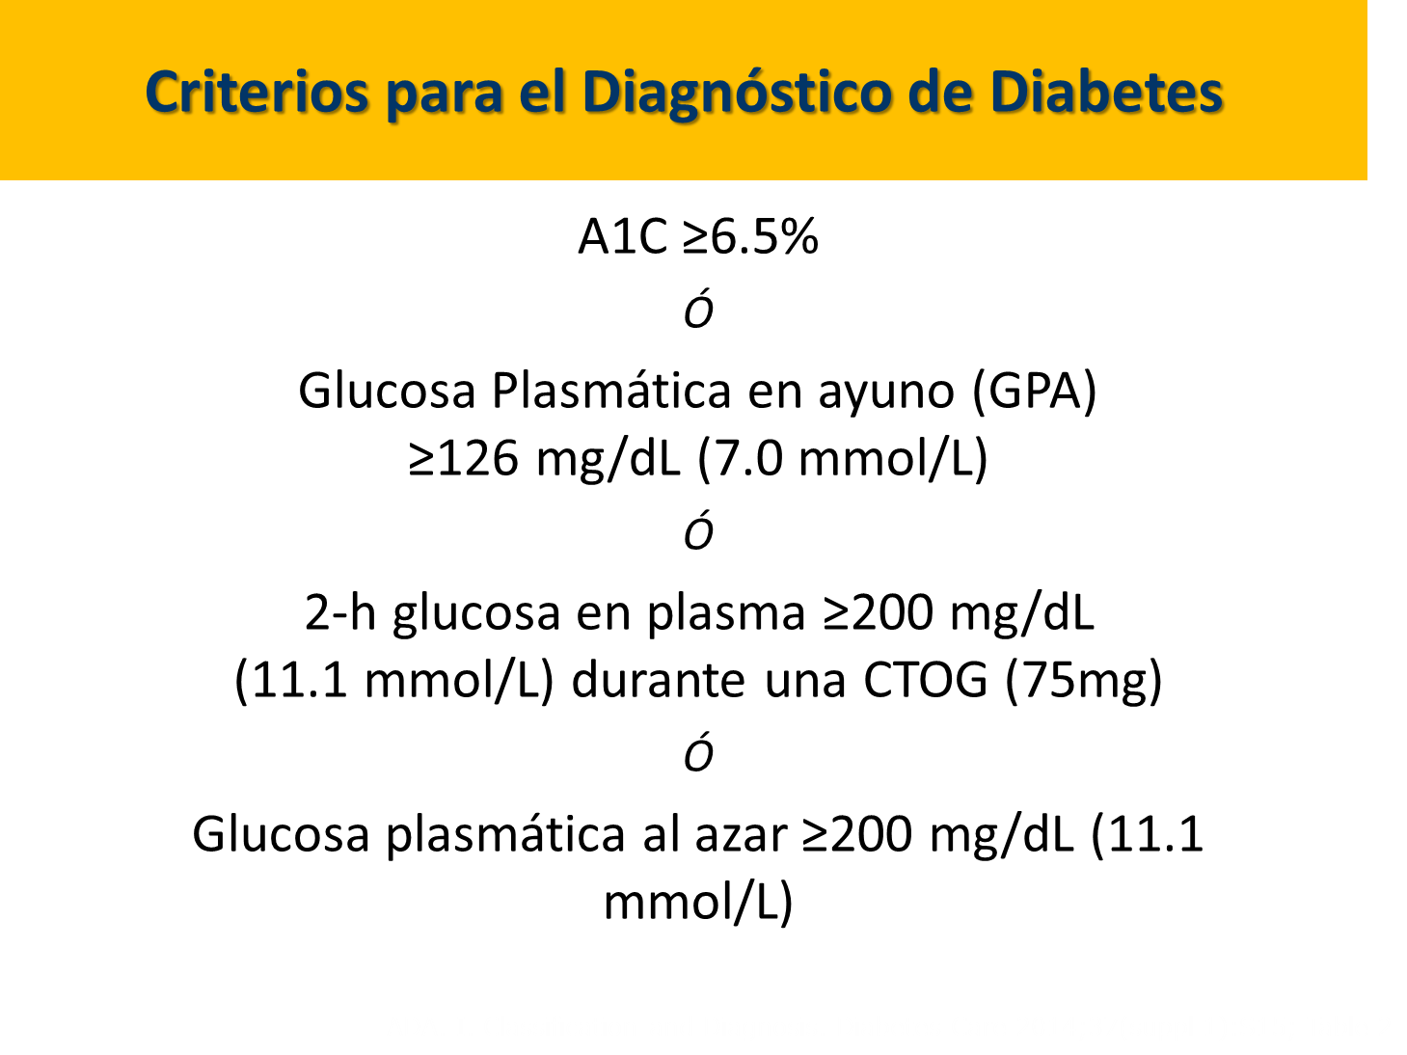
Measuring Hb A1c, we could estimate the
1c average blood sugar integrated over a
number of weeks.
Studies confirmed the utility of accessing the degree of diabetic control of patients with HbA1c
.
Subsequent clinical trials demonstrated that the reduction of Hb A1c was associated with a decrease in 1c diabetic complications.

Slide 3
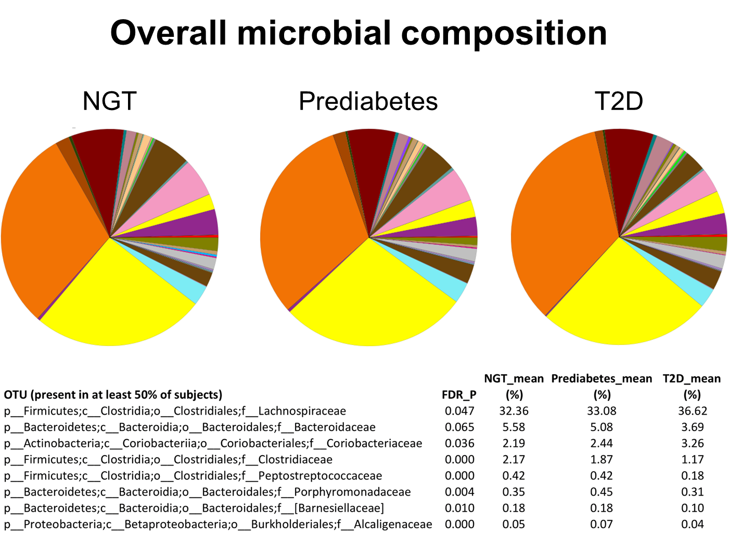
The gut microbiota as a modulator of host
metabolism and obesity
Center for Cardiovascular and Metabolic Research and the Wallenberg Laboratory
University of Gothenburg
Unidad de Investigación Medica en Bioquímica Hospital de Especialidades,
Centro Medico Nacional Siglo XXI, IMSS
Microbial regulation of organismal energy Homeostasis…gut microbiota-based therapies can be used to modulate host metabolism

Slide 4
Dr. Ruth Loos is Director of the Genetics of Obesity and Related Metabolic Traits Program, and co-director of The Charles Bronfman Institute of Personalized Medicine at the Icahn School of Medicine at Mount Sinai.
BIOGRAPHICAL SKETCH
Kinesiología o cinesiología se basa en el estudio científico del movimiento humano y en las ciencias físicas (biomecánica, anatomía músculo esquelética y la fisiología neuromuscular)
Nationality Belgian, Date of birth 10-10-1970
University of Leuven, Belgium BSc 06/1991 Kinesiology
University of Leuven, Belgium MSc 06/1993 Kinesiology
University of Leuven, Belgium MEd 06/1993 Kinesiology
University of Leuven, Belgium MSc 06/1994 Kinesiology: Health and Fitness
University of Leuven, Belgium PhD 11/2001 Medical Sciences: Epidemiol, Genetic.
B. Positions and Honors
Positions and employment
2002 – 2005 Postdoctoral Fellow, Pennington Biomedical Research Center, Baton Rouge, LA, USA
2005 – 2007 Investigator Scientist, Medical Research Council Epidemiology Unit, Institute of Metabolic Science, Cambridge, UK
2007 – 2011 Programme Leader, Medical Research Council Epidemiology Unit, Institute of Metabolic Science, Cambridge, UK
C. Contribution to Science
I have been leading a research group in the field of obesity genetics and have contributed to many crucial discoveries of obesity genes since 2008. I have published >390 peer-reviewed papers, of which 111 lead-author papers. A total of 119 papers have been published in the highest-impact journals in the field (Nature, Nature Genetics, Science, The Lancet, NEJM, PLoS Medicine, PLoS Genetics, AJHG). My H-index is 116 and Citations more than 60, 000

Slide 6


