Slide 1

Caracterización de un sistema serotoninérgico intrínseco en el corazón
Gabriel Manjarrez-Gutiérrez
Laboratorio de Patología Molecular, Unidad de Investigación Biomolecular. Hospital de Cardiología, Centro Médico Nacional, Siglo XXI (CMN-SXXI), Instituto Mexicano del Seguro Social (IMSS), Ciudad de México, México

Slide 2
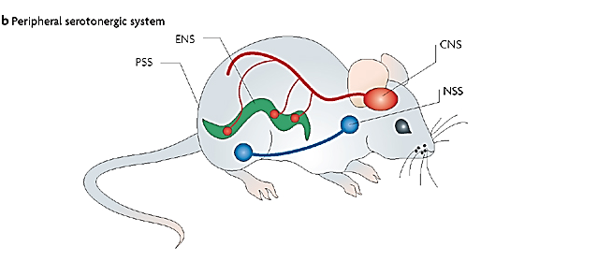
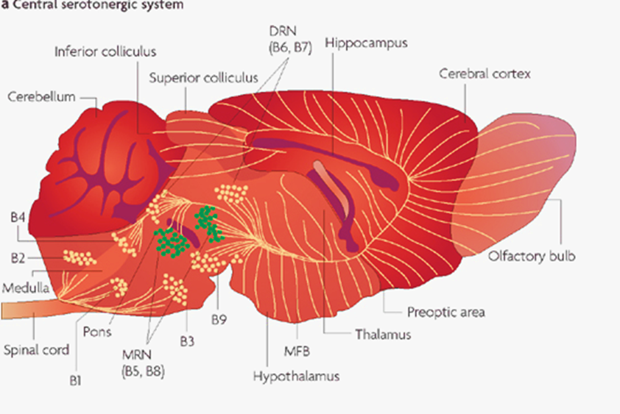
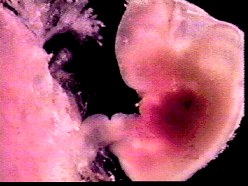
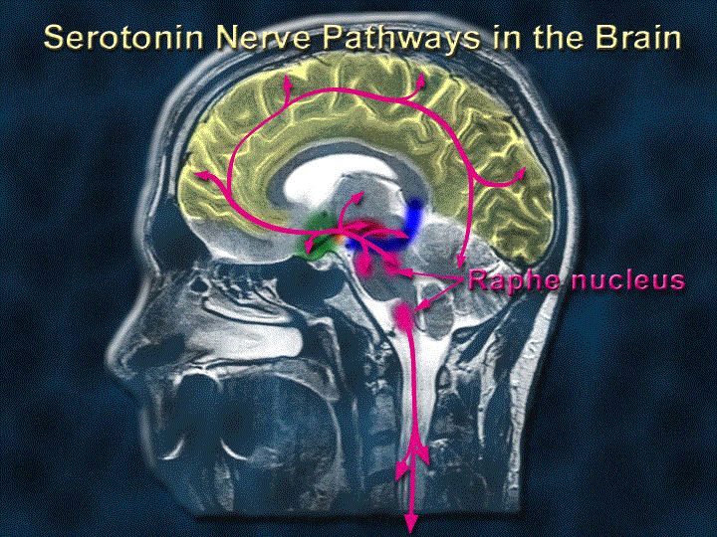
Sistema serotoninérgico
En la rata esta presente en el día 10.5 de vida fetal y alcanza su máxima expresión en la segunda semana de vida posnatal. En los humanos, las neuronas serotoninérgicas están ya presentes en la quinta semana de gestación y aumentan rápidamente a través de la décima semana de vida fetal. Para la semana 15 de gestación la organización típica del sistema serotoninérgico en los núcleos del rafe esta ya conformada.

Slide 3
METABOLISMO DEL L-TRIPTÓFANO
Sangre
BHE
Cerebro-Corazón
DAA
DAA
DAA
DAA
A
A
A
A
Normal
TrpOH
TrpOH
TrpOH
TPH
5
5
5
5
-
-
-
-
HT
HT
HT
5
HT
5
5
5
-
-
-
-
HTP
HTP
HTP
HTP
H
H
H
H
BH
BH
BH
qDB
qDB
qDB
?
qDB
?
?
?
4
4
2
BH
BH
BH
BH
BH
BH
BH
2
BH
2
2
2
2
2
qDB
qDB
qDB
qDB
R
2
L
L
L
L
-
-
-
-
Trp
Trp
Trp
Trp
Ácidos grasos libres
Aminoácidos neutros
BHE = Barrera hemato-encefálica. TPH = Triptófano-5-hidroxilasa. 5HTP= 5-hidroxitriptófano.
DAA = Descarboxilasa de los aminoácidos aromáticos. 5HT = 5-hidroxitriptamina ó serotonina.
qDB₂ = quinonoidedihidrobiotperina. qDBR₂ = quinonoidedihidrobiopterina reductasa.
BH₂ = Dihidrobioperina, BH₄ = tetrahidrobioperina

Slide 4
Serotonin functions in the heart
Serotonin seems an ideal neurohumoral candidate for cardiovascular regulation
Bradycardia or tachycardia
Hypotension or hypertension
Vasodilatation or vasoconstriction
An increased 5-HT availability has been shown to produce arrhythmia, leading to heart block or to valvular fibroplasia
5-HT has also been suggested to regulate cardiovascular development. Recently, disruption of 5-HT_{2B} receptor revealed a role for 5-HT by means of this receptor in heart morphogenesis
Recently, it has been shown that 5-HT, through a direct stimulation of 5HT₃ receptors on sympathetic afferents, participates in the activation of reflex responses

Slide 5
Serotonergic receptors in the heart
Pharmacological analysis also implicates 5-HT_{1A}, 5HT₂, 5HT₃, 5HT₄, and 5HT₇ receptors in cardiovascular function.
These receptors are located either on the nerve endings in the heart or on the myocardium, and their role still remains to be clarified.
Recently, it has been shown that 5-HT, through a direct stimulation of 5HT₃ receptors on sympathetic afferents, participates in the activation of reflex responses.
These are subsequent to an ischemic stress either at the abdominal or at the cardiac level.

Slide 6
Objetivo
Caracterizar bioquímica e inmunohistoquímicamente un sistema serotonínergico intrínseco en el corazón de la rata.
Material y métodos
Se utilizaron ratas machos de la cepa Wistar, con peso corporal promedio de 250 ± 10 g, se adaptaron dos semanas a condiciones estándar de bioterio.
Se obtuvieron los corazones para determinar los principales componentes del sistema serotoninérgico a través de inmunohistoquímica y Western blot para triptófano-5-hidroxilasa (TPH) 1 y 2, el transportador de serotonina (SERT) y los receptores serotoninérgicos 5-HT_{1B}, 5-HT_{2A}, 5-HT_{2B} y 5-HT₄.
Además se determinaron la actividad de la TPH, el L-Triptófano (L-Trp), 5-hidroxitriptamina (serotonina) y el ácido 5-hidoxiindol acético por cromatografía de líquidos de alta resolución.

Slide 7
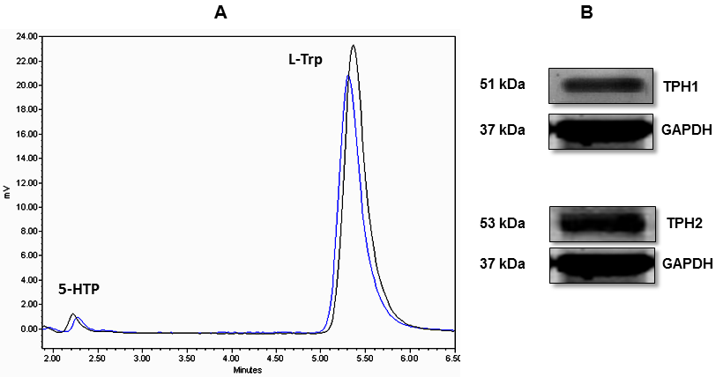
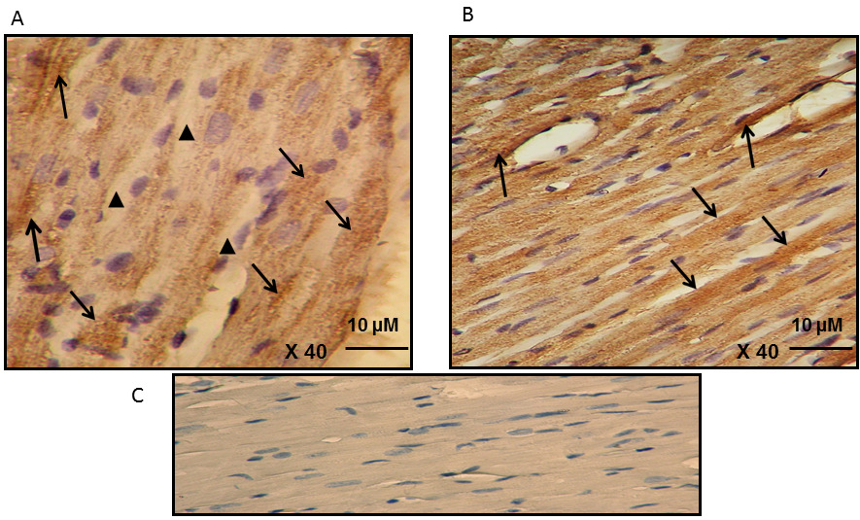
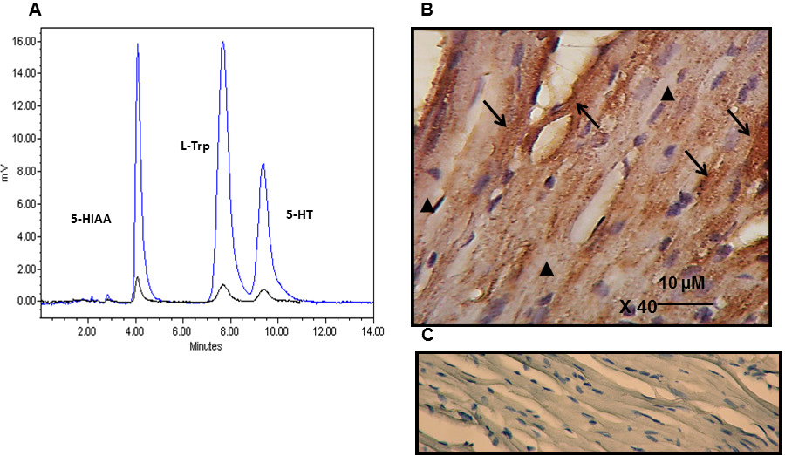
Figure 2. Photomicrographs of longitudinal cuts of the heart that show immunopositive cardiomyocytes for tryptophan-5-hydroxylase (TPs). A) TPH1 and B) TPH2. Cuts were incubated with monoclonal antibodies specific for each of the isoforms (dilution 1:500) and immunoreactivities were detected with secondary antibodies conjugated with peroxidase and revealed with 3,3-diaminobenzidine. Arrows show the immunoreactivity in cytoplasmic conglomerates and in the membranes. Arrowheads point to the sites where there was no immunopositivity of the enzymes.C) Negative control
Figure 1A. Chromatogram representative of a standard 5-HTP and L-Trp (black line) and of the specific activity of TPH obtained in rat heart (blue line). (B) Expression of TPH1 and 2 in rat heart by Western blot. Immunoreactivity was detected with antibodies specific for each of the proteins. One 51-kDa band for TPH1 was observed and another band of 53 kDa that corresponded to TPH2 and GADPH of 37 kDa as internal control.
Figure 3 A. Chromatogram representative of the presence of 5-HIAA, L-Trp, and 5-HT in the heart (black line) and the response of the respective standards (blue line). (B) Photomicrograph of a longitudinal slice of the heart showing 5-HT immunopositive cardiomyocytes. The heart tissue was incubated with polyclonal antibody for the amine (dilution 1:1000) and immunoreactivity was detected with a secondary antibody conjugated with peroxidase and revealed with 3,3-diaminobenzidine. Arrows show immunoreactivity in conglomerates and arrowheads point to the zones with no immunopositivity. C) Negative control.
Glo Adv Res J Med Med Sci 2015; 4(2):083-091

Slide 8
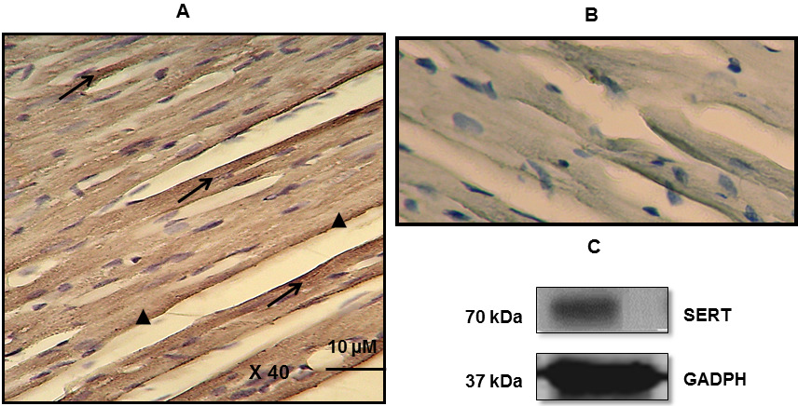
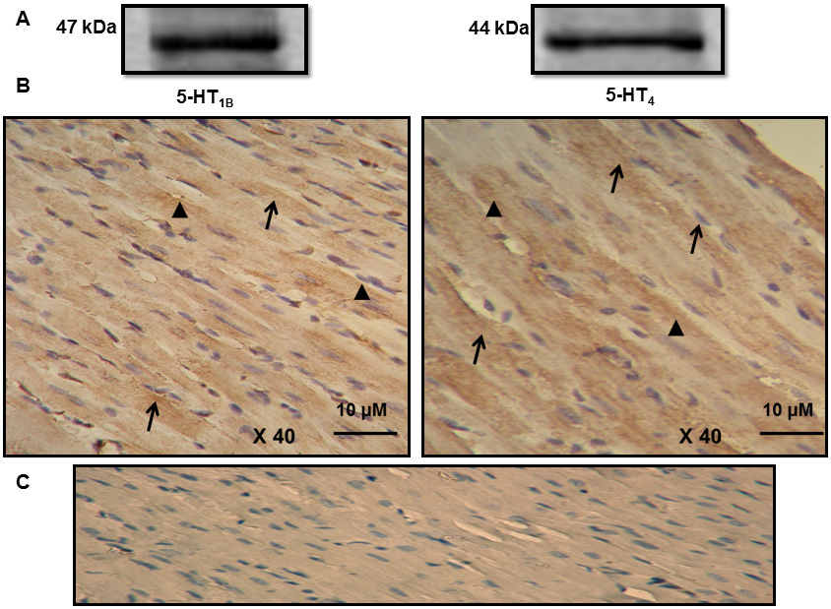
Figure 4 A. Photomicrograph of a longitudinal cut of the heart that shows immunopositive cardiomyocytes for SERT. The cut was incubated with protein-specific monoclonal antibody (dilution 1:500) and immunoreactivity was detected with secondary antibody conjugated to peroxidase and revealed with 3,3-diaminobenzidine. Arrows show immunoreactivity with cytoplasmic conglomerates and in the membranes. Arrowheads show the zones where there was no immunopositivity in the cardiomyocytes. (B) Negative control. C) Expression of SERT by Western blot; immunoreactivity was detected with specific antibodies. A 70-kDa band for SERT and another 37-kDa band was observed, which corresponded to GADPH as internal control for the experiment.
Figure 5A. Expression of 5-HT1B and 5-HT4 receptors in the heart by Western blot; immunoreactivity was detected with specific antibodies for each of the receptors. A 47-kDa band was observed for 5-HT1B and another band of 44 kDa, which corresponded to 5-HT4. (B) Photomicrographs of longitudinal cuts of the heart show cardiomyocytes immunopositive for receptors. Cuts were incubated with specific monoclonal antibodies (dilution 1:400) and immunoreactivity was detected with secondary antibody conjugated to peroxidase and revealed with 3,3-diaminobenzidine. Arrows show conglomerates of the immunoreactivity in the cardiomyocytes. Arrowheads show immunopositivity in the membranes. C) Negative control
Glo Adv Res J Med Med Sci 2015; 4(2):083-091

Slide 9
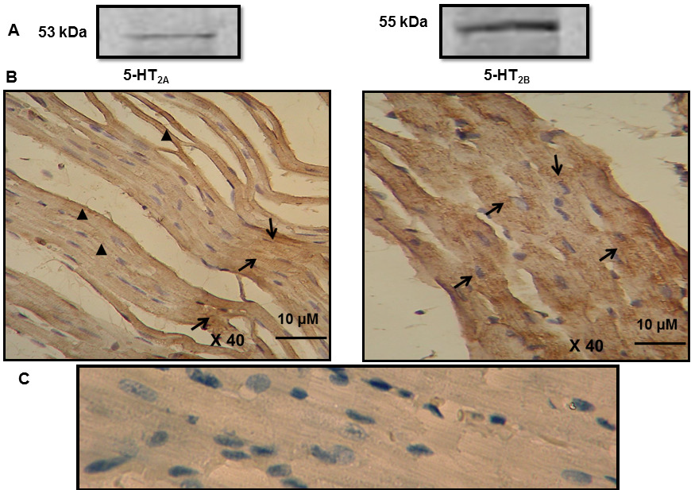
Figure 6A. Expression of 5-HT2A and 5-HT2B receptors in the heart of the adult rat by Western blot; immunoreactivity was detected with antibodies specific for each of the receptors. A 53-kDa band was observed for 5-HT2A and another band of 55 kDa that corresponded to 5-HT2B. (B) Photomicrographs of longitudinal cuts of the heart that show cardiomyocytes immunoreactive for the 5-HT2A and 5-HT2B receptor. Cuts were incubated with monoclonal antibodies specific for each (dilution 1:500) and immunoreactivity was detected with a secondary antibody conjugated to peroxidase and revealed with 3,3-diaminobenzidine. Arrows show immunoreactivity in conglomerates and around the nuclei. Arrowheads show immunopositivity located in the membranes. C) Negative control.
Glo Adv Res J Med Med Sci 2015; 4(2):083-091

Slide 10
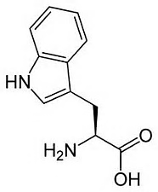

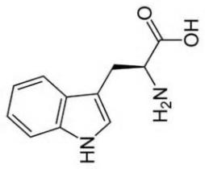

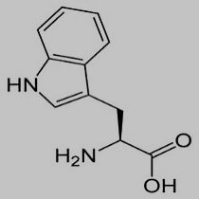
Parácrina
Autócrina
5HT
5HT
5HT
5-HT_{1B}
Liberación
SERT
PKA
AMPc
(−)
AMPc
5-HT₄
5-HT_{2A}
TPH
5HT
MAO
PKA
Gqα
Gqα
5HT
Efectos inotrópicos
(+)
PLC
L-Trp
Actina
Cambios en
actina y miosina
IP3
5HT
Miosina
Expresión
de genes
PIP2
Rhoa
5HT
5HT
Ca²⁺
TGasa
Cambios en el citoesqueleto
Protección
mitocondrial
Rhoa
X
5-HT_{2B}
Gqα o 11
ERK
Bax
PI3K
(−)
Ant1 ↑
Cardiopatía
hipertrófica
Rab4
5HT
Rab4
Caspasa 3 y 9
Apoptosis
Ruptura miofibrilar
Cardiomiopatia dilatada
5HT
Sistema serotoninérgico intrínseco en el cardiomiocito de la rata

Slide 11
Conclusiones
Nuestros hallazgos demuestran la existencia de un sistema serotoninérgico intrínseco en el corazón de la rata hasta ahora no descrito. Puesto que proporciona suficiente evidencia que indica que los cardiomiocitos tienen la maquinaria bioquímica capaz de sintetizar, utilizar y recapturar 5-HT, lo que apoya la hipótesis de las funciones parácrina y autócrina de la 5-HT y el mejor entendimiento de su participación en algunos aspectos fisiopatológicos del corazón.

Slide 12
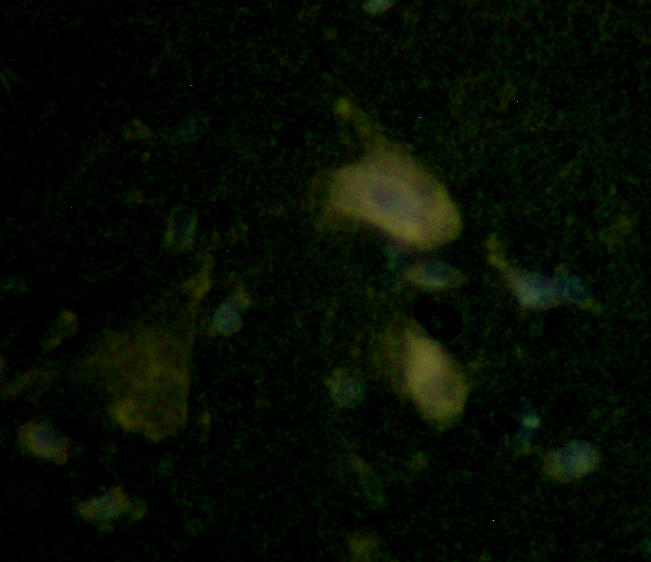

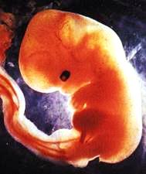
Dr. Gabriel Manjarrez Gutiérrez
Laboratorio de Patología Molecular
UIBCAR. Hospital de Cardiología CMN SXXI
IMSS
Dr. Jorge Hernández R
Dr. Alfonso Boyzo M
CINVESTAV
Victor Manuel Magdaleno
Misael González Ramírez
Edgar Hernández Zamora
Leticia Manuel Apolinar
Alejandro Robles Onofre
Felipe Vázquez Estupiñán
Margarita Delgado
Mónica León Valadez
Nicolás Camacho Calderón
Laura Meneses Hernández
Ivett Medina Aguirre
Susana Mejenes Álvarez
Teresa Godínez López
Julio M. Medina Serrano
Rodolfo Ramírez Campillo
José Alberto Arvizu Flores
Karina Martínez Radilla
Antonio Mondragón Herrera
Teresa Neri Aguirre
Misión imposible
Dra. Rocío Herrera Márquez
Servicio de Endocrinología
Hospital de Pediatría CMN SXXI

