Slide 1



Updates in the systemic treatment for lung cancer: Immunotherapy
Oscar Arrieta MD
Thoracic Oncology Unit
National Cancer Institute of Mexico

Slide 2
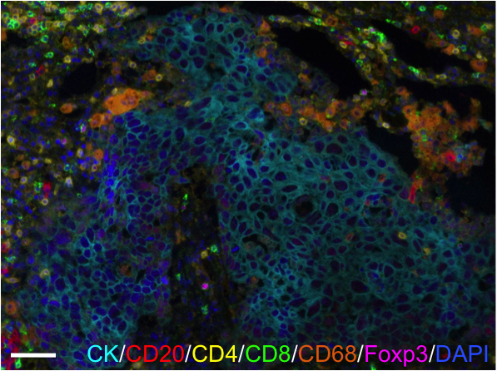

Slide 3
The Immunoediting Hypothesis:
Understanding Patterns of Response
Elimination
Equilibrium
Escape
T reg
T reg
T reg
CTL
NKT
CTL
CTL
NK
NK
CTL
T reg
T cyto
Genetic instability/tumor
heterogeneity
Immune selection
Reprinted by permission from MacMillan Publishers Ltd: [Nat Immunol] Dunn GP, et al. Nat Immunol. 2002;3:991-998. Copyright 2002. Schreiber R, et al. Science. 2011;331:1565-1570.
Mittal D, et al. Curr Opin Immunol. 2014;27:16-25.
Notes:
CTL, cytotoxic T cell lymphocyte; NK, natural killer cell; NKT, natural killer T cell; T reg, T regulatory cell

Slide 4
The goal of Immuno-therapy
Immunotherapy encompasses the development and utilization of new compounds that harness the patient’s own immune system to fight cancer.
THE GOAL
POTENTIAL
To provide durable, long-term survival with a high quality of life for patients with various solid or hematologic malignancies.
It has become a new, innovative treatment modality and a foundation upon which to build treatment strategies
To shift the balance in favor of immunity, allowing tumor eradication or long-term suppression of tumor growth.
Finn OJ. Ann Oncol., 2012.
De Vita VT, et al. N Engl J Med., 2012.
Eggermont A. Ann Oncol. 2012.

Slide 5
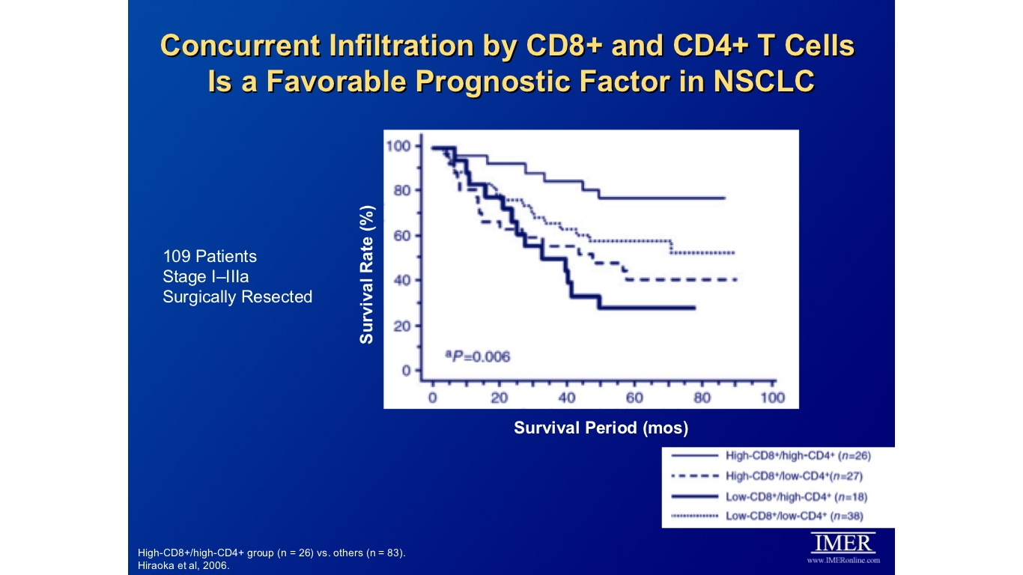
Concurrent infiltration by CD8 and CD4 T cells is favorable for NSCLC
Hiraoka S, et al. JTO 2006.

Slide 6
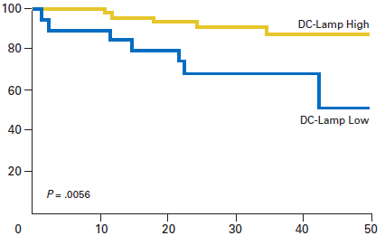
Long-Term Survival for NSCLC Patients With Intratumoral Lymphoid Structures
Method: Analysis of Mature dendritic (DC-Lamp+) cells in 74 early stage NSCLC ptns with prognosis
Result: Density of mature DC was highly associated with a favorable outcome (including overall, disease-specific, and disease-free survival)
Disease-Free Survival (%)
Time (mons)
.
Dieu-Nosjean et. al. JCO. 2008; 26: 4410-17
Notes:
Dieu-Nosjean et al, JCO 2008, 26: 4410-17 (France)
Evaluation of DC-Lamp as a marker of tumor-induced bronchus- associated lymphoid tissue (Ti-BALT) and its prognostic value. Kaplan-Meier curves of disease-free survival for 74 patients with non–small-cell lung cancer depending on the density of tumor-infiltrating DC-Lamp+ mature DC.

Slide 7
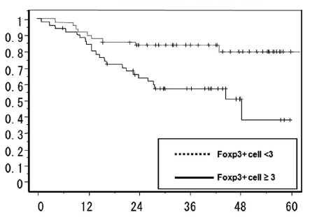
Tumor Infiltrating Tregs in NSCLC
Recurrence-Free Survival
Foxp3 as a specific marker of natural T regulatory cells
Method: Intra-tumoral Treg expression was assessed in 100 ptns following resection of their NSCLC tumor
Result: Tumor-infiltrating FoxP3+ Tregs were associated with worse Recurrence-Free Survival (RFS)
Survival Probability
Survival Time (mons)
Shimizu et. al. J Thorac Oncol. 2010; 5: 585-90

Slide 8
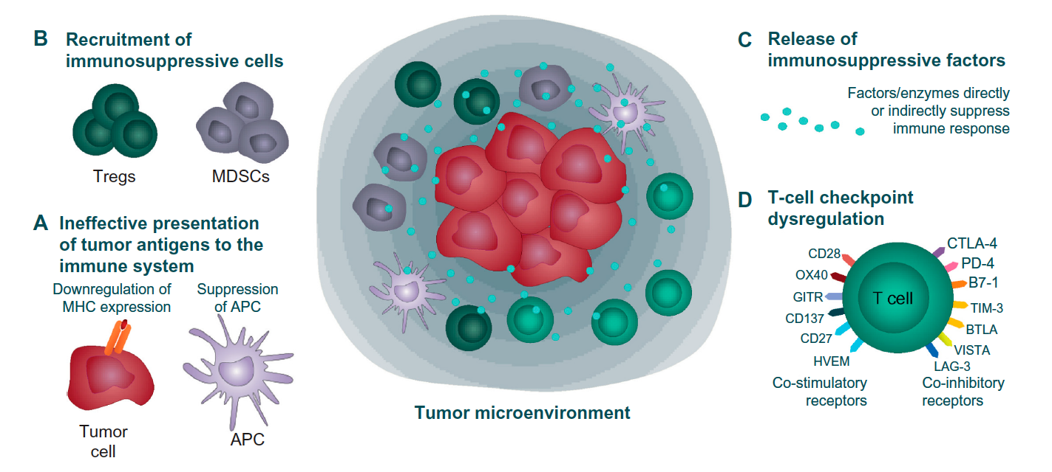
Mechanisms of tumor evasion
Davies Marianne. New modalities of cancer for NSCLC: focus on immunotherapy. Cancer magagement and research. 2014:6 63-75.

Slide 9
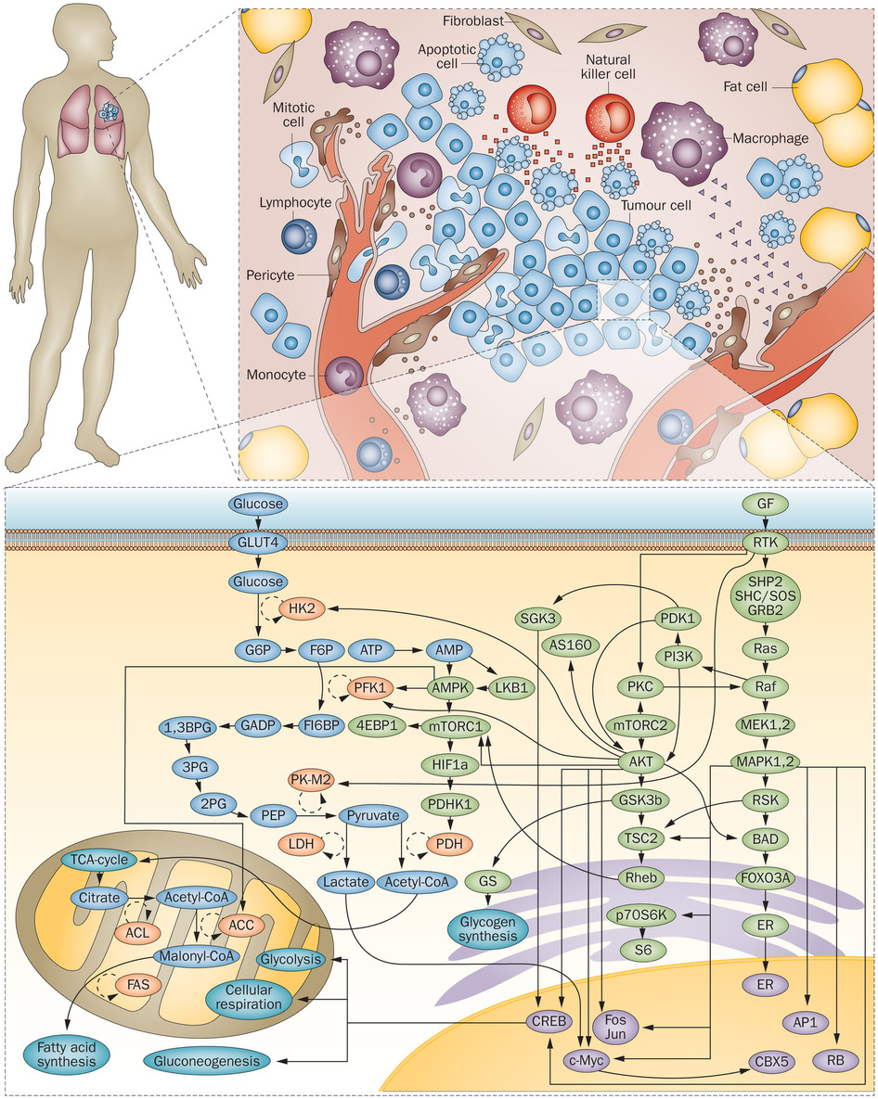
Cell infiltration to the tumor microenvironment
Chronic inflammation
Disturbances in the mechanisms of regulation.
Tumor growth
Tissue remodeling
Formation of new blood vessels
metastasis
Notes:
Los estudios clínicos y epidemiológicos han sugerido una fuerte asociación entre la inflamación local crónica y algunos tipos de cáncer.
Sabemos que en el microambiente tumoral interaccionan un redes complejas diversos tipos celulares con todas sus moléculas de señalización las cuales determinan el curso de un tumor; a causa de la expresión o represión de diferentes genes importantes en la respuesta inmune y de la célula tumoral.
Que pueden llevar a la proliferación de las células tumorales, a la angiogenesis y la diseminacíón tumoral, dando lugar a las metastasis.
Componentes inflamatorios en el desarrollo de la neoplasia incluyen diversas poblaciones de leucocitos ; como los neutrófilos , que responden de inmediato a estímulos inflamatorios y contienen una amplia gama de compuestos tóxicos .

Slide 10
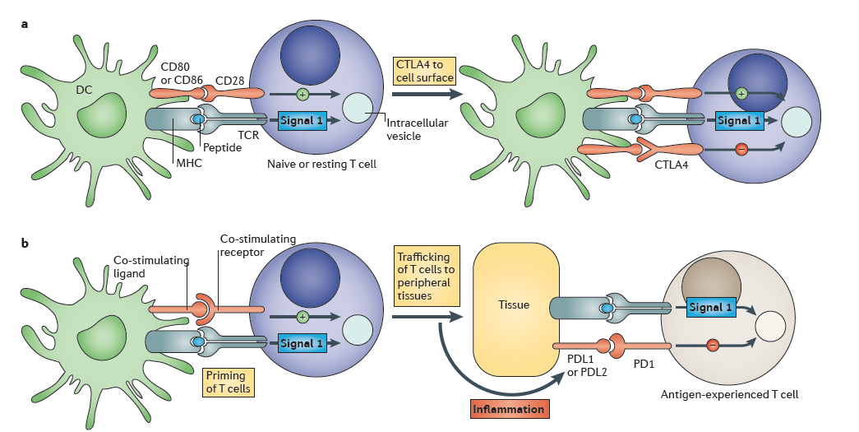
Ligand expression for CTLA-4 and PD-1
Reports suggest that expression of the ligands for CTLA-4 and PD-1 differ resulting in spatial differences in where these interactions are occurring in the body^{1,2}
  CTLA-4:B7 interactions between T cells and antigen presenting cells are postulated to occur primarily in the lymph nodes resulting in T cell inactivation
  PD-1:PD-L1/2 interactions are suggested to occur specifically within peripheral sites resulting in T cell inactivation
Tumor
cell
Topalian, et al. 2012. Curr Opin Imm:24:207-212.
Pardoll 2012. Nature Reviews Cancer:12:252-264.

Slide 11
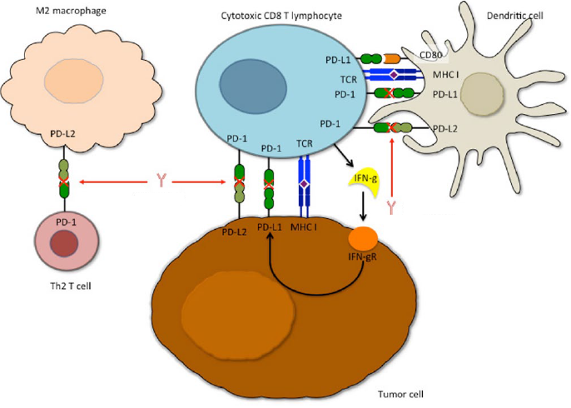
PD-1/PD-L1

Slide 12
Role of PD-1 in Suppressing
Antitumor Immunity
Activation
(cytokines, lysis, prolif., migration)
APC
T cell
B7.1 CD28
(+) Signal 2
MHC-Ag
TCR Signal 1
Tumor
Keir ME et al, Annu Rev Immunol 2008; Pardoll DM, Nat Rev Cancer 2012

Slide 13
Role of PD-1 in Suppressing
Antitumor Immunity
APC
T cell
B7.1 CD28
(+) Signal 2
MHC-Ag
TCR Signal 1
(-)
(-)
(-)
PD-1
PD-L1
Tumor
Tumor
Inhibition
(anergy, exhaustion, death)
Keir ME et al, Annu Rev Immunol 2008; Pardoll DM, Nat Rev Cancer 2012

Slide 14
Role of PD-1 in Suppressing
Antitumor Immunity
Activation
(cytokines, lysis, prolif., migration)
APC
T cell
B7.1 CD28
(+) Signal 2
MHC-Ag
TCR Signal 1
(-)
(-)
(-)
PD-1
Anti-PD-1
PD-L1
Tumor
Tumor
Inhibition
(anergy, exhaustion, death)
Keir ME et al, Annu Rev Immunol 2008; Pardoll DM, Nat Rev Cancer 2012

Slide 15
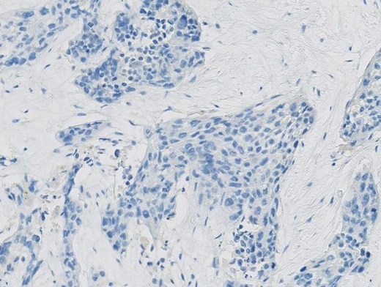
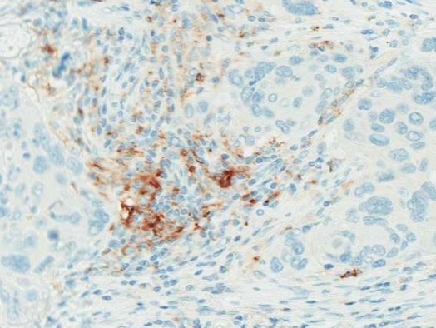
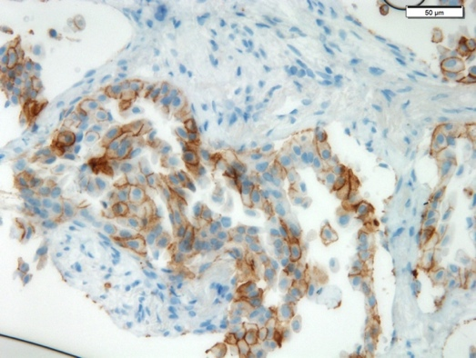
PD-L1 positivity in tumor infiltrating immune cells (IC) is higher than in tumor cells (TC) in NSCLC
PD-L1 negative
PD-L1 positive (IC)
PD-L1 positive (TC)
 | Prevalence of PD-L1-positiveª tumors in NSCLC
 | % of PD-L1+ª (IC) | % of PD-L1+ª (TC) | P-value^{b}
Adenocarcinoma (n=291) | 47% | 28% | <10⁻⁶
Stage I-IIIa (n=254) | 49% | 31% | <10⁻⁶
Stage IIIb-IV (n=37) | 27% | 19% | ns
Squamous Cell Ca (n=155) | 52% | 31% | <10⁻⁵
Stage I-IIIa (n=139) | 54% | 31% | <10⁻⁵
Stage IIIb-IV (n=16) | 38% | 31% | ns
MD Anderson collection (surgically resected NSCLC specimens)
ª PD-L1+ defined as ≥5% IC, or ≥1% TC; assessed by proprietary Genentech/Roche IHC assay
^{b} P-value for PD-L1+ in IC vs TC; McNemar test

Slide 16
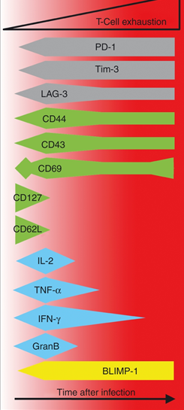
T-Cell Exhaustion

Slide 17
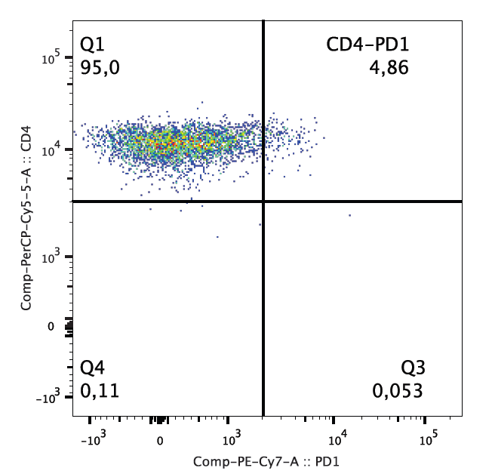
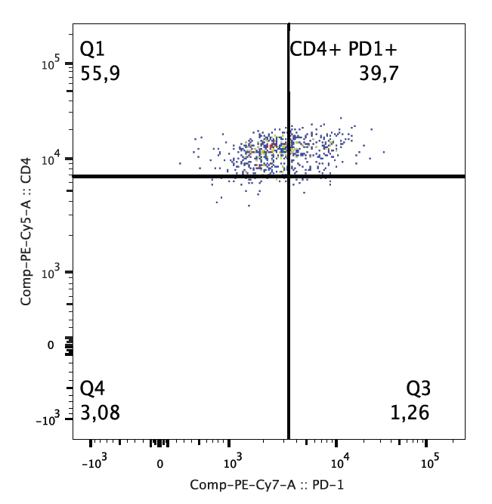


Expresión de PD-1 en células (CD4+)
Sujeto Sano
CD4
Paciente con CPCNP
PD-1

Slide 18
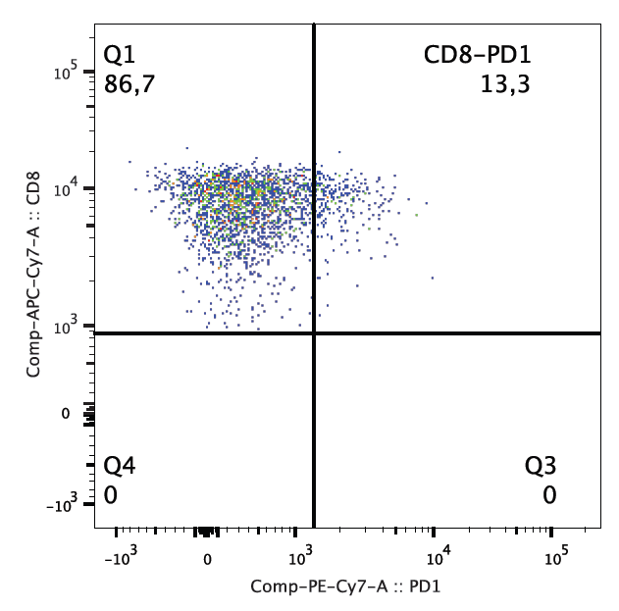
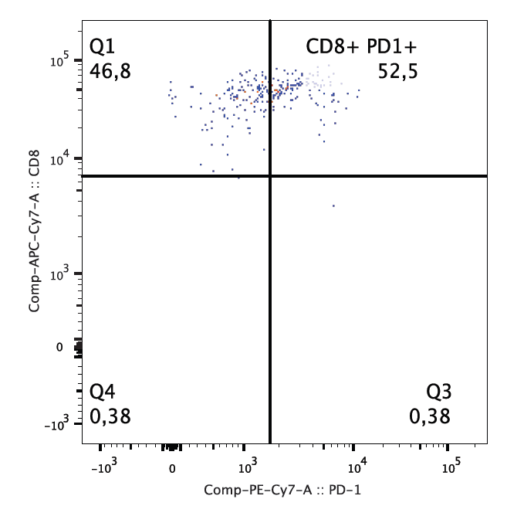
Expresión de PD-1 en células (CD8+)
Sujeto Sano
CD4
Paciente con CPCNP
PD-1

Slide 19
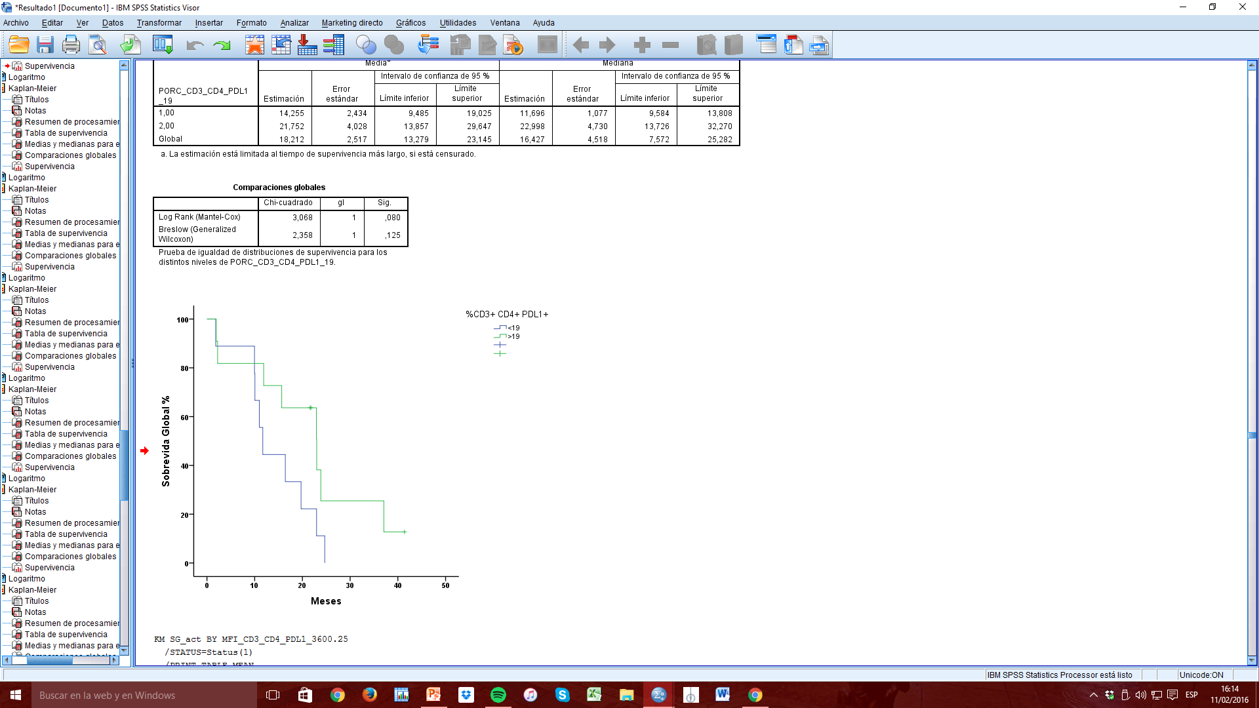
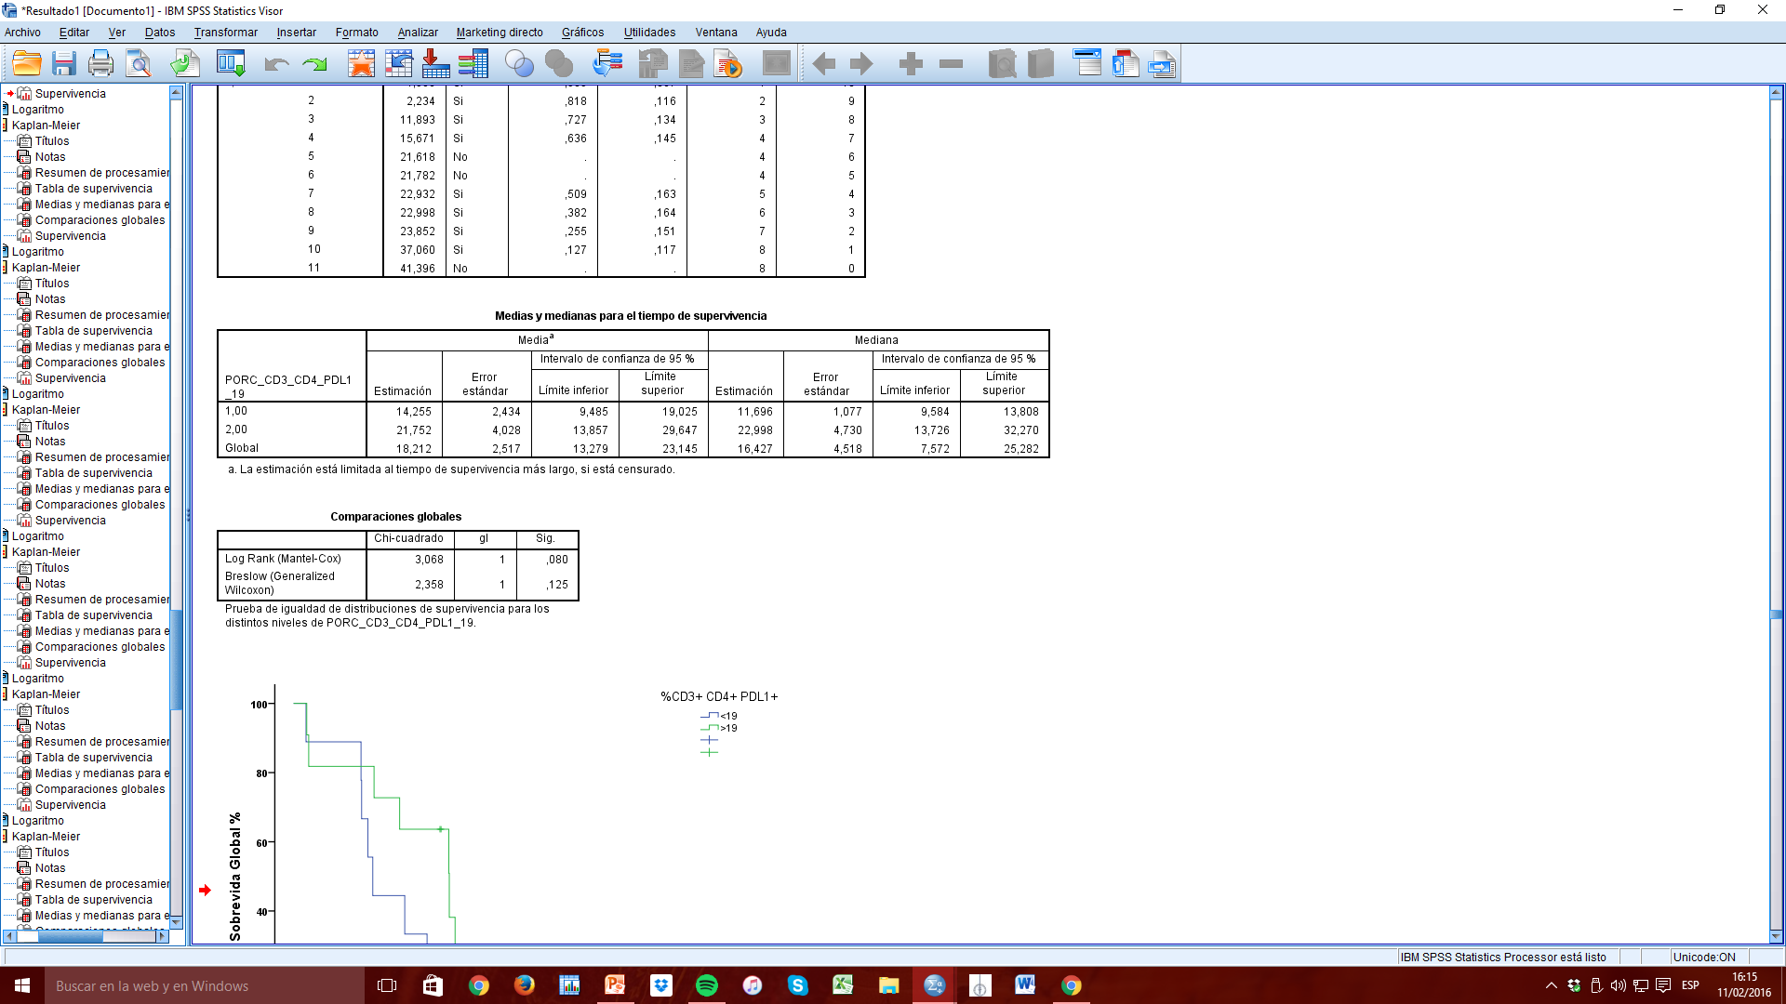
Sobrevida Global (%CD3+ CD4+ PD-L1+)

Slide 20
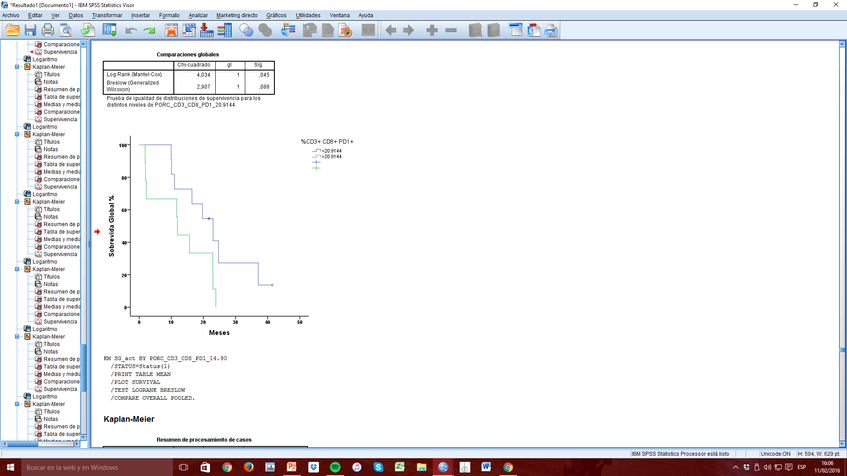
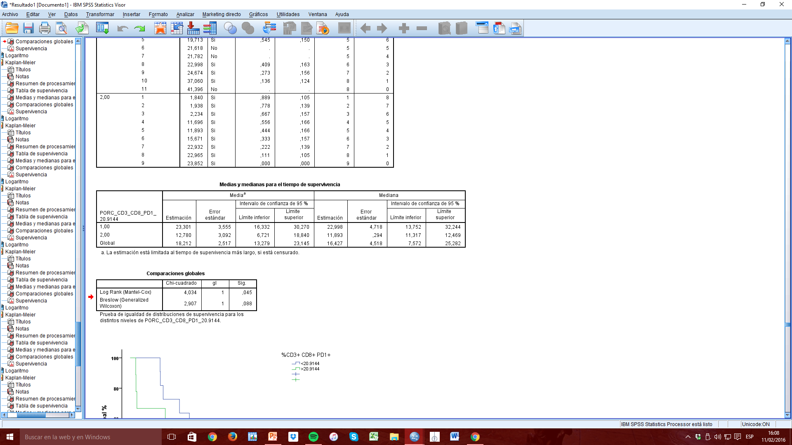
Sobrevida Global (%CD3+ CD8+ PD-1+)

Slide 21
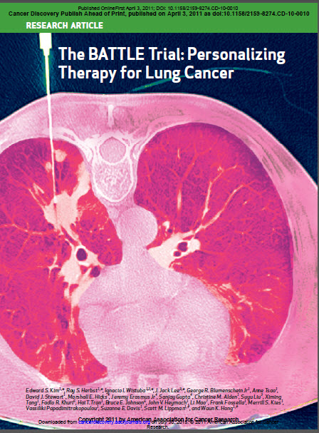

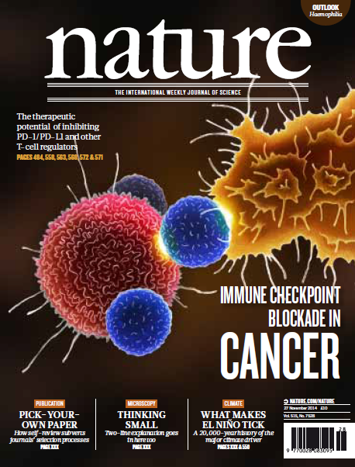
The 10 Year Journey From Battle to Immunotherapy for Lung Cancer
Battle cover
Biomarkers don’t just involve the tumor anymore!

Slide 22
Potential Differences in PD-1 vs PD-L1 Blockade
Anti-PD-1 and anti-PD-L1 antibodies may have different effects due to distinct mechanisms of action in the inhibitory pathway
Anti-PD-1 antibodies:
  Block PD-1 binding to PD-L1 and PD-L2
  Do not block binding of PD-L1 to B7.1
Anti-PD-L1 antibodies:
  Block PD-L1 binding to PD-1 and B7.1
  Do not block binding of PD-1 to PD-L2
Topalian SL, et al. Curr Opin Immunol. 2012;24:207-212.
Notes:
APC, antigen-presenting cell.

Slide 23
PD1 vs. PDL1 Blockade
PDL1
B7.1
Anti-
apoptotic
(tumor)
Anti-
apoptotic
(tumor)
–
T cell
inactivation
Anti-PD1
PDL2
PD1
Tumor cell/
APC
T cell
PDL1
B7.1
Anti-PDL1
Anti-
apoptotic
(tumor)
–
T cell
inactivation
PDL2
PD1

Slide 24
Anti PD-1 and anti PDL-1
Lung cancer

Slide 25
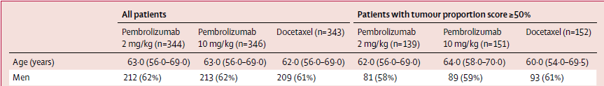
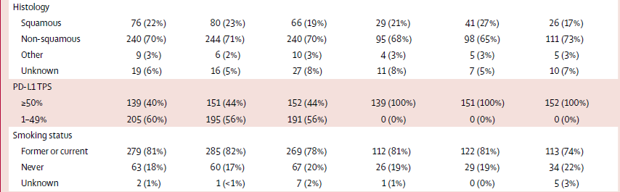

Pembrolizumab vs docetaxel for previously treated, PD-L1+ NCSCL (KEYNOTE-010):
a randomised controlled trial
Herbs RS. Et al. Lancet Onclogy; Published online December 19, 2015.

Slide 26
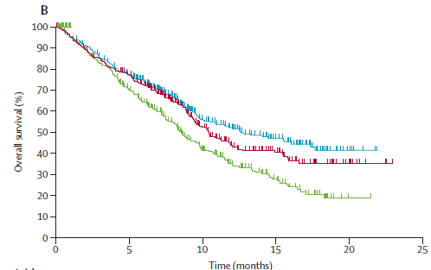
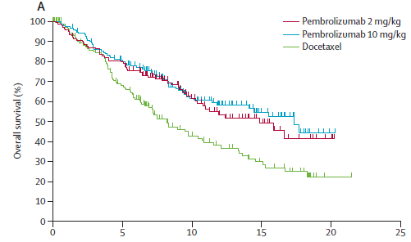
KEYNOTE-010: Supervivencia Global
SVG en todos los pacientes
SVG en score >50%
Tratamiento | Mediana SVG | P (HR)
Docetaxel | 8.5 meses
Pembro 2mg/Kg | 10.4 meses | 0.0008 (0.71)
Pembro 10mg/Kg | 12.7 meses | <0.0001 (0.61)
Tratamiento | Mediana SVG | P (HR)
Docetaxel | 8.2 meses
Pembro 2mg/Kg | 14.9 meses | 0.0002 (0.54)
Pembro 10mg/Kg | 17.3 meses | <0.0001 (0.50)
Herbs RS. Et al. Lancet Onclogy; Published online December 19, 2015.

Slide 27
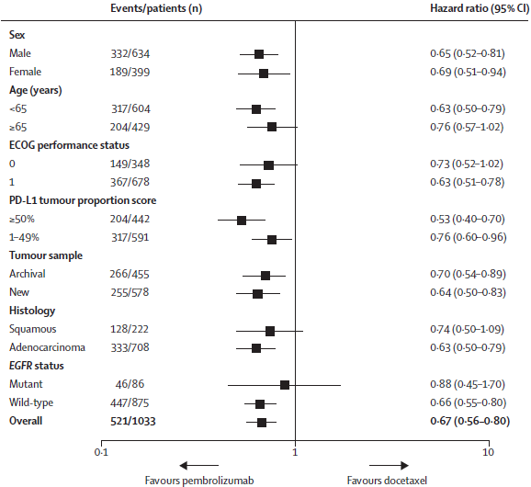
KEYNOTE-010: SVG (análisis de subgrupos)

Slide 28
KEYNOTE-010: CONCLUSIONES
Pembrolizumab demuestra beneficio en SVG comparado con Docetaxel en 2a/3a línea de Tx:
  Reducción del Riesgo de Muerte de un 34% (HR 0.66; P = 0.0008)
  mOS: 11.6 vs 8.5 meses
Pembrolizumab logra mayores tasas de respuesta:
  TRO: 18% vs 9% (P = 0.005)
Pembrolizumab muestra mayor beneficio en SVG en el grupo de PD-L1 >50%:
  Docetaxel 8.2 meses
  Pembro 2mg/Kg 14.9 meses
  Pembro 10mg/Kg 17.3 meses

Slide 29
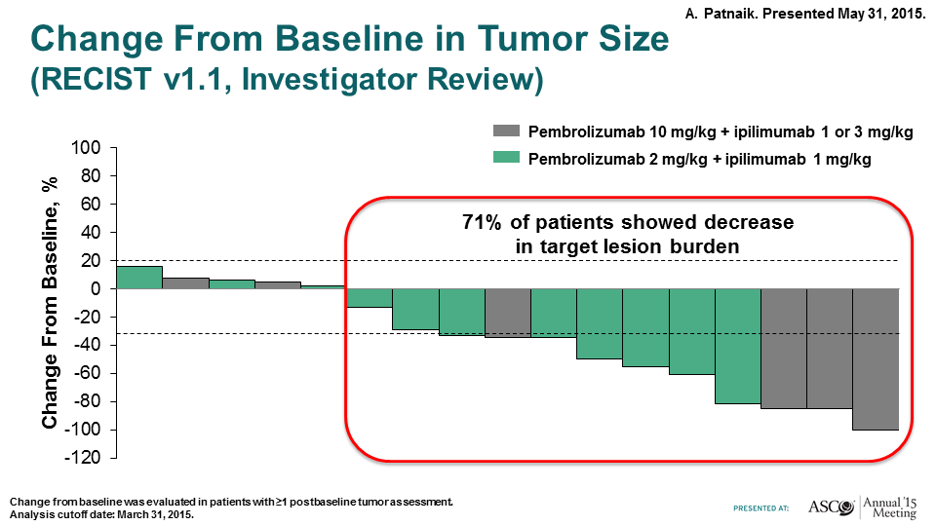
Phase 1 Study of Pembrolizumab + Ipilimumab as Second-Line therapy for
advanced Non-Small Cell Lung Cancer (NSCLC): KEYNOTE-021 Cohort D

Slide 30
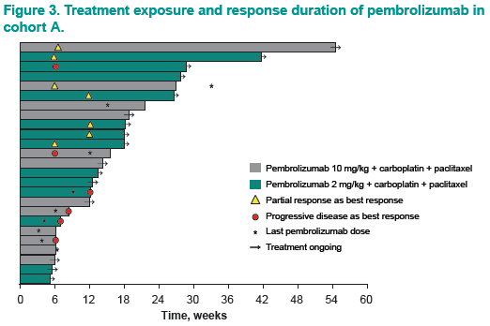
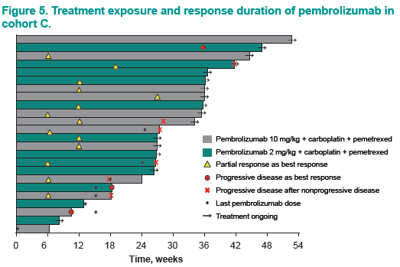
Pembrolizumab (MK-3475) Plus Platinum Doublet Chemotherapy as Front-Line Therapy for Advanced Non-Small Cell Lung Cancer (NSCLC): KEYNOTE-021 Cohorts A and C

Slide 31
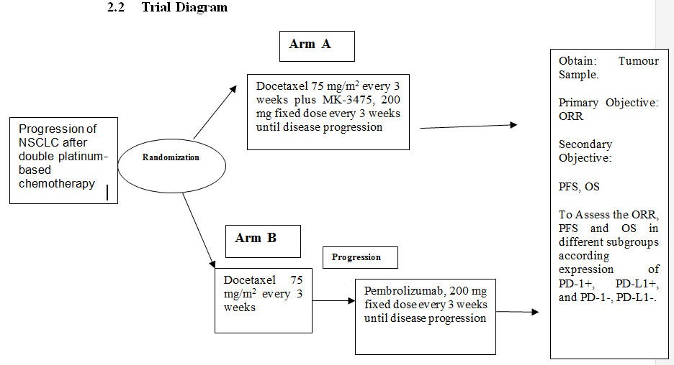
A Randomized, phase II clinical trial of MK-3475 in combination with Docetaxel versus Docetaxel alone in patients with NSCLC previously treated

Slide 32
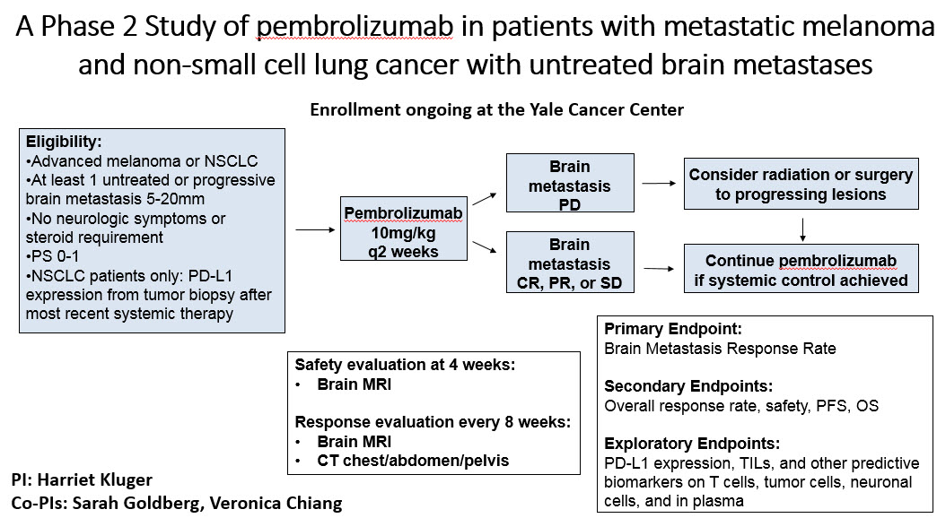
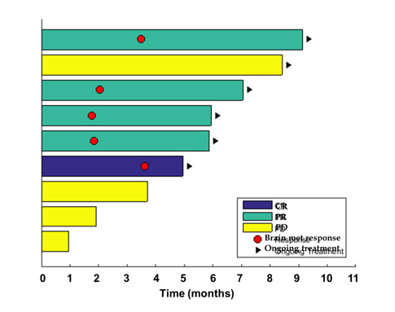
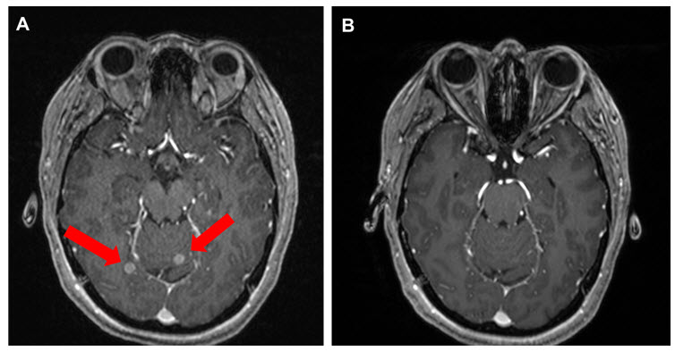
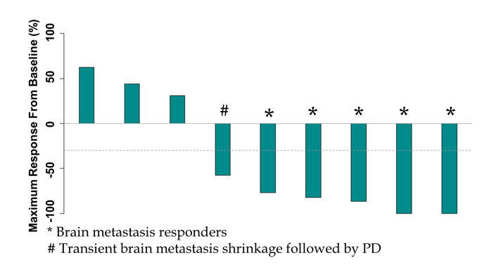
Goldberg, Kluger et al, ASCO 2015

Slide 33
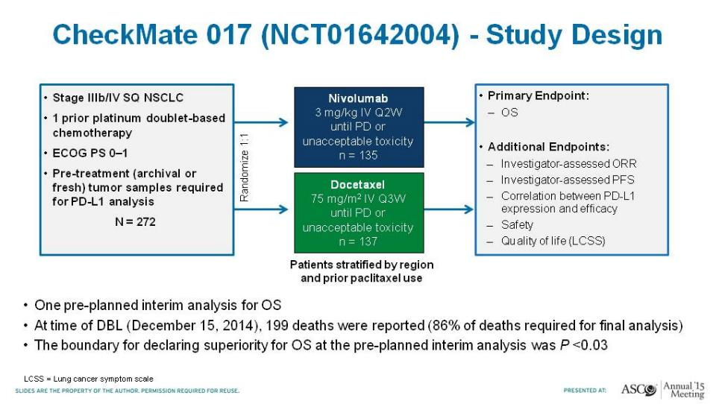
CheckMate 017 (NCT01642004) - Study Design
Spigel D. ASCO 2015.

Slide 34
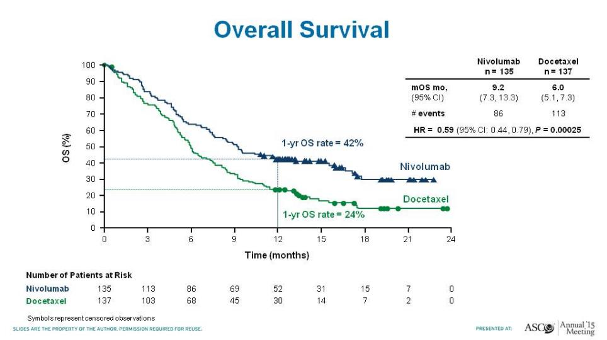
Overall Survival
CheckMate 017
Spigel D. ASCO 2015.

Slide 35
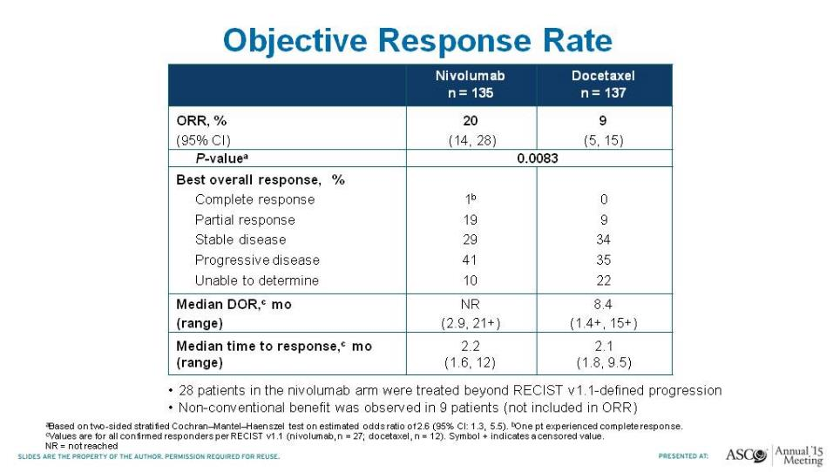
Objective Response Rate
CheckMate 017
Spigel D. ASCO 2015.

Slide 36
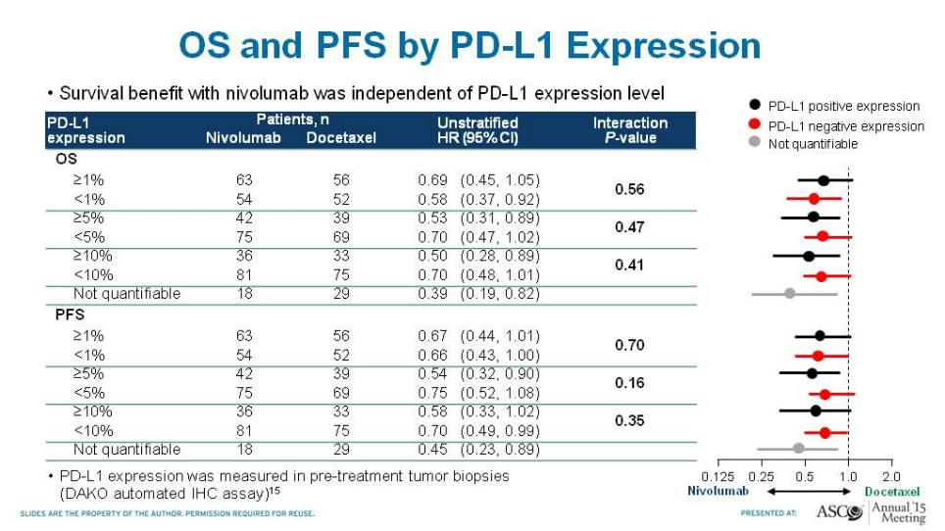
OS and PFS by PD-L1 Expression
CheckMate 017
Spigel D. ASCO 2015.

Slide 37
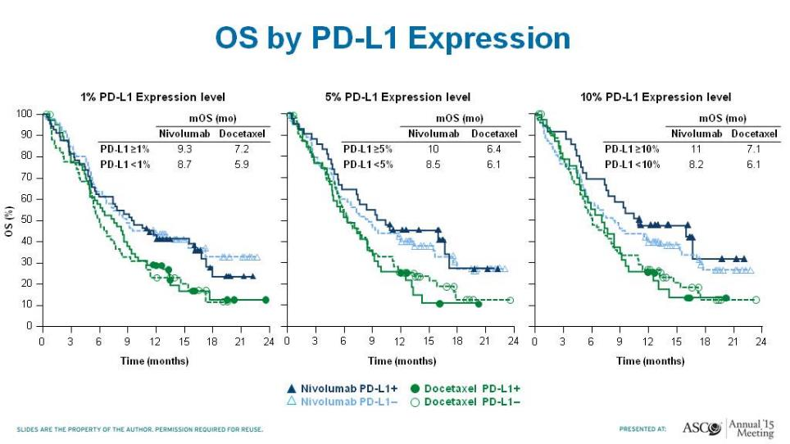
OS by PD-L1 Expression
CheckMate 017
Spigel D. ASCO 2015.

Slide 38
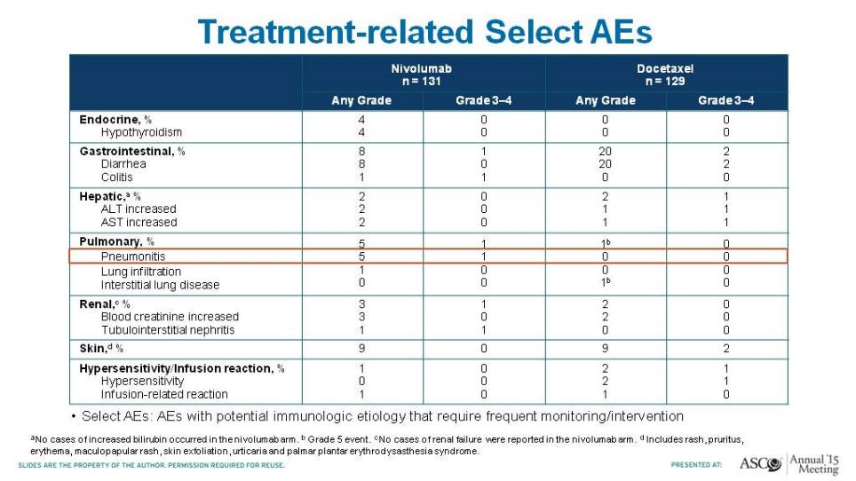
Treatment-related Select AEs
CheckMate 017
Spigel D. ASCO 2015.

Slide 39
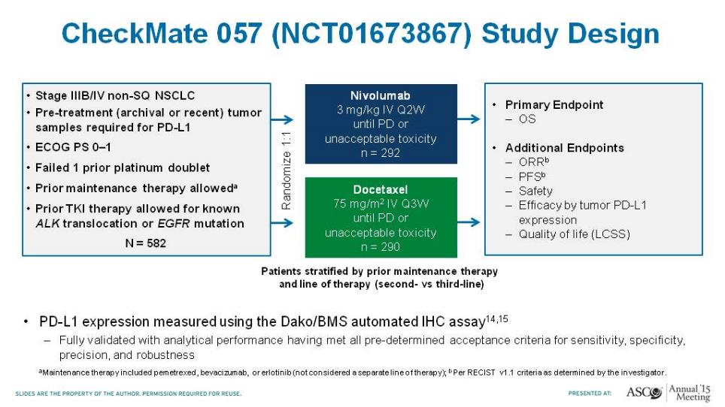
CheckMate 057 (NCT01673867) Study Design
Paz-Ares L. ASCO 2015.

Slide 40
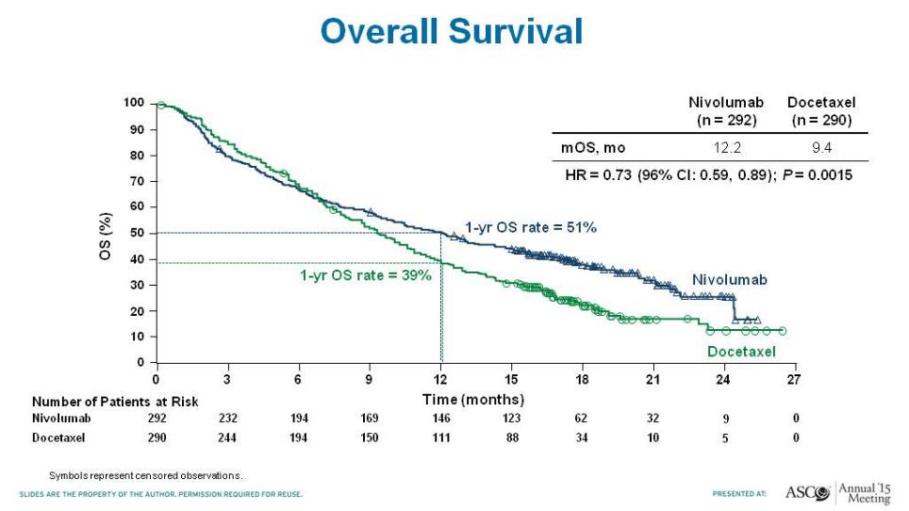
Overall Survival
CheckMate 017
Paz-Ares L. ASCO 2015.

Slide 41
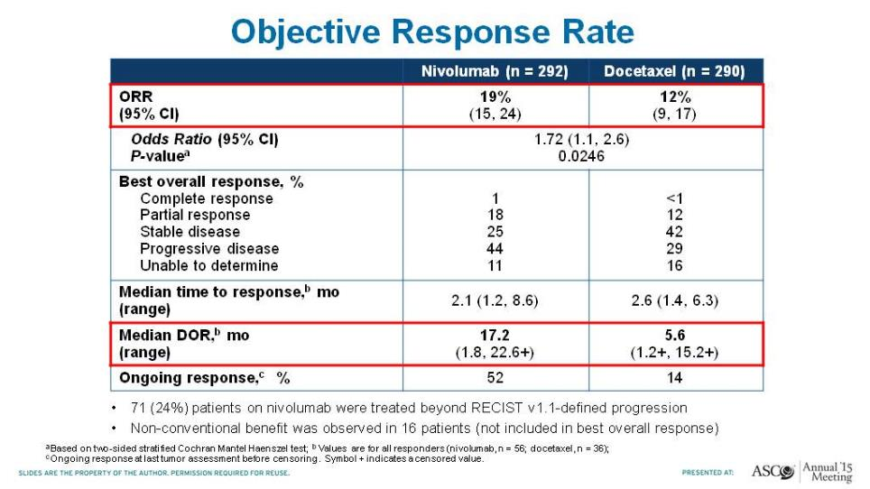
Objective Response Rate
CheckMate 017
Paz-Ares L. ASCO 2015.

Slide 42
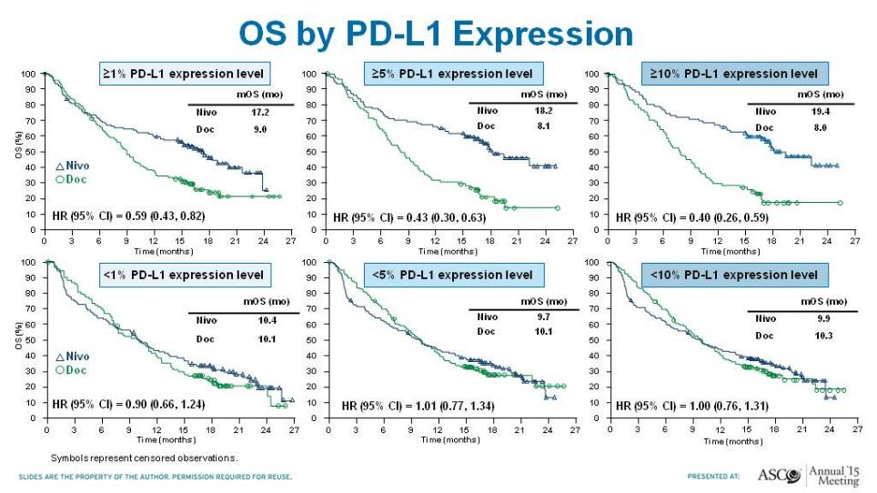
OS by PD-L1 Expression
CheckMate 017
Paz-Ares L. ASCO 2015.

Slide 43


Slide 44
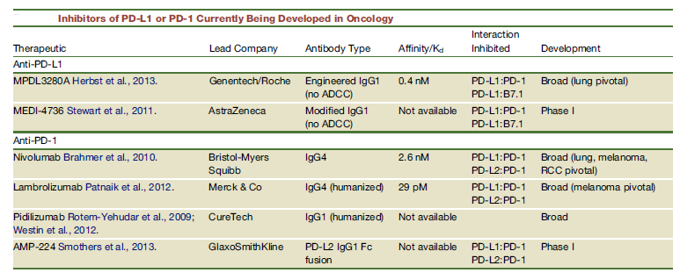
Introduction
Programmed death ligand 1 (PD-L1) is a immune-checkpoint protein expressed on tumour cells and tumor-infiltrating immune cells that downregulates antitumoural T-cell function through binding to PD-1 and B7.1 (CD80).
ATEZOLIZUMAB
Chen D, Mellman I. Immunity 2013;39:1-10.
Notes:
Atezolizumab (MPDL3280A) humanised IgG1 monoclonal anti-PD-L1 antibody that blocks PDL1-PD1 and PDL1-B7.1 interactions →Restoration of antitumoyr T-cell activity.

Slide 45
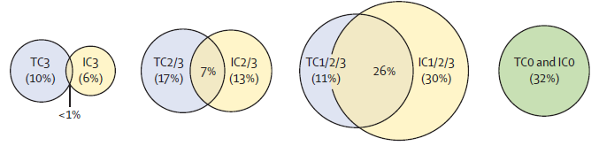
Baseline characteristics
PDL1 scoring criteria in tumour cells and tumour infiltrating immune cells: Prevalence and overlap

Slide 46
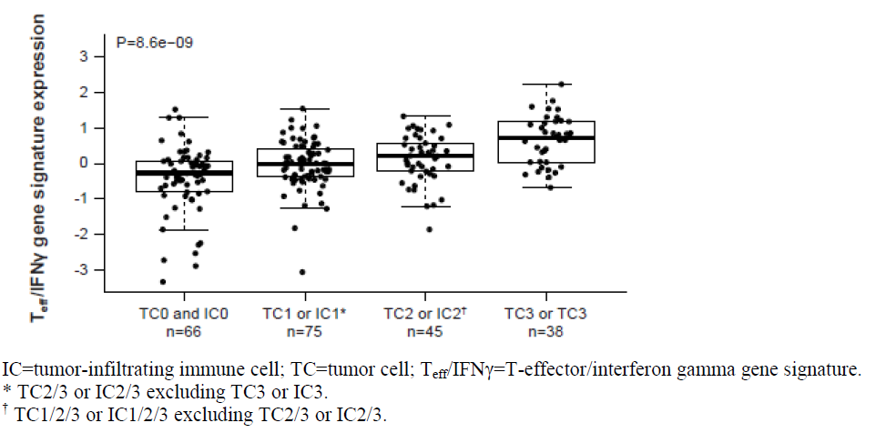
Baseline characteristics

Slide 47
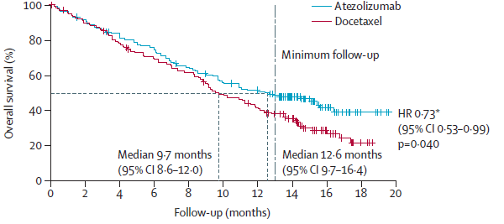
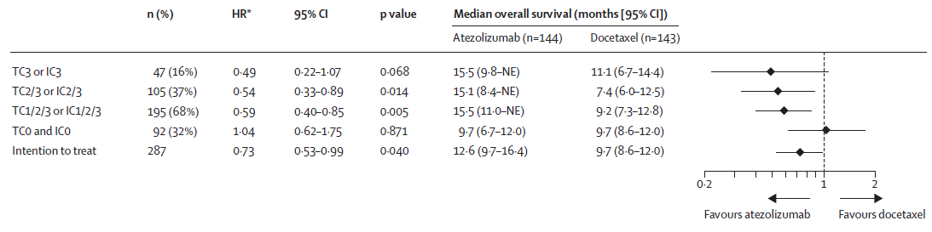
Overall survival

Slide 48

Overall survival

Slide 49

Biomarker analyses for patients receiving PD-L1treatment
Herbst et al, Nature 2014

Slide 50
Actividad de inhibidores de PD-1/PD-L1 en pacientes con CPCNP avanzado previamente tratados
 | Nivolumab | Pembrolizumab | Atezolizumab | Durvalumab | Avelumab
N | 129 | 475 | 175 | 228 | 184
TR SQ-NSCLC NSQ-NSCLC | 17% 18% | 23.5% 19% | 27% 21% | 21% 13% | 14%
EA´s Grados 3/4 | 4.7% | 9.5% | 11% | 8% | 12%
TR: PD-L1 + PD-L1 - | 16% 13% | 42% 10% | 34% 8%
Gettinger S. J Clin Oncol 2015; 33: 2004-2012; Herbs R. Nature 2014; 515: 563-567
Soria JC. ESMO 2013; Garon E. NEJM 2015; 372: 2018-2028
Rizvi n. ASCO 2015; Guley LJ. ASCO 2015

Slide 51

Immune related Adverse Events (IRAEs)

Slide 52
Where we are now
Where we want to be
Could Biopsies and Biomarkers help?
Survival
Survival
Time
Time
Control
Targeted therapies
Immune checkpoint blockade
Combinations/sequencing/biomarker selection
Salvati M, 3rd Intl Symp in Lung Ca, 2014; Ribas A, WCM, 2013; Ribas A, et al. Clin Cancer Res 2012; Drake CG. Ann Oncol 2012
Friends Brookings Conference 2013

Slide 53
Issues with the PDL1 Biomarker
Heterogeneity – multiple tumors and multiple passes within a tumor
Interval between biopsy and treatment
Primary versus metastatic disease
Antibody and staining conditions
Defining a positive result (cut-offs):
  Cell type expressing PD-L1 (immune cell versus tumor or both)
  Location of expression – cell surface versus intracellular versus stromal
  Intensity, percent of cells ‘positive’
  Distribution - patchy versus diffuse, intratumoral versus peripheral

Slide 54

Multiple Assays are Being Used

Slide 55


Expression of PD-L1 is heterogeneous and varies with antibody used
E1L3N
SP142
H&E
Negative
Positive
Immunofluorescence shows stroma and epithelial staining are often concordant and adjacent
1 mm
Green = Cytokeratin
Blue = Nuclei
Red = PD-L1 (SP142)
Unpublished Data: J McLaughlin, K Schalper, R. Herbst and D Rimm (Yale Pathology)

Slide 56

La inmunoterapia en cáncer

Slide 57
Conclusions
Immunotherapy offers new hope for lung cancer patients
Clearly it works better in some than others- biomarkers are critical (a BATTLE like approach)
Combinations will be key
Clinical trials and scientific investigations will guide future progress

