Slide 1
Froguel, Philippe <p.froguel@imperial.ac.uk> Aug 26 at 3:59 AM
Hi Miguel
I need to postpone my trip to Mexico as I will have surgery by the end of September. I have been attacked in the street in Lille by a robber who broke my right hand. i had surgery but I will have another one in late September.}
Sorry for the inconvenience caused
best regards
philippe
On Monday, September 26, 2016 11:03 AM, "Froguel, Philippe" <p.froguel@imperial.ac.uk> wrote:
Hi Miguel
my apologies, I had serious health problems recently. At this stage I can t do much as it is too late to organize the filming of a videoconf.
Please give my lecture at the ANMM. my apologies for the inconvenience caused
regards
philippe
Pr Philippe Froguel, MD, Ph D
-Professor of Genomic Medicine, Head of Department of Genomics of Common Disease, School Of Public Health, Hammersmith Hospital Campus, Imperial College Faculty of Medici ne, Room E303, Burlington-Danes building, Du Cane Road, London, W12 0NN , United Kingdom. Email: p.froguel@imperial.ac.uk
- Directeur de l UMR CNRS 8199-Université de Lille, Directeur de la Fédération de Recherche 3508 Labex EGID et Directeur de l'Equipex LIGAN-Médecine Personnalisée et de l'Institut Génomique de Lille (IGL), Adresse: EGID - UMR 8199 Pôle Recherche - 1er étage Aile Ouest 1 place de Verdun 59045 LILLE CEDEX. Email : philippe.froguel@good.ibl.fr http://www-good.ibl.fr/ et http://www.egid.fr/ Tweeter @philippefroguel

Slide 2
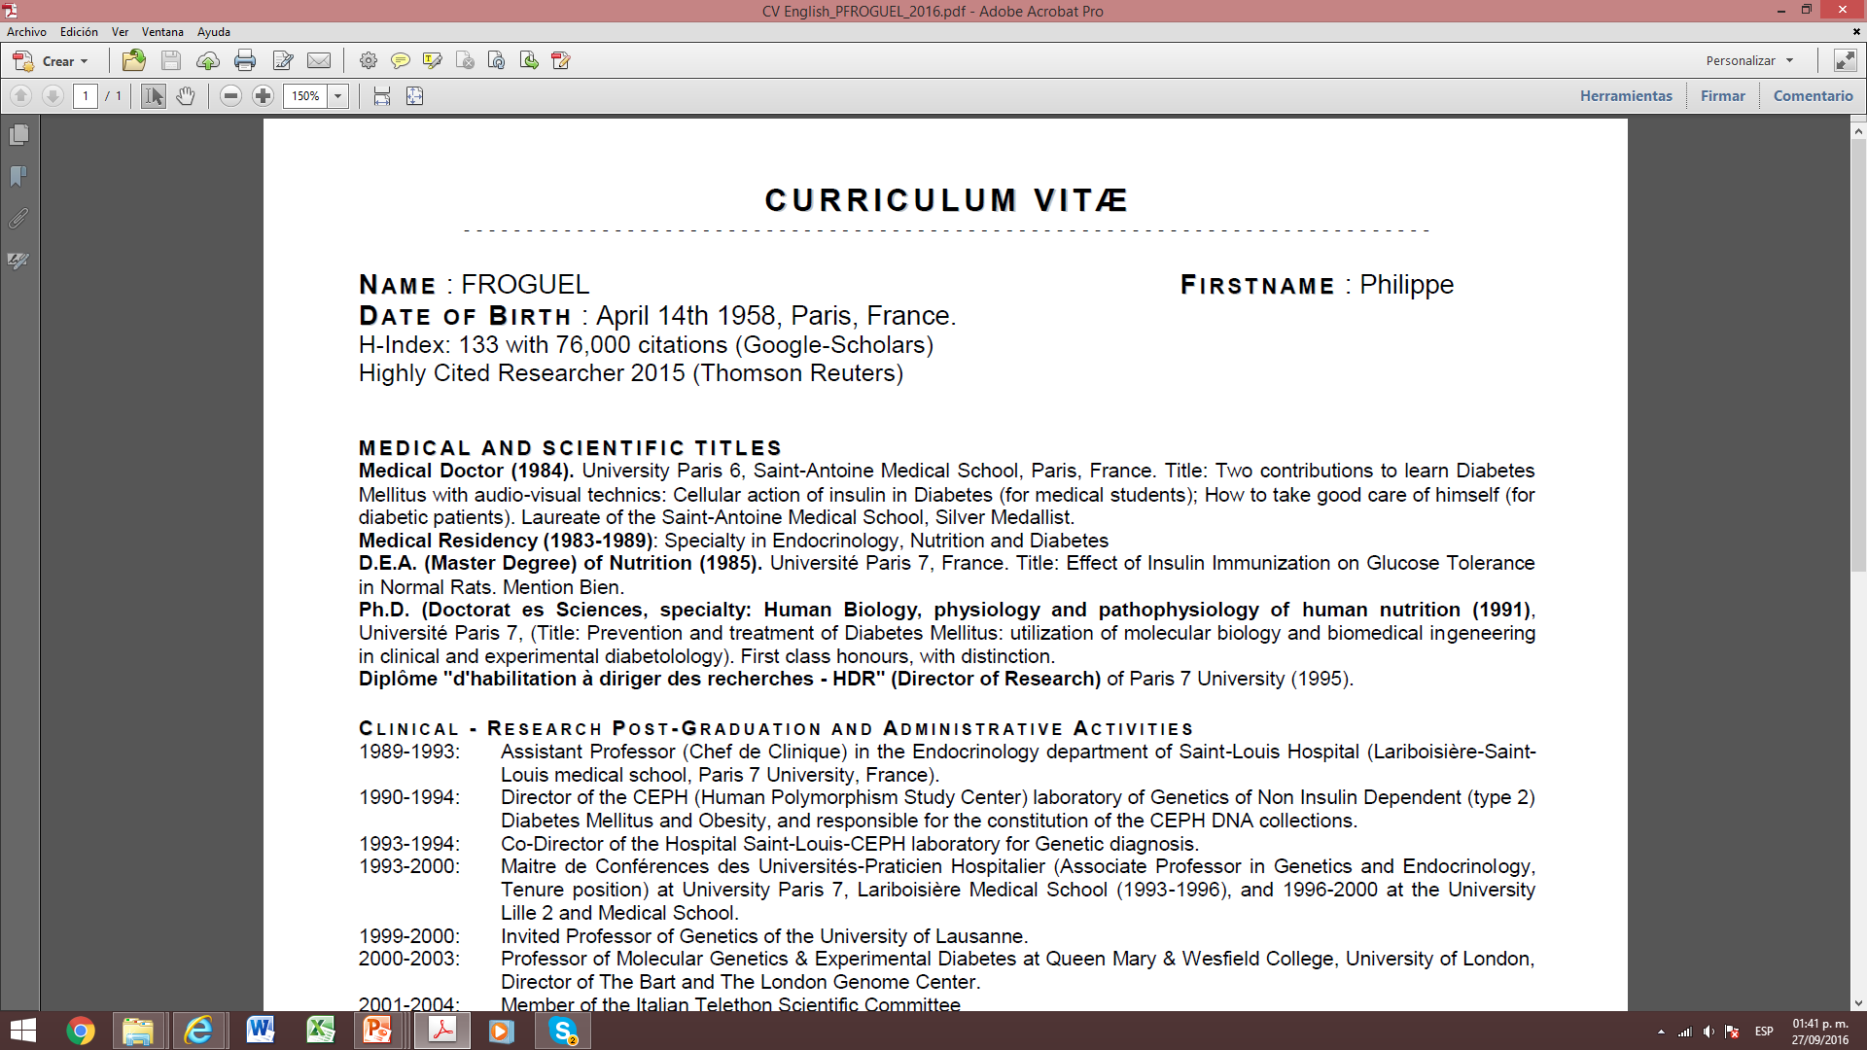

Slide 3
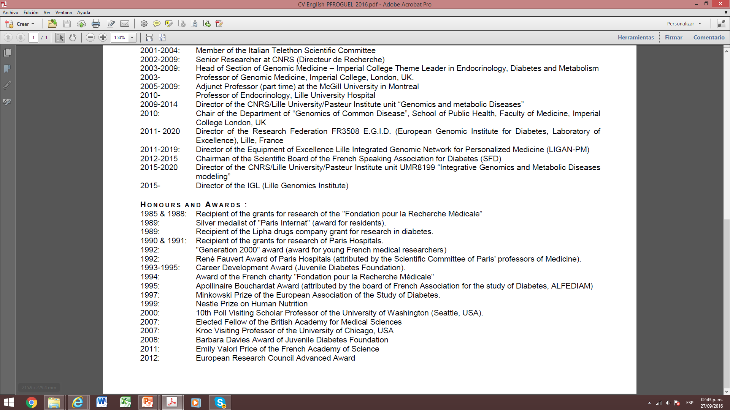

Slide 4
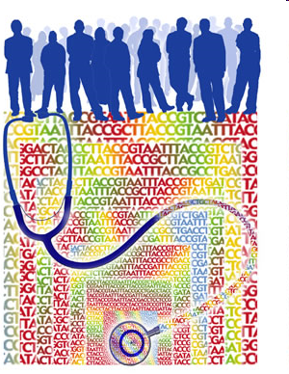



Genomics and innovation
in human health
Diabetes as an example for prediction and personalized medicine
Philippe Froguel, MD, PhD
p.froguel@imperial.ac.uk
Integrated Genomics and metabolic
diseases modelling
CNRS 8199-EGID
Institut Pasteur,de Lille, France
Department of Genomics of Common Disease
Imperial College London, UK

Slide 5
Chronic diseases are a challenge for health care systems
We still don’t know the causes of most chronic diseases
Treatments are moderately efficient, are expensive with side effects
All patients are treated the same although medicine should be personalized to be cost effective

Slide 6
1980-2015: the diabetes field mostly ignored precision medicine
In 1980 overweight diabetic patients were treated differently than normal weight patients.
Today all diabetics receive metformin and if (when) doesn’t work there is no agreed guidelines.
The road is dominated by drug company new products.

Slide 7
To do better, we should elucidate disease etiology in every patient as a clue for precision medicine.
Genomics can help as may differentiate causes from consequences of diseases, opening avenues for the cure of chronic diseases.

Slide 8
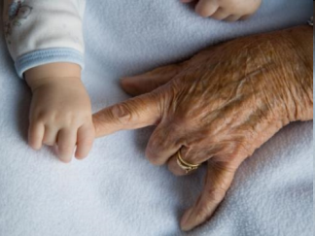
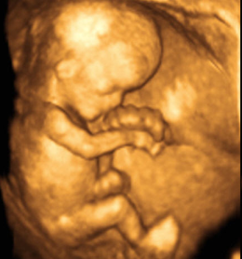


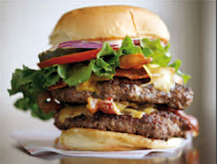
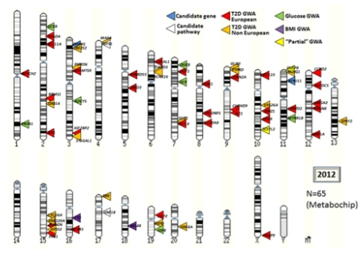
Type 2 diabetes is a genetic disorder
ENVIRONMENT
Type 2 Diabetes
GENETICS
T2D Heritability ~ 40-70%

Slide 9
Heterogeneity of the genetics of T2D
ENVIRONMENT
GENE
MONOGENIC
FORMS
POLYGENIC
FORMS
-> Neonatal Diabetes
-> Maturity-Onset Diabetes of the Young (MODY)
Most common form
(>95% of cases)
Heritability: ~40-70%

Slide 10
► Polygenic forms of T2D
Genes harboring T2D-associated common variants
(originally identified or confirmed by GWAS)
Genes with T2D-associated rare or low-frequency variants
1990
Candidate gene studies
  IRS1, GCK
Candidate gene studies
  KCNJ11, PPARG
Linkage analyses
  HNF4A, TCF7L2
Candidate gene studies
  HNF1B, WFS1
2000
From 2007:
GWAS and meta-analysis of GWAS for T2D / based on high-throughput arrays or Metabochips / in Europeans or other ethnicities
  > 90 genes
GWAS and meta-analysis of GWAS for T2D-related quantitative traits
  MTNR1B, ADCY5, DGKB, PROX1, GCKR
WES
  COBLL1, MACF1
2010
Candidate gene studies (Sanger seq.)
  MTNR1B
WGS and imputation
  PAM, PDX1, CCND2
Candidate gene studies (NGS)
  SLC30A8, PPARG
  WES
  HNF1A

Slide 11

Genome-wide association studies (GWAS)
-> GWAS: Hypothesis of ‘Common Disease, Frequent Variants’
CONTROLS = Normal glucose subjects / lean subjects
CASES = T2D / obese subjects
N
N
QT
Bimodality ->
binary logistic regression
Linearity

Slide 12
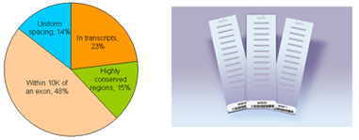


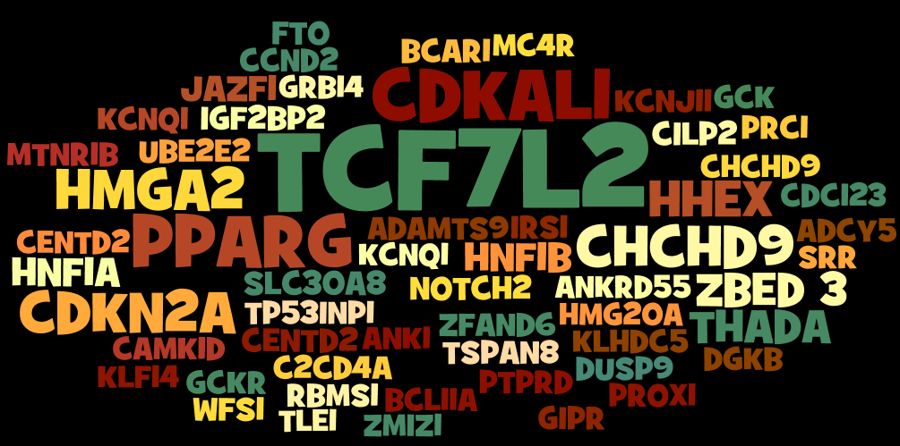
More than 90 loci associated with T2D risk
GWAS
Font size according to the OR
But even if p-values are very low, effects are not strong… (1.08 < OR < 1.45)
=> heritability explained <10%

Slide 13
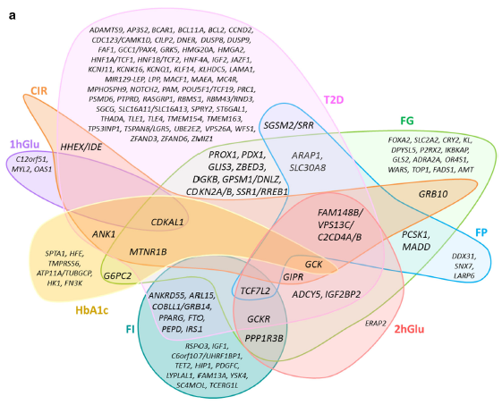
Legacy of genome-wide association studies (GWAS)
(Marullo et al; Curr Diab Rep 2014)

Slide 14
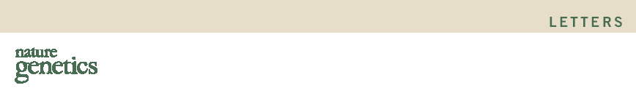
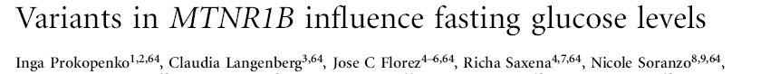
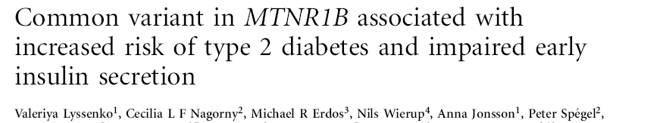
Contribution of rare genetic variants to common T2D?
-> Identification of a novel locus for T2D (MTNR1B)

Slide 15
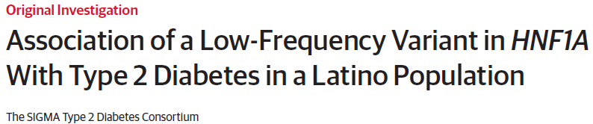
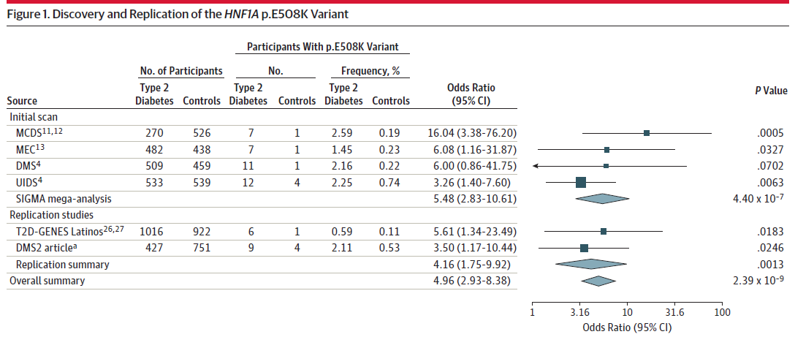
Other genes with rare mutations associated with T2D?
MODY-3

Slide 16
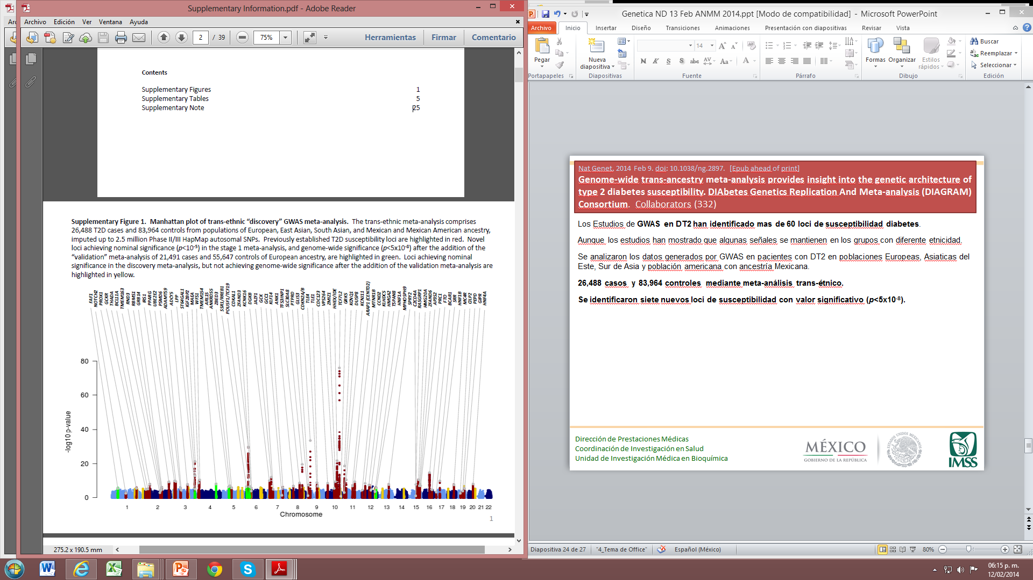
Segundo Escaneo en todo el Genoma en pacientes con DT2
Nat Genet. 2014 Feb 9. doi: 10.1038/ng.2897. [Epub ahead of print] IF: 35.4
Genome-wide trans-ancestry meta-analysis provides insight into the genetic architecture of type 2 diabetes susceptibility. DIAbetes Genetics Replication And Meta-analysis (DIAGRAM) Consortium. Collaborators (332)
Los Estudios de GWAS en DT2 han identificado más de 70 loci de susceptibilidad diabetes.
Aunque los estudios han mostrado que algunas señales se mantienen en los grupos con diferente etnicidad.
Se analizaron los datos generados por GWAS en pacientes con DT2 en poblaciones Europeas, Asiáticas del Este, Sur de Asia y población americana con ancestría Mexicana.
26,488 casos y 83,964 controles mediante meta-análisis trans-étnico.
Se identificaron siete nuevos loci de susceptibilidad con valor significativo (p<5x10⁻⁸).

Slide 17
Spectrum of mutations/genes involved in T2D
EFFECT SIZE
Linkage studies / Sanger sequencing NGS / Functional studies
Rare variants in MODY/ND
28 genes
Large-scale Sanger resequencing / NGS
DNA arrays / Functional studies
=> Rare variants (strong effect)
Rare or low-frequency variants in common T2D
PPARG
MTNR1B
SLC30A8
HNF1A
CCND2 PDX1 PAM
DNA arrays
Genes carrying associated variants in aggregation
Genes carrying single- associated variants
Frequent SNPs in common T2D
92 genes
=> Common SNPs
(small effect)
VARIANT FREQUENCY
New avenues for therapeutic strategy in T2D prevention and care
Towards a better characterization of different T2D subtypes ?

Slide 18
Is genomics efficient for personnalized diabetes medicine ?
Genomics is efficient to elucidate atypical diabetes, and in some cases to radically improve their treatment.
However, genomics only modestly contribute to common T2D prediction
Can we do better for T2D prediction, prevention and early treatment of diabetic patients before complications occur ?

Slide 19
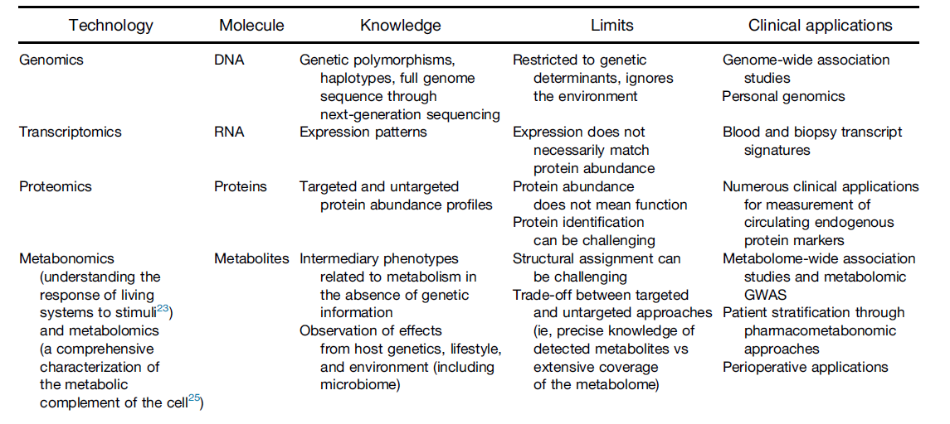

Metabolomics?

Slide 20
Non Targeted Metabonomics analysis
in middle age French DESIR prospective study
Identification of metabolites associated with incident T2D
Evaluation of the ability of metabolomic profile to improve future T2D prediction on top of known clinical, biological and genetic risk factors.

Slide 21
12 metabolites associated with incident type 2 diabetes (p-value<10⁻⁴)
Strengh of association
mannose
glucose
1,5-anhydroglucitol (1,5-AG)
1-palmitoylglycerol* (1-monopalmitin)
2-hydroxybutyrate (AHB)
3-hydroxyisobutyrate
1-oleoylglycerol (1-monoolein)
1-stearoylglycerol (1-monostearin)
beta-sitosterol
isovalerylcarnitine
cotinine (smoking status)
isoleucine*
10⁻¹⁰
…also associated with incident Hyperglycemia
(FG>5.6 mM or T2D)
10⁻⁰⁴

Slide 22
Interactions between metabolites and known T2D risk factors
HR=0.99
HR=0.39
HR=0.59
Stonger Effect when HDL is reduced.
HR=0.26
HR=1.29
HR=2.10
HR=1.24
HR=2.09
**
HR=2.12
HR=1.31
HR=1.37
HR=2.12
HR=1.33
HR=2.42
HR=1.34
HR=1.92
The metabolites can be used to identify at-risk individuals that poorly singled out by clinical risk factors

Slide 23
Metabonomics contributes to better predict T2D incidence
Twelve metabolites significantly associated with incident T2D were identified.
  9 previously reported
  3 novel
Metabolomic risk score improves TD2 diabetes prediction especially :
  in individuals poorly recognized by classic clinical risk factors
  In individuals with an early age of T2D onset.
  Early metabolomic profiling could be used on top of clinical (and genetic) risk factors to improve the early identification of at-risk subjects and therefore implementation of better T2D preventive interventions

Slide 24
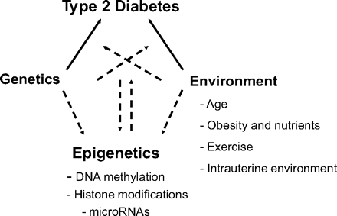
Metabolites
(non coding RNA)

Slide 25
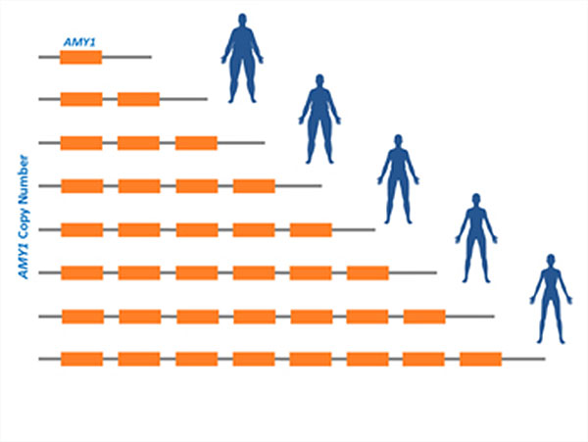
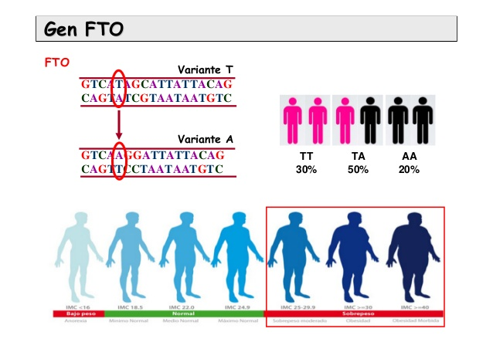
Genes relacionados al desarrollo de obesidad
SNPs
CNVs
Gen FTO
Gen PPARα
Gen AMY1

Slide 26
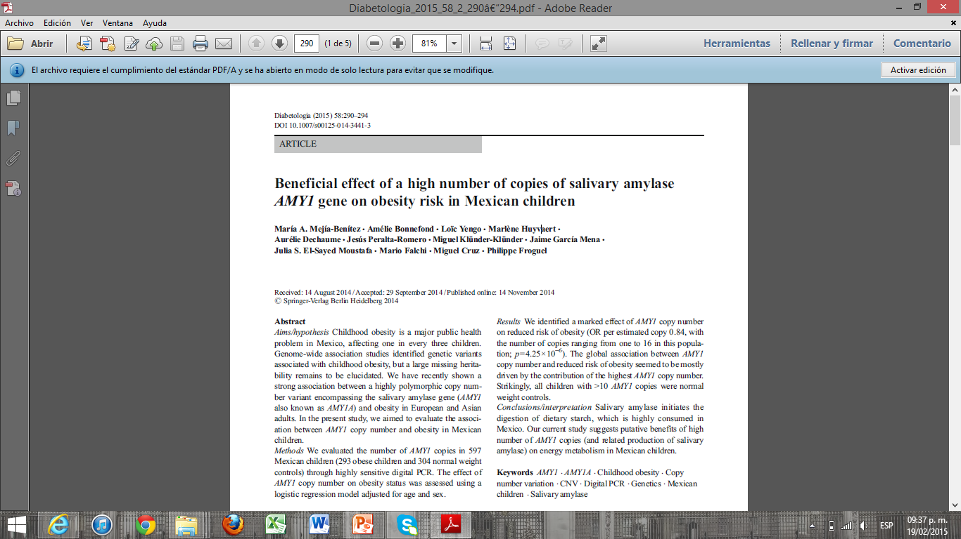
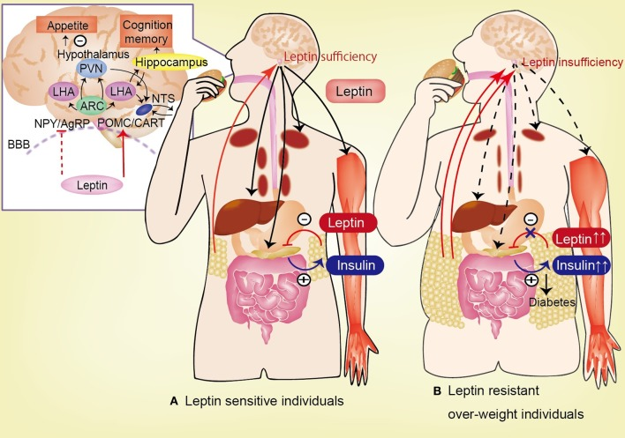

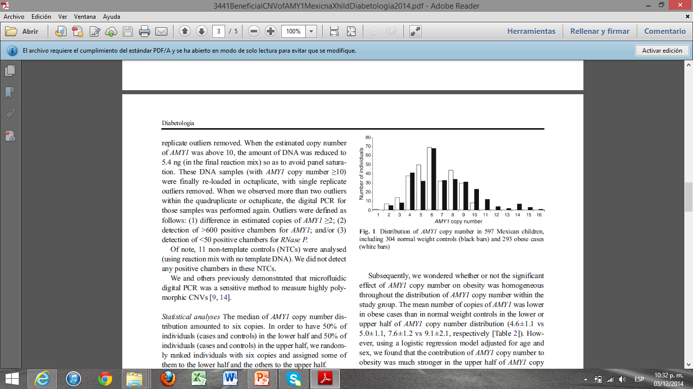
Conclusiones/interpretación:
Poseer mayor número de copias del gen le confiere protección contra la obesidad.
La amilasa salival inicia la digestión de carbohidratos, los cuales son altamente consumidos en la alimentación de los mexicanos.

Slide 27
Can genetics open avenues towards personalizd medicine ?
Genetic characterization of diabetes etiologies can radically improve their treatment.
Omics can improve T2D prediction.

Slide 28
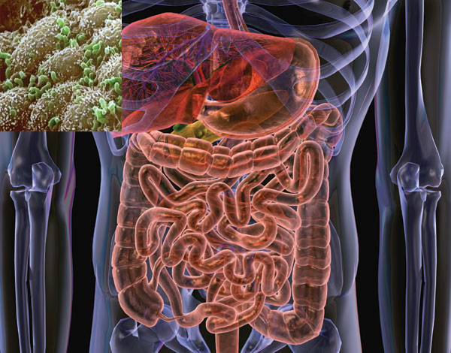
The gut microbiota as a modulator of host metabolism and obesity
Nota: evidencias científicas de la UIMB con el grupo del Dr Backhed
Valentina Tremaroli, PhD
Fredrik Bäckhed
Miguel Cruz
Center for Cardiovascular and Metabolic Research
and the Wallenberg Laboratory
University of Gothenburg
Nature 444, 21 December 2006.

Slide 29
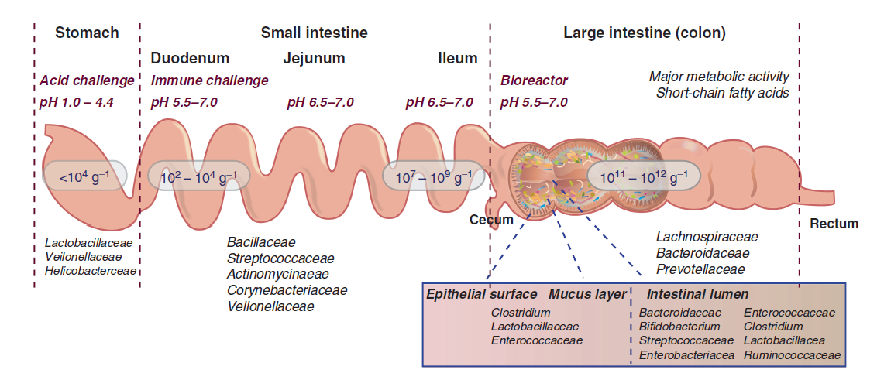
Función de la microbiota intestinal
NO FIRMICUTES
Influenciada por el uso de antibióticos, la edad y la ingesta alimentaria.
Kovatcheva et al., The Prokaryotes (4th edition)

Slide 30
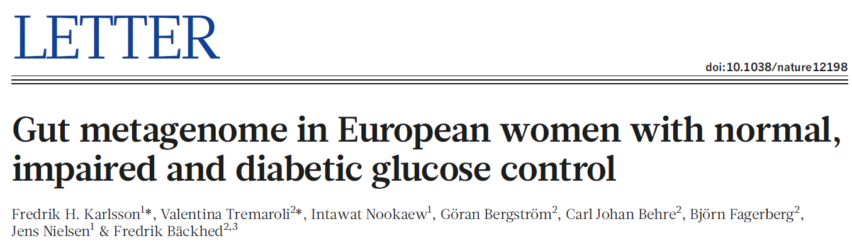
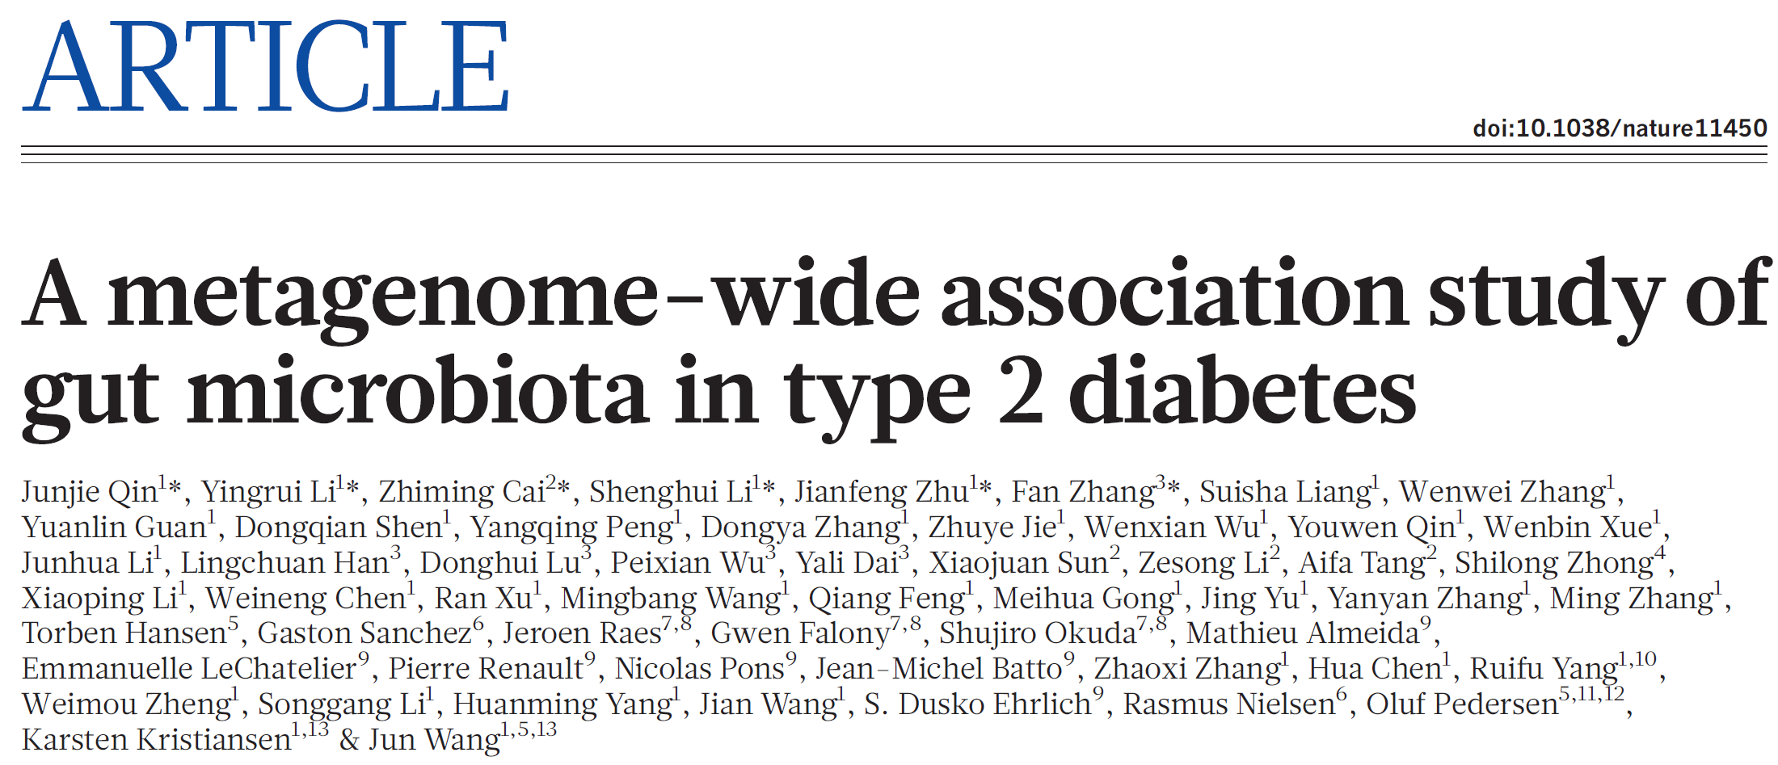
Altered microbiota in T2D

Slide 31
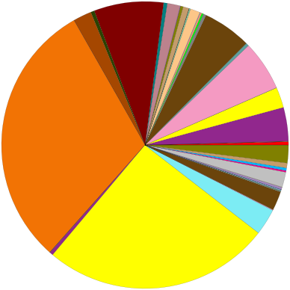
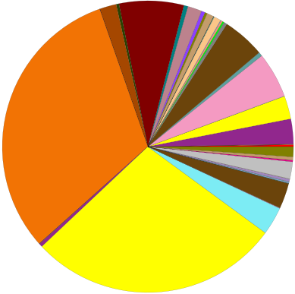
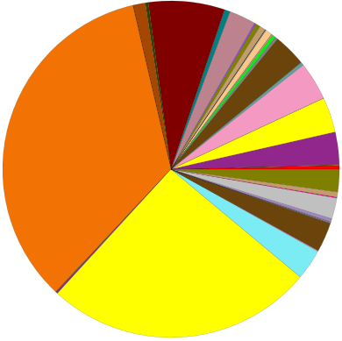
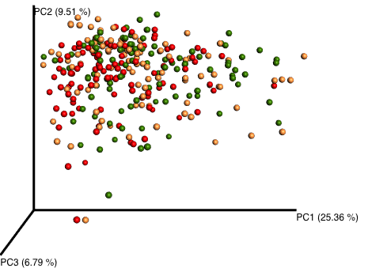
Overall microbial composition
NGT
Prediabetes
T2D
NGT
Significantly different microbiota composition in NGT, prediabetes and T2D, most of the difference between NGT/PreD vs T2D}
NO significant difference for overall microbiota composition between NGT and prediabetes
T2D
Prediabetes
Notes:
Some difference also at broad taxonomic level (differences at species level will be presented later)

Slide 32
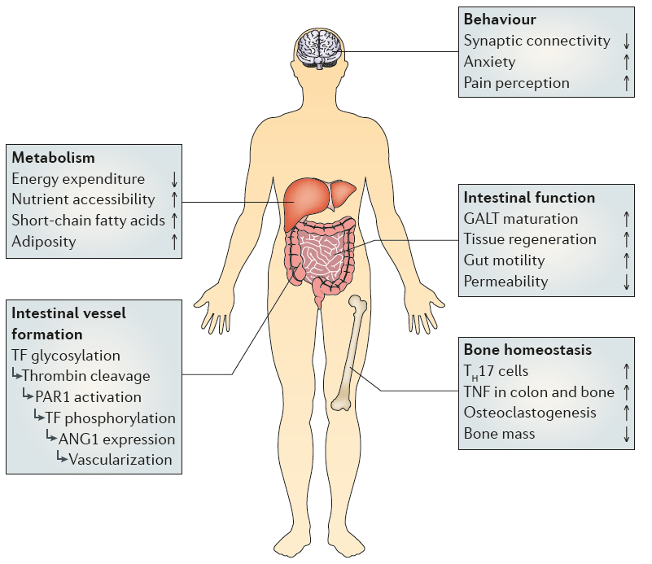
The gut microbiota affects many physiologic processes
Sommer & Bäckhed Nat. Rev. Microbiol 2013
Notes:
The gut microbiota is important for intestinal homeostasis, immune function and inflammation. But the gut microbiota also affect host metabolism

Slide 33
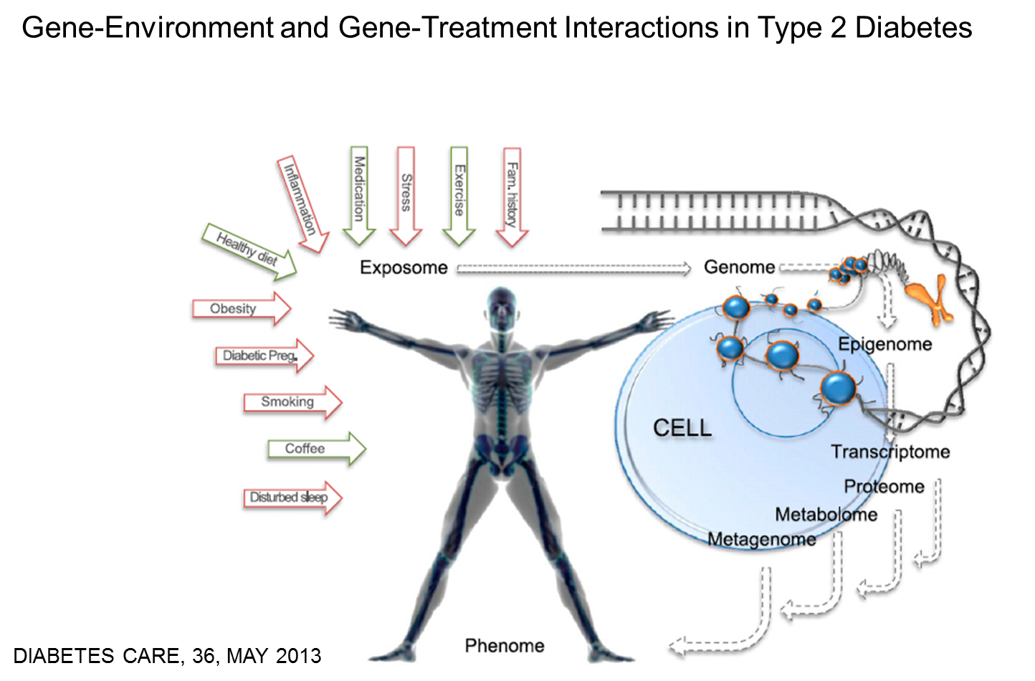

Slide 34
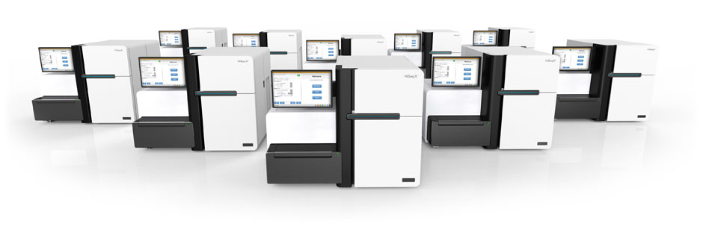




.
Bases para la generación de aplicaciones genómicas innovadoras en la atención de la Salud
Metabonomics
Genome Sequencing
center
Medical interpretation and counselling
Bioinformatics
Prospective Medicine and eHeath
Theranostics
Chronic diseases prevention
and early treatment
Disease etiologies, precision diagnostic and optimized treatment

Slide 35

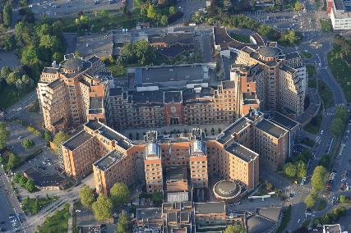
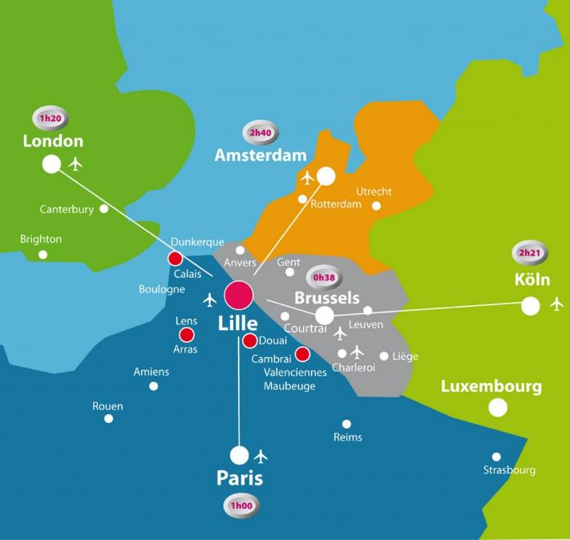
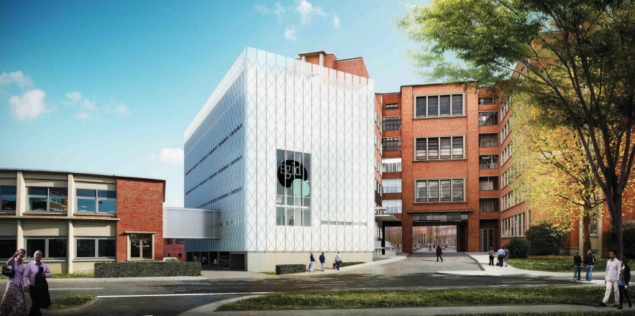
EGID new building, opening first quarter 2016

Slide 36

LIGAN - PM
Amelie Bonnefond
Lille Integrated Genomic Advanced Network Personalized Medicine

