Slide 1

Alteraciones neurocognoscitivas en apnea obstructiva del sueño
Dra. Margarita Reyes Zúñiga
Médico Psiquiatra
Clínica de Trastornos Respiratorios del Dormir
INER

Slide 2
¿Qué es DORMIR?
Dormir es un estado natural y reversible de reducción en la capacidad de respuesta a estímulos externos y relativa inactividad, acompañado por pérdida de la conciencia. Ocurre en intervalos regulares de tiempo y está homeostáticamente regulado.
Borbély AA, Achermann P. Sleep homeostasis and models of sleep regulation. J Biol Rhythms 14: 557–568, 1999.

Slide 3
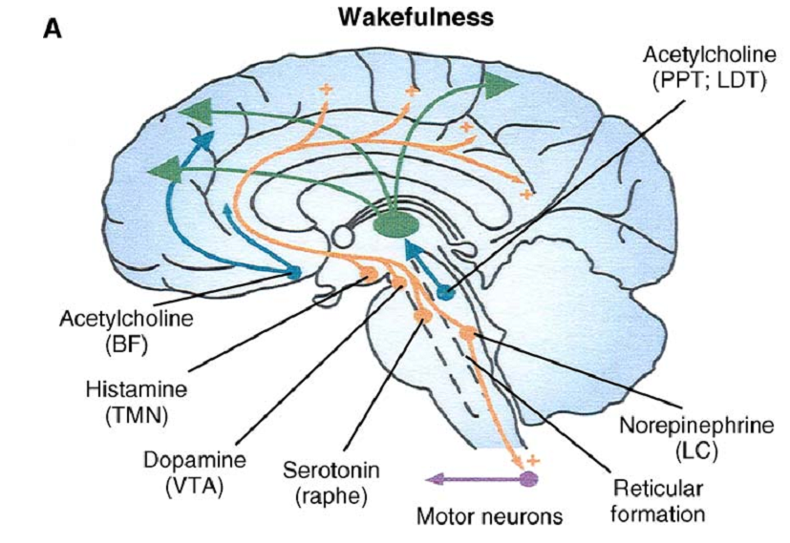
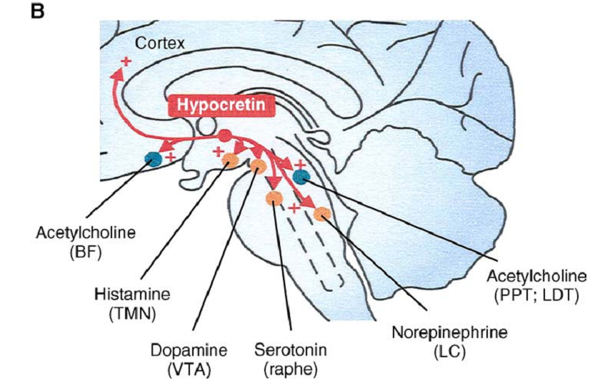
Vigilia

Slide 4
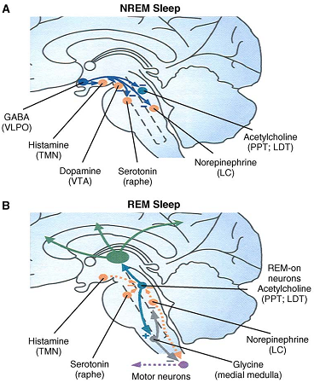
Sueño No MOR
Sueño MOR

Slide 5
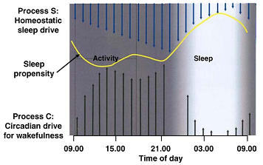
Regulación del sueño

Slide 6
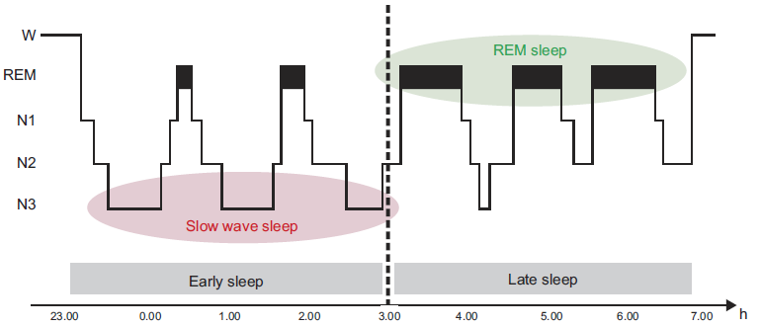
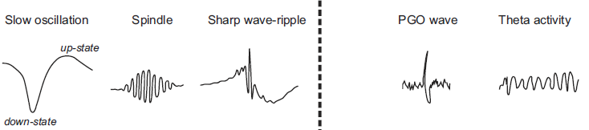
Hipnograma

Slide 7
¿ Para qué nuestro cerebro necesita dormir ?

Slide 8
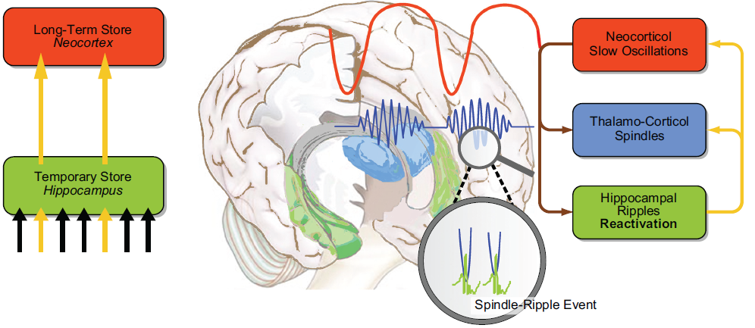
Modelo de consolidación activa durante el sueño
Notes:
A model of active system consolidation during sleep. A: during SWS, memories newly encoded into a temporary store (i.e., the hippocampus in the declarative memory system) are repeatedly reactivated, which drives their gradual redistribution to the long-term store (i.e., the neocortex). B: system consolidation during SWS relies on a dialogue between neocortex and hippocampus under top-down control by the neocortical slow oscillations (red). The depolarizing up phases of the slow oscillations drive the repeated reactivation of hippocampal memory representations together with sharp wave-ripples (green) and thalamo-cortical spindles (blue). This synchronous drive allows for the formation of spindle-ripple events where sharp wave-ripples and associated reactivated memory information becomes nested into succeeding troughs of a spindle (shown at larger scale). In the black-and-white version of the figure, red, green, and blue correspond to dark, middle, and light gray, respectively. [Modified from Born and Wilhelm (125).]

Slide 9
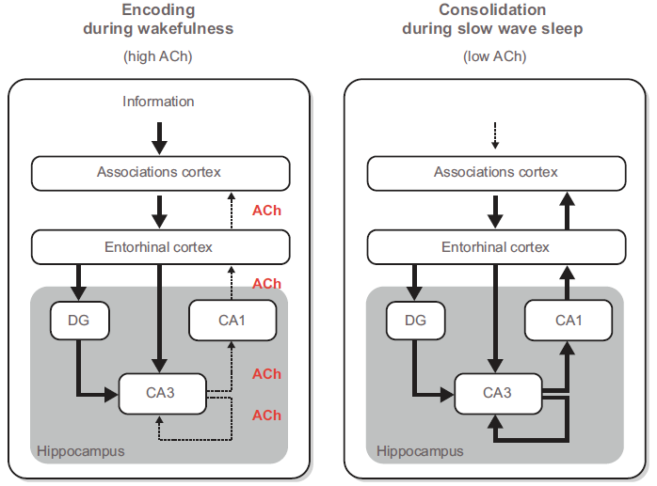
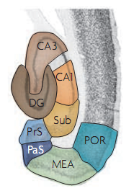
Influencia de la actividad colinérgica en sueño y vigilia
Notes:
Influencia de la actividad colinergica durante el sueño y la vigilia. L a in

Slide 10
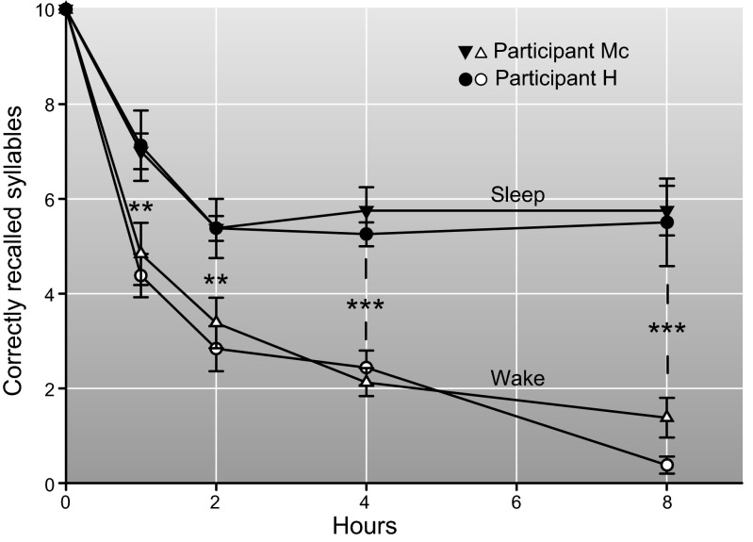
Efectos de intervalos de sueño y vigilia de diferente duración después de una prueba de aprendizaje.
Notes:
Effects of sleep and wake intervals of different length after learning on memory for senseless syllables. Sleep after learning leads to superior recall of syllables after the 1-, 2-, 4-, and 8-h retention interval, compared with wake intervals of the same length. Two subjects (H. and Mc.) participated in this classic study by Jenkins and Dallenbach (603). For each data point, each participant completed 6–8 trials, with the different retention intervals performed in random order. The study took ∼2 mo during which the participants lived in the laboratory and were tested almost every day and night. Data are based on Table 3 in Reference 603, as the original figure contains an erroneous exchange of data points at the 4-h wake retention interval. Values are means ± SE. **P ≤ 0.01; ***P ≤ 0.001.

Slide 11
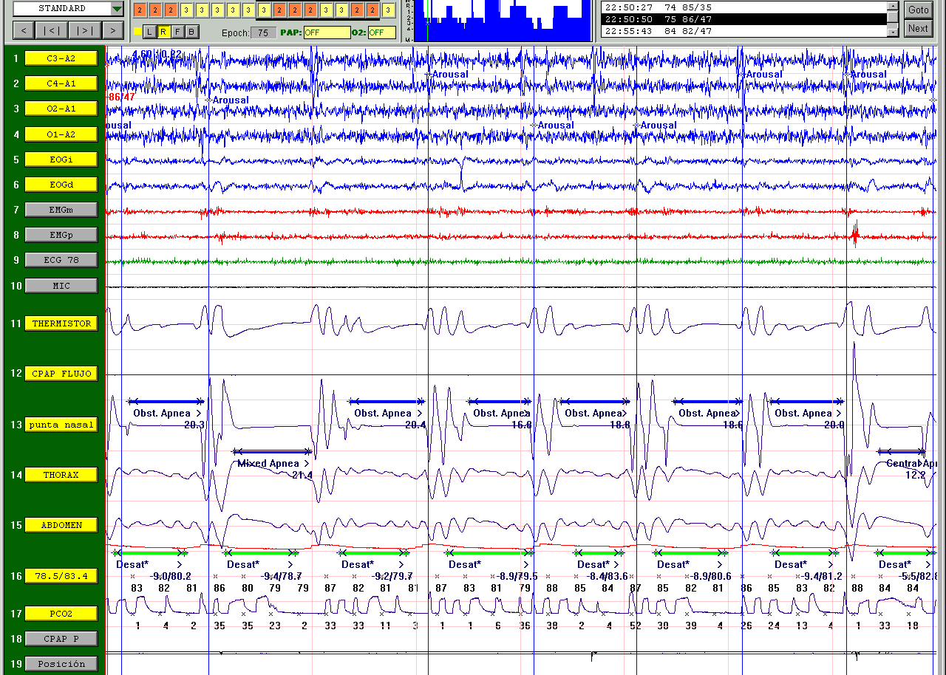

Slide 12
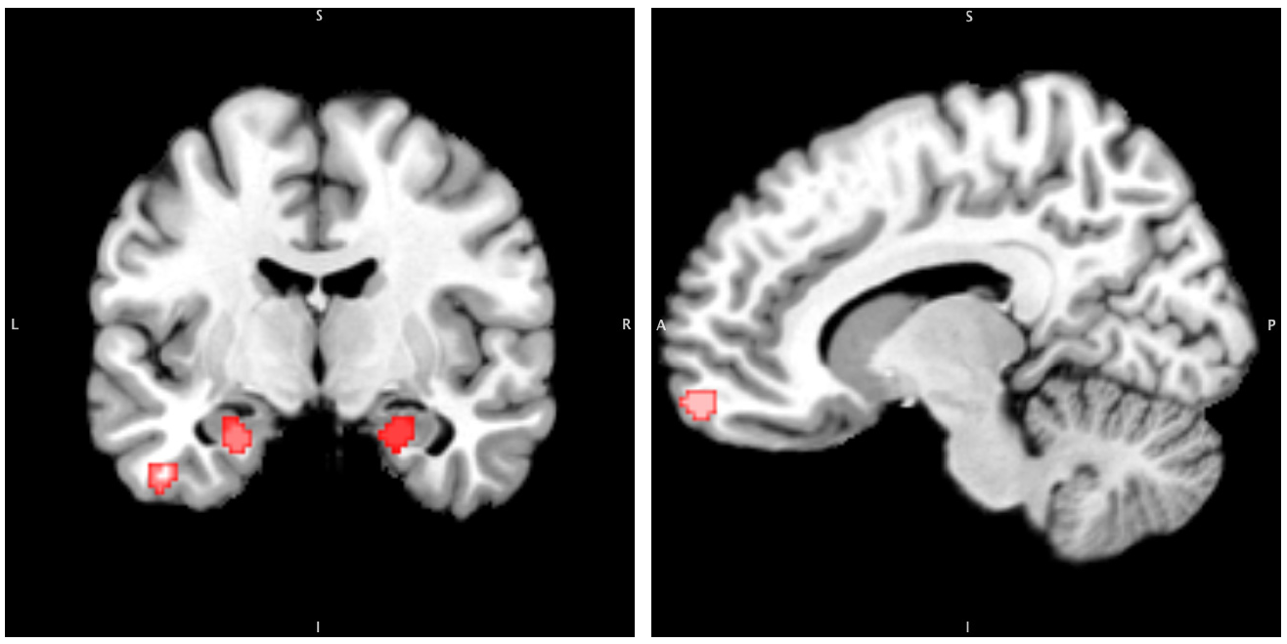
Medición de la reducción de la materia gris en la apnea obstructiva del sueño: un meta-análisis de estimación de la probabilidad de activación.
SLEEP, Vol. 37, No. 1, 2014
Notes:
Results: Regional gray matter reduction in the bilateral parahippocampus and less-convincing right superior frontal and left middle temporal gyri was demonstrated in patients with sleep apnea using an activation likelihood estimation (ALE) procedure to analyze significant differences. Conclusions: Significant reductions in gray matter in patients with sleep apnea occurred in the bilateral parahippocampus and less-convincing frontotemporal regions, which may be related to the neurocognitive processing abnormalities that are common among populations of patients with sleep apnea. Keywords: Meta-analysis, obstructive sleep apnea, voxel-based morphometry Citation: Weng HH; Tsai YH; Chen CF; Lin YC; Yang CT; Tsai YH; Yang CY. Mapping gray matter reductions in obstructive sleep apnea: an

Slide 13
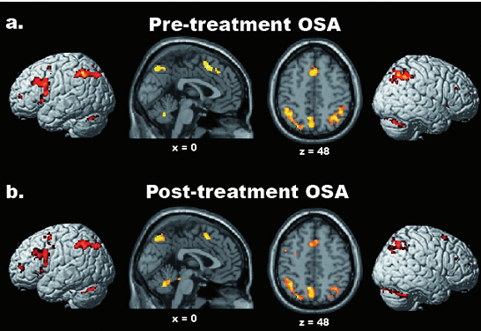
Cambios morfológicos en pacientes con apnea de sueño, antes y después de tratamiento
Sleep 2009;32(9):1161-1172

Slide 14
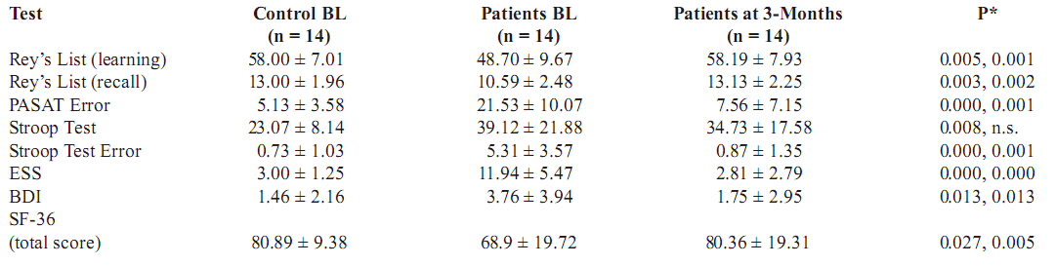
Cambios en la activación cerebral antes y después del tratamiento con Presión Positiva Continua en Apnea Obstructiva del Sueño (AOS)
Sleep 2009;32(9):1161-1172

Slide 15
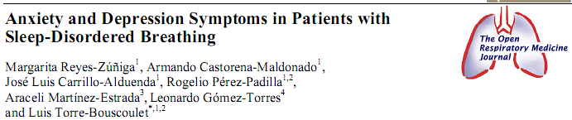
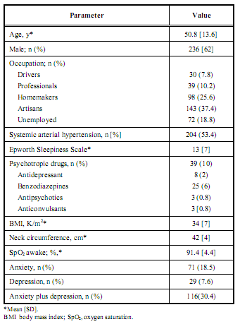
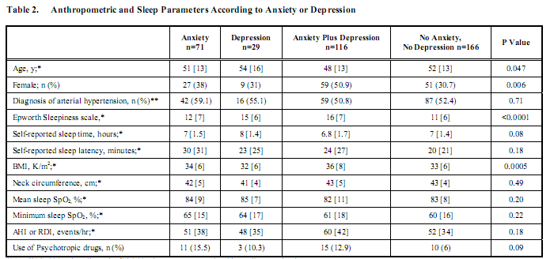

Slide 16
www.medicinadeldormir.org.mx

