Slide 1
Los Grandes Retos de Programas de Vacunacion en America Latina, 1979-2016
Jon Kim Andrus, MD
Adjunct Professor, Center for Global Health
University of Colorado
Academia Nacional de Medicina de Mexico, A.C.
Cuerpo Consultivo del Goberno Federal
La Cuidad de Mexico
8 de marzo, 2017

Slide 2
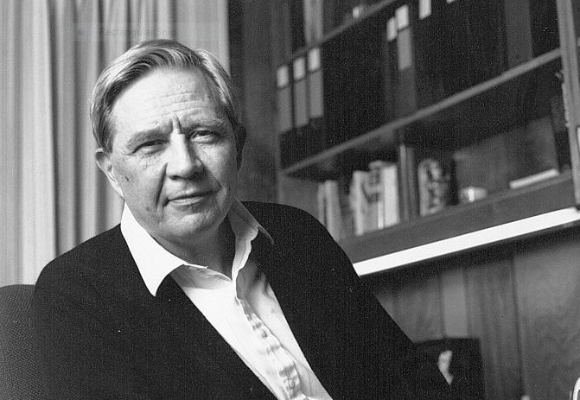

Slide 3
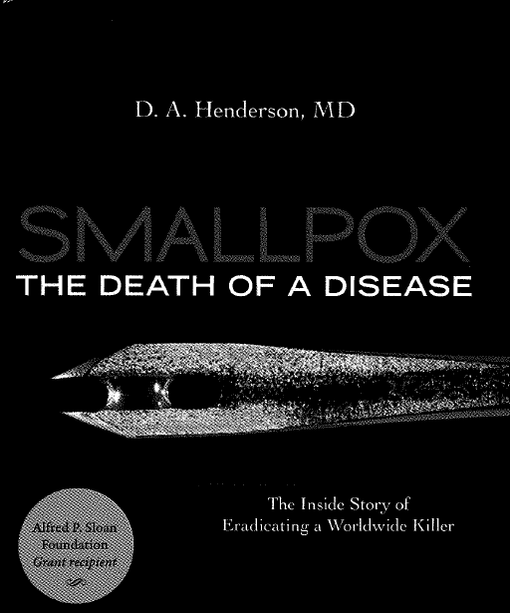

Slide 4
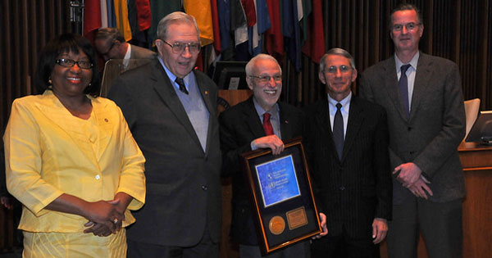

Slide 5
9 key areas of expertise resulting from polio eradication experience
Policy & strategy development
Planning
Management & oversight
Implementation & service delivery
Monitoring & evaluation
Communications & community engagement
Disease surveillance and data analysis
Capacity building
Partnerships & coordination

Slide 6
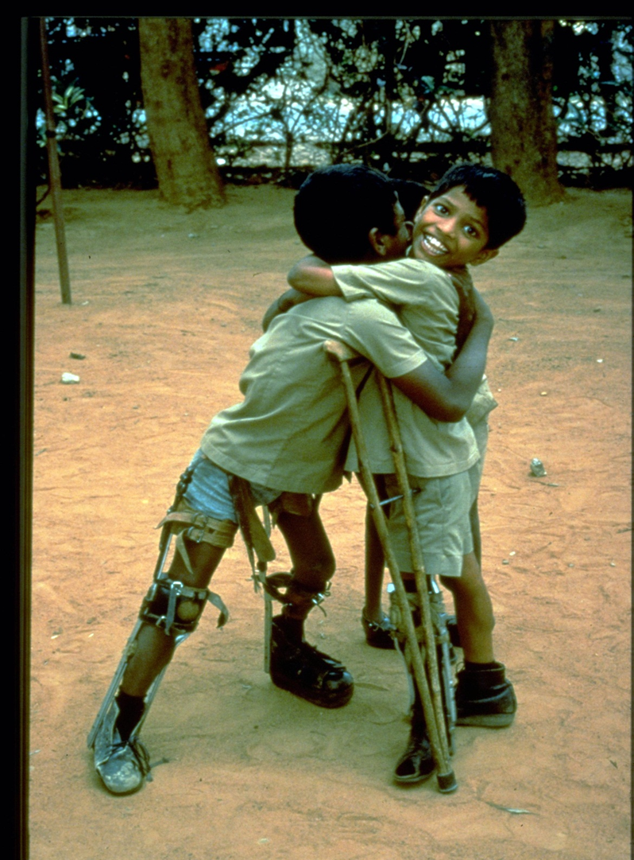

Slide 7

Milestones in the 39 years of the EPI in the Americas
1977
2016
2017
PAHO’s Directing Council establishes the EPI
1979 | Creation of the Revolving Fund
1980 | Creation of international evaluation methodology for the EPI
1983 | “Days of Tranquility”
1985 | Creation of the EPI Technical Advisory Group
1985 | Creation of the Interagency Cooperation Committee
1991 | Last indigenous case of polio in Peru
1994 | Declaration of the goal to eliminate measles
1994 | 1st Region certified free of polio
2003 | 1st Vaccination Week in the Americas
2006 | Launch of the Pro-Vac initiative
2009 | Last indigenous case of rubella and congenital rubella syndrome
2012 | 1st World Immunization Week
2013 | Directing Council resolution on the principles of the Revolving Fund
2015 | 1st Region declared free of rubella
2015 | Directing Council resolution on the Regional Immunization Action Plan
2016 | 1st Region declared free of Measles

Slide 8
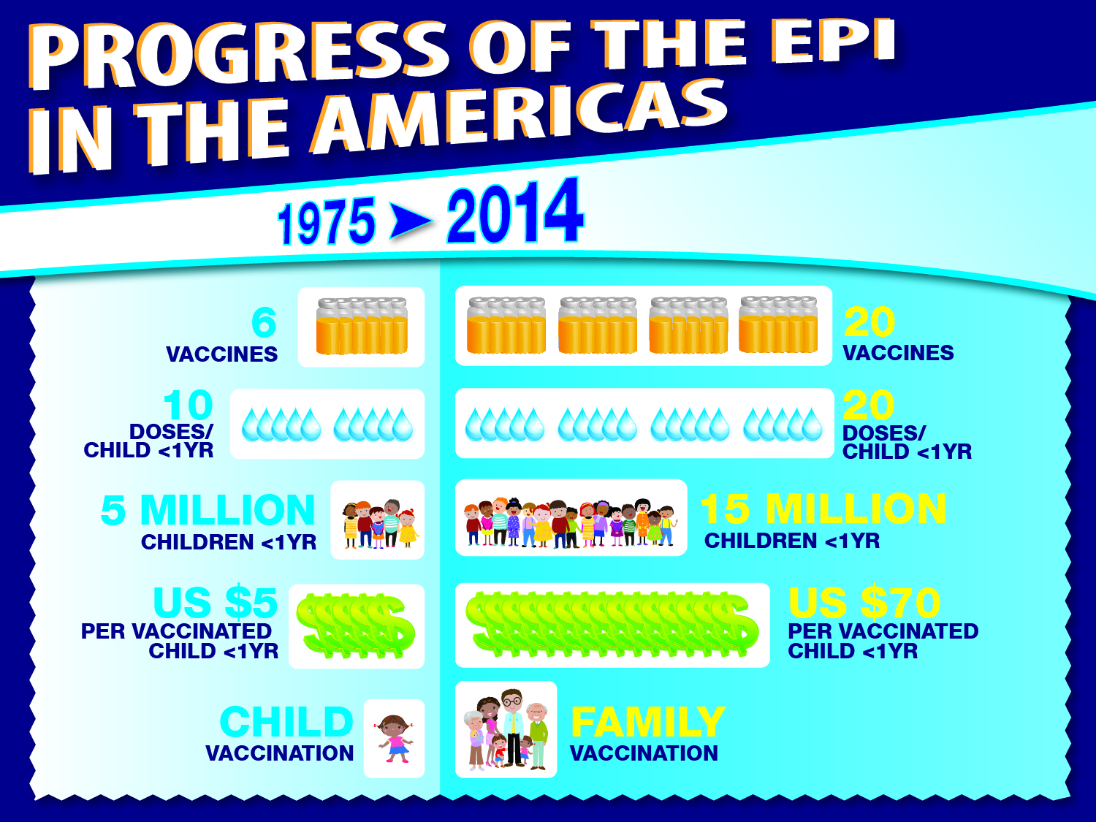

2017
15
LIFE COURSE
LIFE COURSE

Slide 9
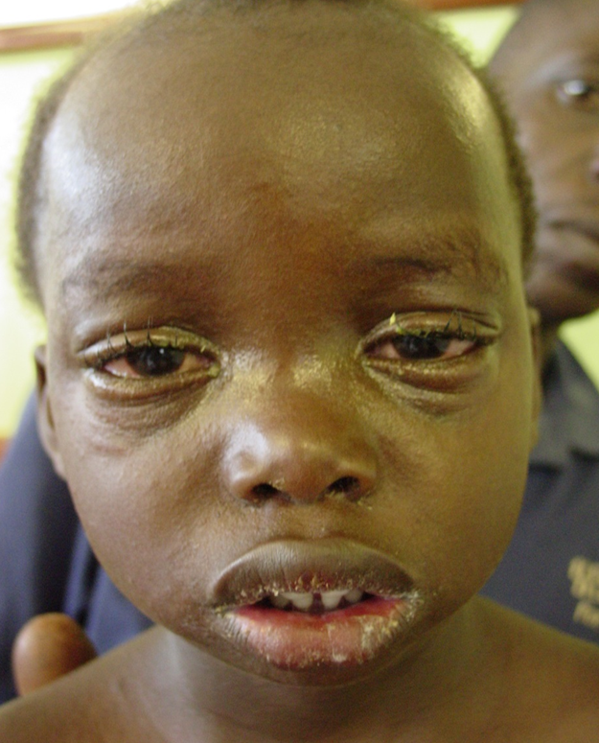

Slide 10
Introduction of New Vaccines
Neumo, Rota, VPH
Neumo, VPH
Argentina
Brasil
Colombia
Ecuador
Estados Unidos
Guyana
Islas Caimán
México
Panamá
Perú
Paraguay
Canadá
Chile
Departamentos franceses ((3)
Municipios holandeses (3)
Trinidad & Tobago
Uruguay
Neumococo
Aruba
Bahamas
Barbados
Bermuda
Costa Rica
Curacao
Neumo, Rota
El Salvador
Guatemala
Honduras
Nicaragua
Rep. Dominicana
Bolivia
Venezuela
Rotavirus
PCV: 28 countries and 6 territories
RV: 17 countries and 1 territories
VPH: 16 countries and 7 territories
Haití
VPH
Surinam
Belize
Fuente: Country Reports to PAHO-WHO-UNICEF (JRF), 2016

Slide 11
Considerations for new vaccine policymaking at country-level
Technical
Social
EVIDENCE
PACKAGE
Operational &
Programmatic
Source: Andrus, JK., Toscano, CM., Lewis, M., Oliveira, L. , et al. 2007, “A model for enhancing evidence-based capacity to make informed policy decisions on the introduction of new vaccines in the Americas: PAHO’s ProVac Initiative”, Public Health Reports, 122(6): 811-816.

Slide 12
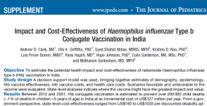
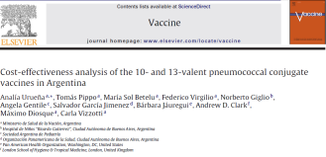

Scenario 1
Scenario 2
Scenario 3
CEA/impact not considered (political decision)
Agency-led CEA/impact
(Hib vaccine in India)
MoH-led CEA/impact (ProVac)
(PCV in Argentina)
TRIVAC model used
Outside agency presented to NITAG
Outside agency led publication of results
No MoH training
GAVI finance available but significant delays in adoption
TRIVAC model used
MoH presented to NITAG
MoH-led publication of results
MoH trained and led subsequent CEA of RV/HPV
PCV quickly financed/adopted
Slide courtesy of Andrew Clark, ProVac Modeller

Slide 13
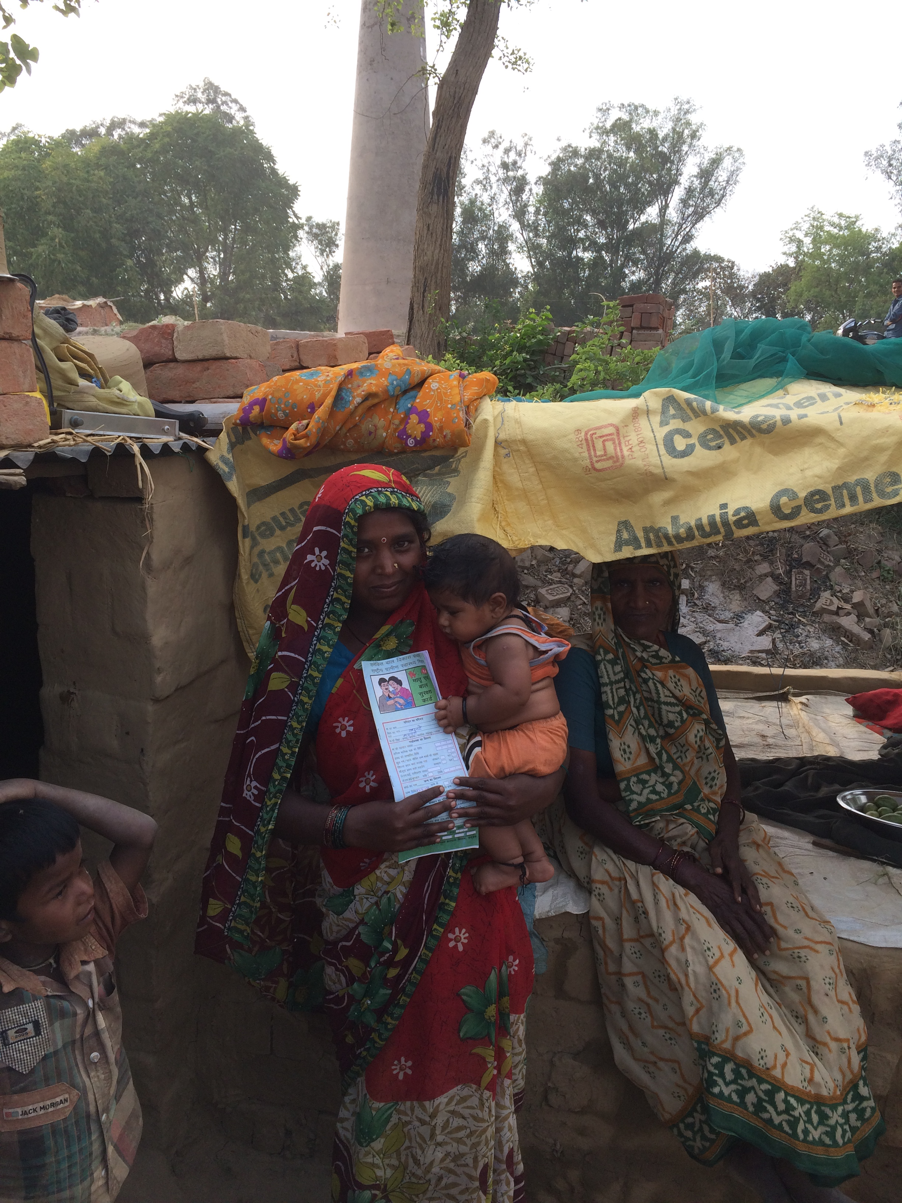

Slide 14
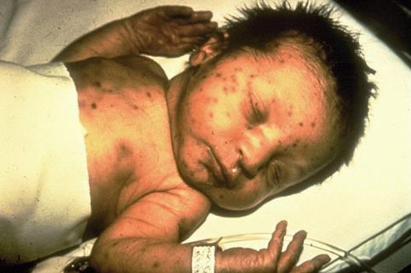
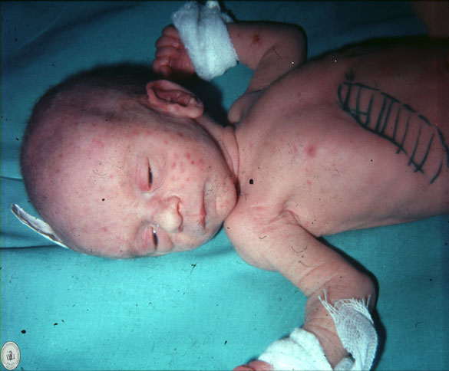

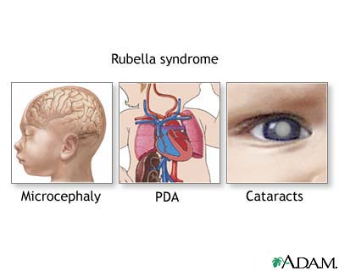
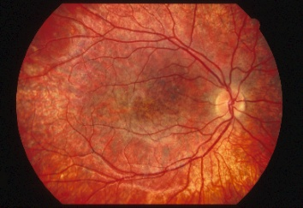
Congenital Rubella Syndrome

Slide 15
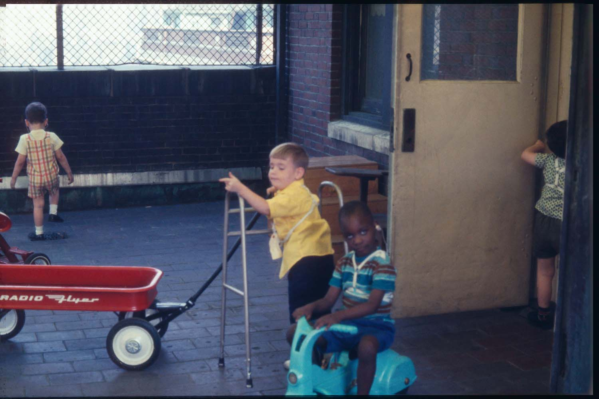
High morbidity rationale for immunization interventions
Autistic boy
Spastic, deaf
Autistic
Deaf-blind, retarded
Rubella Project for Multihandicapped; Bellevue Hospital – 1968
Courtesy Dr. L. Cooper

Slide 16
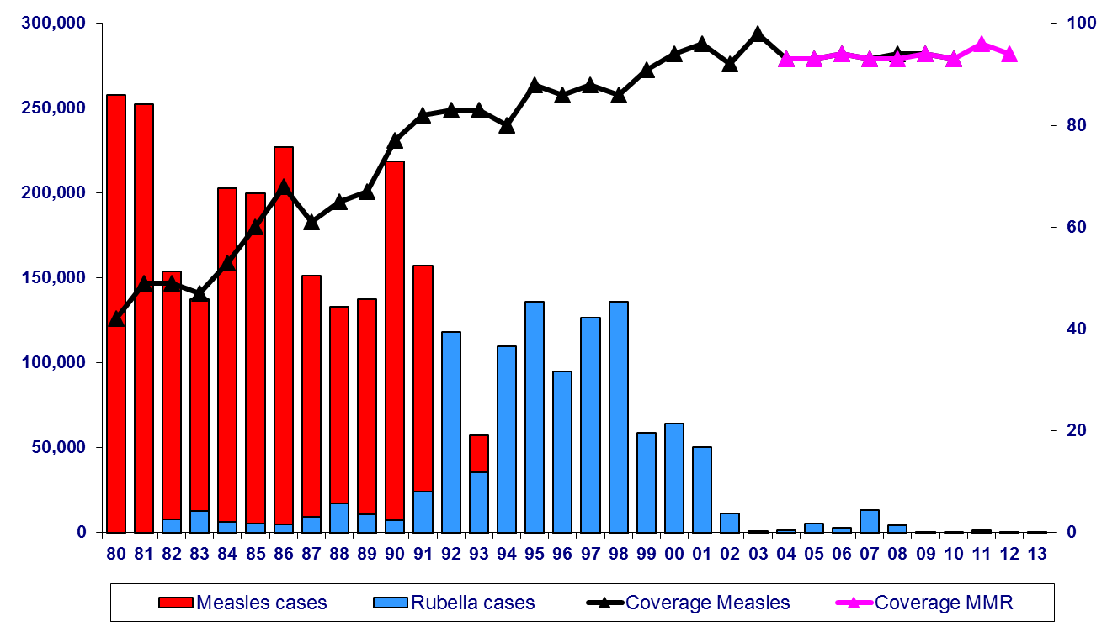
Measles Vaccination Coverage among Children <1 Year of Age* and Reported Measles and Rubella Cases, the Americas 1980-2013*
Catch up campaign
Speed up campaigns
Follow-up campaigns
Confirmed cases
Last endemic measles case
% Vaccination coverage
Last endemic rubella case
* MMR in children 1 year of age by vaccine introduction
Catch up (<15years) | Follow-up (1-4 years) | Speed-up (adol/adult)
140 million | 80 million | 260 million
Source: Country reports to FGL-IM/PAHO
* Data as of February 25, 2013

Slide 17
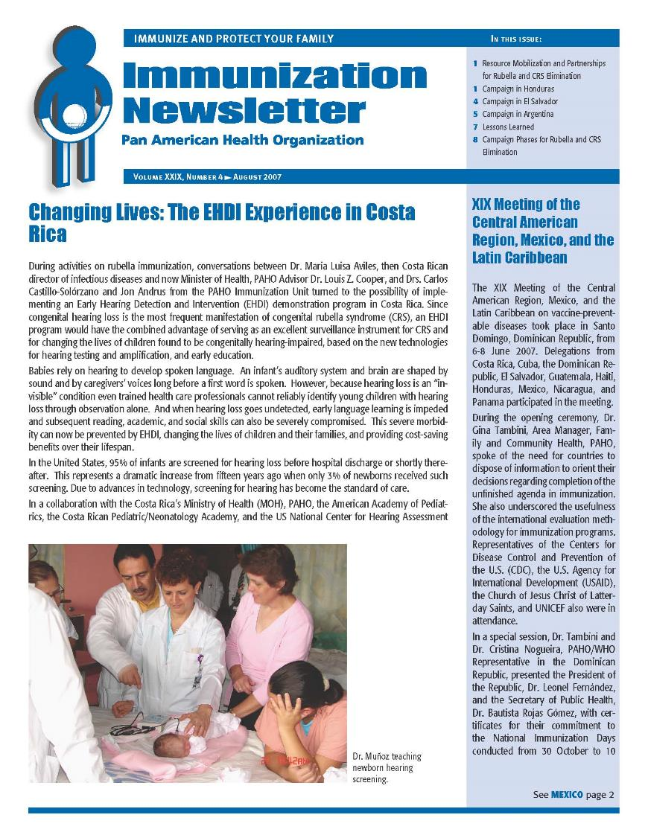
Rubella elimination and primary health care
PAHO. Changing lives: The EHDI experience in Costa Rica. EPI Newsletter August 2007;29(4):1.
Castillo-Solorzano C, Andrus JK. Rubella elimination and improving health care for women. Emerging Infectious Diseases 2004;10(11):17-21.

Slide 19
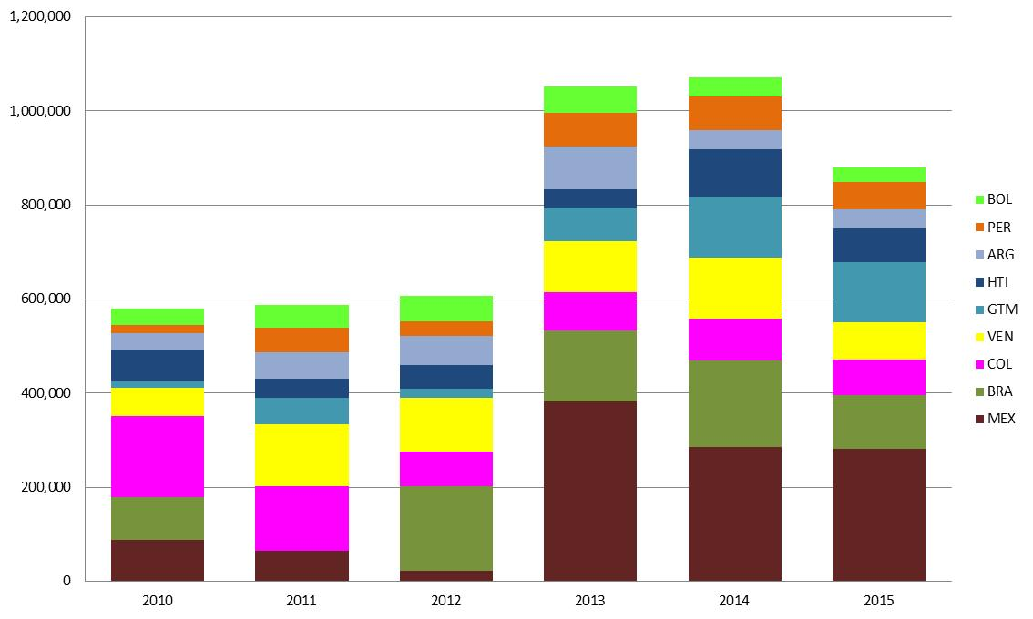
Number of children not vaccinated (DTP3) by year
Selected countries in the Americas, 2010-2015
Provisional data as of 6/30/16, susceptible to changes based on countries’ revisions. Source: Country reports through the PAHO-WHO/UNICEF Joint Reporting Form (JRF) 2016

Slide 20
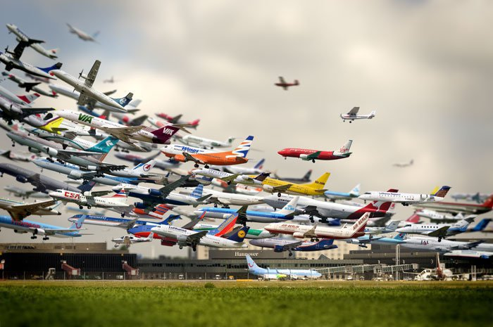

Disease anywhere is disease everywhere

