Slide 1

Tuberculosis Nuevos Tratamientos en Tuberculosis Multidrogoresistente
Dr Eduardo Sada Diaz
Instituto Nacional de Enfermedades Respiratorias
Julio 2017

Slide 2
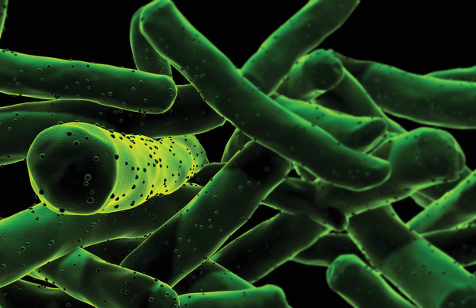

Slide 3
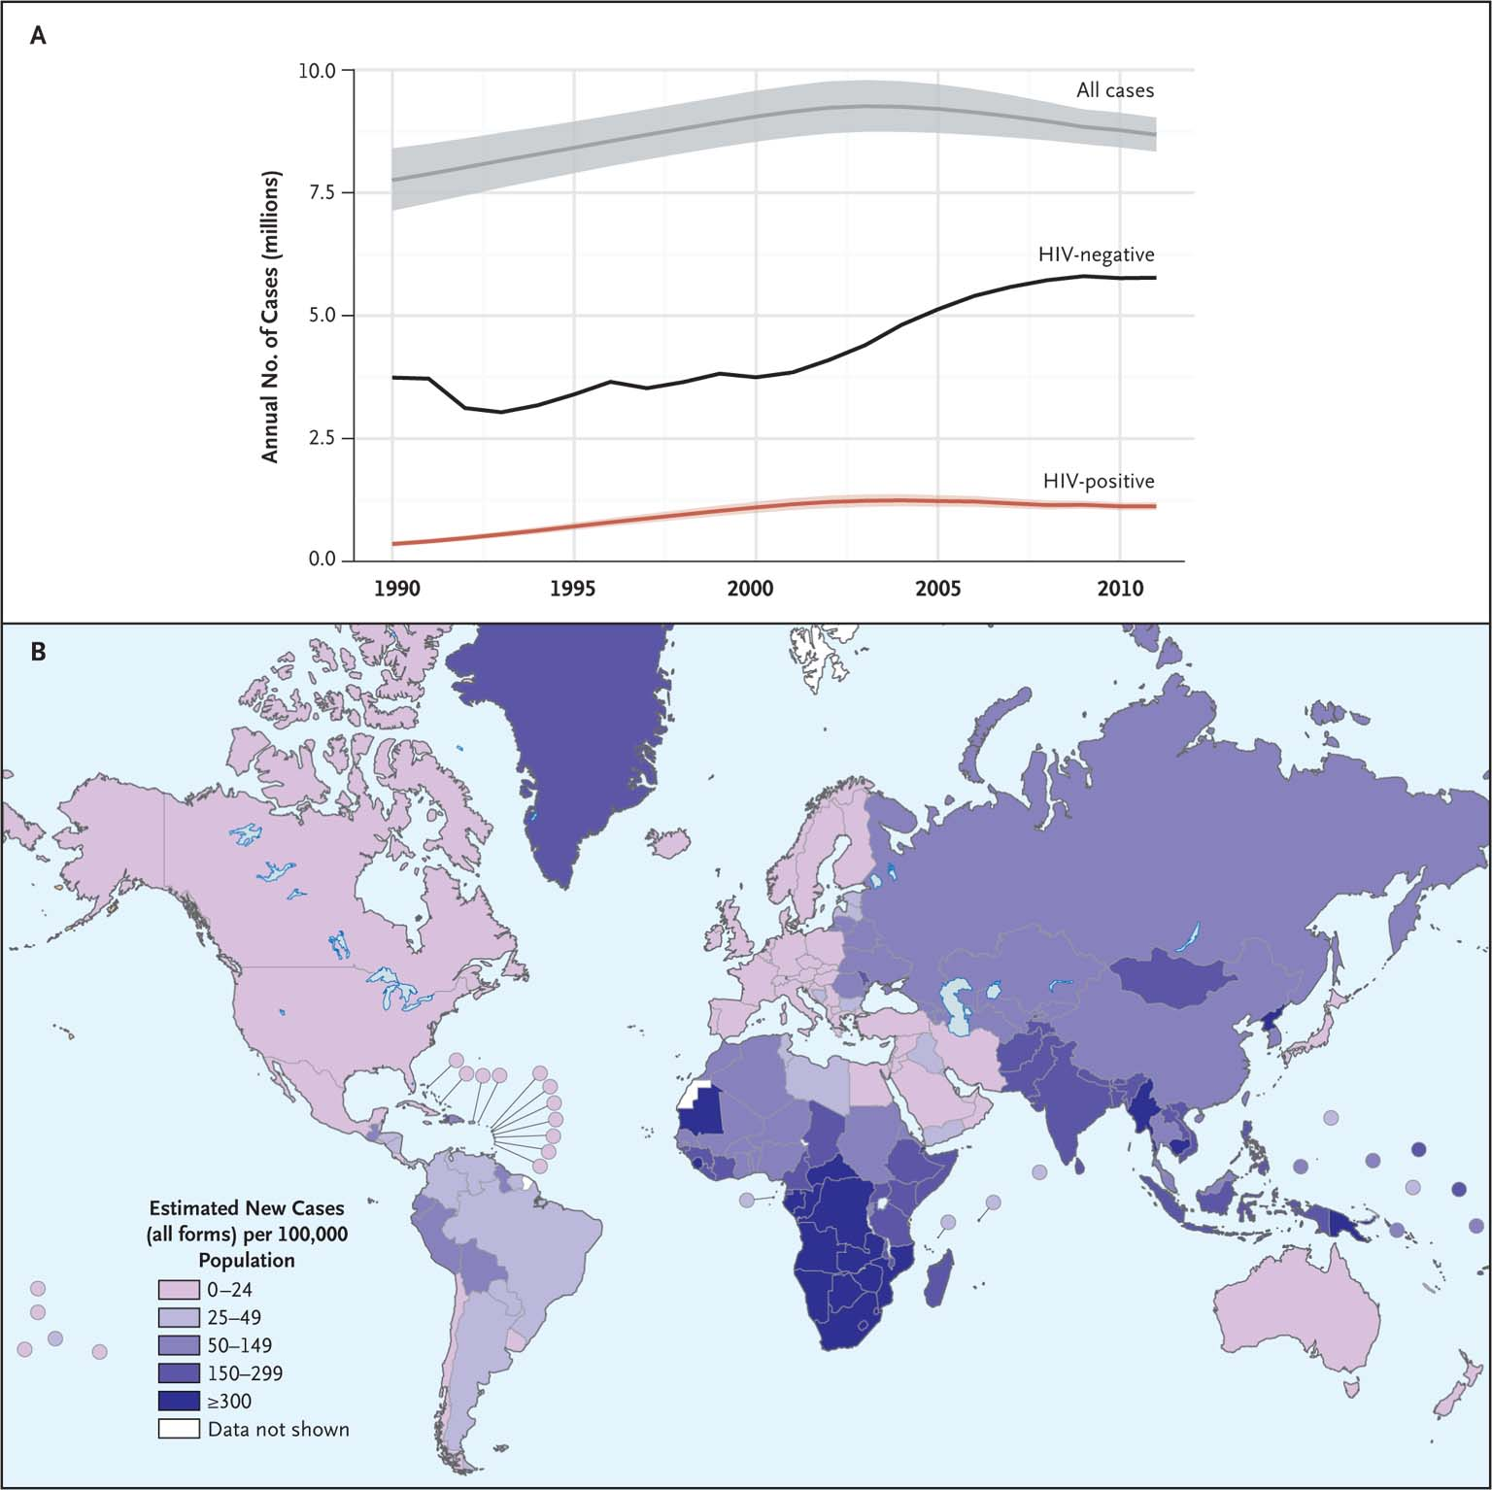
INCIDENCIA GLOBAL EN TUBERCULOSIS
Zumla A et al. N Engl J Med 2013;368:745-755
Notes:
Figure 1 Global Incidence of Tuberculosis. Panel A shows global trends in the estimated incidence of tuberculosis from 1990 through 2011 among all patients, those with human immunodeficiency virus (HIV) coinfection, and without HIV coinfection. The shading around the data curves indicates uncertainty intervals on the basis of available data. Panel B shows the estimated global incidence of tuberculosis in 2011.

Slide 4
TUBERCULOSIS ANTECEDENTES
En 2012 hubo 8.7 millones de nuevos casos de tuberculosis activa.
Los avances en el diagnostico , farmacos y vacunas asi como intervenciones han permitido mantener optimismo en el futuro control de la tuberculosis
MDR tuberculosis Resistencia a Isoniazida y Rifampicina
OMS 2013

Slide 5

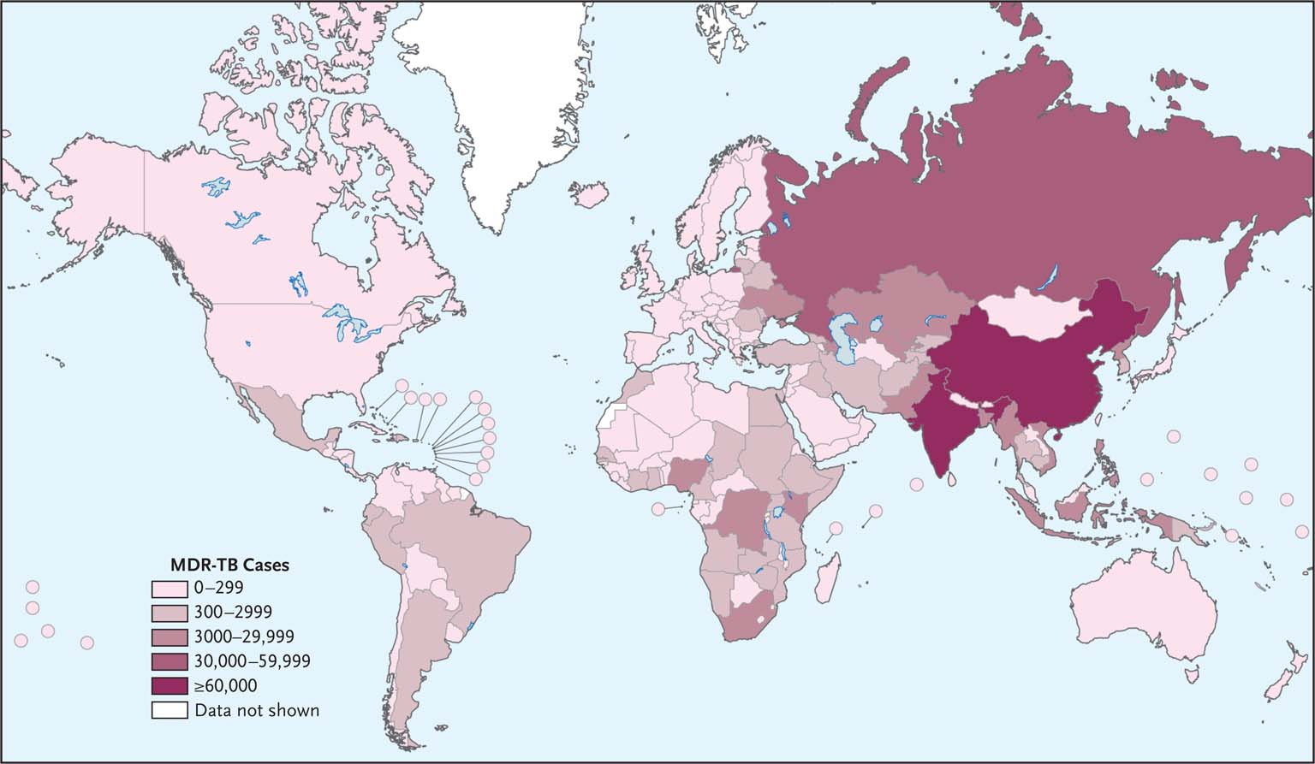

NUMEROS GLOBALES DE CASOS DE TUBERCULOSIS MULTIDROGORESISTENTE
Zumla A et al. N Engl J Med 2013;368:745-755
Notes:
Figure 2 Global Numbers of Cases of Multidrug-Resistant Tuberculosis. Shown are the estimated numbers of cases of multidrug-resistant disease (including extensively drug-resistant disease) among cases of pulmonary tuberculosis that were officially reported in 2011.

Slide 6
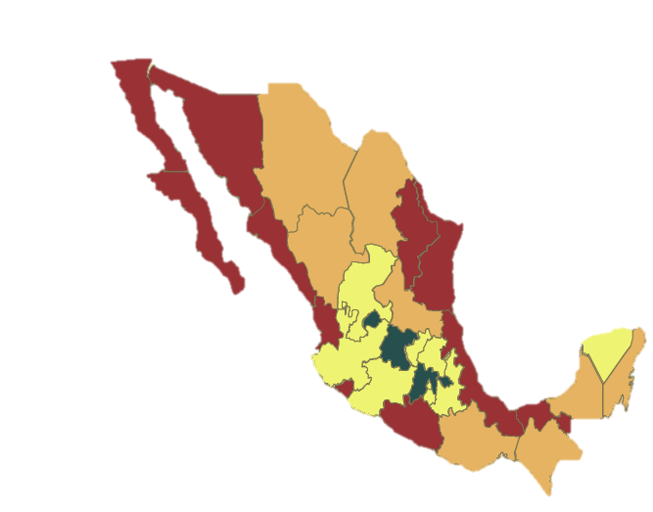
Incidencia estimada 2012 México
SSA
18,999 casos nuevos TB
81.4% pulmonar (15,457)
152 casos nuevos de TB MDR
20.9% TB/DM
7.4% TB/SIDA
TASA (100 000 habs.)
 | >24
 | 14.9-23.9
 | 7.11-14.8
 | <7.10
Plataforma Única de Información /SUIVE/DGE/SS. Cierre 2012

Slide 7
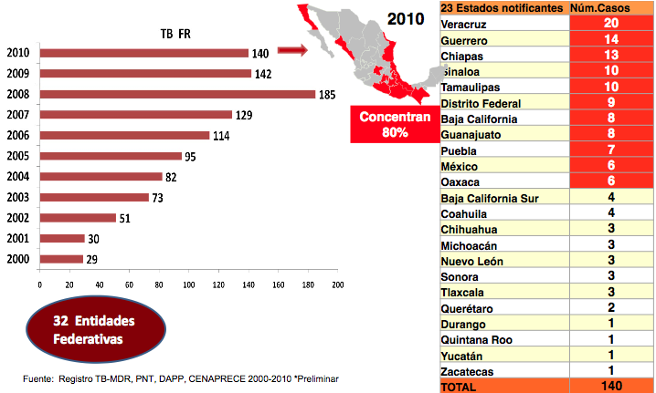
Tuberculosis Farmaco-resistente
(Casos nuevos 2000 – 2010)

Slide 8
Problemas Actuales Prioridades
Coinfecciòn TB –HIV
Tratamientos Ineficientes con Aparición de cepas MDR Y XDR
Poblaciòn | Terapia Actual | Prioridades
TB drogosensible | 4 drogas > 6 Meses 2RHZE + 4 RH | Regimenes cortos Terapias Simples
TB Resistente MDR XDR | Drogas Secundarias Inyectables 48 meses | Tratamiento Oral Corto -Eficaz -Seguro
TB HIV | Interacciòn drogas TB-HIV | No interacciòn Coadminitracion segura
TB latentes | Isoniazida 6-9 meses | Terapia Corta –Segura

Slide 9
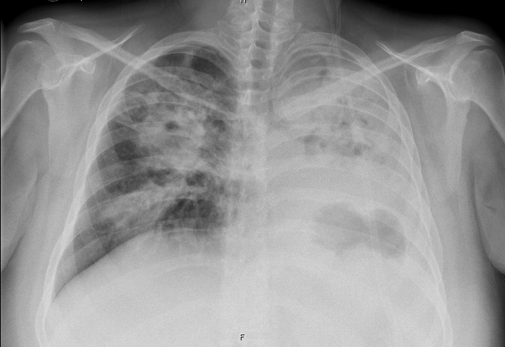
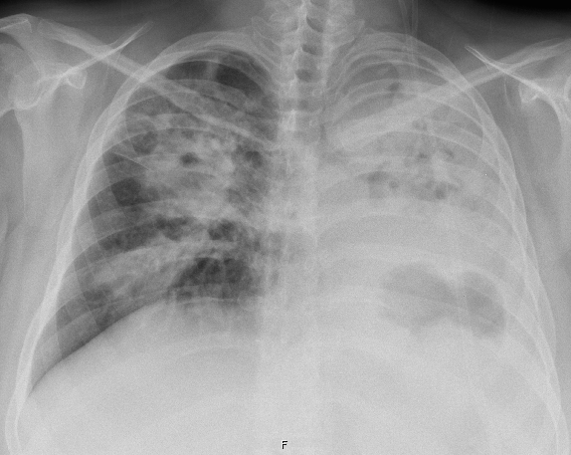
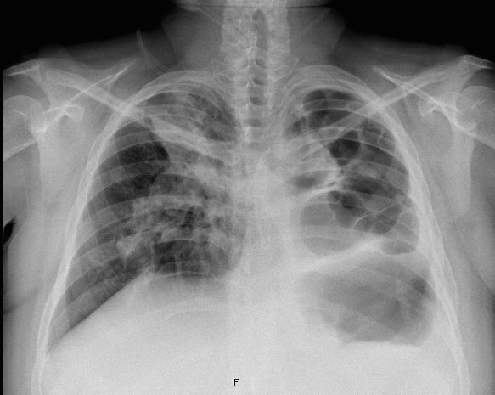
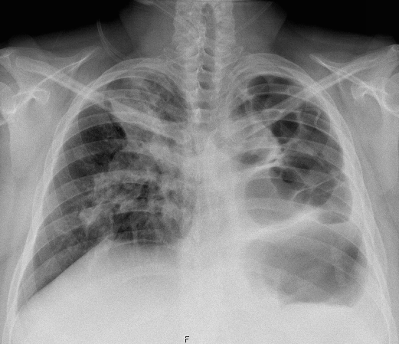
INICIAL
1 AÑO DESPUES
Notes:
Es importante tambien tener en cuenta el costo del paciente y o me refiere a costo economico, si no a costo en cuento funcionalidad pulmonar

Slide 10
Programa de TBP farmaco-resistente en el INER
Período 2010 – 2012
Edad Promedio 44años
  43 MDR Relaciòn H/M
  1 XDR
Promedio de edad: 44.96 años
Promedio de edad: 42.45 años

Slide 11
Perspectivas Históricas
1940 Tratamiento paliativo
( Inmunoterapia- Ambiental -Nutricional )Mortalidad 50%
1944 Introducción de Estreptomicina y PAS
1952 Introducción de Isoniazida
1970 Regimenes combinados 18 meses
Regimenes Acortados RHZE (BMC ) 2RHZE
2010-2014 Desarrollo de Nuevas drogas para TB MDR
/

Slide 12
Desarrollo Pre-Clínico
Desarrollo Clínico
Desarrollo preclínico
GLP
Toxicologia
FASE I
FASE II
FASE III
CPZEN-45
BTZ043
AZD5847
Oxazolidinona
DELAMANID (OPC67683)
TB MDR
Nitro-dihidro-imidazooxazole
DC-159a
TBA-354
Q-201
Linezolid para MDR-TB
Oxazolidinona
GATIFLOXACINO
para DS-TB
SPR-10199
SQ-609
Nuevos Regímenes
Nitroimidazol-oxazina, diarylquinolina, FQ,Derivados del Ac. Nicotínico
MOXIFLOXACINO
para DS-TB
SQ-609
SQ-641
RIFAPENTINA
TB latente
PA-824
Nitroimidazol-oxazina
Quinolonas
Oxazolidinona
Nitroimidazoles
Rifampicinas
RIFAPENTINA
(DS-TB)
BEDAQUILINE (TMC207) TB-MDR y TB-DS
Diarylquinolina
SQ-109
Etilenediamina
Sutezolid (PNU-100480)
Oxazolidinona

Slide 13
Mecanismo de Acción
Diferentes dianas
PA-824
OPC-67683 (Delamanid)
ADN Gyrasa
Gatifloxacin
Moxifloxacin
Bio-
reduction
Pared celular
SQ-109
ARN Polymerasa
Rifapentina
DNA
Reactive
Species
mRNA
H⁺
ADP
ATP
Peptide
Ribosoma
PNU-100480 (Sutezolid)
AZD-5847
ATP Synthase
TMC-207 (bedaquiline)

Slide 14
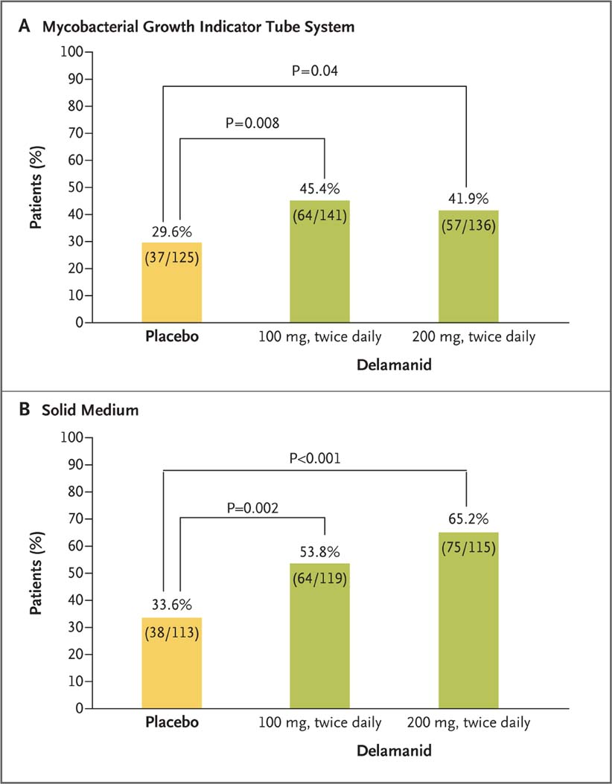
Original Article
Delamanid for Multidrug-Resistant Pulmonary Tuberculosis
N Engl J Med
Volume 366(23):2151-2160
June 7, 2012

Slide 15
Conclusiones
Delamanid se asocio con un incremento en la conversion a dos meses en pacientes con TB MDR.
Este resultado demuestra que Delamanid puede ser una opciòn para el tratamiento de pacientes con TB MDR .

Slide 16
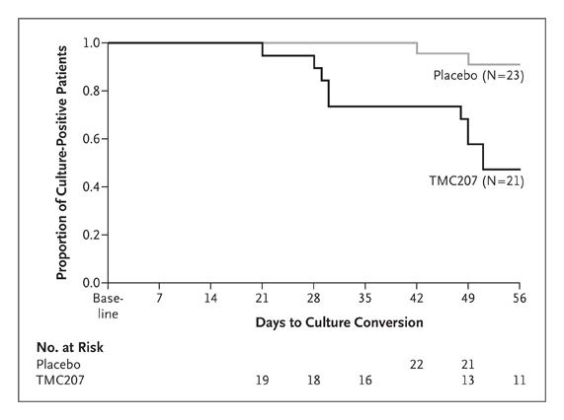
.
Original Article
The Diarylquinoline TMC207 for Multidrug-Resistant Tuberculosis
N Engl J Med
Volume 360(23):2397-2405
June 4, 2009
TMC 207 - Bedaquilina

Slide 17
Conclusion
La actividad clinica de la droga TMC207 demuestra que las ATP sintetasas de MTB MDR son susceptibles de ser afectados por este grupo de medicamentos y por lo tanto son drogas utiles para el tratamiento de TB MDR.

Slide 18
Original Article
Linezolid for Treatment of Chronic Extensively Drug-Resistant Tuberculosis
Myungsun Lee, M.D., Jongseok Lee, Ph.D., Matthew W. Carroll, M.D., Hongjo Choi, M.D., Seonyeong Min, R.N., Taeksun Song, Ph.D., Laura E. Via, Ph.D., Lisa C. Goldfeder, C.C.R.P., Eunhwa Kang, M.Sc., Boyoung Jin, R.N., Hyeeun Park, R.N., Hyunkyung Kwak, B.S., Hyunchul Kim, Ph.D., Han-Seung Jeon, M.S., Ina Jeong, M.D., Joon Sung Joh, M.D., Ray Y. Chen, M.D., Kenneth N. Olivier, M.D., Pamela A. Shaw, Ph.D., Dean Follmann, Ph.D., Sun Dae Song, M.D., Ph.D., Jong-Koo Lee, M.D., Dukhyoung Lee, M.D., Cheon Tae Kim, M.D., Veronique Dartois, Ph.D., Seung-Kyu Park, M.D., Sang-Nae Cho, D.V.M., Ph.D., and Clifton E. Barry, III, Ph.D.
N Engl J Med
Volume 367(16):1508-1518
October 18, 2012

Slide 19
Justificación
1.5 millones de muertes¹
TB Latente
La eficacia de la vacuna BCG es variable²
El régimen de tratamiento de 6 meses
La Isoniazida como terapia preventiva³
Emergencia de cepas drogo-resistentes
Incidencia:
9 x 10⁶ casos
Es necesario buscar nuevas
alternativas terapéuticas
WHO, 2014 http://www.who.int/topics/tuberculosis/en/. 2. Fine PE, The Lancet 1995. 3. WHO, Treatment Guidelines, 2010
Notes:
Instead, such responses cause M. tuberculosis to adopt a clinically silent, latent state of infection, from which the bacteria can be reactivated. (1/3 de la población)
As a practical problem, the limited understanding of immunity to M. tuberculosis deters rapid progress in developing TB vaccines that are superior to Mycobacterium bovis (BCG), a vaccine developed in the early twentieth century that has limited efficacy in preventing active tuberculosis, despite having been administered to >3.5 billion people

Slide 20
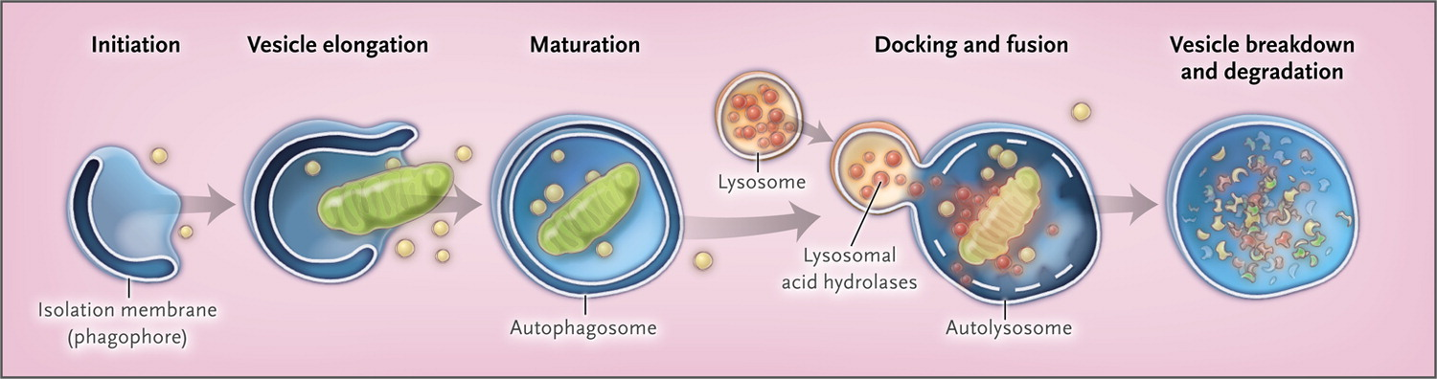

AUTOFAGIA.
Choi AM et al. N Engl J Med 2013;368:651-662.
Notes:
Figure 1. Phases of the Autophagic Pathway. The autophagic pathway proceeds through several phases, including initiation (formation of a preautophagosomal structure leading to an isolation membrane, or phagophore), vesicle elongation, autophagosome maturation and cargo sequestration, and autophagosome–lysosome fusion. In the final stage, autophagosomal contents are degraded by lysosomal acid hydrolases and the contents of the autolysosome are released for metabolic recycling.

Slide 21
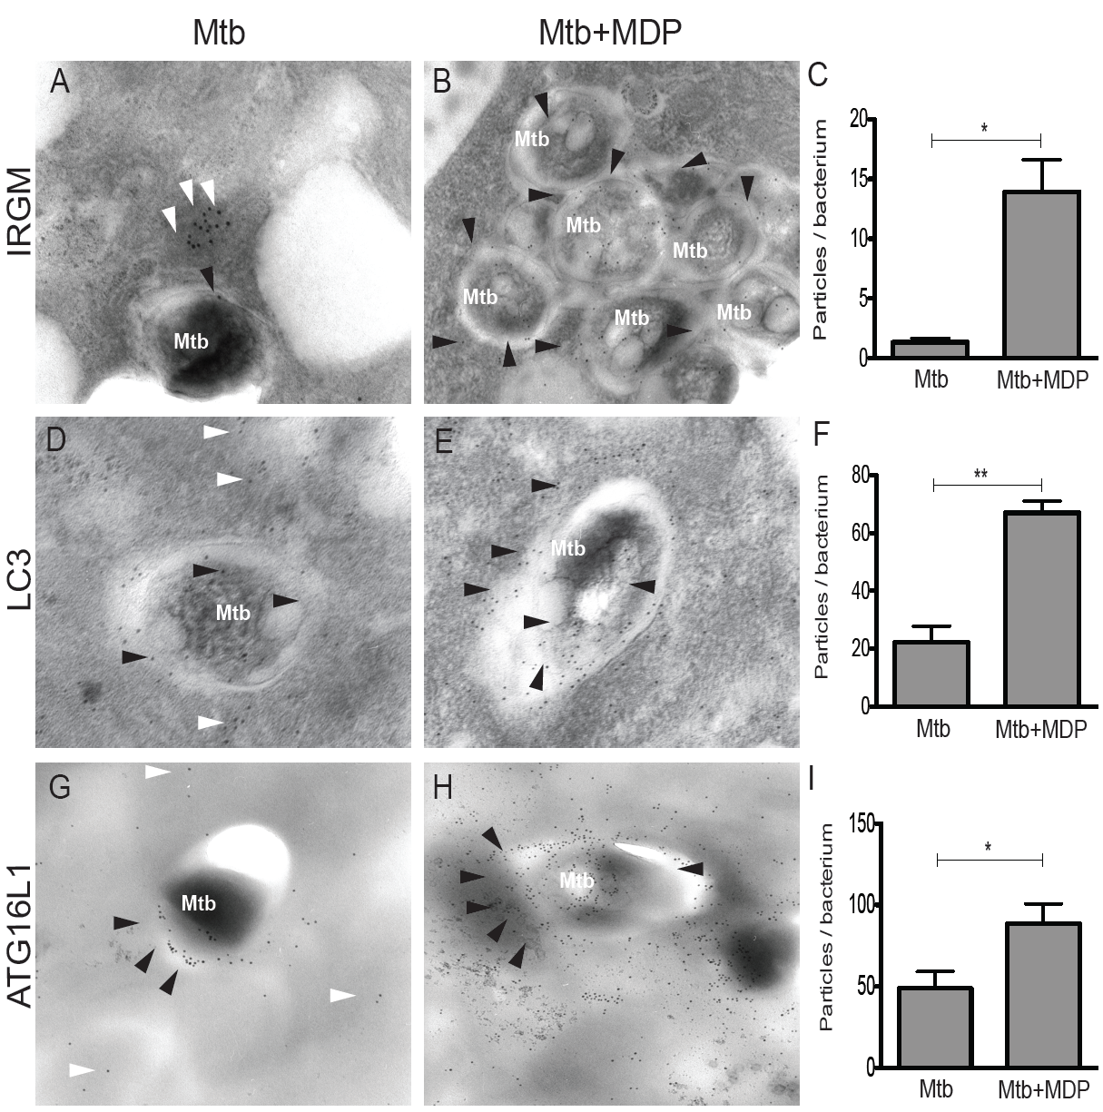

Slide 22
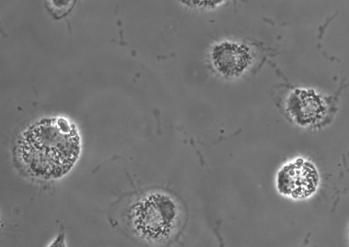
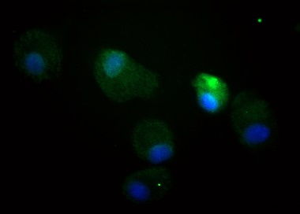
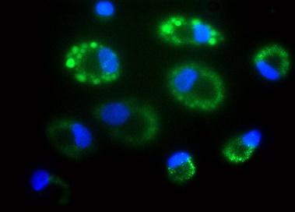
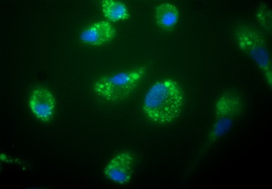
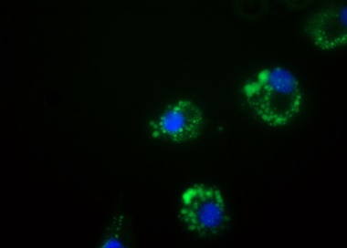
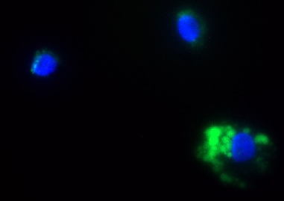
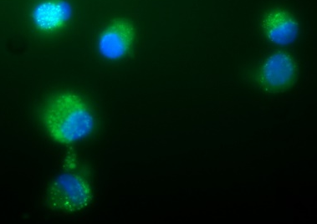
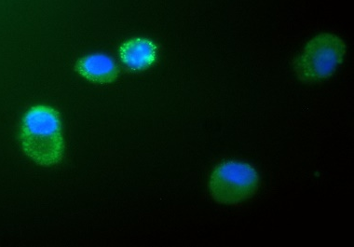
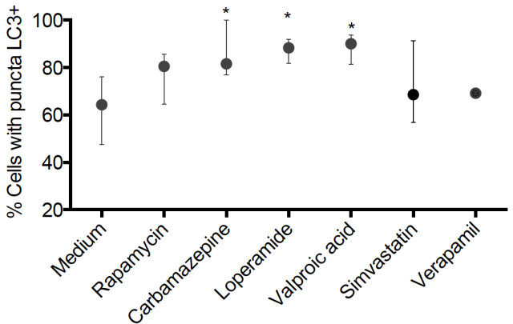
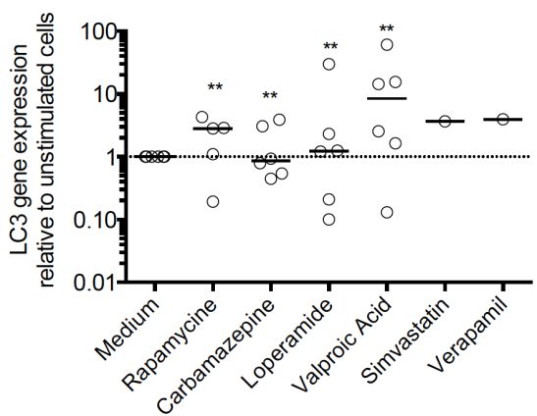
Figura 1.Los fármacos inducen un aumento en el número de macrófagos humanos que realizan autofagia
A
MEDIUM, phase contrast
MEDIUM
RAPAMYCINE
CARBAMAZEPINE
LOPERAMIDE
VALPROIC ACID
SIMVASTATIN
VERAPAMIL
LC3-DAYLIGHT 488
HOESCHT
B
C

Slide 23
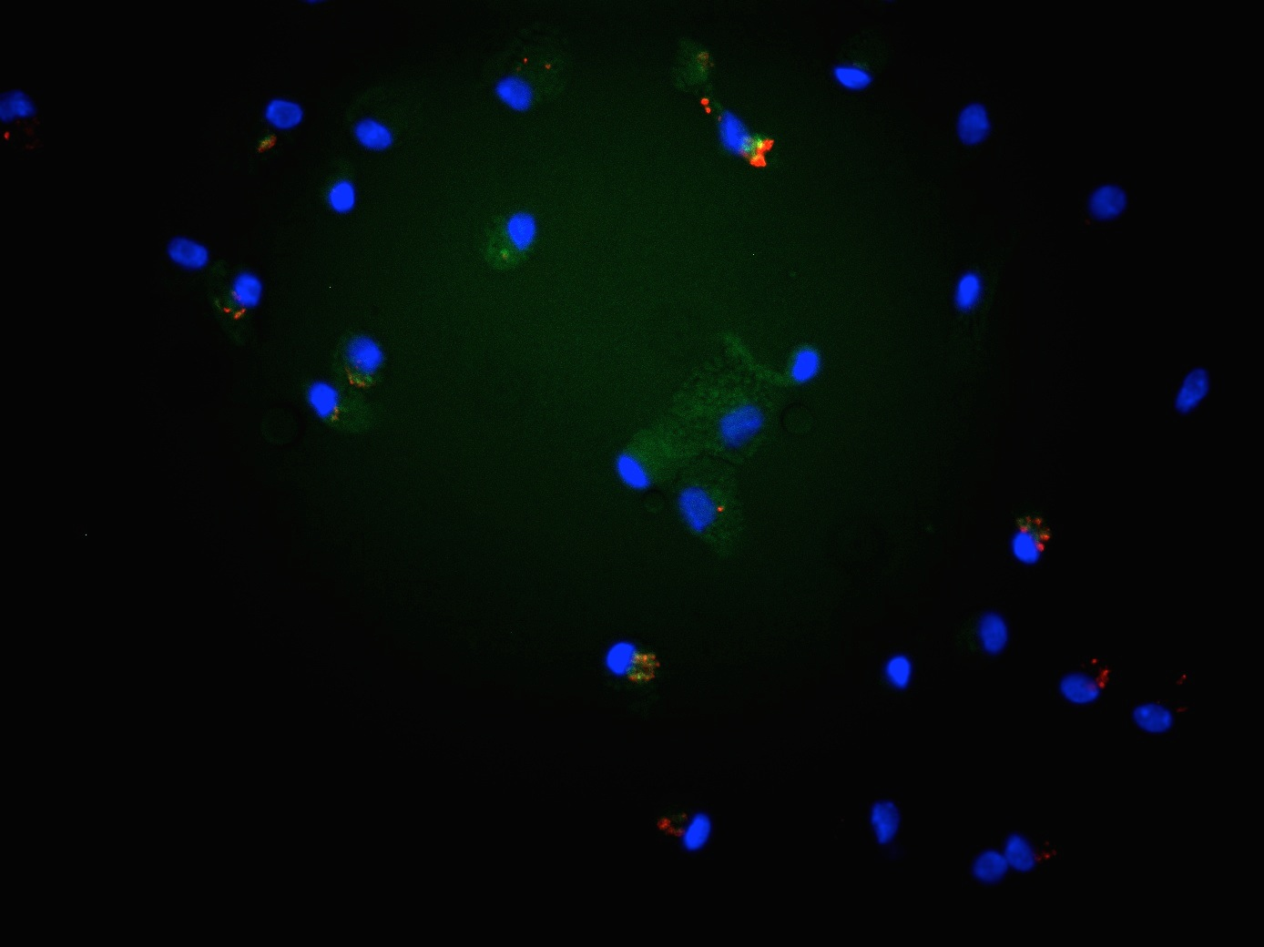
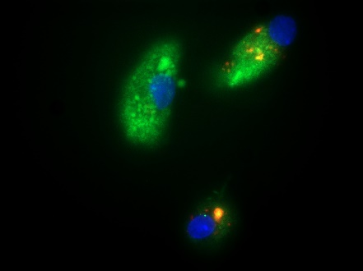

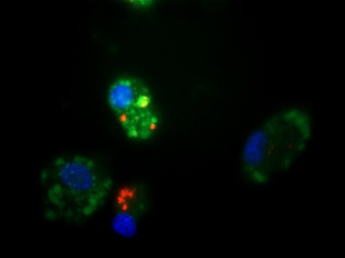
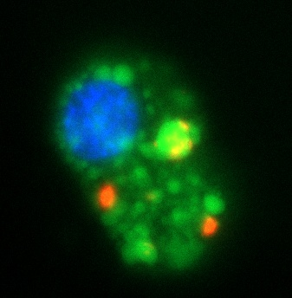
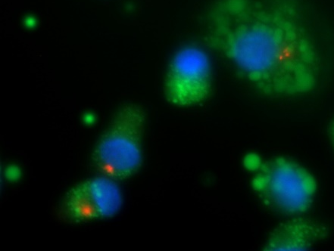

El tratamiento con fármacos favorece el reclutamiento de Mtb dentro de Autofagosomas
MTB
HOESCHT
LC3
MTB
MTB-LC3+
MTB+L
MTB+C
MTB+R

Slide 24
Conclusiòn
La TB MDR constituye un problema de salud o publica con un alto costo para los pacientes y para las instituciones de salud.
Existen nuevas drogas para el tratamiento de TB MDR lo que establece la posibilidad de una mejor manejo terapeutico de estos pacientes.
Se requieren nuevas ideas y alternativas terapeuticas en el tratamiento de Tuberculosis,.
Activadores de Autofagia
Terapia Genica ( péptidos antimicrobianos )
Terapia ( Celulas madre )

Slide 26
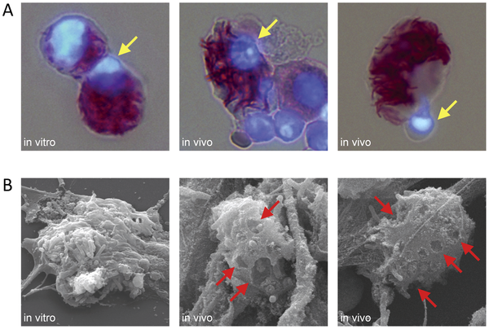

Figure 8. Morphology of macrophage cell death in pulmonary TB.
Repasy T, Lee J, Marino S, Martinez N, et al. (2013) Intracellular Bacillary Burden Reflects a Burst Size for Mycobacterium tuberculosis In Vivo. PLoS Pathog 9(2): e1003190. doi:10.1371/journal.ppat.1003190
http://www.plospathogens.org/article/info:doi/10.1371/journal.ppat.1003190

Slide 27
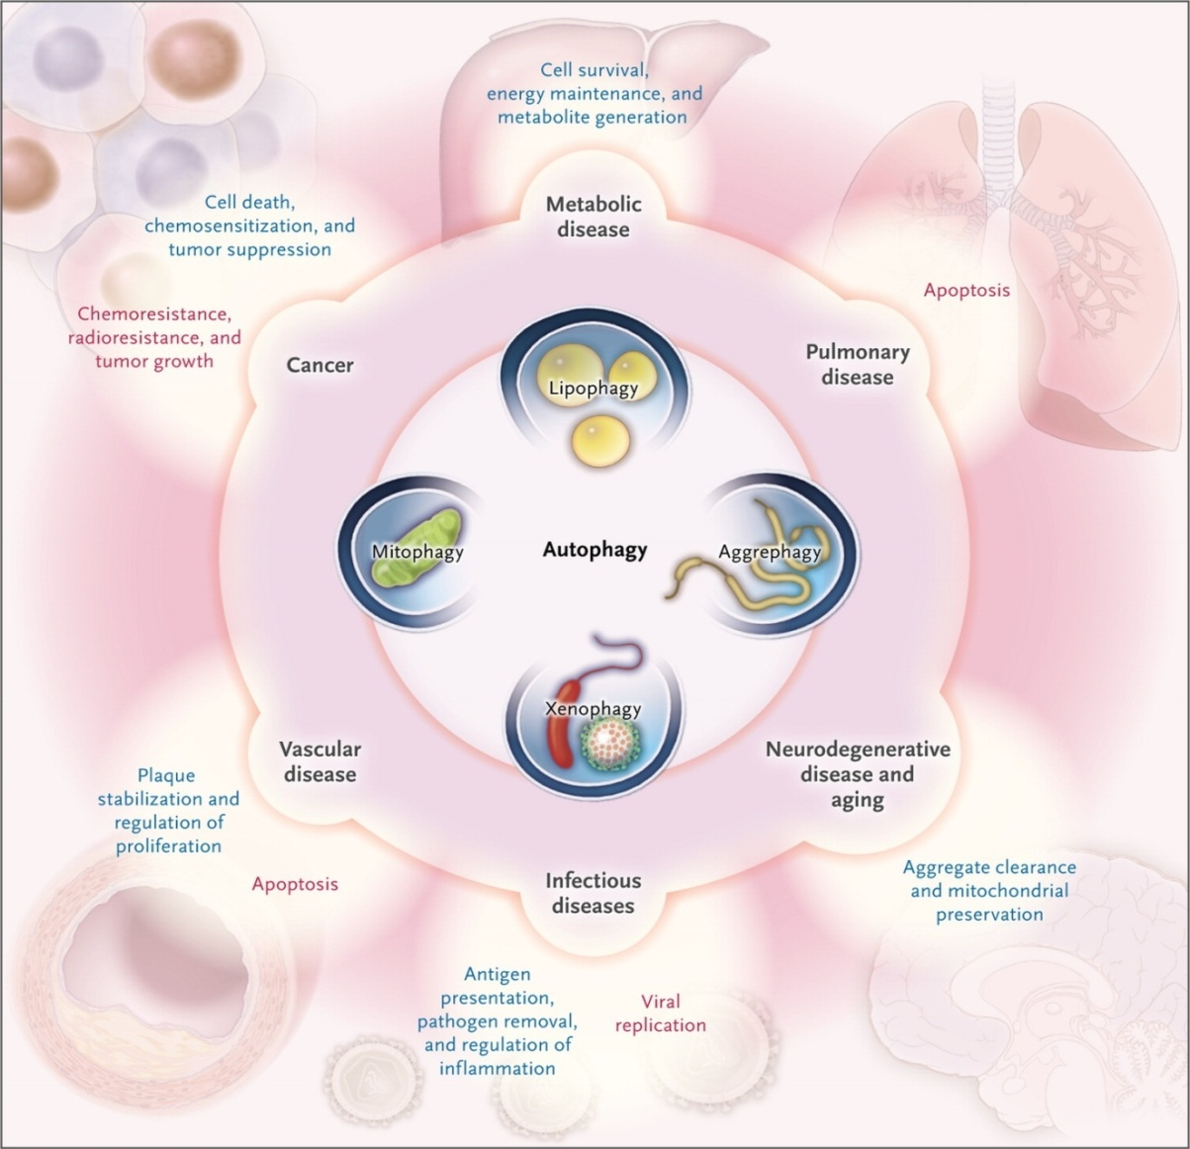
Effects of Autophagy on Disease Progression.
Choi AM et al. N Engl J Med 2013;368:651-662.
Notes:
Figure 3. Effects of Autophagy on Disease Progression. Autophagy influences a number of processes that have various effects on disease progression. Processes that are beneficial (i.e., that inhibit disease progression) are shown in blue, and those that are putatively detrimental (i.e., that promote disease progression) are shown in red. In many diseases, autophagy plays a common role that involves clearance of dysfunctional mitochondria and protein aggregates. The disease mechanisms discussed in this review may be related to the failure of autophagy to perform these functions. Additional mechanisms may include a role for autophagy in the regulation of cell death and proliferation, as shown in models of cardiac and lung diseases. In cancer, autophagy may prevent tumorigenesis but may also promote tumor-cell survival and tumor growth, thus variably affecting the efficacy of anticancer therapies. In infectious disease, autophagy plays a direct role in clearing intracellular pathogens (i.e., xenophagy) and is also involved in regulating inflammatory and immune responses. Regulation of lipid metabolism (lipophagy) is a newly identified function of autophagy that may be important in liver and metabolic diseases.

Slide 28
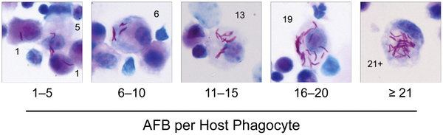
Figure 3. Enumeration of intracellular Mtb in lung phagocytes.
Repasy T, Lee J, Marino S, Martinez N, et al. (2013) Intracellular Bacillary Burden Reflects a Burst Size for Mycobacterium tuberculosis In Vivo. PLoS Pathog 9(2): e1003190. doi:10.1371/journal.ppat.1003190
http://www.plospathogens.org/article/info:doi/10.1371/journal.ppat.1003190

Slide 29
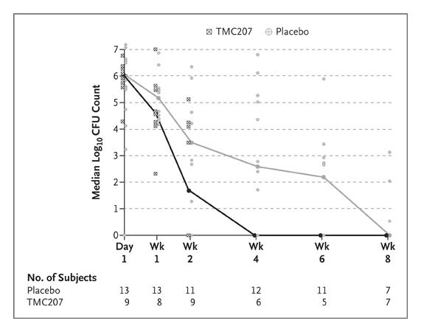
Median (±SD) Log₁₀ Count of Colony-Forming Units (CFUs)
Diacon AH et al. N Engl J Med 2009;360:2397-2405
Notes:
Figure 3. Median (±SD) Log₁₀ Count of Colony-Forming Units (CFUs). Median (±SD) log₁₀ CFU counts over time are shown in the subgroup of 22 patients who provided pooled-sputum samples.

Slide 30
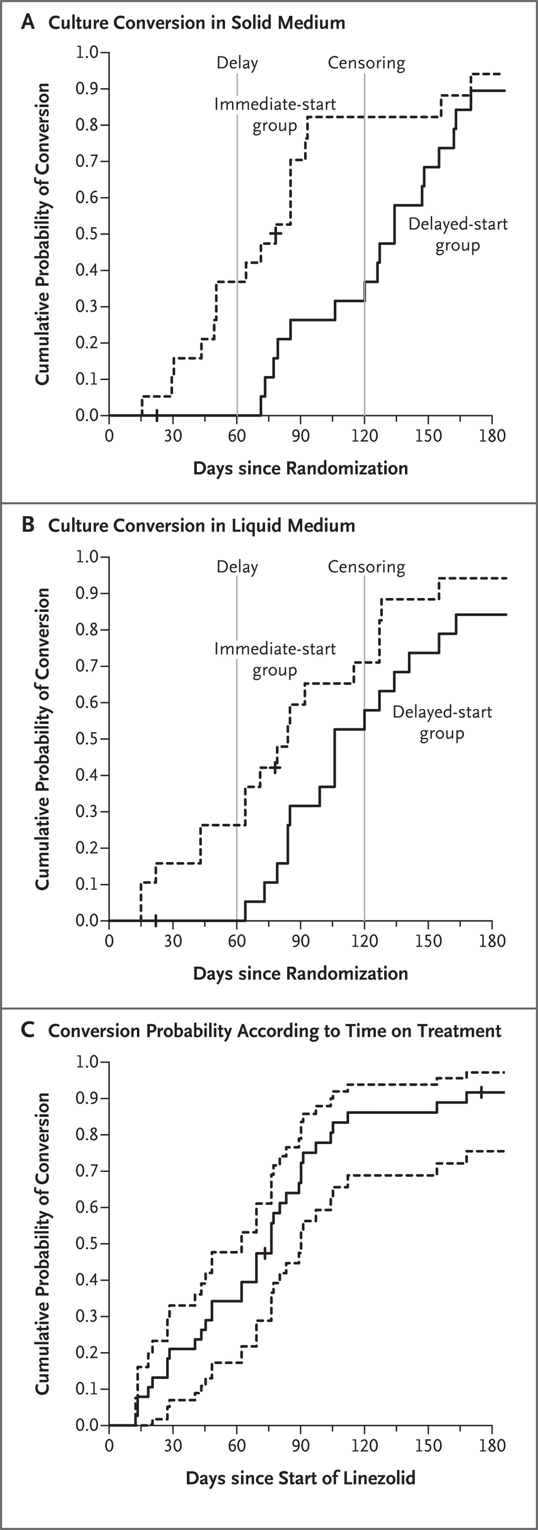
Kaplan–Meier Curves for Culture Conversion According to Time since Randomization.
Lee M et al. N Engl J Med 2012;367:1508-1518
Notes:
Figure 2 Kaplan–Meier Curves for Culture Conversion According to Time since Randomization. Panel A shows the results for solid culture medium, and Panel B the results for liquid culture medium. In both panels, the gray vertical lines indicate the start of treatment (at 2 months) in the delayed-treatment group and the time of data censoring (at 4 months). Panel C shows the time to culture conversion on solid medium (solid line) along with the 95% confidence interval (dashed lines) for the 38 participants who received linezolid, according to the duration of linezolid therapy. Tick marks indicate the censored observations at the time of the last follow-up visit with culture results.

Slide 31
Situación actual

Slide 32
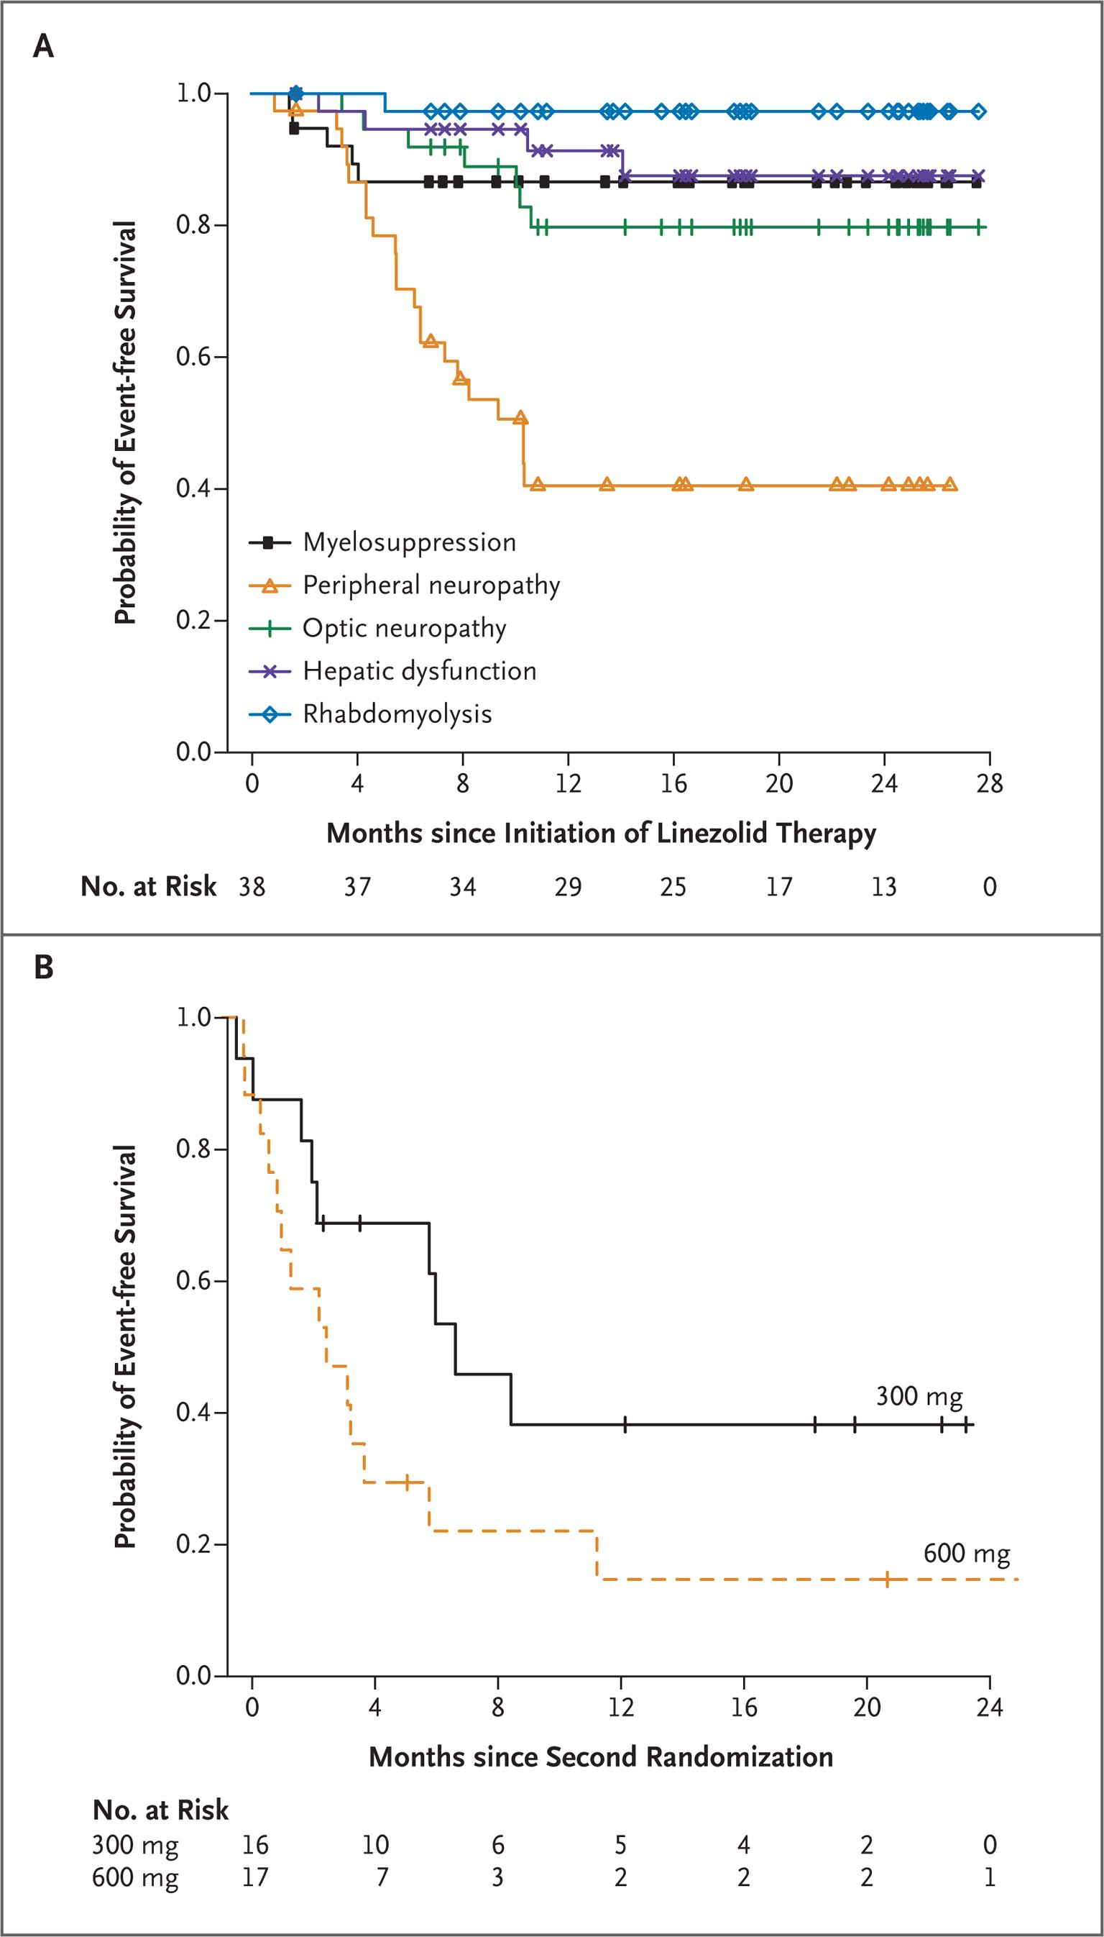
Probability of Event-free Survival over Time.
Lee M et al. N Engl J Med 2012;367:1508-1518
Notes:
Figure 3 Probability of Event-free Survival over Time. The Kaplan–Meier curves in Panel A show the time to the onset of clinically significant adverse events that resulted in a drug holiday or dose adjustment during the study. Symbols indicate data-censoring points for patients remaining in the study (see Table 3 in the Supplementary Appendix for detailed risk estimates corrected for person-years of exposure). The curves in Panel B show the time to the first adverse event in patients after the second randomization to either a continuation of the 600-mg daily dose or a reduced dose of 300 mg per day. Tick marks indicate data-censoring points for individual patients who continued to receive the study drug.

Slide 33
ESTUDIOS FASE III MDR
TMC-C210 NCT01600963 | Brazil, Cambodia, China, Colombia, Estonia, Korea, Latvia, Mexico, Peru, Phillipines, Russia, S Africa, Taiwan, Turkey, Ukraine, Vietnam | M (pre-X)DR-TB HIV −/+ | 9OB+J 9OB+placebo | Evaluate at 15 months: Proportion of patients with SCC
Otsuka NCT01424670 | Estonia, India, Latvia, Lithuania, Moldova, Peru, Phillipines, S Africa | MDR-TB HIV− (HIV+ sub-study) | 4OB+D 4OB+placebo | Evaluate at 2 and 6 months: Proportion of patients with SCC Time to SCC

Slide 34

Fármacos inductores de autofagia para controlar la infección por M. tuberculosis
Instituto Nacional de Enfermedades Respiratorias “Ismael Cosío Villegas”

Slide 35




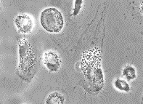




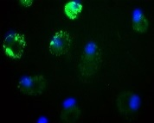



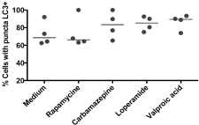

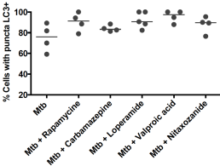
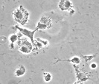
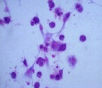
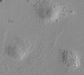
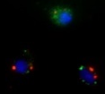

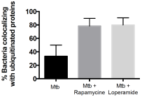

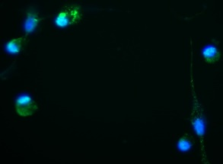
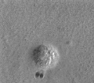
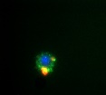
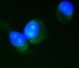
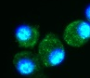
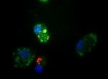

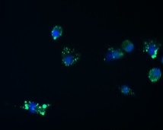






Pharmacological induction of autophagy in macrophages infected with Mycobacterium tuberculosis
Juárez E., Carranza C., Chávez J., Torres M. and Sada E.
National Institute of Respiratory Diseases. Mexico City
Introduction
Objective
Results
Tuberculosis is a major cause of morbidity and mortality in the world today. M. tuberculosis (Mtb) evade the phagosome-lyosome pathway and escape from macrophages bactericidal responses. Autophagy is a complex process that ultimately generates a degradative vesicle called autophagosome. Autophagy has been demonstrated to participate in the control of Mtb infection. Different drugs can induce autophagy, the best known is the immunosupresor drug Rapamycine but different drugs used for other medical problems have demonstrated to induce autophagy. These drugs include Nitazoxamide, Carbamazepine, Loperamide and Valproic Acid. In this project, we used an in vitro model of autophagy in human monocyte derived macrophages (MDM) and primary murine alveolar macrophages (AM) that were infected with Mtb H37Rv; we further examined the induction of autophagy and the containment of Mtb within the autophagosome.
To evaluate the induction of autophagy by Nitazoxanide, Carbamazepine, Loperamide and Valproic Acid in human MDM and murine AM with and without Mtb infection.
Treatment with Rapamycine 250 ng/ml, Loperamide 3 μM, Valproic Acid 1 μM, and Carbamazepine 0.5 μM induced autophagy in MDM. Nitazoxanide did not induce autophagy at concentrations between 1 to 50 μM. qPCR analysis confirmed that all four drugs increased gene expression of typical autophagy marker LC3 (Fig. 1). Autophagy was confirmed by inmunofluorescence microscopy (presence of LC3+ puncta in Fig. 2). In infected MDM, Mtb colocalized with LC3 and ubiquitin following treatment with rapamycin, loperamide, carbamazepine and valproic acid (Fig.3). Rapamycin, loperamide and carbamazepine induced autophagy in alveolar macrophages from mouse lung homogenates. Infected AM also showed confinement of Mtb within autophagosomes after treatment (Fig.4).
Methods
Drug
MDM/AM
24 h
Autophagy evaluation
Drug
Mtb 5:1
MDM/AM
24 h
24 h
Autophagy evaluation
Autophagosomes detection by flow cytometry and fluorescence microscopy (LC3 and/or ATG16L1). Colocalization of Mtb with LC3 and ubiquitin. Gene expression of LC3 and IRGM by qPCR.
A
Carbamazepine
B
Carbamazepine
MEDIUM
RAPAMYCINE
B
A
Loperamide
Conclusion
Valproic acid
Loperamide
Loperamide, valproic acid and carbamazepine were inducers of autophagy that helped contain Mtb within autophagosomes in human and murine macrophages.
These results are a first step of a project that evaluates pharmacological induction of autophagy as adjuvant therapy for tuberculosis.
Median fluorescence intensity relative to
that of unstimulted cells
Fold change LC3 gene expression
CARBAZEPINE
LOPERAMIDE
C
Nitaxozanide
Valproic acid
μM
Rapamycine
μM
HOESCHT
LC3
eduardosadadiaz@yahoo.com
ejuarez@iner.gob.mx
B
ng/ml
Figure 2. Autophagy induction in MDM. Cells were stimulated with rapamycine (250 ng/ml), carbamazepine (0.5μM) and loperamide (3μM) and valproic acid (1μM, not depicted) for 24h. A) The presence of LC3+ vesicles (puncta) evidenced autophagy. Cells were stained with anti-LC3-FITC and nucleus with Hoescht. Magnification 1000x. B) Phase contrast image, 1000x. C) Percentage of cells with LC3 puncta, medians are indicated.
Figure 1. Capability of the study drugs to induce autophagy in human macrophages. Cells were stimulated with increased concentrations of the indicated drugs for 24h and the formation of vesicles was determined by flow cytometry. A) Median fluorescence intensity relative to the unstimulated cells. B) LC3 gene expression relative to that of unstimulated cells measured by qPCR. Mean ± SE of 3 independent experiments.
A
HOESCHT, LC3
MTB, MTB-LC3+
A
C
HOESCHT, LC3
MTB, MTB-LC3+
Mtb
Mtb
Phase contrast
C
Mtb + Loperamide
B
Mtb + Loperamide
MEDIUM
RAPAMYCINE
LOPERAMIDE
ATG16L1
Mtb +
Carbamazepine
Mtb + Carbamazepine
LC3
Mtb +
Rapamycine
Figure 3. Autophagy induction in infecetd MDM. Cells were infected with Mtb H37Rv for 24h followed by treatment with rapamycine (250 ng/m), carbamazepine (0.5μM) and loperamide (3μM), nitaxozanide (10μM) and valproic acid (1μM) for another 24h. A) The presence of LC3+ vesicles was evaluated and quantitated. Cells were stained with anti-LC3-FITC, Mtb and ubiquitin (not depicted) were detected with specific antibodies revealed with Alexa 495 and nucleus with Hoescht. Magnification 1000x. B) Colocalization of Mtb with LC3 (B) and ubiquitin (C), medians are indicated.
HOESCHT
Figure 4. Induction of autophagy in murine alveolar macrophages (AM). AM were isolated from lung homogenates (A) and stimulated with rapamycine, carbamazepine and loperamide for 24h, autophagy was detected using anti ATGC16L1-DayLight 488 or LC3-FITC .Magnification 100x. (B). AM were infected with MtbH37Rv for 24h followed by treatment with the indicated drugs for another 24h. Confinement of Mtb within autophagosomes was detected as described in fig.3 legend (C). Representative of 4 independent experiments.

Slide 37
ESTUDIOS FASE III ACORTADOS 4 MESES
PROYECTO | PAIS | POBLACION | ESQUEMA | OBJETIVOS
RIFAQUIN | S Africa, Zimbabwe, Zambia, Mozambique | DS-TB HIV−/+(CD4>200/μl) | 2RMZE→2Rp_{15/20mg/kg}M[x2/wk] 2RHZE→4RH | Evaluate at 18 months: Clinical failure/relapse
OFLOTUB NCT00216385 | Benin, Guinea, Kenya, Senegal, S Africa | DS-TB HIV−/+ | 2RHPG→2RHG 2RHZE→4RH | Evaluate at 30 months: Clinical failure/relapse
REMoxTB NCT00864383 | China, India, Kenya, Malaysia, Mexico, S Africa, Tanzania, Thailand, Zambia | DS-TB HIV−/+ | 2RHZM→2RHM 2RMZE→2 RM 2RHZE→4RH | Evaluate at 18 months: Clinical failure/relapse

Slide 38


Slide 39
Original Article
Linezolid for Treatment of Chronic Extensively Drug-Resistant Tuberculosis
Myungsun Lee, M.D., Jongseok Lee, Ph.D., Matthew W. Carroll, M.D., Hongjo Choi, M.D., Seonyeong Min, R.N., Taeksun Song, Ph.D., Laura E. Via, Ph.D., Lisa C. Goldfeder, C.C.R.P., Eunhwa Kang, M.Sc., Boyoung Jin, R.N., Hyeeun Park, R.N., Hyunkyung Kwak, B.S., Hyunchul Kim, Ph.D., Han-Seung Jeon, M.S., Ina Jeong, M.D., Joon Sung Joh, M.D., Ray Y. Chen, M.D., Kenneth N. Olivier, M.D., Pamela A. Shaw, Ph.D., Dean Follmann, Ph.D., Sun Dae Song, M.D., Ph.D., Jong-Koo Lee, M.D., Dukhyoung Lee, M.D., Cheon Tae Kim, M.D., Veronique Dartois, Ph.D., Seung-Kyu Park, M.D., Sang-Nae Cho, D.V.M., Ph.D., and Clifton E. Barry, III, Ph.D.
N Engl J Med
Volume 367(16):1508-1518
October 18, 2012

Slide 40



Slide 41
Bedaquiline is the first new TB drug since the introduction of rifampin in 1970.

