Slide 1

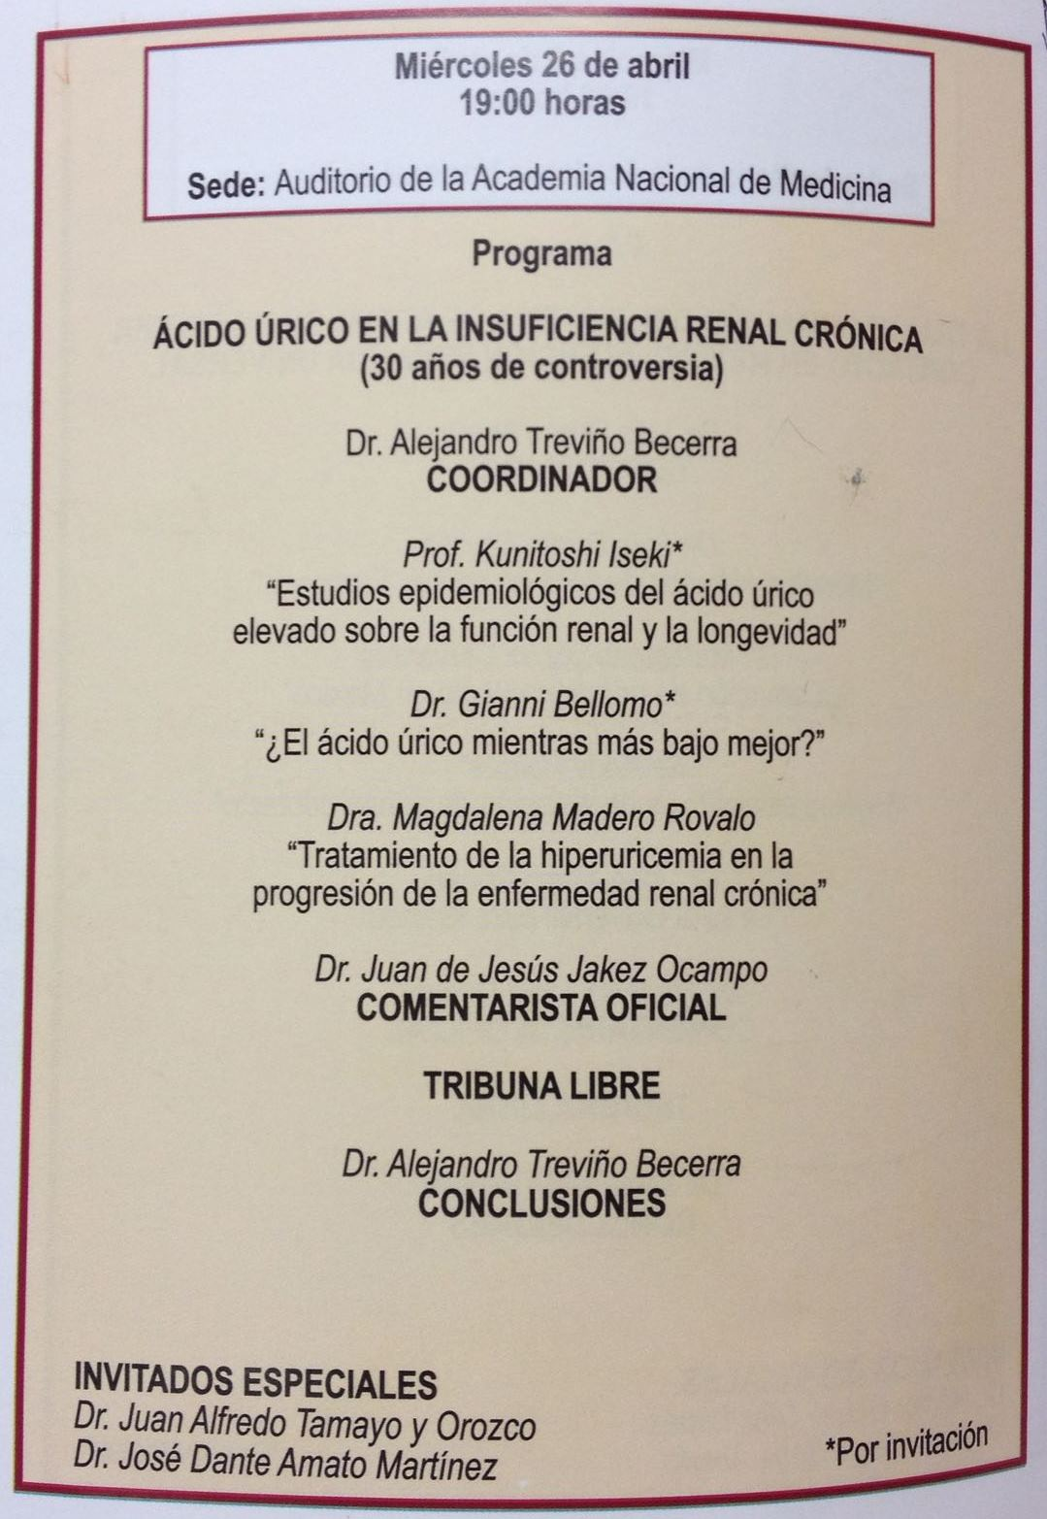
A. Treviño

Slide 2
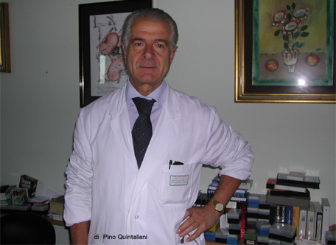
In Memoriam Prof. Umberto Buoncristiani
Perugia, Italia, 1940-2016

Slide 3
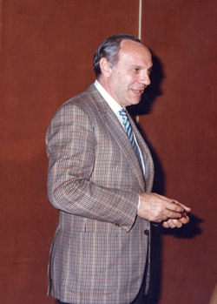
In Memoriam - Prof. Carmelo Giordano
1930-2016 NAPOLES, ITALIA

Slide 4
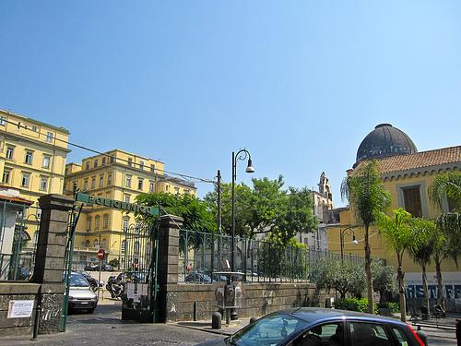
THE POLICLINICO IN MIRAGLIA SQUARE
(that was then destroyed by the earthquake of Nov 23, 1980).

Slide 5
Various creative clinical scientists worked during sabbaticals at the nephrological unit directed by Prof. Carmelo Giordano. The fist— Prof. Kazimierz Backzyk―who was later professor of Nephrology at the Medical University of Poznan (Poland) —arrived in Naples just in the days in which Eastern Europe was separated from the West with the construction of the wall in Berlin (Germany). Prof. Malcolm E. Phillips came to Naples from London as a Wellcome Trust Research Fellow for 2 years. His fellowship was arranged between Professors Hugh de Wardener and Carmelo Giordano. He studied amino acid losses and the effects of essential amino acid supplements in hemodialysis patients and the utilisation of D-amino acids and keto-acids in healthy and uremic patients (Lancet 1972). Later, when back in London, (Dr). Phillips was for varying periods General Manager of the Charing Cross Hospital and Medical Director of the Charing Cross and Hammersmith Hospitals. Prof. Otto Busato came from the department of nephrology at the University of Porto Alegre (Brazil) to work on nutrition and peritoneal dialysis. Also Prof. Alejandro Trevino Becerra came with the same goal and subsequently remained―as it is evident― anchored to the topic life-long. Prof. Francisco Gonzalez, Chair of Medicine and chief of nephrology at Louisiana State university during his stay attracted many young investigators to acid base balance in HD and PD and focused his research on pharmacological means to augment peritoneal dialysis clearances. The list of visiting scientists includes Professors Karl Julius Ullrich, Shaul Massry, Klaus Hierholzer, Gerhard Malnic, and Willem Kolff who was attracted by the use of sorbents for wearable kidney. In fact Prof. Giordano with Professors Yatzidis, Chang and Friedman introduced the use sorbents in medicine. The monograph on Sorbents and their clinical applications (Academic Press, New York 1980) is the outcome of such interest. The Group of Sorbents for Portable-Wearable kidneys was coordinated by Professor Renato Esposito (professor of nutrition and included Professors Giovanni Demma, Piero Bello (both Doctors in Chemistry), Prof. Ernst Quarto (bioengineer) and Prof. Giacomino Randazzo (Professor of Biochemistry), and finally also Doctor Norina Lanzetti (a nephrologist). They synthesized oxystarch and oxycellulose to be used orally (alone or in combination with charcoal) or for regeneration of dialysis fluid in wearable-portable kidneys. Both substances were potent binders for urea, and other nitrogenous waste products. Professors Esposito, Bello and Quarto also hypothesized the advent of inert material used for hydroponic cultivations to reabsorb water in human gastrointestinal tract. A field now in progress in many international laboratories.

Slide 6
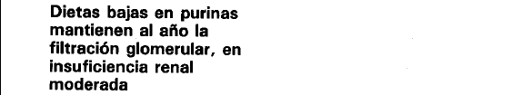
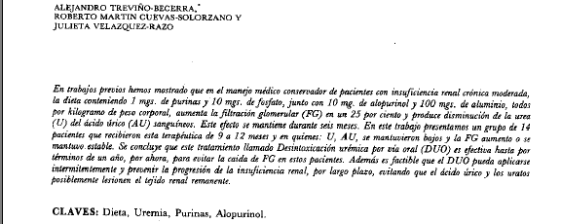
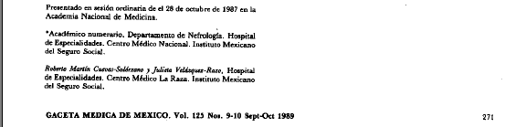
TOXICITY OF HYPERURICEMIA (HyU) IN CHRONIC RENAL FAILURE

Slide 7
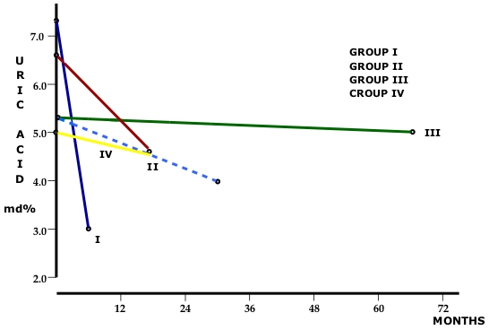
TOXICITY OF HYPERURICEMIA (HyU) IN CHRONIC RENAL FAILURE
BLOOD URIC ACID CORRELATION, WITH LOW PURINE DIET AND ALOPURINOL
Dr. A. Treviño-Becerra

Slide 8
TOXICITY OF HYPERURICEMIA (HyU) IN CHRONIC RENAL FAILURE
Four publications were reviewed. Results
Uric Acid (mg)
Pt
Months
B
F
14 (1)
6
7.2 +- 2.8
2.9 +- 1.8
(1985)
14 (2)
2
6.7 +- 3.0
4.5 +- 1.7
12 (3)
66
5.3 +- 1.6
4.8 +- 2.3
49 (4)
24
6.5 +- 4.7
4.7 +- 1.9
89
X 23
6.4 +- 2.3
4.2 +- 1.9
B: baseline
F: final
-35%
(1-4) Dr. A. Treviño-Becerra

Slide 9
TOXICITY OF HYPERURICEMIA (HyU) IN CHRONIC RENAL FAILURE
Results
(1-4) Dr. A. Treviño-Becerra

Slide 10
TOXICITY OF HYPERURICEMIA (HyU) IN CHRONIC RENAL FAILURE
FLUJO PLASMATICO (HIPURAN I¹³¹) EN SIETE PACIENTES CON NEFRECTOMIA UNILATERAL ANTES Y DESPUES DE LAS DIETAS SIN PURINAS
Pacientes | Basal | Final | Aumento
 | ml/min. | ml/min. | %
1 | 419 | 416 | 0
2 | 447 | 464 | 4
3 | 490 | 547 | 12
4 | 431 | 621 | 44
5 | 262 | 392 | 50
6 | 428 | 454 | 6
7 | 122 | 196 | 60
m | 371 | 441 | 25
DS | 131 | 135
P | <0.0025
Nefrología Mexicana, Vol. 13, No. 1, 1992:pp 18

Slide 11
TOXICITY OF HYPERURICEMIA (HyU) IN CHRONIC RENAL FAILURE
UREMIC SYMPTOMS
 | 1 | 2 | 3 | 4 | 5 | 6 | 7 | TOTAL
HALITOSIS | - | + | - | + | - | + | - | 3
DISTASTE | - | + | - | + | - | + | - | 3
ANOREXY | - | + | - | + | - | ++ | - | 4
SICKNESS | - | + | + | + | - | - | - | 3
VOMITING | - | + | - | + | - | - | - | 2
ASTHENIA | - | + | + | ++ | - | - | - | 4
COLD INTOLERANCE | - | + | - | ++ | - | - | - | 3
TOTAL 22 | 0 | 7 | 2 | 9 | 0 | 4 | 0 | 22
A
B
 | 1 | 2 | 3 | 4 | 5 | 6 |  | TOTAL
HALITOSIS | ++ | - | + | ++ | + | + |  | 7
DISTASTE | ++ | - | + | ++ | + | + |  | 7
ANOREXY | - | - | - | ++ | + | - |  | 4
SICKNESS | + | - | - | ++ | ++ | - |  | 5
VOMITING
ASTHENIA | - | - | - | ++ | + | - |  | 3
COLD INTOLERANCE | - | - | - | ++ | + | - |  | 3
TOTAL 31 | 6 | 0 | 2 | 12 | 9 | 2 |  | 29

Slide 12
TOXICITY OF HYPERURICEMIA (HyU) IN CHRONIC RENAL FAILURE
FACTORS THAT PRODUCE HyU IN CRF
DECREASE GLOMERULAR FILTRATION
DIURETICS
METABOLIC ACIDOSIS
MALNUTRITION-CAQUEXIA
HIGH PROTEINS OR PURINE DIETS
CATABOLISM
KETOACIDS
OTHERS
Dr. A. Treviño-Becerra

Slide 13
ERRORES FRECUENTES DEL MANEJO DEL ACIDO URICO EN LA ERC
No medir acido úrico en sangre, ni en orina
Desnutrición y deshidratación del enfermo
Aumentar proteína vegetal y suprimir animal
No calcular productos acido úrico y fosforo
Emplear colchicina y uricosuricos
No prescribir alopurinol o prescribirlo a dosis ”Homeopaticas”
Suspender alopurinol cuando se inicia el descenso de A.U. y mantener al A.U. alto
No advertir sobre sus efectos secundarios
A. Treviño

Slide 14
A. Treviño

Slide 15
A. Treviño

Slide 16

TOXICITY OF HYPERURICEMIA (HyU) IN CHRONIC RENAL FAILURE
DR. ALEJANDRO TREVIÑO-BECERRA
DIRECTOR RESEARCH AND TEACHING DEPT.
HOSPITAL JUAREZ DE MÉXICO, O.D. SSA
MÉXICO, D.F.

