Slide 1


Dear colleagues,
unfortunately, due to declining health status, I am unable to take part in this exciting scientific event, however, I am sure dr.Alejandro TreviÑ0 will do a great job in my place. I wish you all a fruitful and productive meeting
Gianni Bellomo

Slide 2
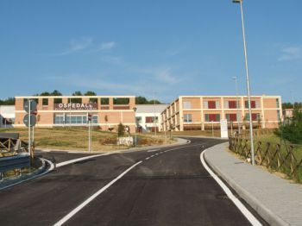
URIC ACID AND THE KIDNEY, THE LOWER THE BETTER?
Dr.Gianni Bellomo, Department of Nephrology MVT Hospital, USL Umbria 1, Todi, Italy

Slide 3
The answer to the title question is not easy to provide…..

Slide 4
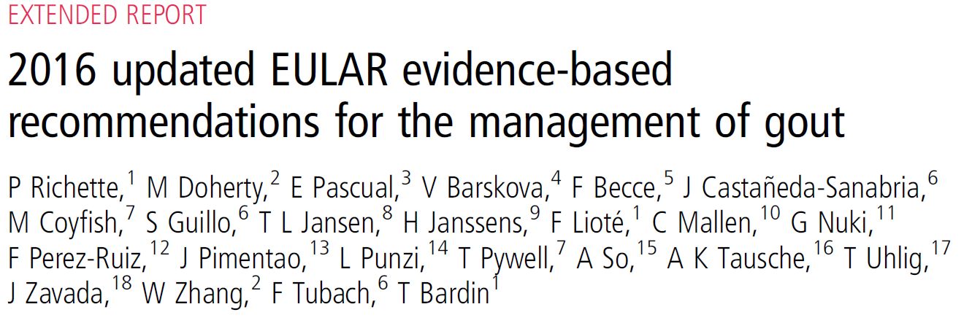
For patients on ULT, SUA level should be monitored and maintained to <6 mg/dL (360 mmol/L). A lower SUA target (<5 mg/dL; 300 mmol/L) to facilitate faster dissolution of crystals is recommended for patients with severe gout (tophi, chronic arthropathy, frequent attacks) until total crystal dissolution and resolution of gout.
Notes:
In patients with gout, the guidelines from EULAR suggest a lower target UA for patients with severe gout

Slide 5
…..BUT WHAT ABOUT THE KIDNEY AND RENAL DISEASE?
In this case what we really need is a treatment to target trial, comparing prospectively the renal benefits achieved at different UA targets. The following slide proposes a crude outline of how such a study could be formulated

Slide 6
Hyperuricemia yreatment to target trial
No intervention
Target UA
<6.0 mg/dl
Target UA
<4.0 mg/dl
Intervention:
XOI, uricosuric, urate oxidases, diet….
5 yrs
5 yrs
eGFR(CKD-EPI)
eGFR(CKD-EPI)
Notes:
Just a schematic diagram of the study

Slide 7
What do we expect from this study?
….We might be able to conclude that uric acid is a renal risk factor and that lowering its levels provides renal benefits proportional to the degree of its lowering, if…

Slide 8
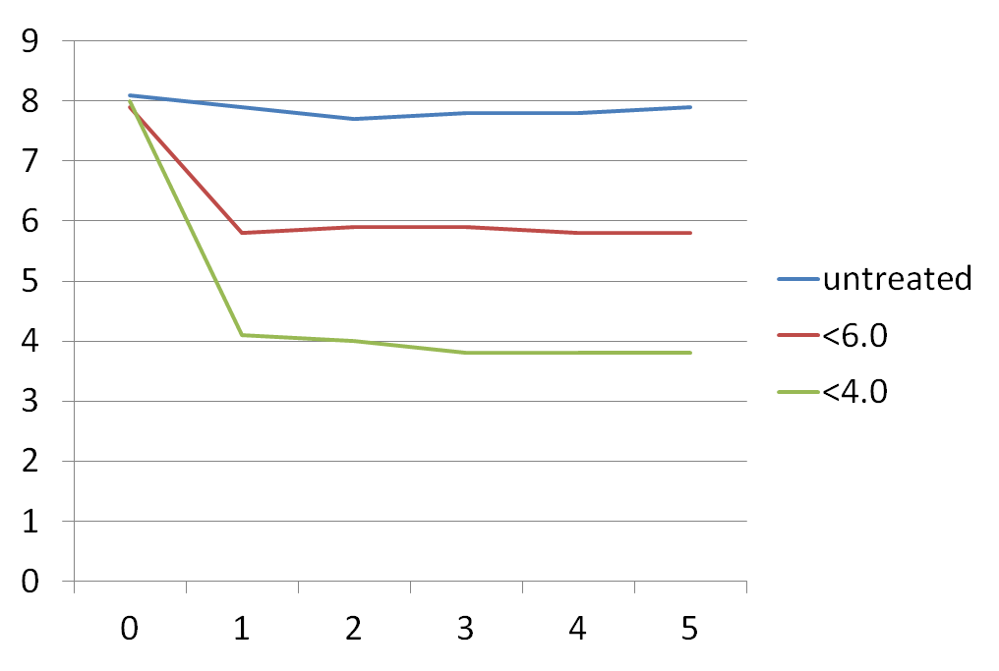
…if the target UA levels are actually achieved…
Serum UA,mg/dl
Time from baseline(yrs)

Slide 9
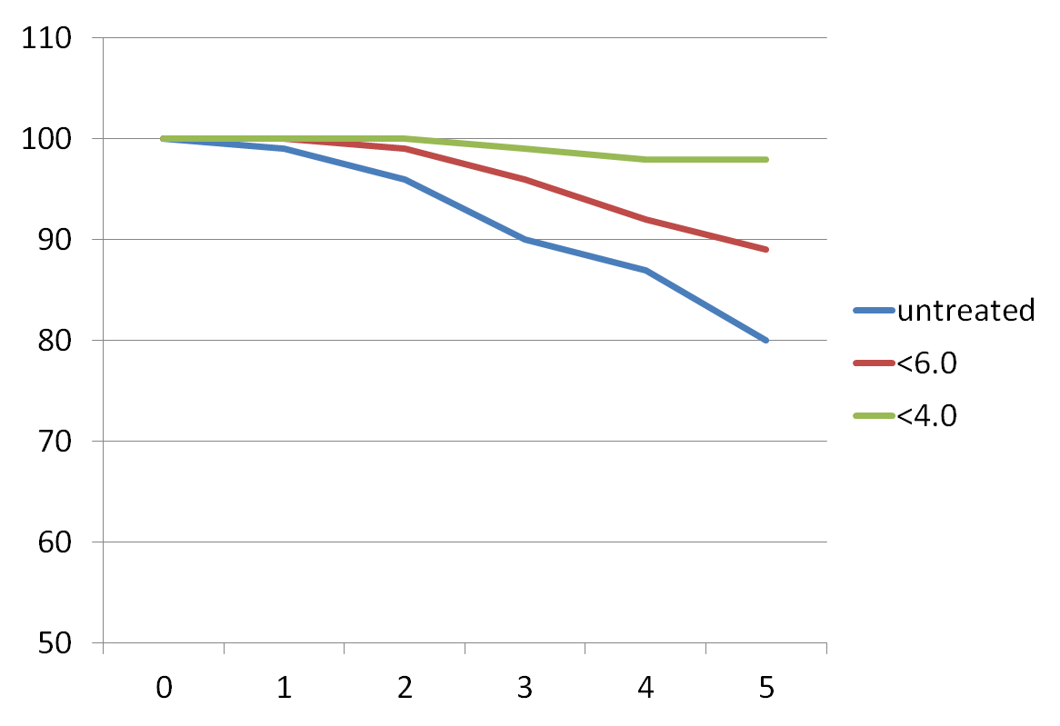
…if eGFR is better preserved with decreasing UA levels
eGFR, ml/min
Time from baseline(years)

Slide 10
… if eGFR change is comparable in subjects treated with XOi and other hypouricemic agents, thus indicating that the effect is due to UA reduction, and not to XO inhibition per se
XOi
Other hypouricemic agents
eGFR(ml/min)
Time from baseline(yrs)

Slide 11
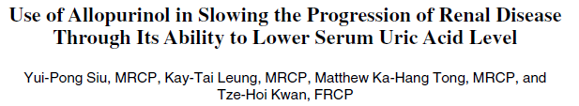
Country(year): Taiwan(2006)
Population studied(n): CKD 3-4(n=54)
Intervention: allopurinol 100-300 mg vs usual therapy
Length of observation: 1 year
Study outcome: reduced BP, slowing serum creatinine increase
Serum UA: allopurinol 9.75→5.88, control 9.92→10.08
Notes:
In this study from Taiwan of patients with CKD, allopurinol treatment led to a slower decrease of renal function, achieved UA 5.88 mg/dl

Slide 12
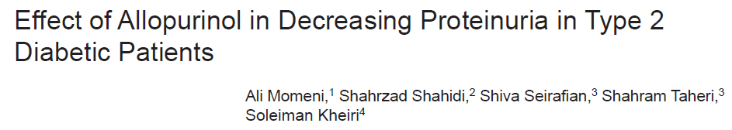
IJKD 2010;4:128-32
www.ijkd.org
Country(year): Iran(2010)
Population studied(n): type 2 DM with nephropathy(proteinuria +serum creatinine <3.0 mg/dl,n=40)
Intervention: allopurinol 100 mg vs placebo
Length of observation: 4 months
Study outcome: reduction of proteinuria in intervention group
Serum UA: intervention 5.96→5.31, control 6.50→6.44 mg/dl
Notes:
In this study from Iran 4 months of treatment with allopurinol in type 2 diabetics led to a reduction of proteinuria, target UA achieved slightly above 5 mg/dl

Slide 13
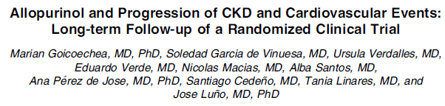
Country(year): Spain (2015)
Population studied(n): CKD 3(n=113)
Intervention: allopurinol 100 mg
Length of observation: 7 years
Study outcome: slowing of eGFR decline, reduced incidence of renal events
Serum UA: intervention 7.8→6.6, control 7.3→7.1 mg/dl
Notes:
In this 7-year follow-up of the study of Goicoechea renal benefit was maintained in the treatment arm of the study, at UA levels 6.6 mg/dl

Slide 14
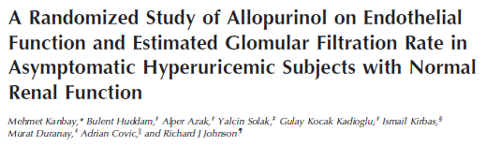
Country(year): Turkey(2011)
Population studied(n): asymptomatic hyperuricemia(n=97)
Intervention: allopurinol 300 mg, vs no treatment
Length of observation: 4 months
Study outcome: reduced BP, increased eGFR in allopurinol group
Serum UA: allopurinol 8.3→5.8, control 7.9→7.2 mg/dl
Notes:
In this study from Turkey(hyperuricemic subjects withou CKD), allopurinol treatment led to increased eGFR and reduced blood pressure, achieved UA levels 5.8 mg/dl

Slide 15
Indian Journal of Nephrology
Medknow Publications
Allopurinol for prevention of progression of kidney disease with hyperuricemia
B. H. Santhosh Pai, G. Swarnalatha, [...], and K. V. Dakshinamurty
Country(year): India(2013)
Population studied(n): CKD, stage 3-4(n=183)
Intervention: allopurinol 100 mg vs no treatment
Length of observation: 2 years
Study outcome: reduction of blood pressure and CKD progression in treated group
Serum UA: intervention 9.1→5.3mg/dl, control 9.2-9.9 mg/dl
Notes:
In this study from India in patients with CKD, allopurinol treatment led to a reduction of blood pressure and slower eGFR decline, UA levels achieved 5.3 mg/dl

Slide 16
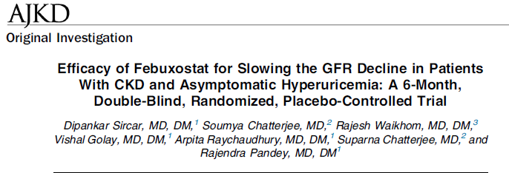
Am J Kidney Dis. 66(6):945-950. ª 2015 by the National Kidney Foundation, Inc.
Country(year): India(2015)
Population studied(n): CKD 3-4(n=93)
Intervention: febuxostat 40 mg vs placebo
Length of observation: 6 months
Study outcome: slowing of eGFR decline in febuxostat group
Serum UA: intervention 9.0→5.2 control 8.2→7.8 mg/dl
Notes:
In this study from India a renal benefit was achieved with febuxostat 40 mg once a day, over as short a follow-up as 6 months. Target UA levels slightly above 5.0 mg/dl

Slide 17
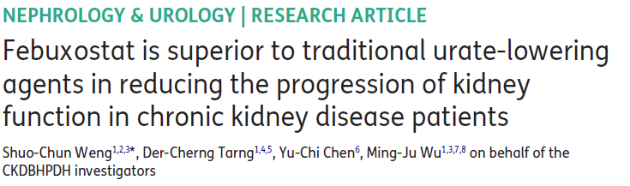

Country(year):Taiwan(2016)
Population studied(n): CKD (n=2460)
Intervention: febuxostat “ab initio” (n=40), conversion to febuxostat from other urate lowering treatments(oULT n=206), vs oULT continued, n=2214
Length of observation: 1 year
Study outcome: slowing of eGFR decline in febuxostat and conversion groups compare to oULT
Serum UA: febuxostat 9.45→6.7, conversion 8.5→6.3. oULT 7.2→ 7.0 mg/dl
Notes:
In this study from Taiwan CKD patients treated “ab initio” or who were shifted to febuxostat from other hypouricemic treatments, had a better renal outcome. Target UA achieved between 6.3 to 6.7 mg/dl

Slide 18
WORK IN PROGRESS
PERL study( www.perl-study.org): USA, Canada, Denmark; RCT of allopurinol vs placebo, patients with type 1 diabetes, 3 years. Primary outcome measure: change in i(iohexol)GFR.
FREED study(Journal of Cardiology 66 (2015) 298–303 ): Japan, RCT of febuxostat vs allopurinol in elderly population(>65 yrs), 3 years. Primary outcome measure: composite of cerebral, cardiovascular, and renal events, and all deaths including death due to cerebral, cardiovascular, and renal disease, new or recurring cerebrovascular disease, new or recurring non-fatal coronary artery disease, cardiac failure requiring hospitalization, arteriosclerotic disease requiring treatment, renal impairment, new atrial fibrillation, and all deaths other than cerebral or cardiovascular or renal disease
Notes:
Two ongoing studies, one performed in type 1 diabetics(allopurinol vs placebo), the other in an elderly Japanese population(febuxostat vs allopurinol) are likely to provide important results

Slide 19
Despite the heterogeneity of the intervention study, a beneficial renal effect was achieved at an average serum uric acid level consistently above 5.0, and often 6.0 mg/dl.
So, from a renal standpoint,there is no compelling evidence to overtreat hyperuricemia, and given the results of the intervention studies, a target serum UA between 5.0 and 6.0 mg/dl, seems reasonable

Slide 20
…and now, what about hypouricemia?
When is “low” too low?
<3.0 mg/dl?
<2.0 mg/dl?
Is it harmful?

Slide 21
HYPOURICEMIA
Generally defined as SUA <2.0 mg/dl
Usually asymptomatic
Pregnant women may show serum UA<3.0 or even 2.0 mg/dl, with no apparent harm to the mother or fetus
Congenital hypouricemia with hyperuricosuria may result from a number of defects in urate transporters. Such patients are more often asymptomatic, however they may be more prone to develop renal failure following strenuous exercise, as well as urate lithiasis

Slide 22
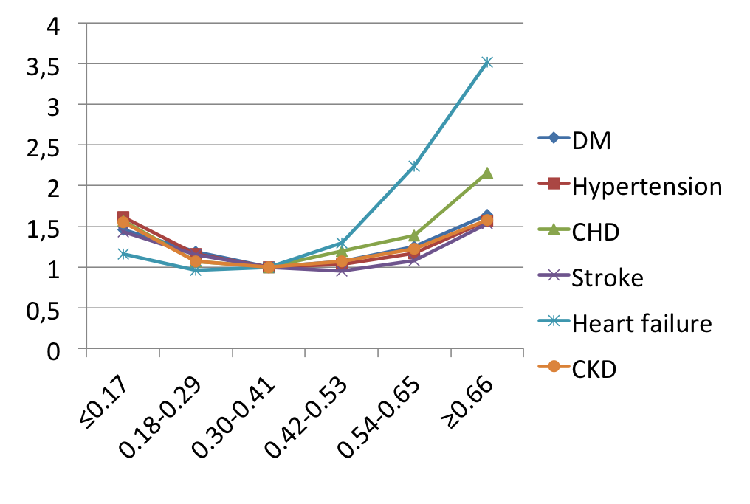
Correlation between SUA and CV mortality
Hazard ratios
6 mg/dl
Serum UA(mmol/l)
Rheumatology 2013; 52: 127-134
Notes:
Most epidemiological studies show a J-shaped relation between UA levels and CV morbidity and mortality: here , in a study from Taiwan, CV hazard rises steeply with increasing serum UA(particularly in heart failure), but a moderate increase is apparent also for very low serum UA(please consider that low serum UA may be a marker of poor nutritional status)

Slide 23
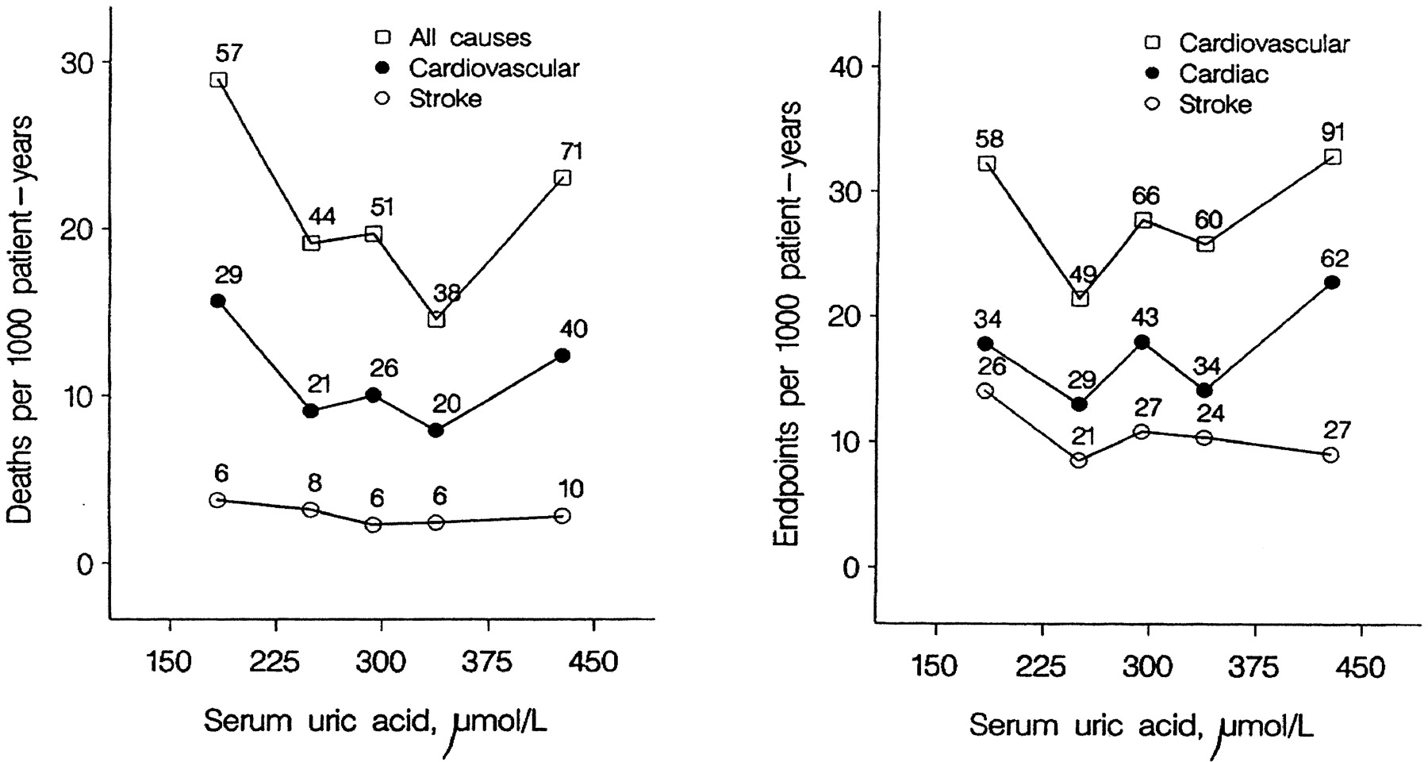

Figure 2. Relationship between serum uric acid at baseline and outcome.
Peter W. de Leeuw et al. JASN 2002;13:2213-2222
©2002 by American Society of Nephrology
Notes:
Figure 2. Relationship between serum uric acid at baseline and outcome. Left panel: Age- and gender-adjusted death rates in quintiles of serum uric acid. The number of deaths is given for each quintile. Right panel: Age- and gender-adjusted fatal and nonfatal event rates in quintiles of serum uric acid. The number of endpoints is given for each quintile.

Slide 24
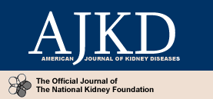

J-shaped mortality relationship for uric acid in patients with CKD5
<5.3 mg/dl)
5.4-8.9 mg/dl
>8.9 mg/dl
Suliman et al, AJKD 2006: 48;761-771
Notes:
Again, a J-shaped relationship between serum UA and all-cause mortality is observed in patients with stage 5 CKD

Slide 25
…….A THEORETICAL CONCERN…………
In treated patients SUA is also a marker of the extent of Xanthine oxidase inhibition
With increasing blockage of XO, precursor compounds such as hypoxanthine(highly soluble, poses no problems) and xanthine(insoluble at physiologic pH) tend to accumulate
A theoretical concern about the risk of developing xanthine nephropathy may exist: a few cases, limited to patients with the tumor lysis syndrome, have been reported with the use of allopurinol, but we do not know whether the use of more potent, non-competitive XO inhibitors may increase such a risk

Slide 26
Conclusions
URIC ACID AND THE KIDNEY, THE LOWER THE BETTER?
A definitive answer requires a treatment to target trial of hyperuricemia, however, to our knowledge, no such a trial has been completed yet
The few, heterogeneous, RCTs available, have consistently shown a beneficial effects on renal function with treatment of hyperuricemia; such effects are achieved at average serum UA levels >5.0 mg/dl and often > 6.0 mg/dl, so, a target serum UA between 5.0 and 6.0 mg/dl appears reasonable.
Although hypouricemia in itself does not seem to pose a threat to the patients’ health, there are potential concerns of overtreatment and it is recommended to avoid long-term serum UA levels <3.0 mg/dl

Slide 27
GRACIAS POR SU ATENCION
Notes:
27
27
27
27

Slide 29
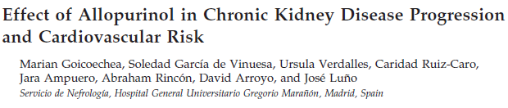
Country(year): Spain(2010)
Population studied(n): CKD 3(n=113)
Intervention: allopurinol 100 mg vs placebo
Length of observation: 2 years
Study outcome: slowing of eGFR decline
Serum UA: intervention 7.8→6.0, control 7.3→7.5 mg/dl
Notes:
In this placebo-controlled RCT, a better renal outcome was observed in the intervention arm, UA levels achieved around 6.0 mg/dl

Slide 30
For patients on ULT, SUA level should be monitored and maintained to <6 mg/dL (360 mmol/L). A lower SUA target (<5 mg/dL; 300 mmol/L) to facilitate faster dissolution of crystals is recommended for patients with severe gout (tophi, chronic arthropathy, frequent attacks) until total crystal dissolution and resolution of gout. SUA level <3 mg/dL is not recommended in the long term
Notes:
Finally, the EULAR guidelines, concerning patients with gout, do not recommend a long-term serum UA target <3.0 mg/dl

